Slide 1

ChandaNest - The Trust Layer for Tier-2 Real Estate in India
Chandrapur, MH
Trust-first property discovery for tier-2 India.
Product deck v1

Slide 2
Why Property Discovery Still Lacks Trust in Tier-2 India
Buyers
Owners
Market
Fragmented discovery across brokers and WhatsApp
No verified media or details
Manual listing and follow-ups
No visibility on enquiries and status
Duplicate inventory and trust gaps
No consistent publish workflow

Slide 3
A Single System of Record for Tier-2 Real Estate
Unified workflows for owners, agents, and admins
Verified listings with signed media and audit trails
Built to scale city by city without losing quality
Owners
List and manage enquiries
Agents / Agencies
Portfolio and lead pipeline
Admin / Enterprise
Moderation and governance

Slide 4
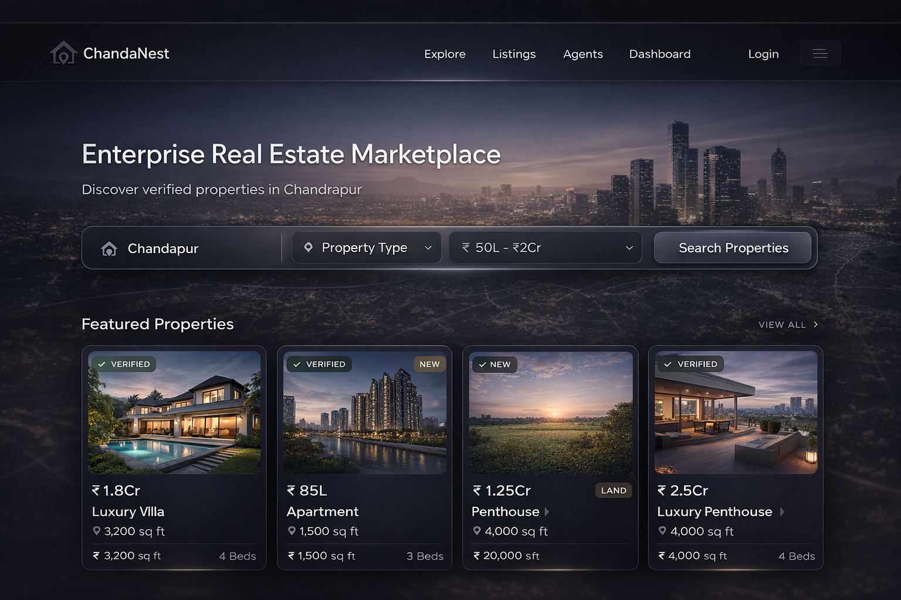
Designed for Every Stakeholder in the Property Ecosystem
Search-led landing for Chandrapur
Clean intent filters
Featured verified listings

Slide 5
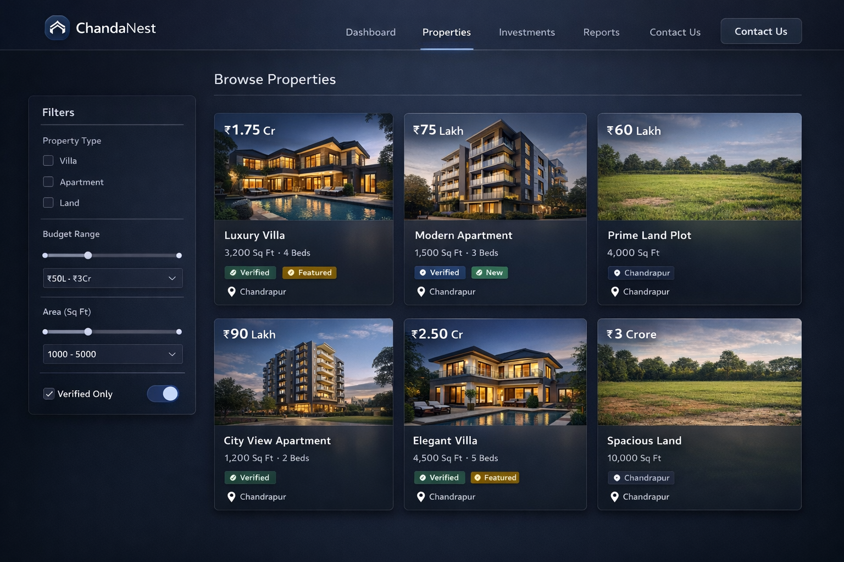
Search-First Property Discovery Built for Buyer Intent
Clear price and area at a glance
Consistent intent and status badges
Optimized for quick scanning

Slide 6
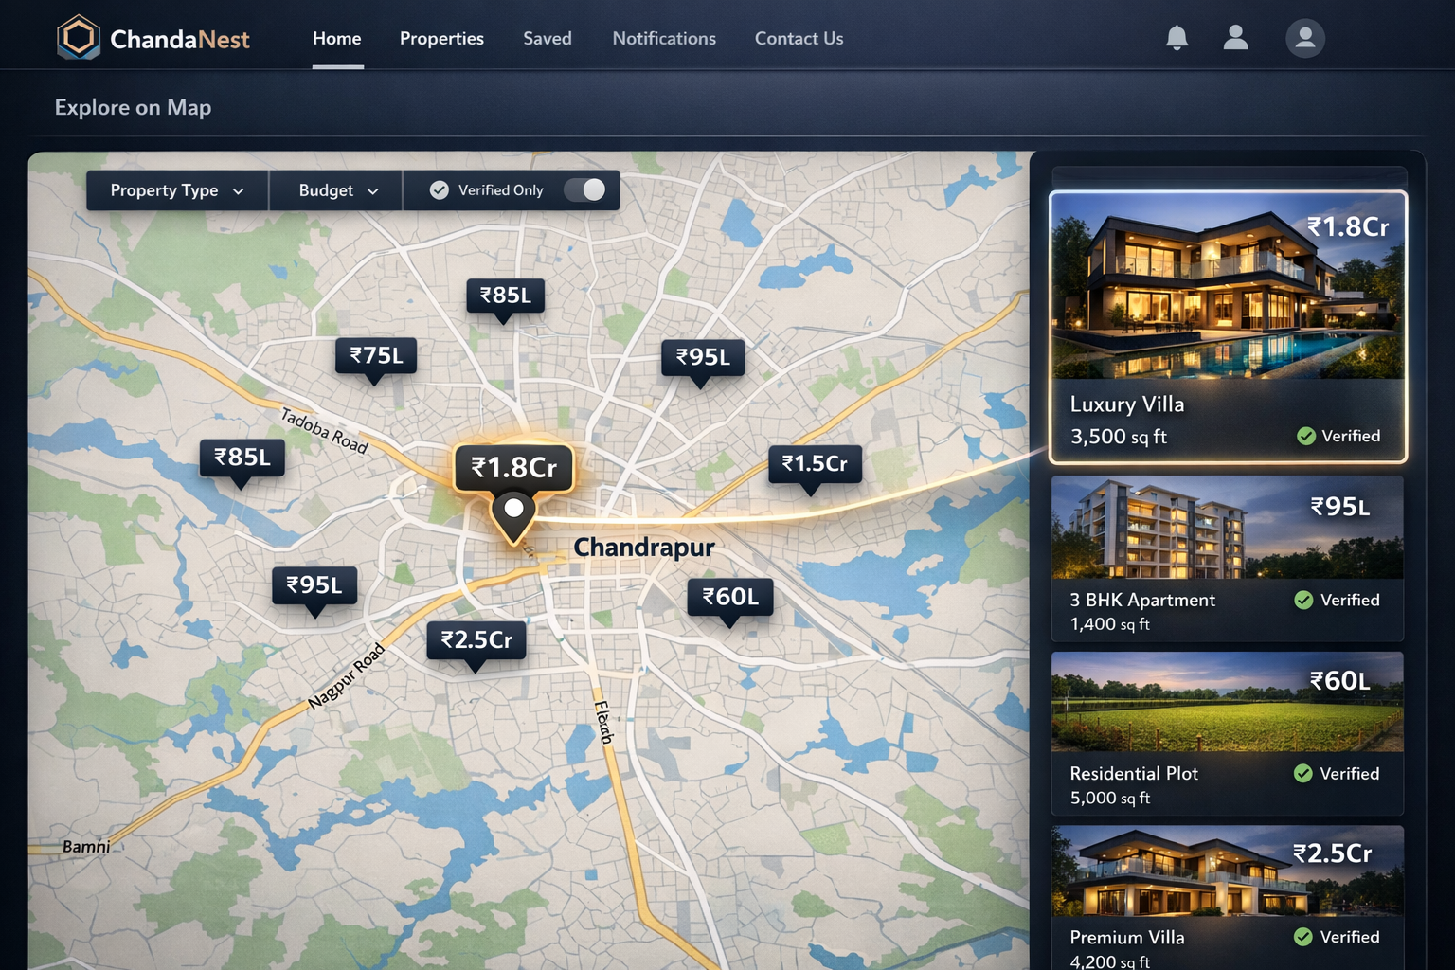
Fast, Comparable Views That Reduce Buyer Friction
Pin-based search by area
Quick previews without leaving the map
Compare nearby options

Slide 7
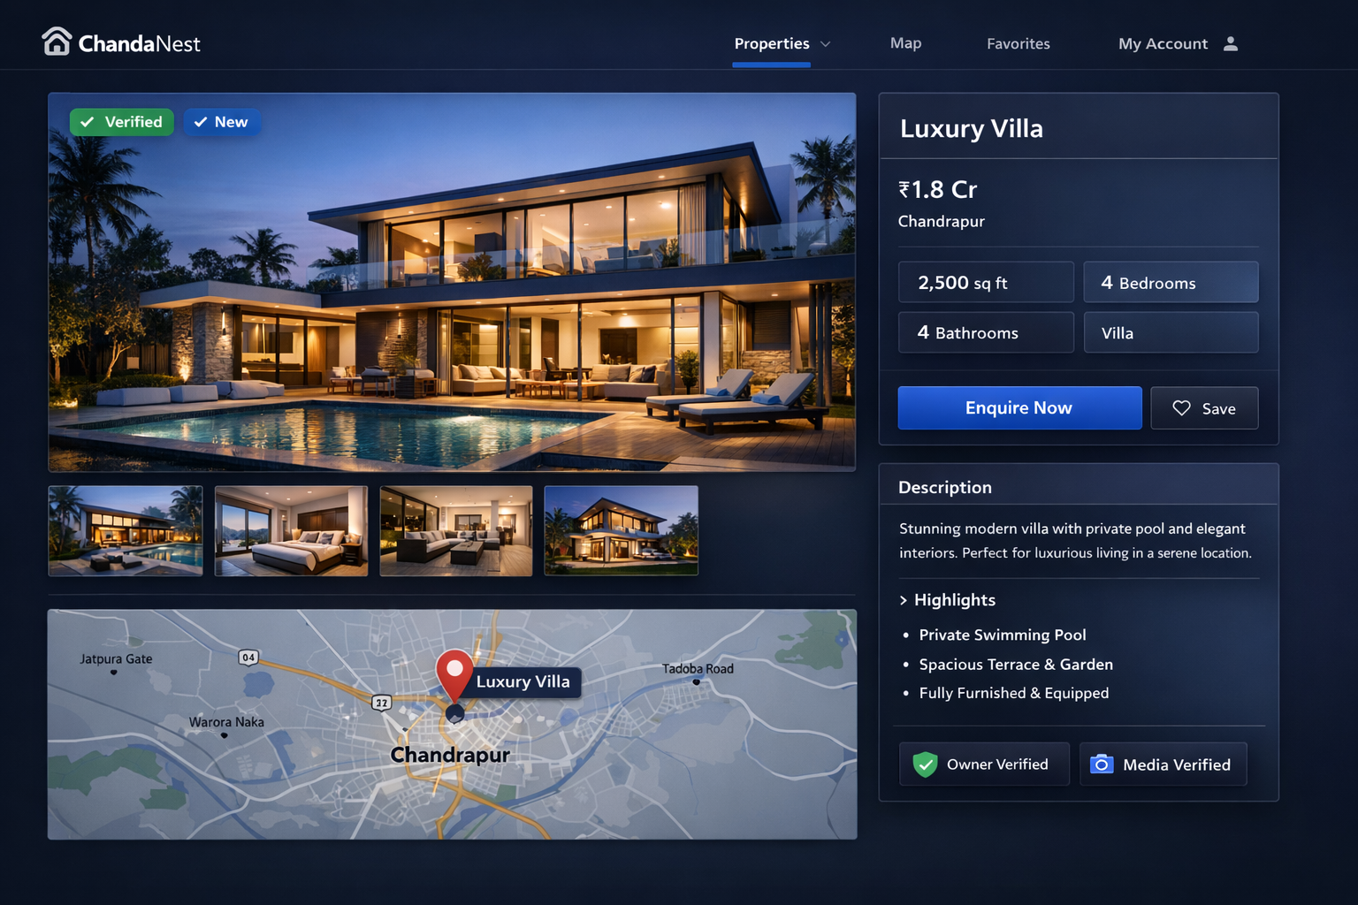
Locality-First Exploration with Real-Time Context
Premium gallery and key specs
Location context and nearby view
Direct contact CTA

Slide 8
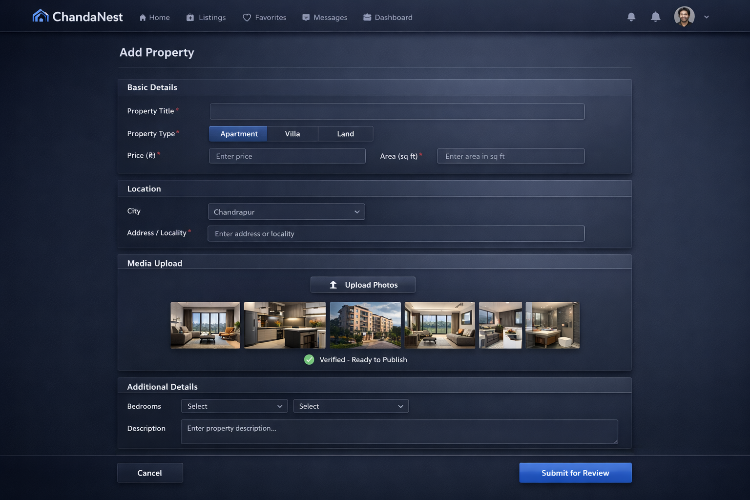
Complete Transparency for Confident Property Decisions
Step-based form with validation
Media upload built in
Ready for submit in minutes

Slide 9
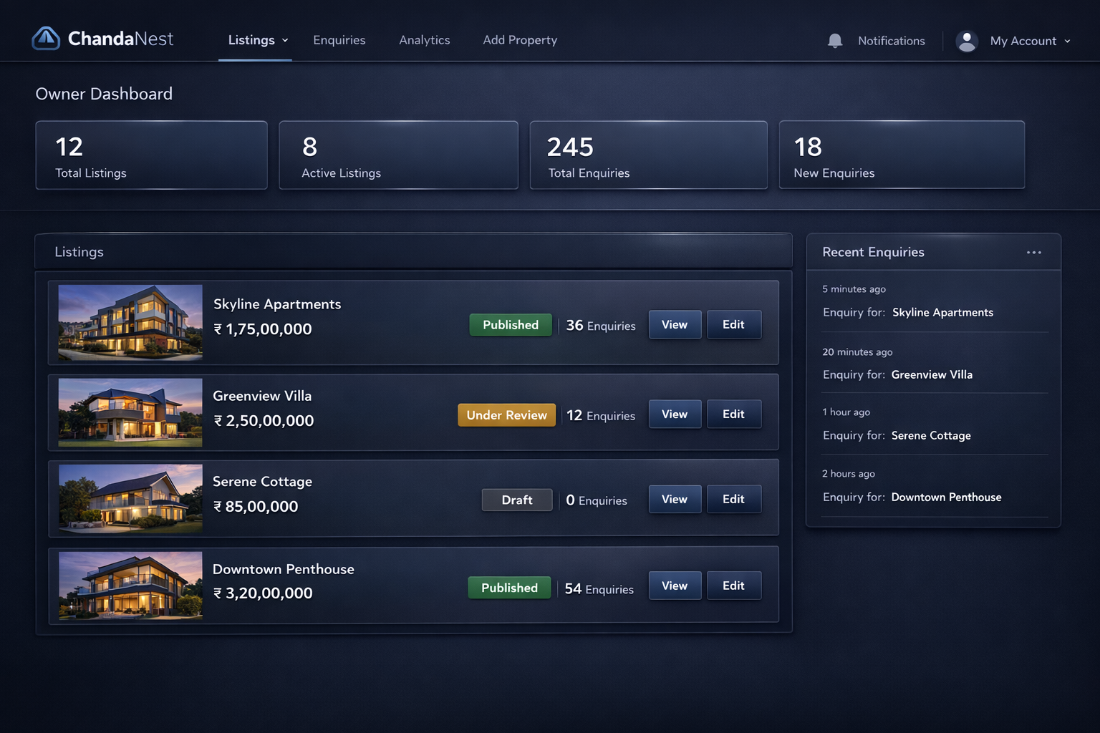
Guided Listing Creation with Built-In Quality Controls
Listing status at a glance
Enquiry counts per listing
Quick actions for edits

Slide 10
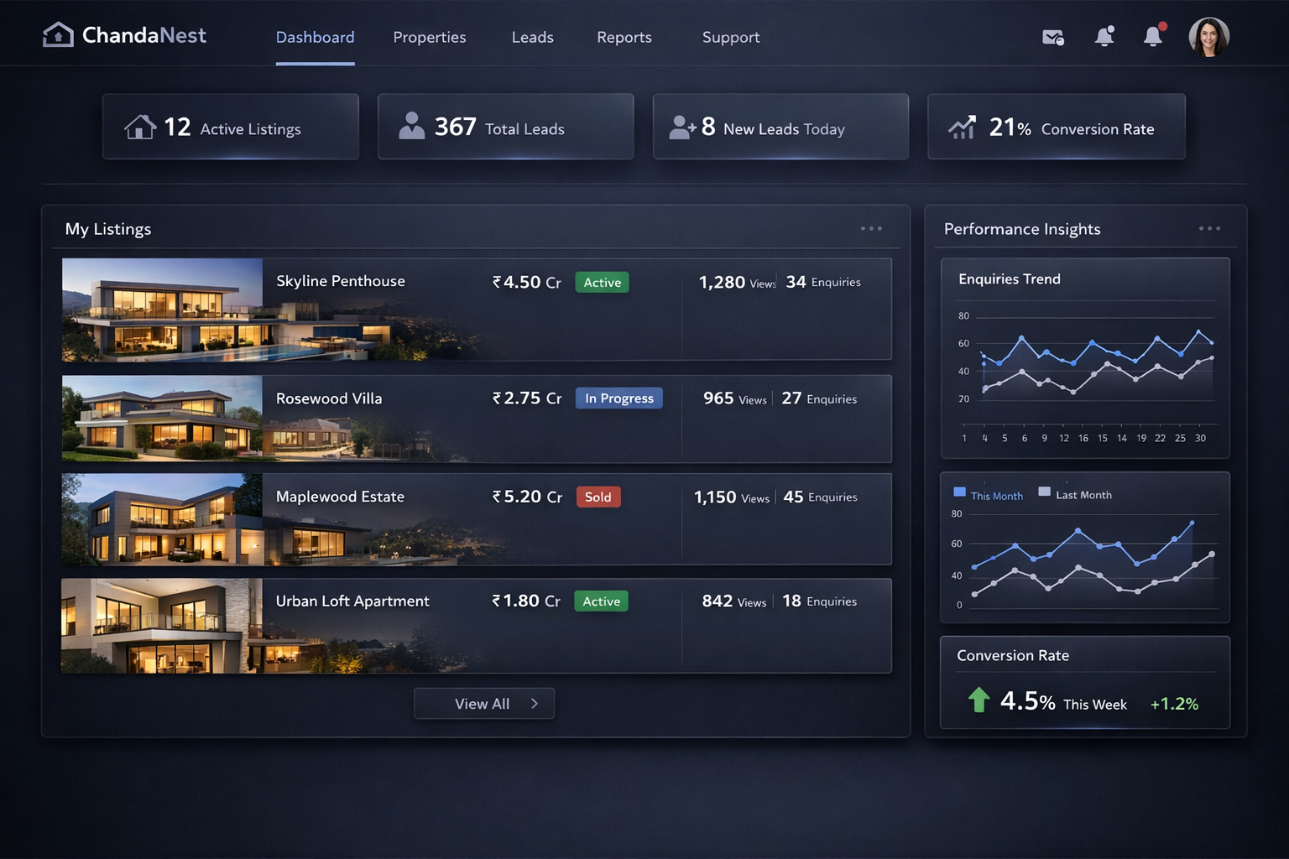
Full Visibility into Listings, Enquiries, and Status
Portfolio overview and lead pipeline
KPI cards for activity
Performance by listing

Slide 11
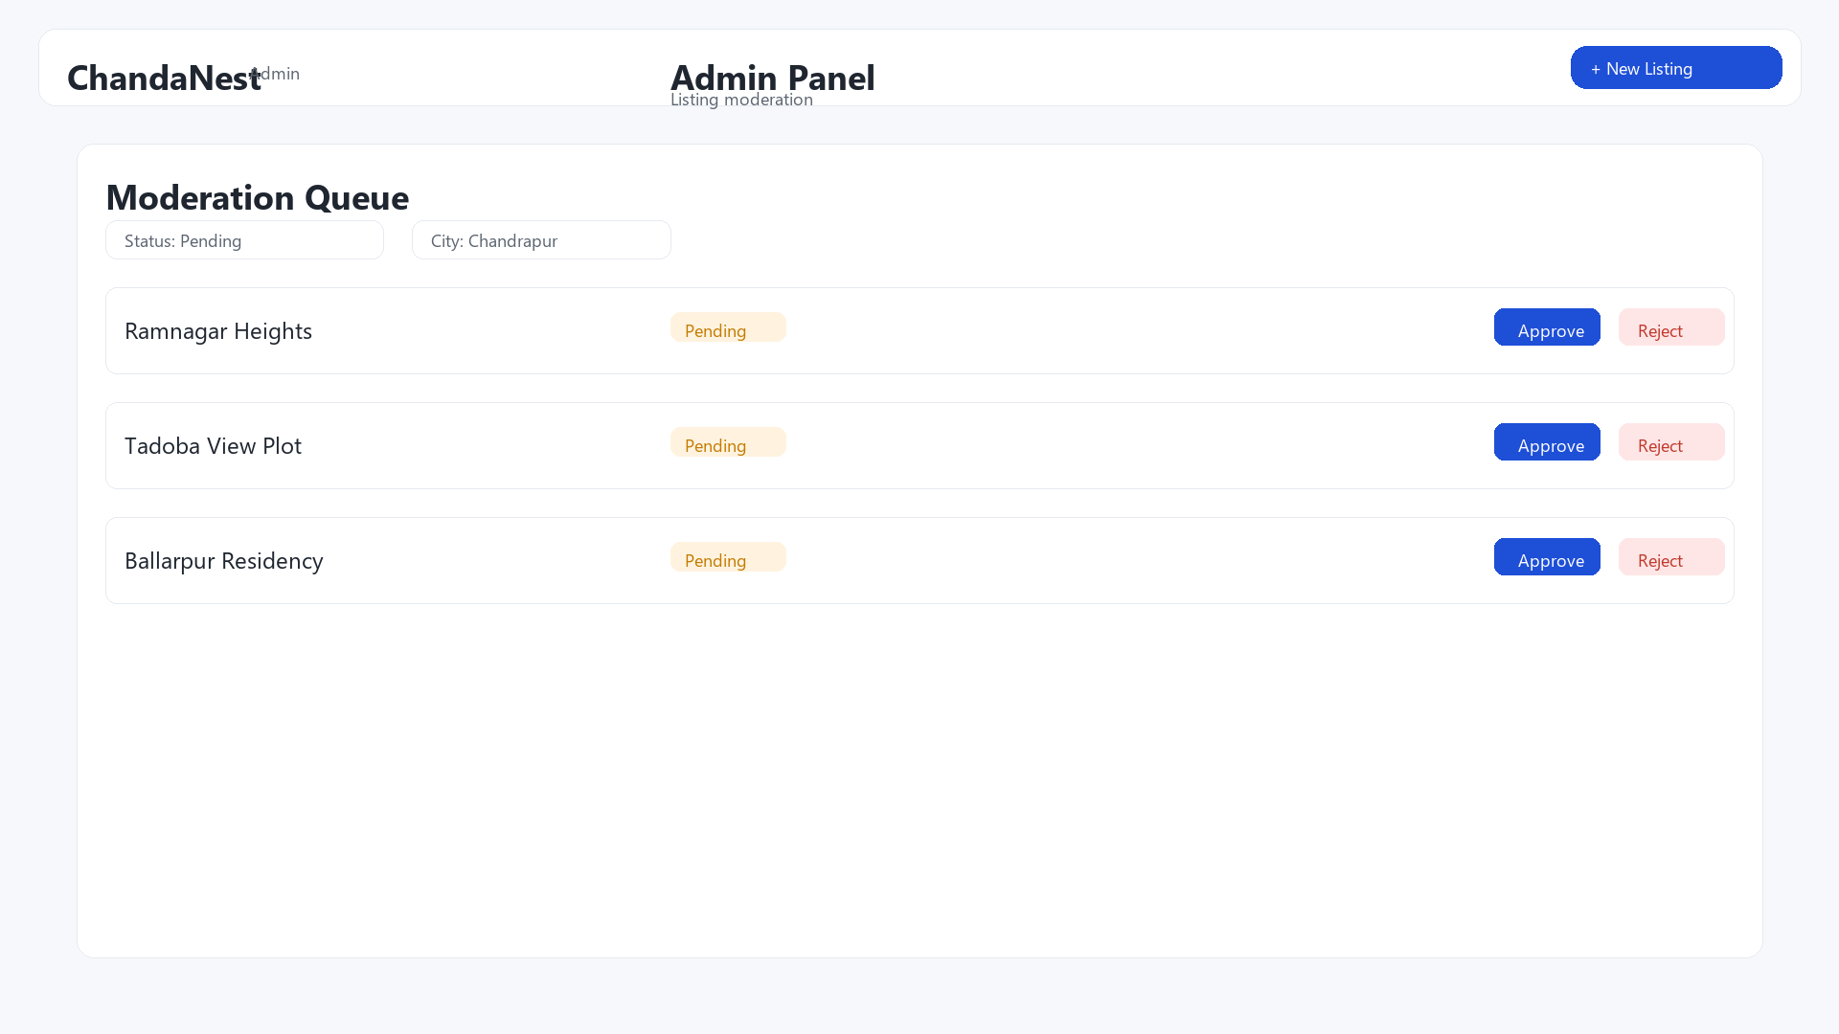
Professional Portfolio and Conversion Management
Moderation queue with filters
Approve or reject in one view
Visibility governance

Slide 12
Policy-Driven Moderation and Platform Governance
Draft
Submit
Admin Review
Publish
Ensures completeness and compliance before public visibility.

Slide 13
Governed Publishing from Draft to Public Visibility
Owner KYC verification
Signed media URLs (tamper-resistant)
Audit trail on listing edits

Slide 14
Trust Is Designed Into the Platform
Primary KPI
Verified inventory growth
Secondary KPI
Enquiry response time
Secondary KPI
Conversion rate
Operational KPI
Listing completeness

Slide 15
From Chandrapur to a Multi-City Real Estate Platform
Scale
Product
Business
Expand to more cities
Local partnerships and onboarding playbook
Deeper analytics and automation
Lead CRM and notifications
Enterprise onboarding at scale
Plans, billing, and reporting
ChandaNest is built for trust-first scale in Indian tier-2 cities.

