Slide 1
Supervised Machine Learning and Learning Theory Lecture 21: Foundation models II
November 15, 2024
Reference: https://stanford-cs324.github.io/

Slide 2
Lecture plan
Modeling

Slide 3
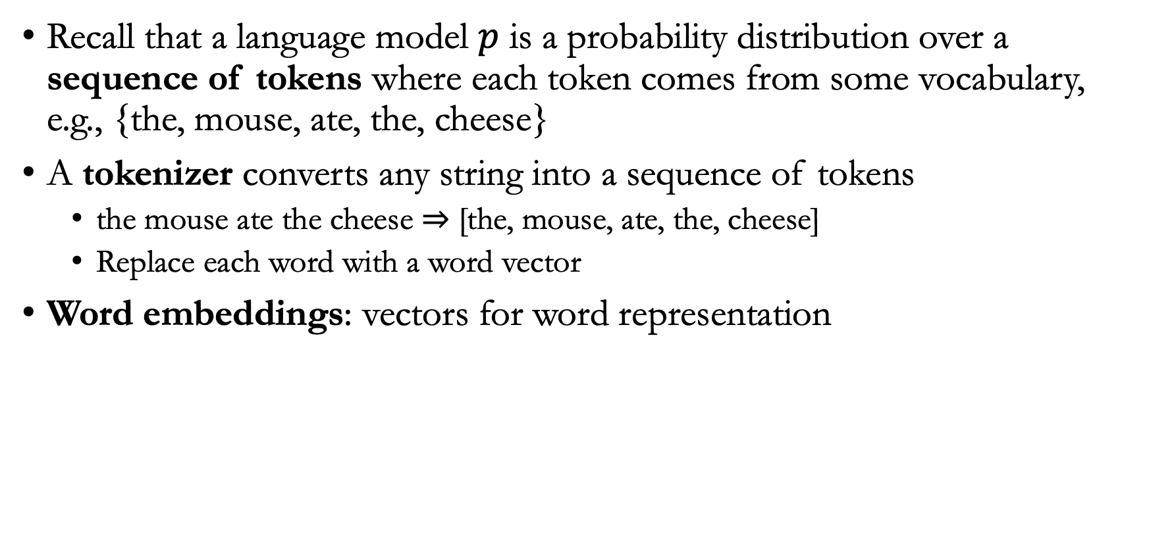
Tokenization
Recall that a language model $p$ is a probability distribution over a sequence of tokens where each token comes from some vocabulary, e.g., {the, mouse, ate, the, cheese}
A tokenizer converts any string into a sequence of tokens
the mouse ate the cheese $⇒$ [the, mouse, ate, the, cheese]
Replace each word with a word vector
Word embeddings: vectors for word representation

Slide 4
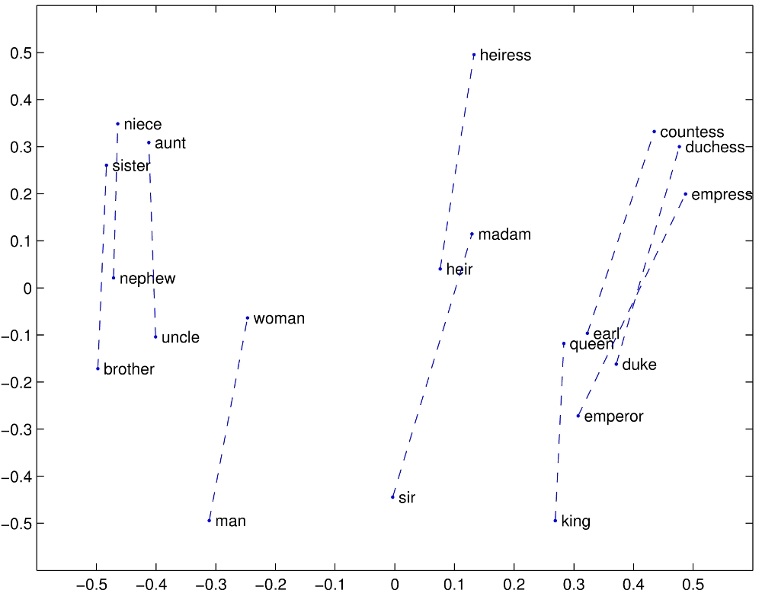
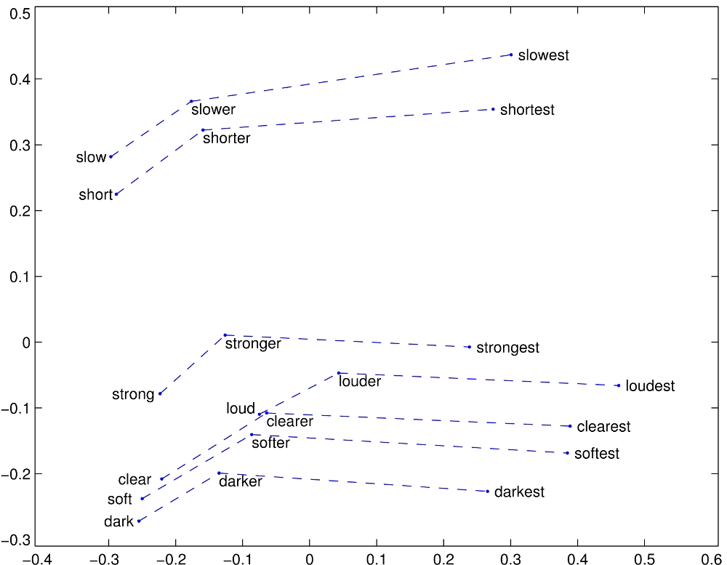
Word embeddings can indicate linear substructures
Male vs. female relationship
Comparative - superlative

Slide 5
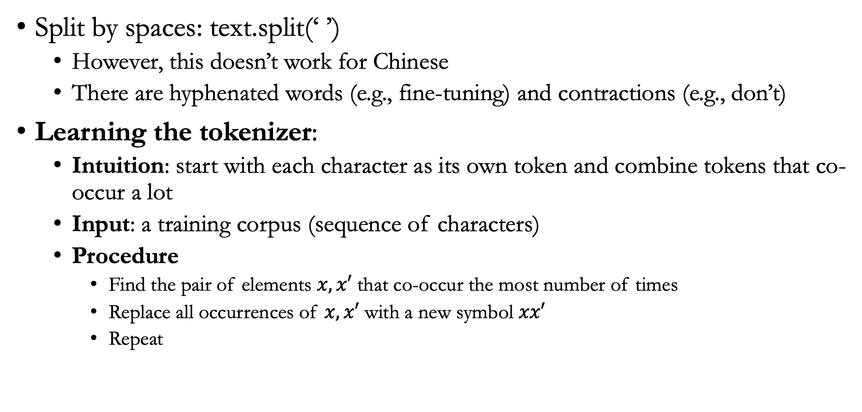
What makes a good tokenizer?
Split by spaces: text.split(‘ ’)
However, this doesn’t work for Chinese
There are hyphenated words (e.g., fine-tuning) and contractions (e.g., don’t)
Learning the tokenizer:
Intuition: start with each character as its own token and combine tokens that co-occur a lot
Input: a training corpus (sequence of characters)
Procedure
Find the pair of elements $x,x′$ that co-occur the most number of times
Replace all occurrences of $x,x′$ with a new symbol $xx′$
Repeat

Slide 6
Tokenizer example
Example
[t, h, e, _, c, a, r], [t, h, e, _, c, a, t], [t, h, e, _, r, a, t]
[th, e, _, c, a, r], [th, e, _, c, a, t], [th, e, _, r, a, t] (th occurs 3x)
[the, _, c, a, r], [the, _, c, a, t], [the, _, r, a, t] (the occurs 3x)
[the, _, ca, r], [the, _, ca, t], [the, _, r, a, t] (ca occurs 2x)

Slide 7
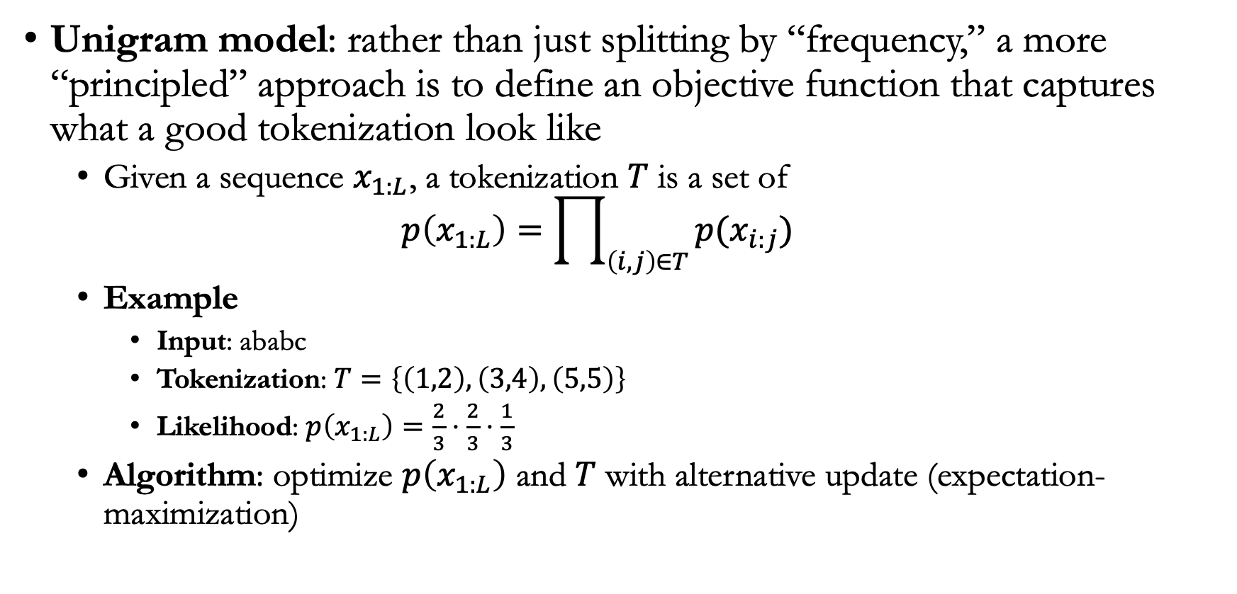
Unigram model
Unigram model: rather than just splitting by “frequency,” a more “principled” approach is to define an objective function that captures what a good tokenization look like
Given a sequence $x_{1:L}$, a tokenization $T$ is a set of
$$p\left(x_{1:L}\right)=\prod_{\left(i,j\right)∈T}{p(x_{i:j})}$$
Example
Input: ababc
Tokenization: $T=\left\{\left(1,2\right),\left(3,4\right),\left(5,5\right)\right\}$
Likelihood: $p\left(x_{1:L}\right)=\frac{2}{3}⋅\frac{2}{3}⋅\frac{1}{3}$
Algorithm: optimize $p\left(x_{1:L}\right)$ and $T$ with alternative update (expectation-maximization)

Slide 8
Models
There are three types of language models
Encoder-only (BERT, RoBERTa, etc.)
Decoder-only (GPT-2, GPT-3, etc.)
Encoder-decoder (BART, T5, etc.)

Slide 9
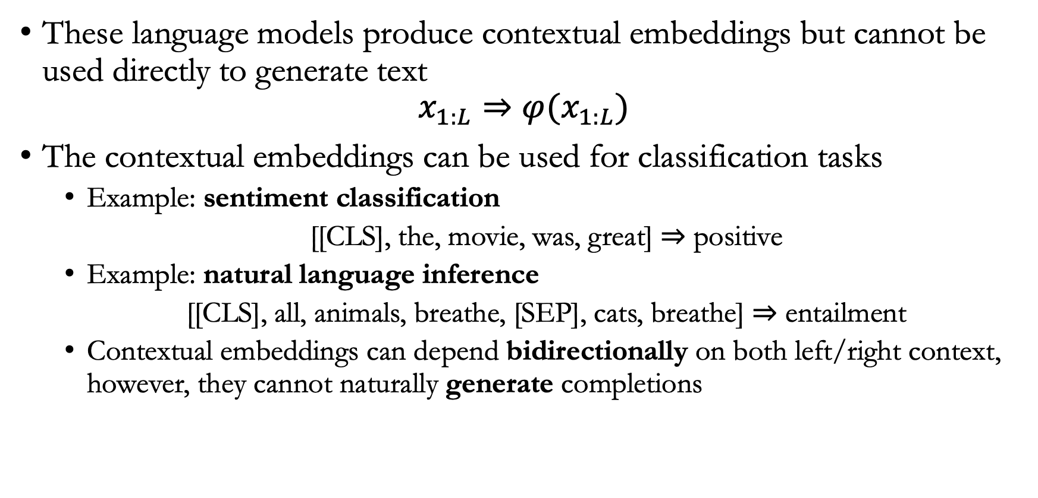
Encoder-only
These language models produce contextual embeddings but cannot be used directly to generate text
$$x_{1:L}⇒φ(x_{1:L})$$
The contextual embeddings can be used for classification tasks
Example: sentiment classification
[[CLS], the, movie, was, great] $⇒$ positive
Example: natural language inference
[[CLS], all, animals, breathe, [SEP], cats, breathe] $⇒$ entailment
Contextual embeddings can depend bidirectionally on both left/right context, however, they cannot naturally generate completions

Slide 10
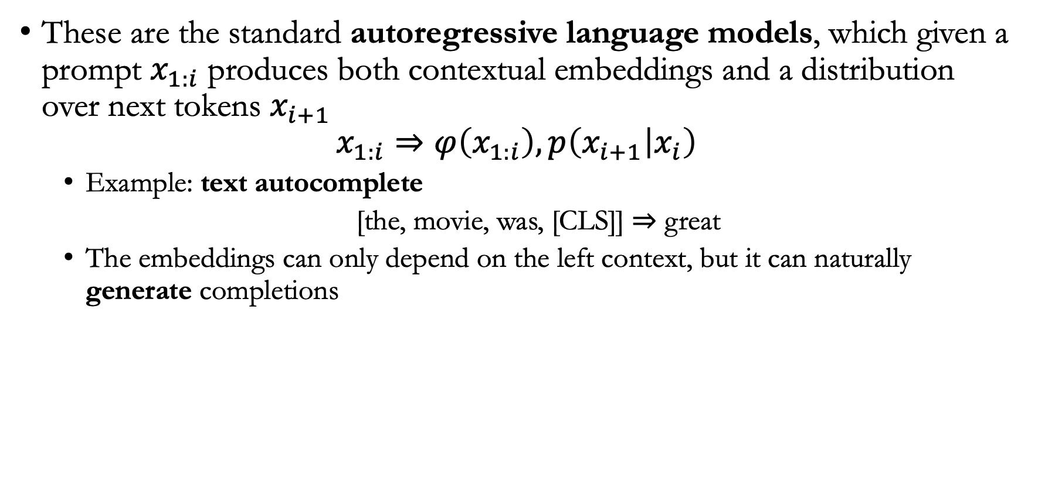
Decoder-only
These are the standard autoregressive language models, which given a prompt $x_{1:i}$ produces both contextual embeddings and a distribution over next tokens $x_{i+1}$
$$x_{1:i}⇒φ\left(x_{1:i}\right),p\left(x_{i+1} | x_{i}\right)$$
Example: text autocomplete
[the, movie, was, [CLS]] $⇒$ great
The embeddings can only depend on the left context, but it can naturally generate completions

Slide 11
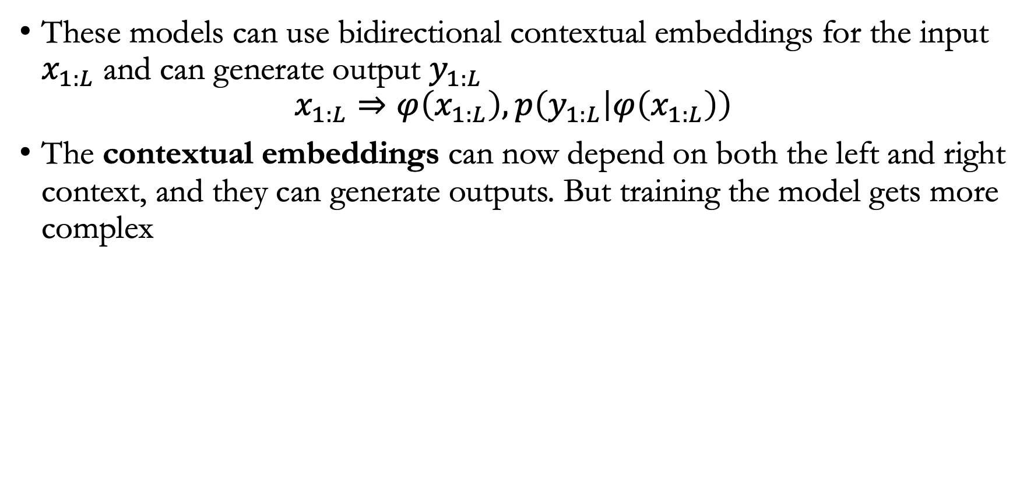
Encoder-decoder
These models can use bidirectional contextual embeddings for the input $x_{1:L}$ and can generate output $y_{1:L}$
$$x_{1:L}⇒φ\left(x_{1:L}\right),p\left(y_{1:L} | φ\left(x_{1:L}\right)\right)$$
The contextual embeddings can now depend on both the left and right context, and they can generate outputs. But training the model gets more complex

Slide 12
Models
Suppose that for each token, we have converted them into an embedding vector
For the model design, we may use
Feed-forward neural networks
Recurrent neural networks
Transformers (or blocks of transformers)

Slide 13
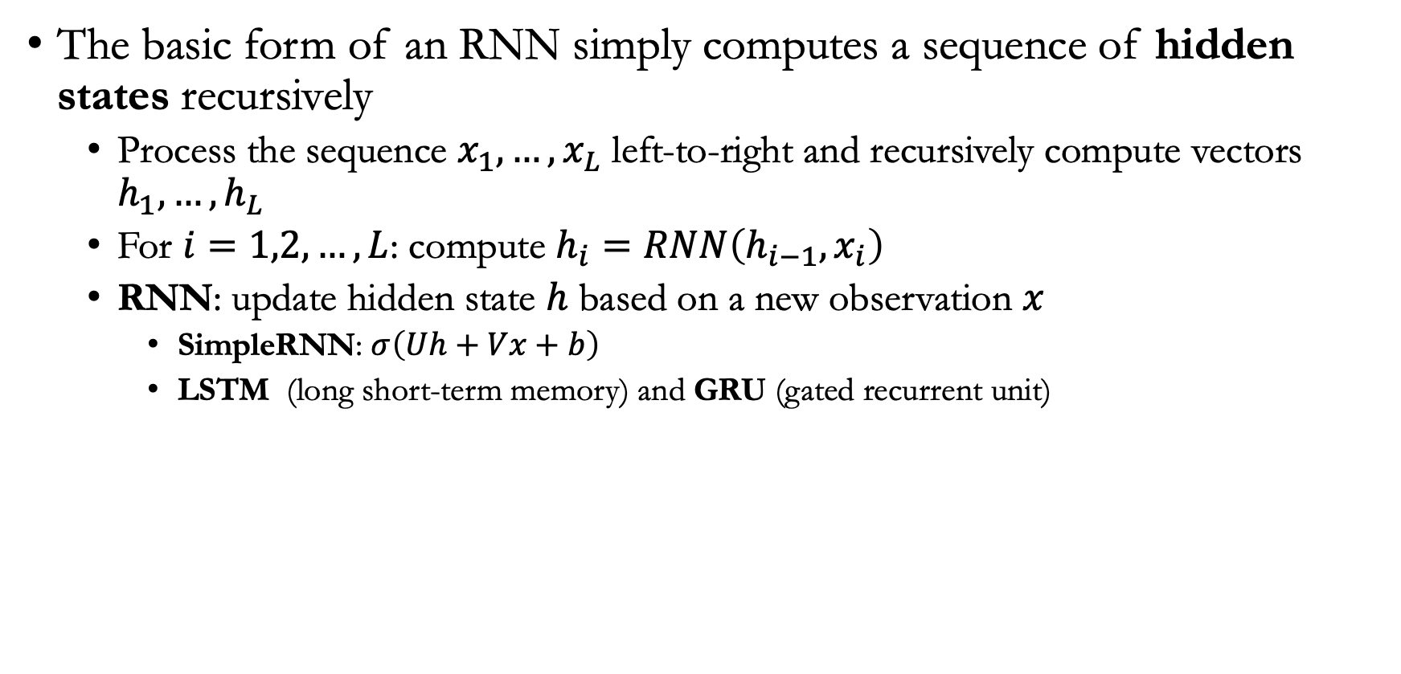
Recurrent neural networks
The basic form of an RNN simply computes a sequence of hidden states recursively
Process the sequence $x_{1},…,x_{L}$ left-to-right and recursively compute vectors $h_{1},…,h_{L}$
For $i=1,2,…,L$: compute $h_{i}=RNN\left(h_{i−1},x_{i}\right)$
RNN: update hidden state $h$ based on a new observation $x$
SimpleRNN: $σ\left(Uh+Vx+b\right)$
LSTM (long short-term memory) and GRU (gated recurrent unit)

Slide 14
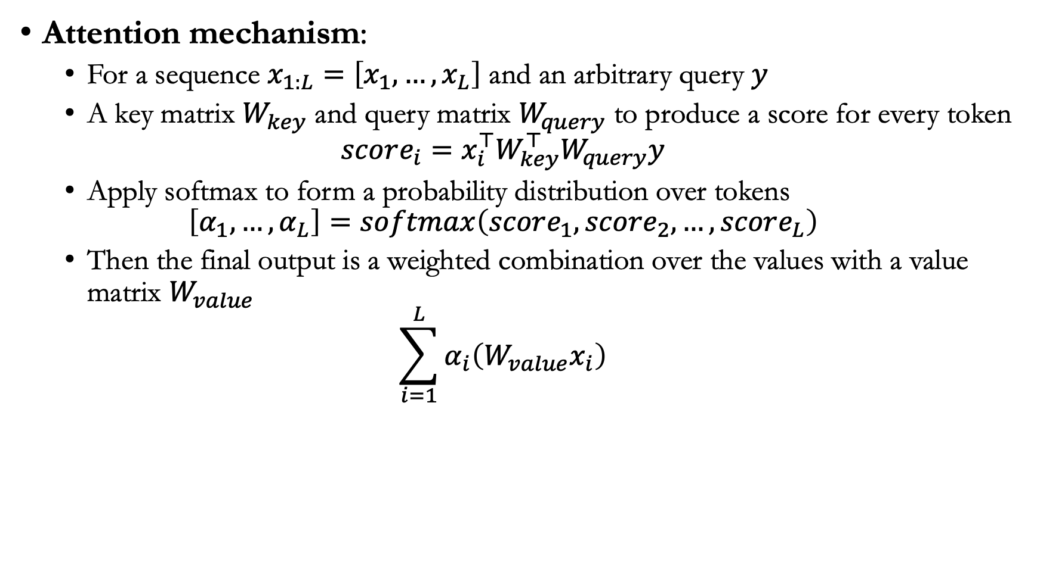
Transformers
Attention mechanism:
For a sequence $x_{1:L}=\left[x_{1},…,x_{L}\right]$ and an arbitrary query $y$
A key matrix $W_{key}$ and query matrix $W_{query}$ to produce a score for every token
$$score_{i}=x_{i}^{⊤}W_{key}^{⊤}W_{query}y$$
Apply softmax to form a probability distribution over tokens
$$\left[α_{1},…,α_{L}\right]=softmax\left(score_{1},score_{2},…,score_{L}\right)$$
Then the final output is a weighted combination over the values with a value matrix $W_{value}$
$$\sum_{i=1}^{L}{α_{i}\left(W_{value}x_{i}\right)}$$

Slide 15
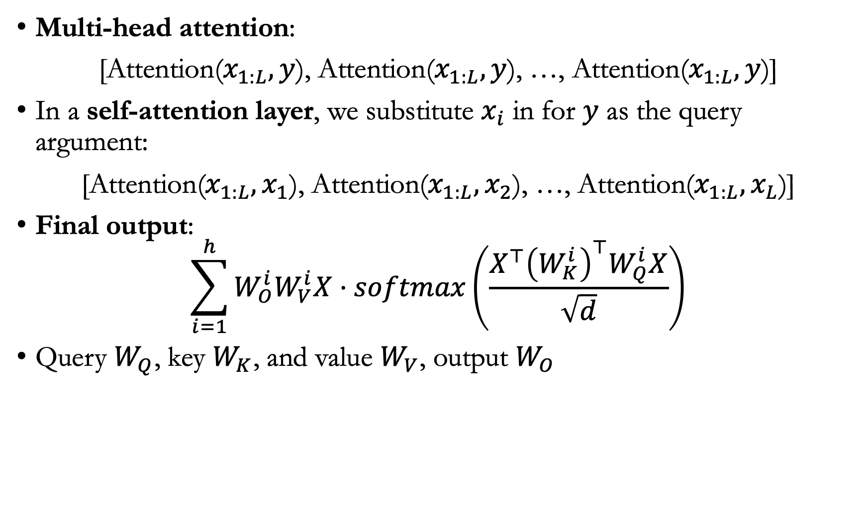
Self-attention and multi-head attention
Multi-head attention:
[Attention($x_{1:L},y$), Attention($x_{1:L},y$), …, Attention($x_{1:L},y$)]
In a self-attention layer, we substitute $x_{i}$ in for $y$ as the query argument:
[Attention($x_{1:L},x_{1}$), Attention($x_{1:L},x_{2}$), …, Attention($x_{1:L},x_{L}$)]
Final output:
$$\sum_{i=1}^{h}{W_{O}^{i}W_{V}^{i}X⋅softmax\left(\frac{X^{⊤}{\left(W_{K}^{i}\right)}^{⊤}W_{Q}^{i}X}{\sqrt{d}}\right)}$$
Query $W_{Q}$, key $W_{K}$, and value $W_{V}$, output $W_{O}$

Slide 16

Various tricks to improve training
Residual connection: Instead of applying function $f$
$$f\left(x_{1:L}\right)$$
Apply
$$x_{1:L}+f\left(x_{1:L}\right)$$
Layer normalization: Extract the mean and covariance of the input

Slide 17
Positional embeddings
For each position in the sequence, add an extra embedding vector for that position
GPT-3: Stack the transformer block 96 times, along with positional embeddings

Slide 18
Lecture plan
Training

Slide 19
Objective functions
Decoder-only (GPT-3): compute unidirectional contextual embeddings, generate one token at a time
Encoder-only (BERT): compute bidirectional contextual embeddings
Encoder-decoder (T5): encode input, decode output

Slide 20
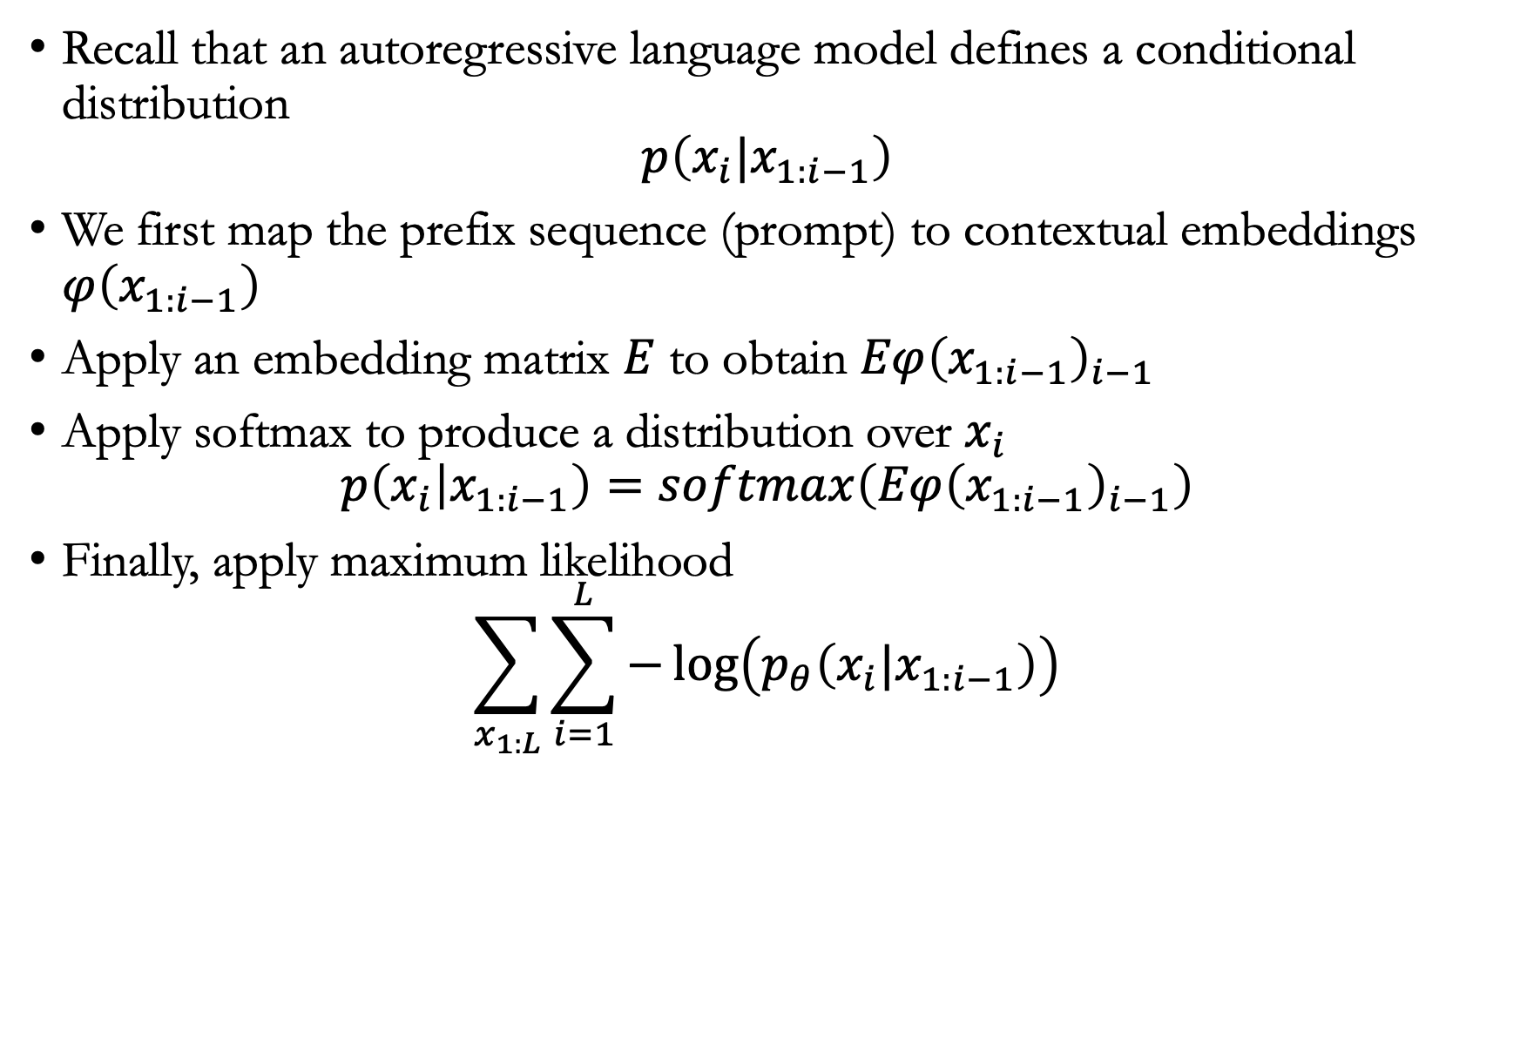
Decoder-only models
Recall that an autoregressive language model defines a conditional distribution
$$p\left(x_{i}|x_{1:i−1}\right)$$
We first map the prefix sequence (prompt) to contextual embeddings $φ\left(x_{1:i−1}\right)$
Apply an embedding matrix $E$ to obtain $Eφ{\left(x_{1:i−1}\right)}_{i−1}$
Apply softmax to produce a distribution over $x_{i}$
$$p\left(x_{i} | x_{1:i−1}\right)=softmax\left(Eφ{\left(x_{1:i−1}\right)}_{i−1}\right)$$
Finally, apply maximum likelihood
$$\sum_{x_{1:L}}{\sum_{i=1}^{L}{−\log\left(p_{θ}\left(x_{i}|x_{1:i−1}\right)\right)}}$$

Slide 21
Encoder-only models
BERT objective:
Masked language modeling: Mask out a particular token, ask the model to predict the missing token
Next sentence prediction: BERT is trained on pairs of sentences concatenated. The goal of next sentence prediction is to predict whether the second sentence follows from the first or not

Slide 22
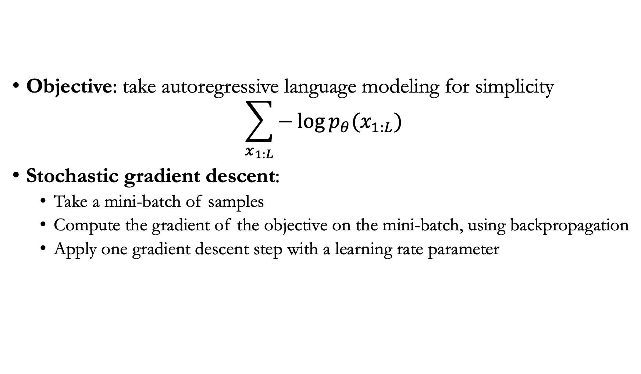
Optimization algorithms
Objective: take autoregressive language modeling for simplicity
$$\sum_{x_{1:L}}{−\log{p_{θ}(x_{1:L})}}$$
Stochastic gradient descent:
Take a mini-batch of samples
Compute the gradient of the objective on the mini-batch, using backpropagation
Apply one gradient descent step with a learning rate parameter

Slide 23
Second-order optimization: Hessian matrix
Quadratic approximation: In addition to the gradient, take Hessian into the Taylor’s expansion
Definition (Hessian matrix)
Let $f:ℝ^{m}→ℝ$ be a function
The Hessian matrix of $f(w)$ is an $m$ by $m$ matrix
The $(i,j)$-th entry of $f(w)$ is equal to $\frac{∂f(w)}{∂w_{i}∂w_{j}}$

Slide 24
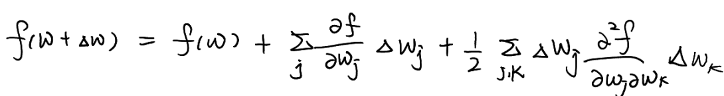
Quadratic approximation
Quadratic approximation: In addition to the gradient, take Hessian into the Taylor’s expansion
The Taylor’s expansion approximates $f(w+Δw)$ with:
$f\left(w\right),$ gradient of $f\left(w\right)$, and Hessian of $f\left(w\right)$

Slide 25
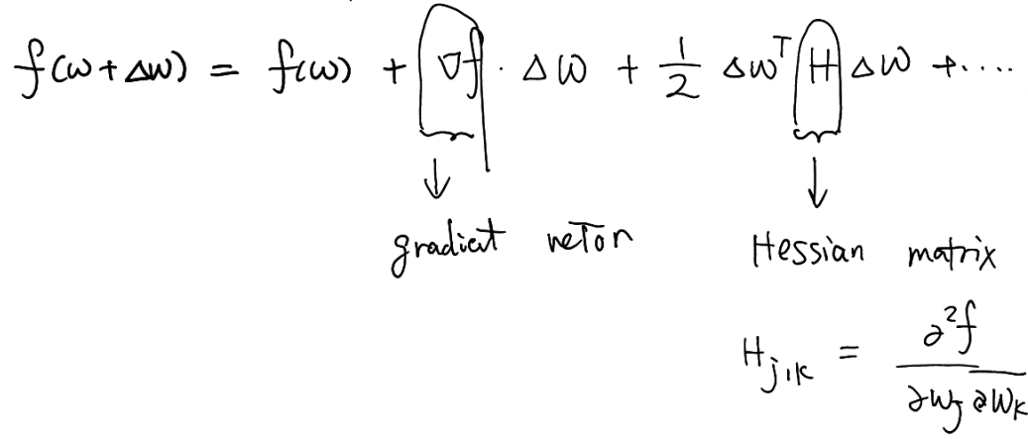
Hessian-based optimization
Matrix notation
Key step in Hessian-based optimization
Minimize the above over $Δ(w)$
Setting the gradient to zero leads to $Δ\left(w\right)=H^{−1}∇f$

Slide 26

Newton’s method
Pseudocode for Newton’s method
Set a step size $η$, number of epochs $T$
Choose an initialization $w_{0}$
For $t=1,…,T$
Update $w_{t}←w_{t−1}−η⋅H^{−1}\left(w_{t−1}\right)∇f\left(w_{t−1}\right)$

Slide 27
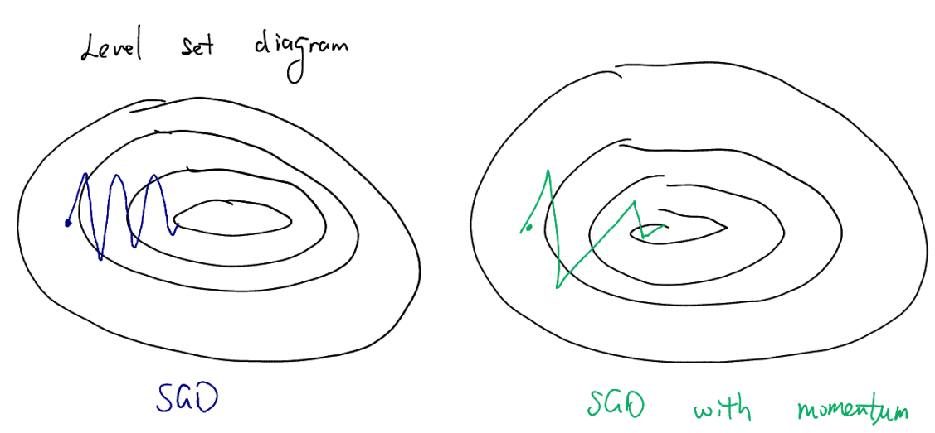
Momentum-based gradient descent
Momentum follows a similar idea while avoiding computing the Hessian and its inverse

Slide 28
Momentum-based gradient descent
Formulation
A momentum vector $v_{t}$
A momentum rate $γ$
Step size $η$
Implementation of momentum-based gradient descent
For $t=1,…,T$
Update momentum: $v_{t}←{γ⋅v}_{t−1}+η⋅∇f(w_{t})$
Update parameter: $w_{t}←w_{t}−v_{t}$
Example: Suppose $v_{0}=0$. Then, $v_{t}$ is the cumulative sum of previous gradients

Slide 29
Adaptive gradient
Adaptive gradient is an adaptive learning rate scheme for performing stochastic gradient descent
Idea: Perform smaller updates (i.e. smaller step sizes) for parameters associated with frequently occurring features, and larger updates (i.e. higher step sizes) for parameters associated with infrequently occurring features
Small $η$
Small $η$
Small $η$
Large $η$
Small $η$
Small $η$
Large $η$
Small $η$

Slide 30
Adaptive gradient
Formulation
Let $f:ℝ^{m}→ℝ$ be a function
Let $G^{t}$ be an $m$ by $m$ matrix
Implementation for adaptive gradient
For $t=1,…,T$
Update $G^{t}$: $G^{t}←G^{t−1}+∇f\left(w_{t−1}\right)∇f{\left(w_{t−1}\right)}^{⊤}$
Let $R$ be $G^{t}$ after setting its non-diagonal entries to zero
Update $w_{t}$: $w_{t}←w_{t−1}−η⋅{\left(R+ε\right)}^{−\frac{1}{2}}⋅∇f(w_{t−1})$, where $ε$ is a small perturbation
Contrast with gradient descent
Update $w_{t}$: $w_{t}←w_{t−1}−η⋅∇f(w_{t−1})$

Slide 31
Lecture plan
Adaptation

Slide 32
Why adapt the language model?
Language models are trained in a task-agnostic way
However, downstream tasks can be very different from language modeling on the Pile
Consider natural language inference (NLI) task
Premise: I have never seen an apple that is not red
Hypothesis: I have never seen an apple
Correct output: Not entailment
Ways downstream tasks can be different
Topic shift: the downstream task is focused on a new or specific topic
Temporal shift: the downstream task requires new knowledge that is unavailable during pre-training

Slide 33
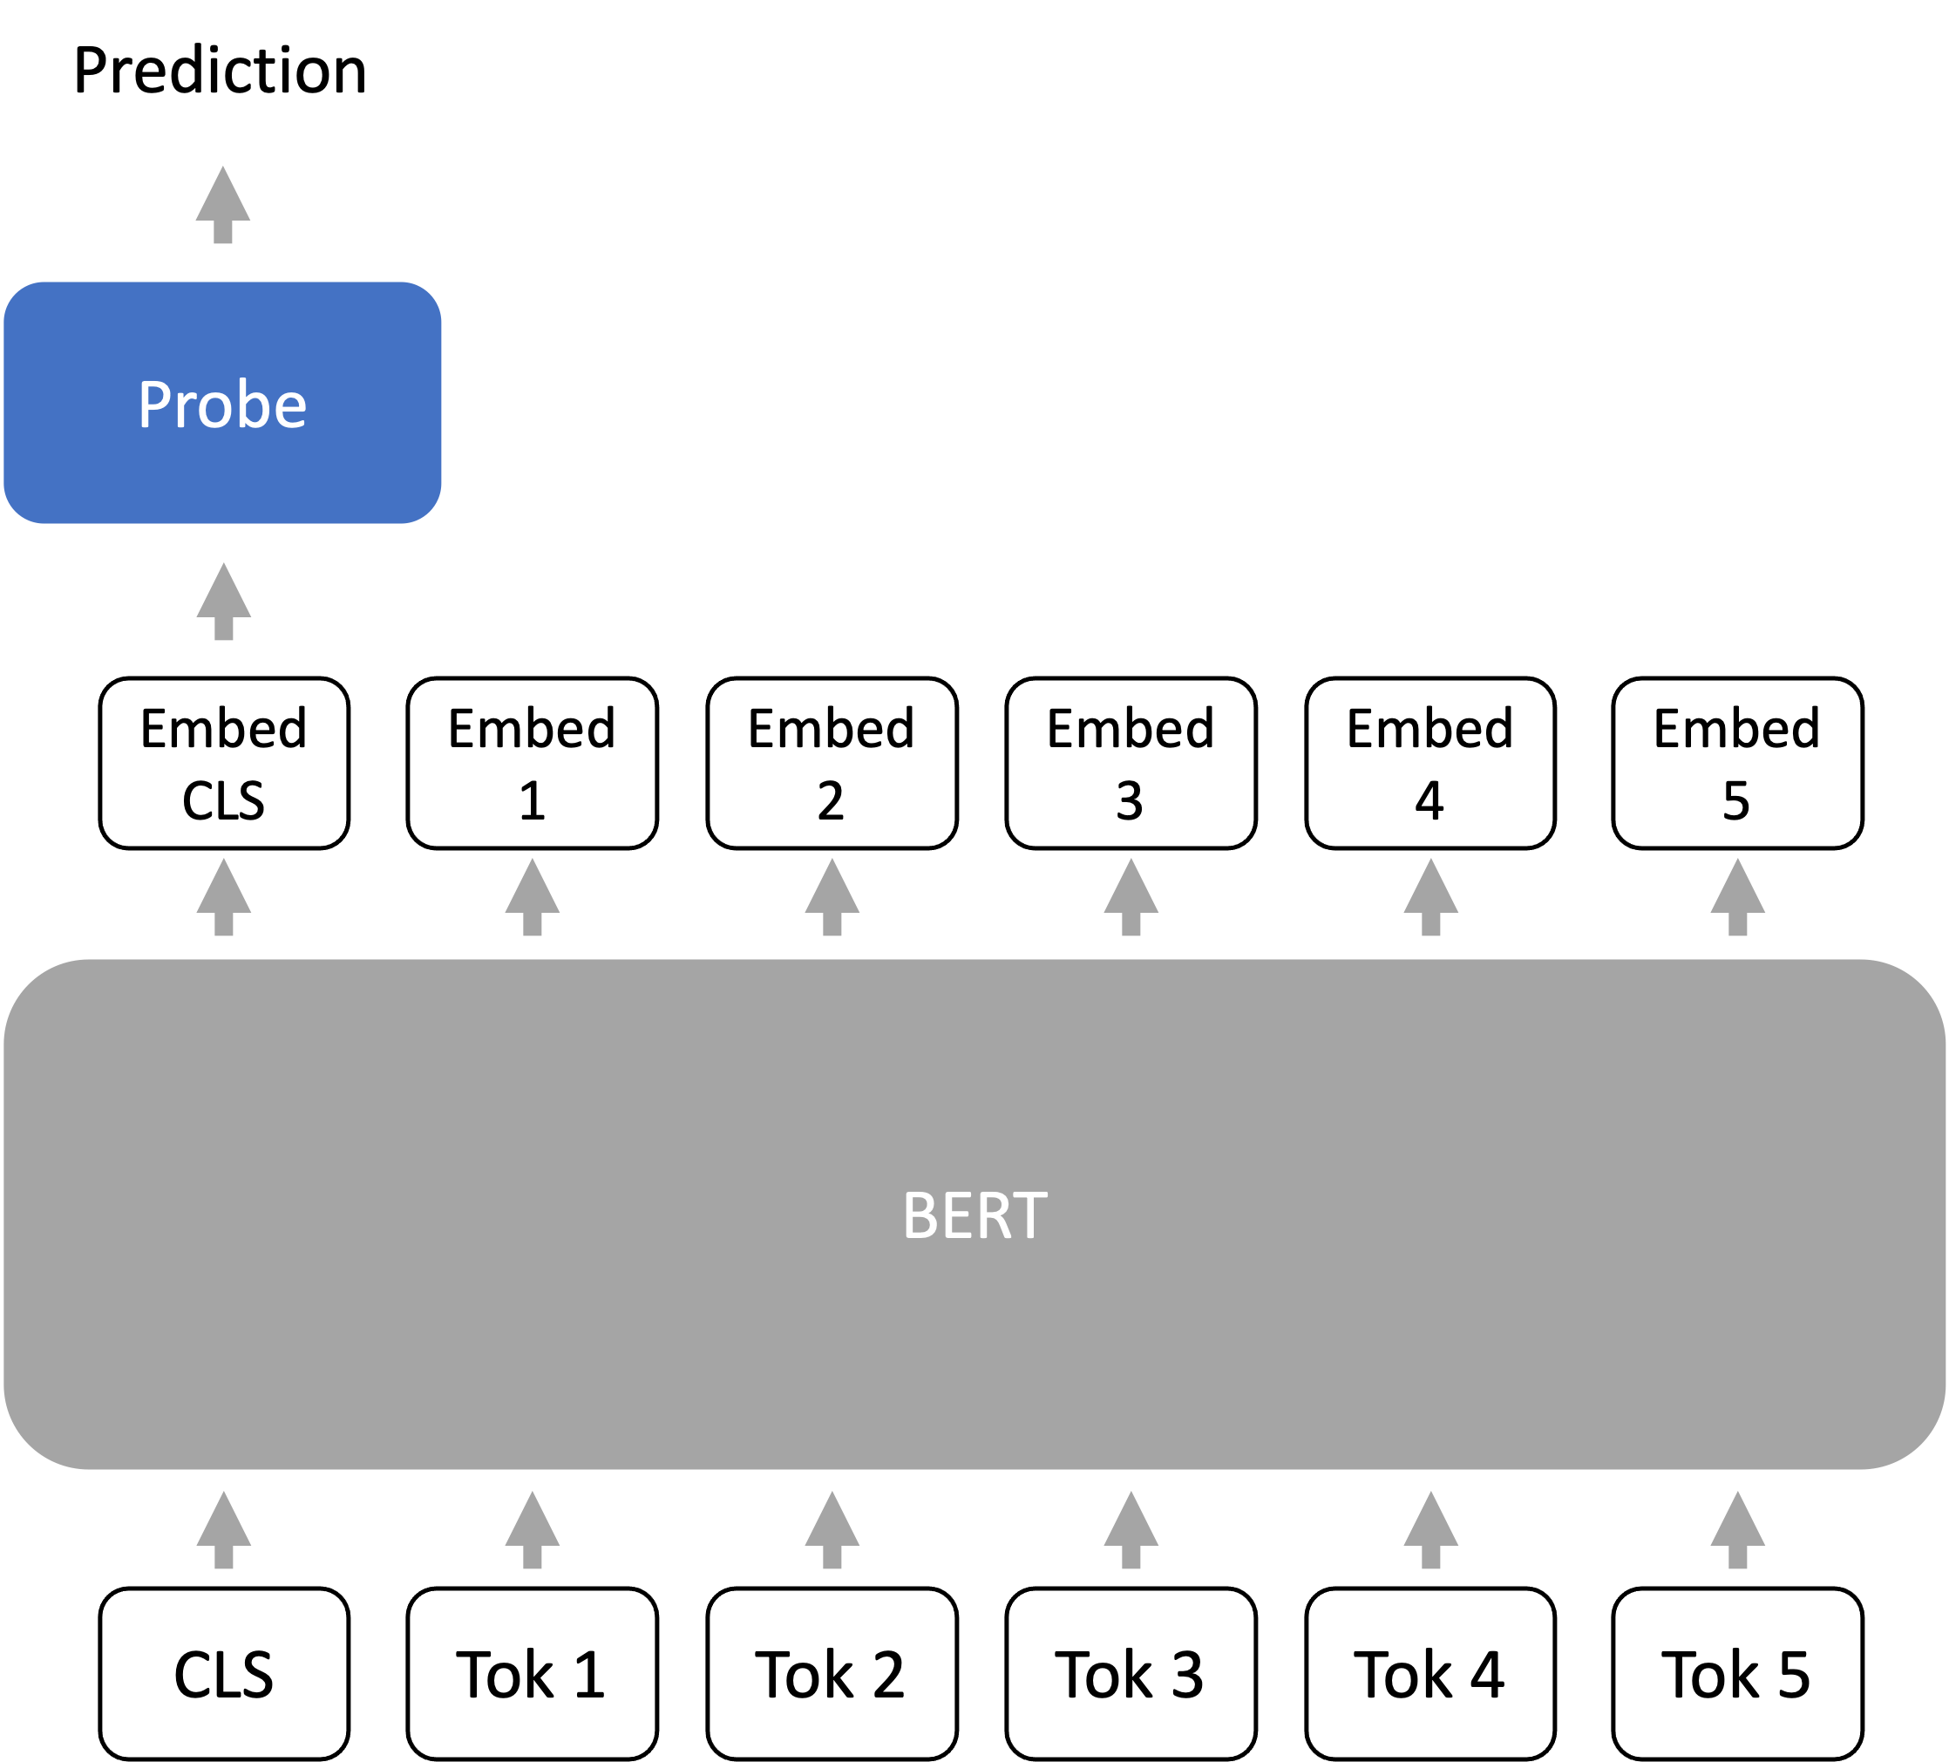
Probing
Train a probe (or prediction head) from the last layer representations of the language model to the output (e.g., class label)

Slide 34
Fine-tuning
Using the entire language model parameters as the initialization or base model for optimization
Usually, fine-tuning will produce a model that is fairly close to the base model
Low-rank adapters and quantized adapters optimize the number of bits per performance

Slide 35
Human preference alignment
Collect human-written demonstrations of desired behavior
Performance supervised fine-tuning on the demonstrations
On a set of instructions, sample outputs from the language model for each instruction, then gather human preferences for which sampled output is most preferred
Fine-tune the model with a reinforcement learning objective to maximize human preference reward

Slide 36
Summary
We need to adapt language models to a diverse array of downstream tasks, which may be different from pretraining task
Probing trains a task-specific prediction head on top of a frozen language model, treating the model as a good representation extractor
Fine-tuning treats the model parameters as initialization for further training on a downstream task
Lightweight fine-tuning strikes a balance between probing and fine-tuning by optimizing only a few parameters

Slide 37
Announcements
HW3 grades will be released this afternoon (almost there)
We will also release HW4 as well (this homework will be much lighter to account for final course project)
Further reading
Multitask Prompted Training Enables Zero-Shot Task Generalization
Finetuned Language Models Are Zero-Shot Learners
Towards a Unified View of Parameter-Efficient Transfer Learning

