Slide 1
Supervised Machine Learning and Learning Theory
Lecture 24: A gentle introduction on how to think about causal and effect
November 26, 2024

Slide 2
Lecture overview
Warm up:
  SVD: the math behind PCS. Can you write down the SVD form of a matrix?
  Principal component regression: do you still remember what it is?
  Several clustering methods depending on our needs
  What is contrastive learning?
A gentle introduction to cause and effect:
  Model setup
  Estimators
  Assignment mechanisms and experimental design

Slide 3
Lecture plan
  The potential outcomes framework

Slide 4
From prediction to causal inference
Causal and effect:
  Will increasing minimum wage increase the unemployment rate?
  Does hiring immigrant workers affect negatively on the employment of domestic workers?
  Does the size of a class affect negatively on the test performance of students?
Estimate the effect of an intervention or a change on a platform:
  Will increasing the interest rate affect daily spending?
  Will adding a new surge pricing feature on Uber affect the number of requested rides?

Slide 5
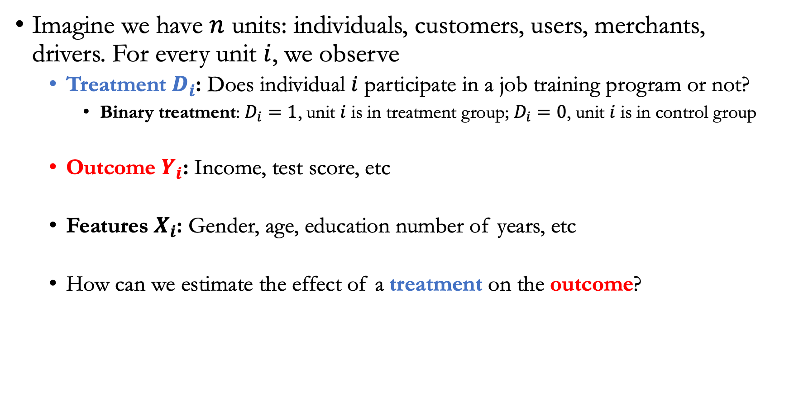
A problem setup
Imagine we have $n$ units: individuals, customers, users, merchants, drivers. For every unit $i$, we observe
  Treatment $D_{i}$: Does individual $i$ participate in a job training program or not?
    Binary treatment: $D_{i}=1$, unit $i$ is in treatment group; $D_{i}=0$, unit $i$ is in control group
  Outcome $Y_{i}$: Income, test score, etc
  Features $X_{i}$: Gender, age, education number of years, etc
  How can we estimate the effect of a treatment on the outcome?

Slide 6

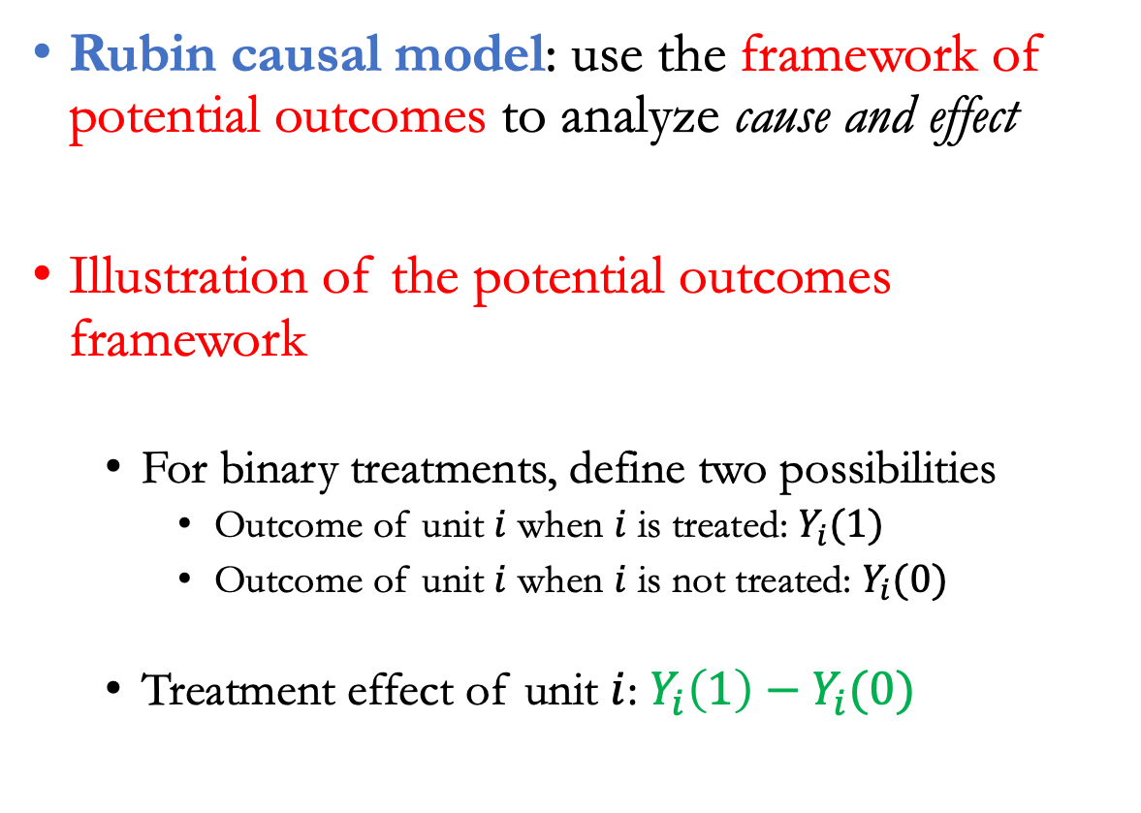


The potential outcomes framework
Rubin causal model: use the framework of potential outcomes to analyze cause and effect
Illustration of the potential outcomes framework
  For binary treatments, define two possibilities
    Outcome of unit $i$ when $i$ is treated: $Y_{i}(1)$
    Outcome of unit $i$ when $i$ is not treated: $Y_{i}(0)$
  Treatment effect of unit $i$: $Y_{i}\left(1\right)−Y_{i}(0)$
$$Y_{i}(1)$$
$$Y_{i}(0)$$
Two roads diverged in a yellow wood, and I---I took the one less traveled by. And that has made all the difference

Slide 7
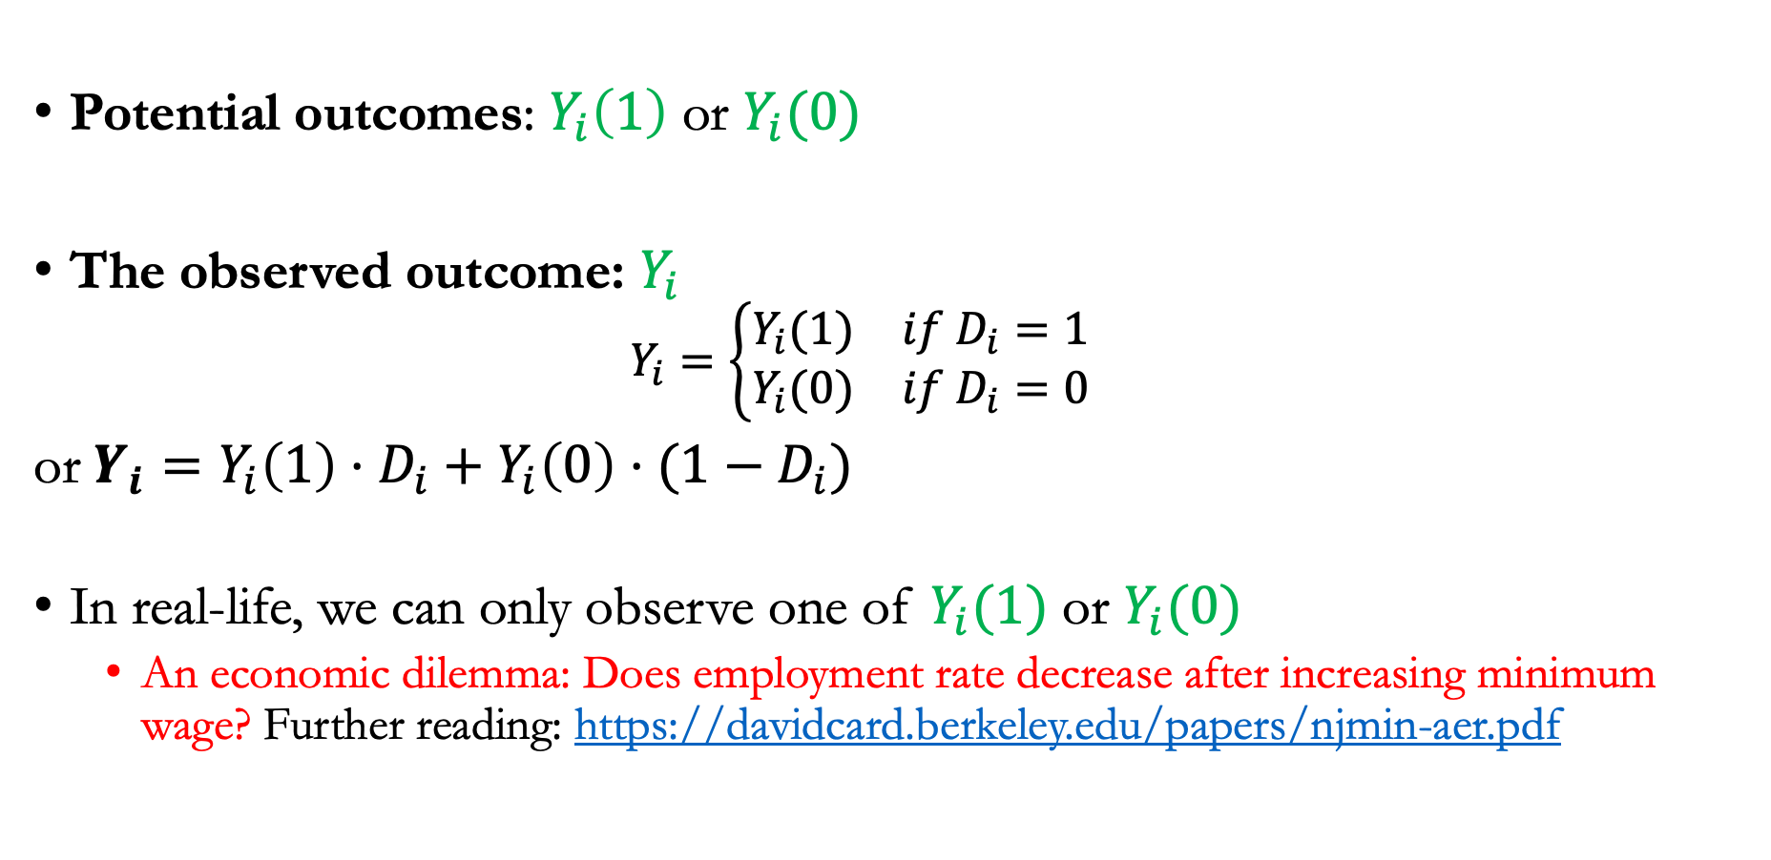
Potential vs. observed outcomes
Potential outcomes: $Y_{i}\left(1\right)$ or $Y_{i}(0)$
The observed outcome: $Y_{i}$
  $$Y_{i}=\left\{\begin{matrix}Y_{i}(1) & if D_{i}=1 \\ Y_{i}(0) & if D_{i}=0\end{matrix}\right.$$
or $Y_{i}=Y_{i}\left(1\right)⋅D_{i}+Y_{i}\left(0\right)⋅(1−D_{i})$
In real-life, we can only observe one of $Y_{i}(1)$ or $Y_{i}(0)$
  An economic dilemma: Does employment rate decrease after increasing minimum wage? Further reading: https://davidcard.berkeley.edu/papers/njmin-aer.pdf

Slide 8
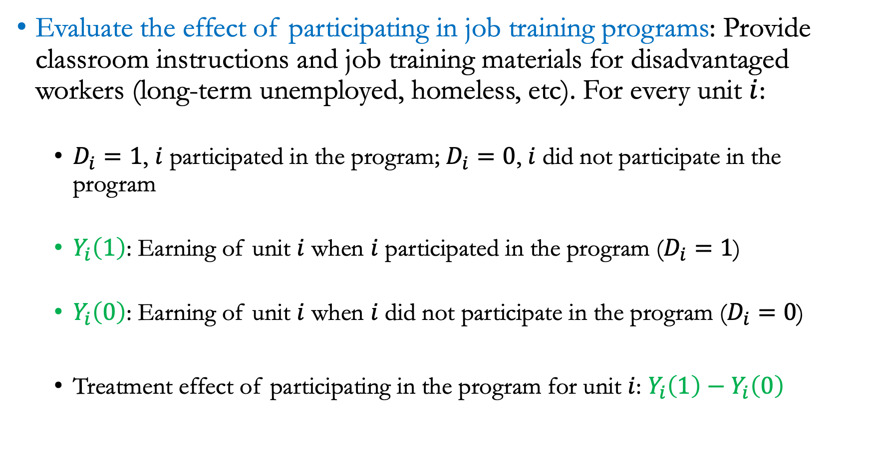
Examples
Evaluate the effect of participating in job training programs: Provide classroom instructions and job training materials for disadvantaged workers (long-term unemployed, homeless, etc). For every unit $i$:
  $D_{i}=1$, $i$ participated in the program; $D_{i}=0$, $i$ did not participate in the program
  $Y_{i}\left(1\right)$: Earning of unit $i$ when $i$ participated in the program ($D_{i}=1$)
  $Y_{i}\left(0\right)$: Earning of unit $i$ when $i$ did not participate in the program ($D_{i}=0$)
  Treatment effect of participating in the program for unit $i$: $Y_{i}\left(1\right)−Y_{i}\left(0\right)$

Slide 9
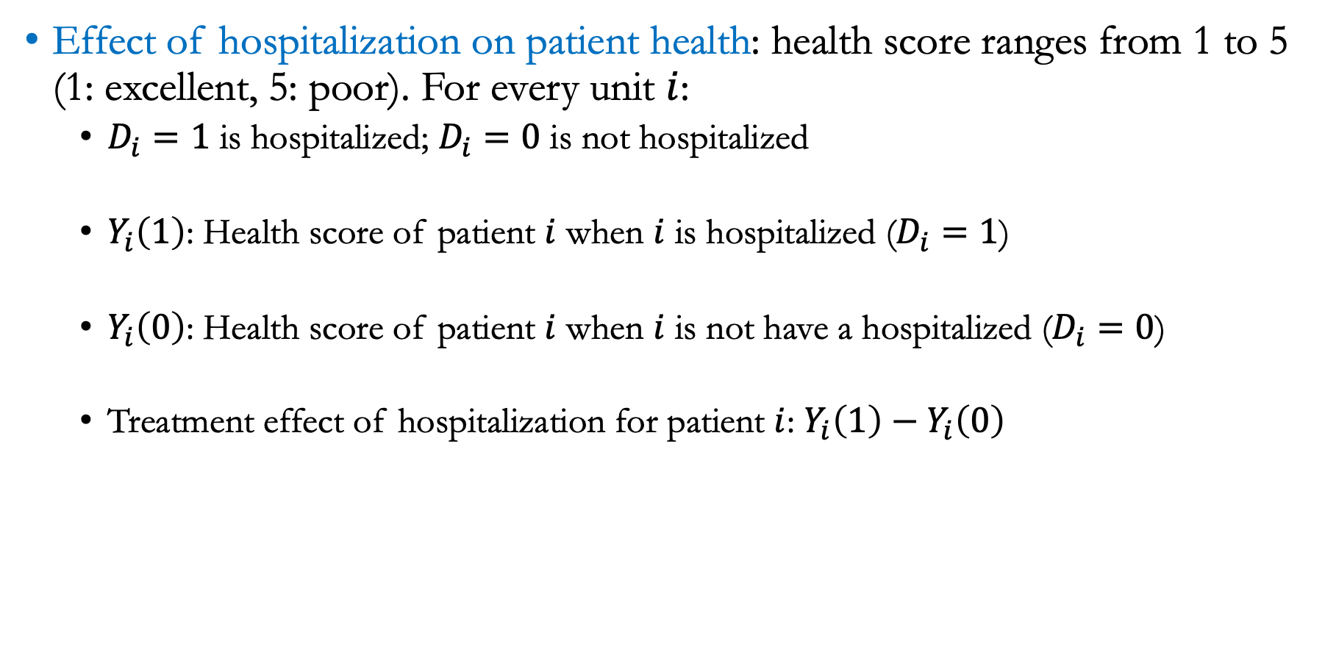
Examples
Effect of hospitalization on patient health: health score ranges from 1 to 5 (1: excellent, 5: poor). For every unit $i$:
  $D_{i}=1$ is hospitalized; $D_{i}=0$ is not hospitalized
  $Y_{i}\left(1\right)$: Health score of patient $i$ when $i$ is hospitalized ($D_{i}=1$)
  $Y_{i}\left(0\right)$: Health score of patient $i$ when $i$ is not have a hospitalized ($D_{i}=0$)
  Treatment effect of hospitalization for patient $i$: $Y_{i}\left(1\right)−Y_{i}\left(0\right)$

Slide 10
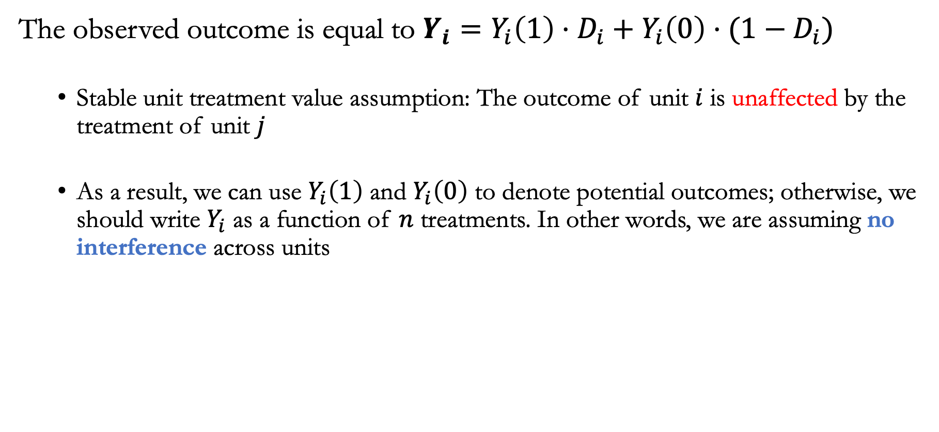
The no interference across unit assumption
The observed outcome is equal to $Y_{i}=Y_{i}\left(1\right)⋅D_{i}+Y_{i}\left(0\right)⋅(1−D_{i})$
  Stable unit treatment value assumption: The outcome of unit $i$ is unaffected by the treatment of unit $j$
  As a result, we can use $Y_{i}\left(1\right)$ and $Y_{i}\left(0\right)$ to denote potential outcomes; otherwise, we should write $Y_{i}$ as a function of $n$ treatments. In other words, we are assuming no interference across units

Slide 11
Lecture plan
  Treatment effects

Slide 12
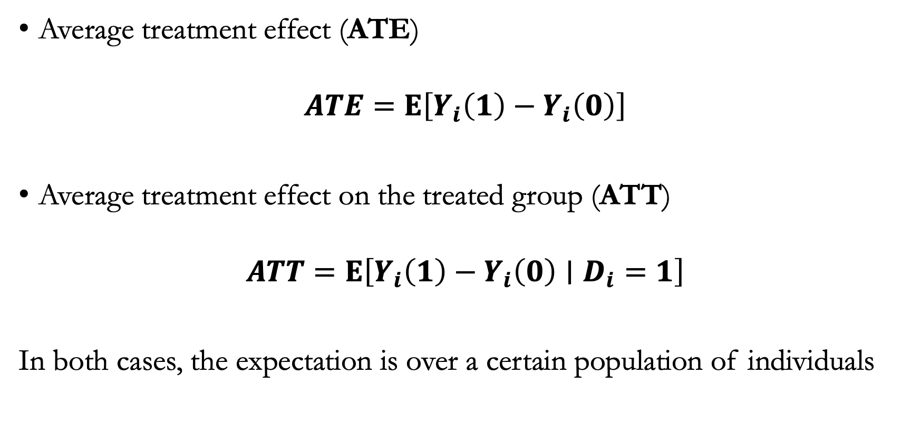
Treatment effects
Average treatment effect (ATE)
$$ATE=E\left[Y_{i}\left(1\right)−Y_{i}\left(0\right)\right]$$
Average treatment effect on the treated group (ATT)
$$ATT=E\left[Y_{i}\left(1\right)−Y_{i}\left(0\right)∣D_{i}=1\right]$$
In both cases, the expectation is over a certain population of individuals

Slide 13
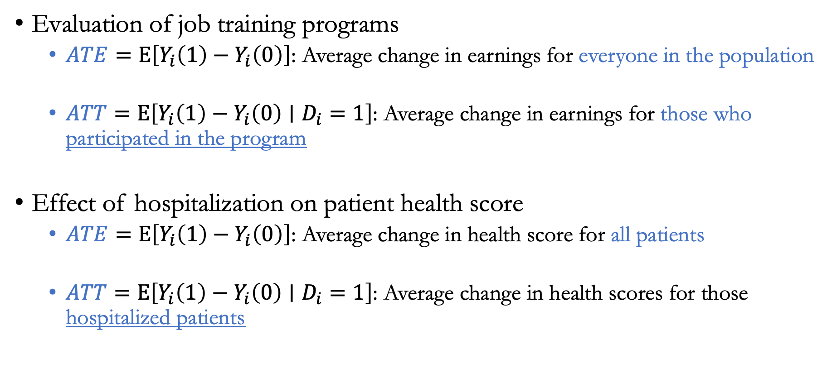
Examples
$\text{Evaluation} \text{of} \text{job} \text{training} \text{programs}$
  $ATE=E\left[Y_{i}\left(1\right)−Y_{i}\left(0\right)\right]$: Average change in earnings for everyone in the population
  $ATT=E\left[Y_{i}\left(1\right)−Y_{i}\left(0\right)∣D_{i}=1\right]$: Average change in earnings for those who participated in the program
Effect of hospitalization on patient health score
  $ATE=E\left[Y_{i}\left(1\right)−Y_{i}\left(0\right)\right]$: Average change in health score for all patients
  $ATT=E\left[Y_{i}\left(1\right)−Y_{i}\left(0\right)∣D_{i}=1\right]$: Average change in health scores for those hospitalized patients

Slide 14
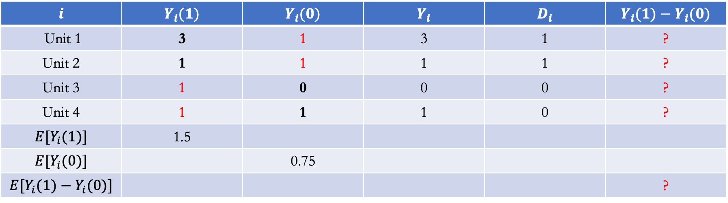
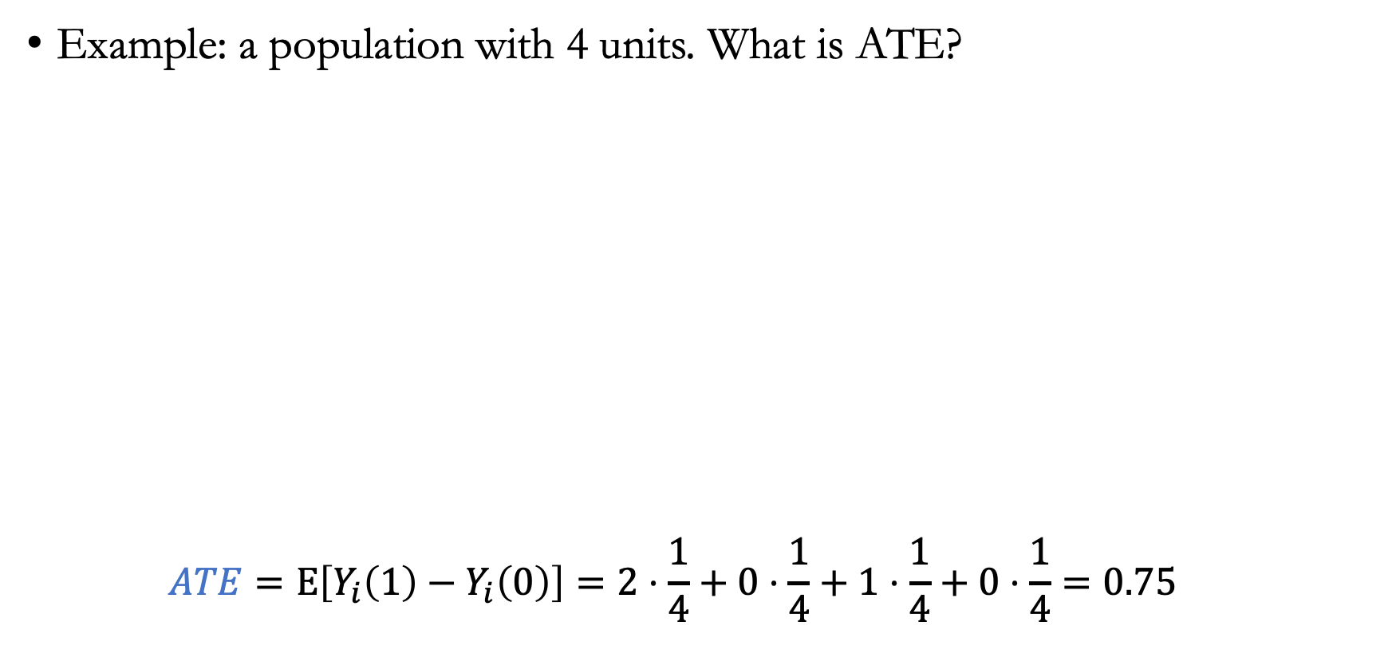
Average treatment effect (ATE)
Example: a population with 4 units. What is ATE?
  $$ATE=E\left[Y_{i}\left(1\right)−Y_{i}\left(0\right)\right]=2⋅\frac{1}{4}+0⋅\frac{1}{4}+1⋅\frac{1}{4}+0⋅\frac{1}{4}=0.75$$
$$i$$ | $$Y_{i}(1)$$ | $$Y_{i}(0)$$ | $$Y_{i}$$ | $$D_{i}$$ | $$Y_{i}(1)−Y_{i}(0)$$
Unit 1 | 3 | 1 | 3 | 1 | ?
Unit 2 | 1 | 1 | 1 | 1 | ?
Unit 3 | 1 | 0 | 0 | 0 | ?
Unit 4 | 1 | 1 | 1 | 0 | ?
$${E[Y}_{i}(1)]$$ | 1.5
$${E[Y}_{i}(0)]$$ |  | 0.75
$${E[Y}_{i}(1)−Y_{i}(0)]$$ |  |  |  |  | ?

Slide 15
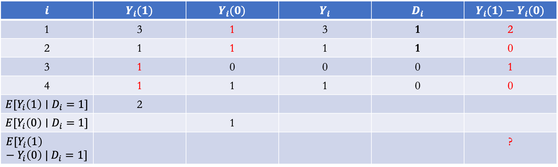
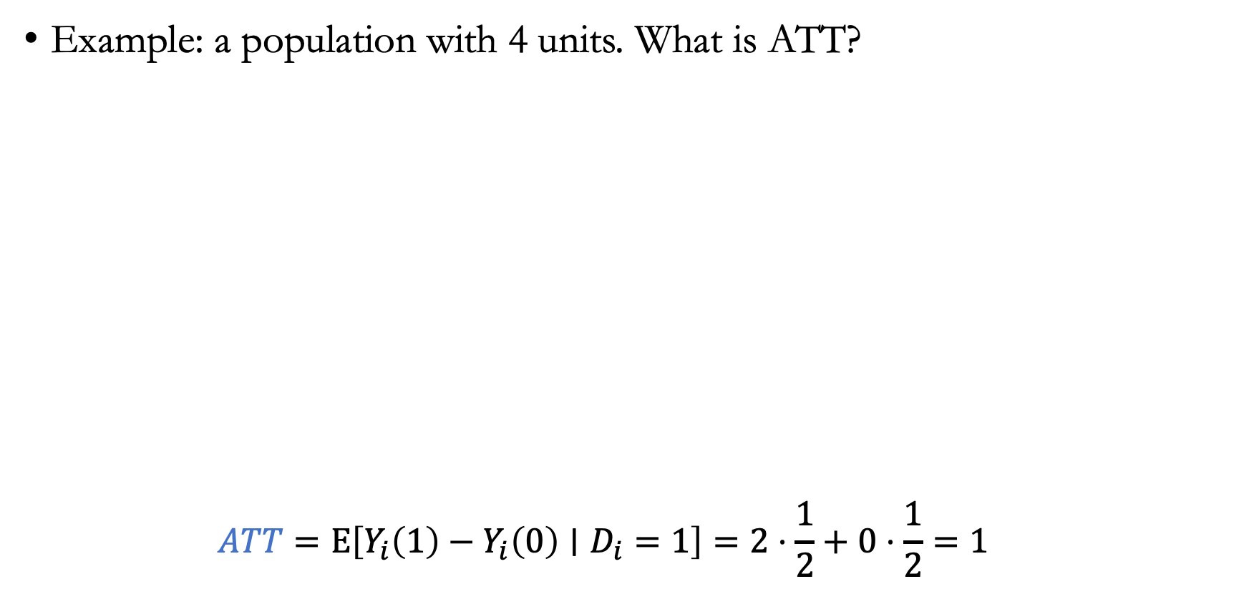
Average treatment effect on the treated (ATT)
Example: a population with 4 units. What is ATT?
  $$ATT=E\left[Y_{i}\left(1\right)−Y_{i}\left(0\right)∣D_{i}=1\right]=2⋅\frac{1}{2}+0⋅\frac{1}{2}=1$$
$$i$$ | $$Y_{i}(1)$$ | $$Y_{i}(0)$$ | $$Y_{i}$$ | $$D_{i}$$ | $$Y_{i}(1)−Y_{i}(0)$$
1 | 3 | 1 | 3 | 1 | 2
2 | 1 | 1 | 1 | 1 | 0
3 | 1 | 0 | 0 | 0 | 1
4 | 1 | 1 | 1 | 0 | 0
$${E[Y}_{i}\left(1\right)∣D_{i}=1]$$ | 2
$${E[Y}_{i}\left(0\right)∣D_{i}=1]$$ |  | 1
$${E[Y}_{i}\left(1\right)−Y_{i}\left(0\right) | D_{i}=1]$$ |  |  |  |  | ?

Slide 16
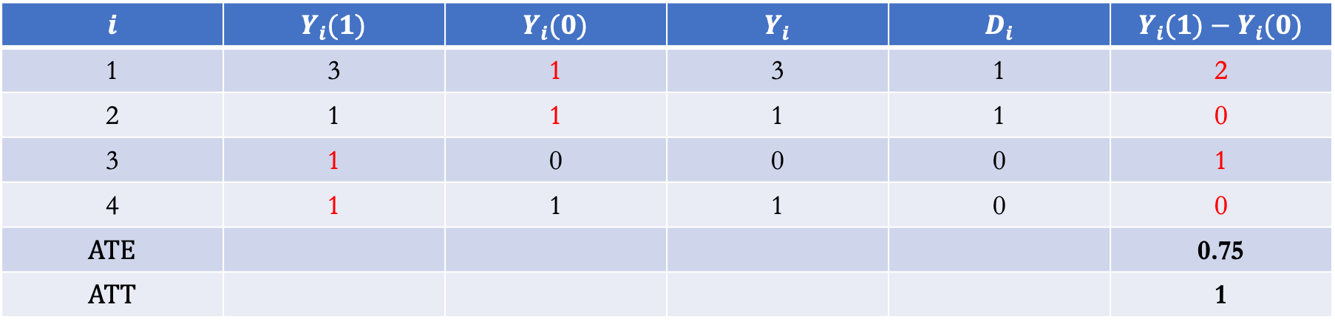
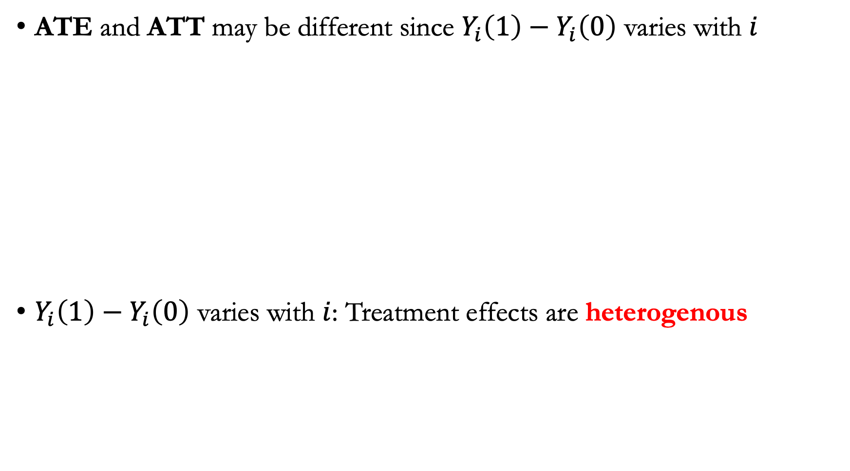
Treatment effects are heterogenous
ATE and ATT may be different since $Y_{i}\left(1\right)−Y_{i}\left(0\right)$ varies with $i$
$Y_{i}\left(1\right)−Y_{i}\left(0\right)$ varies with $i$: Treatment effects are heterogenous
$$i$$ | $$Y_{i}(1)$$ | $$Y_{i}(0)$$ | $$Y_{i}$$ | $$D_{i}$$ | $$Y_{i}(1)−Y_{i}(0)$$
1 | 3 | 1 | 3 | 1 | 2
2 | 1 | 1 | 1 | 1 | 0
3 | 1 | 0 | 0 | 0 | 1
4 | 1 | 1 | 1 | 0 | 0
$$ATE$$ |  |  |  |  | 0.75
$$ATT$$ |  |  |  |  | 1

Slide 17
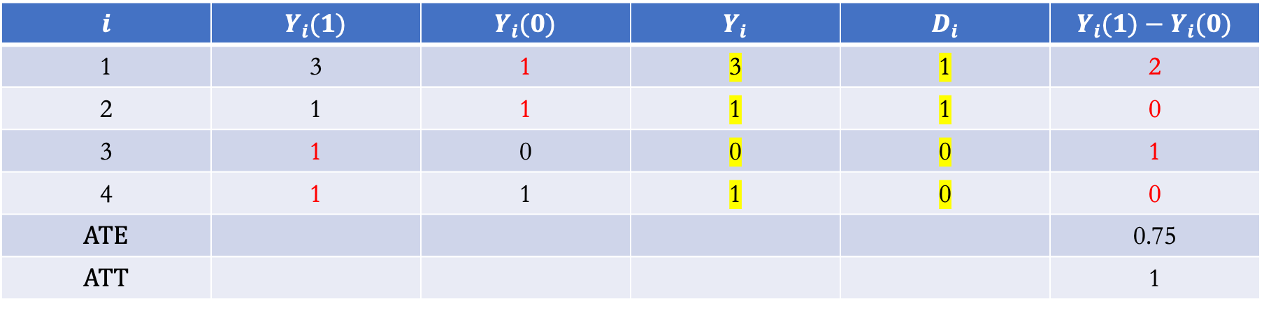
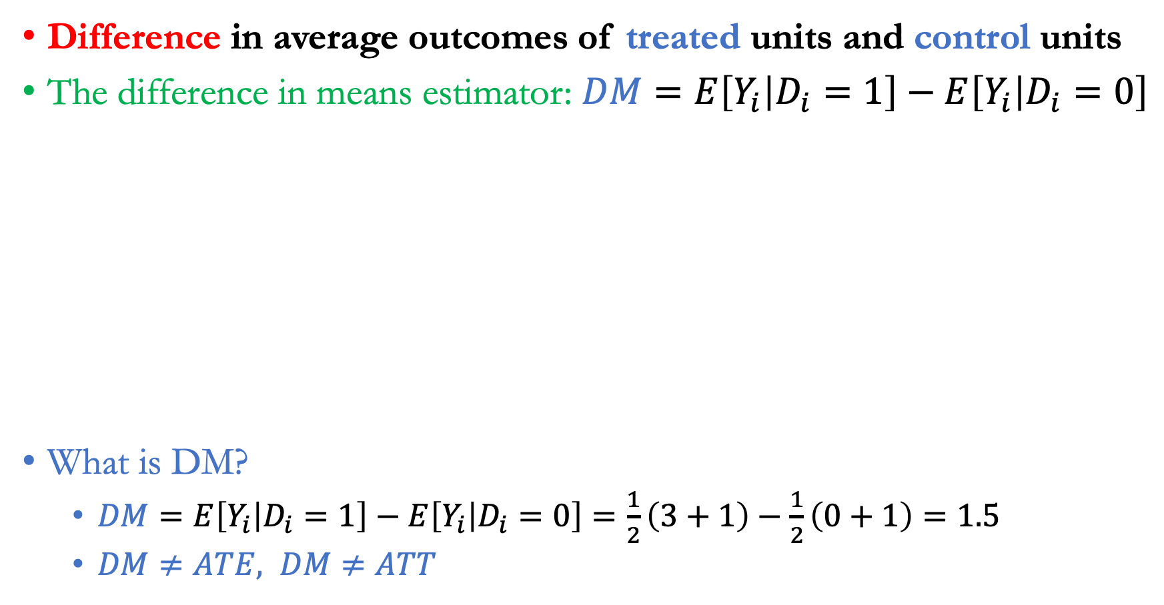
The difference in means estimator
Difference in average outcomes of treated units and control units
The difference in means estimator: $DM=E\left[Y_{i} | D_{i}=1\right]−E\left[Y_{i} | D_{i}=0\right]$
What is DM?
  $DM=E\left[Y_{i} | D_{i}=1\right]−E\left[Y_{i} | D_{i}=0\right]=\frac{1}{2}\left(3+1\right)−\frac{1}{2}\left(0+1\right)=1.5$
  $DM≠ATE, DM≠ATT$
$$i$$ | $$Y_{i}(1)$$ | $$Y_{i}(0)$$ | $$Y_{i}$$ | $$D_{i}$$ | $$Y_{i}(1)−Y_{i}(0)$$
1 | 3 | 1 | 3 | 1 | 2
2 | 1 | 1 | 1 | 1 | 0
3 | 1 | 0 | 0 | 0 | 1
4 | 1 | 1 | 1 | 0 | 0
$$ATE$$ |  |  |  |  | 0.75
$$ATT$$ |  |  |  |  | 1

Slide 18
Lecture plan
  Selection bias

Slide 19
Selection bias
Evaluation of job training programs: Participants are self-selected from a subpopulation of individuals in difficult labor situations
Effect of hospitalization on patient health: People who got hospitalized may be less healthy to begin with
Treatments and outcomes can be correlated

Slide 20
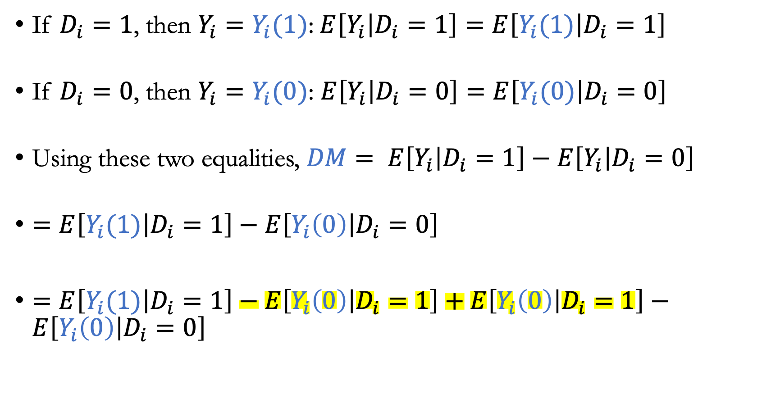
Decomposition of difference-in-means
If $D_{i}=1$, then $Y_{i}=Y_{i}(1)$: $E\left[Y_{i} | D_{i}=1\right]=E\left[Y_{i}(1) | D_{i}=1\right]$
If $D_{i}=0$, then $Y_{i}=Y_{i}(0)$: $E\left[Y_{i} | D_{i}=0\right]=E\left[Y_{i}(0) | D_{i}=0\right]$
Using these two equalities, $DM= E\left[Y_{i} | D_{i}=1\right]−E\left[Y_{i} | D_{i}=0\right]$
$=E\left[Y_{i}(1) | D_{i}=1\right]−E\left[Y_{i}\left(0\right) | D_{i}=0\right]$
$=E\left[Y_{i}(1) | D_{i}=1\right]−E\left[Y_{i}\left(0\right) | D_{i}=1\right]+E\left[Y_{i}\left(0\right) | D_{i}=1\right]−E\left[Y_{i}\left(0\right) | D_{i}=0\right]$

Slide 21
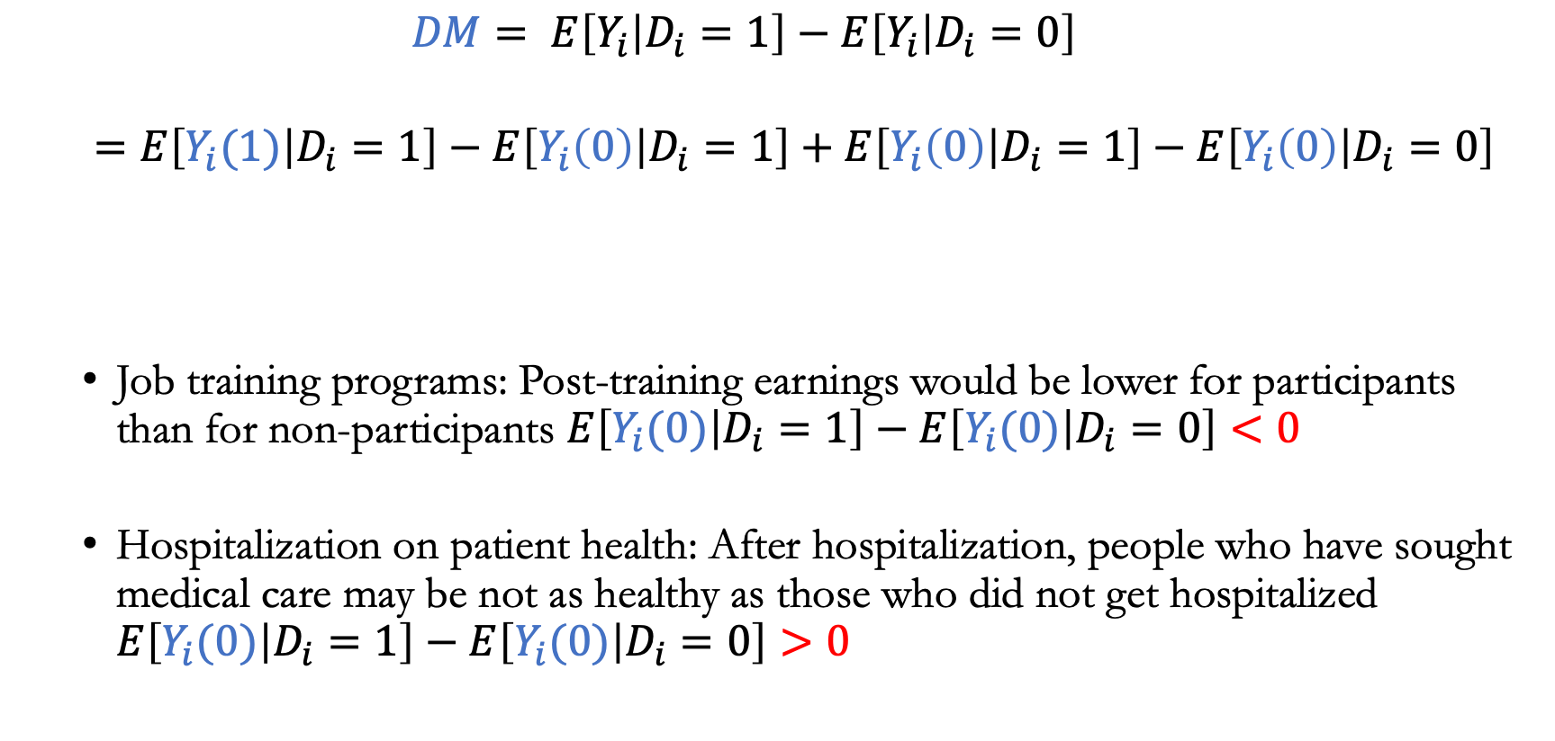
Selection bias in DM
  $$DM= E\left[Y_{i} | D_{i}=1\right]−E\left[Y_{i} | D_{i}=0\right]$$
  $=E\left[Y_{i}(1) | D_{i}=1\right]−E\left[Y_{i}\left(0\right) | D_{i}=1\right]+E\left[Y_{i}\left(0\right) | D_{i}=1\right]−E\left[Y_{i}\left(0\right) | D_{i}=0\right]$
  Job training programs: Post-training earnings would be lower for participants than for non-participants $E\left[Y_{i}(0) | D_{i}=1\right]−E\left[Y_{i}(0) | D_{i}=0\right]<0$
  Hospitalization on patient health: After hospitalization, people who have sought medical care may be not as healthy as those who did not get hospitalized $E\left[Y_{i}(0) | D_{i}=1\right]−E\left[Y_{i}(0) | D_{i}=0\right]>0$
Average treatment effect on the treated group
“Selection bias” in the counterfactual outcome

Slide 22
Lecture plan
  Assignments / Experimental design

Slide 23

Assignment
In practice, how should we determine which units should be selected for treatment?
Imagine launching an experiment on a digital platform like Uber or Amazon
  Random assignment/experiments: Individuals are randomly selected in the job training program. Also called randomized control trials (RCT) in biomedical and health sciences
  Selection based on features: Individuals are selected in the program based on gender, education level, age (matching)

Slide 24
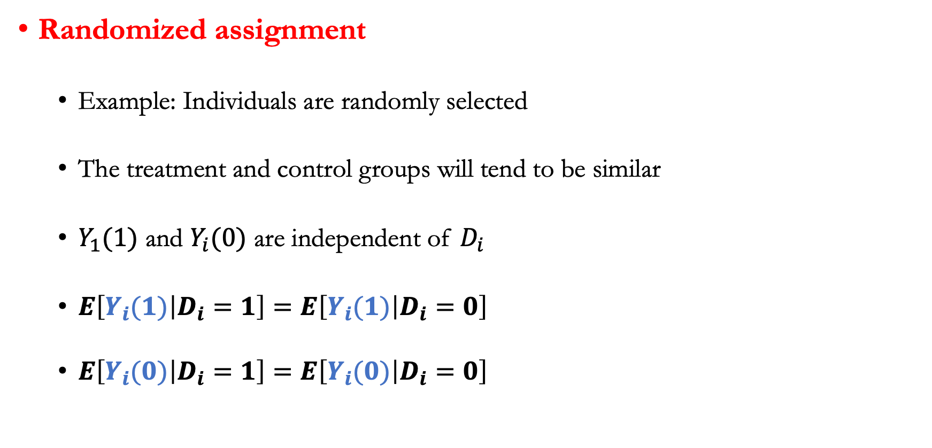
Randomized control trials
Randomized assignment
  Example: Individuals are randomly selected
  The treatment and control groups will tend to be similar
  $Y_{1}(1)$ and $Y_{i}(0)$ are independent of $D_{i}$
  $E\left[Y_{i}(1) | D_{i}=1\right]=E\left[Y_{i}(1) | D_{i}=0\right]$
  $E\left[Y_{i}(0) | D_{i}=1\right]=E\left[Y_{i}(0) | D_{i}=0\right]$

Slide 25

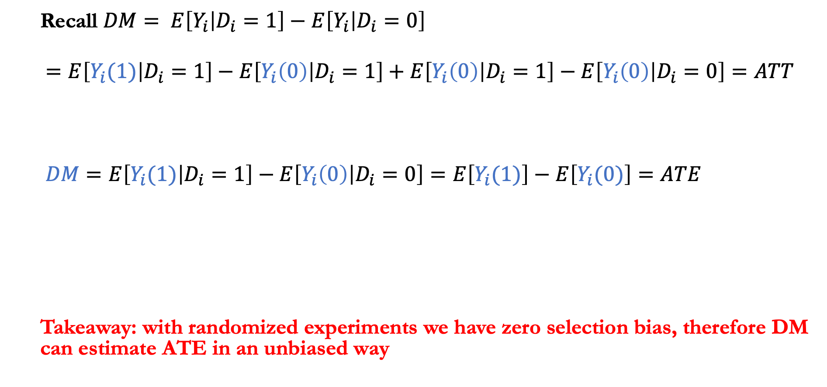
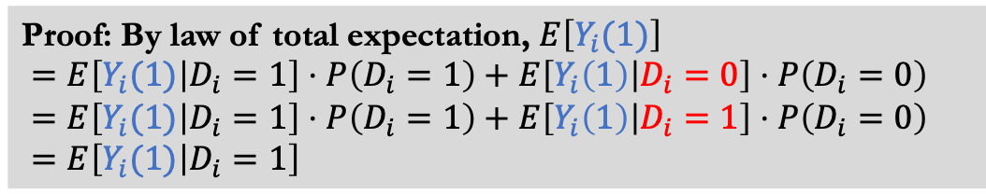
Selection bias is zero under random assignment
  Recall $DM= E\left[Y_{i} | D_{i}=1\right]−E\left[Y_{i} | D_{i}=0\right]$
  $=E\left[Y_{i}(1) | D_{i}=1\right]−E\left[Y_{i}\left(0\right) | D_{i}=1\right]+E\left[Y_{i}\left(0\right) | D_{i}=1\right]−E\left[Y_{i}\left(0\right) | D_{i}=0\right]=ATT$
  $DM=E\left[Y_{i}(1) | D_{i}=1\right]−E\left[Y_{i}\left(0\right) | D_{i}=0\right]=E\left[Y_{i}(1)\right]−E\left[Y_{i}(0)\right]=ATE$
  Takeaway: with randomized experiments we have zero selection bias, therefore DM can estimate ATE in an unbiased way
ATT
Selection bias $=0$
Proof: By law of total expectation, $E\left[Y_{i}(1)\right]$
$=E\left[Y_{i}(1) | D_{i}=1\right]⋅P\left(D_{i}=1\right)+E\left[Y_{i}\left(1\right) | D_{i}=0\right]⋅P\left(D_{i}=0\right)$
$=E\left[Y_{i}(1) | D_{i}=1\right]⋅P\left(D_{i}=1\right)+E\left[Y_{i}\left(1\right) | D_{i}=1\right]⋅P\left(D_{i}=0\right)$
$=E\left[Y_{i}(1) | D_{i}=1\right]$

Slide 26
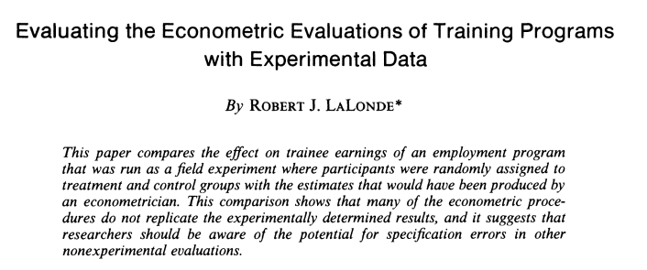
LaLonde’s study (1986)
Study based on a dataset collected by the national supported work demonstration
Dataset: https://rugg2.github.io/Lalonde%20dataset%20-%20Causal%20Inference.html
Notes:
Table 5

Slide 27
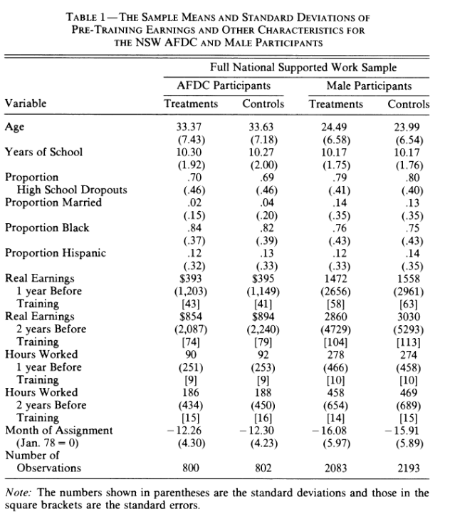
LaLonde’s study (American Economic Review 1986)
In the observed data, the treated group has 185 participants
The control group is drawn randomly from US citizens

Slide 28
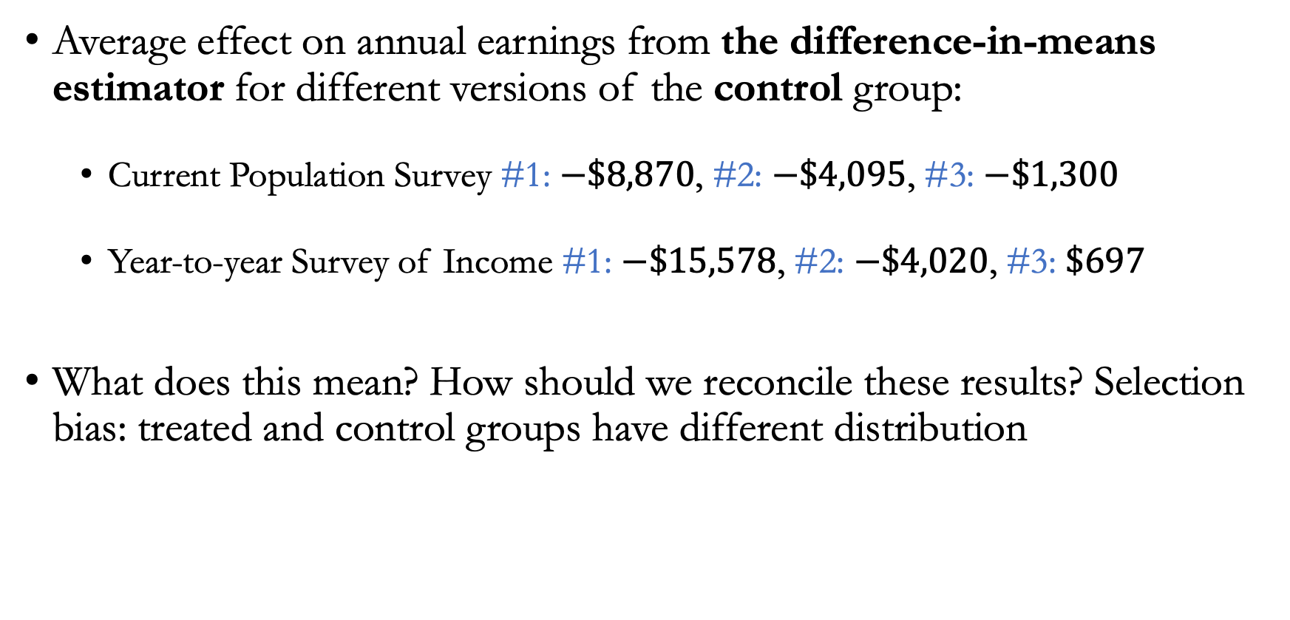
Selection bias
Average effect on annual earnings from the difference-in-means estimator for different versions of the control group:
  Current Population Survey #1: $−\$8,870$, #2: $−\$4,095$, #3: $−\$1,300$
  Year-to-year Survey of Income #1: $−\$15,578$, #2: $−\$4,020$, #3: $\$697$
What does this mean? How should we reconcile these results? Selection bias: treated and control groups have different distribution

Slide 29
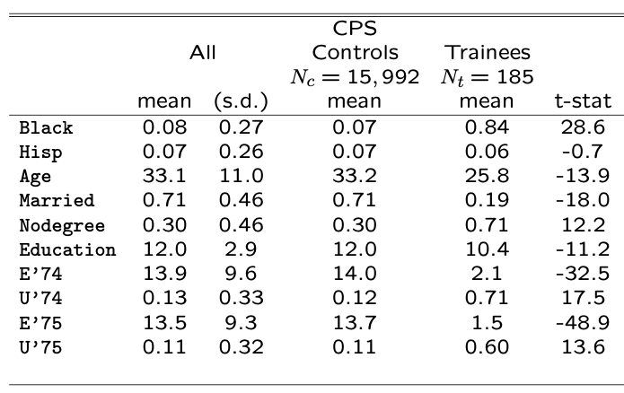
Measuring population statistics
Various demographic statistics for the trainees and control groups

Slide 30
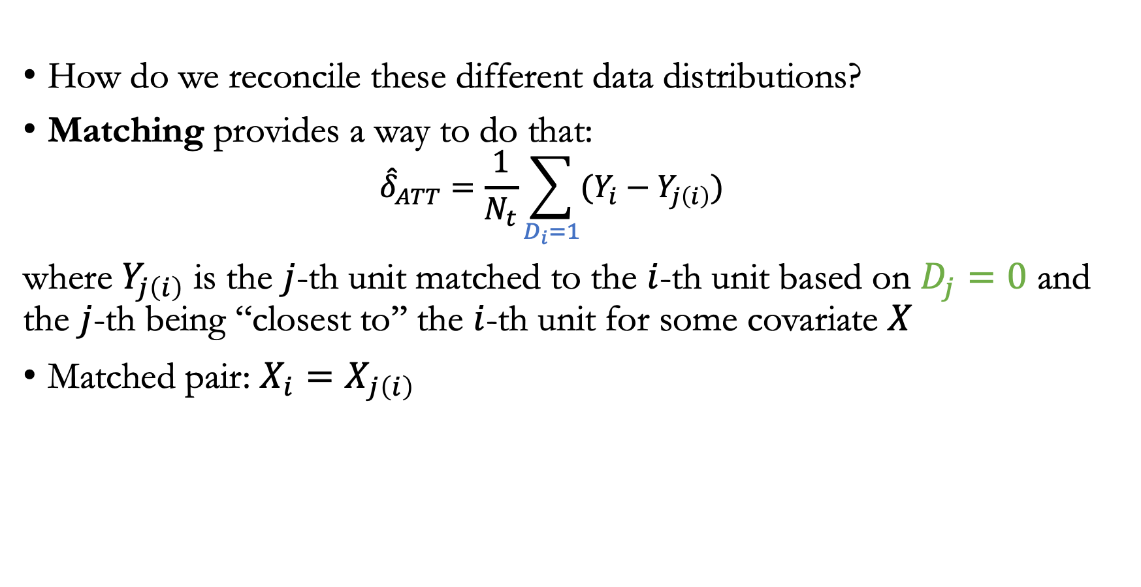
Matching
How do we reconcile these different data distributions?
Matching provides a way to do that:
  $${\hat{δ}}_{ATT}=\frac{1}{N_{t}}\sum_{D_{i}=1}{(Y_{i}−Y_{j\left(i\right)})}$$
where $Y_{j\left(i\right)}$ is the $j$-th unit matched to the $i$-th unit based on $D_{j}=0$ and the $j$-th being “closest to’’ the $i$-th unit for some covariate $X$
Matched pair: $X_{i}=X_{j\left(i\right)}$

Slide 31
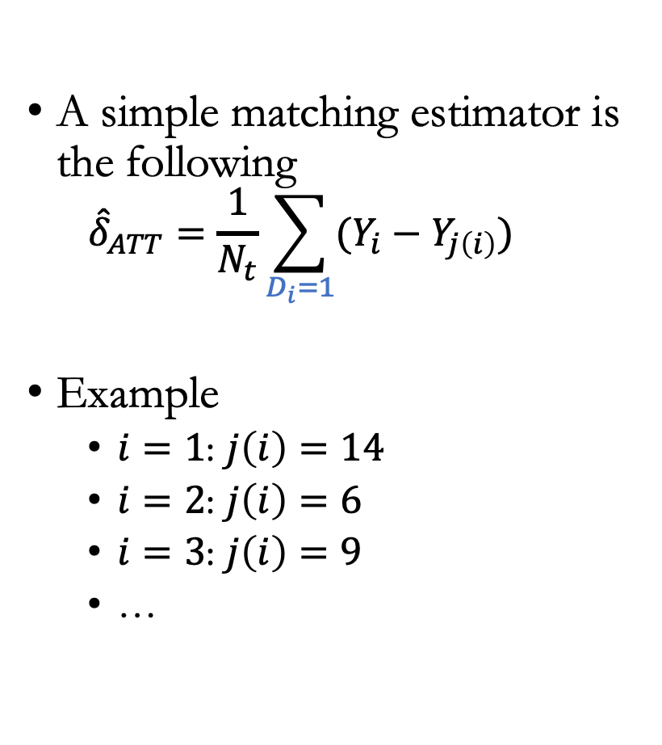
An example
A simple matching estimator is the following
  $${\hat{δ}}_{ATT}=\frac{1}{N_{t}}\sum_{D_{i}=1}{(Y_{i}−Y_{j\left(i\right)})}$$
Example
  $i=1$: $j\left(i\right)=14$
  $i=2$: $j\left(i\right)=6$
  $i=3$: $j\left(i\right)=9$
  …
Trainees |  |  | Non-Trainees
Unit | Age | Earnings | Unit | Age | Earnings
1 | 18 | 9500 | 1 | 20 | 8500
2 | 29 | 12250 | 2 | 27 | 10075
3 | 24 | 11000 | 3 | 21 | 8725
4 | 27 | 11750 | 4 | 39 | 12775
5 | 33 | 13250 | 5 | 38 | 12550
6 | 22 | 10500 | 6 | 29 | 10525
7 | 19 | 9750 | 7 | 39 | 12775
8 | 20 | 10000 | 8 | 33 | 11425
9 | 21 | 10250 | 9 | 24 | 9400
10 | 30 | 12500 | 10 | 30 | 10750
 |  |  | 11 | 33 | 11425
 |  |  | 12 | 36 | 12100
 |  |  | 13 | 22 | 8950
 |  |  | 14 | 18 | 8050
 |  |  | 15 | 43 | 13675
 |  |  | 16 | 39 | 12775
 |  |  | 17 | 19 | 8275
 |  |  | 18 | 30 | 9000
 |  |  | 19 | 51 | 15475
 |  |  | 20 | 48 | 14800
Mean | 24.3 | $11,075 |  | 31.95 | $11,101.25

Slide 32
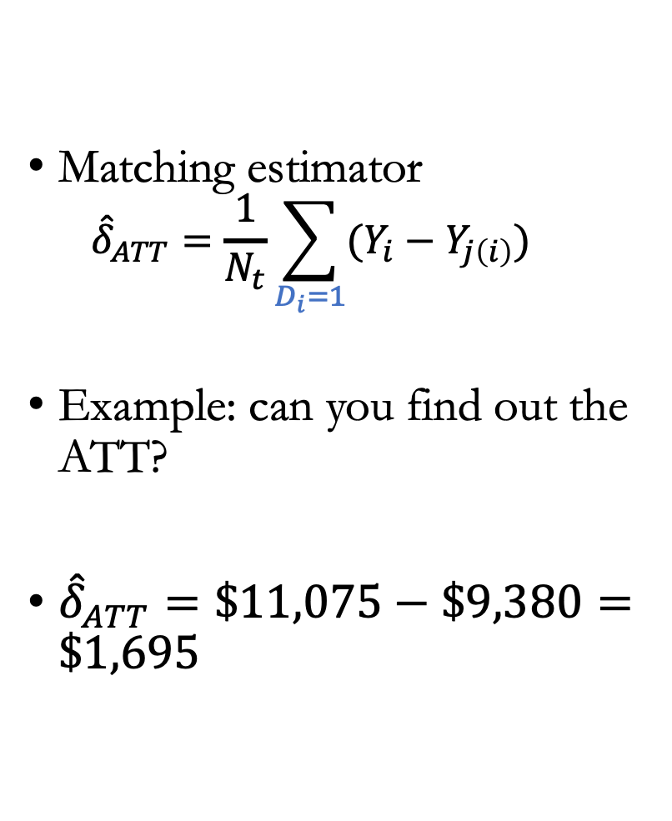
An example
Matching estimator
  $${\hat{δ}}_{ATT}=\frac{1}{N_{t}}\sum_{D_{i}=1}{(Y_{i}−Y_{j\left(i\right)})}$$
Example: can you find out the ATT?
${\hat{δ}}_{ATT}=\$11,075−\$9,380=\$1,695$
Trainees |  |  | Non-Trainees |  |  | Matched Sample
Unit | Age | Earnings | Unit | Age | Earnings | Unit | Age | Earnings
1 | 18 | 9500 | 1 | 20 | 8500 | 14 | 18 | 8050
2 | 29 | 12250 | 2 | 27 | 10075 | 6 | 29 | 10525
3 | 24 | 11000 | 3 | 21 | 8725 | 9 | 24 | 9400
4 | 27 | 11750 | 4 | 39 | 12775 | 8 | 27 | 10075
5 | 33 | 13250 | 5 | 38 | 12550 | 11 | 33 | 11425
6 | 22 | 10500 | 6 | 29 | 10525 | 13 | 22 | 8950
7 | 19 | 9750 | 7 | 39 | 12775 | 17 | 19 | 8275
8 | 20 | 10000 | 8 | 33 | 11425 | 1 | 20 | 8500
9 | 21 | 10250 | 9 | 24 | 9400 | 3 | 21 | 8725
10 | 30 | 12500 | 10 | 30 | 10750 | 10,18 | 30 | 9875
 |  |  | 11 | 33 | 11425
 |  |  | 12 | 36 | 12100
 |  |  | 13 | 22 | 8950
 |  |  | 14 | 18 | 8050
 |  |  | 15 | 43 | 13675
 |  |  | 16 | 39 | 12775
 |  |  | 17 | 19 | 8275
 |  |  | 18 | 30 | 9000
 |  |  | 19 | 51 | 15475
 |  |  | 20 | 48 | 14800
Mean | 24.3 | $11,075 |  | 31.95 | $11,101.25 |  | 24.3 | $9,380

Slide 33
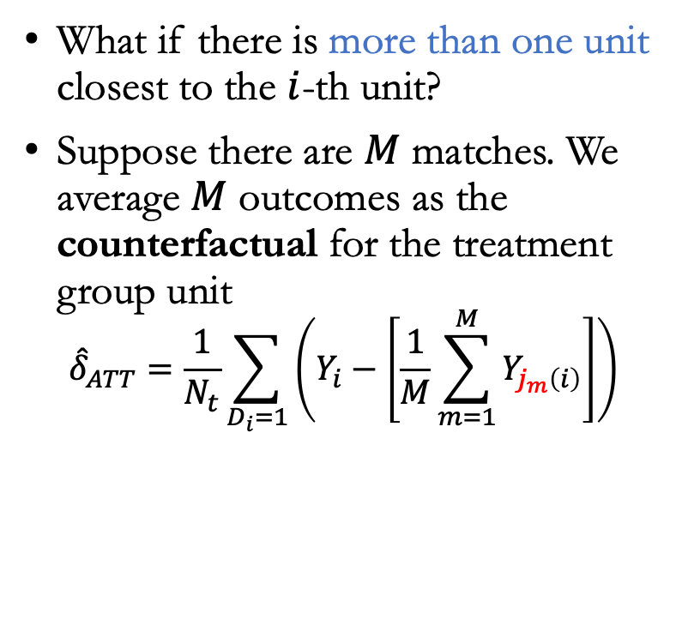
More than one match
What if there is more than one unit closest to the $i$-th unit?
Suppose there are $M$ matches. We average $M$ outcomes as the counterfactual for the treatment group unit
$${\hat{δ}}_{ATT}=\frac{1}{N_{t}}\sum_{D_{i}=1}{\left(Y_{i}−\left[\frac{1}{M}\sum_{m=1}^{M}{Y_{j_{m}\left(i\right)}}\right]\right)}$$
Trainees |  |  | Non-Trainees |  |  | Matched Sample
Unit | Age | Earnings | Unit | Age | Earnings | Unit | Age | Earnings
1 | 18 | 9500 | 1 | 20 | 8500 | 14 | 18 | 8050
2 | 29 | 12250 | 2 | 27 | 10075 | 6 | 29 | 10525
3 | 24 | 11000 | 3 | 21 | 8725 | 9 | 24 | 9400
4 | 27 | 11750 | 4 | 39 | 12775 | 8 | 27 | 10075
5 | 33 | 13250 | 5 | 38 | 12550 | 11 | 33 | 11425
6 | 22 | 10500 | 6 | 29 | 10525 | 13 | 22 | 8950
7 | 19 | 9750 | 7 | 39 | 12775 | 17 | 19 | 8275
8 | 20 | 10000 | 8 | 33 | 11425 | 1 | 20 | 8500
9 | 21 | 10250 | 9 | 24 | 9400 | 3 | 21 | 8725
10 | 30 | 12500 | 10 | 30 | 10750 | 10,18 | 30 | 9875
 |  |  | 11 | 33 | 11425
 |  |  | 12 | 36 | 12100
 |  |  | 13 | 22 | 8950
 |  |  | 14 | 18 | 8050
 |  |  | 15 | 43 | 13675
 |  |  | 16 | 39 | 12775
 |  |  | 17 | 19 | 8275
 |  |  | 18 | 30 | 9000
 |  |  | 19 | 51 | 15475
 |  |  | 20 | 48 | 14800
Mean | 24.3 | $11,075 |  | 31.95 | $11,101.25 |  | 24.3 | $9,380

Slide 34
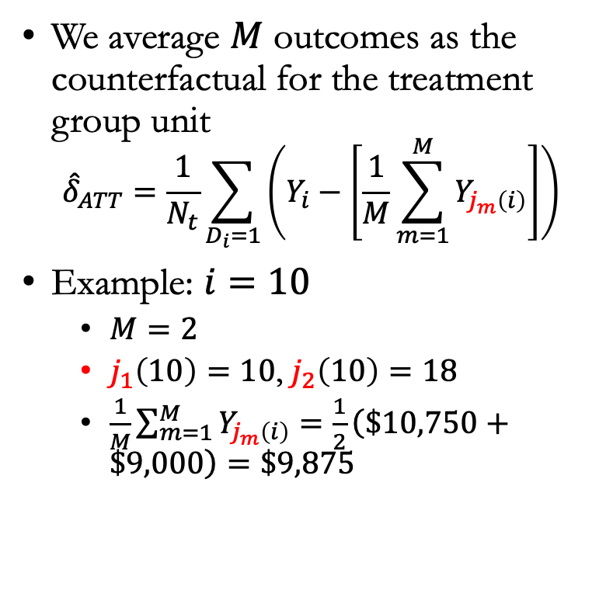
More than one match
We average $M$ outcomes as the counterfactual for the treatment group unit
$${\hat{δ}}_{ATT}=\frac{1}{N_{t}}\sum_{D_{i}=1}{\left(Y_{i}−\left[\frac{1}{M}\sum_{m=1}^{M}{Y_{j_{m}\left(i\right)}}\right]\right)}$$
Example: $i=10$
  $M=2$
  $j_{1}\left(10\right)=10$, $j_{2}\left(10\right)=18$
  $\frac{1}{M}\sum_{m=1}^{M}{Y_{j_{m}\left(i\right)}}=\frac{1}{2}\left(\$10,750+\$9,000\right)=\$9,875$
Trainees |  |  | Non-Trainees |  |  | Matched Sample
Unit | Age | Earnings | Unit | Age | Earnings | Unit | Age | Earnings
1 | 18 | 9500 | 1 | 20 | 8500 | 14 | 18 | 8050
2 | 29 | 12250 | 2 | 27 | 10075 | 6 | 29 | 10525
3 | 24 | 11000 | 3 | 21 | 8725 | 9 | 24 | 9400
4 | 27 | 11750 | 4 | 39 | 12775 | 8 | 27 | 10075
5 | 33 | 13250 | 5 | 38 | 12550 | 11 | 33 | 11425
6 | 22 | 10500 | 6 | 29 | 10525 | 13 | 22 | 8950
7 | 19 | 9750 | 7 | 39 | 12775 | 17 | 19 | 8275
8 | 20 | 10000 | 8 | 33 | 11425 | 1 | 20 | 8500
9 | 21 | 10250 | 9 | 24 | 9400 | 3 | 21 | 8725
10 | 30 | 12500 | 10 | 30 | 10750 | 10,18 | 30 | 9875
 |  |  | 11 | 33 | 11425
 |  |  | 12 | 36 | 12100
 |  |  | 13 | 22 | 8950
 |  |  | 14 | 18 | 8050
 |  |  | 15 | 43 | 13675
 |  |  | 16 | 39 | 12775
 |  |  | 17 | 19 | 8275
 |  |  | 18 | 30 | 9000
 |  |  | 19 | 51 | 15475
 |  |  | 20 | 48 | 14800
Mean | 24.3 | $11,075 |  | 31.95 | $11,101.25 |  | 24.3 | $9,380

Slide 35
Nearest neighbor matching
What if we could not find another unit with that exact same feature value?
Find the closest match via KNN
Trainees |  |  | Non-Trainees
Unit | Age | Earnings | Unit | Age | Earnings
1 | 18 | 9500 | 1 | 20 | 8500
2 | 29 | 12250 | 2 | 27 | 10075
3 | 24 | 11000 | 3 | 21 | 8725
4 | 27 | 11750 | 4 | 39 | 12775
5 | 33 | 13250 | 5 | 38 | 12550
6 | 22 | 10500 | 6 | 29 | 10525
7 | 19 | 9750 | 7 | 39 | 12775
8 | 20 | 10000 | 8 | 33 | 11425
9 | 21 | 10250 | 9 | 24 | 9400
10 | 30 | 12500 | 10 | 30 | 10750
11 | 52 | 15000 | 11 | 33 | 11425
 |  |  | 12 | 36 | 12100
 |  |  | 13 | 22 | 8950
 |  |  | 14 | 18 | 8050
 |  |  | 15 | 43 | 13675
 |  |  | 16 | 39 | 12775
 |  |  | 17 | 19 | 8275
 |  |  | 18 | 30 | 9000
 |  |  | 19 | 51 | 15475
 |  |  | 20 | 48 | 14800
Mean | 24.3 | $11,075 |  | 31.95 | $11,101.25

Slide 36
An example of nearest neighbor matching
How to define one unit’s covariate to be “close” to someone else’s?
  One covariate only: find the unit with the closest covariate value
  More than one covariate: apply a distance measure in calculating nearest neighbor
Trainees |  |  | Non-Trainees
Unit | Age | Earnings | Unit | Age | Earnings
1 | 18 | 9500 | 1 | 20 | 8500
2 | 29 | 12250 | 2 | 27 | 10075
3 | 24 | 11000 | 3 | 21 | 8725
4 | 27 | 11750 | 4 | 39 | 12775
5 | 33 | 13250 | 5 | 38 | 12550
6 | 22 | 10500 | 6 | 29 | 10525
7 | 19 | 9750 | 7 | 39 | 12775
8 | 20 | 10000 | 8 | 33 | 11425
9 | 21 | 10250 | 9 | 24 | 9400
10 | 30 | 12500 | 10 | 30 | 10750
11 | 52 | 15000 | 11 | 33 | 11425
 |  |  | 12 | 36 | 12100
 |  |  | 13 | 22 | 8950
 |  |  | 14 | 18 | 8050
 |  |  | 15 | 43 | 13675
 |  |  | 16 | 39 | 12775
 |  |  | 17 | 19 | 8275
 |  |  | 18 | 30 | 9000
 |  |  | 19 | 51 | 15475
 |  |  | 20 | 48 | 14800
Mean | 24.3 | $11,075 |  | 31.95 | $11,101.25

Slide 37
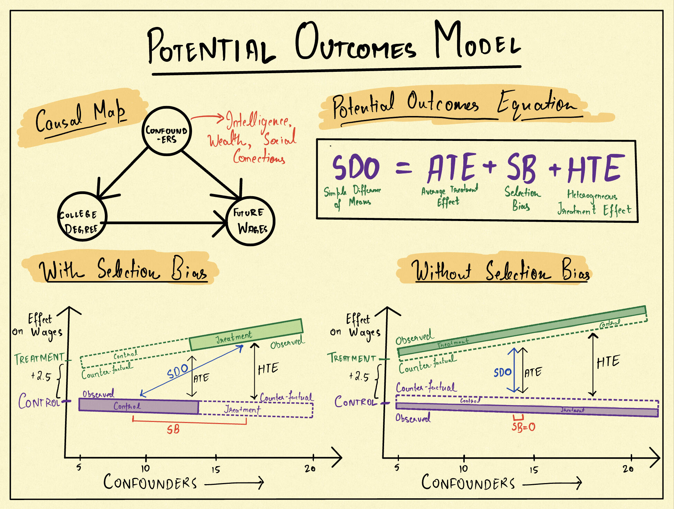
Summary of today’s lecture: The potential outcomes model

Slide 38
Announcements
Homework 4 due today!
Homework 5 released: Due on December 5
Project discussion in class: December 6
Course project submission instruction added to google doc: https://docs.google.com/document/d/1EmhNv4yWqkrABGb_BMmwvphdPk9LI61mgHsmzO2T1Lk/edit?usp=sharing, due on December 9

