Slide 1
Supervised Machine Learning and Learning Theory
Lecture 2: Linear Regression, with Some Review of Linear Algebra
September 10, 2024

Slide 2
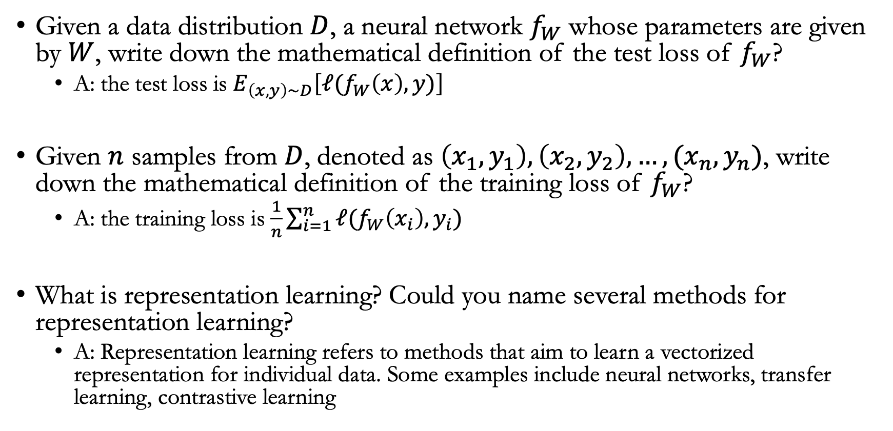
In-class quiz questions
Given a data distribution $D$, a neural network $f_{W}$ whose parameters are given by $W$, write down the mathematical definition of the test loss of $f_{W}$?
  A: the test loss is $E_{\left(x,y\right)∼D}\left[ℓ(f_{W}\left(x\right),y)\right]$
Given $n$ samples from $D$, denoted as $\left(x_{1},y_{1}\right),\left(x_{2},y_{2}\right),…,(x_{n},y_{n})$, write down the mathematical definition of the training loss of $f_{W}$?
  A: the training loss is $\frac{1}{n}\sum_{i=1}^{n}{ℓ(f_{W}\left(x_{i}\right),y_{i})}$
What is representation learning? Could you name several methods for representation learning?
  A: Representation learning refers to methods that aim to learn a vectorized representation for individual data. Some examples include neural networks, transfer learning, contrastive learning

Slide 3
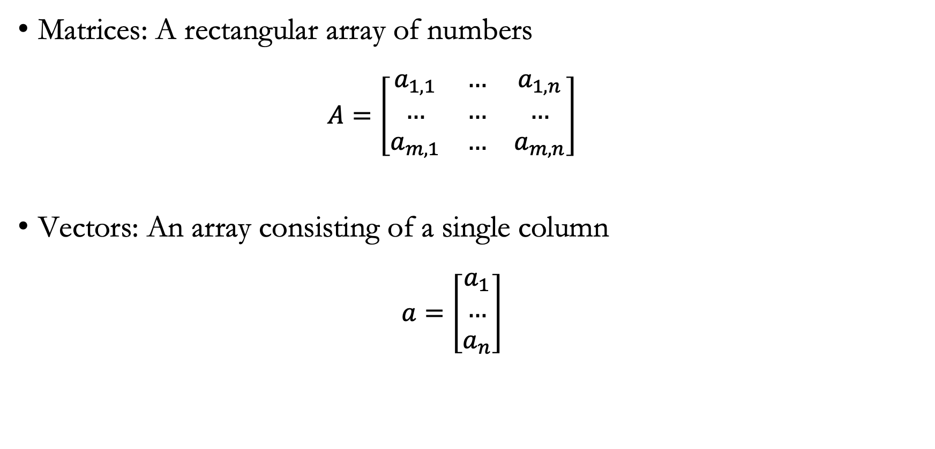
Matrices and vectors
Matrices: A rectangular array of numbers
  $$A=\left[\begin{matrix}a_{1,1} & … & a_{1,n} \\ … & … & … \\ a_{m,1} & … & a_{m,n}\end{matrix}\right]$$
Vectors: An array consisting of a single column
  $$a=\left[\begin{matrix}a_{1} \\ … \\ a_{n}\end{matrix}\right]$$

Slide 4
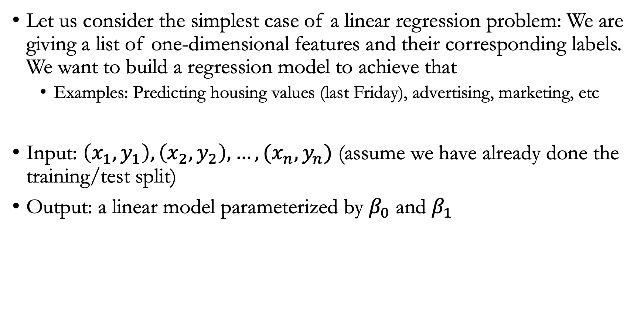
Simple linear regression
Let us consider the simplest case of a linear regression problem: We are giving a list of one-dimensional features and their corresponding labels. We want to build a regression model to achieve that
  Examples: Predicting housing values (last Friday), advertising, marketing, etc
Input: $\left(x_{1},y_{1}\right),\left(x_{2},y_{2}\right),…,(x_{n},y_{n})$ (assume we have already done the training/test split)
Output: a linear model parameterized by $β_{0}$ and $β_{1}$

Slide 5


Examples of $β_{0}$ and $β_{1}$
Fitting a regression model mapping TA ad spending to Sales amount
$β_{1}$: Slope
$β_{0}$: Intercept

Slide 6
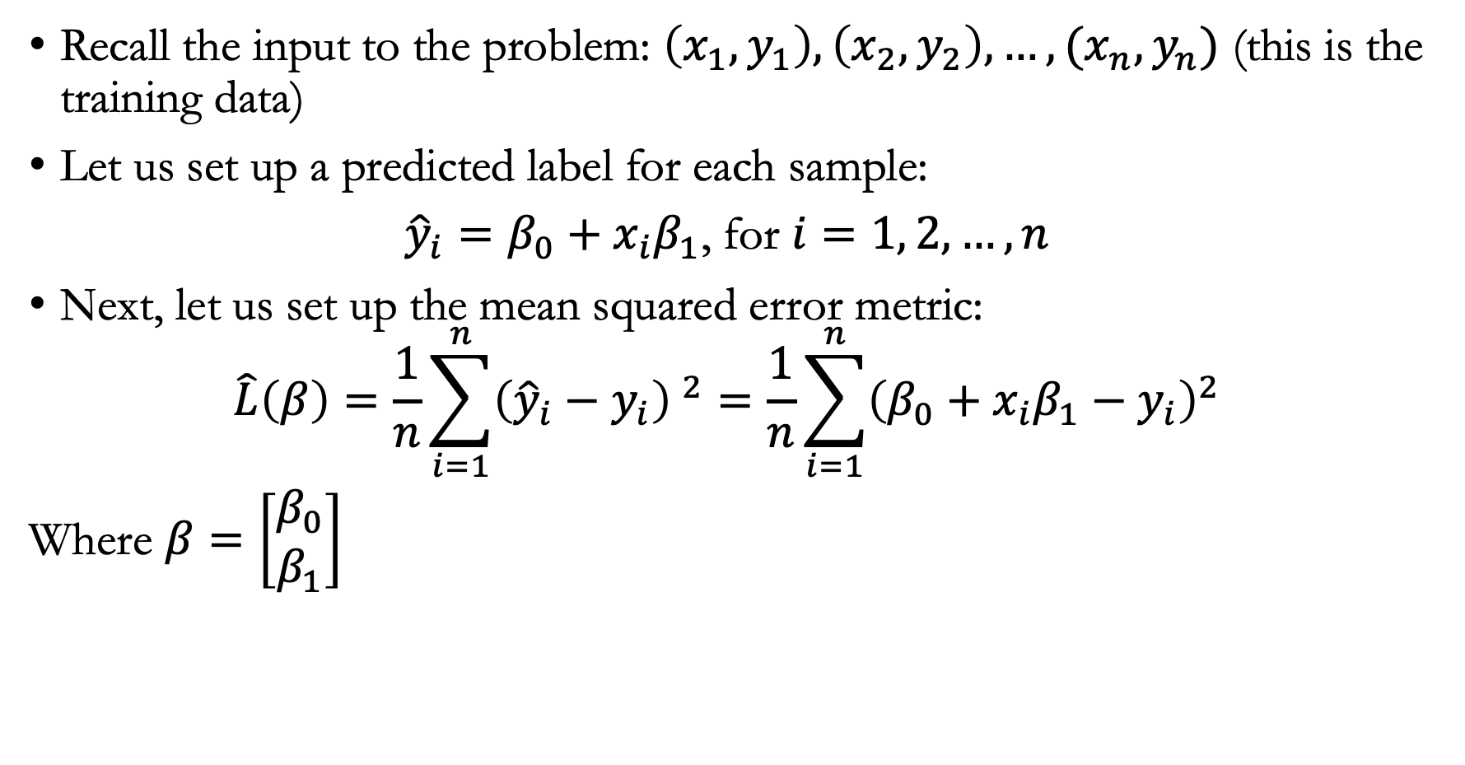
Setting up the linear model
Recall the input to the problem: $\left(x_{1},y_{1}\right),\left(x_{2},y_{2}\right),…,(x_{n},y_{n})$ (this is the training data)
Let us set up a predicted label for each sample:
${\hat{y}}_{i}=β_{0}+x_{i}β_{1}$, for $i=1, 2, …, n$
Next, let us set up the mean squared error metric:
$$\hat{L}\left(β\right)=\frac{1}{n}{\sum_{i=1}^{n}{\left({\hat{y}}_{i}−y_{i}\right)} }^{2}=\frac{1}{n}\sum_{i=1}^{n}{{\left(β_{0}+x_{i}β_{1}−y_{i}\right)}^{2}}$$
Where $β=\left[\begin{matrix}β_{0} \\ β_{1}\end{matrix}\right]$

Slide 7
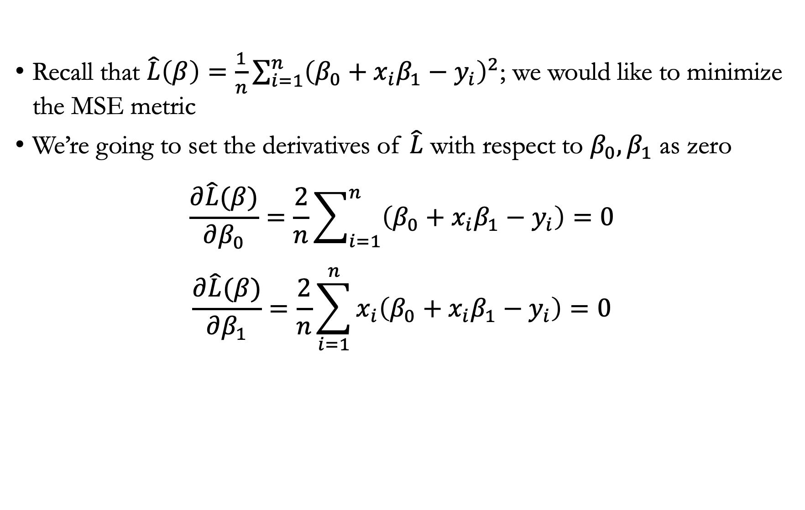
Solving for $β_{0}$ and $β_{1}$
Recall that $\hat{L}\left(β\right)=\frac{1}{n}\sum_{i=1}^{n}{{\left(β_{0}+x_{i}β_{1}−y_{i}\right)}^{2}}$; we would like to minimize the MSE metric
We’re going to set the derivatives of $\hat{L}$ with respect to $β_{0},β_{1}$ as zero
$$\frac{∂\hat{L}(β)}{∂β_{0}}=\frac{2}{n}\sum_{i=1}^{n}{\left(β_{0}+x_{i}β_{1}−y_{i}\right)}=0$$
$$\frac{∂\hat{L}(β)}{∂β_{1}}=\frac{2}{n}\sum_{i=1}^{n}{x_{i}\left(β_{0}+x_{i}β_{1}−y_{i}\right)=0}$$

Slide 8
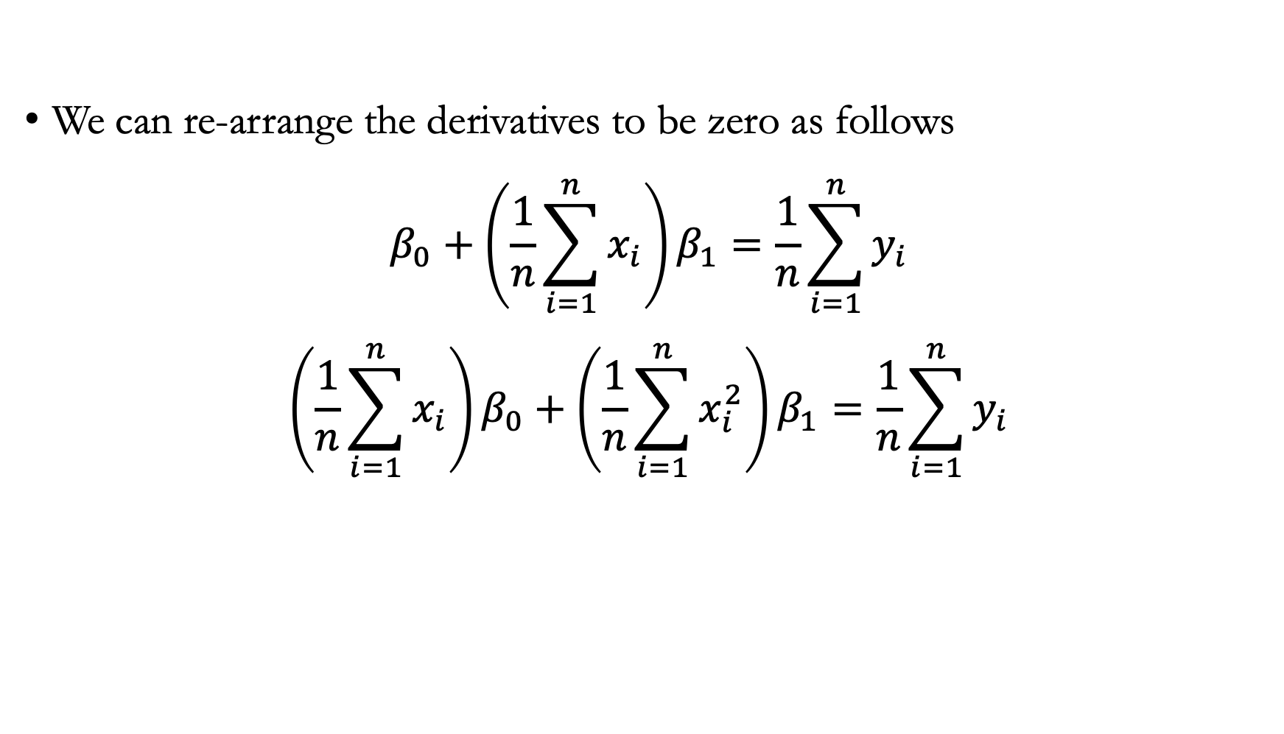
Solving for $β_{0}$ and $β_{1}$
We can re-arrange the derivatives to be zero as follows
$$β_{0}+\left(\frac{1}{n}\sum_{i=1}^{n}{x_{i}}\right)β_{1}=\frac{1}{n}\sum_{i=1}^{n}{y_{i}}$$
$$\left(\frac{1}{n}\sum_{i=1}^{n}{x_{i}}\right)β_{0}+\left(\frac{1}{n}\sum_{i=1}^{n}{x_{i}^{2}}\right)β_{1}=\frac{1}{n}\sum_{i=1}^{n}{y_{i}}$$

Slide 9
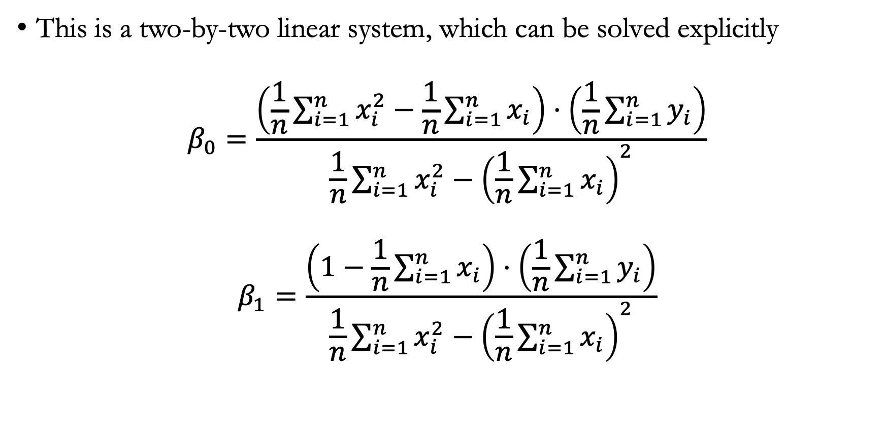
Final solution
This is a two-by-two linear system, which can be solved explicitly
$$β_{0}=\frac{\left(\frac{1}{n}\sum_{i=1}^{n}{x_{i}^{2}−\frac{1}{n}\sum_{i=1}^{n}{x_{i}}}\right)⋅\left(\frac{1}{n}\sum_{i=1}^{n}{y_{i}}\right)}{\frac{1}{n}\sum_{i=1}^{n}{x_{i}^{2}}−{\left(\frac{1}{n}\sum_{i=1}^{n}{x_{i}}\right)}^{2}}$$
$$β_{1}=\frac{\left(1−\frac{1}{n}\sum_{i=1}^{n}{x_{i}}\right)⋅\left(\frac{1}{n}\sum_{i=1}^{n}{y_{i}}\right)}{\frac{1}{n}\sum_{i=1}^{n}{x_{i}^{2}}−{\left(\frac{1}{n}\sum_{i=1}^{n}{x_{i}}\right)}^{2}}$$

Slide 10
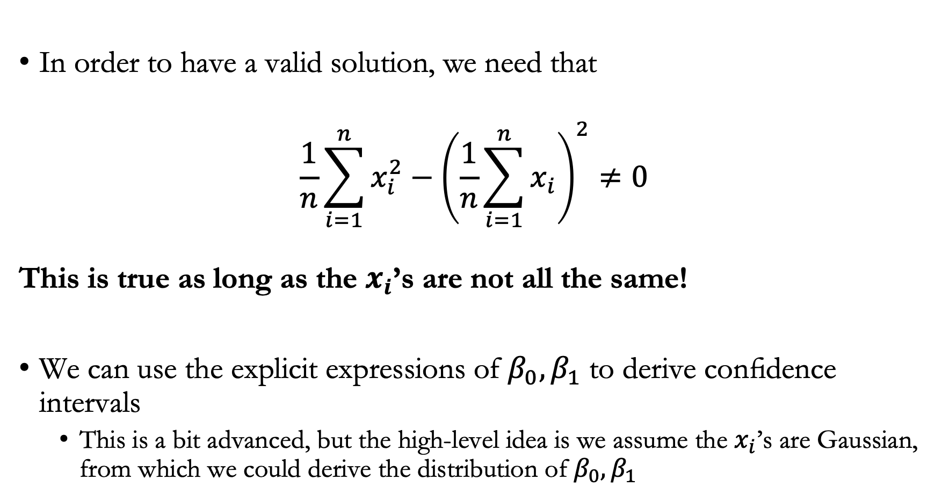
Takeaways
In order to have a valid solution, we need that
$$\frac{1}{n}\sum_{i=1}^{n}{x_{i}^{2}}−{\left(\frac{1}{n}\sum_{i=1}^{n}{x_{i}}\right)}^{2}≠0$$
This is true as long as the $x_{i}$’s are not all the same!
We can use the explicit expressions of $β_{0},β_{1}$ to derive confidence intervals
  This is a bit advanced, but the high-level idea is we assume the $x_{i}$’s are Gaussian, from which we could derive the distribution of $β_{0},β_{1}$

Slide 11
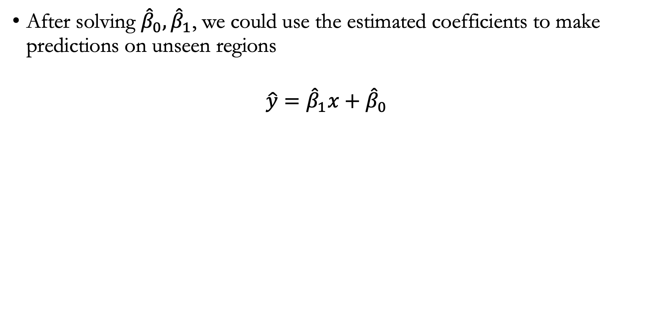
Summary of simple linear regression
After solving ${\hat{β}}_{0},{\hat{β}}_{1}$, we could use the estimated coefficients to make predictions on unseen regions
$$\hat{y}={\hat{β}}_{1}x+{\hat{β}}_{0}$$
Notes:
In the Advertising example, this data set consists of the TV advertising budget and product sales in n = 200 different markets.
Example
Is there a relationship between advertising budget and sales?
evidence of an association between advertising expenditure and sales
How strong is the relationship between advertising budget and sales?
we would like to know the strength of this relationship. Does knowl- edge of the advertising budget provide a lot of information about product sales
Which media are associated with sales?
How large is the association between each medium and sales?
for predicting a quantitative response Y on the basis of a single predictor variable
It assumes that there is approximately a linear relationship between X and Y
“≈” as “is approximately modeled as”

Slide 12
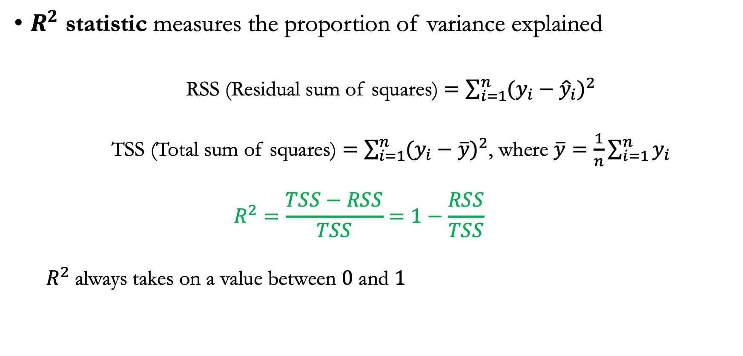
Evaluation metrics
$R^{2}$ statistic measures the proportion of variance explained
  RSS (Residual sum of squares) $=\sum_{i=1}^{n}{(y_{i}−{\hat{y}}_{i})^{2}}$
  TSS (Total sum of squares) $=\sum_{i=1}^{n}{(y_{i}−\overline{y})^{2}}$, where $\overline{y}=\frac{1}{n}\sum_{i=1}^{n}{y_{i}}$
  $$R^{2}=\frac{TSS−RSS}{TSS}=1−\frac{RSS}{TSS}$$
  $R^{2}$always takes on a value between $0$ and $1$

Slide 13
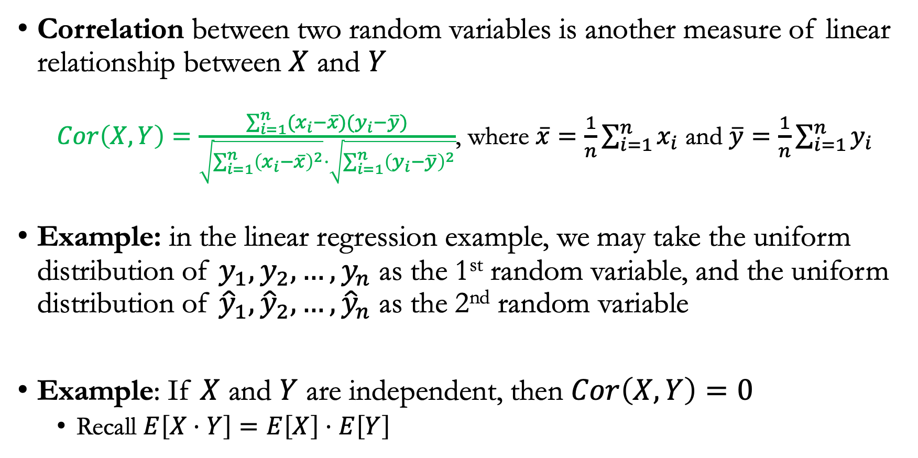
Evaluation metrics
Correlation between two random variables is another measure of linear relationship between $X$ and $Y$
  $Cor\left(X,Y\right)=\frac{\sum_{i=1}^{n}{(x_{i}−\overline{x})(y_{i}−\overline{y})}}{\sqrt{\sum_{i=1}^{n}{{\left(x_{i}−\overline{x}\right)}^{2}}}⋅\sqrt{\sum_{i=1}^{n}{{\left(y_{i}−\overline{y}\right)}^{2}}}}$, where $\overline{x}=\frac{1}{n}\sum_{i=1}^{n}{x_{i}}$ and $\overline{y}=\frac{1}{n}\sum_{i=1}^{n}{y_{i}}$
Example: in the linear regression example, we may take the uniform distribution of $y_{1},y_{2},…,y_{n}$ as the 1st random variable, and the uniform distribution of ${\hat{y}}_{1},{\hat{y}}_{2},…,{\hat{y}}_{n}$ as the 2nd random variable
Example: If $X$ and $Y$ are independent, then $Cor\left(X,Y\right)=0$
  Recall $E\left[X⋅Y\right]=E\left[X\right]⋅E\left[Y\right]$

Slide 14
Lecture plan
Multiple linear regression

Slide 15
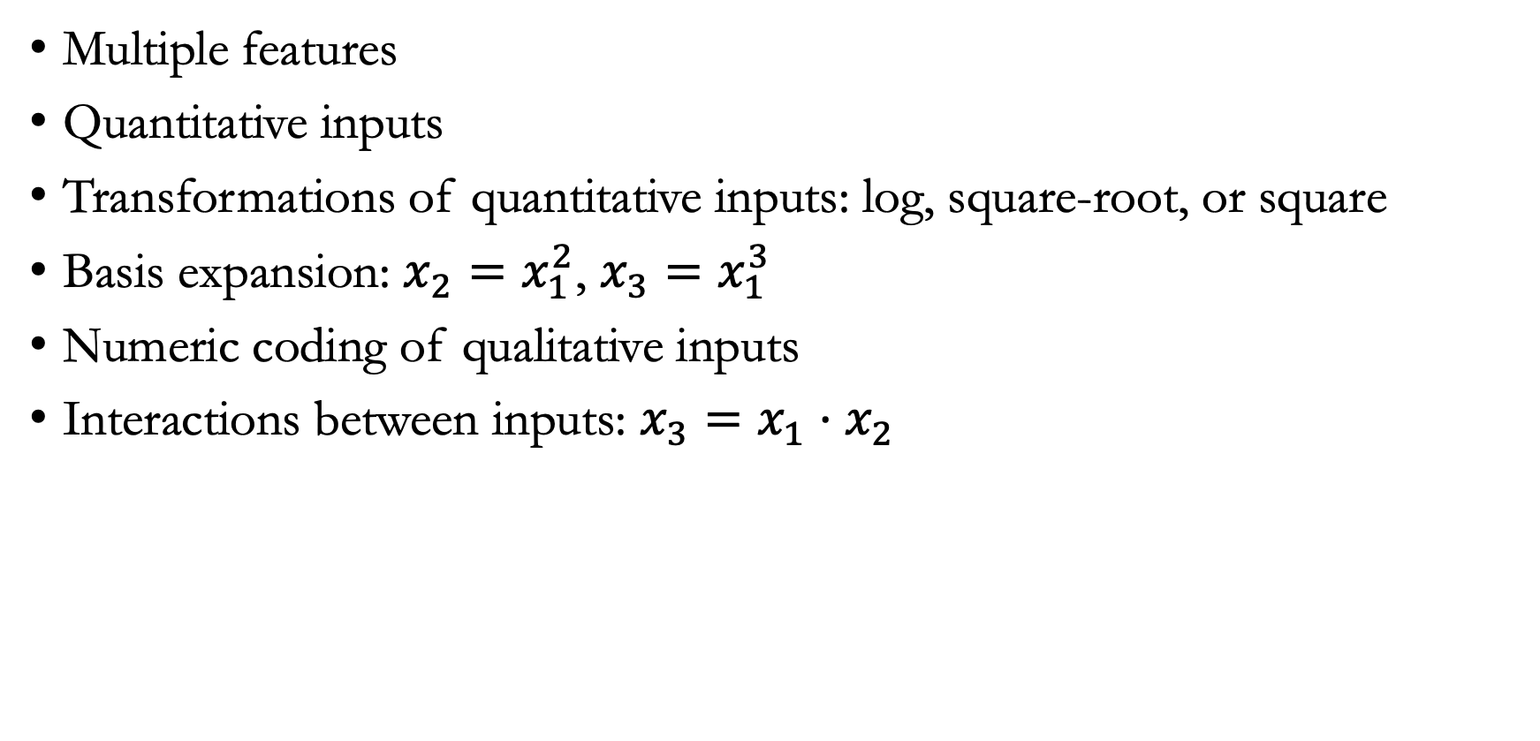
Multiple linear regression
Multiple features
Quantitative inputs
Transformations of quantitative inputs: log, square-root, or square
Basis expansion: $x_{2}=x_{1}^{2}$, $x_{3}=x_{1}^{3}$
Numeric coding of qualitative inputs
Interactions between inputs: $x_{3}=x_{1}⋅x_{2}$

Slide 16
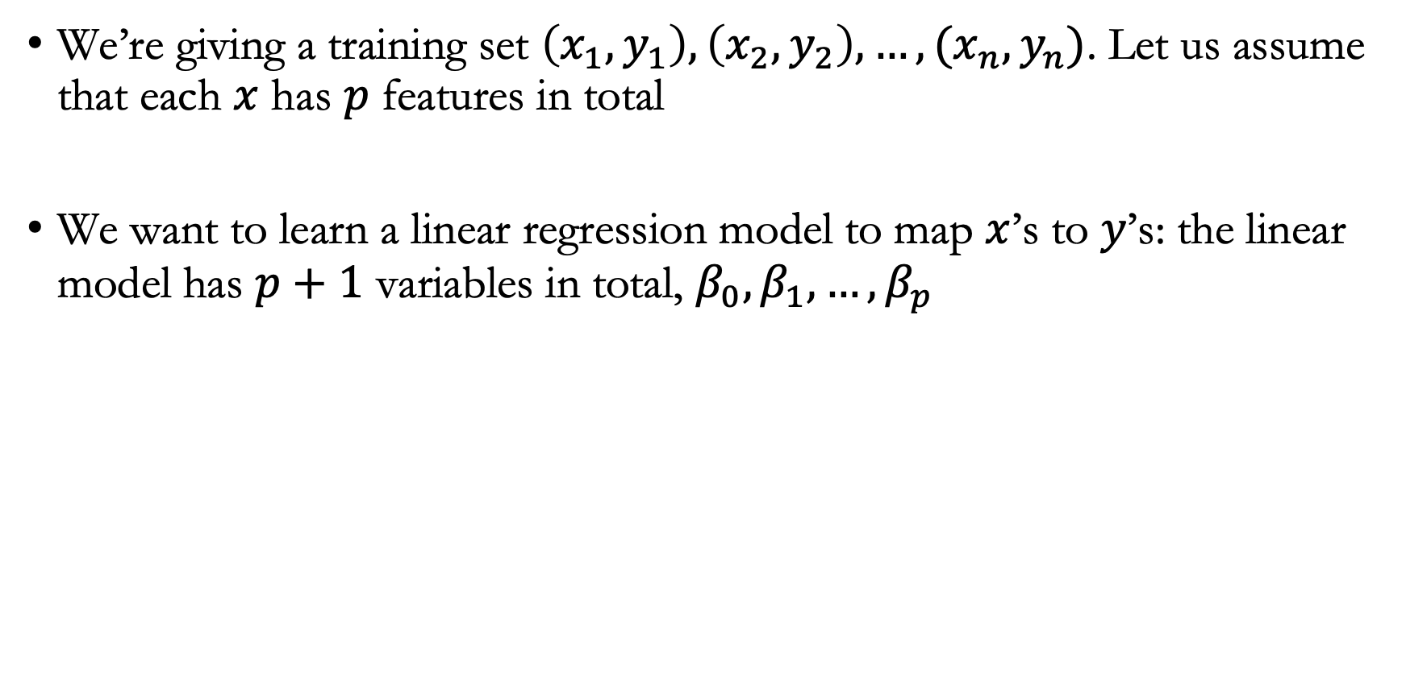
Setting up the problem
We’re giving a training set $\left(x_{1},y_{1}\right),\left(x_{2},y_{2}\right),…,(x_{n},y_{n})$. Let us assume that each $x$ has $p$ features in total
We want to learn a linear regression model to map $x$’s to $y$’s: the linear model has $p+1$ variables in total, $β_{0},β_{1},…,β_{p}$

Slide 17
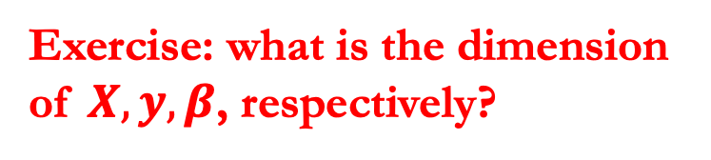
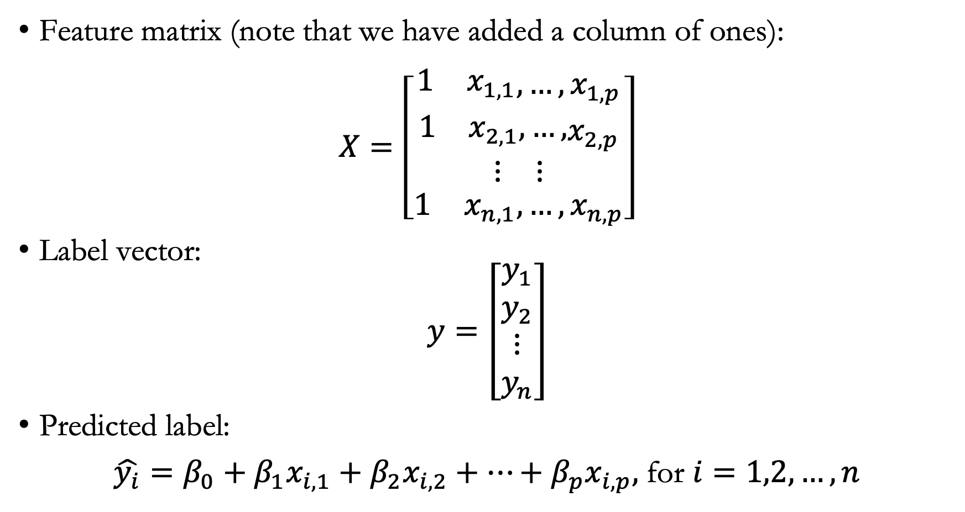
Let us introduce several matrix notations
Feature matrix (note that we have added a column of ones):
$$X=\left[\begin{matrix}\begin{matrix}\begin{matrix}1 & x_{1,1}\end{matrix},…,x_{1,p} \\ \begin{matrix}1 & x_{2,1},…,\end{matrix}x_{2,p}\end{matrix} \\ \begin{matrix}⋮ & ⋮\end{matrix} \\ \begin{matrix}1 & x_{n,1},…,x_{n,p}\end{matrix}\end{matrix}\right]$$
Label vector:
$$y=\left[\begin{matrix}\begin{matrix}y_{1} \\ y_{2}\end{matrix} \\ ⋮ \\ y_{n}\end{matrix}\right]$$
Predicted label:
${\hat{y_{i}}=β_{0}+β_{1}x}_{i,1}+β_{2}x_{i,2}+…+β_{p}x_{i,p},$ for $i=1,2,…,n$
Exercise: what is the dimension of $X,y,β$, respectively?

Slide 18
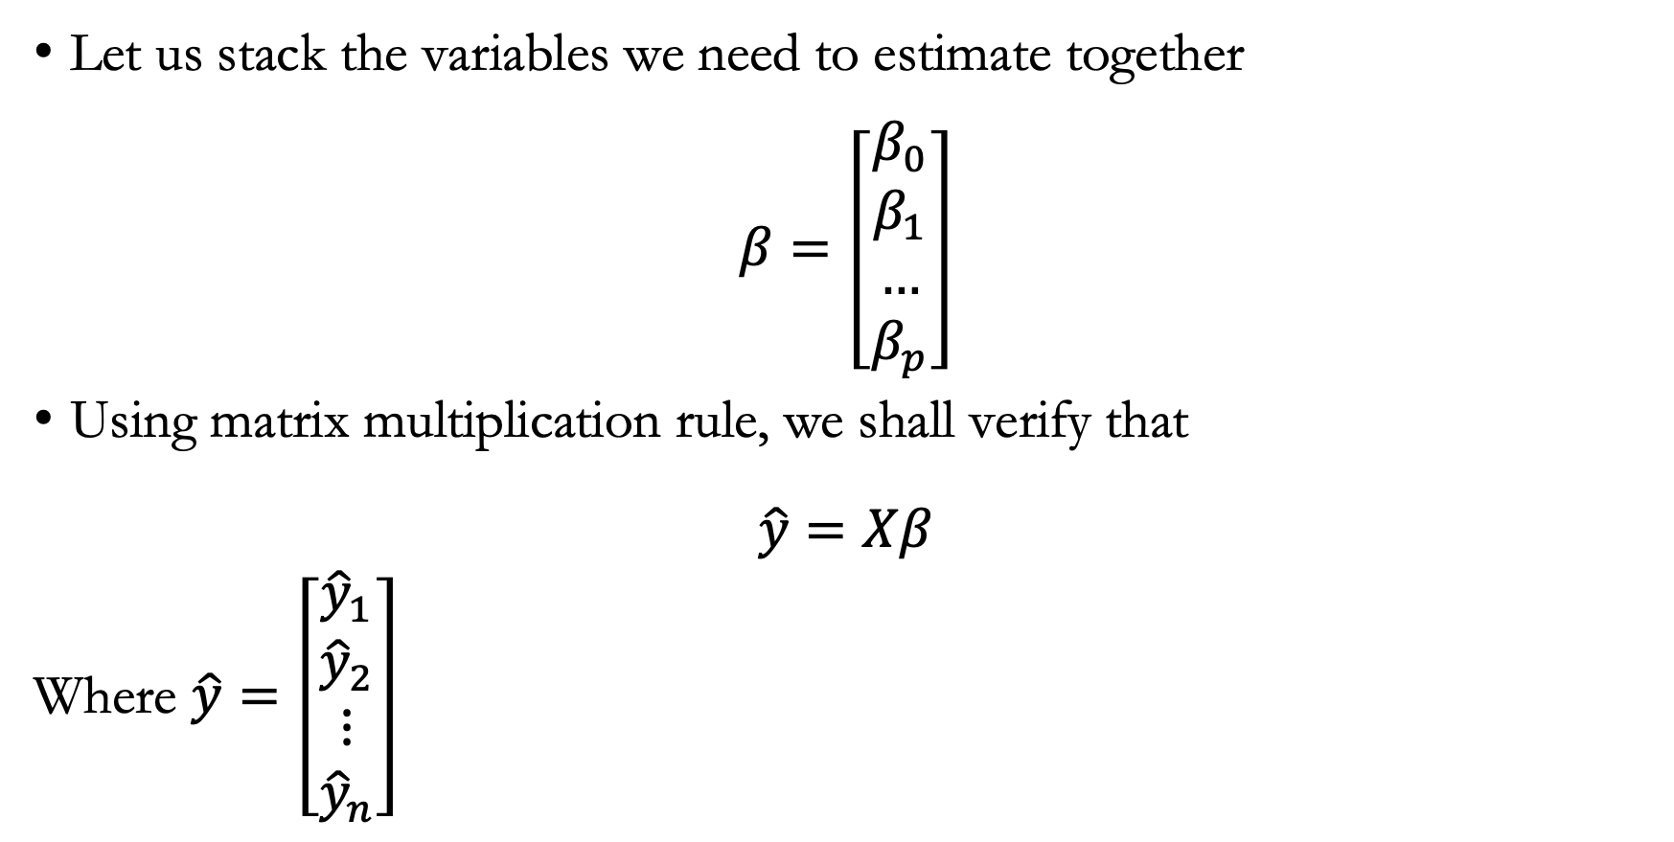
More matrix notations
Let us stack the variables we need to estimate together
$$β=\left[\begin{matrix}β_{0} \\ \begin{aligned}β_{1} \\ … \\ β_{p}\end{aligned}\end{matrix}\right]$$
Using matrix multiplication rule, we shall verify that
$$\hat{y}=Xβ$$
Where $\hat{y}=\left[\begin{matrix}\begin{matrix}{\hat{y}}_{1} \\ {\hat{y}}_{2}\end{matrix} \\ ⋮ \\ {\hat{y}}_{n}\end{matrix}\right]$

Slide 19
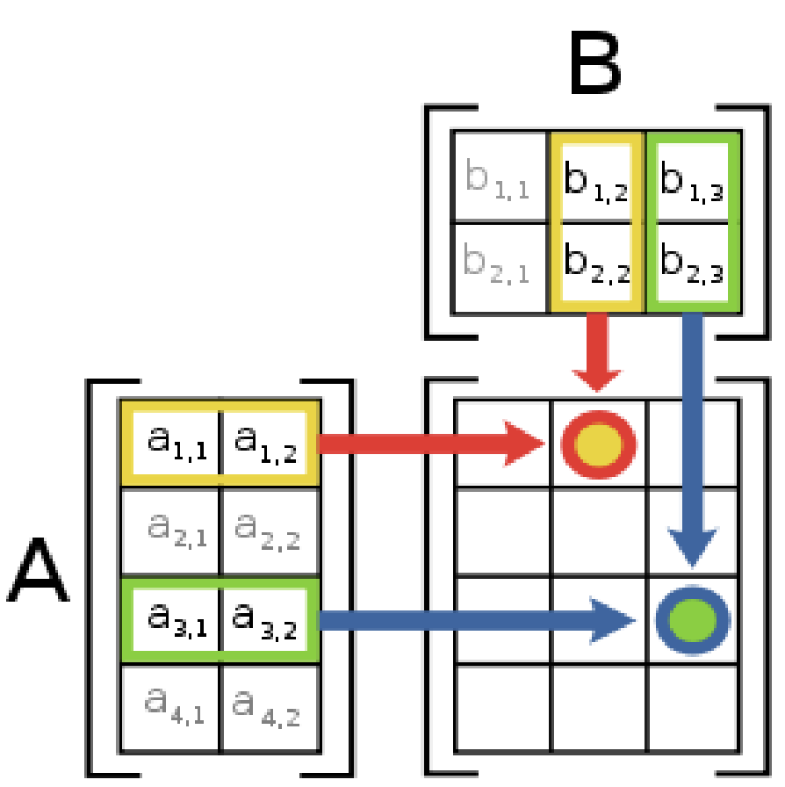
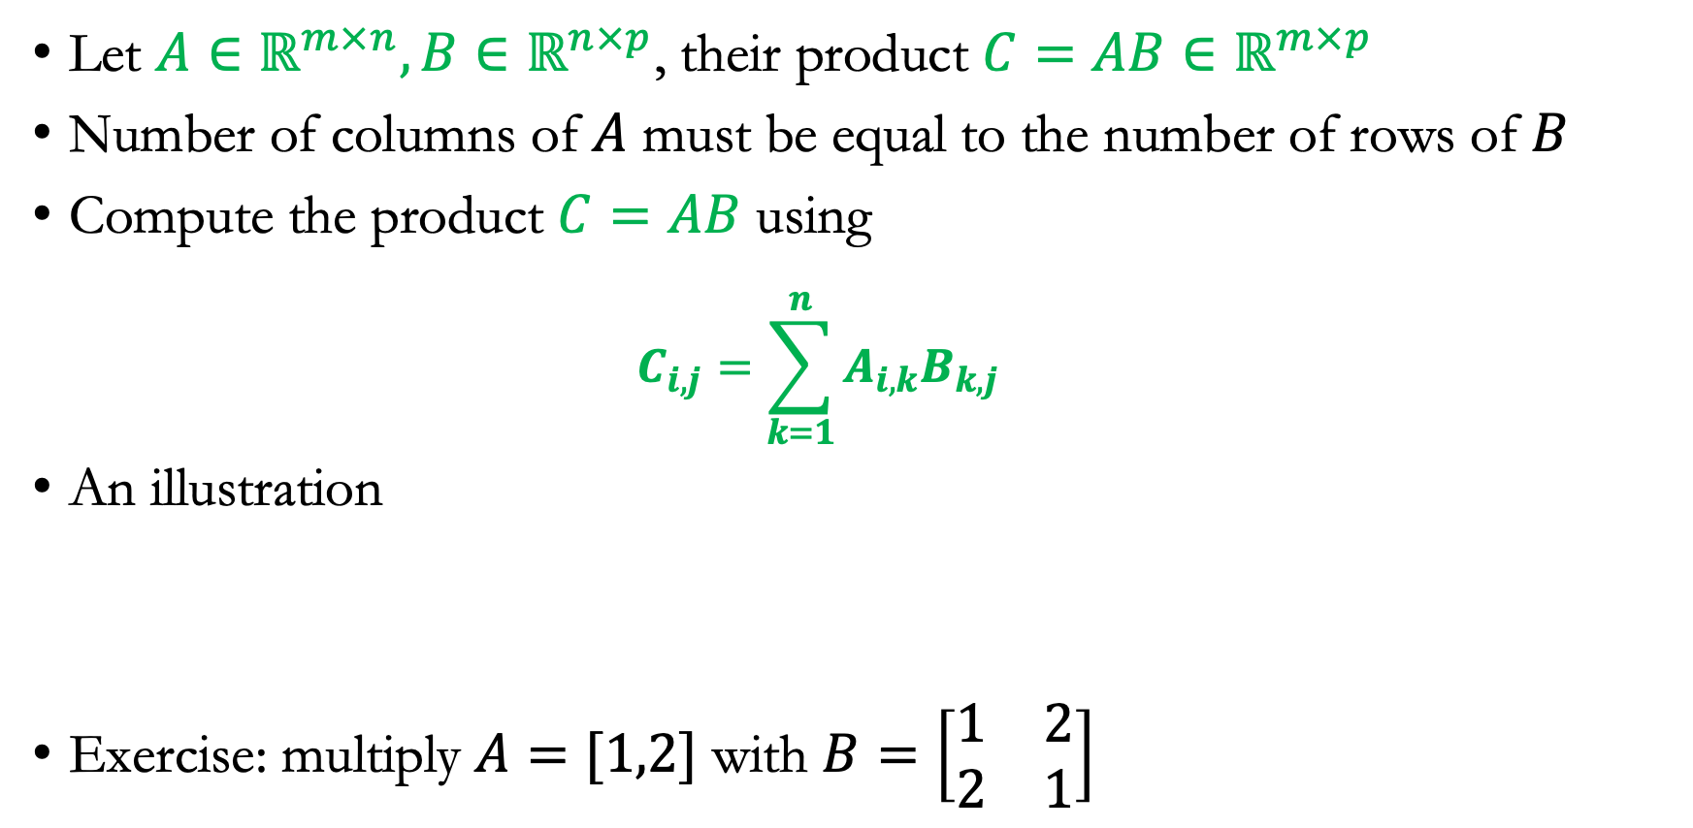
One slide about matrix multiplication
Let $A∈ℝ^{m×n}, B∈ℝ^{n×p}$, their product $C=AB∈ℝ^{m×p}$
Number of columns of $A$ must be equal to the number of rows of $B$
Compute the product $C=AB$ using
  $$C_{i,j}=\sum_{k=1}^{n}{A_{i,k}B_{k,j}}$$
An illustration
Exercise: multiply $A=[1,2]$ with $B=\left[\begin{matrix}1 & 2 \\ 2 & 1\end{matrix}\right]$

Slide 20
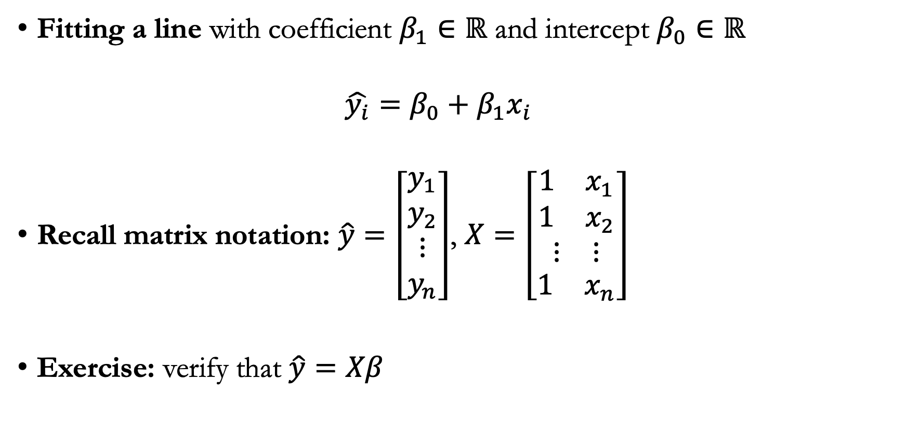
Start with the one-dimensional case
Fitting a line with coefficient $β_{1}∈ℝ$ and intercept $β_{0}∈ℝ$
  $${\hat{y_{i}}=β_{0}+β_{1}x}_{i}$$
Recall matrix notation: $\hat{y}=\left[\begin{matrix}\begin{matrix}y_{1} \\ y_{2}\end{matrix} \\ ⋮ \\ y_{n}\end{matrix}\right]$, $X=\left[\begin{matrix}\begin{matrix}\begin{matrix}1 & x_{1}\end{matrix} \\ \begin{matrix}1 & x_{2}\end{matrix}\end{matrix} \\ \begin{matrix}⋮ & ⋮\end{matrix} \\ \begin{matrix}1 & x_{n}\end{matrix}\end{matrix}\right]$
Exercise: verify that $\hat{y}=Xβ$

Slide 21
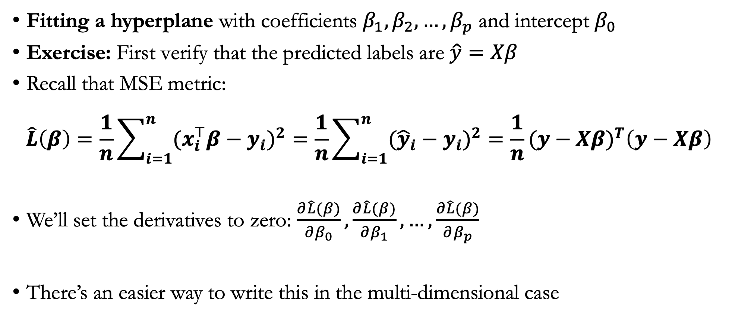
Move to the multi-dimensional case
Fitting a hyperplane with coefficients $β_{1},β_{2},…,β_{p}$ and intercept $β_{0}$
Exercise: First verify that the predicted labels are $\hat{y}=Xβ$
Recall that MSE metric:
$$\hat{L}\left(β\right)=\frac{1}{n}\sum_{i=1}^{n}{(x_{i}^{⊤}β−y_{i})^{2}}=\frac{1}{n}\sum_{i=1}^{n}{({\hat{y}}_{i}−y_{i})^{2}}=\frac{1}{n}(y−Xβ)^{T}\left(y−Xβ\right)$$
We’ll set the derivatives to zero: $\frac{∂\hat{L}(β)}{∂β_{0}},\frac{∂\hat{L}(β)}{∂β_{1}},…,\frac{∂\hat{L}(β)}{∂β_{p}}$
There’s an easier way to write this in the multi-dimensional case

Slide 22
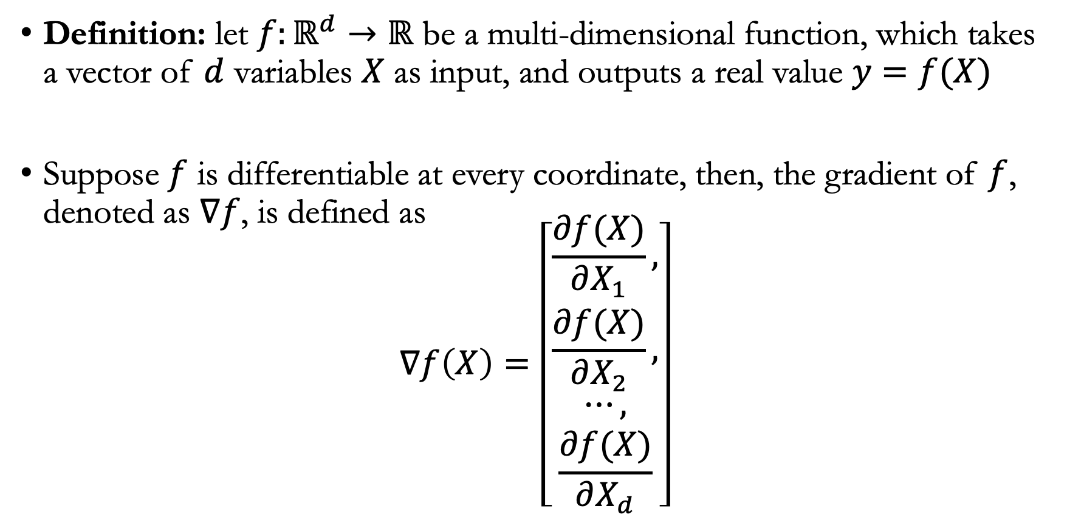
Defining the gradient
Definition: let $f:ℝ^{d}→ℝ$ be a multi-dimensional function, which takes a vector of $d$ variables $X$ as input, and outputs a real value $y=f(X)$
Suppose $f$ is differentiable at every coordinate, then, the gradient of $f$, denoted as $∇f$, is defined as
$$∇f\left(X\right)=\left[\begin{aligned}\frac{∂f(X)}{∂X_{1}}, \\ \frac{∂f(X)}{∂X_{2}}, \\ ⋯, \\ \frac{∂f(X)}{∂X_{d}}\end{aligned}\right]$$

Slide 23
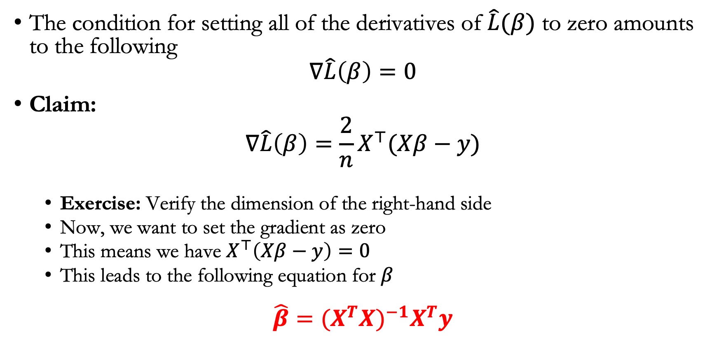
Back to estimating the coefficients
The condition for setting all of the derivatives of $\hat{L}(β)$ to zero amounts to the following
$$∇\hat{L}\left(β\right)=0$$
Claim:
$$∇\hat{L}\left(β\right)=\frac{2}{n}X^{⊤}(Xβ−y)$$
  Exercise: Verify the dimension of the right-hand side
  Now, we want to set the gradient as zero
  This means we have $X^{⊤}\left(Xβ−y\right)=0$
  This leads to the following equation for $β$
$$\hat{β}=(X^{T}X)^{−1}X^{T}y$$
This is called the Ordinary Least Squares (OLS) estimator
Notes:
In other words, we want to find an intercept β0 and a slope β1 such
that the resulting line is as close as possible to the n = 200 data points
by far the most common approach involves minimizing the least squares criterion, and we take that approach in this chapter.
Alternative approaches will be considered in Chapter 6.

Slide 24
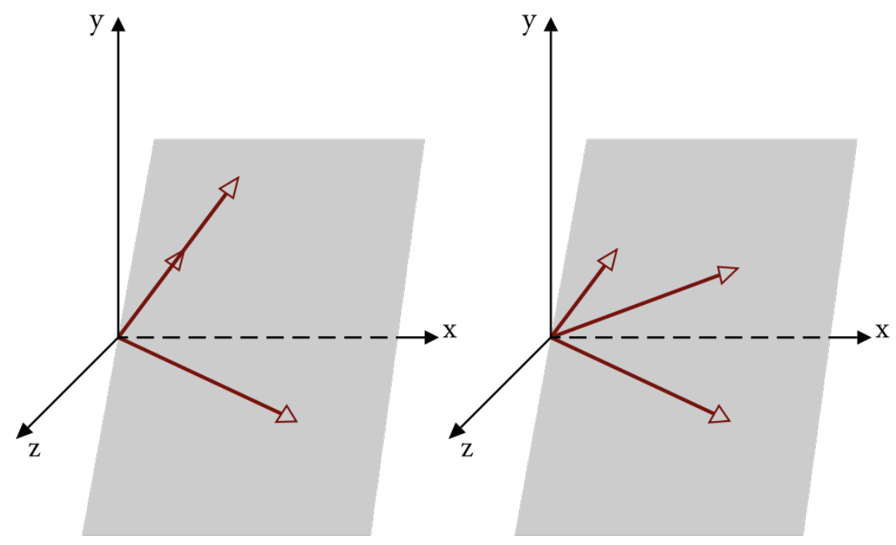
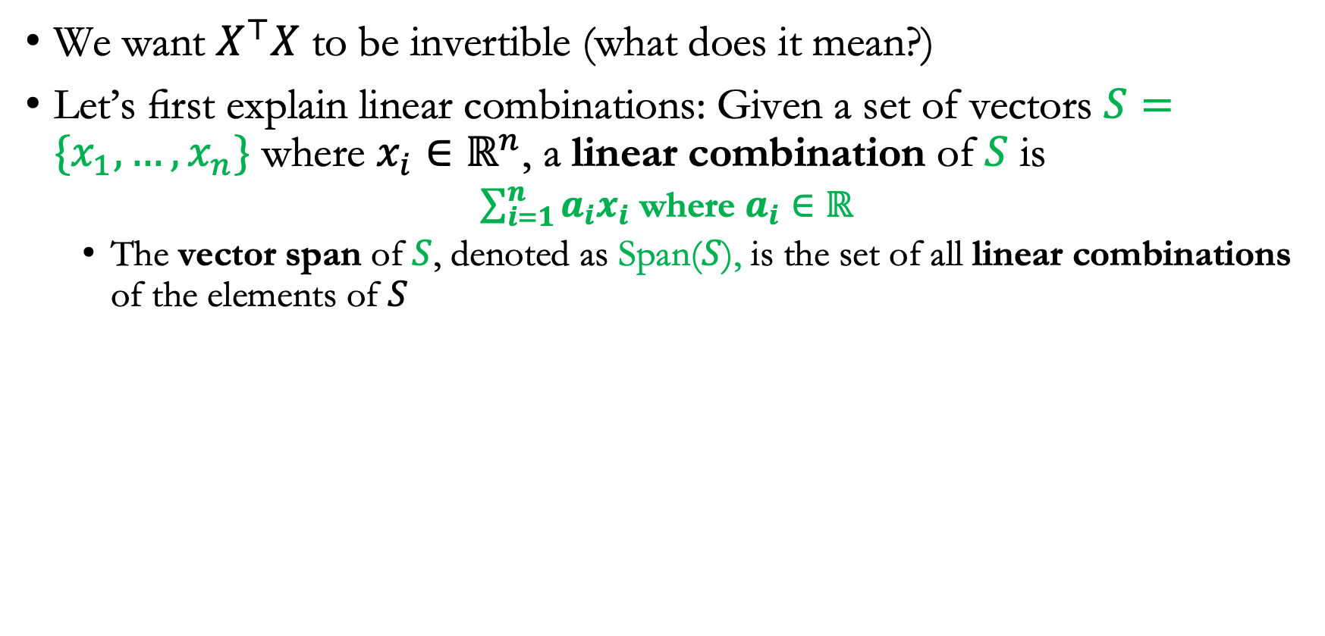
Takeaways
We want $X^{⊤}X$ to be invertible (what does it mean?)
Let’s first explain linear combinations: Given a set of vectors $S=\{x_{1},…,x_{n}\}$ where $x_{i}∈ℝ^{n}$, a linear combination of $S$ is
  $\sum_{i=1}^{n}{a_{i}x_{i}}$ where $a_{i}∈ℝ$
  The vector span of $S$, denoted as Span($S$), is the set of all linear combinations of the elements of $S$

Slide 25
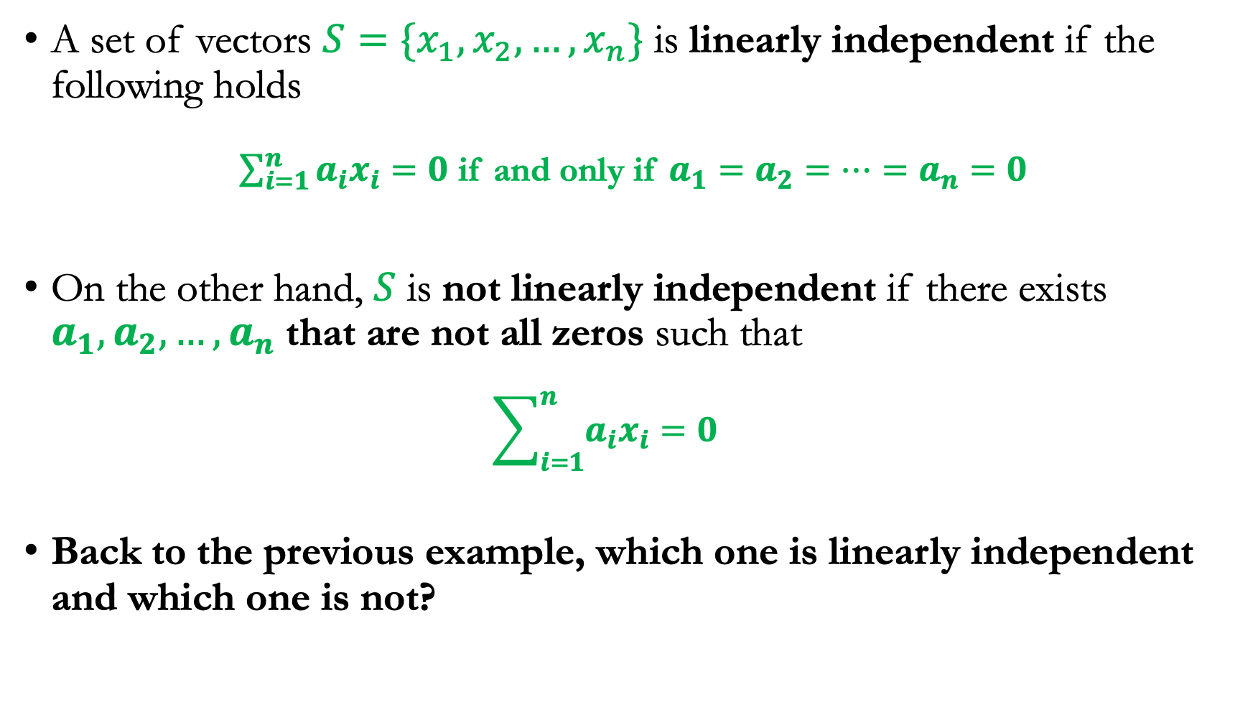
Linearly independent vs. not linearly independent
A set of vectors $S=\{x_{1},x_{2},…,x_{n}\}$ is linearly independent if the following holds
  $\sum_{i=1}^{n}{a_{i}x_{i}=0}$ if and only if $a_{1}=a_{2}=…=a_{n}=0$
On the other hand, $S$ is not linearly independent if there exists $a_{1},a_{2},…,a_{n}$ that are not all zeros such that
  $$\sum_{i=1}^{n}{a_{i}x_{i}=0}$$
Back to the previous example, which one is linearly independent and which one is not?

Slide 26
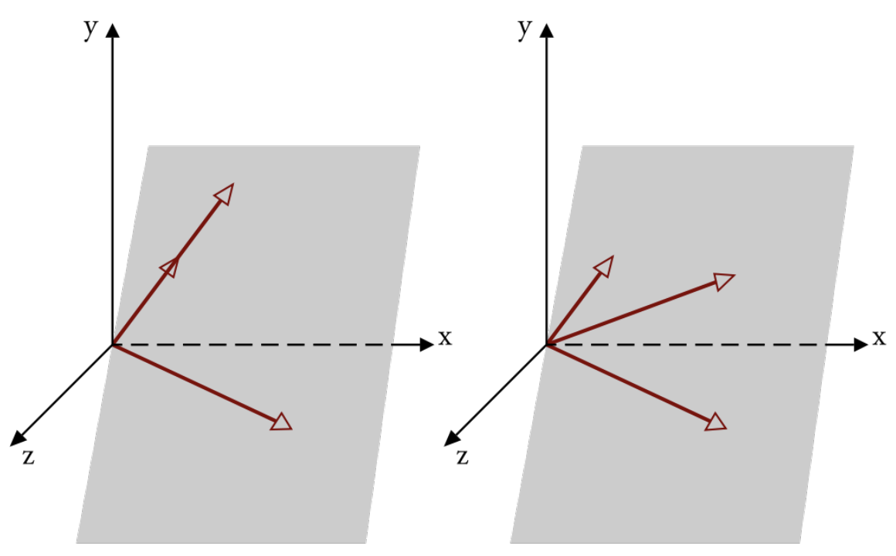
Examples of linearly independent vectors
Left: The two vectors are linearly independent
Right: The three vectors are not linearly independent

Slide 27
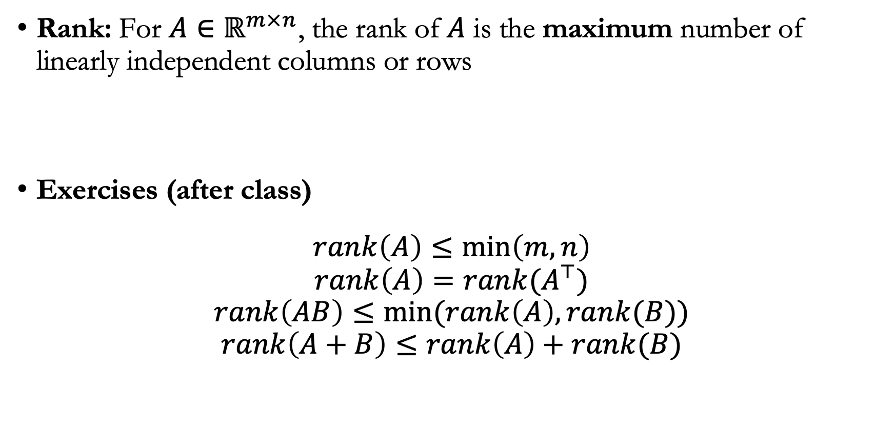
Rank
Rank: For $A∈ℝ^{m×n}$, the rank of $A$ is the maximum number of linearly independent columns or rows
Exercises (after class)
$$rank\left(A\right)≤\min\left(m,n\right)$$
$$rank\left(A\right)=rank(A^{⊤})$$
$$rank\left(AB\right)≤min⁡(rank\left(A\right),rank(B))$$
$$rank\left(A+B\right)≤rank\left(A\right)+rank(B)$$

Slide 28
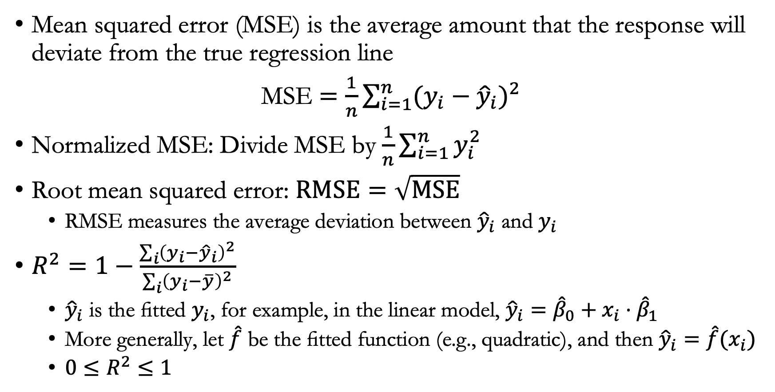
Metrics
Mean squared error (MSE) is the average amount that the response will deviate from the true regression line
MSE $=\frac{1}{n}\sum_{i=1}^{n}{(y_{i}−{\hat{y}}_{i})^{2}}$
Normalized MSE: Divide MSE by $\frac{1}{n}\sum_{i=1}^{n}{y_{i}^{2}}$
Root mean squared error: $RMSE=\sqrt{MSE}$
  RMSE measures the average deviation between ${\hat{y}}_{i}$ and $y_{i}$
$R^{2}=1−\frac{\sum_{i}{{\left(y_{i}−{\hat{y}}_{i}\right)}^{2}}}{\sum_{i}{{\left(y_{i}−\overline{y}\right)}^{2}}}$
  ${\hat{y}}_{i}$ is the fitted $y_{i}$, for example, in the linear model, ${\hat{y}}_{i}={\hat{β}}_{0}+x_{i}⋅{\hat{β}}_{1}$
  More generally, let $\hat{f}$ be the fitted function (e.g., quadratic), and then ${\hat{y}}_{i}=\hat{f}(x_{i})$
  ${0≤R}^{2}≤1$

Slide 29
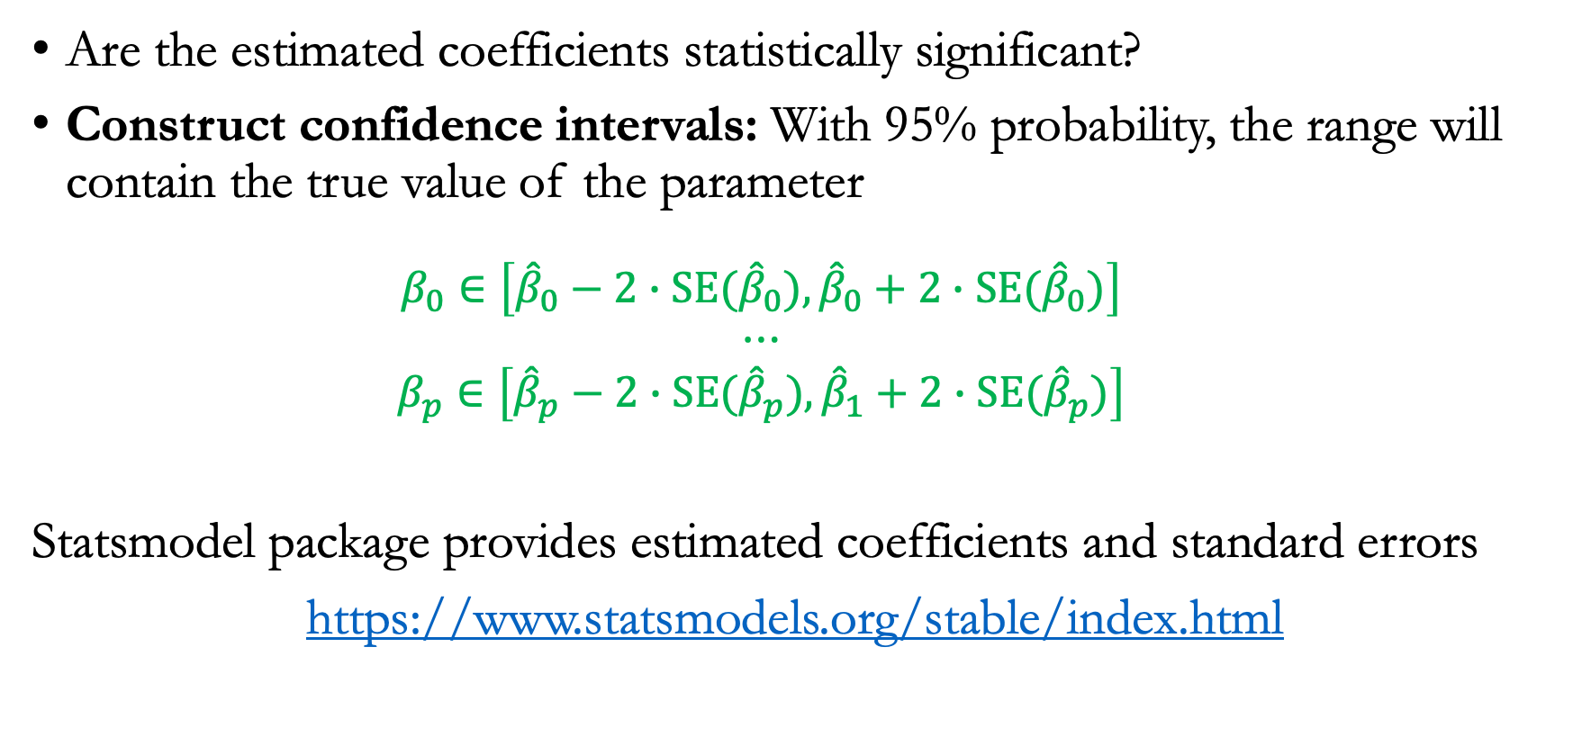
Setting confidence intervals
Are the estimated coefficients statistically significant?
Construct confidence intervals: With 95% probability, the range will contain the true value of the parameter
  $$β_{0}∈\left[{\hat{β}}_{0}−2∙SE{(\hat{β}}_{0}),{\hat{β}}_{0}+2∙SE{(\hat{β}}_{0})\right]$$
  $$⋯$$
  $$β_{p}∈\left[{\hat{β}}_{p}−2∙SE{(\hat{β}}_{p}),{\hat{β}}_{1}+2∙SE{(\hat{β}}_{p})\right]$$
Statsmodel package provides estimated coefficients and standard errors
https://www.statsmodels.org/stable/index.html
Notes:
how accurate is the sample mean μˆ as an estimate of μ?
How far off will that single estimate of μˆ be?
Roughly speaking, the standard error tells us the average amount that this estimate μˆ differs from the actual value of μ.
Standard errors can be used to compute confidence intervals. A 95% confidence interval is defined as a range of values such that with 95% probability
A 95% confidence interval has the following property: if we take repeated samples and construct the confidence interval for each sample, 95% of the intervals will contain the true unknown value of the parameter.

Slide 30
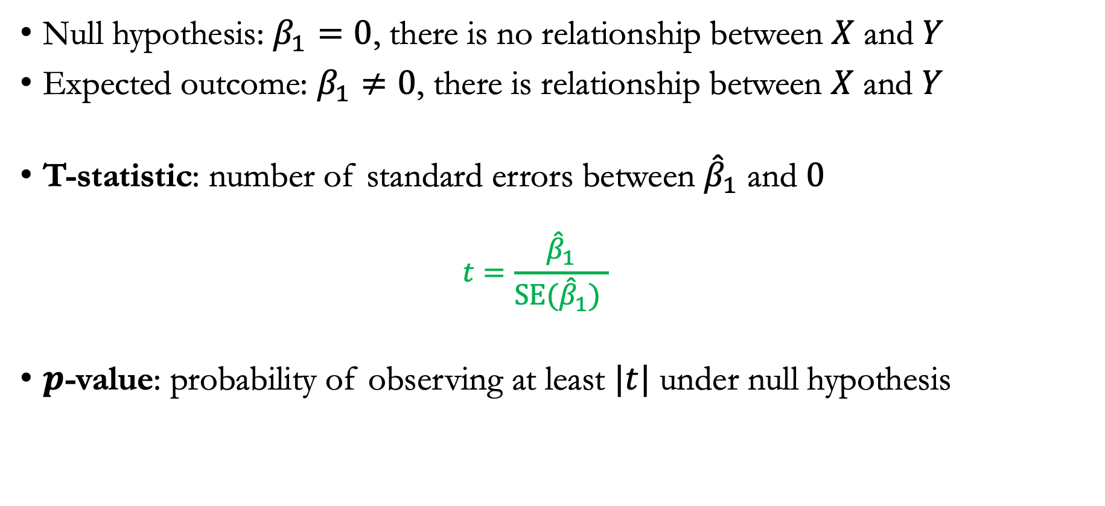
Hypothesis testing and significance values
Null hypothesis: $β_{1}=0$, there is no relationship between $X$ and $Y$
Expected outcome: $β_{1}≠0$, there is relationship between $X$ and $Y$
T-statistic: number of standard errors between ${\hat{β}}_{1}$ and $0$
  $$t=\frac{{\hat{β}}_{1}}{SE{(\hat{β}}_{1}) }$$
$p$-value: probability of observing at least $|t|$ under null hypothesis
Notes:
Standard errors can also be used to perform hypothesis tests on the coefficients
ifβ1 =0thenthemodel(3.5)reducestoY =β0+ε,andXis
not associated with Y . To test the null hypothesis, we need to determine
whether β1, our estimate for β1, is sufficiently far from zero that we can
be confident that β1 is non-zero. How far is far enough? This of course
depends on the accuracy of β1—that is, it depends on SE(β1). If SE(β1) is
small, then even relatively small values of β1 may provide strong evidence
that β1 ̸= 0, and hence that there is a relationship between X and Y . In
contrast, if SE(β1) is large, then β1 must be large in absolute value in order for us to reject the null hypothesis. In practice, we compute a t-statistic, given by

Slide 31
Announcements
Office hour: 12:30 PM – 1:30 PM, 177 Huntington Ave FL 22, Room 2211
  Also accessible via Zoom, see link on Canvas
1st homework will be released on Friday
TAs: Deb Roy, Michael Zhang

