Slide 1
Supervised Machine Learning and Learning Theory
Lecture 6: Cross-validation, bootstrap, and subset selection
September 24, 2024
1/ 47

Slide 2
Warm-up questions
What’s the difference between the logistic function and logistic loss?
  A: The logit function is a probability between zero and one, the logistic loss takes the negative log of the logit
How could we extend the logit model to multi-class classification?
  A: Via cross-entropy loss
What is the mixture of Gaussians model?
  A: We have a mixing proportion for each Gaussian, and each Gaussian has a separate mean and covariance matrix
What’s the difference between LDA and QDA?
  A: LDA uses linear decision boundary whereas QDA uses a quadratic decision boundary
Why does QDA have a quadratic decision boundary?
  A: Because QDA uses a different covariance matrix in each Gaussian

Slide 3
Cross validation
Goal: Using the training dataset alone, find out the test error as closely as possible
A first attempt: Randomly split the data in two parts; Train the method in the first part, compute the error on the second part
Issue: loses half the data samples, and the split has a lot of randomness

Slide 4
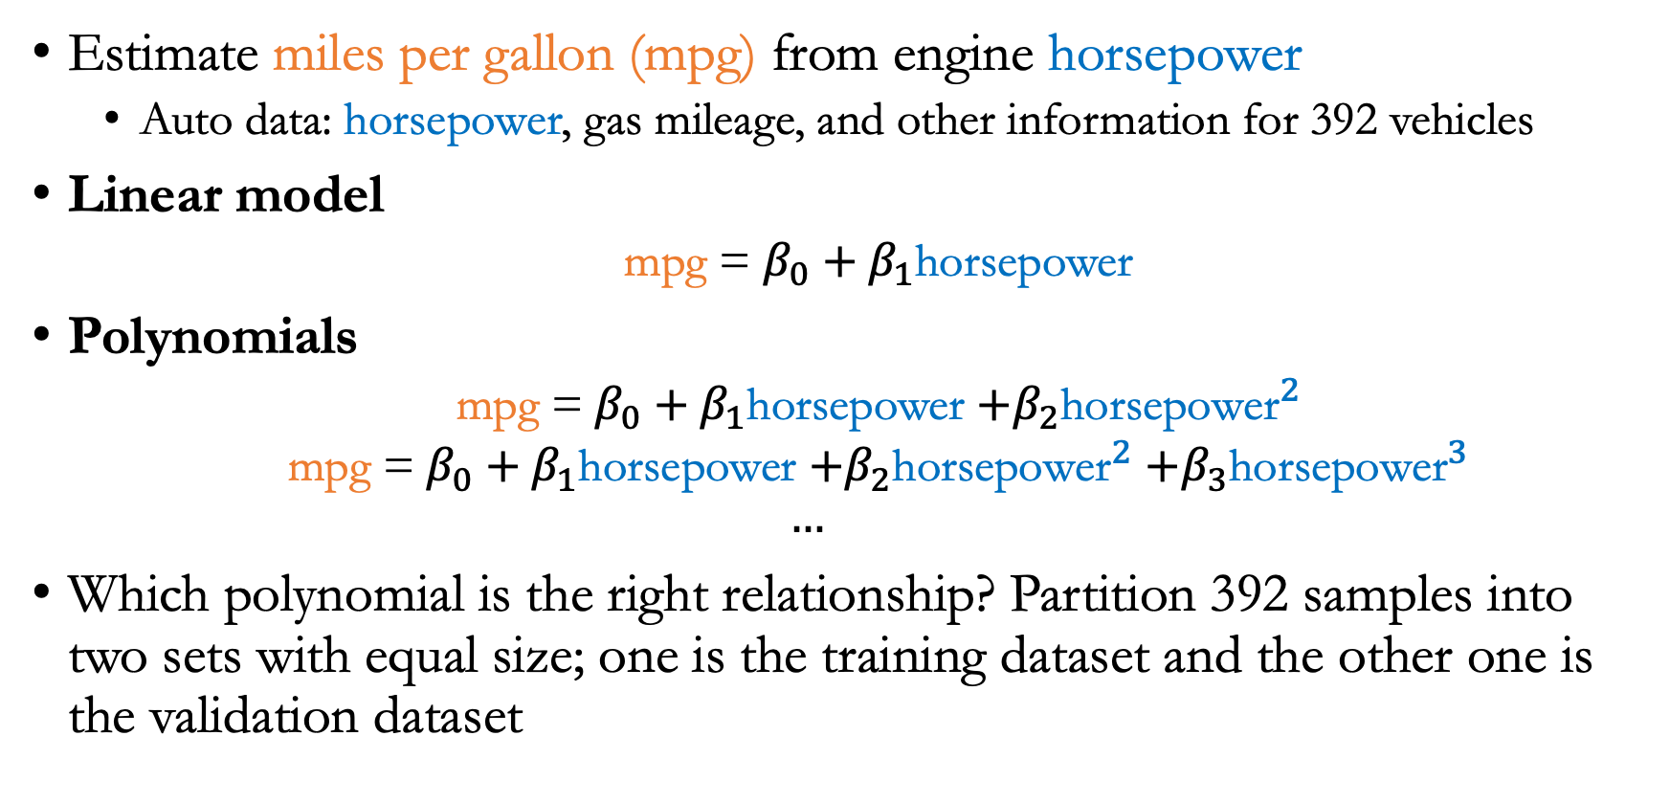
Example
Estimate miles per gallon (mpg) from engine horsepower
  Auto data: horsepower, gas mileage, and other information for 392 vehicles
Linear model
  mpg = $β_{0}+β_{1}$horsepower
Polynomials
  mpg = $β_{0}+β_{1}$horsepower $+β_{2}{\text{horsepower}}^{2}$
  mpg = $β_{0}+β_{1}$horsepower $+β_{2}{\text{horsepower}}^{2}$ $+β_{3}{\text{horsepower}}^{3}$
  $$…$$
Which polynomial is the right relationship? Partition 392 samples into two sets with equal size; one is the training dataset and the other one is the validation dataset

Slide 5
Example
Estimate miles per gallon (mpg) from engine horsepower
Each line is the result with a different random split of the data into two parts
Every split yields a different estimate

Slide 6
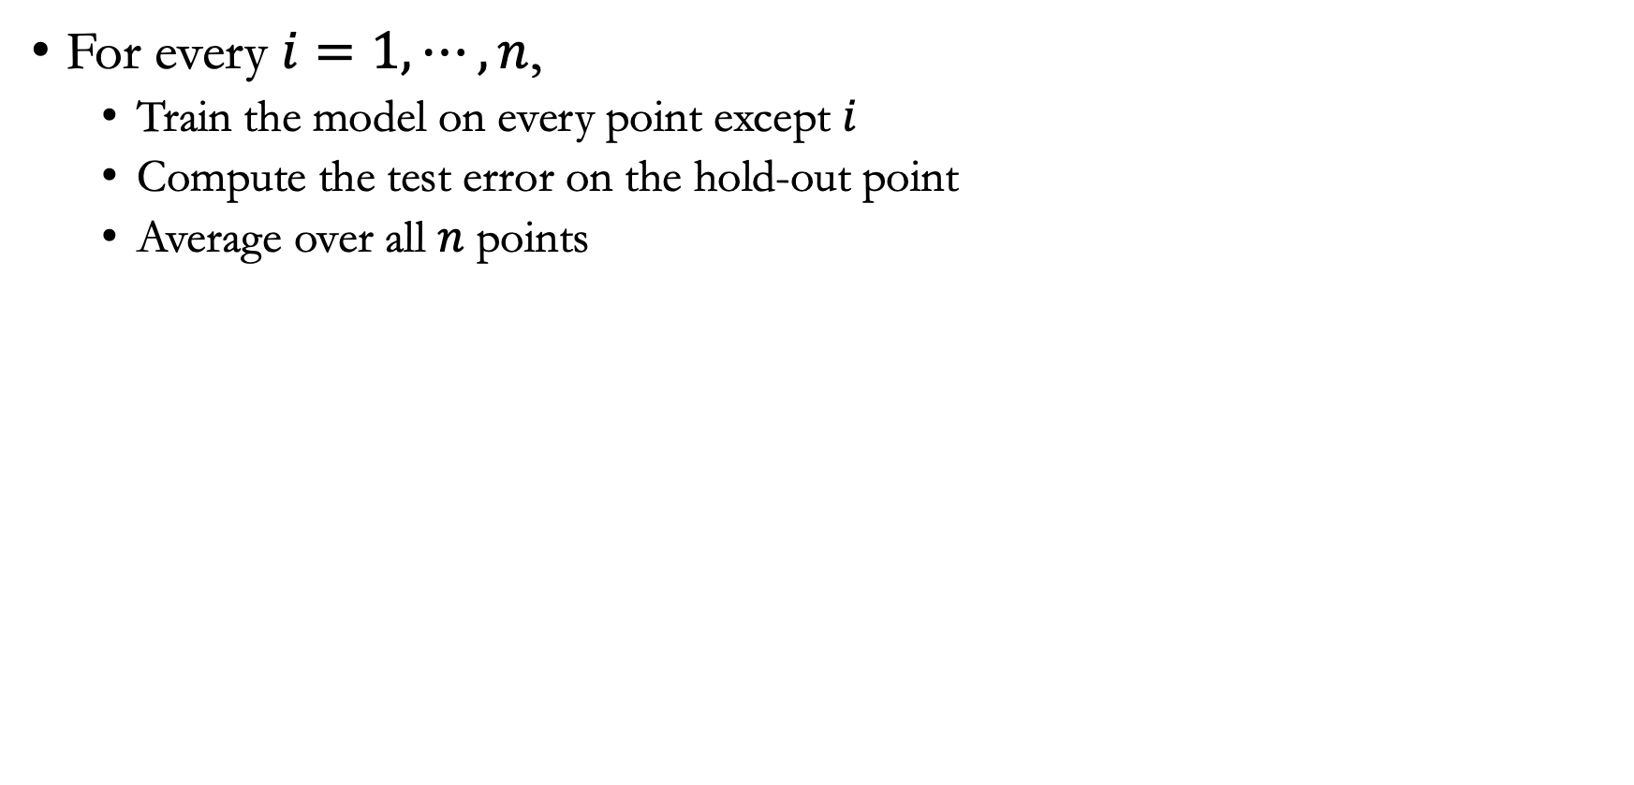
Leave one out cross-validation
For every $i=1,⋯,n$,
  Train the model on every point except $i$
  Compute the test error on the hold-out point
  Average over all $n$ points

Slide 7

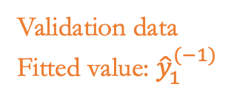
Leave one out cross-validation
Validation data
Fitted value: ${\hat{y}}_{1}^{(−1)}$
Training data ($n−1$ points)

Slide 8

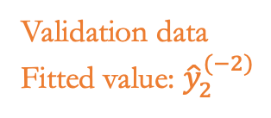
Leave one out cross-validation
Training data ($n−1$ points)
Validation data
Fitted value: ${\hat{y}}_{2}^{(−2)}$

Slide 9

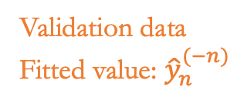
Leave one out cross-validation
Training data ($n−1$ points)
Validation data
Fitted value: ${\hat{y}}_{n}^{(−n)}$

Slide 10




Leave one out cross-validation
Fitted value
$${\hat{y}}_{1}^{(−1)}$$
$${\hat{y}}_{2}^{(−2)}$$
Estimate cross-validation error
$$⋮$$
$${\hat{y}}_{n}^{(−n)}$$

Slide 11
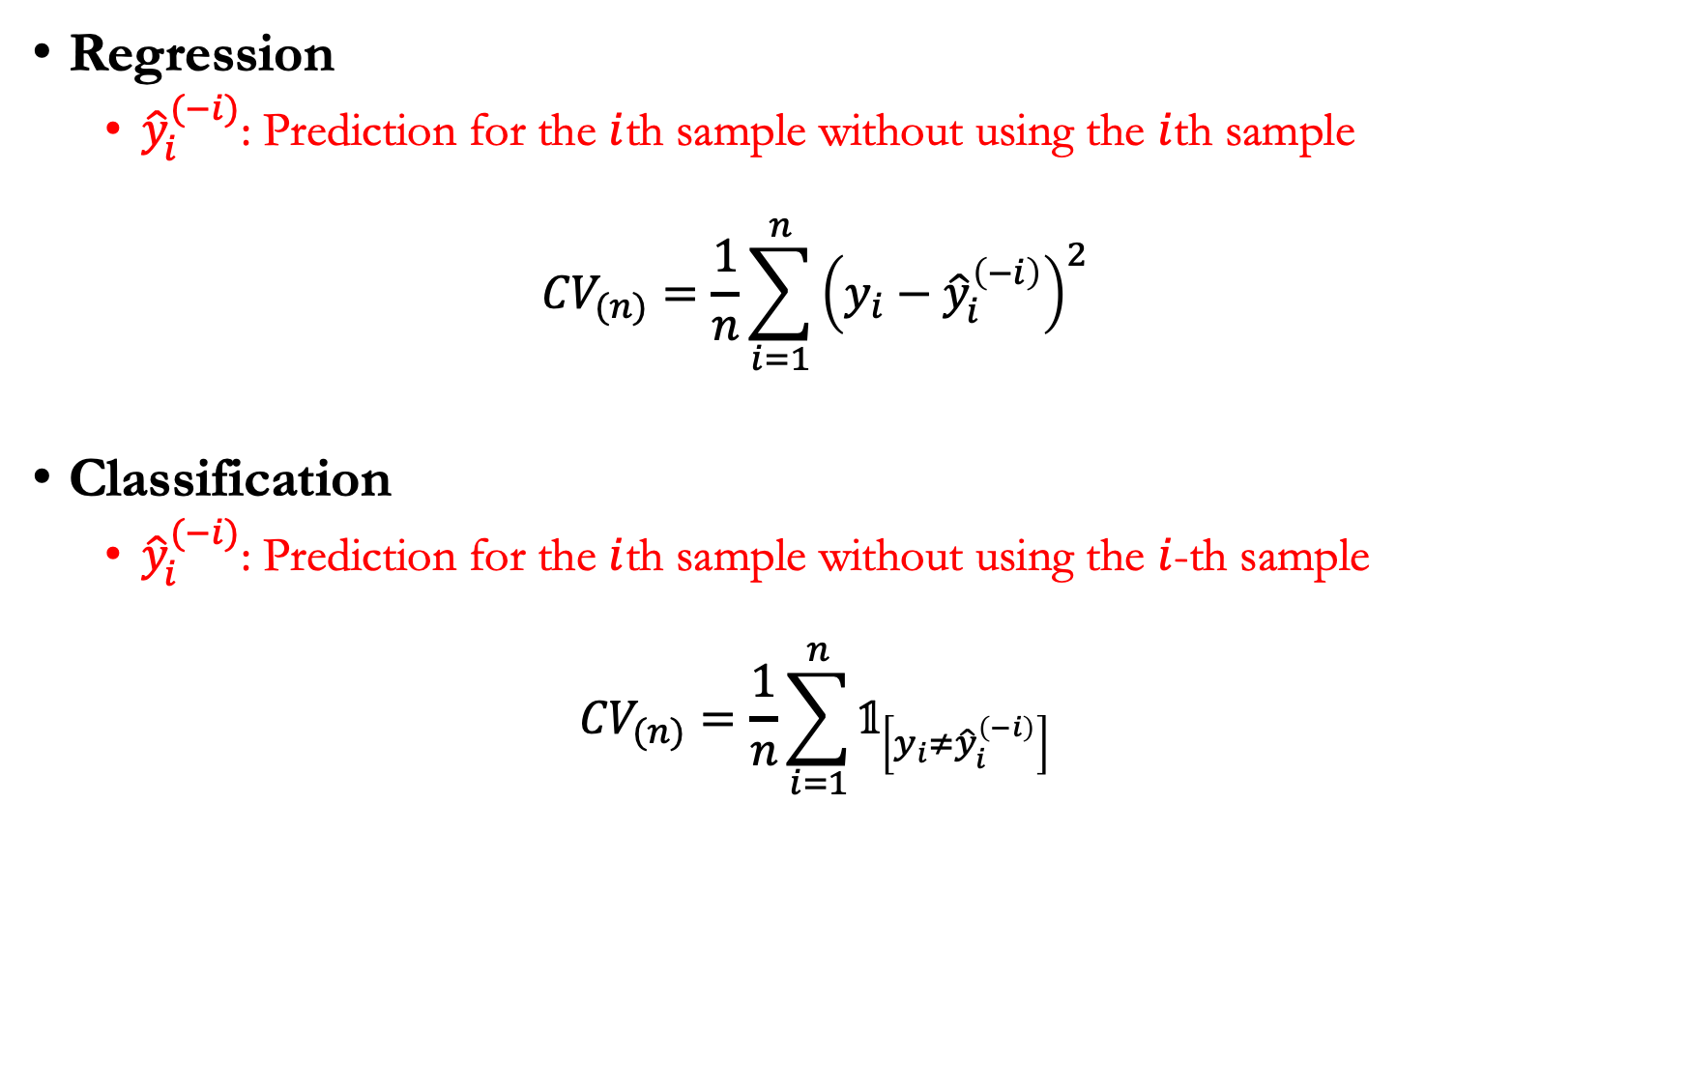
LOOCV
Regression
  ${\hat{y}}_{i}^{(−i)}$: Prediction for the $i$th sample without using the $i$th sample
  $${CV}_{(n)}=\frac{1}{n}\sum_{i=1}^{n}{{\left(y_{i}−{\hat{y}}_{i}^{\left(−i\right)}\right)}^{2}}$$
Classification
  ${\hat{y}}_{i}^{(−i)}$: Prediction for the $i$th sample without using the $i$-th sample
  $${CV}_{(n)}=\frac{1}{n}\sum_{i=1}^{n}{𝟙_{\left[y_{i}≠{\hat{y}}_{i}^{\left(−i\right)}\right]}}$$

Slide 12
Back to our example
Estimate miles per gallon (mpg) from engine horsepower
LOOCV curve vs. random splitting

Slide 13
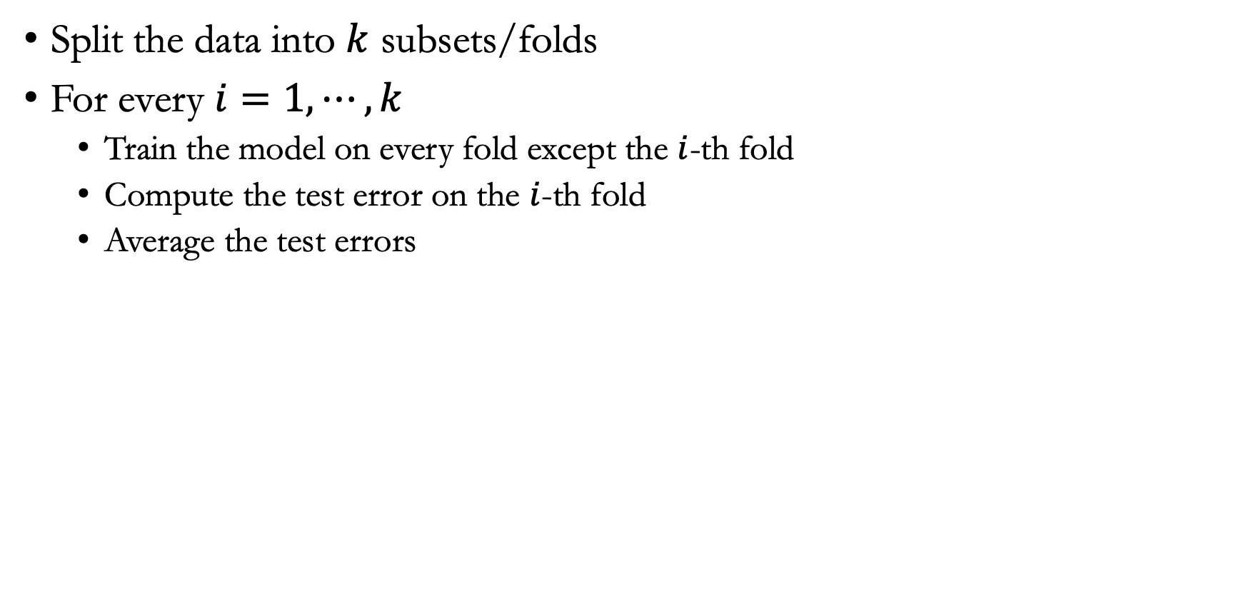
$k$-fold cross-validation
Split the data into $k$ subsets/folds
For every $i=1, ⋯,k$
  Train the model on every fold except the $i$-th fold
  Compute the test error on the $i$-th fold
  Average the test errors

Slide 14
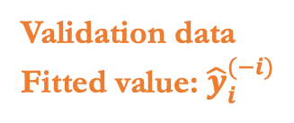

$k$-fold cross-validation
Validation data
Fitted value: ${\hat{y}}_{i}^{(−i)}$
Training data ($n−\frac{n}{k}$ points)

Slide 15
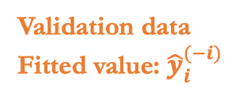

$k$-fold cross-validation
Training data ($n−\frac{n}{k}$ points)
Validation data
Fitted value: ${\hat{y}}_{i}^{(−i)}$

Slide 16
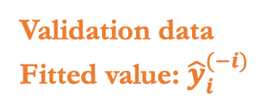

$k$-fold cross-validation
Training data ($n−\frac{n}{k}$ points)
Validation data
Fitted value: ${\hat{y}}_{i}^{(−i)}$

Slide 17

$k$-fold cross-validation
Fitted value
$${\hat{y}}_{1}^{(−1)}$$
$${\hat{y}}_{2}^{(−2)}$$
Estimate cross-validation error
$$⋮$$
$${\hat{y}}_{n}^{(−n)}$$

Slide 18
LOOCV vs. $k$-fold cross-validation
Estimate miles per gallon (mpg) from engine horsepower
The LOOCV error curve vs. ten-fold cross-validation error curve

Slide 19
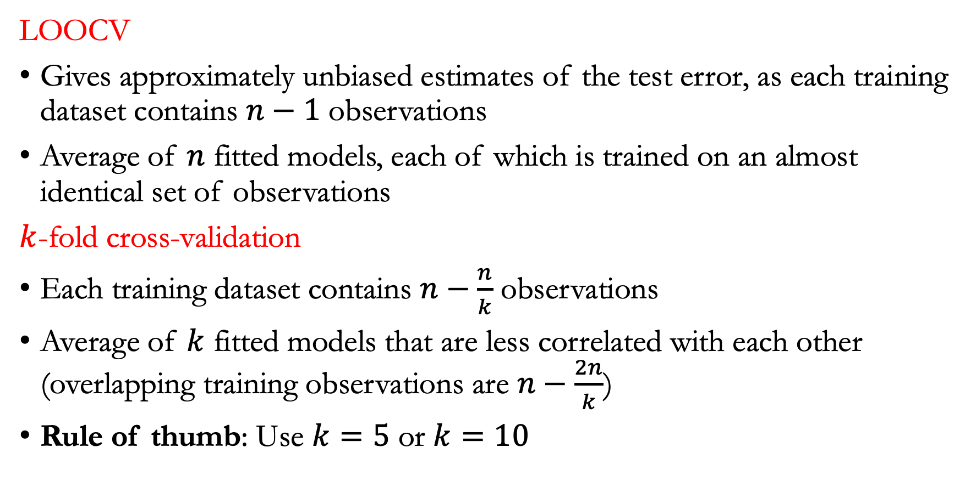
LOOCV vs. $k$-fold cross-validation
LOOCV
Gives approximately unbiased estimates of the test error, as each training dataset contains $n−1$ observations
Average of $n$ fitted models, each of which is trained on an almost identical set of observations
$k$-fold cross-validation
Each training dataset contains $n−\frac{n}{k}$ observations
Average of $k$ fitted models that are less correlated with each other (overlapping training observations are $n−\frac{2n}{k}$)
Rule of thumb: Use $k=5$ or $k=10$

Slide 20
Lecture plan
Bootstrap

Slide 21
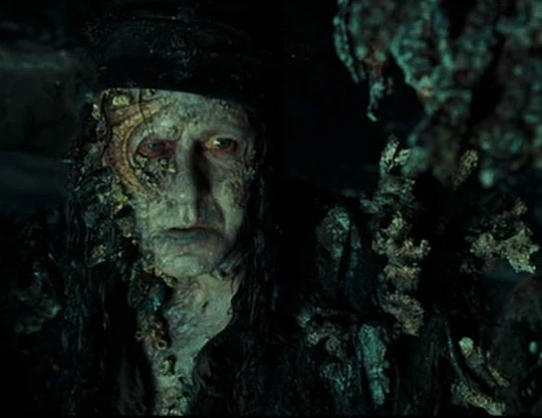
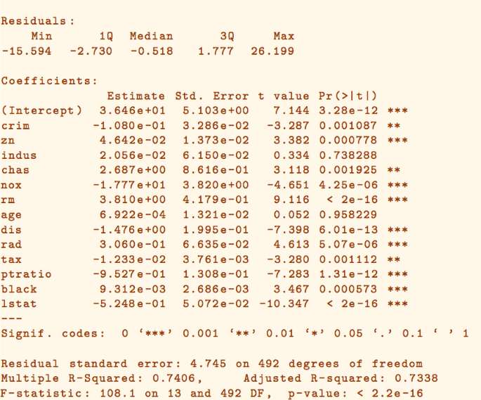
Cross-validation vs. Bootstrap
Cross-validation: Provide the test error with an independent validation set
Bootstrap: Provide the standard error of model estimates

Slide 22
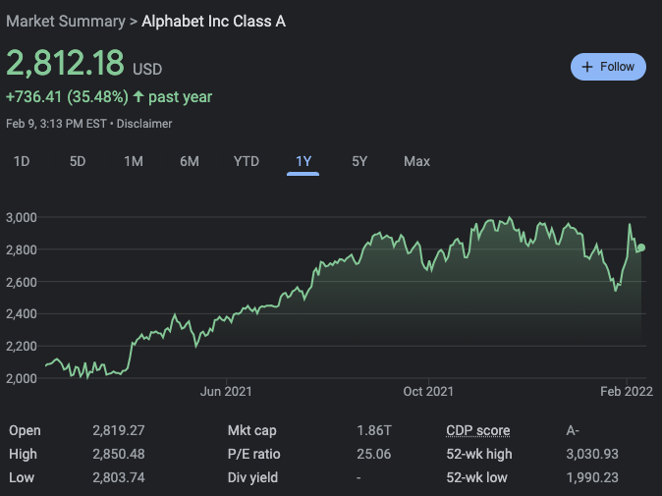
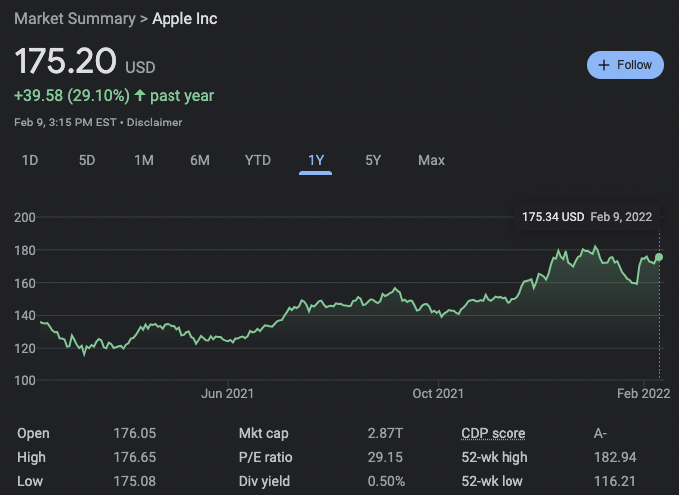
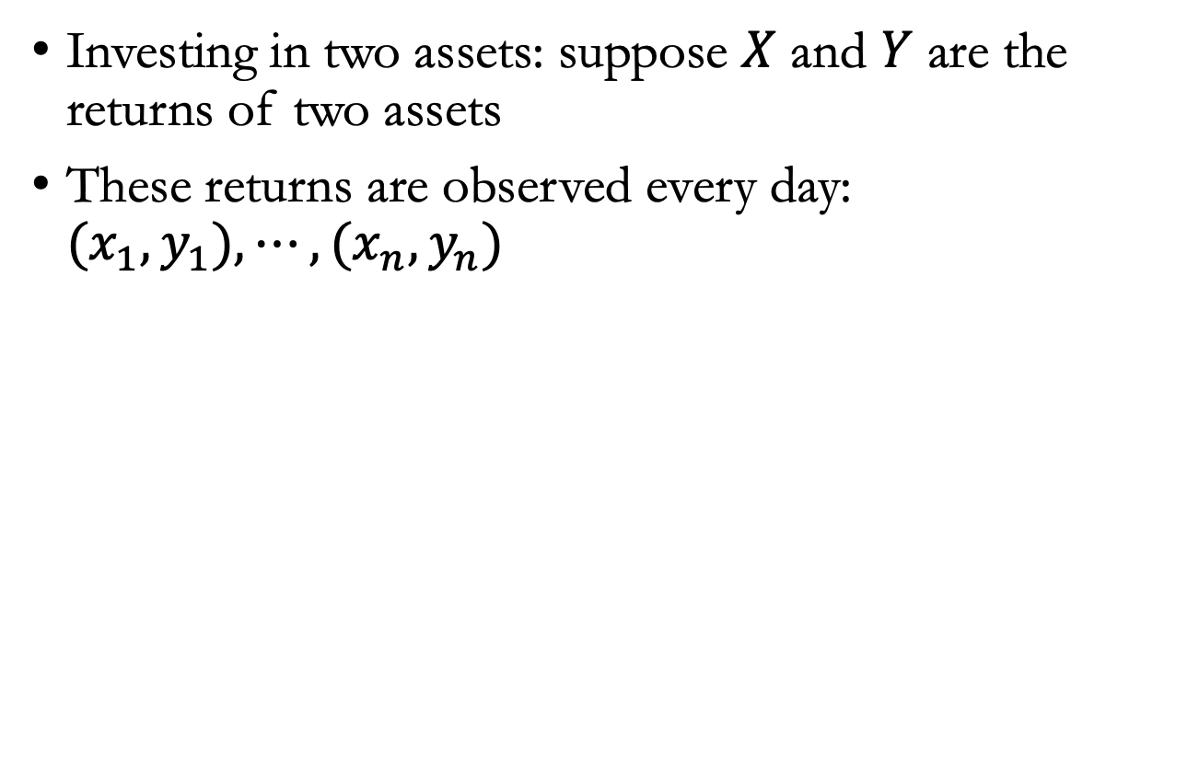
Example
Investing in two assets: suppose $X$ and $Y$ are the returns of two assets
These returns are observed every day: ${(x}_{1},y_{1}),⋯,(x_{n},y_{n})$

Slide 23
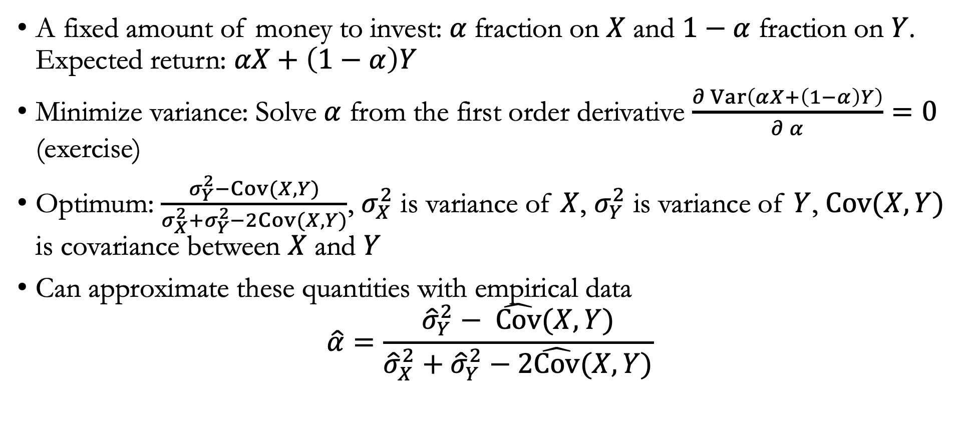
Example
A fixed amount of money to invest: $α$fraction on $X$ and $1−α$ fraction on $Y$. Expected return: $αX+\left(1−α\right)Y$
Minimize variance: Solve $α$ from the first order derivative $\frac{∂ Var\left(αX+\left(1−α\right)Y\right)}{∂ α}=0$ (exercise)
Optimum: $\frac{σ_{Y}^{2}−Cov(X,Y)}{{σ_{X}^{2}+σ}_{Y}^{2}−2Cov(X,Y)}$, $σ_{X}^{2}$ is variance of $X$, $σ_{Y}^{2}$ is variance of $Y$, $Cov(X,Y)$ is covariance between $X$ and $Y$
Can approximate these quantities with empirical data
$$\hat{α}=\frac{{\hat{σ}}_{Y}^{2}− \hat{Cov}(X,Y)}{{\hat{σ}}_{X}^{2}+{\hat{σ}}_{Y}^{2}−2\hat{Cov}(X,Y)}$$

Slide 24
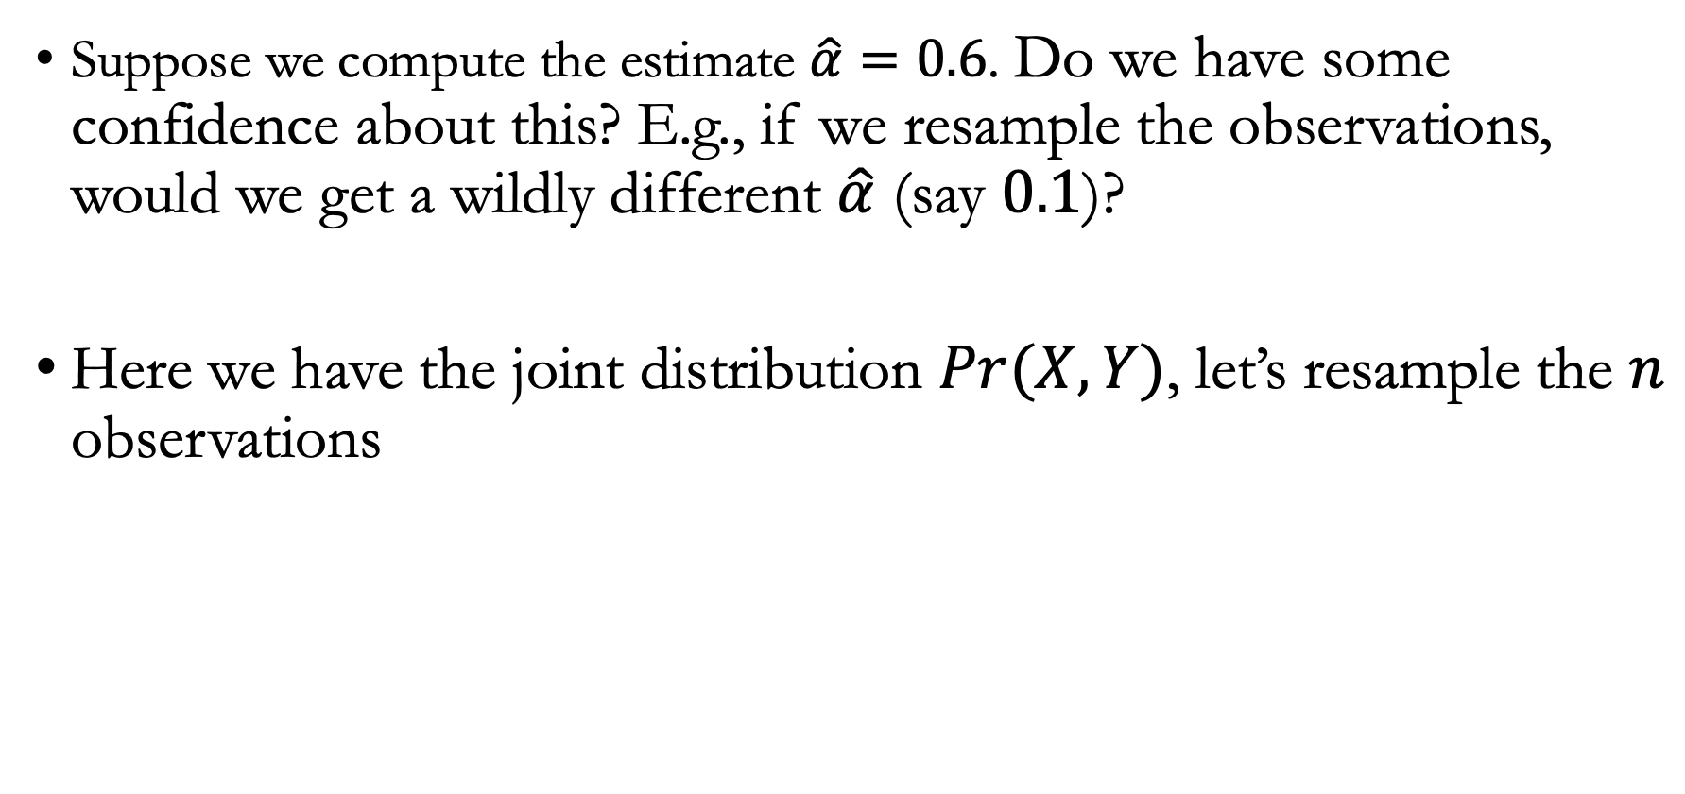
Resampling
Suppose we compute the estimate $\hat{α}=0.6$. Do we have some confidence about this? E.g., if we resample the observations, would we get a wildly different $\hat{α}$ (say $0.1$)?
Here we have the joint distribution $Pr(X,Y)$, let’s resample the $n$ observations

Slide 25
Resample the $X,Y$
Resample $n$ observations

Slide 26


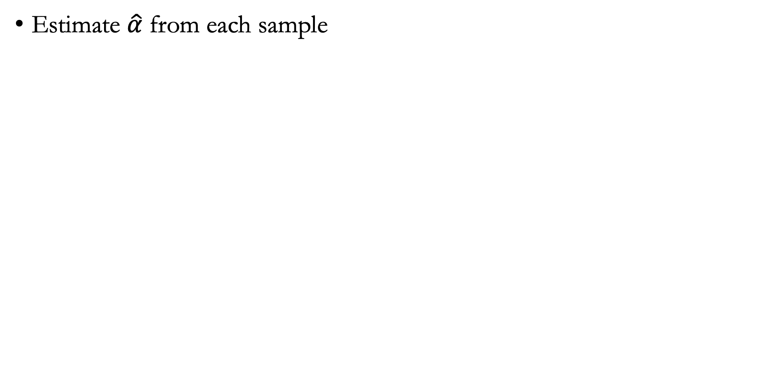






Thought experiment
Estimate $\hat{α}$ from each sample
$$\left(x_{1}^{\left(1\right)},⋯,x_{n}^{\left(1\right)}\right)$$
$$\left(x_{1}^{\left(2\right)},⋯,x_{n}^{\left(2\right)}\right)$$
Get ${\hat{α}}^{(1)}$
Get ${\hat{α}}^{(2)}$
$$\left(x_{1}^{\left(3\right)},⋯,x_{n}^{\left(3\right)}\right)$$
$$\left(x_{1}^{\left(4\right)},⋯,x_{n}^{\left(4\right)}\right)$$
Get ${\hat{α}}^{(3)}$
Get ${\hat{α}}^{(4)}$

Slide 27
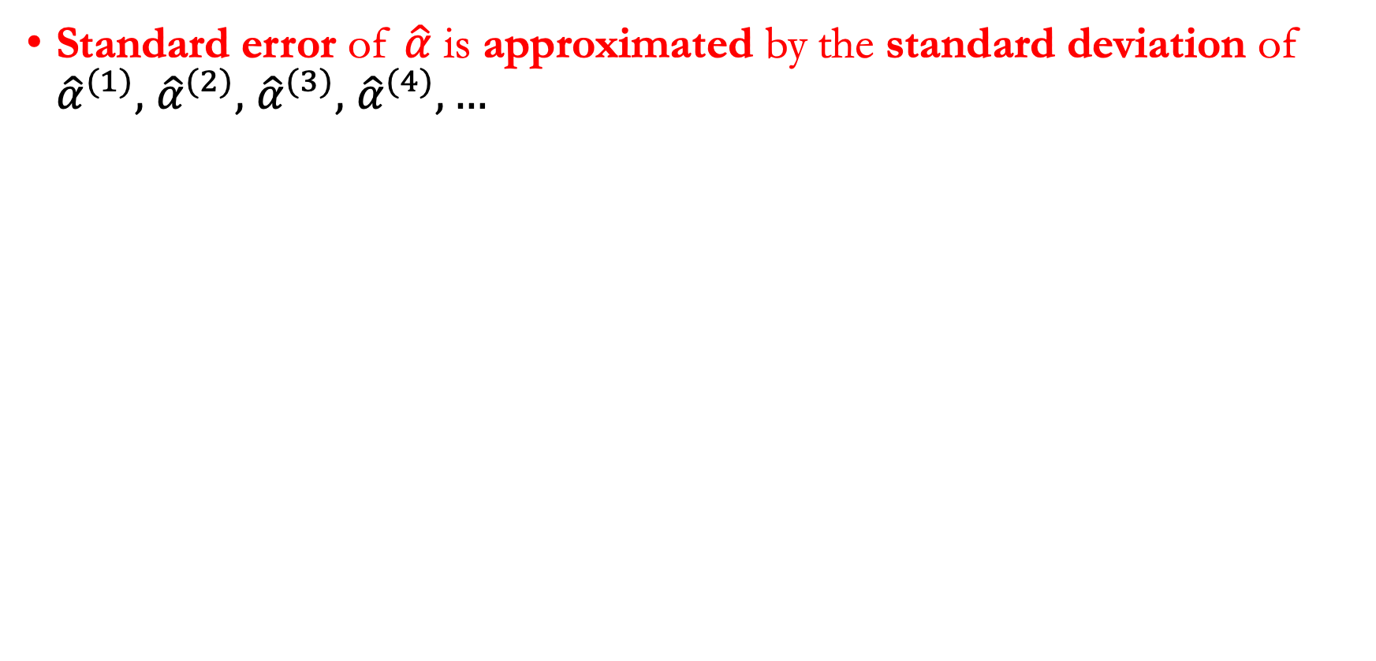
Thought experiment
Standard error of $\hat{α}$ is approximated by the standard deviation of ${\hat{α}}^{(1)},$ ${\hat{α}}^{(2)},$ ${\hat{α}}^{(3)},$ ${\hat{α}}^{(4)}, …$
$$\left(x_{1}^{\left(1\right)},⋯,x_{n}^{\left(1\right)}\right)$$
$$\left(x_{1}^{\left(2\right)},⋯,x_{n}^{\left(2\right)}\right)$$
Get ${\hat{α}}^{(1)}$
Get ${\hat{α}}^{(2)}$
$$\left(x_{1}^{\left(3\right)},⋯,x_{n}^{\left(3\right)}\right)$$
$$\left(x_{1}^{\left(4\right)},⋯,x_{n}^{\left(4\right)}\right)$$
Get ${\hat{α}}^{(3)}$
Get ${\hat{α}}^{(4)}$

Slide 28
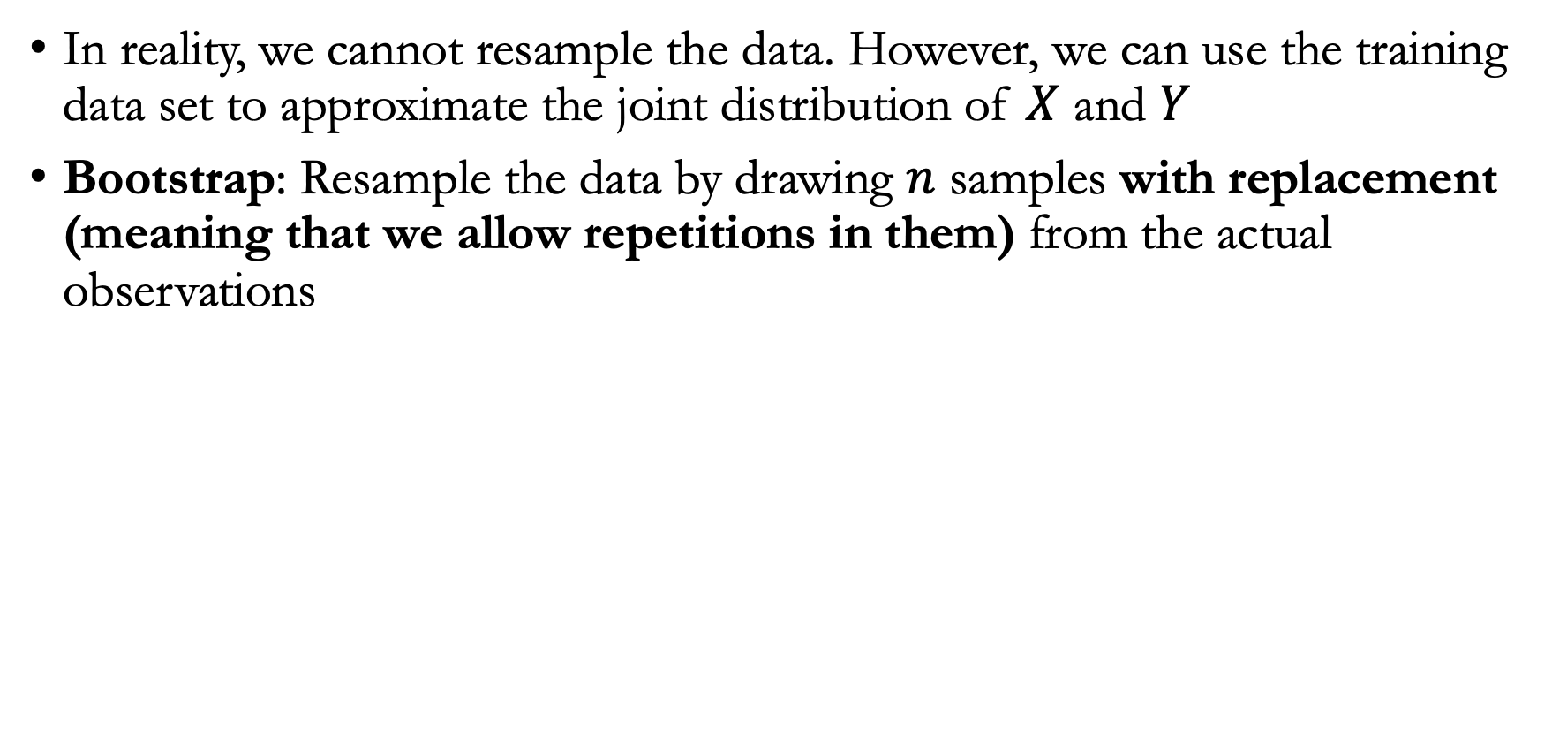
Bootstrap
In reality, we cannot resample the data. However, we can use the training data set to approximate the joint distribution of $X$ and $Y$
Bootstrap: Resample the data by drawing $n$ samples with replacement (meaning that we allow repetitions in them) from the actual observations

Slide 29
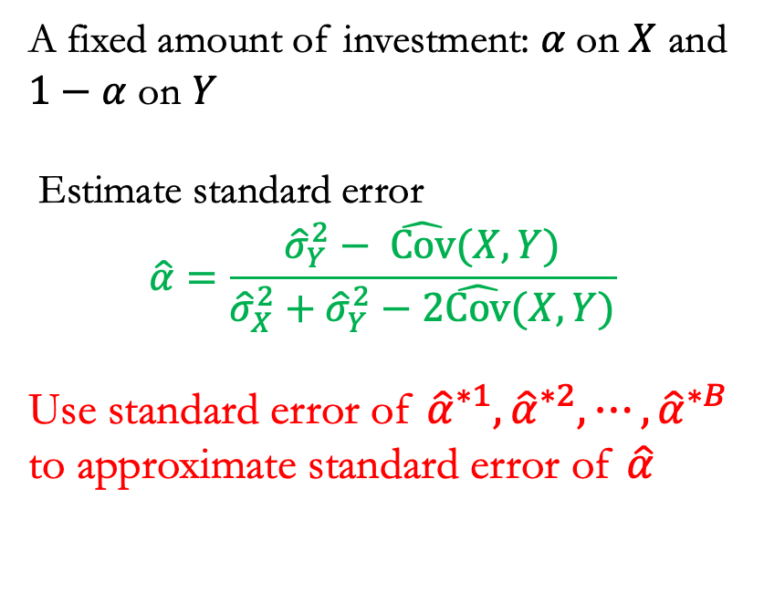
Bootstrap
A fixed amount of investment: $α$on $X$ and $1−α$ on $Y$
Estimate standard error
$$\hat{α}=\frac{{\hat{σ}}_{Y}^{2}− \hat{Cov}(X,Y)}{{\hat{σ}}_{X}^{2}+{\hat{σ}}_{Y}^{2}−2\hat{Cov}(X,Y)}$$
Use standard error of ${\hat{α}}^{∗1}, {\hat{α}}^{∗2}, ⋯,{\hat{α}}^{∗B}$ to approximate standard error of $\hat{α}$

Slide 30

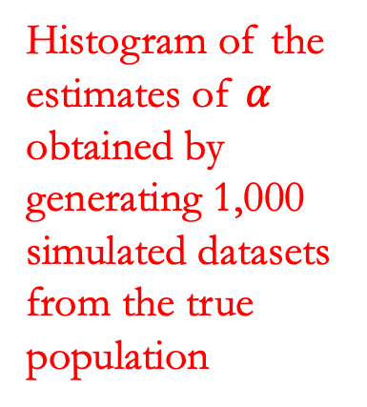
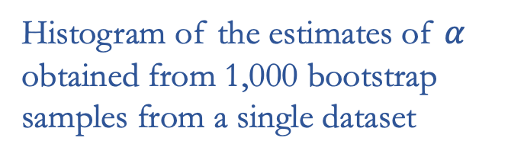
Bootstrap vs. resampling from the true distribution
Histogram of the estimates of $α$ obtained by generating 1,000 simulated datasets from the true population
Histogram of the estimates of $α$ obtained from 1,000 bootstrap samples from a single dataset
True value of $α$

Slide 31
Quiz
In bootstrap, how large is the resampled set?
How many distinct samples are there in the resampled set (in expectation)?

Slide 32
Lecture plan
Subset selection

Slide 33
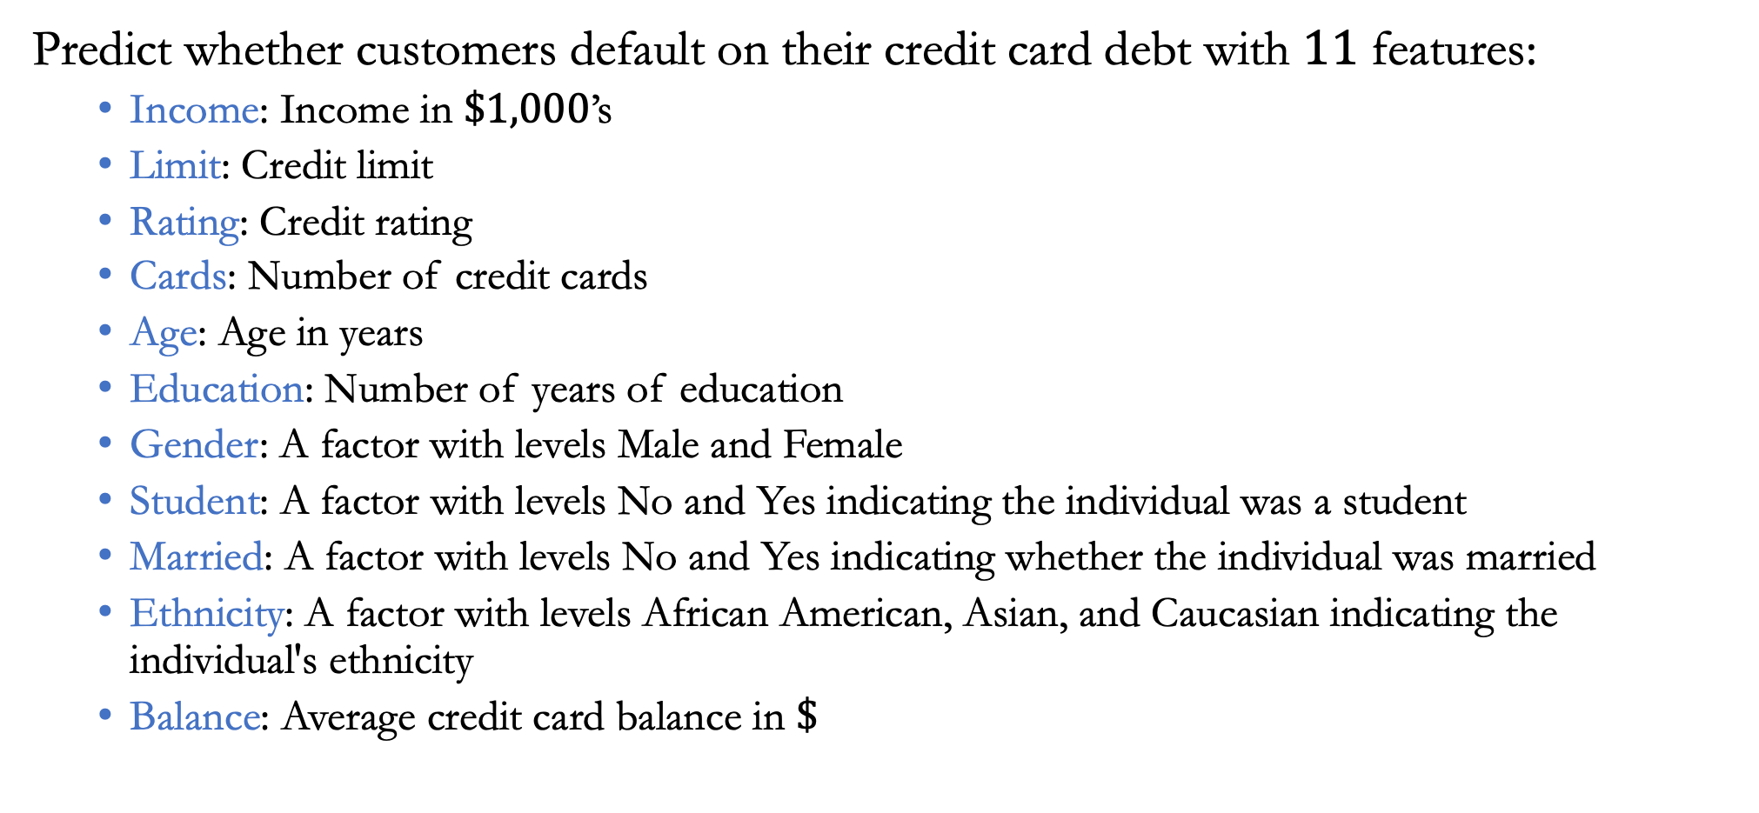
Example
Predict whether customers default on their credit card debt with $11$ features:
  Income: Income in $\$1,000$’s
  Limit: Credit limit
  Rating: Credit rating
  Cards: Number of credit cards
  Age: Age in years
  Education: Number of years of education
  Gender: A factor with levels Male and Female
  Student: A factor with levels No and Yes indicating the individual was a student
  Married: A factor with levels No and Yes indicating whether the individual was married
  Ethnicity: A factor with levels African American, Asian, and Caucasian indicating the individual's ethnicity
  Balance: Average credit card balance in $\$$

Slide 34
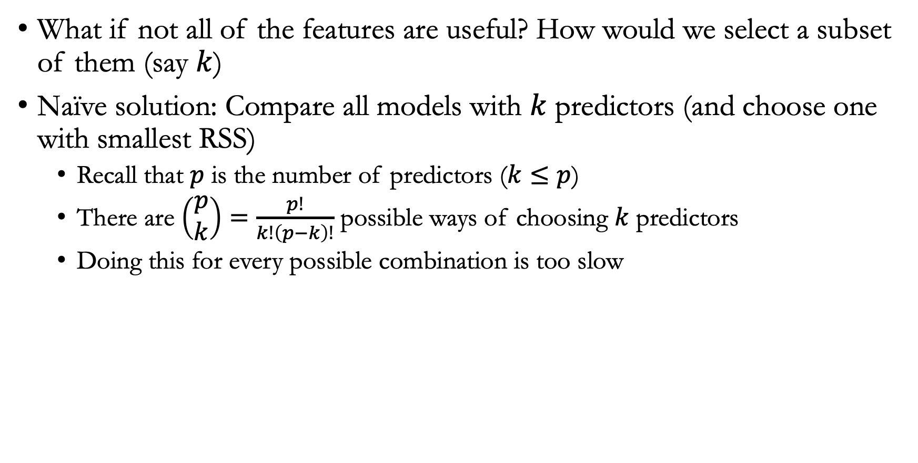
Subset selection
What if not all of the features are useful? How would we select a subset of them (say $k$)
Naïve solution: Compare all models with $k$ predictors (and choose one with smallest RSS)
  Recall that $p$ is the number of predictors ($k≤p$)
  There are $\left(\begin{matrix}p \\ k\end{matrix}\right)=\frac{p!}{k!\left(p−k\right)!}$ possible ways of choosing $k$ predictors
  Doing this for every possible combination is too slow
Notes:
the x-axis ranges from 1 to 11, since one of the variables is categorical and takes on three values
Ethnicity: A factor with levels African American, Asian, and Caucasian indicating the individual's ethnicity

Slide 35
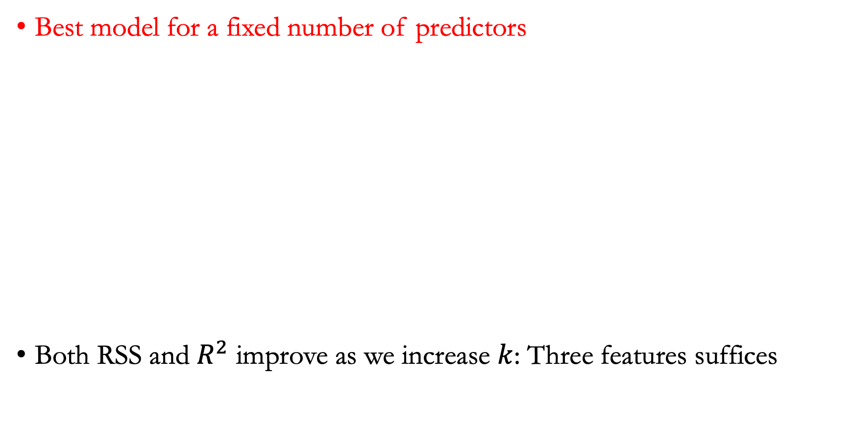
Example
Best model for a fixed number of predictors
Both RSS and $R^{2}$ improve as we increase $k$: Three features suffices

Slide 36
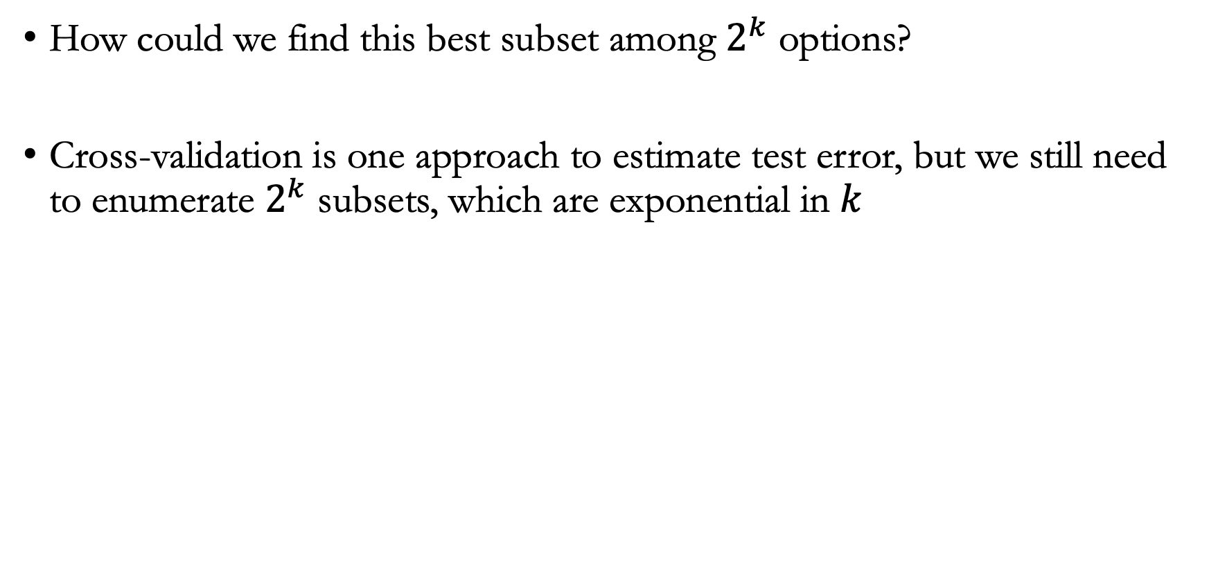
Best subset selection
How could we find this best subset among $2^{k}$ options?
Cross-validation is one approach to estimate test error, but we still need to enumerate $2^{k}$ subsets, which are exponential in $k$

Slide 37
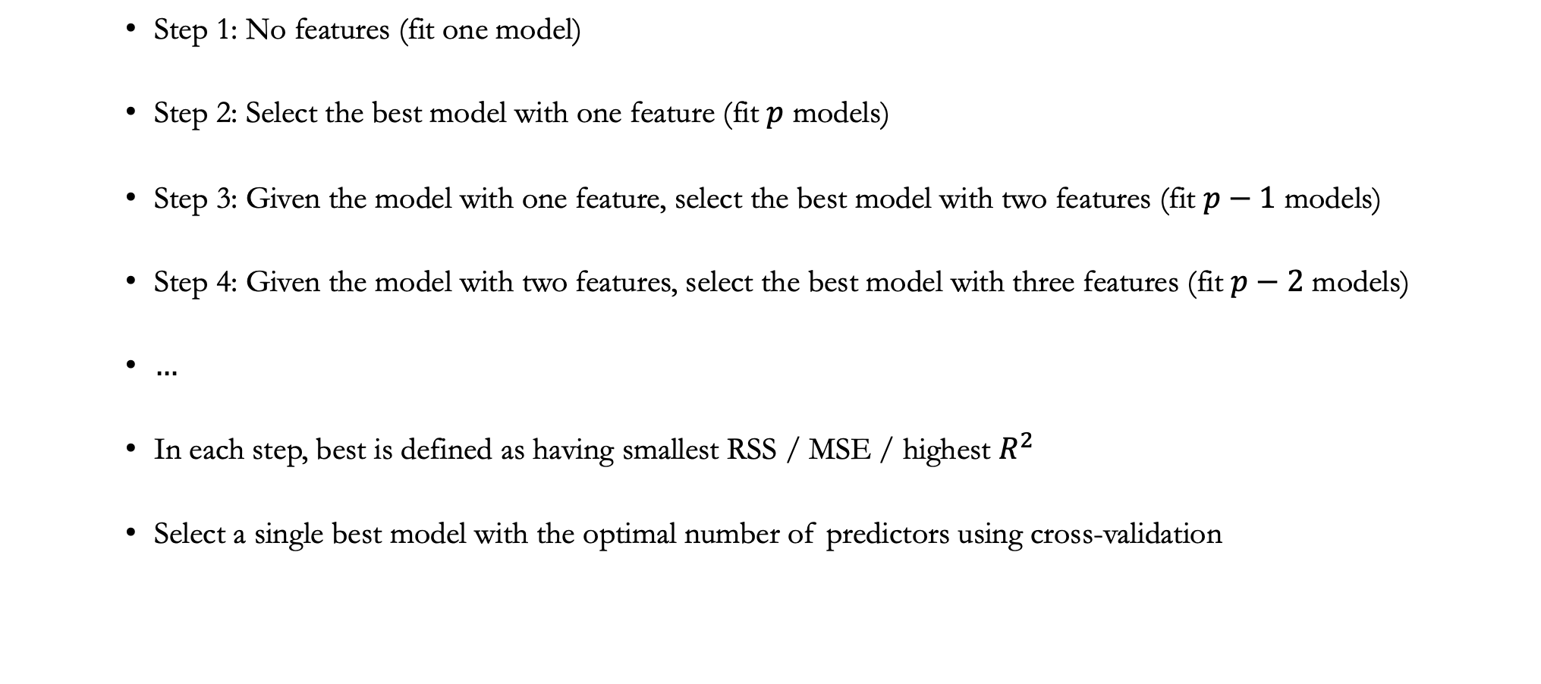
Forward stepwise selection
    Step 1: No features (fit one model)
    Step 2: Select the best model with one feature (fit $p$ models)
    Step 3: Given the model with one feature, select the best model with two features (fit $p−1$ models)
    Step 4: Given the model with two features, select the best model with three features (fit $p−2$ models)
    $…$
    In each step, best is defined as having smallest RSS / MSE / highest $R^{2}$
    Select a single best model with the optimal number of predictors using cross-validation

Slide 38
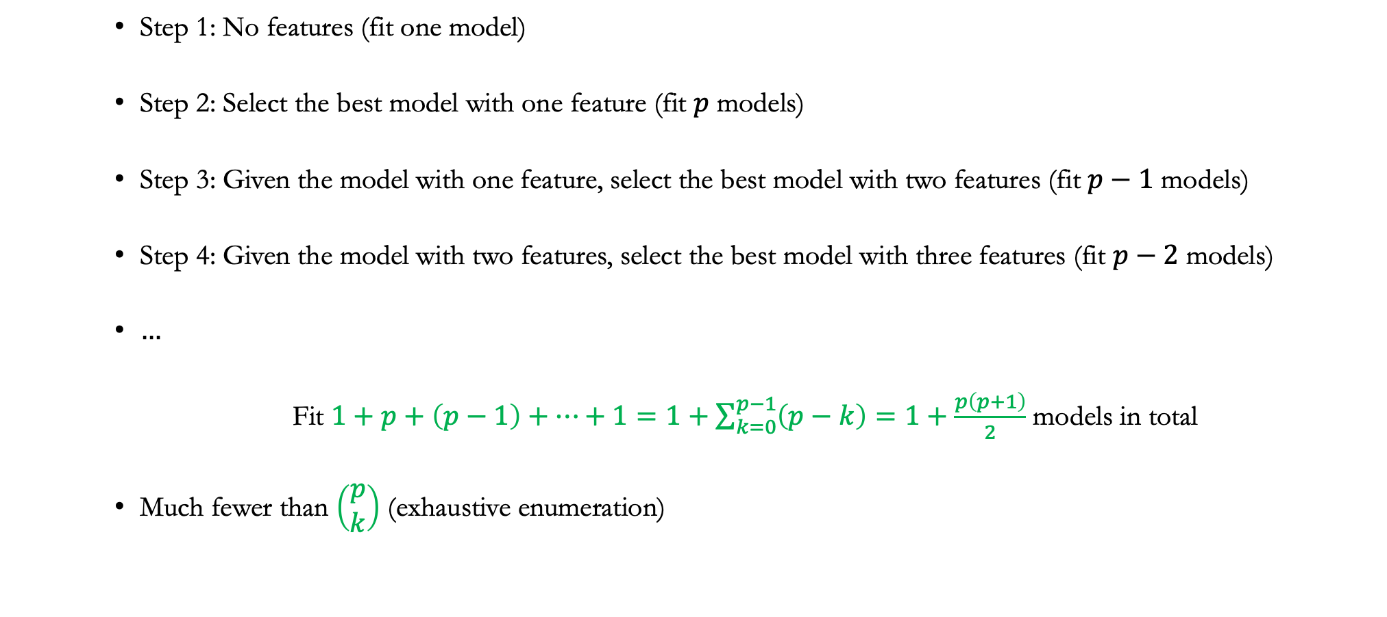
Forward stepwise selection
    Step 1: No features (fit one model)
    Step 2: Select the best model with one feature (fit $p$ models)
    Step 3: Given the model with one feature, select the best model with two features (fit $p−1$ models)
    Step 4: Given the model with two features, select the best model with three features (fit $p−2$ models)
    $…$
    Fit $1+p+\left(p−1\right)+⋯+1=1+\sum_{k=0}^{p−1}{\left(p−k\right)=1+\frac{p\left(p+1\right)}{2}}$ models in total
    Much fewer than $\left(\begin{matrix}p \\ k\end{matrix}\right)$ (exhaustive enumeration)

Slide 39
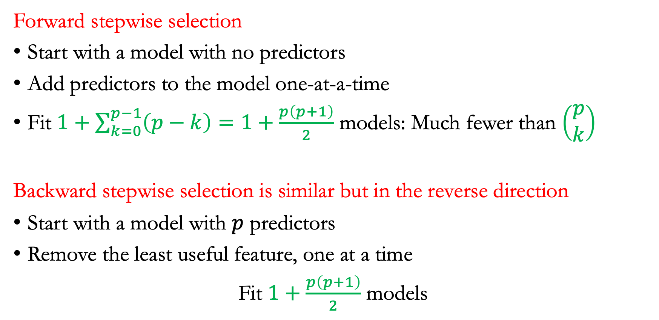
Summary: stepwise selection
Forward stepwise selection
Start with a model with no predictors
Add predictors to the model one-at-a-time
Fit $1+\sum_{k=0}^{p−1}{\left(p−k\right)=1+\frac{p\left(p+1\right)}{2}}$ models: Much fewer than $\left(\begin{matrix}p \\ k\end{matrix}\right)$
Backward stepwise selection is similar but in the reverse direction
Start with a model with $p$ predictors
Remove the least useful feature, one at a time
Fit $1+\frac{p\left(p+1\right)}{2}$ models

Slide 40
Announcements
Join piazza (if you haven’t done so!!)
Homework 1 due on Friday: submit a single PDF file on gradescope
Also on Friday, Homework 2 will be released

