Slide 1
Supervised Machine Learning and Learning Theory
Lecture 7: Regularization
September 27, 2024

Slide 2
Warm up questions
What is the purpose of the bootstrap procedure? And how does it work?
  A: Bootstrap resamples the dataset multiple times so we could use it to estimate the standard errors of model coefficients
When do we expect to perform subset selection?
  A: When some of the features are not useful
Could you write down the logistic regression model for classifying handwritten digits?
  A: Use the cross-entropy loss, we set a linear model for each class, then we write the loss function based on the linear model outcome for each class (softmax followed by negative log loss)

Slide 3
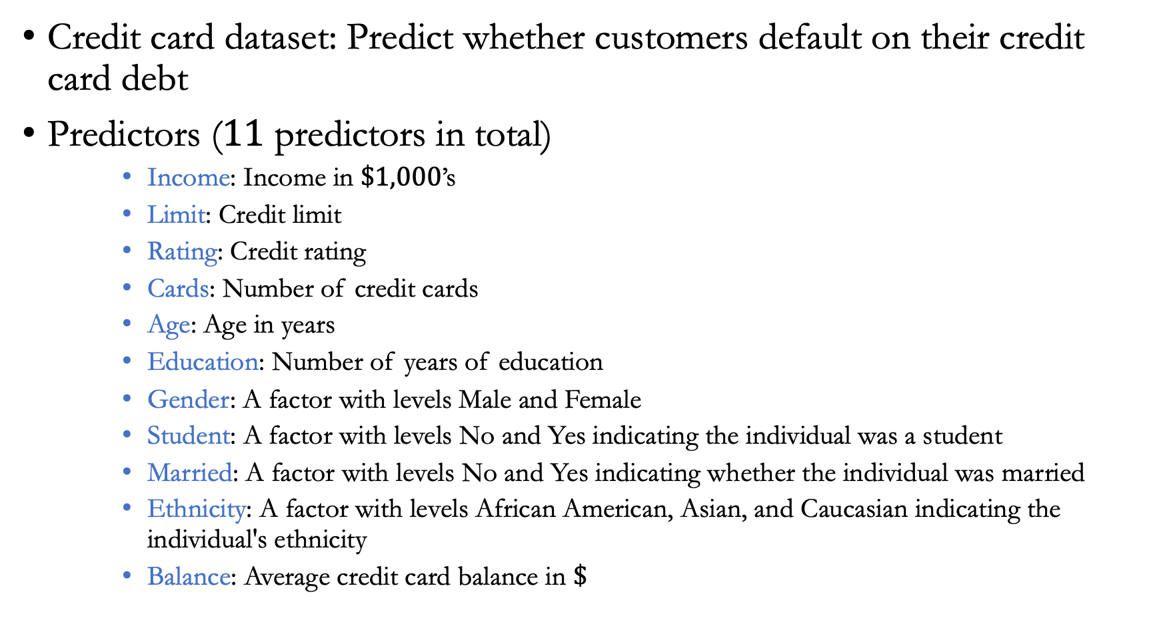
Example
Credit card dataset: Predict whether customers default on their credit card debt
Predictors ($11$ predictors in total)
    Income: Income in $\$1,000$’s
    Limit: Credit limit
    Rating: Credit rating
    Cards: Number of credit cards
    Age: Age in years
    Education: Number of years of education
    Gender: A factor with levels Male and Female
    Student: A factor with levels No and Yes indicating the individual was a student
    Married: A factor with levels No and Yes indicating whether the individual was married
    Ethnicity: A factor with levels African American, Asian, and Caucasian indicating the individual's ethnicity
    Balance: Average credit card balance in $\$$

Slide 4
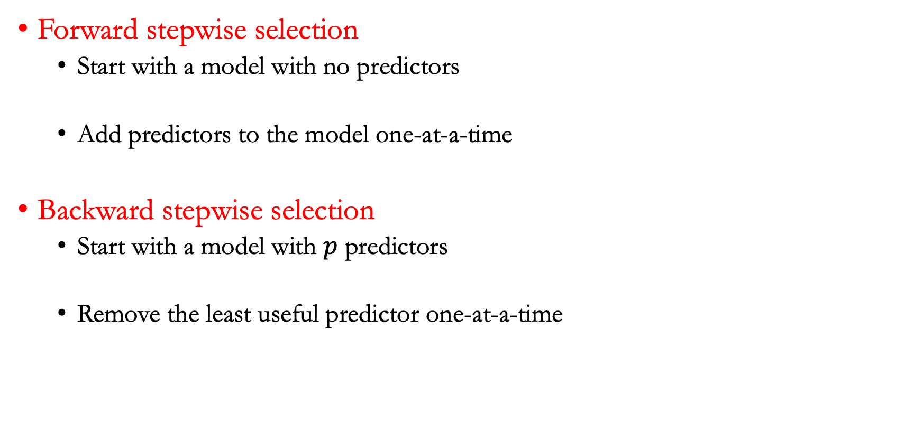
Stepwise selection methods
Forward stepwise selection
  Start with a model with no predictors
  Add predictors to the model one-at-a-time
Backward stepwise selection
  Start with a model with $p$ predictors
  Remove the least useful predictor one-at-a-time

Slide 5
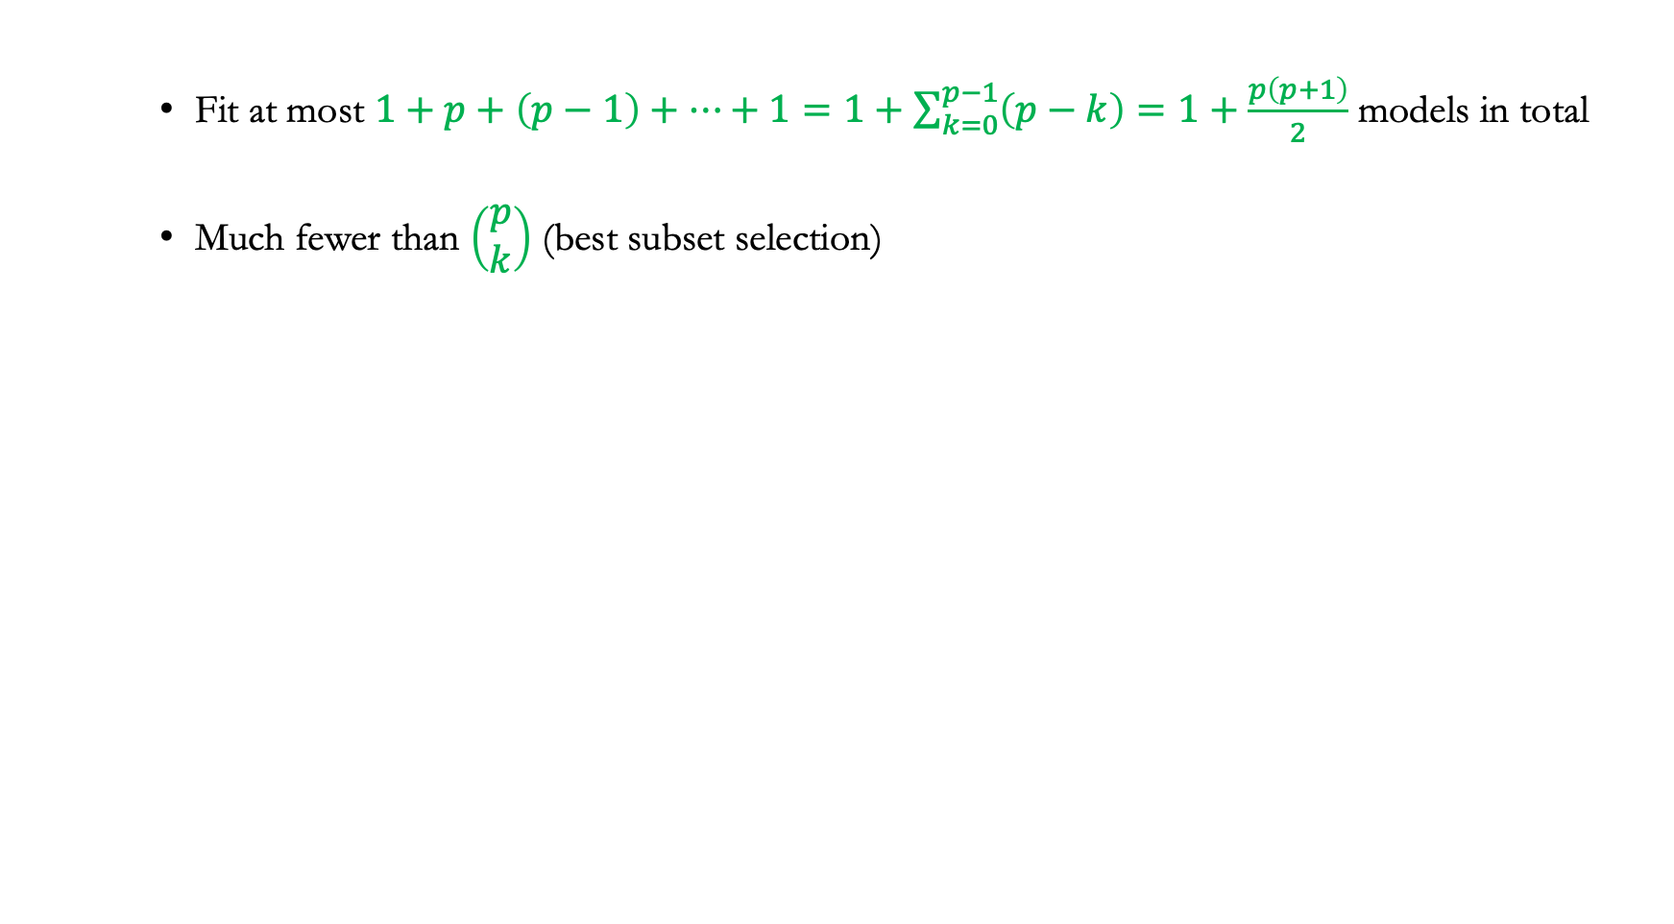
Forward stepwise selection
    Fit at most $1+p+\left(p−1\right)+⋯+1=1+\sum_{k=0}^{p−1}{\left(p−k\right)=1+\frac{p\left(p+1\right)}{2}}$ models in total
    Much fewer than $\left(\begin{matrix}p \\ k\end{matrix}\right)$ (best subset selection)

Slide 6
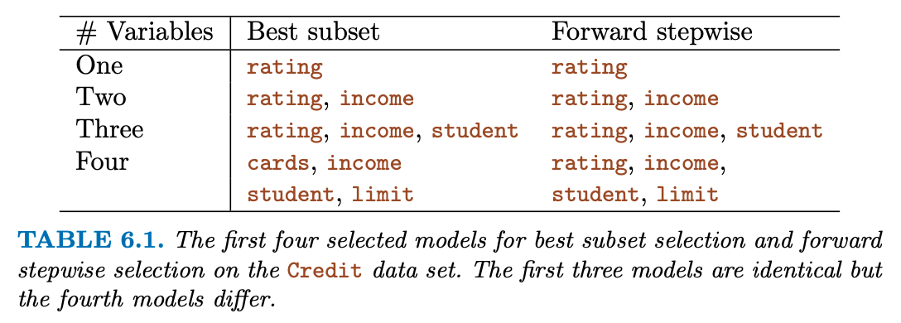
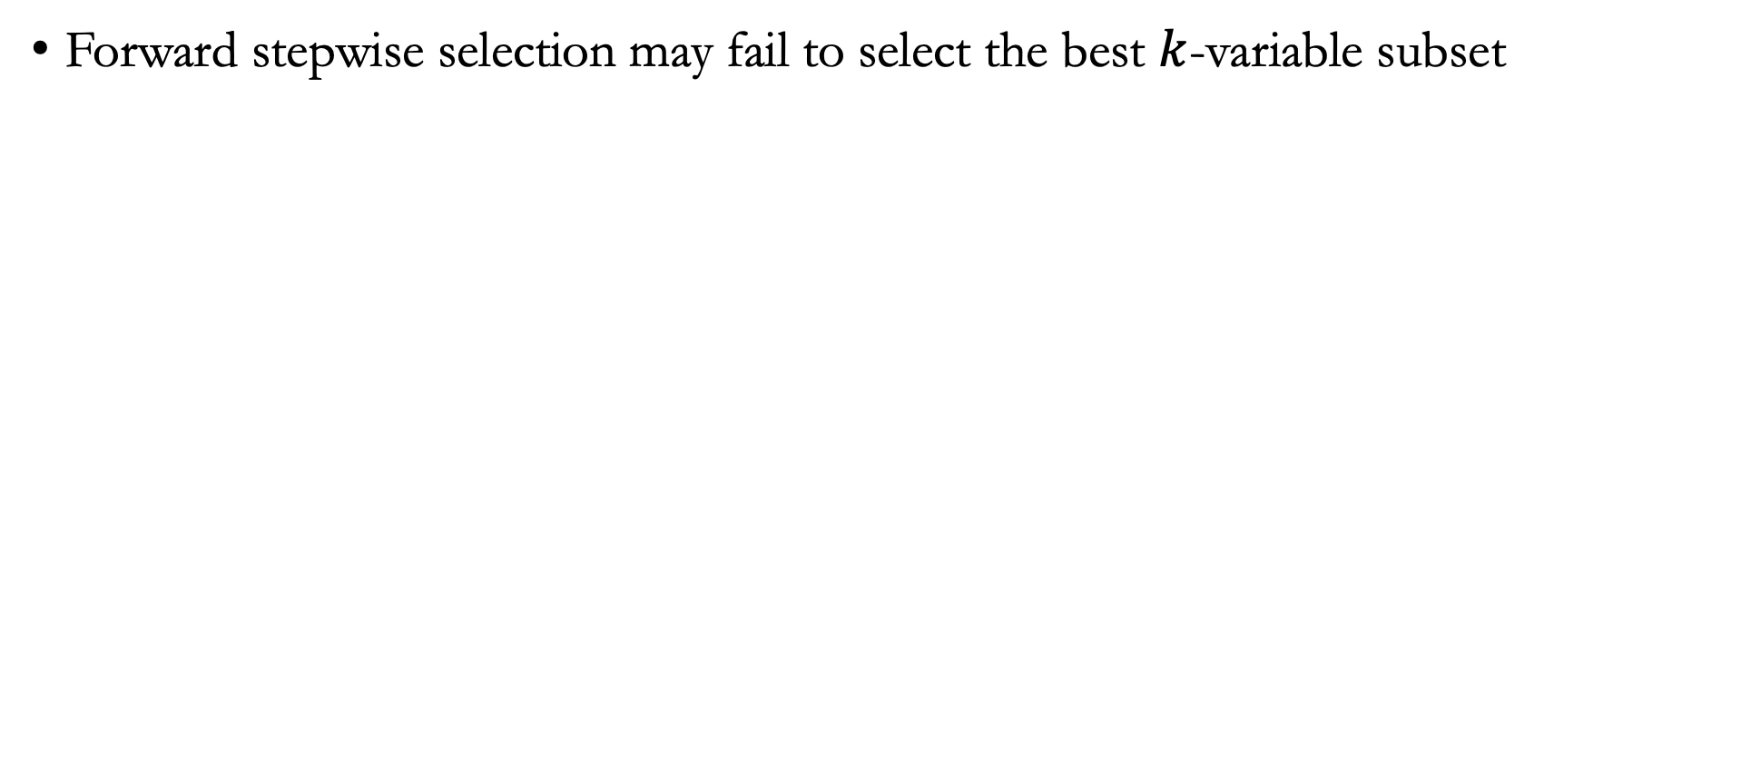
Forward selection vs. best subset
Forward stepwise selection may fail to select the best $k$-variable subset

Slide 7
Lecture plan
Ridge regression

Slide 8
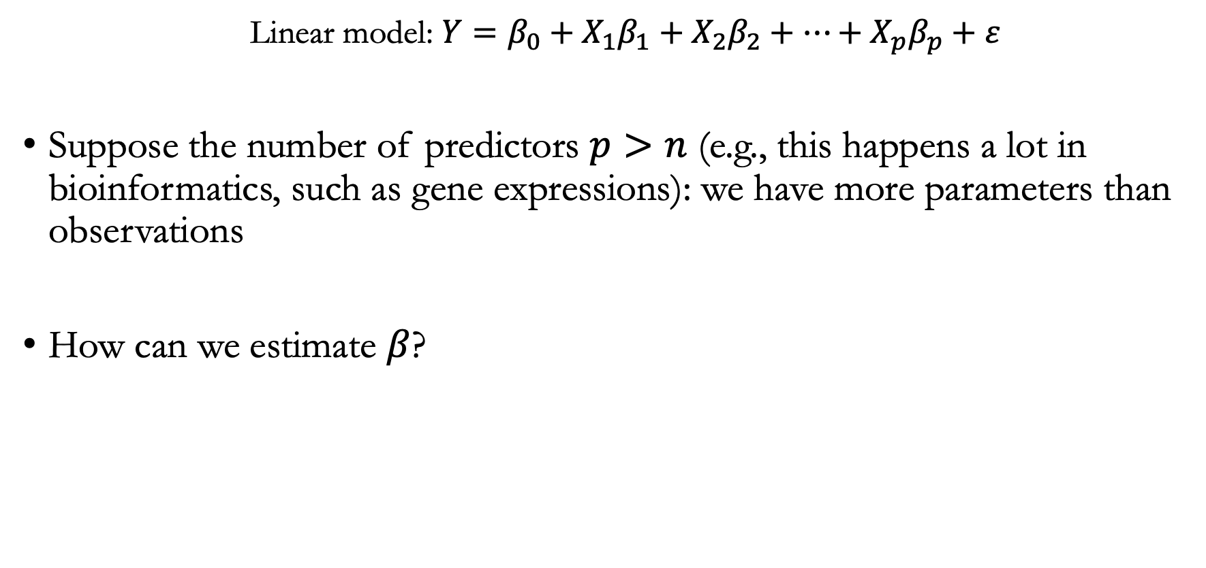
Motivation
  Linear model: ${Y=β_{0}+X}_{1}β_{1}+X_{2}β_{2}+⋯+X_{p}β_{p}+ε$
Suppose the number of predictors $p>n$ (e.g., this happens a lot in bioinformatics, such as gene expressions): we have more parameters than observations
How can we estimate $β$?

Slide 9
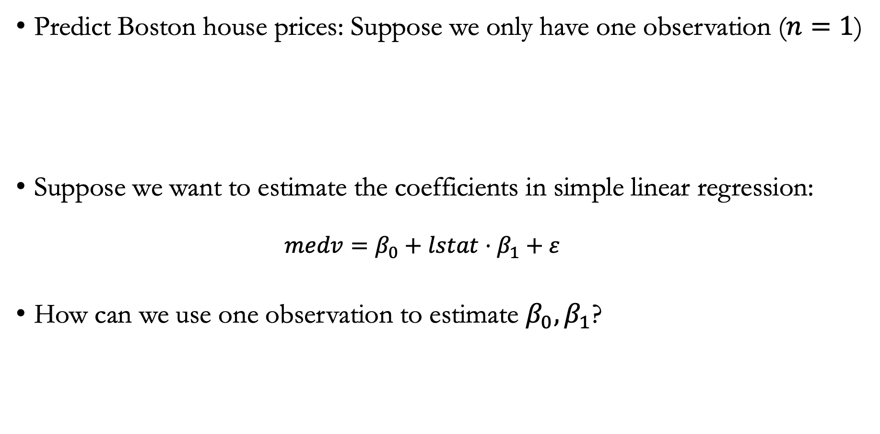
Example
Predict Boston house prices: Suppose we only have one observation ($n=1$)
Suppose we want to estimate the coefficients in simple linear regression:
  $$medv=β_{0}+lstat⋅β_{1}+ε$$
How can we use one observation to estimate $β_{0},β_{1}$?
Notes:
CRIM - per capita crime rate by town
ZN - proportion of residential land zoned for lots over 25,000 sq.ft.
INDUS - proportion of non-retail business acres per town.
CHAS - Charles River dummy variable (1 if tract bounds river; 0 otherwise)
NOX - nitric oxides concentration (parts per 10 million)
RM - average number of rooms per dwelling
AGE - proportion of owner-occupied units built prior to 1940
DIS - weighted distances to five Boston employment centres
RAD - index of accessibility to radial highways
TAX - full-value property-tax rate per $10,000
PTRATIO - pupil-teacher ratio by town
B - 1000(Bk - 0.63)^2 where Bk is the proportion of blacks by town
LSTAT - % lower status of the population
MEDV - Median value of owner-occupied homes in $1000's

Slide 10
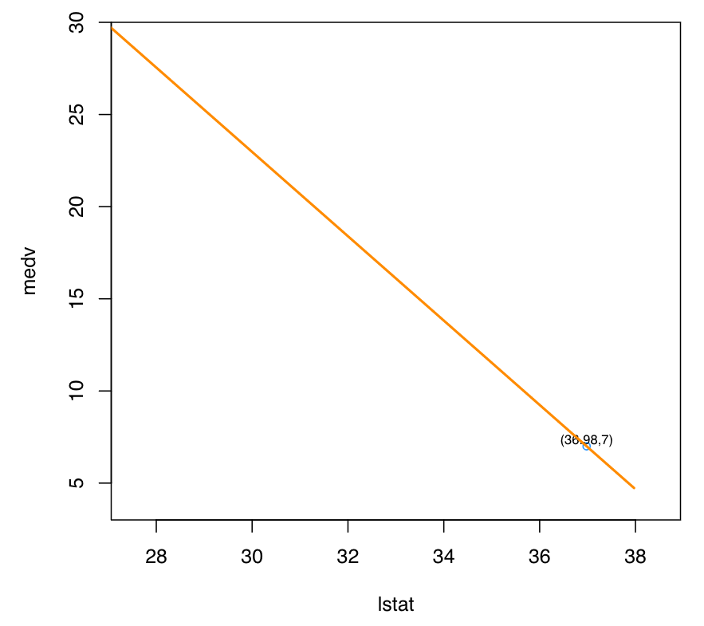
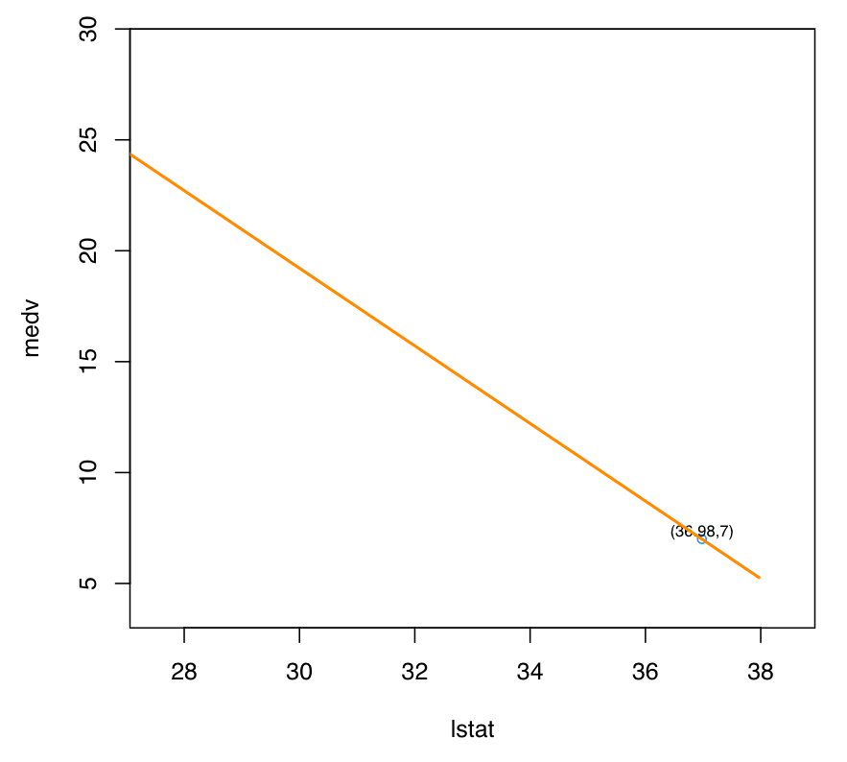
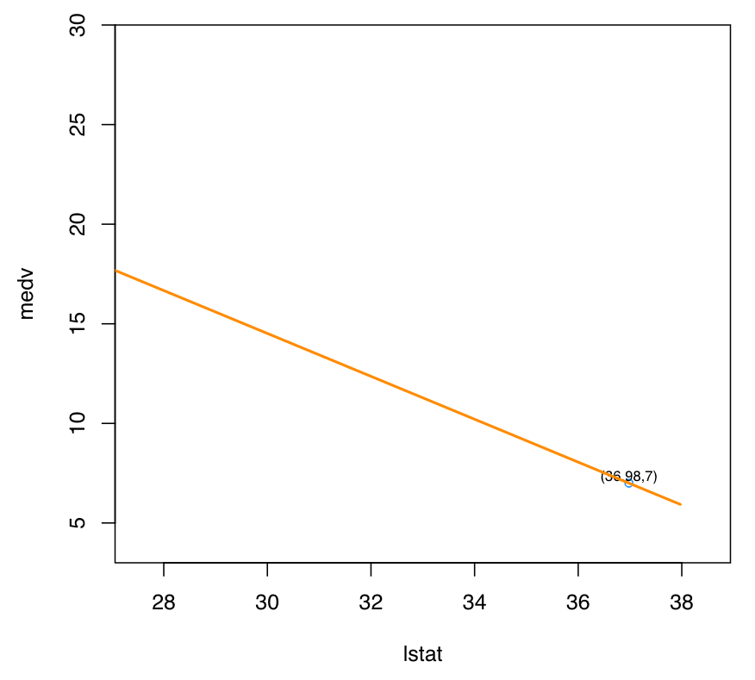
Which $β_{0}$ and $β_{1}$ should we choose?
All of these are valid solutions!

Slide 11
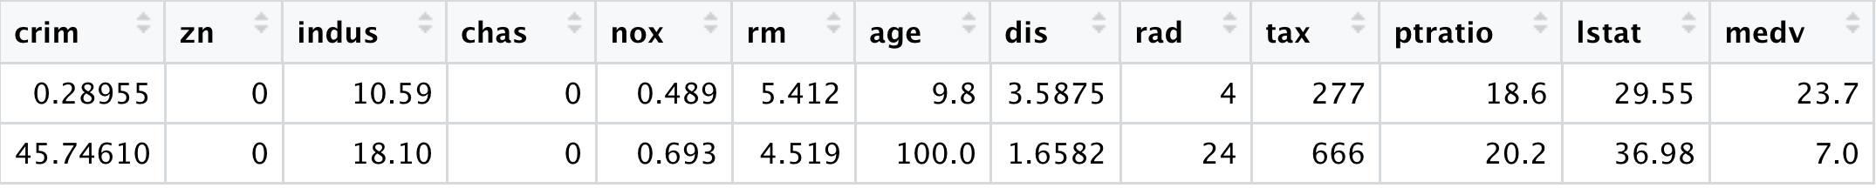
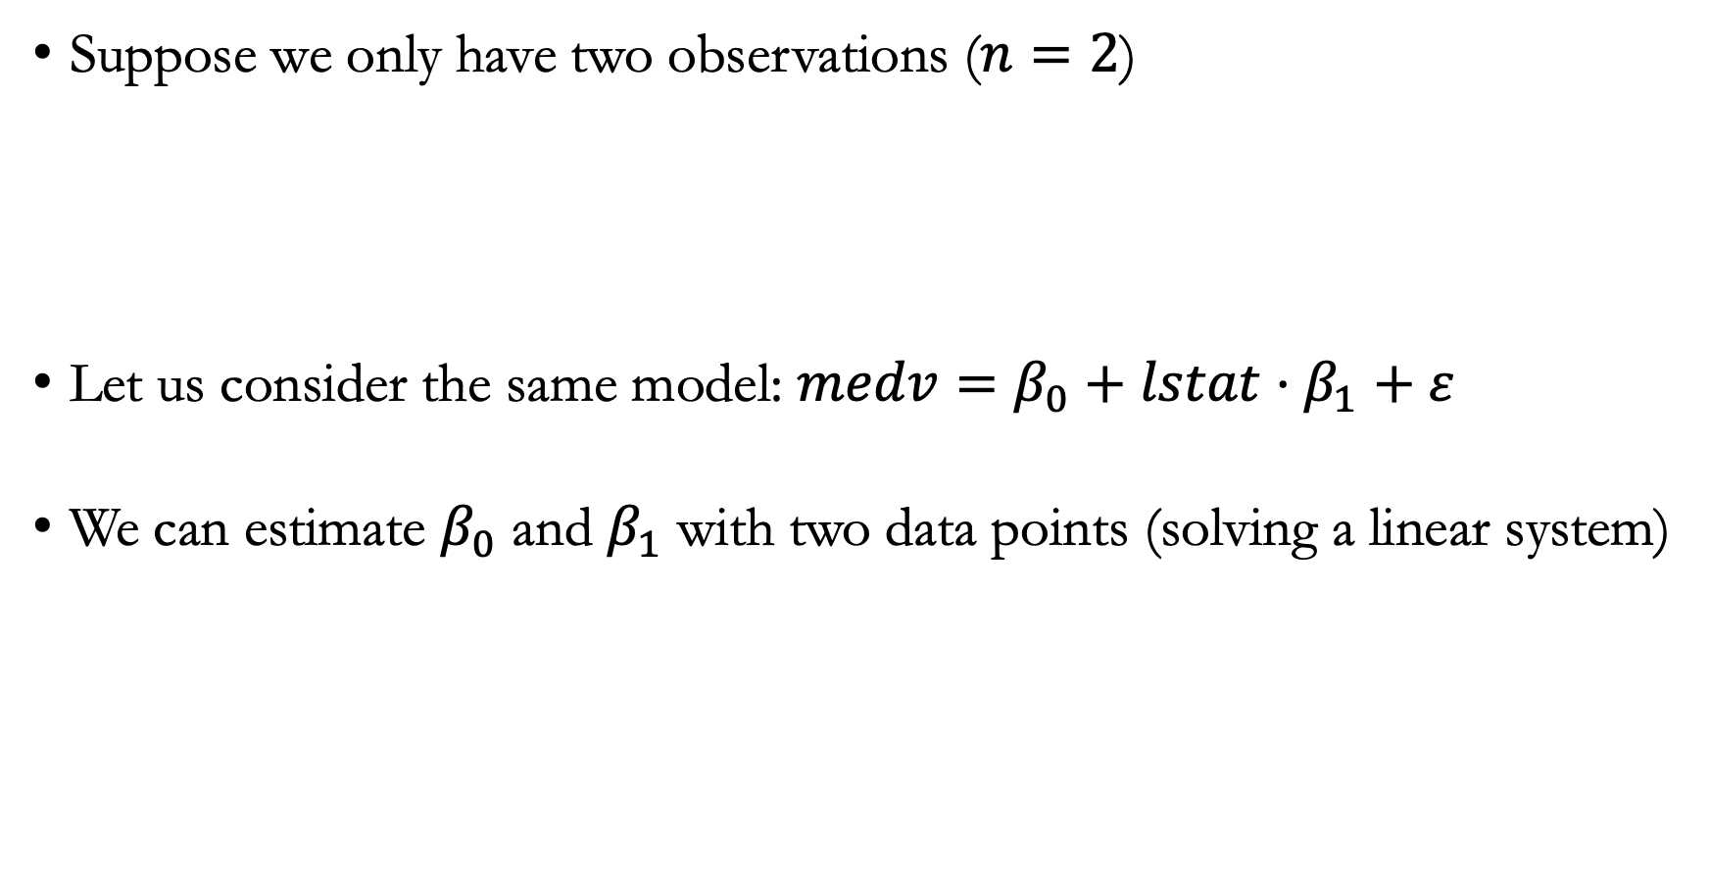
If we have one more observation…
Suppose we only have two observations ($n=2$)
Let us consider the same model: $medv=β_{0}+lstat⋅β_{1}+ε$
We can estimate $β_{0}$ and $β_{1}$ with two data points (solving a linear system)
Notes:
CRIM - per capita crime rate by town
ZN - proportion of residential land zoned for lots over 25,000 sq.ft.
INDUS - proportion of non-retail business acres per town.
CHAS - Charles River dummy variable (1 if tract bounds river; 0 otherwise)
NOX - nitric oxides concentration (parts per 10 million)
RM - average number of rooms per dwelling
AGE - proportion of owner-occupied units built prior to 1940
DIS - weighted distances to five Boston employment centres
RAD - index of accessibility to radial highways
TAX - full-value property-tax rate per $10,000
PTRATIO - pupil-teacher ratio by town
B - 1000(Bk - 0.63)^2 where Bk is the proportion of blacks by town
LSTAT - % lower status of the population
MEDV - Median value of owner-occupied homes in $1000's

Slide 12
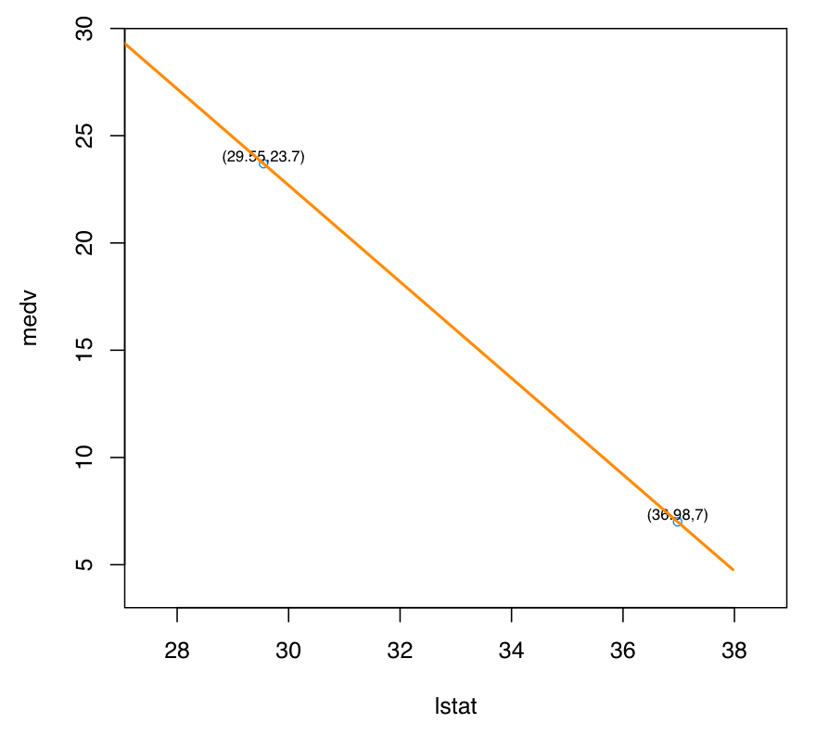
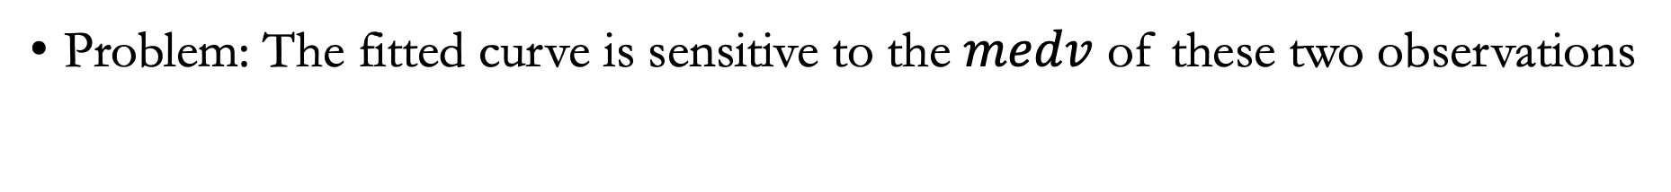
Example
Problem: The fitted curve is sensitive to the $medv$ of these two observations

Slide 13
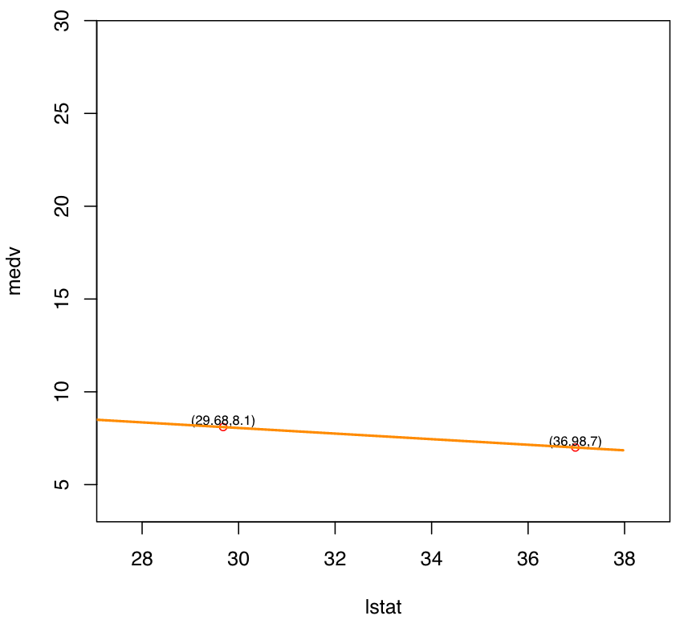
Example
If one of the two observations changes, we can get a very different fitted curve
This is an example of overfitting…
Question: can you think of other examples of overfitting?

Slide 14
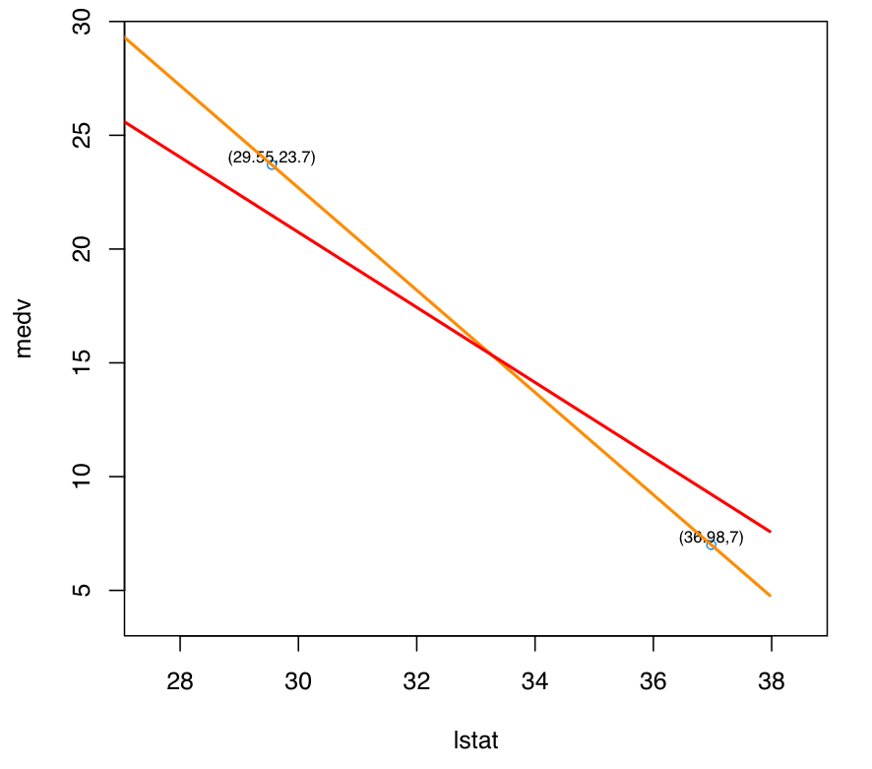
Ridge regression
Find a new line that does not fit the training data perfectly
Introduce a small amount of bias into the fit to data

Slide 15
Ridge regression
This can be achieved with Ridge regression: by adding a small amount of bias, we reduce variance (i.e., the fitted lines are less sensitive to changes with the input)

Slide 16
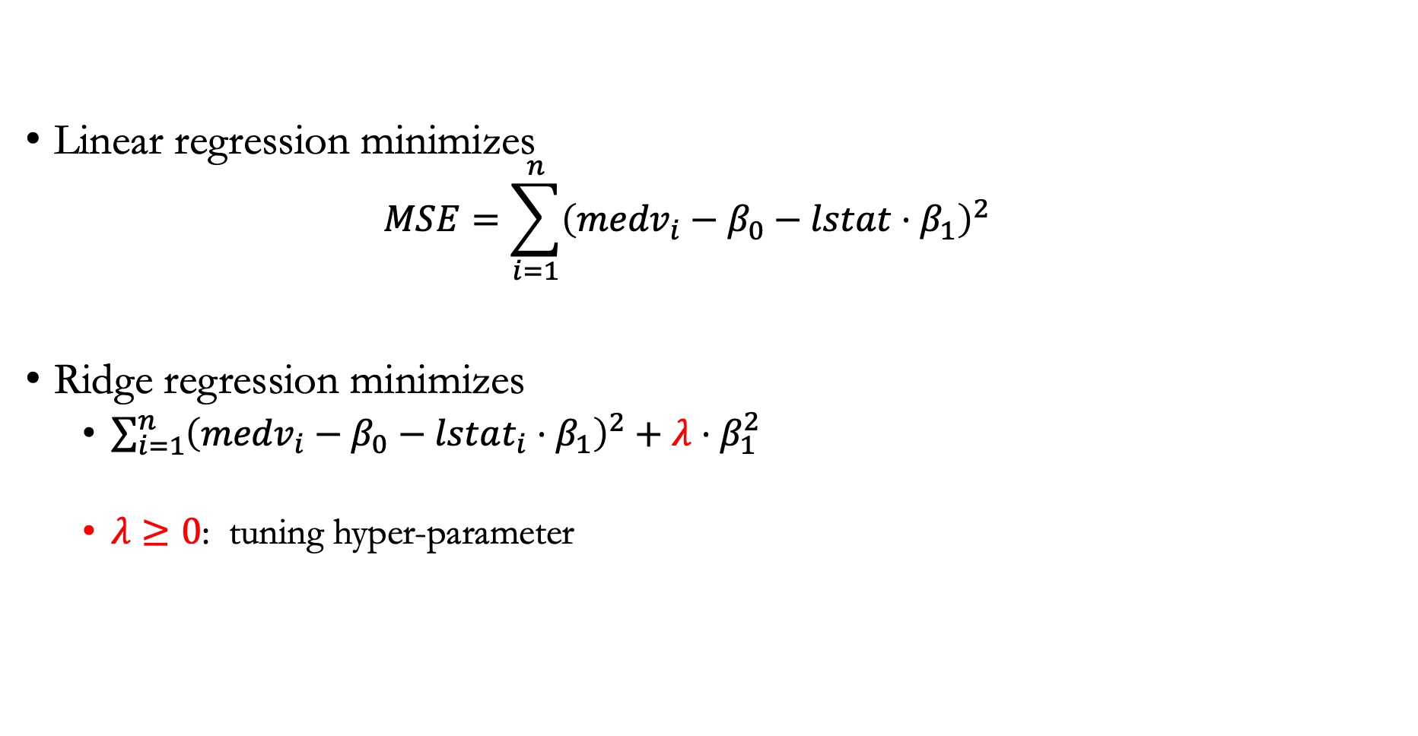
Fitting ridge regression
Linear regression minimizes
  $$MSE=\sum_{i=1}^{n}{{\left({medv}_{i}−β_{0}−lstat⋅β_{1}\right)}^{2}}$$
Ridge regression minimizes
  $\sum_{i=1}^{n}{{\left({medv}_{i}−β_{0}−lstat_{i}⋅β_{1}\right)}^{2}}+λ⋅β_{1}^{2}$
  $λ≥0$: tuning hyper-parameter

Slide 17
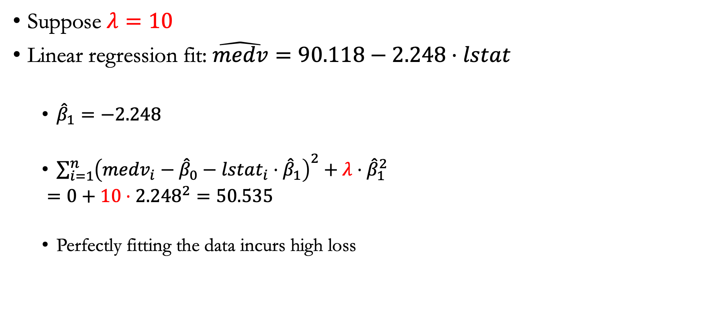
Example
Suppose $λ=10$
Linear regression fit: $\hat{medv}=90.118−2.248⋅lstat$
  ${\hat{β}}_{1}=−2.248$
  $\sum_{i=1}^{n}{{\left({medv}_{i}−{\hat{β}}_{0}−lstat_{i}⋅{\hat{β}}_{1}\right)}^{2}}+λ⋅{\hat{β}}_{1}^{2}$
  $=0+10⋅{2.248}^{2}=50.535$
  Perfectly fitting the data incurs high loss

Slide 18
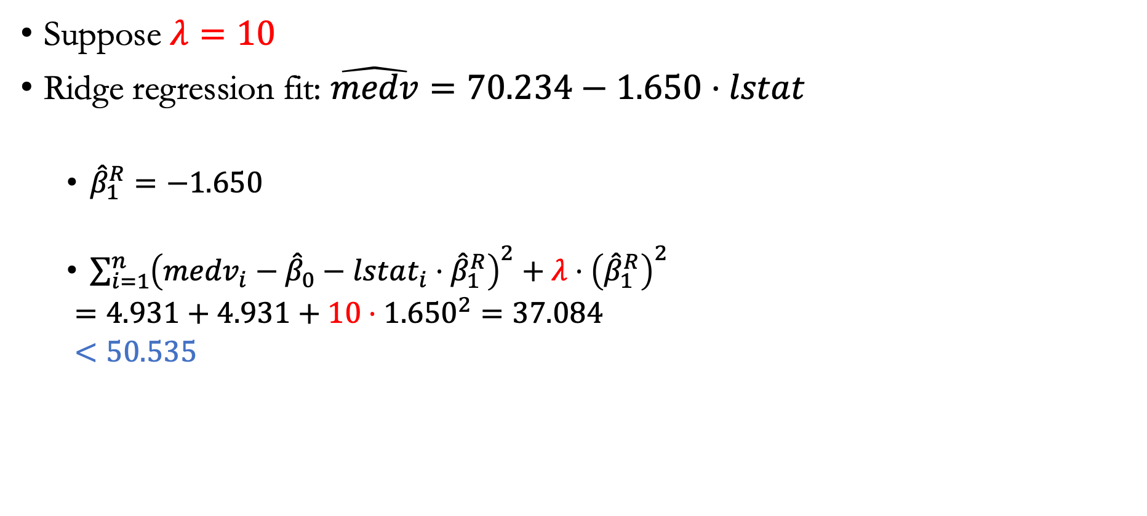
Ridge regression
Suppose $λ=10$
Ridge regression fit: $\hat{medv}=70.234−1.650⋅lstat$
  ${\hat{β}}_{1}^{R}=−1.650$
  $\sum_{i=1}^{n}{{\left({medv}_{i}−{\hat{β}}_{0}−lstat_{i}⋅{\hat{β}}_{1}^{R}\right)}^{2}}+λ⋅{\left({\hat{β}}_{1}^{R}\right)}^{2}$
  $=4.931+4.931+10⋅{1.650}^{2}=37.084$
  $<50.535$

Slide 19
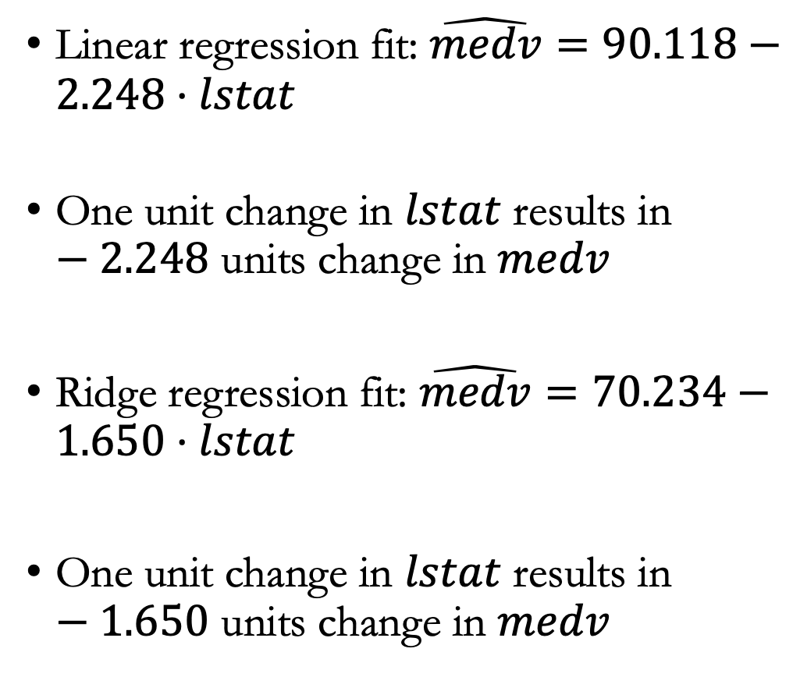
Ridge regression is less sensitive to $lstat$
Linear regression fit: $\hat{medv}=90.118−2.248⋅lstat$
One unit change in $lstat$ results in $−2.248$ units change in $medv$
Ridge regression fit: $\hat{medv}=70.234−1.650⋅lstat$
One unit change in $lstat$ results in $−1.650$ units change in $medv$

Slide 20
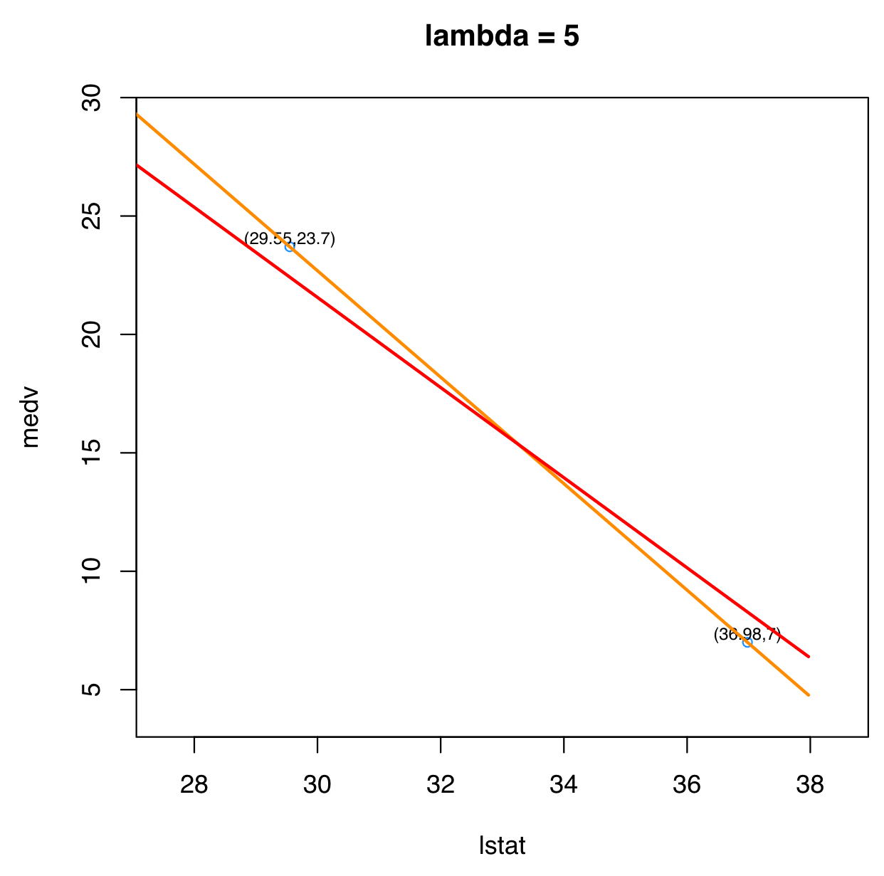
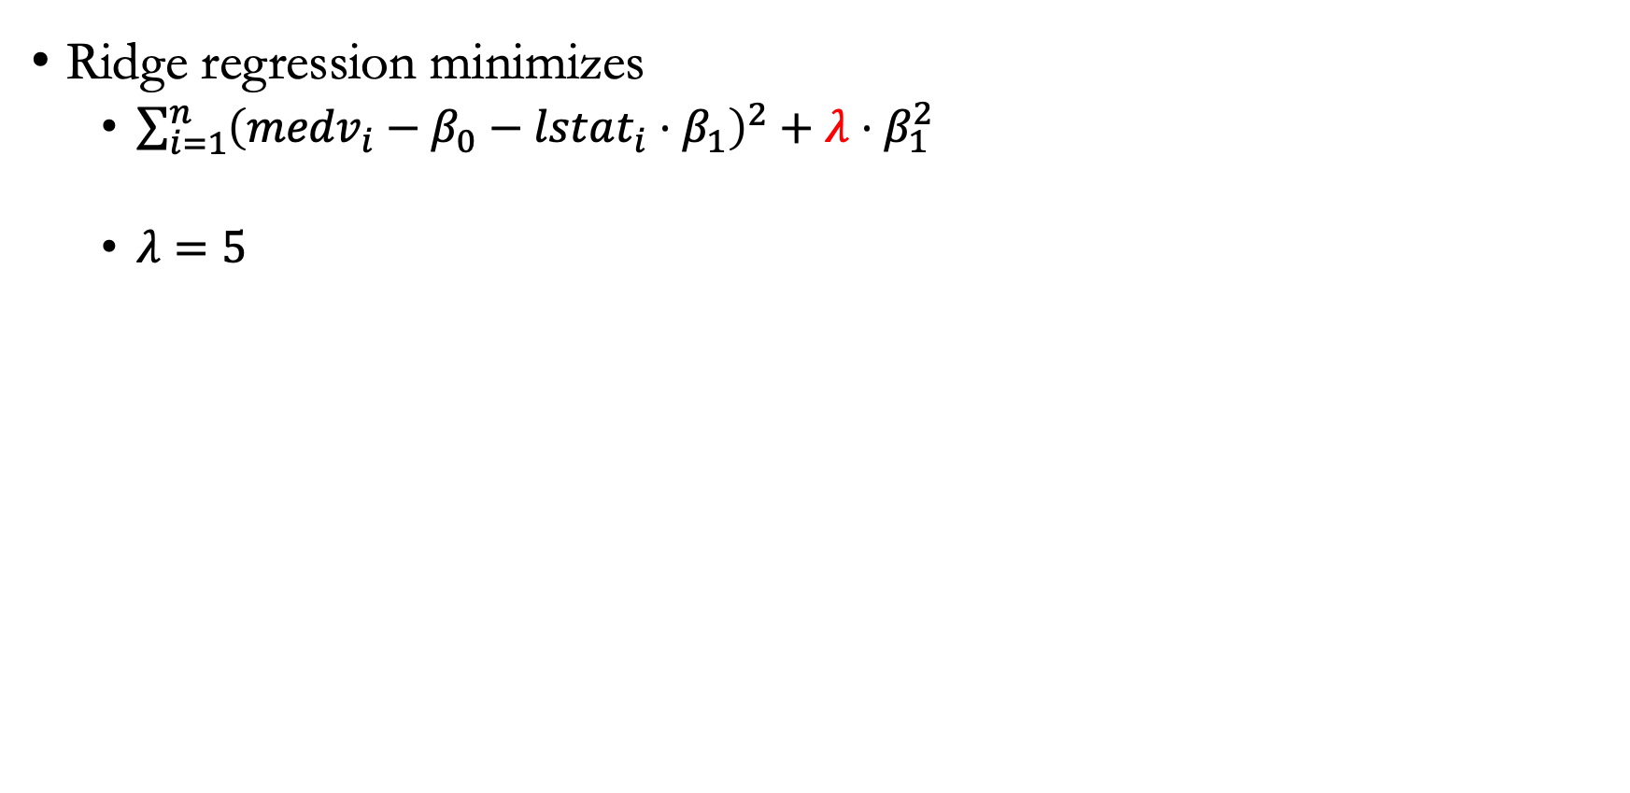
Role of $λ$ in ridge regression
Ridge regression minimizes
  $\sum_{i=1}^{n}{{\left({medv}_{i}−β_{0}−lstat_{i}⋅β_{1}\right)}^{2}}+λ⋅β_{1}^{2}$
  $λ=5$

Slide 21
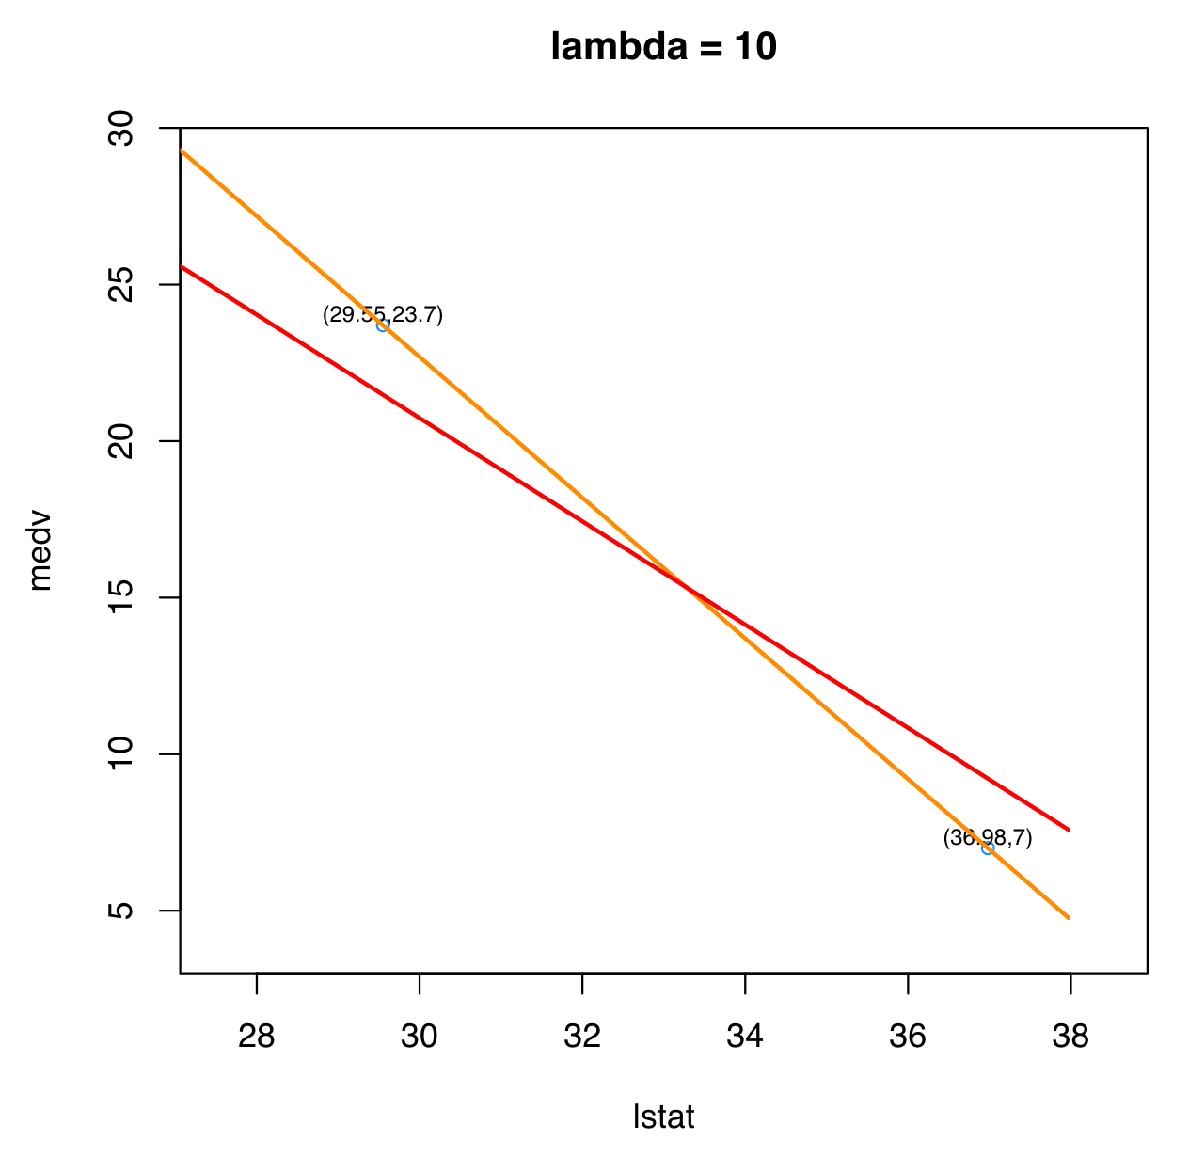

Role of $λ$ in ridge regression
Ridge regression minimizes
  $\sum_{i=1}^{n}{{\left({medv}_{i}−β_{0}−lstat_{i}⋅β_{1}\right)}^{2}}+λ⋅β_{1}^{2}$
  $λ=10$

Slide 22
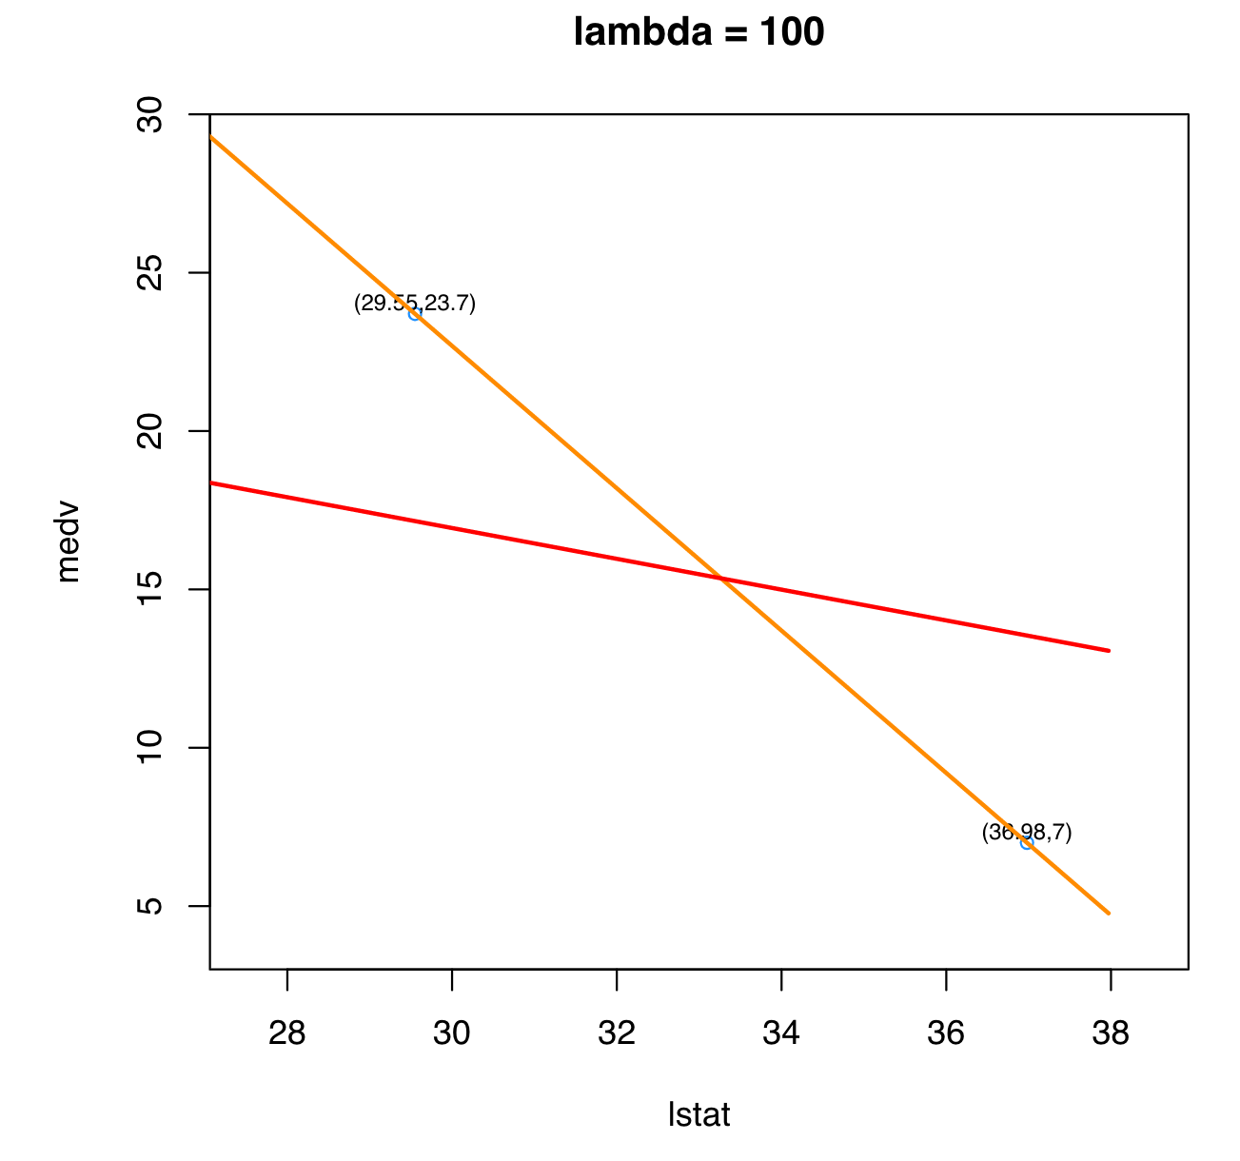

Role of $λ$ in ridge regression
Ridge regression minimizes
  $\sum_{i=1}^{n}{{\left({medv}_{i}−β_{0}−lstat_{i}⋅β_{1}\right)}^{2}}+λ⋅β_{1}^{2}$
  $λ=100$

Slide 23
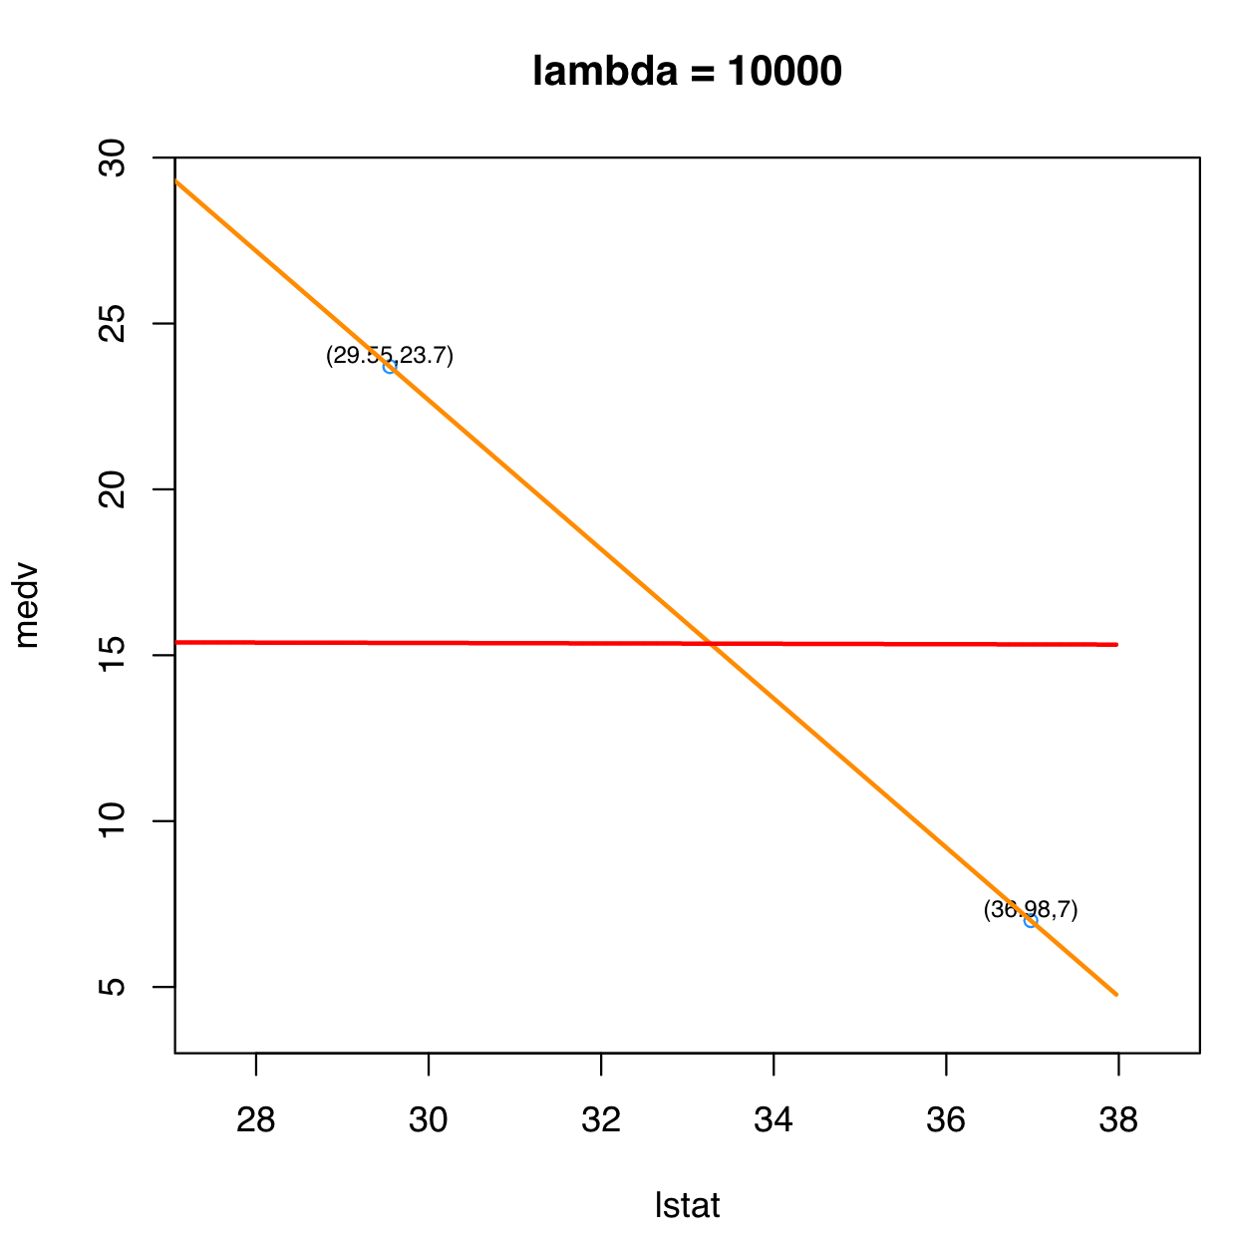
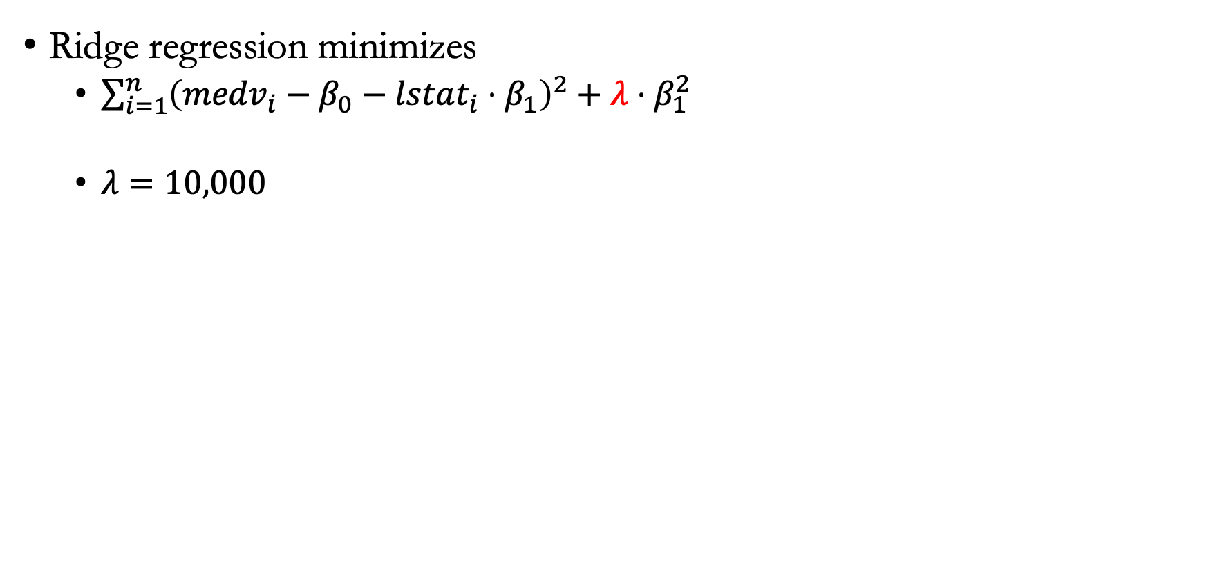
Role of $λ$ in ridge regression
Ridge regression minimizes
  $\sum_{i=1}^{n}{{\left({medv}_{i}−β_{0}−lstat_{i}⋅β_{1}\right)}^{2}}+λ⋅β_{1}^{2}$
  $λ=10,000$

Slide 24
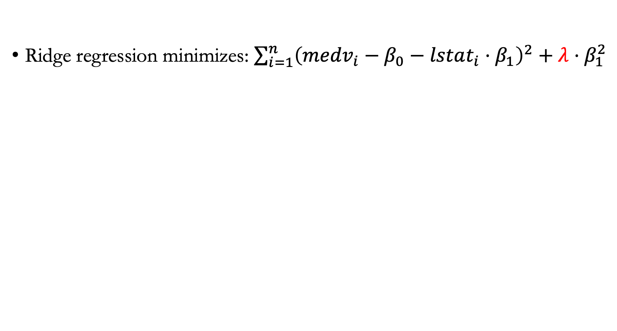
Predictive line is less sensitive to $Δlstat$ as $λ$ increases
Ridge regression minimizes: $\sum_{i=1}^{n}{{\left({medv}_{i}−β_{0}−lstat_{i}⋅β_{1}\right)}^{2}}+λ⋅β_{1}^{2}$

Slide 25
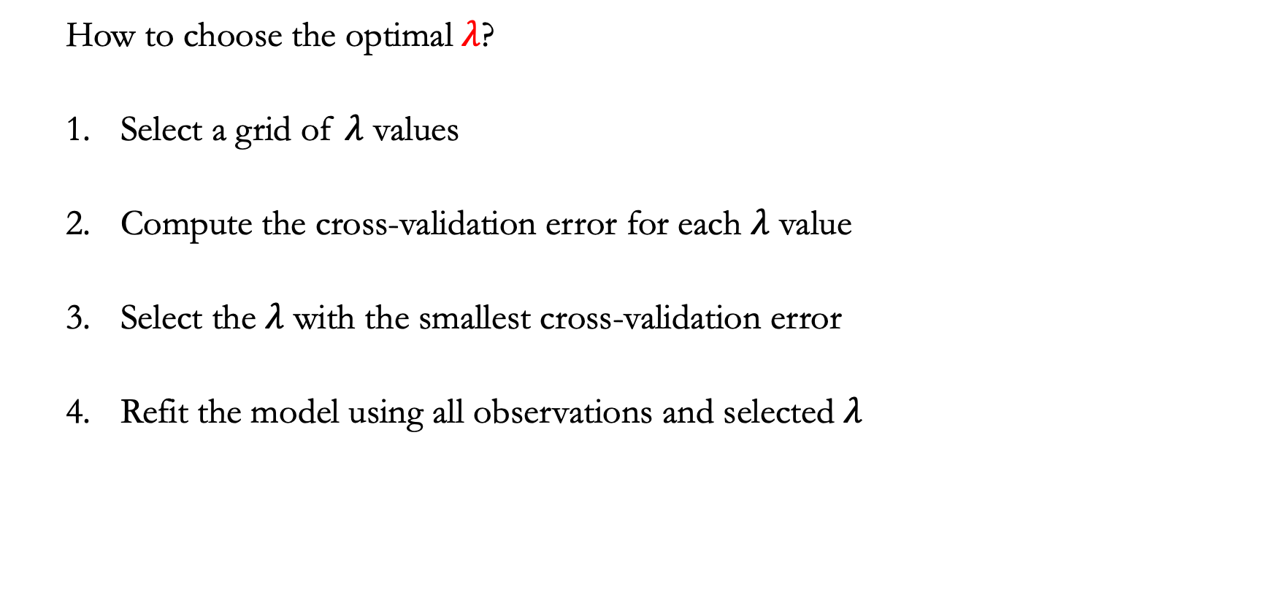
Choose $λ$ by cross-validation
  How to choose the optimal $λ$?
  Select a grid of $λ$ values
  Compute the cross-validation error for each $λ$ value
  Select the $λ$ with the smallest cross-validation error
  Refit the model using all observations and selected $λ$

Slide 26
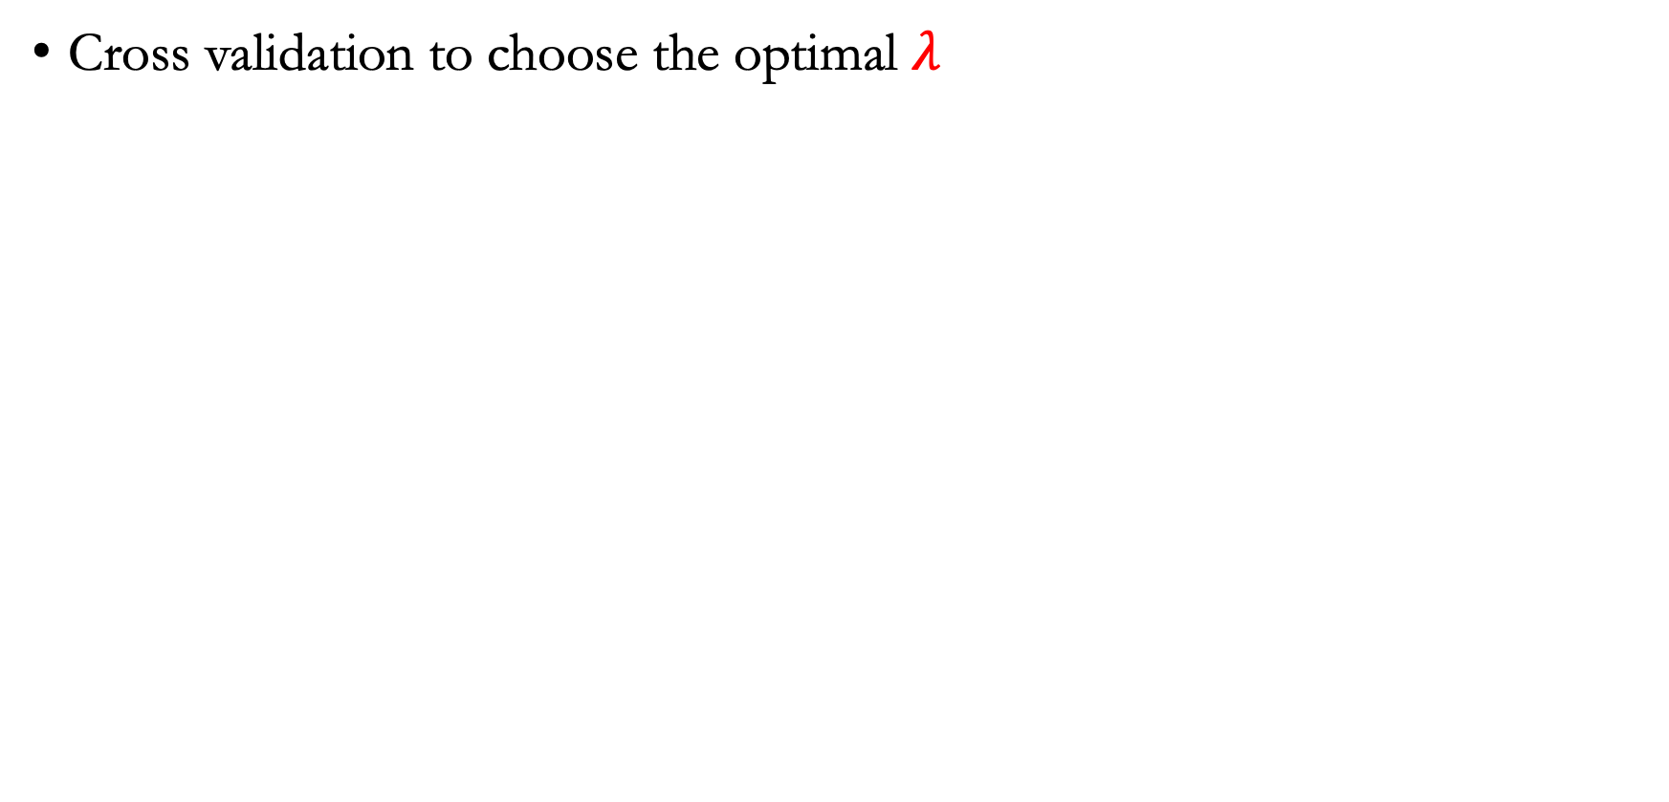
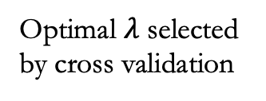
Example: Credit card dataset (ridge regression)
Cross validation to choose the optimal $λ$
Optimal $λ$ selected by cross validation

Slide 27
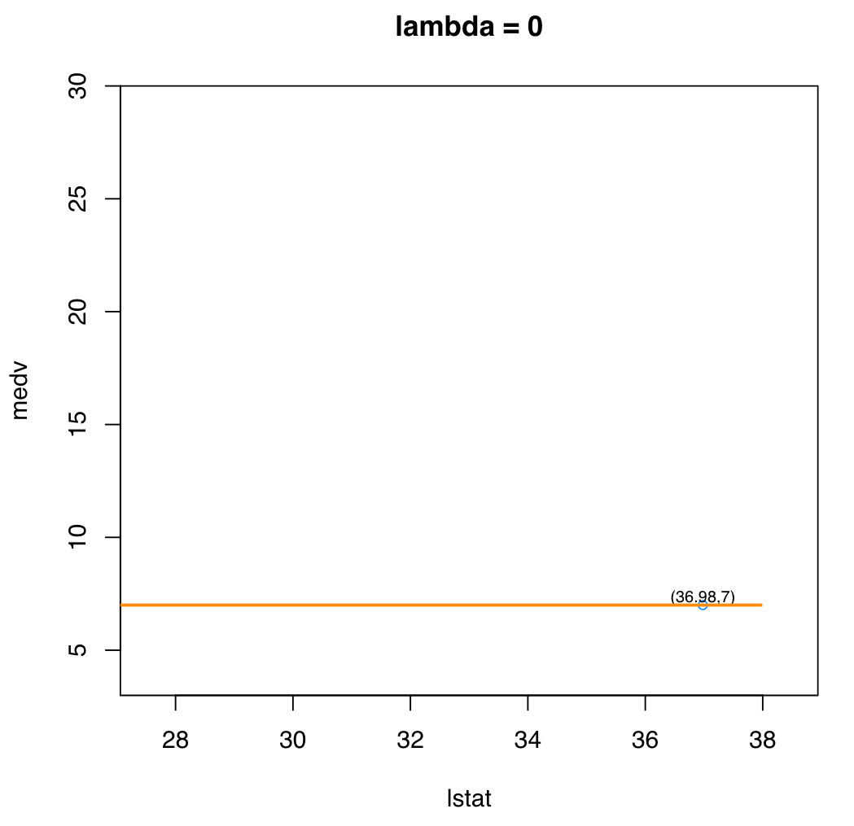
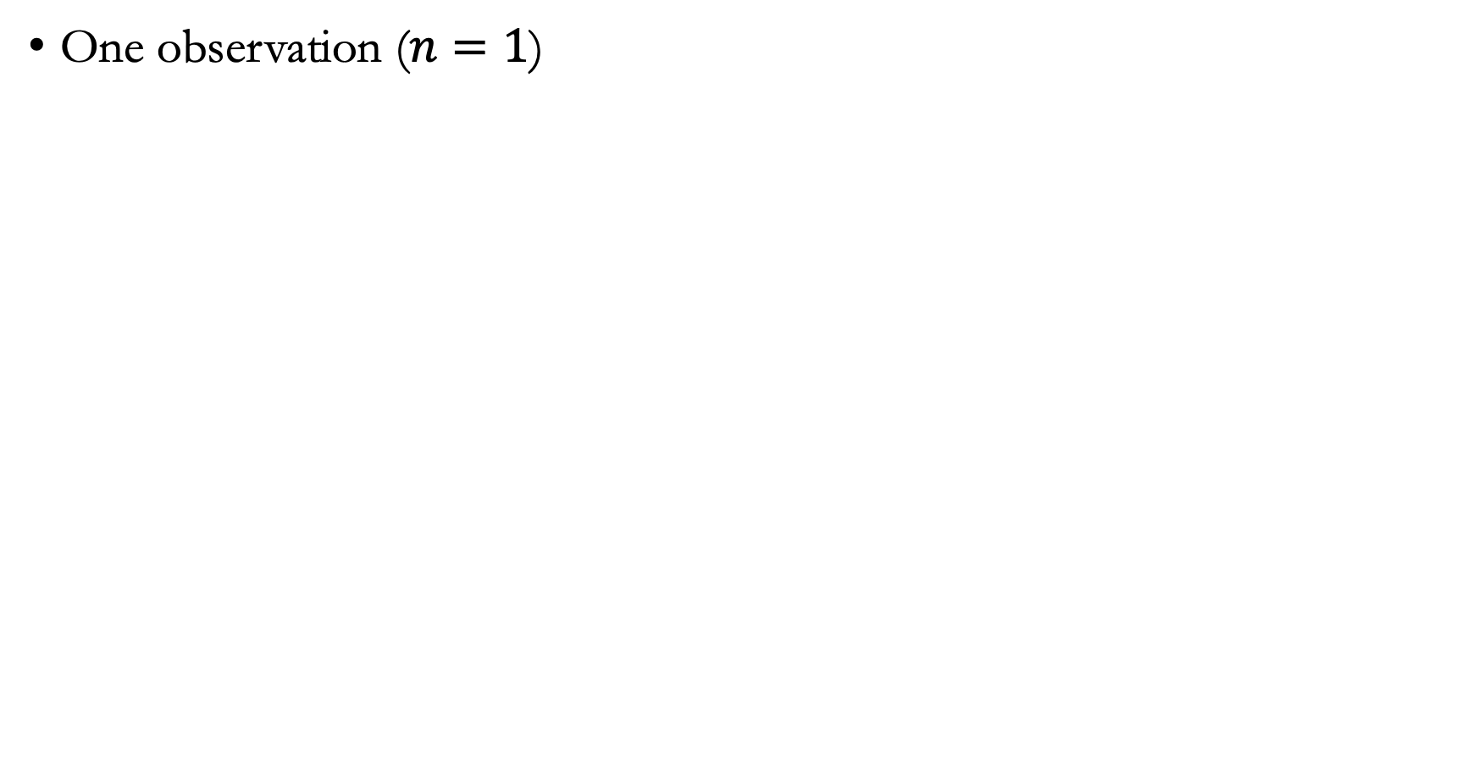
Quiz: Which line is the ridge regression fit?
One observation ($n=1$)

Slide 28
Lecture plan
LASSO

Slide 29
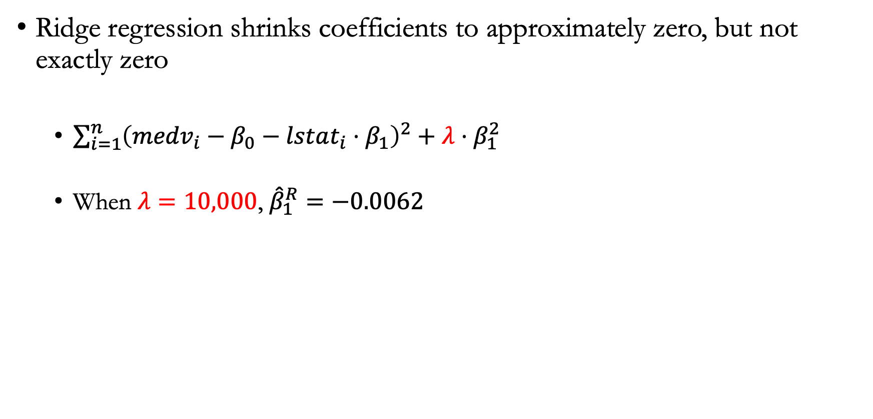
Motivation
Ridge regression shrinks coefficients to approximately zero, but not exactly zero
  $\sum_{i=1}^{n}{{\left({medv}_{i}−β_{0}−lstat_{i}⋅β_{1}\right)}^{2}}+λ⋅β_{1}^{2}$
  When $λ=10,000$, ${\hat{β}}_{1}^{R}=−0.0062$

Slide 30
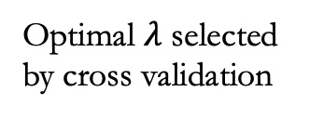
What if we want set them as zero?
In the credit card dataset, the standardized ridge coefficients for variables other than income, limit, rating, and student are nonzero
What if we want to perform variable selection?
Optimal $λ$ selected by cross validation

Slide 31
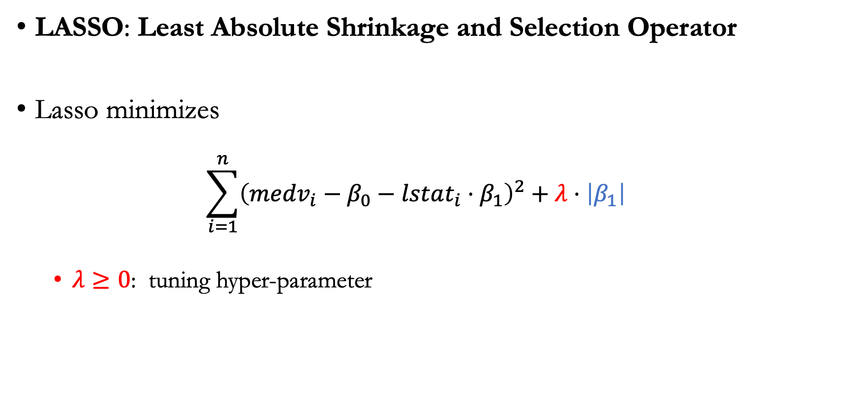
One predictor
LASSO: Least Absolute Shrinkage and Selection Operator
Lasso minimizes
  $$\sum_{i=1}^{n}{{\left({medv}_{i}−β_{0}−lstat_{i}⋅β_{1}\right)}^{2}}+λ⋅\left|β_{1}\right|$$
  $λ≥0$: tuning hyper-parameter

Slide 32
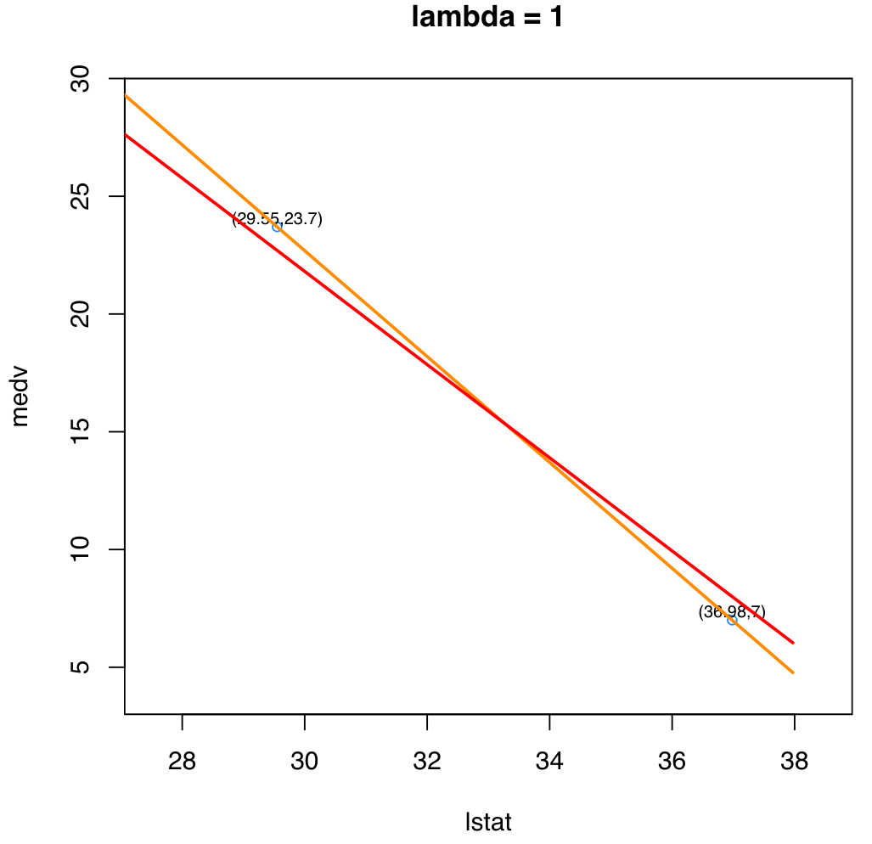
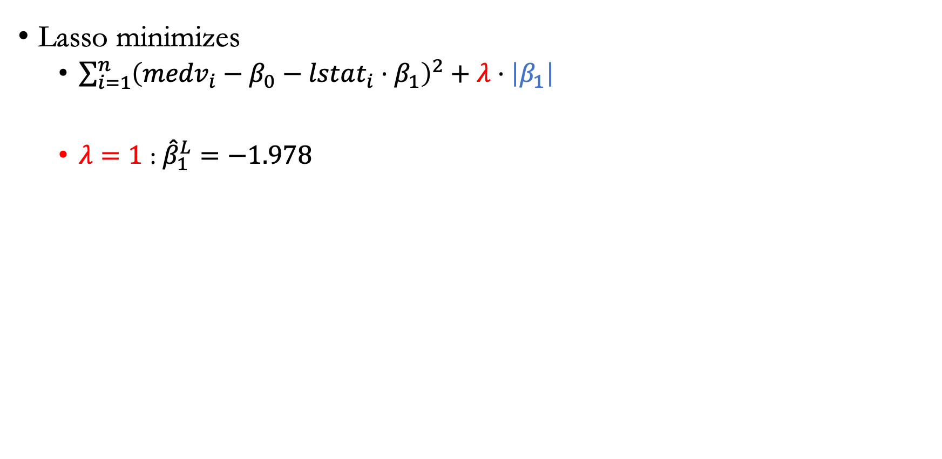
Role of $λ$ in Lasso
Lasso minimizes
  $\sum_{i=1}^{n}{{\left({medv}_{i}−β_{0}−lstat_{i}⋅β_{1}\right)}^{2}}+λ⋅\left|β_{1}\right|$
  $λ=1$ : ${\hat{β}}_{1}^{L}=−1.978$

Slide 33
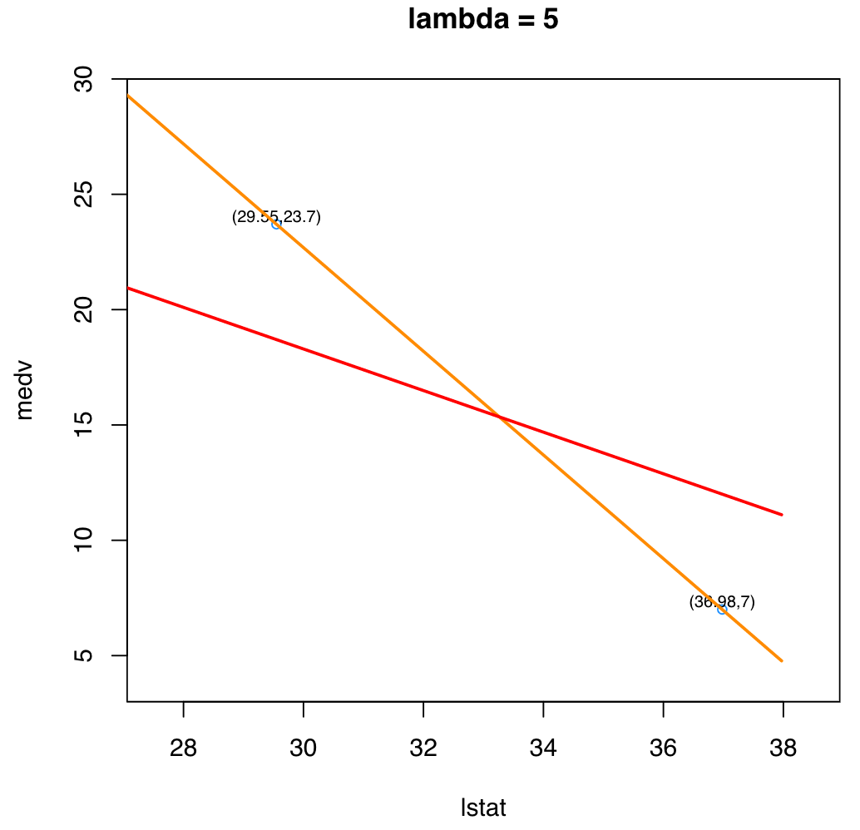

Role of $λ$ in Lasso
Lasso minimizes
  $\sum_{i=1}^{n}{{\left({medv}_{i}−β_{0}−lstat_{i}⋅β_{1}\right)}^{2}}+λ⋅\left|β_{1}\right|$
  $λ=5$ : ${\hat{β}}_{1}^{L}=−0.902$

Slide 34
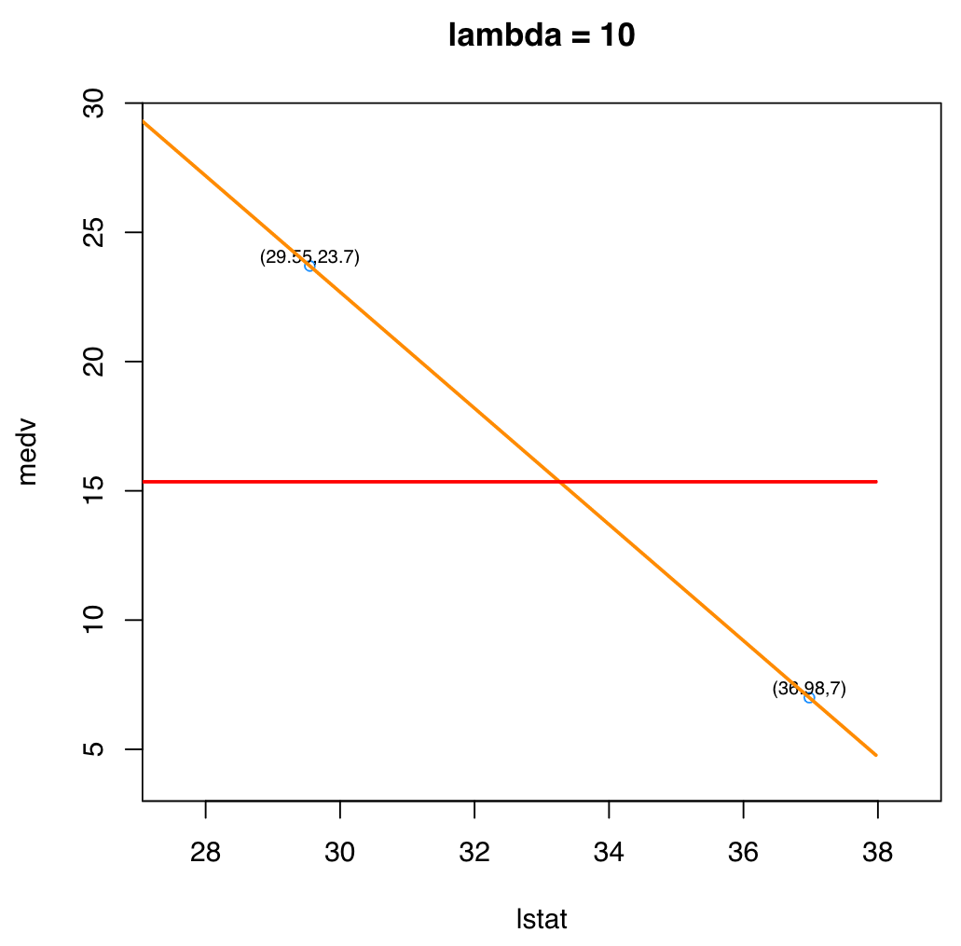
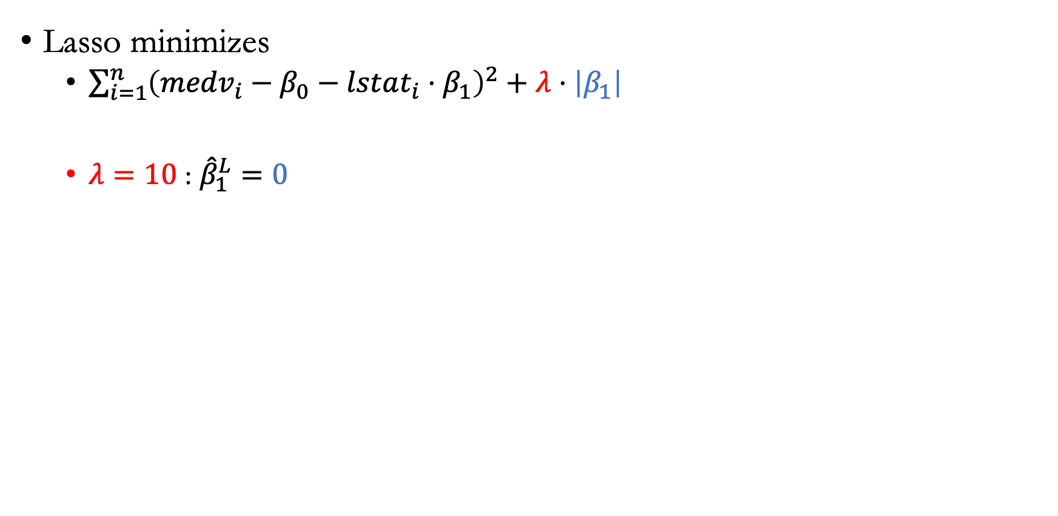
Role of $λ$ in Lasso
Lasso minimizes
  $\sum_{i=1}^{n}{{\left({medv}_{i}−β_{0}−lstat_{i}⋅β_{1}\right)}^{2}}+λ⋅\left|β_{1}\right|$
  $λ=10$ : ${\hat{β}}_{1}^{L}=0$

Slide 35
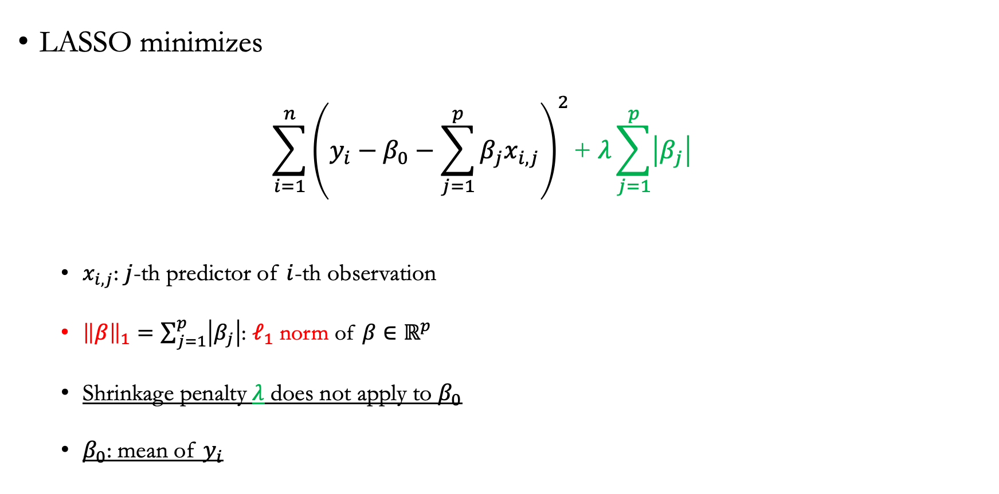
Multiple predictors
LASSO minimizes
  $$\sum_{i=1}^{n}{{\left(y_{i}−β_{0}−\sum_{j=1}^{p}{β_{j}x_{i,j}}\right)}^{2}}\text{+} λ\sum_{j=1}^{p}{\left|β_{j}\right|}$$
  $x_{i,j}$: $j$-th predictor of $i$-th observation
  ${\left\|β\right\|}_{1}=\sum_{j=1}^{p}{\left|β_{j}\right|}$: $ℓ_{1}$ norm of $β∈ℝ^{p}$
  Shrinkage penalty $λ$ does not apply to $β_{0}$
  $β_{0}$: mean of $y_{i}$

Slide 36
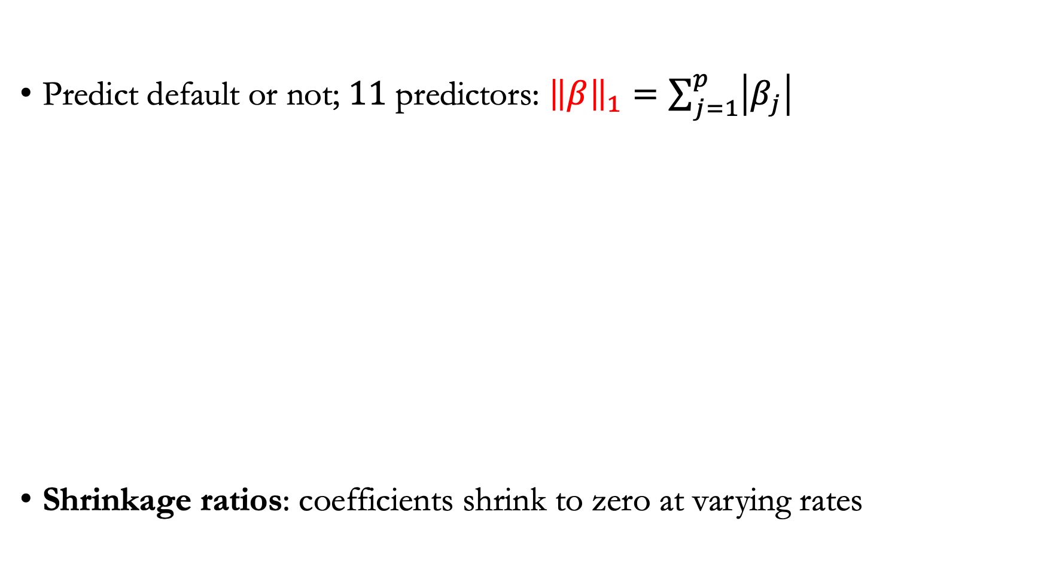
Example: Applying LASSO to the credit card dataset
Predict default or not; $11$ predictors: ${\left\|β\right\|}_{1}=\sum_{j=1}^{p}{\left|β_{j}\right|}$
Shrinkage ratios: coefficients shrink to zero at varying rates
Shrinkage ratio

Slide 37
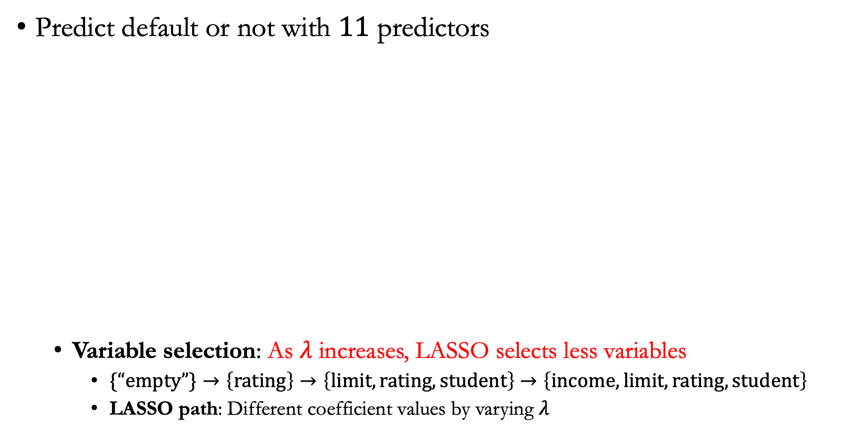
Example: Credit card dataset (LASSO)
Predict default or not with $11$ predictors
  Variable selection: As $λ$ increases, LASSO selects less variables
    $\{“empty”\}→\left\{rating\right\}→\left\{limit, rating,student\right\}$ $→\left\{income, limit, rating,student\right\}$
    LASSO path: Different coefficient values by varying $λ$

Slide 38
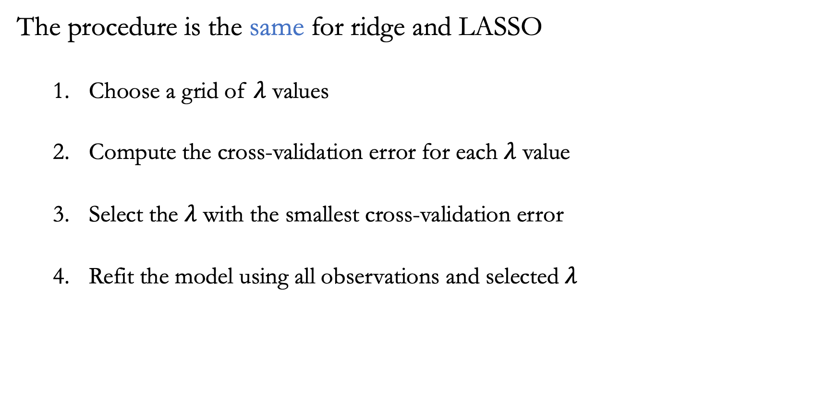
Choose $λ$ by cross-validation
The procedure is the same for ridge and LASSO
  Choose a grid of $λ$ values
  Compute the cross-validation error for each $λ$ value
  Select the $λ$ with the smallest cross-validation error
  Refit the model using all observations and selected $λ$

Slide 39
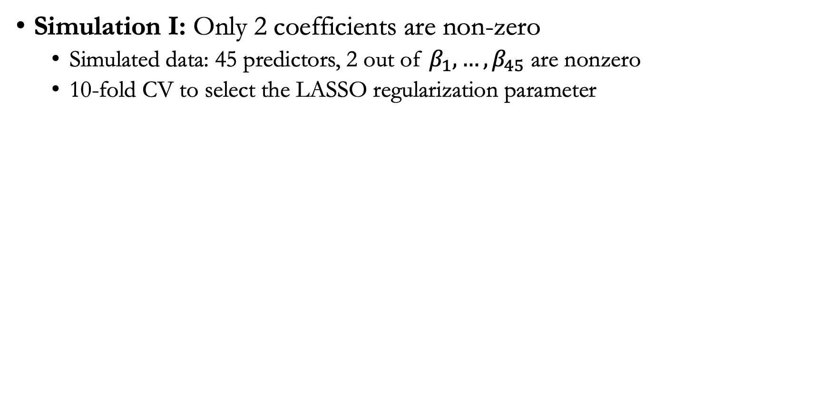
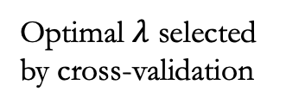
Example
Simulation I: Only 2 coefficients are non-zero
  Simulated data: 45 predictors, 2 out of $β_{1},…,β_{45}$ are nonzero
  10-fold CV to select the LASSO regularization parameter
Linear regression solution
Optimal $λ$ selected by cross-validation

Slide 40
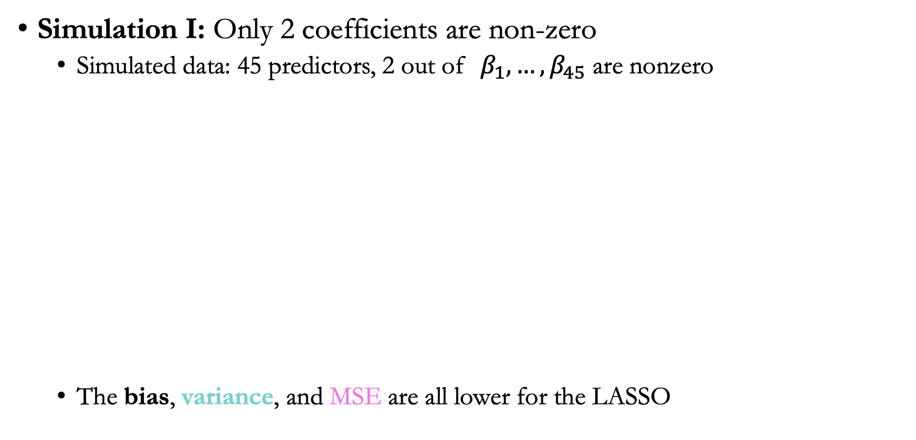
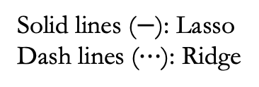
LASSO vs. ridge regularization
Simulation I: Only 2 coefficients are non-zero
  Simulated data: 45 predictors, 2 out of $β_{1},…,β_{45}$ are nonzero
  The bias, variance, and MSE are all lower for the LASSO
Solid lines ($−$): Lasso
Dash lines ($⋯$): Ridge
MSE
Variance
Bias

Slide 41
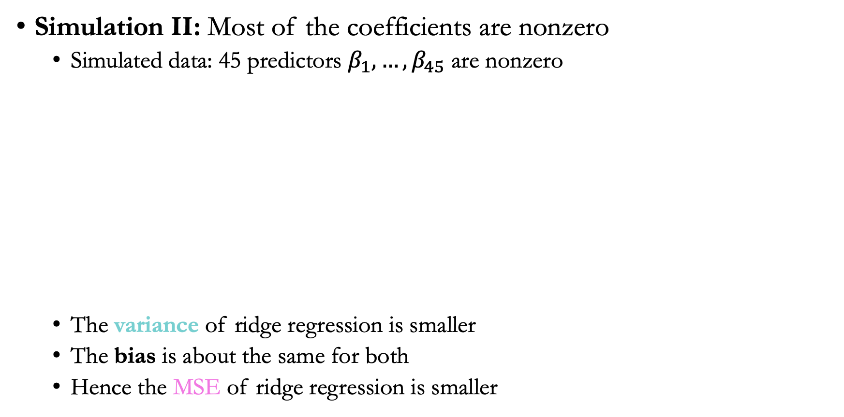
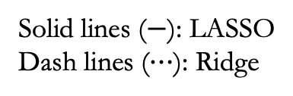
LASSO vs. Ridge regularization
Simulation II: Most of the coefficients are nonzero
  Simulated data: 45 predictors $β_{1},…,β_{45}$ are nonzero
  The variance of ridge regression is smaller
  The bias is about the same for both
  Hence the MSE of ridge regression is smaller
Solid lines ($−$): LASSO
Dash lines ($⋯$): Ridge
MSE
Variance
Bias

Slide 42
Summary
Lasso performs better if a small number of predictors with large coefficients
Ridge performs better if many predictors with similar coefficients

Slide 43
Announcement
Homework 1 due today
OH poll: 177 or WVH?
Homework 2 will be posted later this afternoon

