Slide 1
Supervised Machine Learning and Learning Theory
Coding/technical interviews
October 4, 2024

Slide 2
Self introduction
Key to a brilliant introduction
  Concise but well-organized; allows others to remember you
  A technically challenging experience that distinguishes you from the other candidates
  A heartfelt story that gives the audience an authentic feeling about you

Slide 3
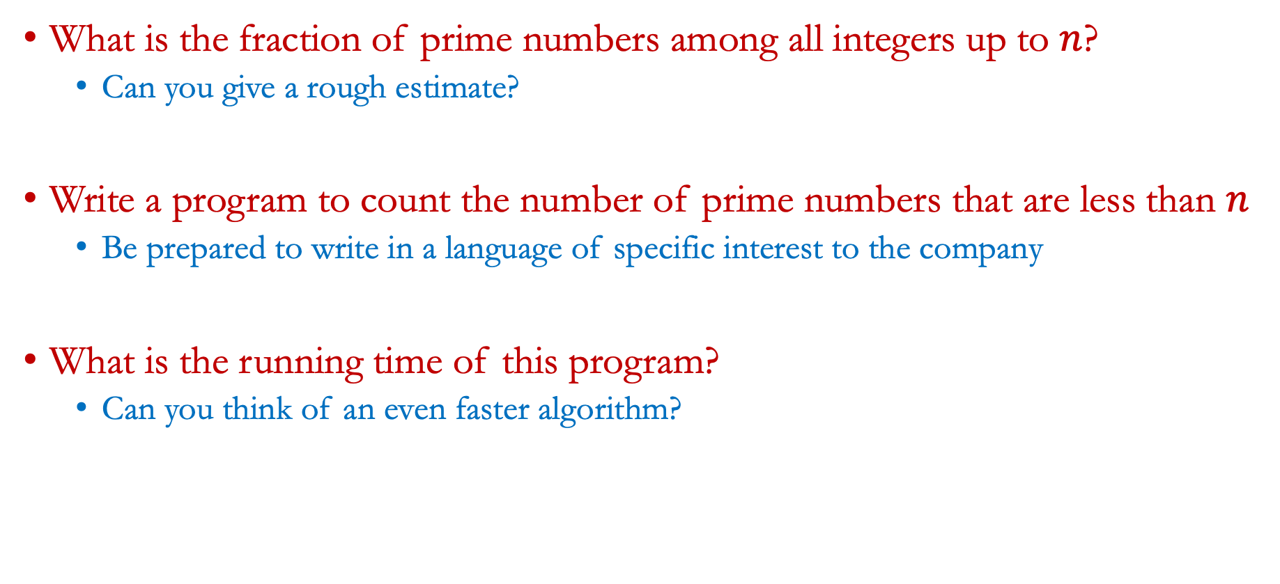
First technical question
What is the fraction of prime numbers among all integers up to $n$?
  Can you give a rough estimate?
Write a program to count the number of prime numbers that are less than $n$
  Be prepared to write in a language of specific interest to the company
What is the running time of this program?
  Can you think of an even faster algorithm?

Slide 4
Second technical question
Given a list of IP addresses of users, how could we count the number of distinct IP addresses?
  Is there a better solution than the naïve solution?
What is a faster solution?
  Hint: Min/Max sketch
Suppose that, in addition, we’d like to know the number of distinct IP addresses for range queries; what should we do?
  Hint: Binary index tree

Slide 5
Other related questions
Describe a software engineering or machine learning project that you’ve done before
  Hint: Why is this a technically challenging project?
  The key to career success in a tech company is the ability to solve a very challenging problem, e.g., think of the early days at Google (now OpenAI/Anthropic)
What is the most extensive program that you’ve ever written?
How do you imagine yourself contribute to the company/team that you’ll be joining?
  Hint: Imagine a dream team that you’d like to join
Ask questions for the interviewee
  Ask a well-thought-out question shows your interest to their position

Slide 6
Key to success in interviews
Be confident
Think fast; shows you’re smart
Show deep understanding about a technical area of interest to the company

Slide 7
Resume tips
Be concise
  A long list of relevant courses are probably not the best of space (Hopefully, that’s not your main achievement so far)
  Likewise, a long list of random activities distracts reviewing experience
Highlight any awards/honors you’ve won in prior life
Include a short description of each project/employment experience you’ve had, and how much you have contributed
Be professional: Include your personal website (a.k.a., linkedin page), email address, phone number, and physical address
Apply widely, even to different industries from what you’ve expected
  Opportunity only comes to those who are prepared for it

Slide 8
Social networks
Set up a LinkedIn page (get yourself noted by HRs)
GitHub profile or stack overflow account (shows you are engaged in community development)
Happy to read resumes and provide feedback! Email me at ho.zhang@northeastern.edu

