Slide 1
Supervised Machine Learning and Learning Theory
Lecture 13: Implementation of Neural Networks in PyTorch
October 18, 2024

Slide 2
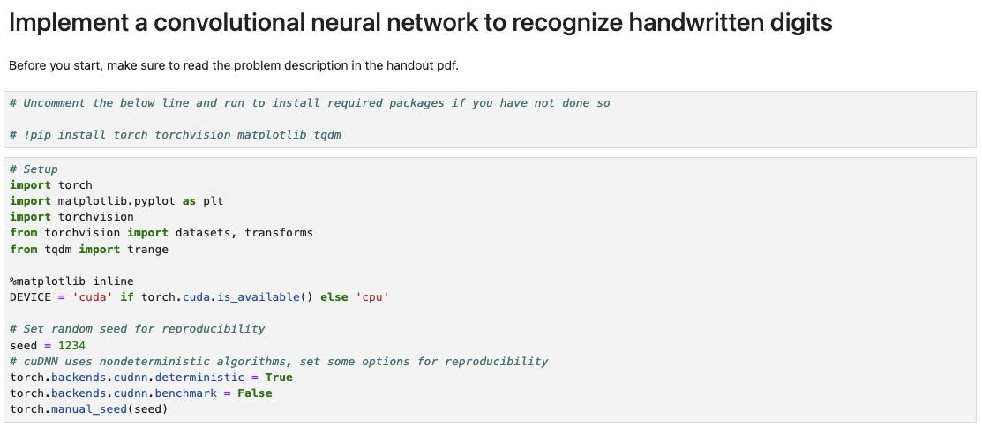
Review: Implementation in PyTorch
Loading dependencies

Slide 3
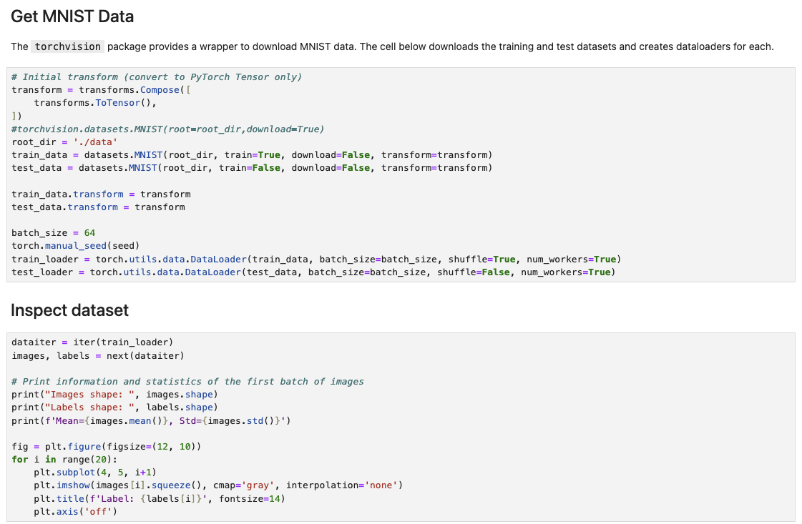
Review: Loading dataset

Slide 4
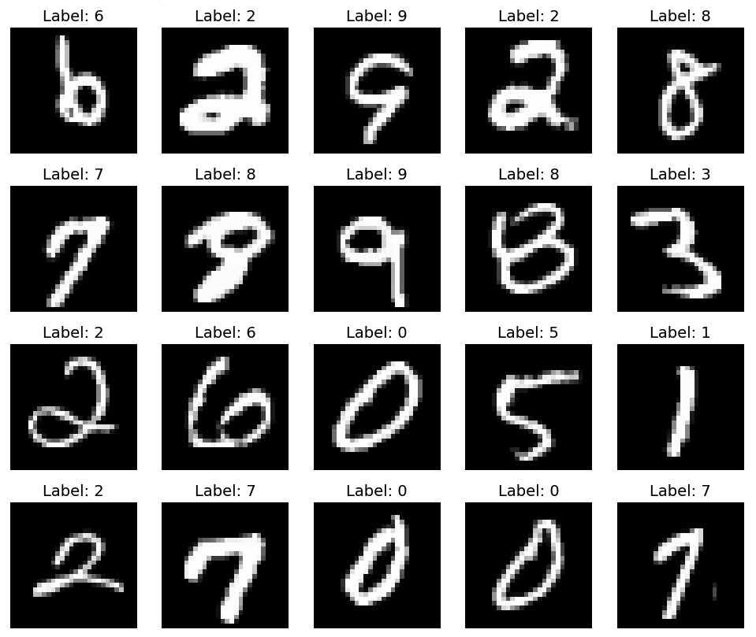
Review: Visualization

Slide 5
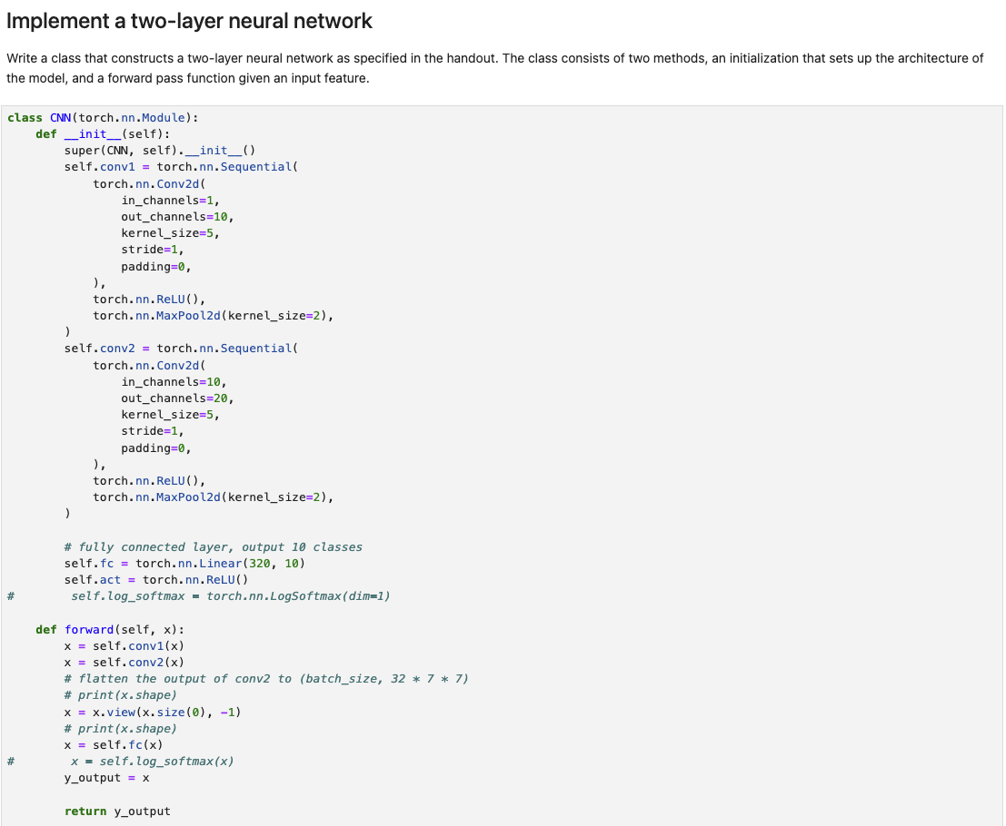
Review: Defining network architecture
1st convolution
2nd convolution
Fully-connected layer
Forward pass (in a couple of slides)

Slide 6
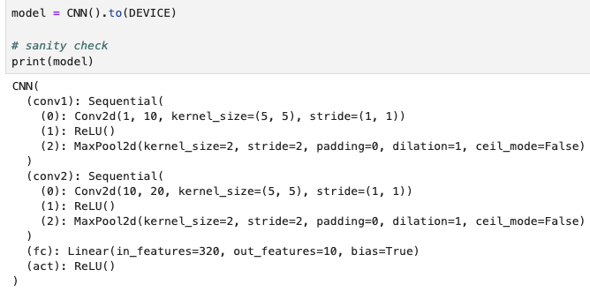
Review: Defining network architecture
Number of in-channels: This is one for MNIST, since the image is black-white
Number of out-channels: This is the number of filters at this layer

Slide 7
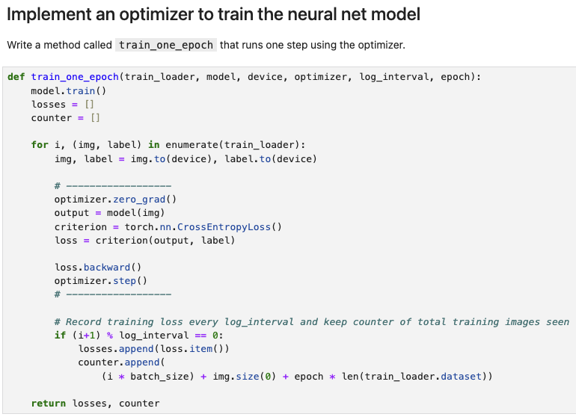
Review: Training procedure
PyTorch implementation of SGD (will elaborate in today’s lecture)

Slide 8
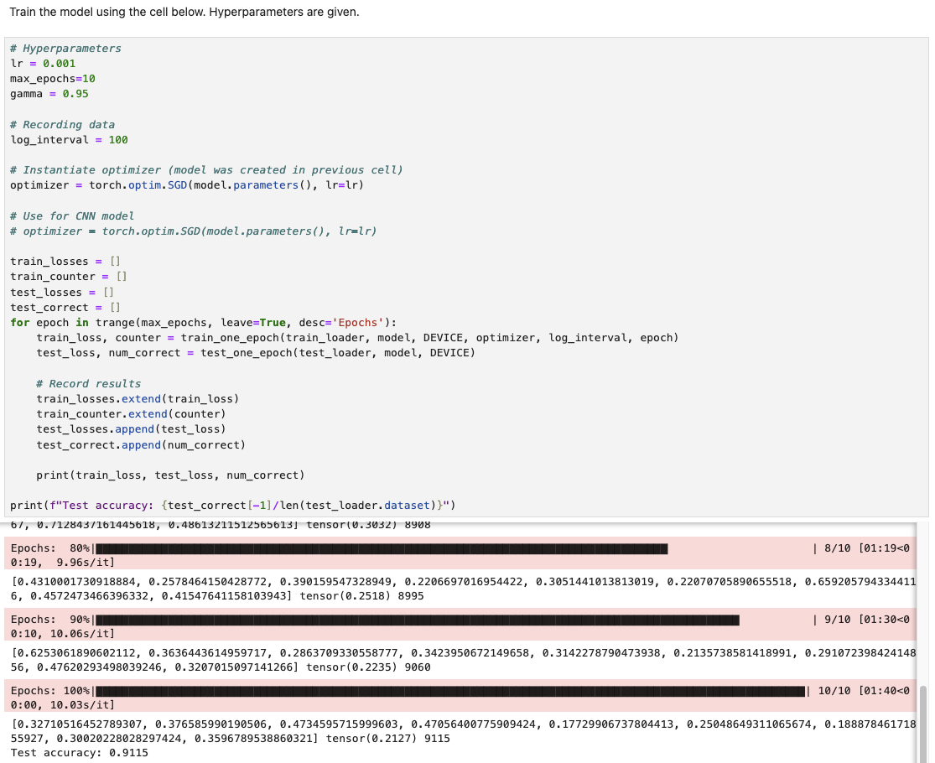
Review: Test accuracy

Slide 9
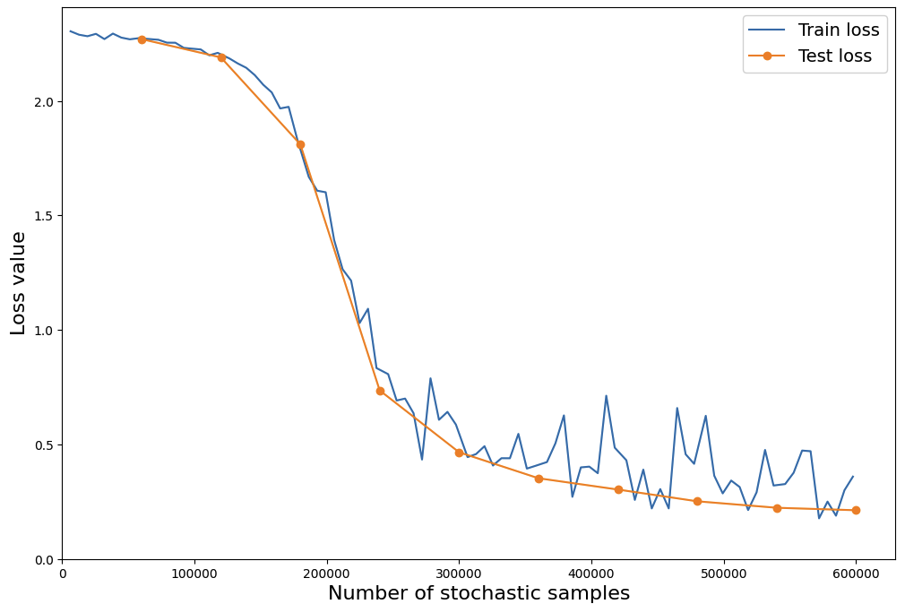
Review: Training and test loss curves

Slide 10
Lecture plan
The forward pass

Slide 11
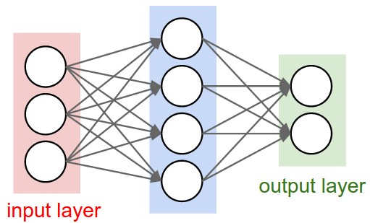
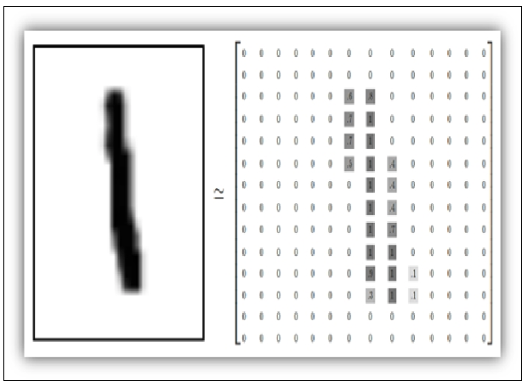
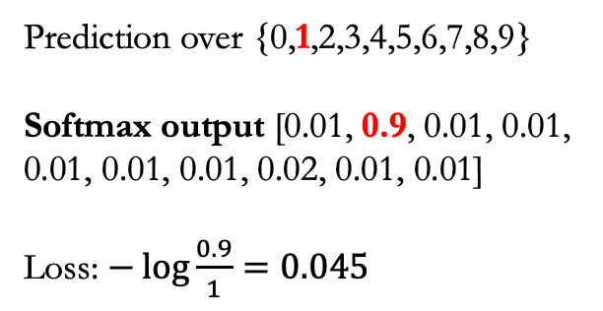
A single input
Forward pass: compute the output of a neural network given an input
Prediction over {0,1,2,3,4,5,6,7,8,9}
Softmax output [0.01, 0.9, 0.01, 0.01, 0.01, 0.01, 0.01, 0.02, 0.01, 0.01]
Loss: $−\log{\frac{0.9}{1}}=0.045$
How do we get this output?

Slide 12
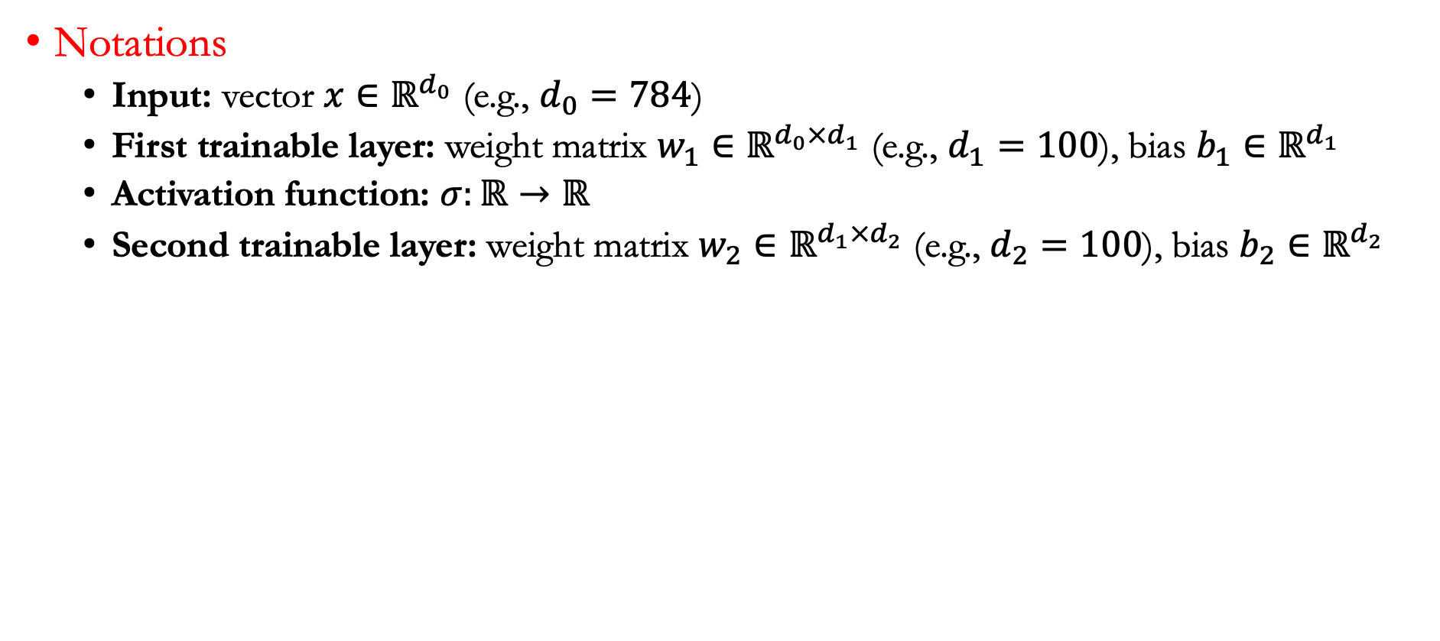
Forward pass: A single input
Notations
  Input: vector $x∈ℝ^{d_{0}}$ (e.g., $d_{0}=784$)
  First trainable layer: weight matrix $w_{1}∈ℝ^{d_{0}×d_{1}}$ (e.g., $d_{1}=100$), bias $b_{1}∈ℝ^{d_{1}}$
  Activation function: $σ:ℝ→ℝ$
  Second trainable layer: weight matrix $w_{2}∈ℝ^{d_{1}×d_{2}}$ (e.g., $d_{2}=100$), bias $b_{2}∈ℝ^{d_{2}}$

Slide 13
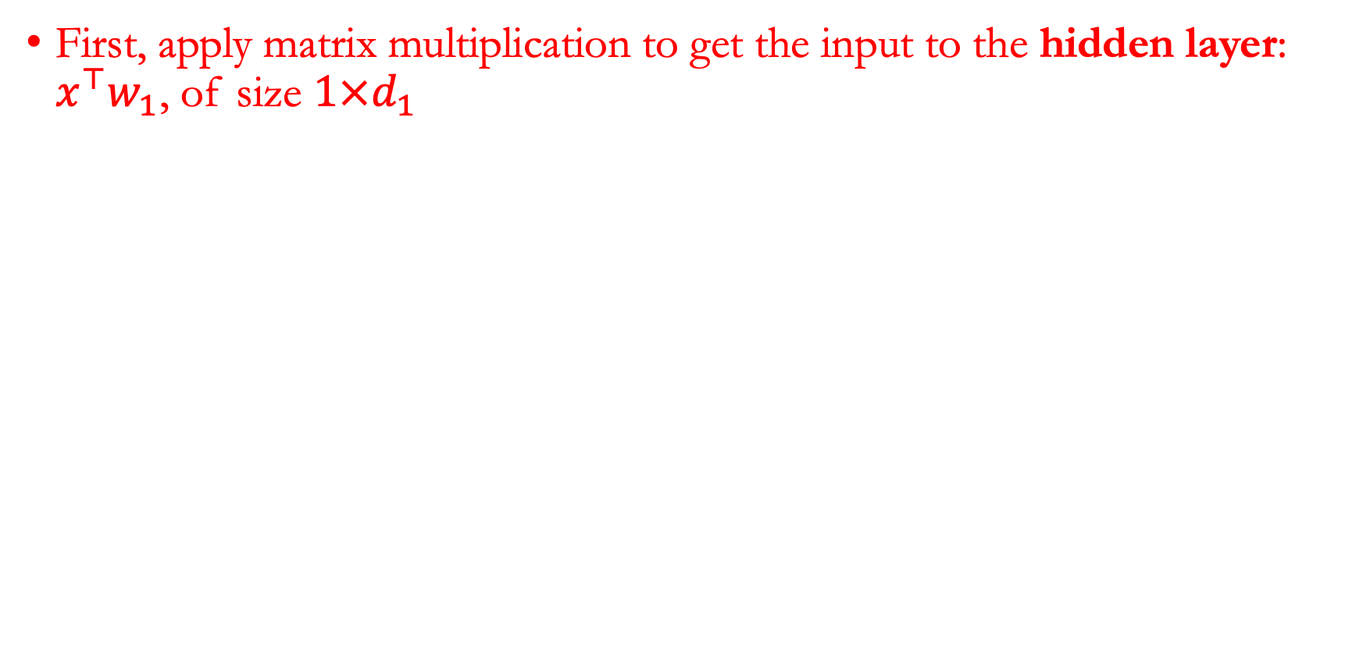
Illustration of forward pass
First, apply matrix multiplication to get the input to the hidden layer: $x^{⊤}w_{1}$, of size $1×d_{1}$

Slide 14
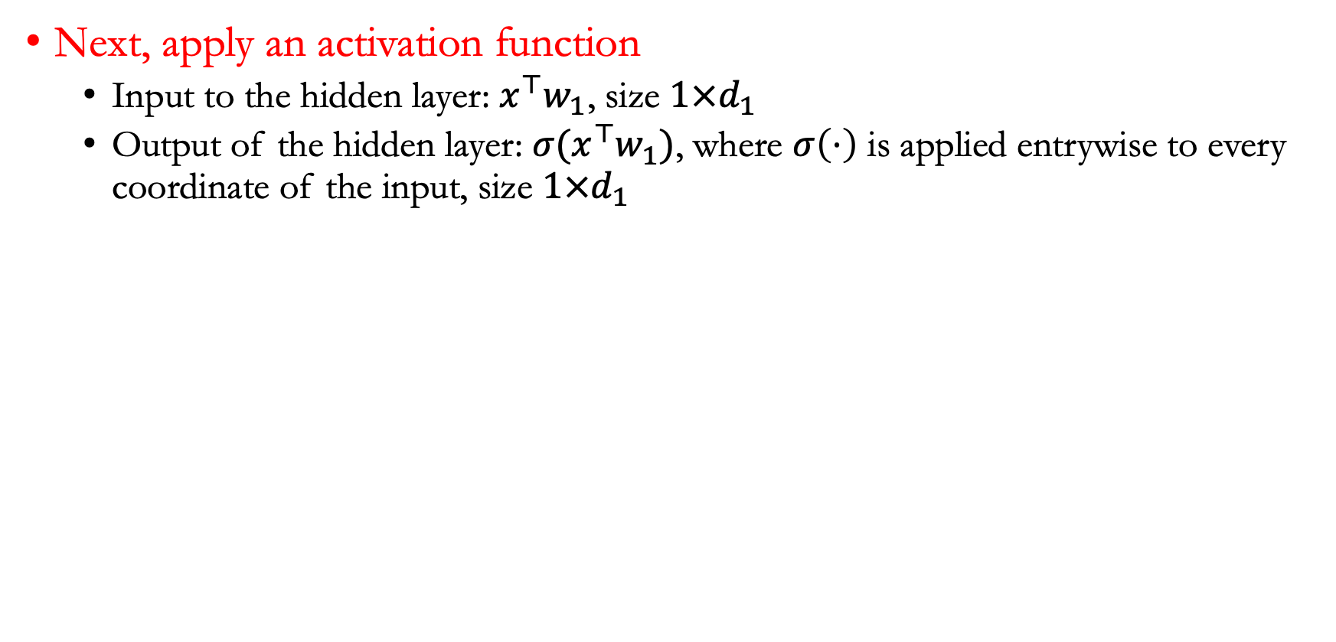
Illustration of forward pass
Next, apply an activation function
  Input to the hidden layer: $x^{⊤}w_{1}$, size $1×d_{1}$
  Output of the hidden layer: $σ(x^{⊤}w_{1})$, where $σ\left(⋅\right)$ is applied entrywise to every coordinate of the input, size $1×d_{1}$

Slide 15
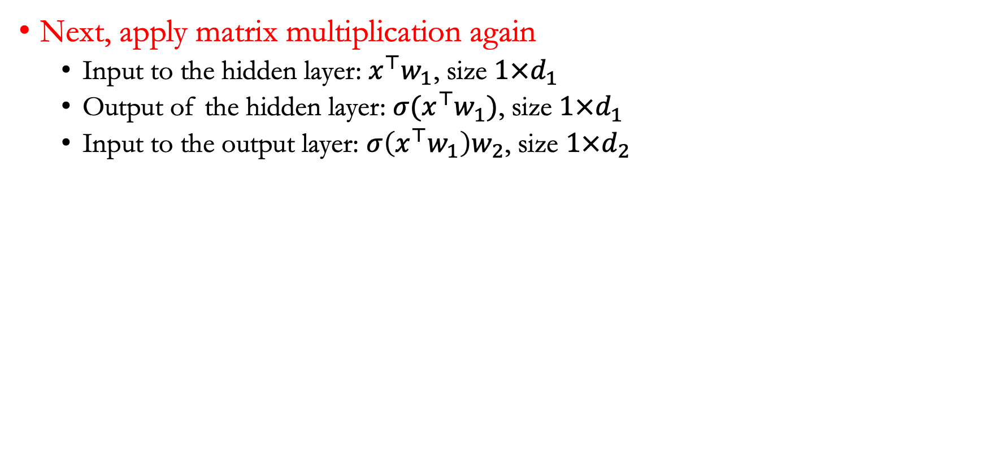
Illustration of forward pass
Next, apply matrix multiplication again
  Input to the hidden layer: $x^{⊤}w_{1}$, size $1×d_{1}$
  Output of the hidden layer: $σ(x^{⊤}w_{1})$, size $1×d_{1}$
  Input to the output layer: $σ\left(x^{⊤}w_{1}\right)w_{2}$, size $1×d_{2}$

Slide 16
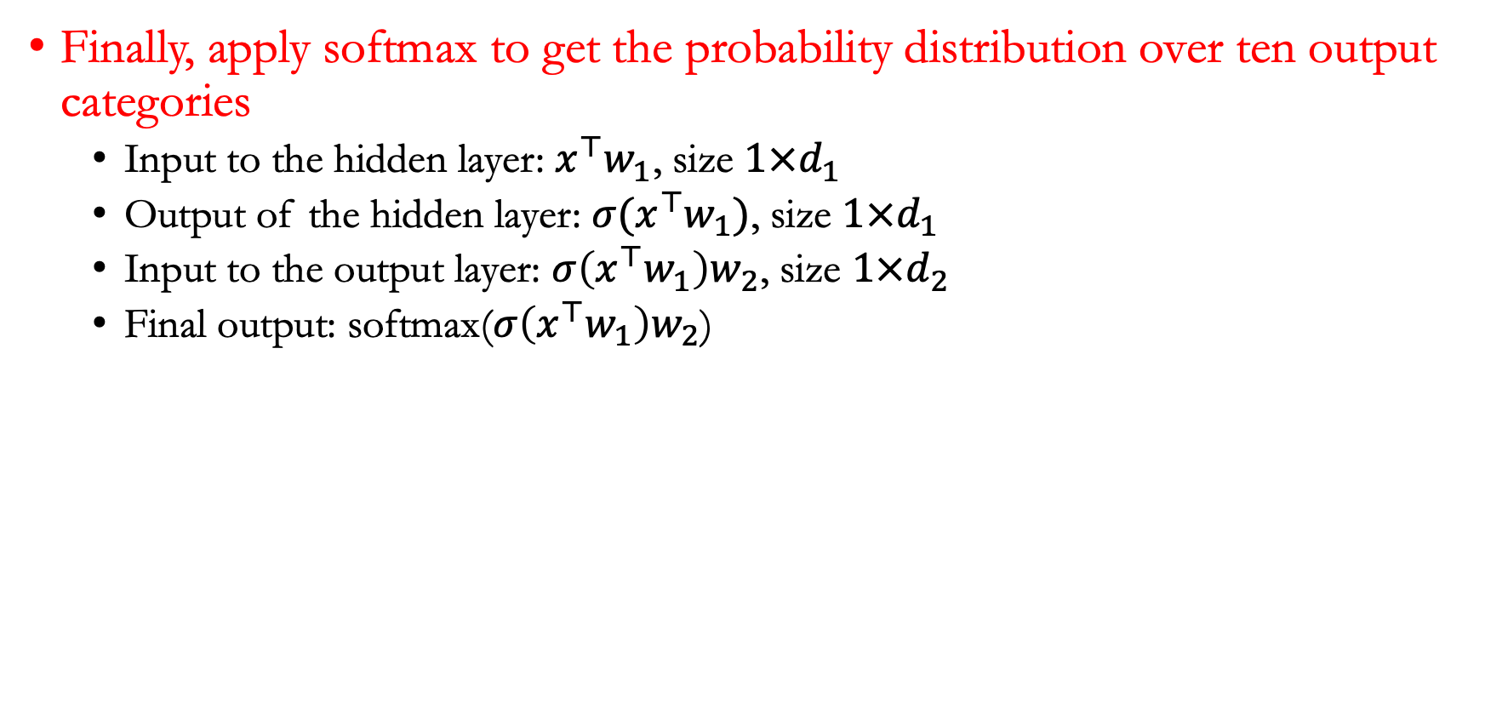
Illustration of forward pass
Finally, apply softmax to get the probability distribution over ten output categories
  Input to the hidden layer: $x^{⊤}w_{1}$, size $1×d_{1}$
  Output of the hidden layer: $σ(x^{⊤}w_{1})$, size $1×d_{1}$
  Input to the output layer: $σ\left(x^{⊤}w_{1}\right)w_{2}$, size $1×d_{2}$
  Final output: softmax($σ\left(x^{⊤}w_{1}\right)w_{2}$)
Softmax output [0.01, 0.9, 0.01, 0.01, 0.01, 0.01, 0.01, 0.02, 0.01, 0.01]

Slide 17
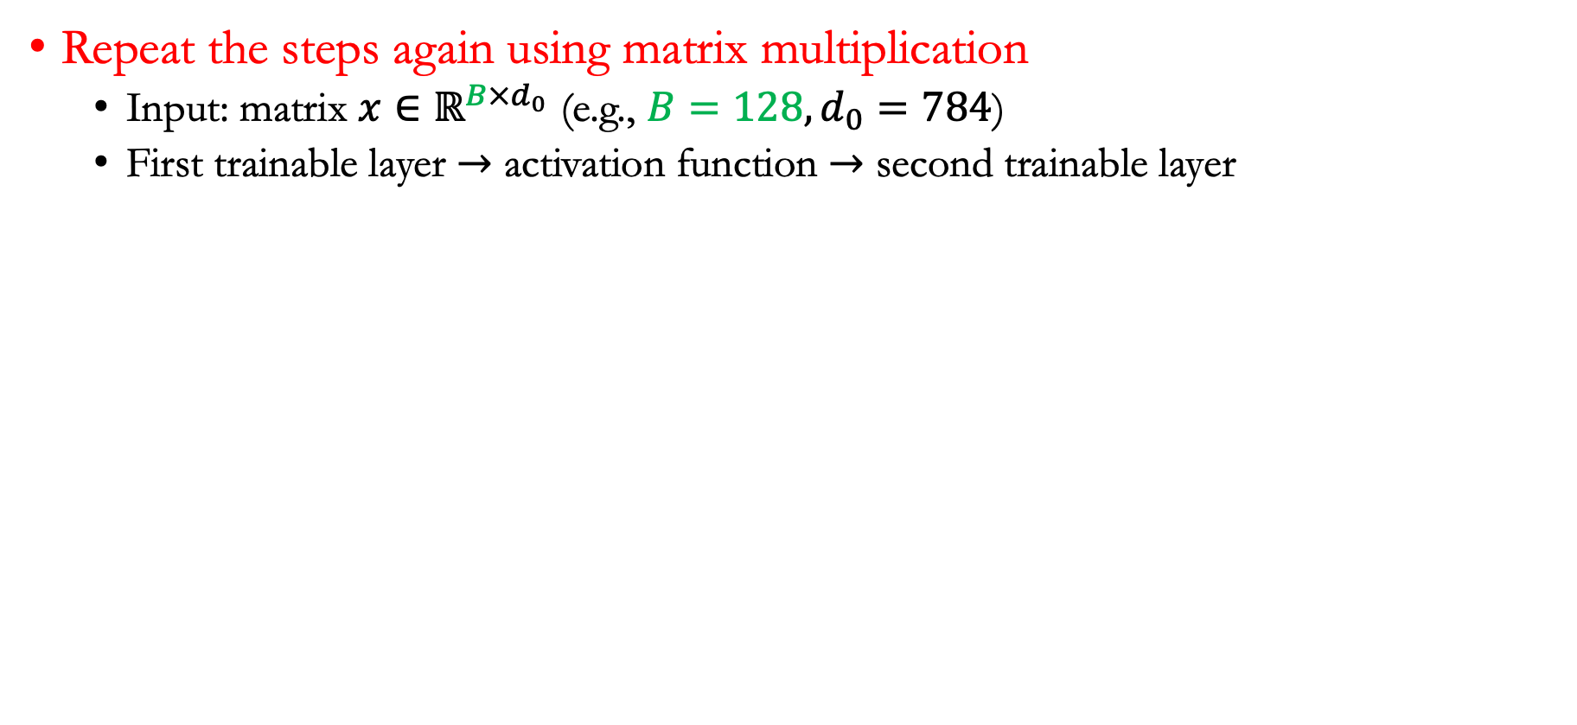
Applying forward pass to a batch of inputs
Repeat the steps again using matrix multiplication
  Input: matrix $x∈ℝ^{B×d_{0}}$ (e.g., $B=128,d_{0}=784$)
  First trainable layer $→$ activation function $→$ second trainable layer
Softmax [0.01, 0.9, 0.01, 0.01, 0.01, 0.01, 0.01, 0.02, 0.01, 0.01]
Softmax [0.01, 0.91, 0.01, 0.01, 0.01, 0.01, 0.01, 0.01, 0.01, 0.01]

Slide 18
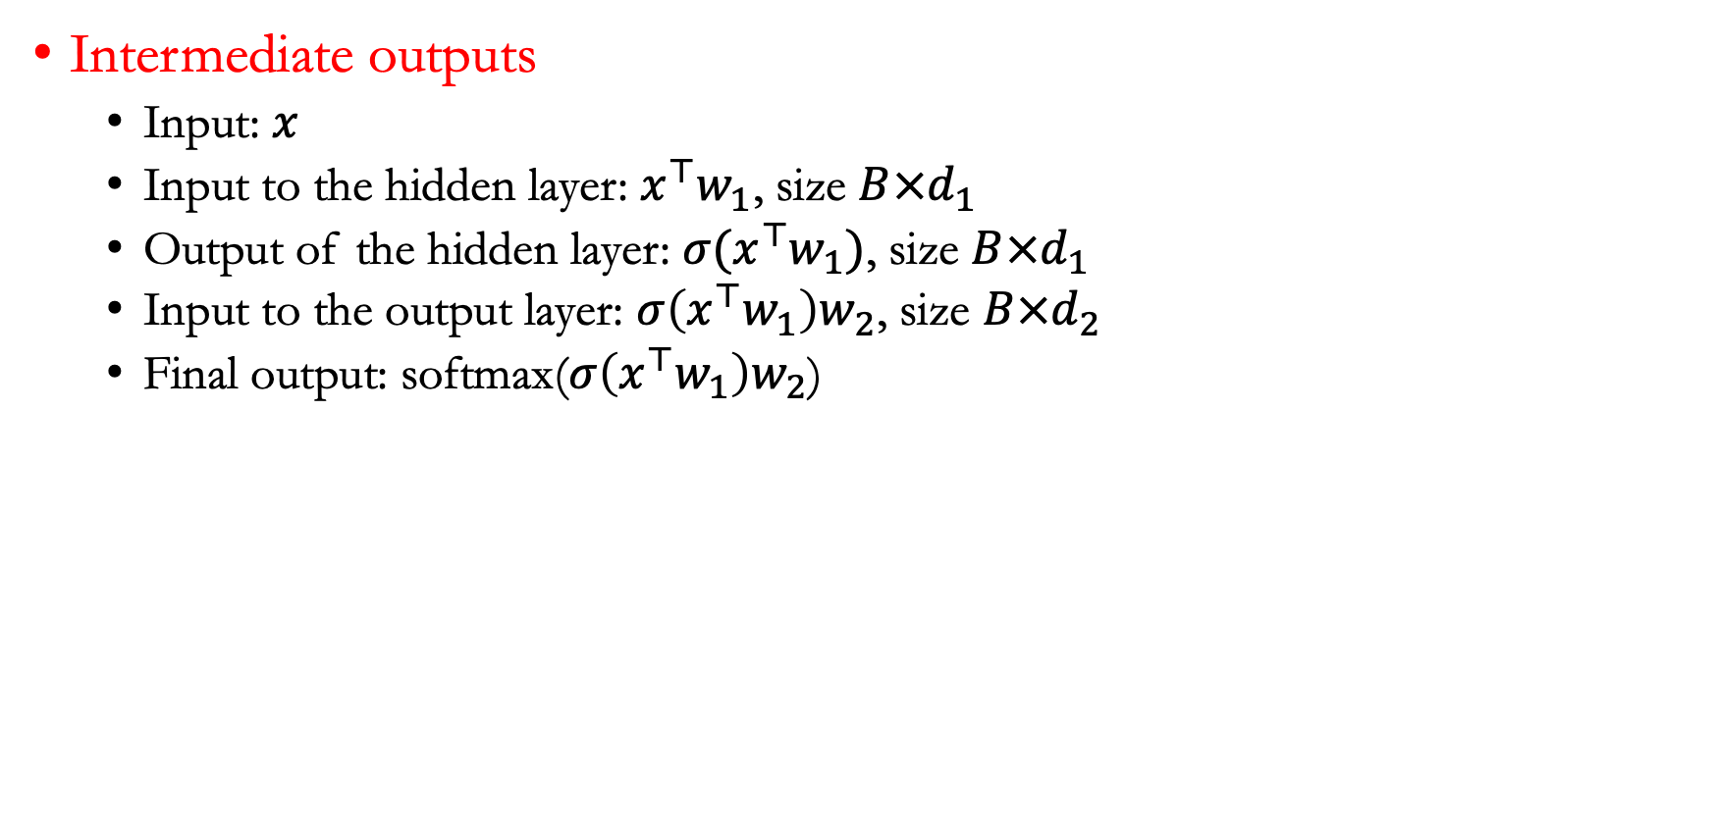
Applying forward pass to a batch of inputs
Intermediate outputs
  Input: $x$
  Input to the hidden layer: $x^{⊤}w_{1}$, size $B×d_{1}$
  Output of the hidden layer: $σ(x^{⊤}w_{1})$, size $B×d_{1}$
  Input to the output layer: $σ\left(x^{⊤}w_{1}\right)w_{2}$, size $B×d_{2}$
  Final output: softmax($σ\left(x^{⊤}w_{1}\right)w_{2}$)

Slide 19
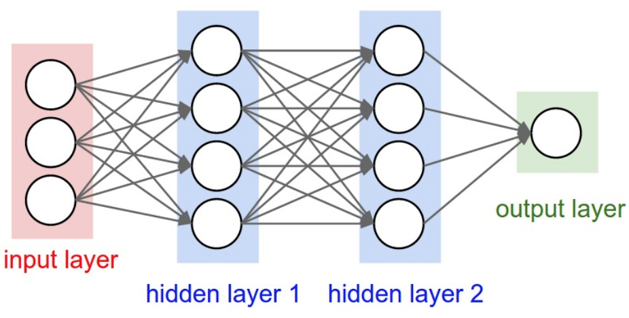
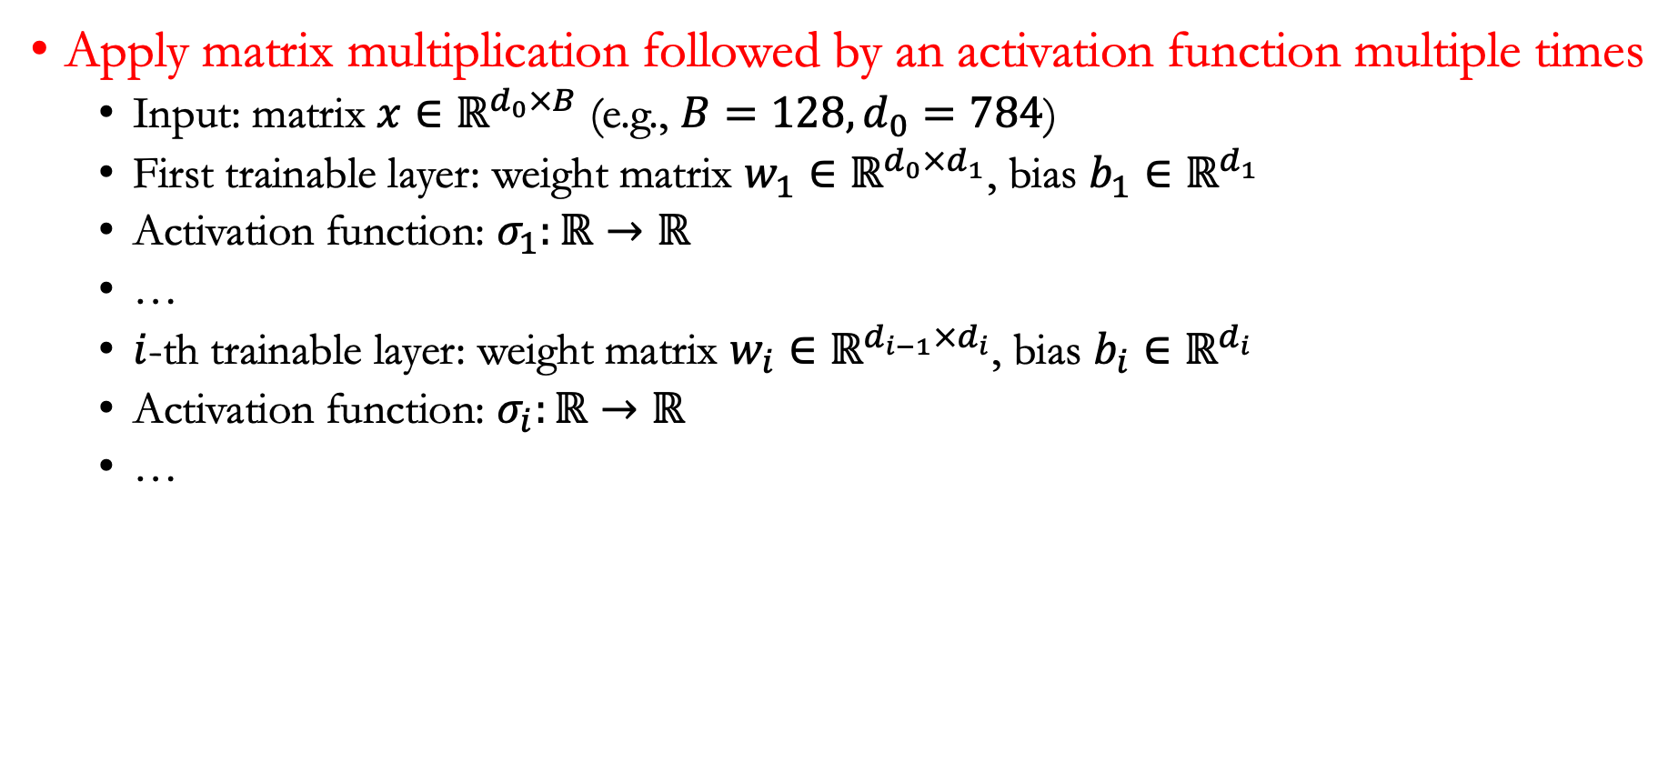
Multiple layers
Apply matrix multiplication followed by an activation function multiple times
  Input: matrix $x∈ℝ^{d_{0}×B}$ (e.g., $B=128,d_{0}=784$)
  First trainable layer: weight matrix $w_{1}∈ℝ^{d_{0}×d_{1}}$, bias $b_{1}∈ℝ^{d_{1}}$
  Activation function: $σ_{1}:ℝ→ℝ$
  …
  $i$-th trainable layer: weight matrix $w_{i}∈ℝ^{d_{i−1}×d_{i}}$, bias $b_{i}∈ℝ^{d_{i}}$
  Activation function: $σ_{i}:ℝ→ℝ$
  …

Slide 20
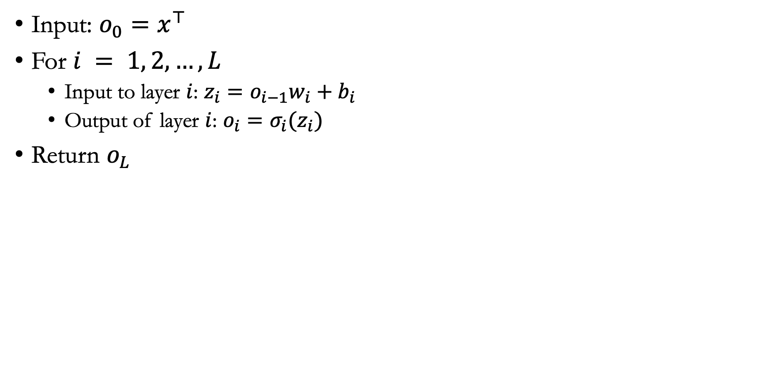
Pseudocode for forward pass
Input: $o_{0}=x^{⊤}$
For $i = 1, 2, …, L$
  Input to layer $i$: $z_{i}=o_{i−1}w_{i}+b_{i}$
  Output of layer $i$: $o_{i}=σ_{i}(z_{i})$
Return $o_{L}$

Slide 21
Lecture plan
PyTorch implementation of stochastic gradient descent

Slide 22
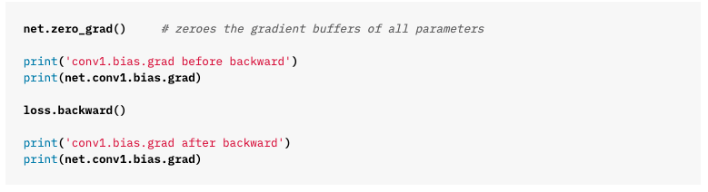
Running example in PyTorch
Calculate gradient via backpropagation (an efficient algorithm to compute the gradient---we’ll cover this topic next lecture)

Slide 23
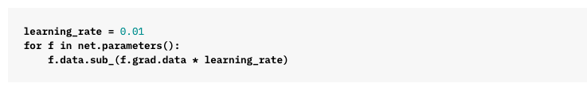
Running example in PyTorch
Update the weights: Based on a learning rate parameter, we apply stochastic gradient descent

Slide 24
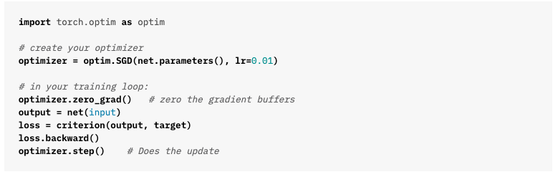
Running example in PyTorch
Stochastic gradient descent wrapped up in pytorch codes

Slide 25
Lecture plan
PyTorch implementation of linear/nonlinear classifiers

Slide 26
Using neural networks for regression and classification
Neural networks can be used to solve regression and classification problems
We will consider a toy data setting for training a neural network in PyTorch
We will use a linear classifier, then a nonlinear classifier, and compare their results

Slide 27
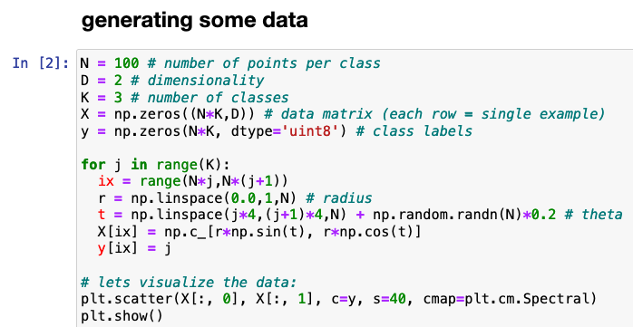
Generating data
Generate a two-dimensional dataset with nonlinear decision boundaries

Slide 28
Visualization

Slide 29
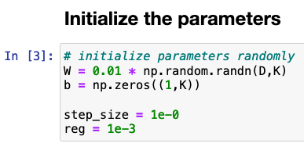
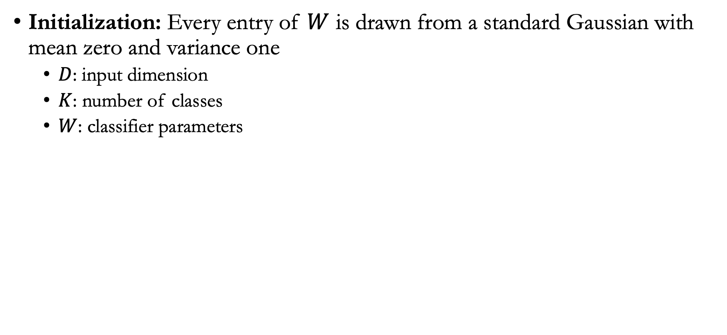
Initialization
Initialization: Every entry of $W$ is drawn from a standard Gaussian with mean zero and variance one
  $D$: input dimension
  $K$: number of classes
  $W$: classifier parameters

Slide 30
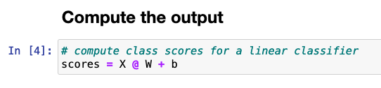
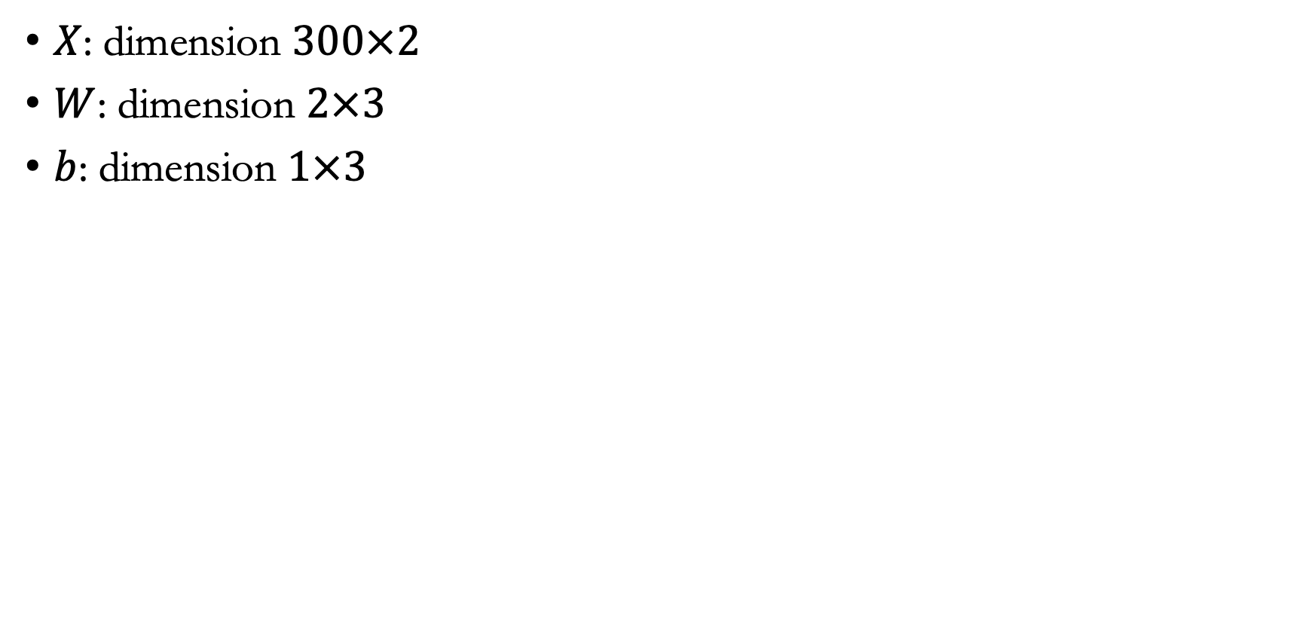
Matrix multiplication
$X$: dimension $300×2$
$W$: dimension $2×3$
$b$: dimension $1×3$
Adds $b$ into every row of $X @ W$ (means matrix multiplication in numpy)

Slide 31
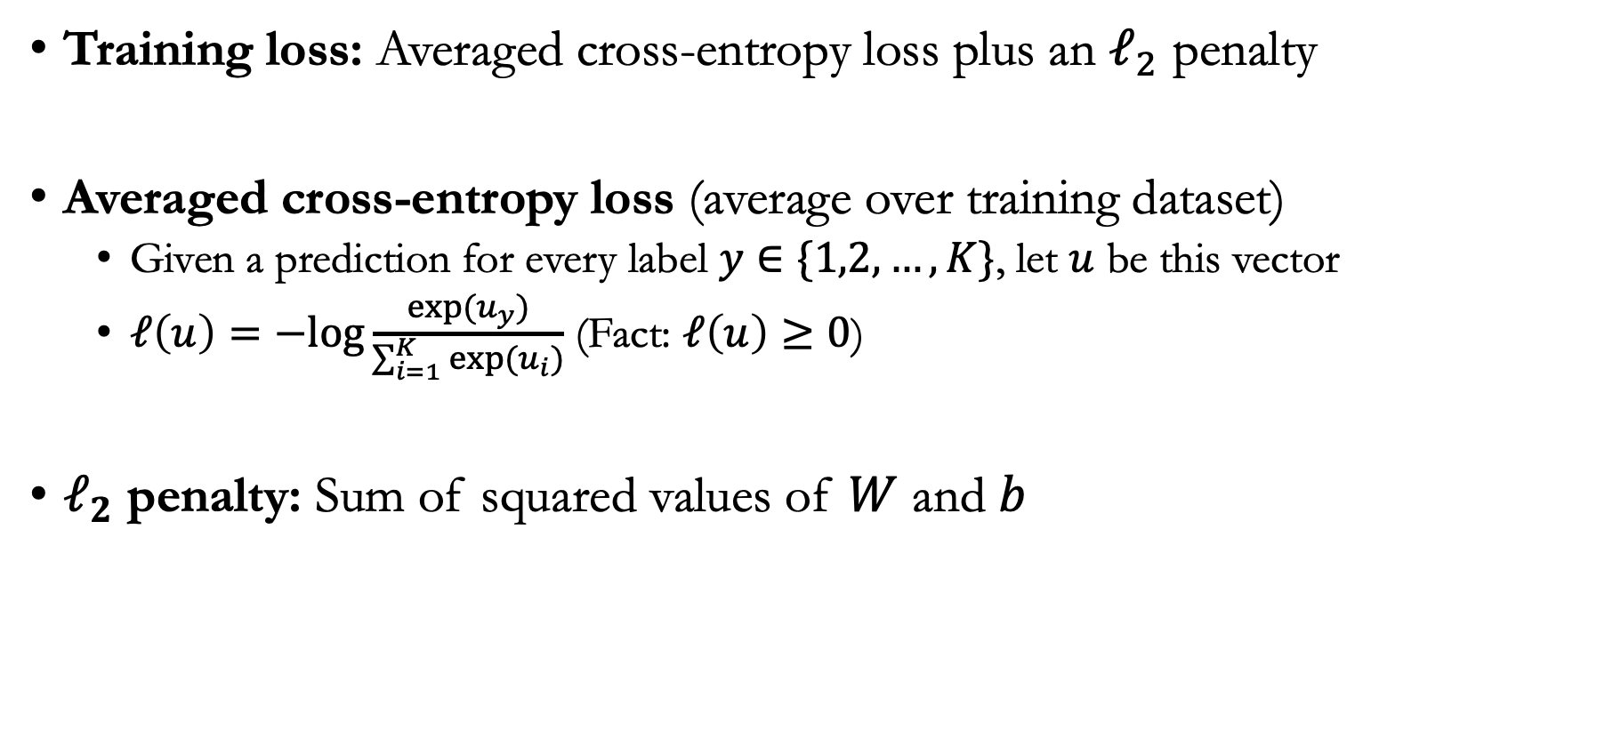
Loss function
Training loss: Averaged cross-entropy loss plus an $ℓ_{2}$ penalty
Averaged cross-entropy loss (average over training dataset)
  Given a prediction for every label $y∈\{1,2,…,K\}$, let $u$ be this vector
  $ℓ\left(u\right)=−log{\frac{exp⁡(u_{y})}{\sum_{i=1}^{K}{\exp{(u_{i})}}}}$ (Fact: $ℓ\left(u\right)≥0$)
$ℓ_{2}$ penalty: Sum of squared values of $W$ and $b$

Slide 32
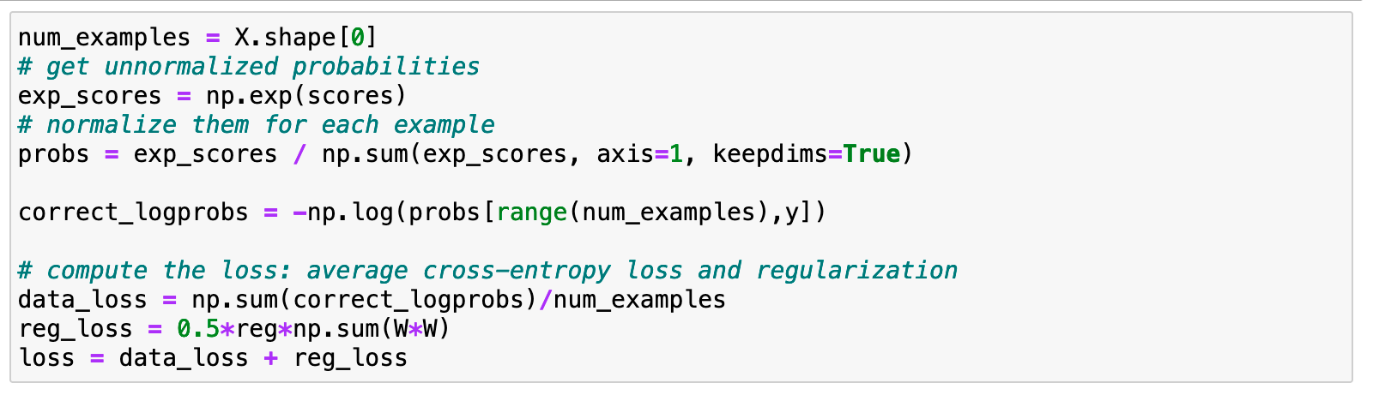
Cross-entropy loss

Slide 33
$ℓ_{2}$ penalty

Slide 34
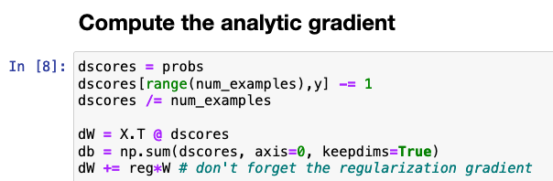
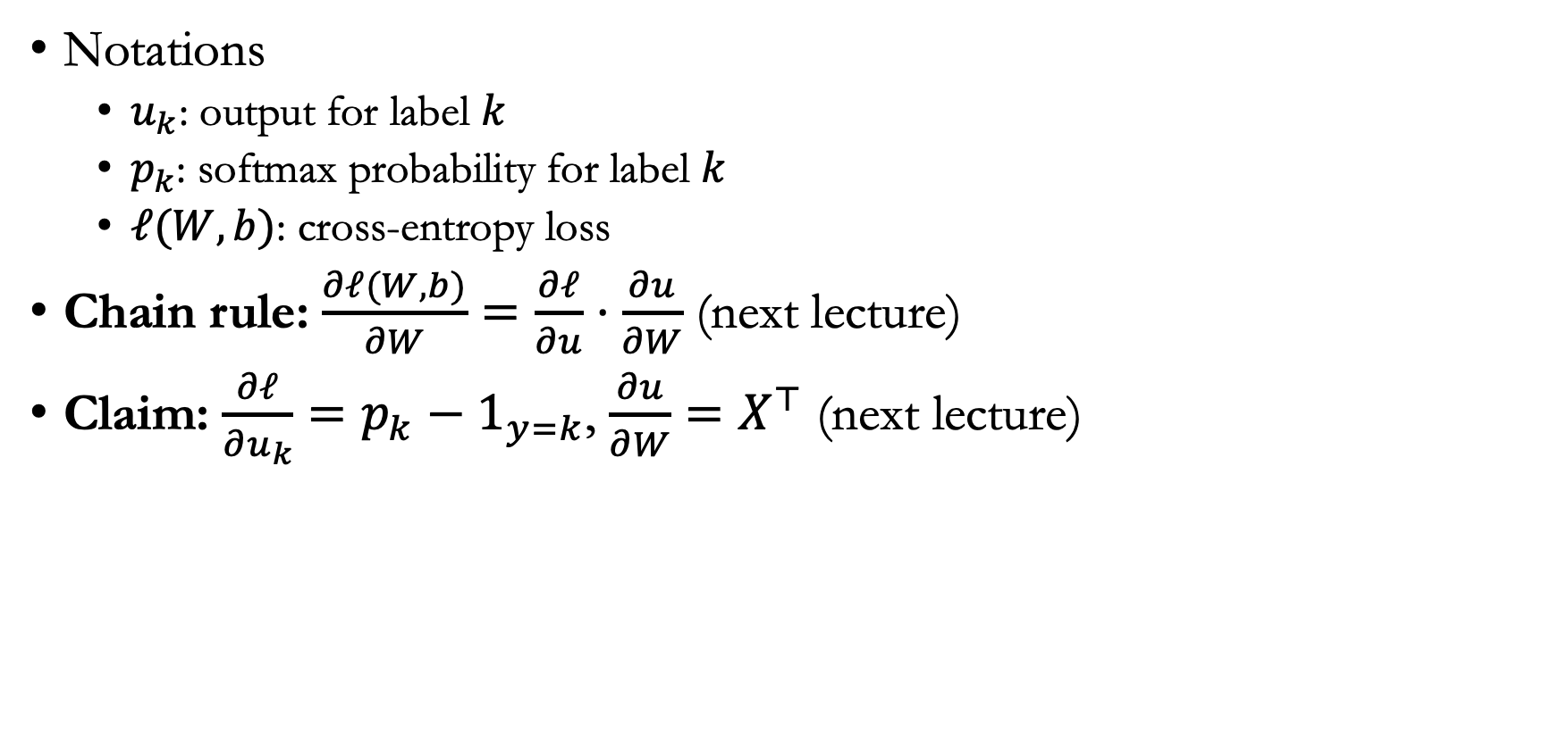
Compute gradient
Notations
  $u_{k}$: output for label $k$
  $p_{k}$: softmax probability for label $k$
  $ℓ(W,b)$: cross-entropy loss
Chain rule: $\frac{∂ℓ(W,b)}{∂W}=\frac{∂ℓ}{∂u}⋅\frac{∂u}{∂W}$ (next lecture)
Claim: $\frac{∂ℓ}{∂u_{k}}=p_{k}−1_{y=k}$, $\frac{∂u}{∂W}=X^{⊤}$ (next lecture)
Gradient on bias adds up
all the log probabilities

Slide 35
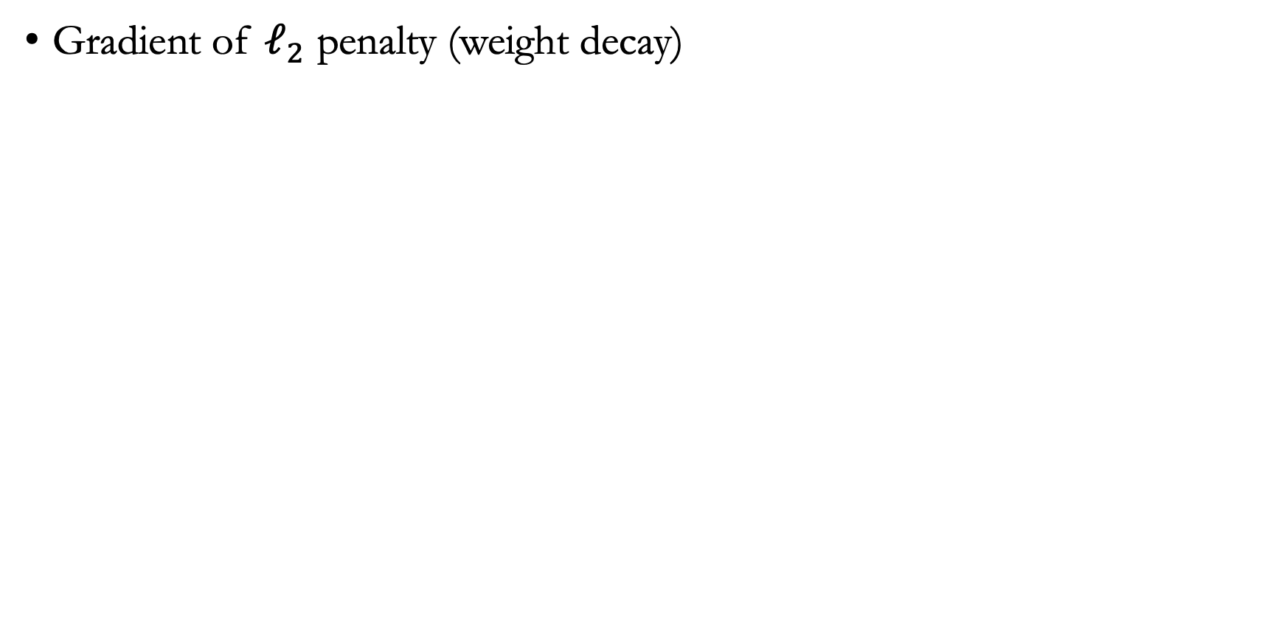
Compute the gradient
Gradient of $ℓ_{2}$ penalty (weight decay)

Slide 36
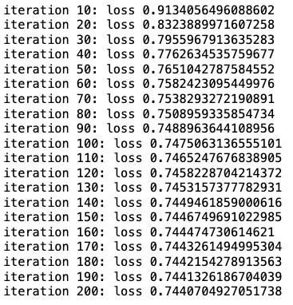
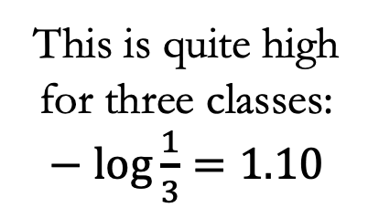
Trainng loss
This is quite high for three classes: $−\log{\frac{1}{3}}=1.10$

Slide 37
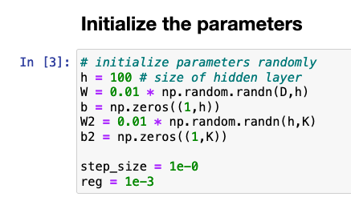
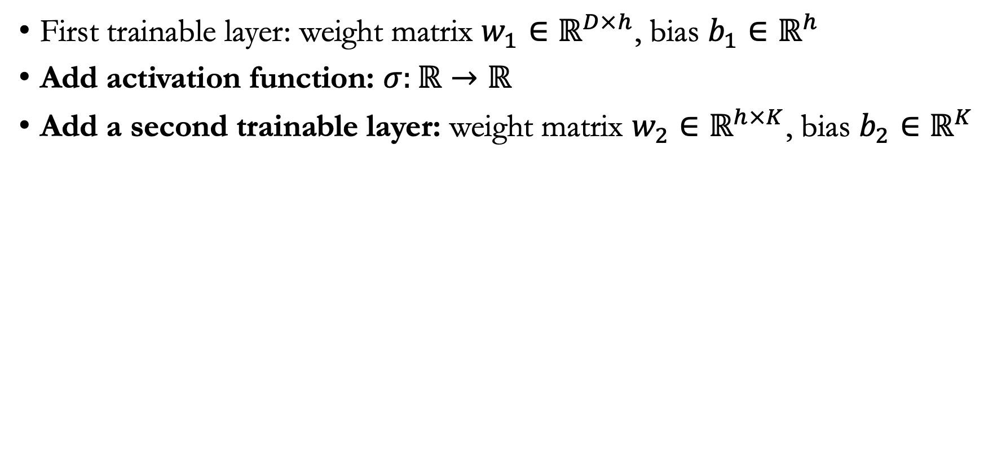
Can we do better?
First trainable layer: weight matrix $w_{1}∈ℝ^{D×h}$, bias $b_{1}∈ℝ^{h}$
Add activation function: $σ:ℝ→ℝ$
Add a second trainable layer: weight matrix $w_{2}∈ℝ^{h×K}$, bias $b_{2}∈ℝ^{K}$

Slide 38
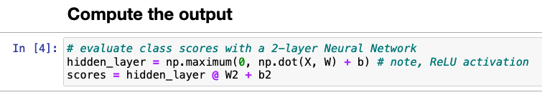
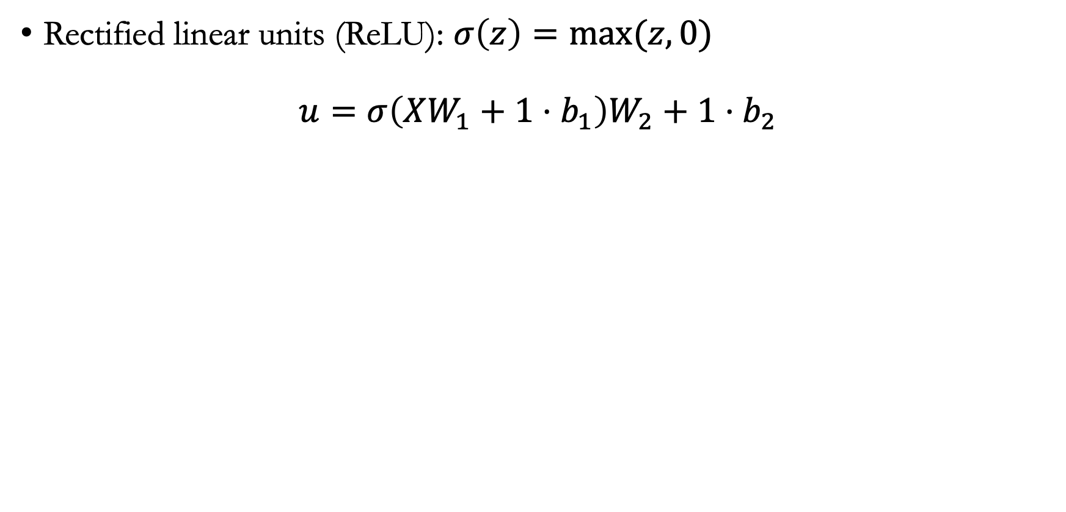
Compute output
Rectified linear units (ReLU): $σ\left(z\right)=max⁡(z,0)$
$$u=σ\left(XW_{1}+1⋅b_{1}\right)W_{2}+1⋅b_{2}$$

Slide 39
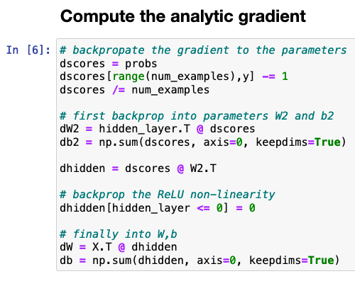
Compute gradient
Gradient of the second layer: Similar to the linear layer case since it is only for the cross-entropy loss. Treat the hidden layer output as input
Gradient of the first layer

Slide 40
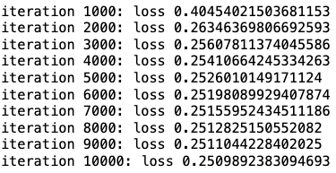
Training results
Comparing loss between linear classifier (left) and ReLU classifier (right)

Slide 41
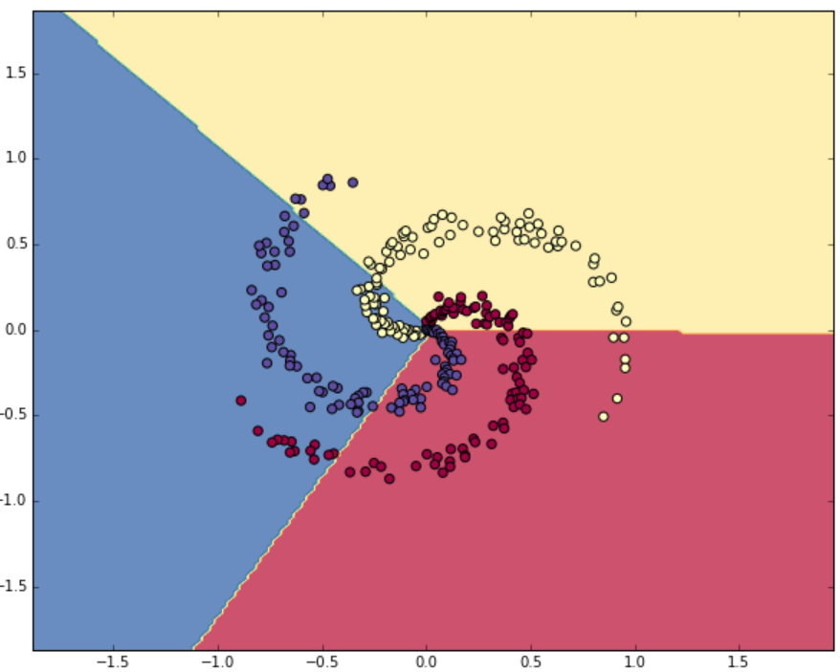
Visualization
Visualizing decision boundaries

Slide 42
Announcements
Instructions for the course project will be released this afternoon

