Slide 1

Team Trojans

Slide 2
Team Members
MD. Abir Hasan Munna
Zannatul Ferdous Tunny
Imran Hossain

Slide 3
MD. Abir Hasan Munna
Team leader (POC)
Developer
Bangladesh University of Professionals
Department of ICT
Phone no. 01710402310
Email: abirmunna091@gmail.com
Address: Dakshinkhan, Dhaka-1230

Slide 4
Zannatul Ferdous Tunny
Project Manager
Bangladesh University of Professionals
Department of ICT
Phone no. 01521443809
Email: zannatulferdous489@gmail.com
Address: Dakshinkhan, Dhaka-1230

Slide 5
Imran Hossain
Editor
Bangladesh University of Professionals
Department of ICT
Phone no. 01521106564
Email: imranhossainrana.2014@gmail.com
Address: Khilkhet, Dhaka-1229

Slide 6
Challenge:
Introduction of an Effective and Modern Solid Waste Management System.

Slide 7
Project:
Green BD

Slide 8
Our Solution
Collecting several types of waste materials from different sectors
Processing the waste material using frontier technology

Slide 9
How are we solving?

Slide 10
Collection of Trashes
Processing of Trash

Slide 11
Collecting the wastes around us

Slide 12
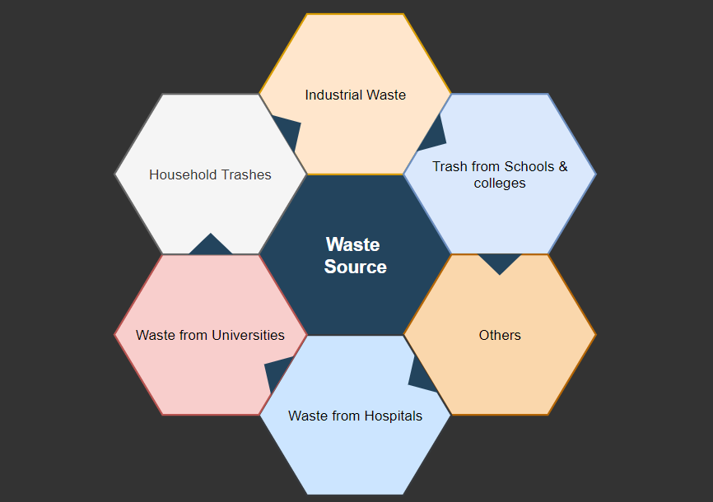

Slide 13
Household Waste
Hospital
Industrial Waste
Schools, Colleges & Universities

Slide 14
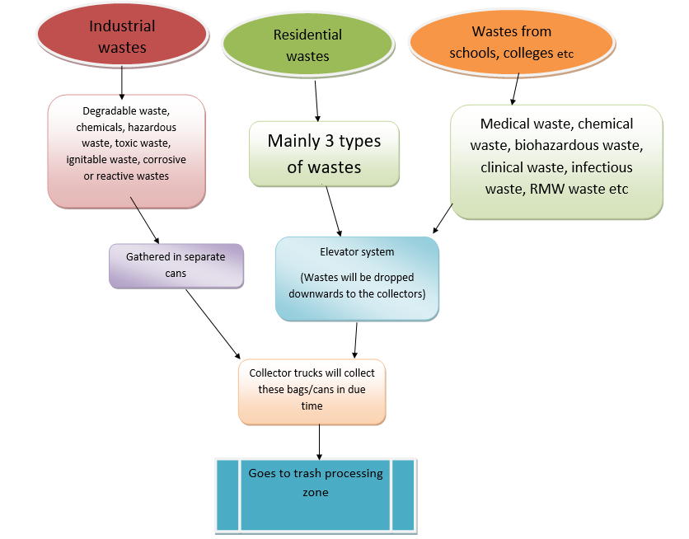
Collection of Waste
To be edited

Slide 15
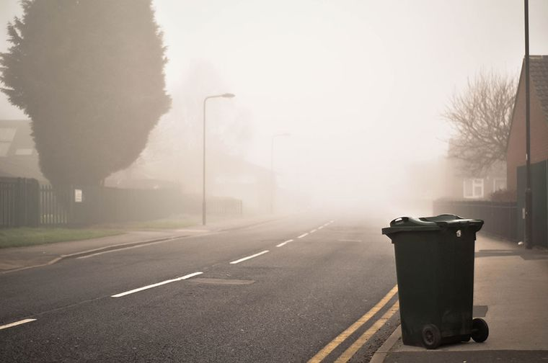
Household wastes
3 types of wastes
Elevator system
Dumps Wastes in the Trash Can
Collector trucks will collect trash in due time
Smart Bin Alongside the window

Slide 16
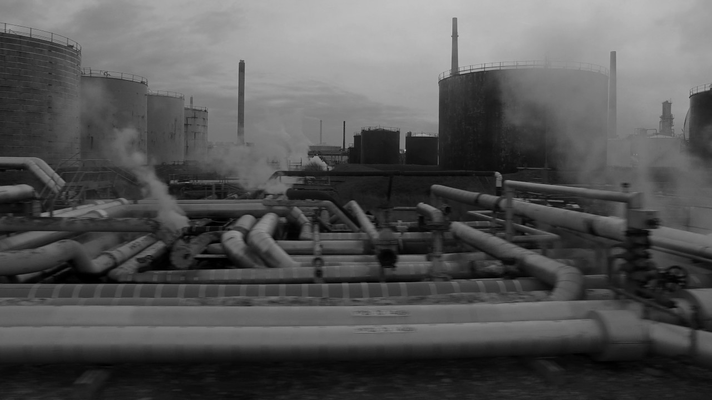
Industrial wastes
Degradable waste, chemicals, hazardous waste, toxic waste, ignitable waste
Gathered in separate cans
Goes to Processing zone

Slide 17
Hospital waste

Slide 18
Wastes from schools, colleges, Universities, Hospital
Medical waste, chemical waste.
Infectious waste, RMW waste etc.
Biohazardous waste, clinical waste
Goes to trash processing zone

Slide 19
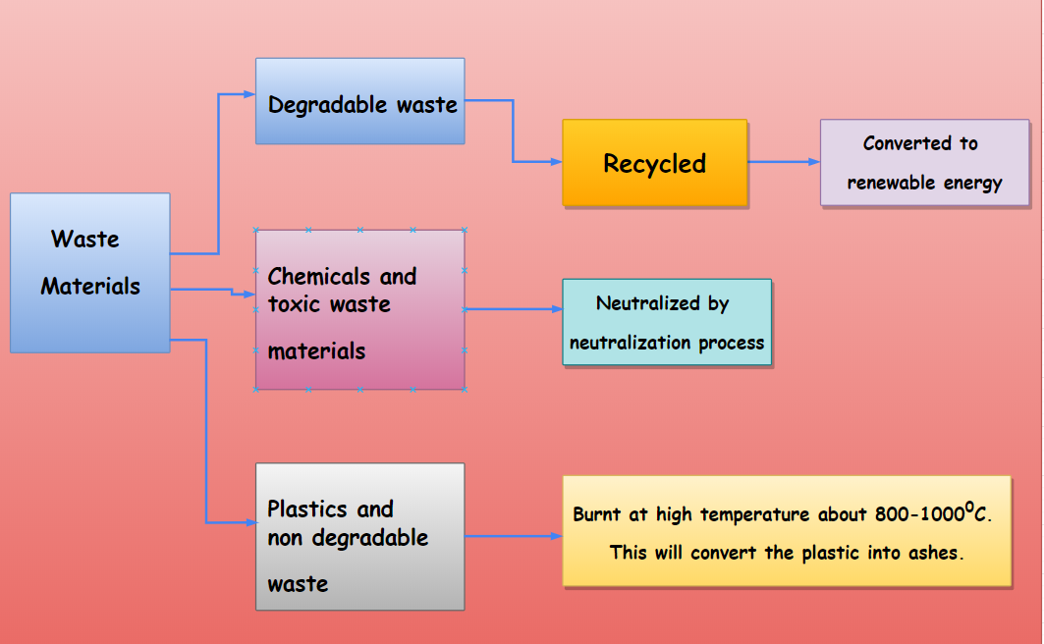
Processing of the waste products

Slide 20
Technologies we’ll be using

Slide 21
Our Project will contain:
Automation technology
Robotics
Image processing/ machine learning
Internet of Things
N.B. This project will be combination of software and hardware

Slide 22
Marketing & Finance
For revenue plan, we have common customers who will avail our services.
For marketing, we will use the municipality help.
Budget is not fixed yet.

Slide 23
Expectations
We will be facing some difficulties while making this project a successful one and specially while launching. For which we expect help from Startup Bangladesh-iDEA project. We expect mentoring, Co-working space, Investment Matchmaking, Incubation, Legal support, Lab support.

