Slide 1
Researching and developing new ways to visualize complex data

Slide 2
Overview
Introduction
Point
Definition of research and development.
What is visualization (Tools and techniques)?
Why do we need visualization for complex data?
Tools used in visualizing complex data.
Graphical Displays
Importance of research in developing new ways to visualize complex data.
How are the new ways developed?
Final Words

Slide 3
Introduction
Data is life and therefore we need to get and extract information from the data using a tool called EDA (Exploratory Data Analysis) and specifically visualization.
Visualization is a very important tool in the analysis of data.
To develop the society, we need data and every single day, a large amount of data is released most especially through the internet and because of the complexity of some of these data, we need more complex visualizations to get insight from them.

Slide 4
Points

Slide 5
Definition of research and development.
Research according to Merriam-Webster is the careful study that is done to find and report new knowledge about something while development is the act or process of growing something or causing something to grow or become larger or more advanced.

Slide 6
What is visualization (Tools and techniques)?
Visualization is known simply as the act or process of interpreting in visual terms or of putting into visible form but in exploratory data analysis(EDA), visualization is known as a way of making sense of all the data, ideas and information.
Tools
There are various visualization tools such as Tableau, Visme, Fusioncharts, Data Wrapper and Zing Chart (for Javascript and HTML5 charts), ggplot, Plotly, Matplotlib, ,Seaborn, Bokeh, Pygal, Altair, Geoplotlib(Python libraries).
Techniques
Charts, Plots, Maps, Diagrams and Matrix.

Slide 7
Why do we need visualization for complex data?
Visualizing complex data will help in getting the audience’s attention.
It solves the problem of relaying complex information.
Capable of identifying areas that need attention or improvement.
It helps to find insights in the complex data.
It helps to identify relationship and patterns in complex data.

Slide 8
Tools used in visualizing complex data
Microsoft Azure Power BI: Exceptional for its highly intuitive drag and drop interface, short learning curve and large integration capabilities.
ELK Stack Kibana: Part of Elastic Stack that turns data into visual insights, built on and designed to work on ElasticSearch data only.
Grafana: Professional data visualization and analytic tool that supports up to 30 data sources, including AWS, ElasticSearch and Prometheus.

Slide 9
Graphical Display

Slide 10
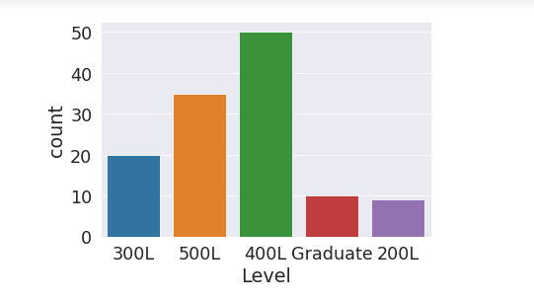
Student Data

Slide 11
Importance of research in developing new ways to visualize complex data
Helps to understand the audience.
Helps to gain insight into how to develop new ways in visualizing complex data.
Helps to understand how to visualize your data depending on the content and context of your data.
Exposes to tools, techniques that can be very useful in your visualization.
Widens your horizon.

Slide 12
How are the new ways developed?

Slide 13
Process
Understand EVERYTHING about the data you want to visualize.
Determine what you are trying to visualize and the information you are trying to communicate.
Know your audience.
Use a visual that conveys the information in the best and simplest form for your audience.
Choose good, effective and efficient visualization tools and techniques.
Explore your imaginations and bring them to life.

Slide 14
Final words

Slide 15
You do not need to be a visualization guru to develop new ways to visualize complex data.
what you need to have is insight.
you need to see into your data and make it open up on what it is hiding.
Remember, if you can see it, you can have it and if you can imagine it, you can do it.

Slide 16
THANK YOU

