Slide 1

E-commerce
CUSTOMER CHURN
CUSTOMER CHURN
PREDICTION
By Fauzan H Putra

Slide 2
03
BUSINESS UNDERSTANDING
05
DATA OVERVIEW
LIST OF CONTENTS
06
DATA CLEANING
07
FEATURE SELECTION
In this presentation, we are going to see how data analysis and machine learning model can predict customers churning from E Commerce
08
MODELING
09
EVALUATION METRICS
13
CONCLUSION
14
RECOMMENDATION

Slide 3


BUSINESS UNDERSTANDING
Copi is a burgeoning E-Commerce platform in Southeast Asia that has recently experienced a 15% customer churn rate, signifying a significant portion of customers departing from the platform.

Slide 4
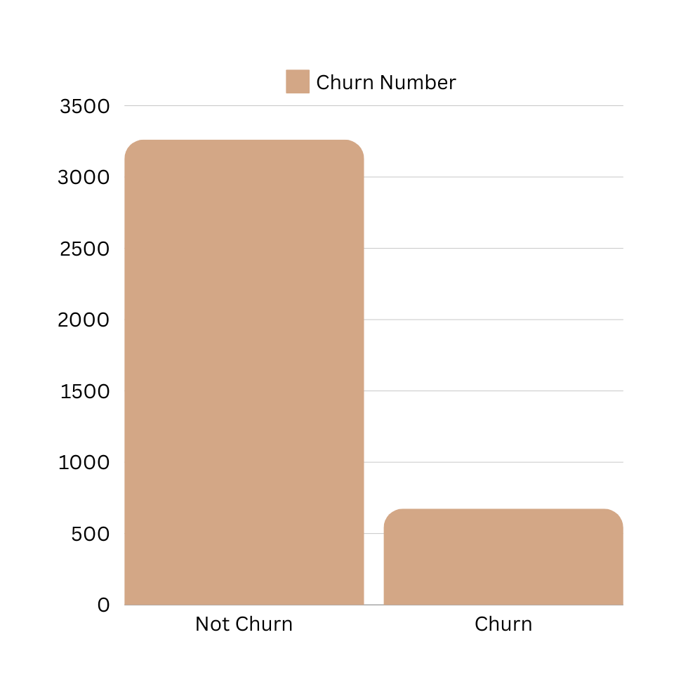
Copi e-commerce shows high customer satisfaction, but customer churn within the customer base may be a challenge.
As a Data Science consultant, we are glad to help analyse Copi’s churning customer behaviours in order to detect which customer that will depart the service.
By successfully detecting churning customer, we can provide recommendations to make the customer retain.

Slide 5
Column Name | Data Type | Miss. Val (%) | Sample
Tenure | float64 | 4.92% | [15.0, 27.0]
WarehouseToHome | float64 | 4.29% | [29.0, 13.0]
NumberofDeviceRegistered | int64 | 0% | [4, 6]
PreferedOrderCat | object | 0% | [Mobile, Fashion]
SatisfactionScore | int64 | 0% | [3, 4]
MaritalStatus | object | 0% | [Married, Single]
NumberOfAddress | int64 | 0% | [2, 5]
Complain | int64 | 0% | [0, 1]
DaySinceLastOrder | float64 | 5.4% | [7.0, 8.0]
CashbackAmount | float64 | 0% | [143.32, 129.29]
Churn | int64 | 0% | [0, 1]
Dataset
OVERVIEW
There are 3914 rows of data with each rows representing customer behaviour towards their churn or not.
Predictor features:
Tenure
Distance to Warehouse
Number of Devices
Preferred order category
SatisfactionScore
Marital Status
Number of their Address
Complains
Days since last order
Cashback Amount
Target feature: Churn

Slide 6
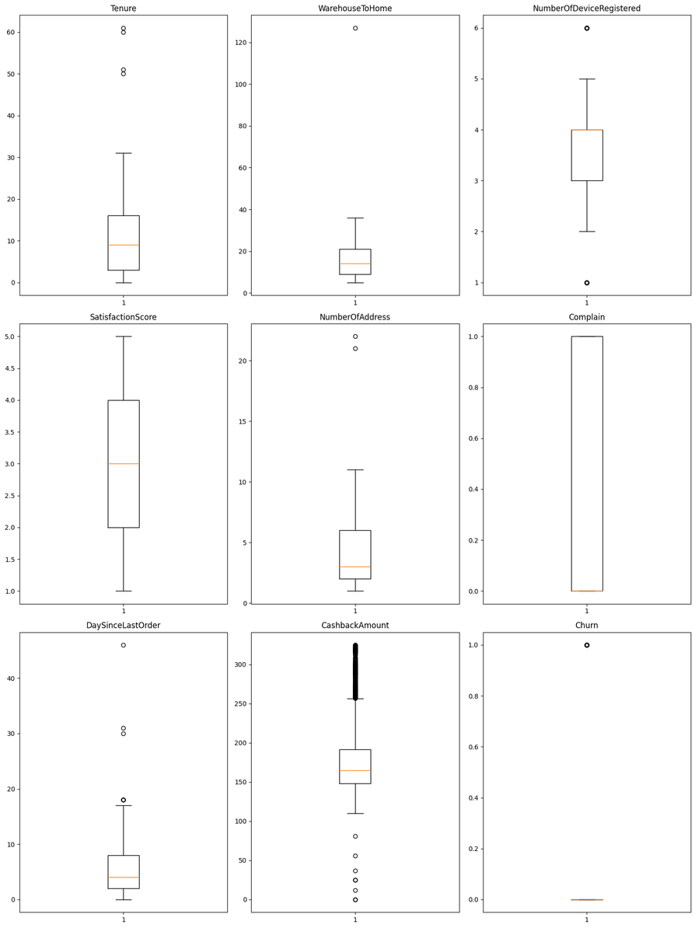
Data
CLEANING
&
FEATURE
ENGINEERING
In order to cleaning the data we have to get rid of the extreme outliers and handle the missing values

Slide 7
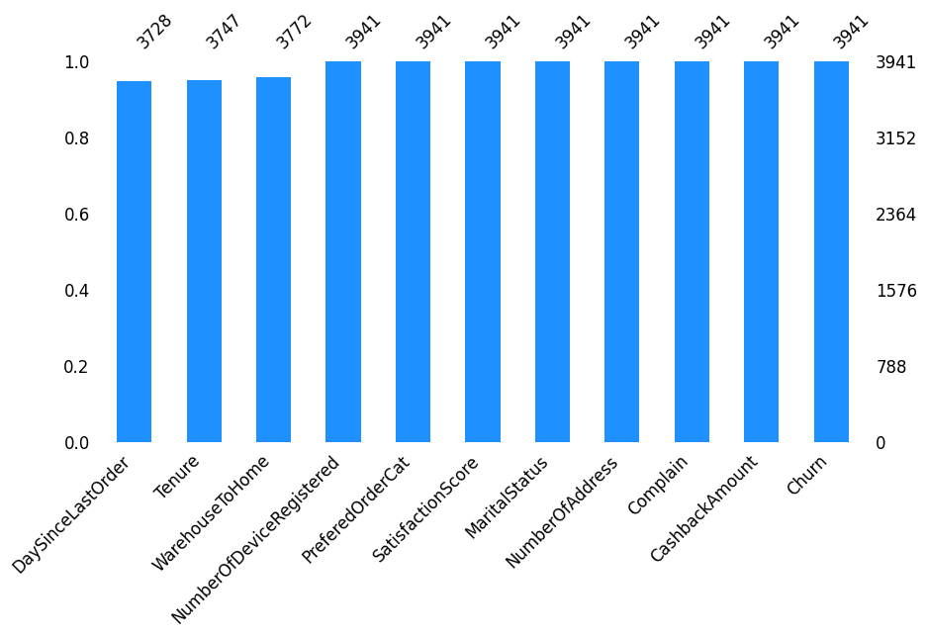
Data
CLEANING
3000+
Rows of Data
3/11
Columns with missing values
<6%
missing values @ columns
DaySinceLastOrder
Tenure and
WarehouseToHome
are the ones with missing values, let’s see how each other correlates

Slide 8
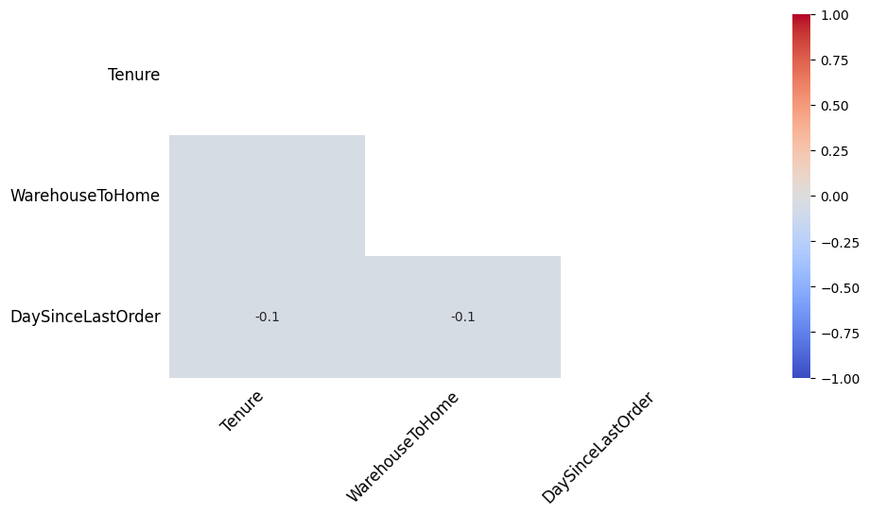
Missing Values are not so correlates, hence we can just drop the missing values of those columns from our dataset

Slide 9
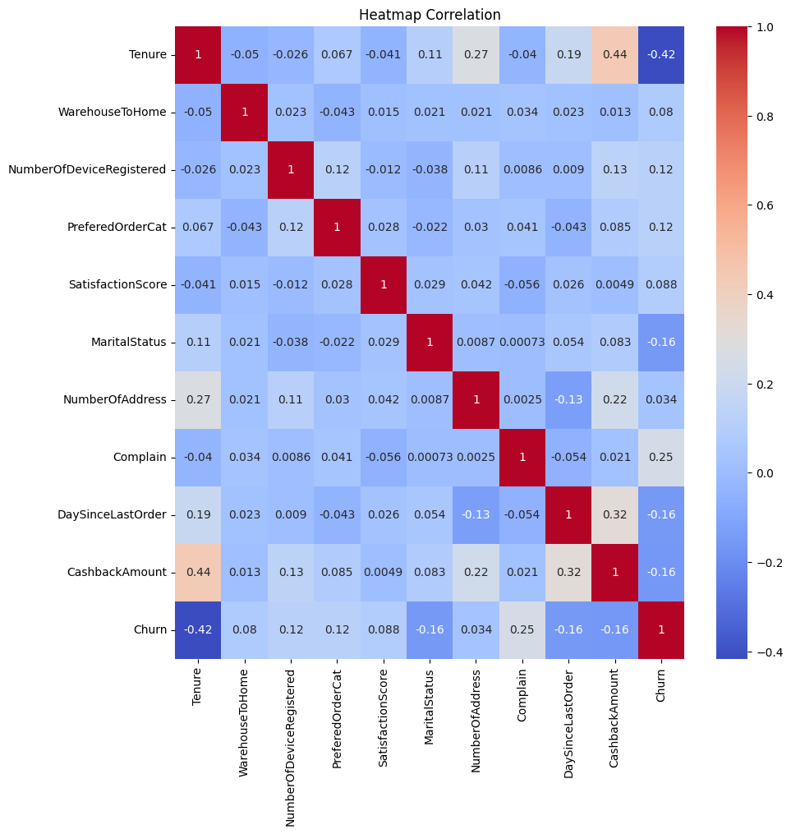
FEATURE
ENGINEERING
Columns that correlates with target
Tenure, Complain, CashbackAmount, DaySinceLastOrder, MaritalStatus, PreferedOrderCat, NumberofDeviceRegistered
Columns that doesn’t correlate with target
NumberOfAddress, SatisfactionScore, WarehouseToHome

Slide 10
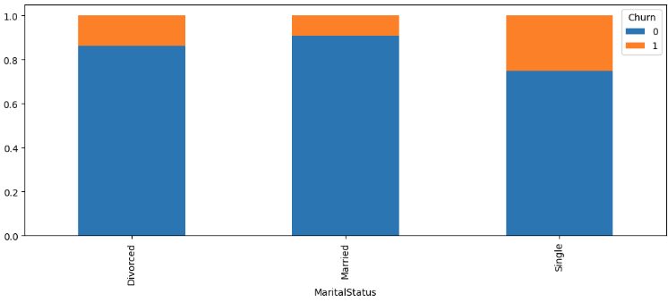
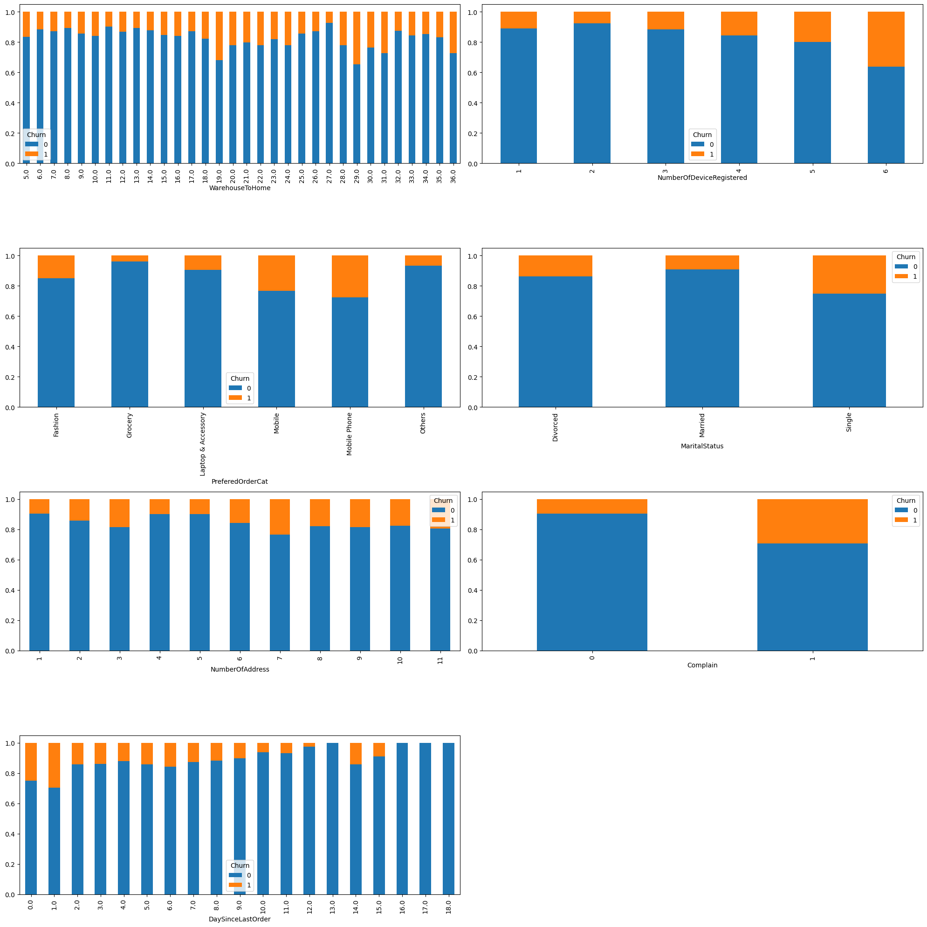
Findings
&
SOLUTION
Based on last month data
Marital Status vs churn
Num of Devices vs Churn
Complain vs Churn
Order Categories vs Churn

Slide 11
Churn
Marital Status | Not Churn % | Churn %
Single | 74.95% | 25.04%
Divorced | 86.06% | 13.93%
Maried | 90.68% | 9.31%
VS
MARITAL STATUS
On the last month in Copi, we have found that most customer who are churning are single people

Slide 12
Churn
VS
NUM OF DEVICES
Num Of Devices | Not Churn % | Churn %
6 | 63.91% | 36.09%
5 | 80.0% | 20.0%
4 | 84.28% | 15.72%
3 | 88.44% | 11.56%
2 | 92.26% | 7.74%
1 | 89.13% | 10.87%
We also found that most of the customer who churns have 2 number of devices

Slide 13
Churn
VS
COMPLAIN
Complain | Not Churn % | Churn %
Filed Complaint | 70.80% | 29.20%
Didn’t File Complaint | 90.38% | 9.62%
We also found that Copi customer who churns are the one who filed complain. This makes sense

Slide 14
Churn
Prefered Order Categories | Not Churn % | Churn %
Mobile Phone | 72.35% | 27.65%
Mobile | 76.73% | 23.24%
Fashion | 84.93% | 15.07%
Laptop & Accessory | 90.59% | 9.41%
Others | 93.30% | 6.70%
Grocery | 96.13% | 3.87%
VS
In order categories, Copi’s customers that churn the most are the one that prefered oreder categories are Mobile Phone
ORDER CATEGORIES
CATEGORIES

Slide 15

Validation
SCORE
XG Boost Is Choosen for having best recall score
Model | Recall Score
XGBoost | 93.4%
RandomForest | 90.2%
Decision Tree | 90.1%

Slide 16
Simulation
Without Our Model
- Lost Customers due to churning -> 4% * 100 millions = 4 millions
- If each customer could generate 2 USD in Copi
- Lost revenue due to churning -> 2 * 4 Million USD = 8 million USD
With our model
- Lost Customers due to churning -> 4% * 100 millions = 4 millions
- Customers retain with our model -> 93% * 4 million = 3.72 millions
- If each customer could generate 2 USD in Copi
- Lost revenue due to churning -> 2 * 4 Million USD = 8 million USD
- Revenue retained with our model -> 93% * 8 Million USD = 7.44 Million USD
- Amount of revenue retained -> 8 - 7.44 = 560.000 USD
From the calculation above, our model can save quite a number of revenue

Slide 17
THANKS

