Slide 1

Using Apache Cassandra from Python
Jeremiah Jordan
Morningstar, Inc.

Slide 2
Who am I?
Software Engineer @ Morningstar, Inc. for 1.5 Years
Using Python 2.6/2.7 for 1.5 Years
Using Cassandra for 1.5 Years

Slide 3
Why are you here?
You were too lazy to get out of your seat.
Someone said “NoSQL”.
You want to learn about using Cassandra from Python.

Slide 4
What am I going to talk about?
What is Cassandra
Starting up a local dev/unit test instance
Using Cassandra from Python
Indexing / Schema Design

Slide 5
What am I not going to talk about?
Setting up and maintaining a production cluster

Slide 6
Where can I get the slides?
http://goo.gl/8Byd8
points to
http://www.slideshare.net/jeremiahdjordan/pycon-2012-apache-cassandra

Slide 7
What is Apache Cassandra?
(Buzz Word Description)
“Cassandra is a highly scalable, eventually consistent, distributed, structured key-value store. Cassandra brings together the distributed systems technologies from Dynamo and the data model from Google's BigTable. Like Dynamo, Cassandra is eventually consistent. Like BigTable, Cassandra provides a ColumnFamily-based data model richer than typical key/value systems.”
From the Cassandra Wiki: http://wiki.apache.org/cassandra/

Slide 8
What is Apache Cassandra?
Column based key-value store (multi-level dictionary)
Combination of Dynamo (Amazon)and BigTable (Google)
Schema-optional

Slide 9
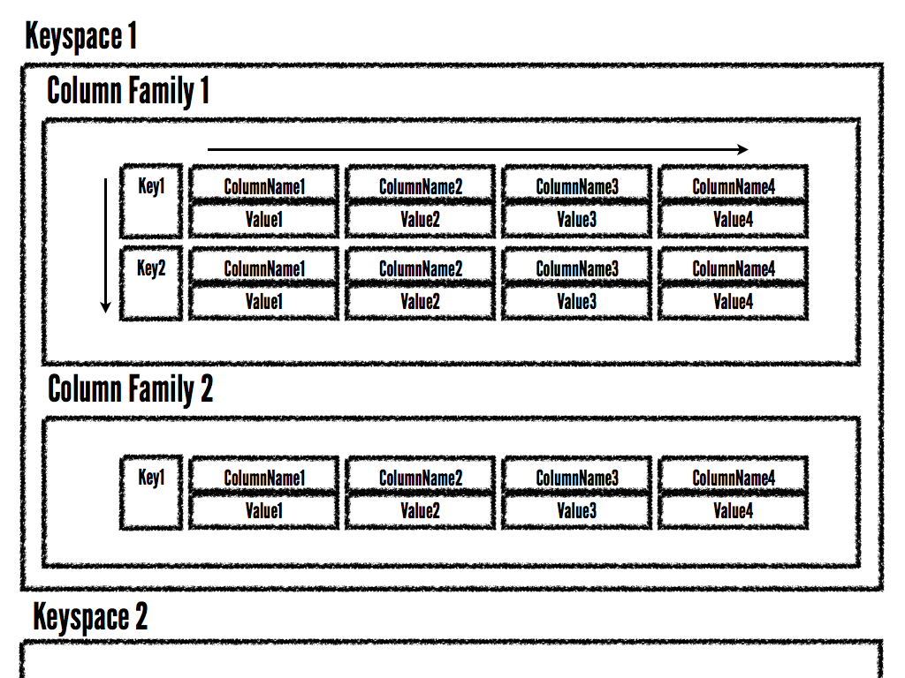

Slide 10
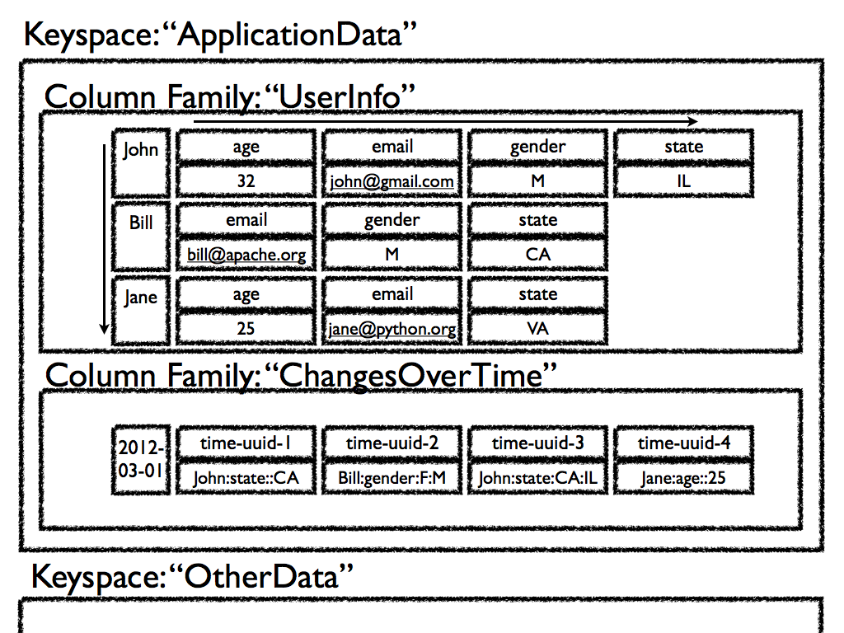

Slide 11
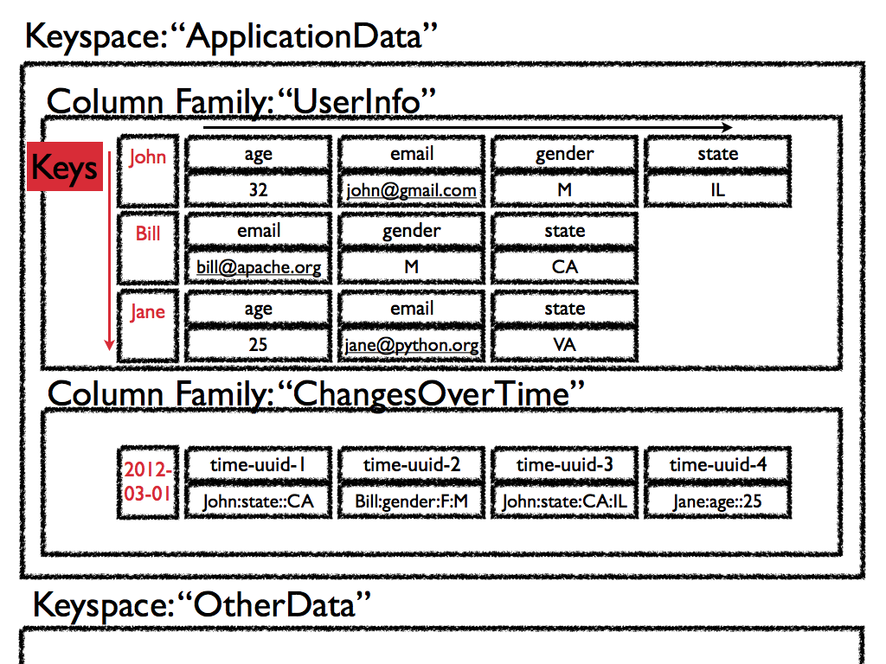

Slide 12
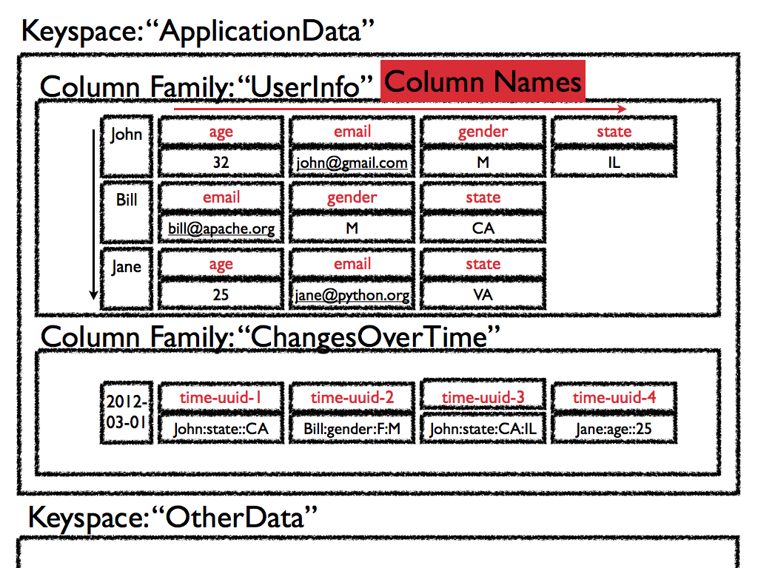

Slide 13
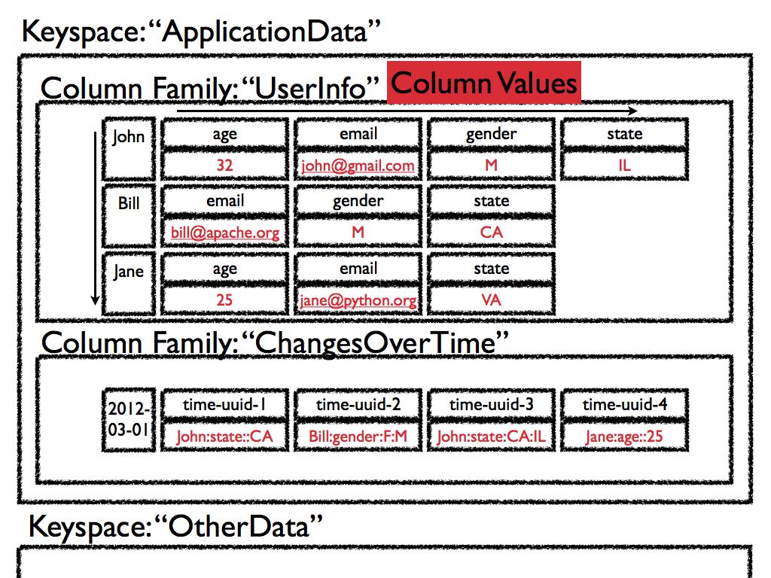

Slide 14
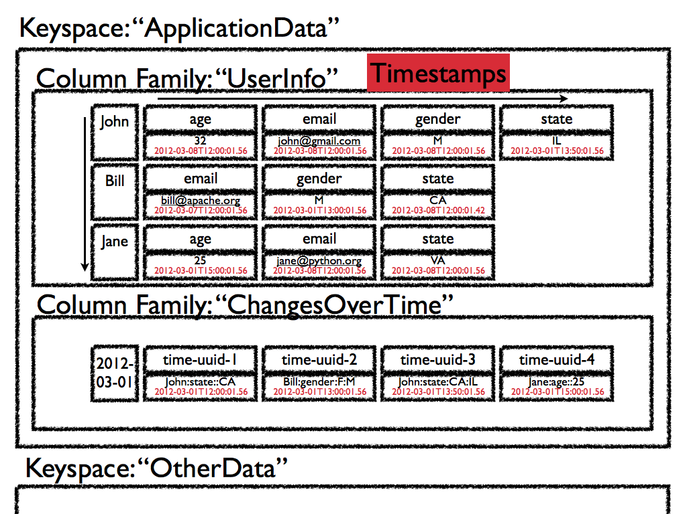

Slide 15
Multi-level Dictionary
Column Family
{"UserInfo":
{"John": {"age" : 32,
"email" : "john@gmail.com",
"gender": "M",
"state" : "IL"}}}
Columns
Key
Values

Slide 16
Well really this
{"UserInfo":
{"John":
OrderedDict(
[("age", 32),
("email", "john@gmail.com"),
("gender", "M"),
("state", "IL")])}}

Slide 17
Where do I get it?
From the Apache Cassandra project:
http://cassandra.apache.org/
Or DataStax hosts some Debian and RedHat packages:
http://www.datastax.com/docs/1.0/install/install_package

Slide 18
How do I run it?
Edit conf/cassandra.yaml
  Change data/commit log locations
  defaults: /var/cassandra/data and /var/cassandra/commitlog
Edit conf/log4j-server.properties
Change the log location/levels
default: /var/log/cassandra/system.log

Slide 19
How do I run it?
Edit conf/cassandra-env.sh
(bin/cassandra.bat on windows)
  Update JVM Memory usage
  default: 1/2 your ram

Slide 20
How do I run it?
$ ./cassandra -f
Foreground

Slide 21
Setup tips for local instances
Make templates out of cassandra.yaml and log4j-server.properties
Update “cassandra” script to generate the actual files
(run them through “sed” or something)

Slide 22
Server is running, what now?
$ ./cassandra-cli
connect localhost/9160;
create keyspace ApplicationData
with placement_strategy =
'org.apache.cassandra.
locator.SimpleStrategy'
and strategy_options =
[{replication_factor:1}];

Slide 23
Server is running, what now?
use ApplicationData;
create column family UserInfo
and comparator = 'AsciiType';
create column family ChangesOverTime
and comparator = 'TimeUUIDType';

Slide 24
Connect from Python
http://wiki.apache.org/cassandra/ClientOptions
Thrift - See the “interface” directory (Do not use!!!)
Pycassa - pip install pycassa
Telephus (twisted) - pip telephus
DB-API 2.0 (CQL) - pip cassandra-dbapi2

Slide 25
Thrift (don’t use it)
from thrift.transport import TSocket, TTransport
from thrift.protocol import TBinaryProtocol
from pycassa.cassandra.c10 import Cassandra, ttypes
socket = TSocket.TSocket('localhost', 9160)
transport = TTransport.TFramedTransport(socket)
protocol = TBinaryProtocol.TBinaryProtocolAccelerated(transport)
client = Cassandra.Client(protocol)
transport.open()
client.set_keyspace('ApplicationData')
import time
client.batch_mutate(
mutation_map=
{'John': {'UserInfo':
[ttypes.Mutation(
ttypes.ColumnOrSuperColumn(
ttypes.Column(name='email',
value='john@gmail.com',
timestamp= long(time.time()*1e6),
ttl=None)))]}},
consistency_level= ttypes.ConsistencyLevel.QUORUM)

Slide 26
Pycassa
import pycassa
from pycassa.pool import ConnectionPool
from pycassa.columnfamily import ColumnFamily
pool = ConnectionPool('ApplicationData',
['localhost:9160'])
col_fam = ColumnFamily(pool, 'UserInfo')
col_fam.insert('John', {'email': 'john@gmail.com'})

Slide 27
Pycassa
http://pycassa.github.com/pycassa/
https://github.com/twissandra/twissandra

Slide 28
Connect
pool = ConnectionPool('ApplicationData',
['localhost:9160'])
Keyspace
Server List

Slide 29
Open Column Family
col_fam = ColumnFamily(pool,
'UserInfo')
Connection Pool
Column Family

Slide 30
Write
col_fam.insert('John',
{'email':
'john@gmail.com'})
Key
Column Value
Column Name

Slide 31
Read
readData = col_fam.get('John',
columns=['email'])
Key
Column Names

Slide 32
Delete
col_fam.remove('John',
columns=['email'])
Key
Column Names

Slide 33
Batch
col_fam.batch_insert(
{'John': {'email': 'john@gmail.com',
'state': 'IL',
'gender': 'M'},
'Jane': {'email': 'jane@python.org',
'state': 'CA'}})
Column Names
Keys
Column Values

Slide 34
Batch (streaming)
b = col_fam.batch(queue_size=10)
b.insert('John',
{'email': 'john@gmail.com',
'state': 'IL',
'gender': 'F'})
b.insert('Jane',
{'email': 'jane@python.org',
'state': 'CA'})

Slide 35
Batch (streaming)
b.remove('John', ['gender'])
b.remove('Jane')
b.send()

Slide 36
Batch (Multi-CF)
from pycassa.batch import Mutator
import uuid
b = Mutator(pool)
b.insert(col_fam,
'John', {'gender':'M'})
b.insert(index_fam,
'2012-03-09',
{uuid.uuid1().bytes:
'John:gender:F:M'})

Slide 37
Batch Read
readData = col_fam.multiget(['John',
'Jane',
'Bill'])

Slide 38
Column Slice
d = col_fam.get('Jane',
column_start='email',
column_finish='state')
d = col_fam.get('Bill',
column_reversed=True,
column_count=2)

Slide 39
Column Slice
startTime = pycassa.util.
convert_time_to_uuid(time.time()-600)
d = index_fam.get('2012-03-31',
column_start=startTime,
column_count=30)

Slide 40
Types
from pycassa.types import *
col_fam.column_validators['age'] =
IntegerType()
col_fam.column_validators['height'] =
FloatType()
col_fam.insert('John', {'age':32,
'height':6.1})

Slide 41
Column Family Map
from pycassa.types import *
class User(object):
key = Utf8Type()
email = AsciiType()
age = IntegerType()
height = FloatType()
joined = DateType()

Slide 42
Column Family Map
from pycassa.columnfamilymap import
ColumnFamilyMap
cfmap = ColumnFamilyMap(User, pool,
'UserInfo')

Slide 43
Write
from datetime import datetime
user = User()
user.key = 'John'
user.email = 'john@gmail.com'
user.age = 32
user.height = 6.1
user.joined = datetime.now()
cfmap.insert(user)

Slide 44
Read/Delete
  user = cfmap.get('John')
users = cfmap.multiget(['John', 'Jane'])
  cfmap.remove(user)

Slide 45
Timestamps/Consistency
col_fam.read_consistency_level =
ConsistencyLevel.QUORUM
col_fam.write_consistency_level =
ConsistencyLevel.ONE
col_fam.get('John',
read_consistency_level=
ConsistencyLevel.ONE)
col_fam.get('John',
include_timestamp=True)

Slide 46
Indexing
Native secondary indexes
Roll your own with wide rows

Slide 47
Indexing Links
Intro to indexing
http://www.datastax.com/dev/blog/whats-new-cassandra-07-secondary-indexes
Blog post and presentation going through some options
  http://www.anuff.com/2011/02/indexing-in-cassandra.html
http://www.slideshare.net/edanuff/indexing-in-cassandra
Another blog post describing different patterns for indexing
http://pkghosh.wordpress.com/2011/03/02/cassandra-secondary-index-patterns/

Slide 48
Native Indexes
Easy to add, just update the schema
Can use filtering queries
Not recommended for high cardinality values (i.e. timestamps, birth dates, keywords, etc.)
Makes writes slower to indexed columns (read before write)

Slide 49
Add Index
update column family UserInfo
with column_metadata=[
{column_name: state,
validation_class: UTF8Type,
index_type: KEYS};

Slide 50
Native Indexes
from pycassa.index import *
state_expr = create_index_expression('state',
'IL')
age_expr = create_index_expression('age',
20,
GT)
clause = create_index_clause([state_expr,
age_expr],
count=20)
for key, userInfo in \
col_fam.get_indexed_slices(clause):
# Do Stuff

Slide 51
Rolling Your Own
Removing changed values yourself
Know the new value doesn't exists, no read before write
Index can be denormalized query, not just an index.
Can use things like composite columns, and other tricks to allow range like searches.

Slide 52
Lessons Learned
Use indexes. Don't iterate over keys.
New Query == New Column Family
Don't be afraid to write your data to multiple places (Batch)

Slide 53
Questions?

