Slide 1
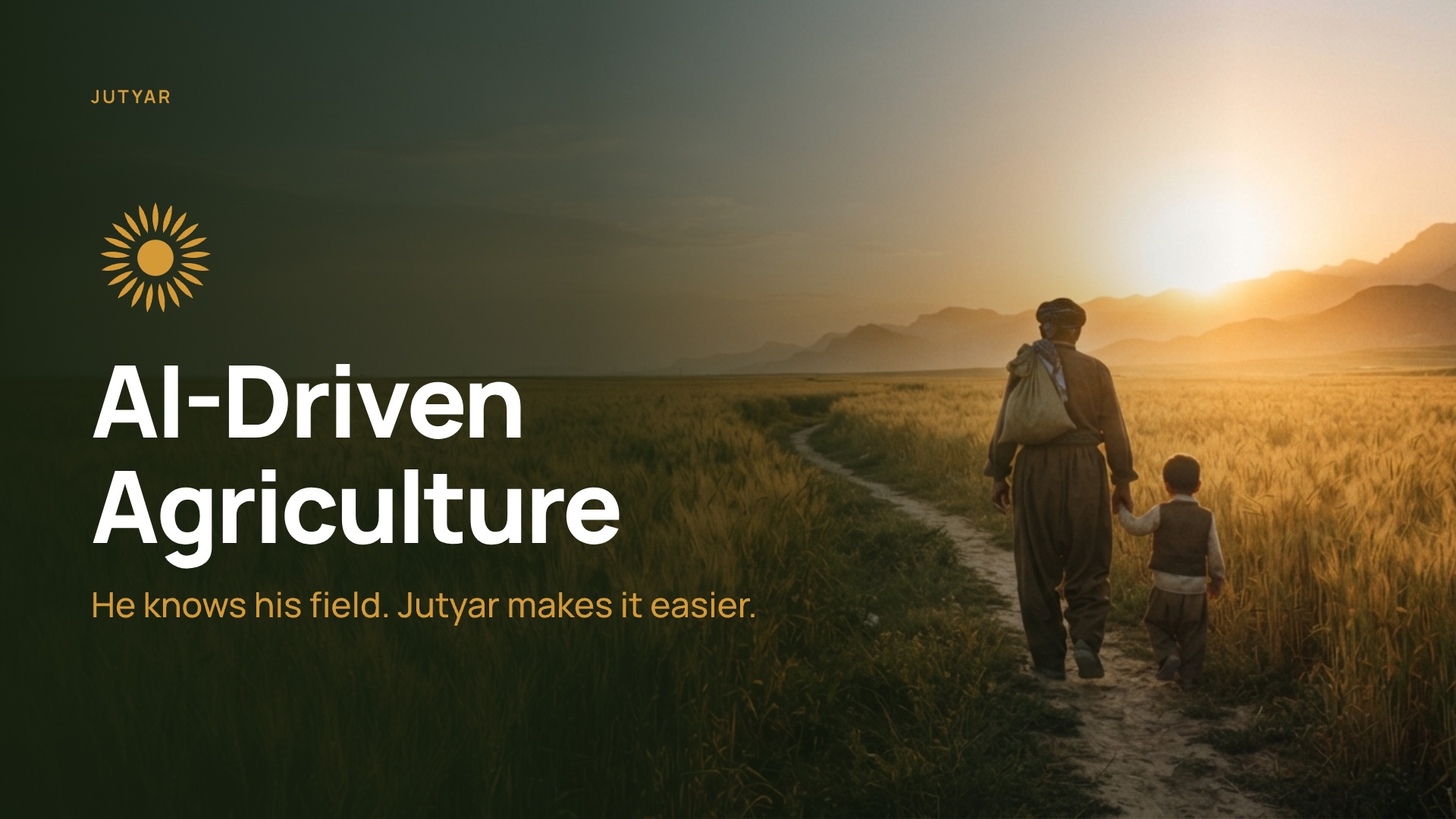
Notes:
On screen before the judges arrive. Phone in hand, app open. Say your ID when asked.

Slide 2
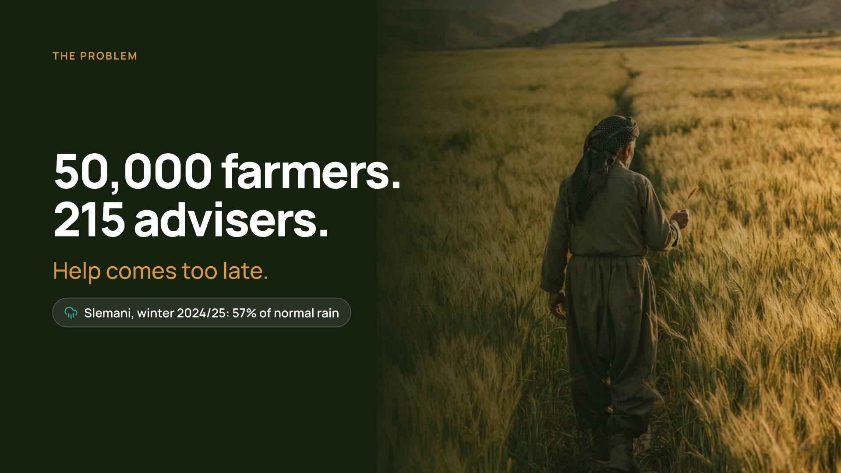
Notes:
0:00 to 0:10. Kurdistan has about 50,000 wheat farmers and only about 215 advisers. Jutyar puts an adviser in every farmer's pocket. Let me show you.

Slide 3
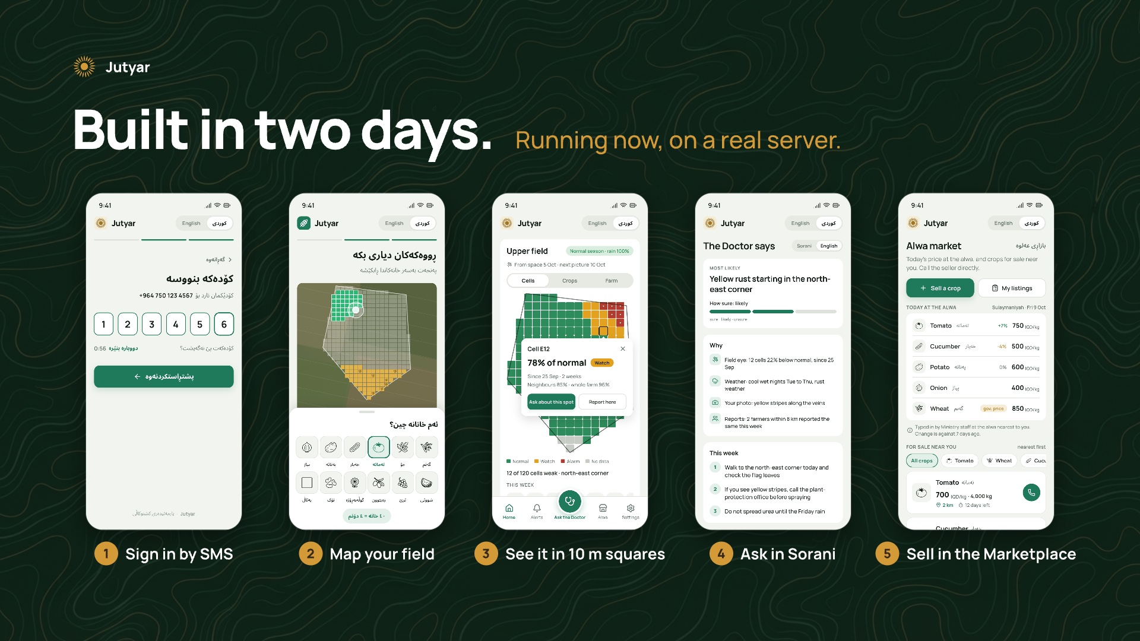
Notes:
0:10 to 1:15. DEMO ON THE PHONE. This is running now, on a real server. I sign in with my phone number and an SMS code. This is my farm. I walked its corners and marked my crops. The app cuts it into 10 metre squares, the size of one satellite pixel. Here is my 10-day plan from the live forecast. I asked a question with a photo, and this is the answer, in Sorani. And this is Alwa, the marketplace: my tomatoes are on sale, and other farmers see them on their phones.

Slide 4
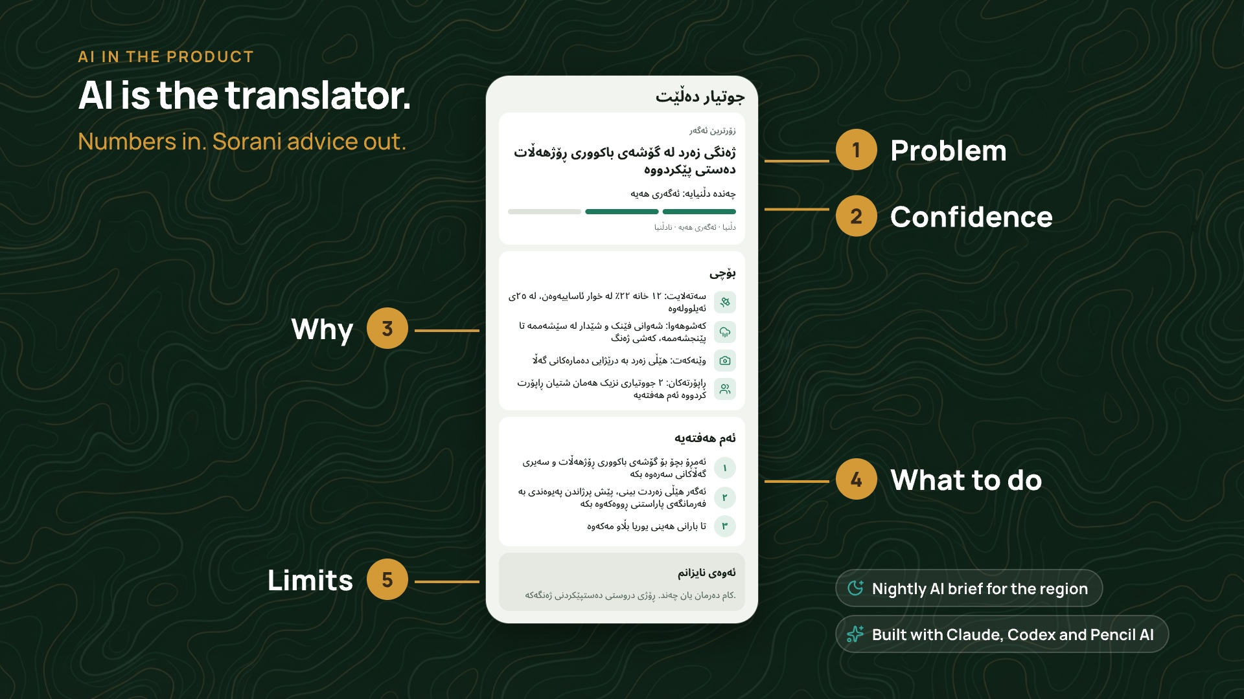
Notes:
1:15 to 1:50. AI is the translator. The satellite, the forecast and the field's history are only numbers. An AI model turns them, with the farmer's photo, into advice in Sorani, and it says when it is unsure. Every night another AI agent writes the daily brief for the region. And we built all of this with AI: Claude, Codex and Pencil.

Slide 5
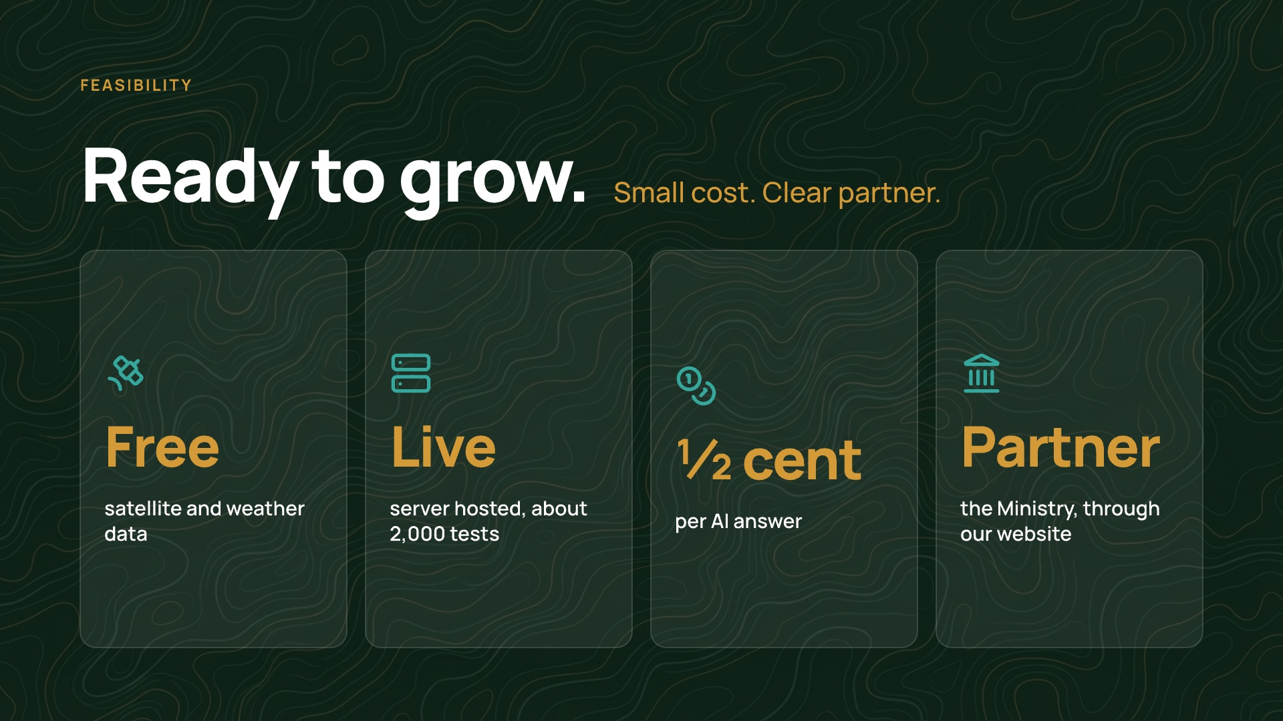
Notes:
1:50 to 2:30. LAST SLIDE. Is it realistic? The data is free. The server is live, with about 2,000 tests. One AI answer costs half a cent. The Ministry gets its own website, with the farms, the alerts and the region on one map. We start with wheat farmers in Slemani. App, server and website, built in two days. This is Jutyar. Thank you.

Slide 6
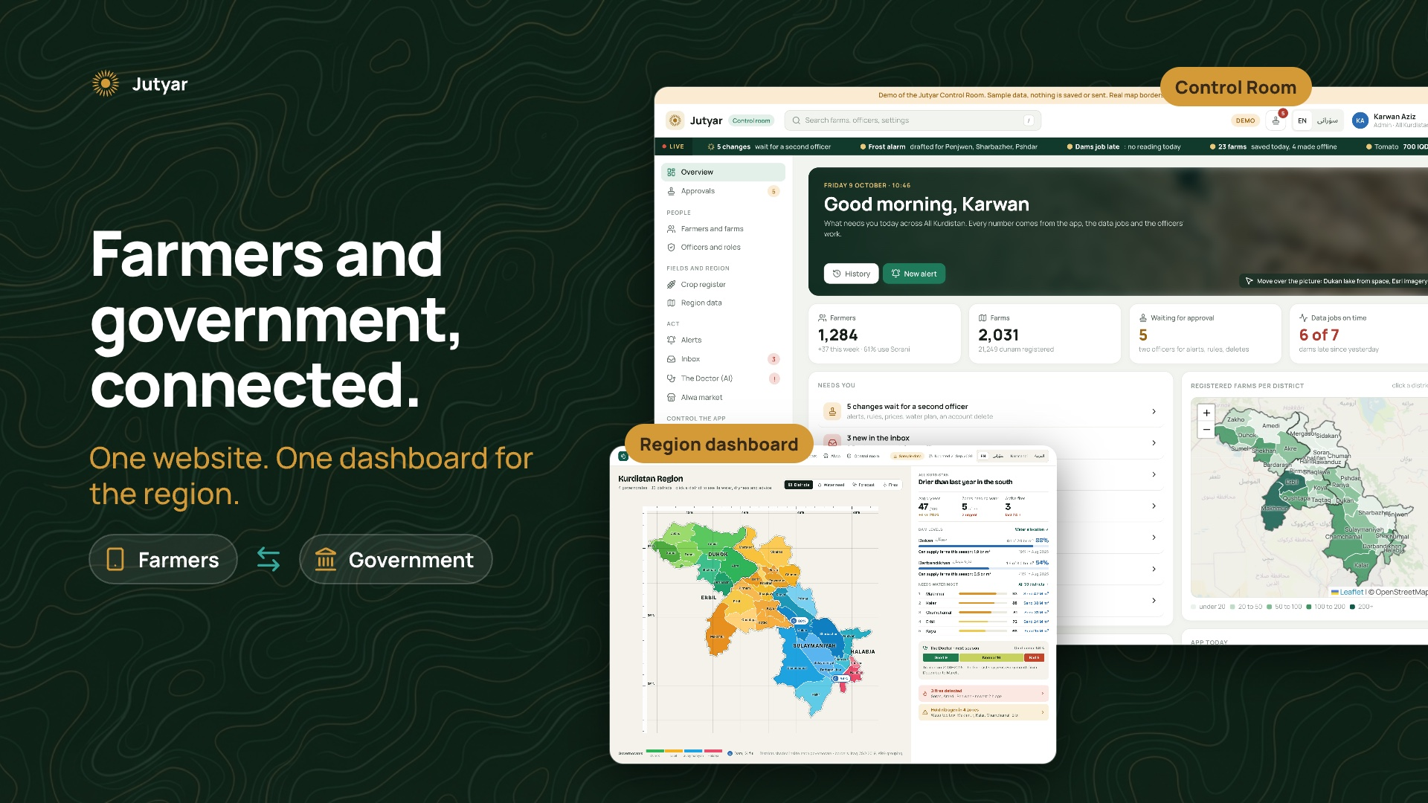
Notes:
BACKUP FOR QUESTIONS. The website: the Control Room and the region dashboard. These pictures are designs with sample numbers.

Slide 7
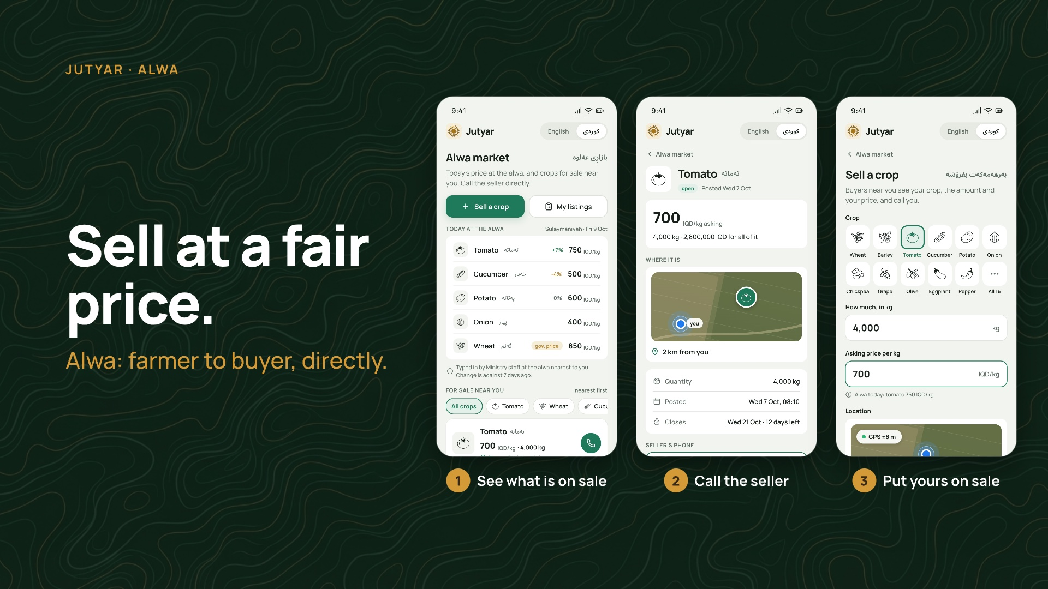
Notes:
BACKUP FOR QUESTIONS. Alwa, the marketplace: see what is on sale, call the seller, put yours on sale.

Slide 8
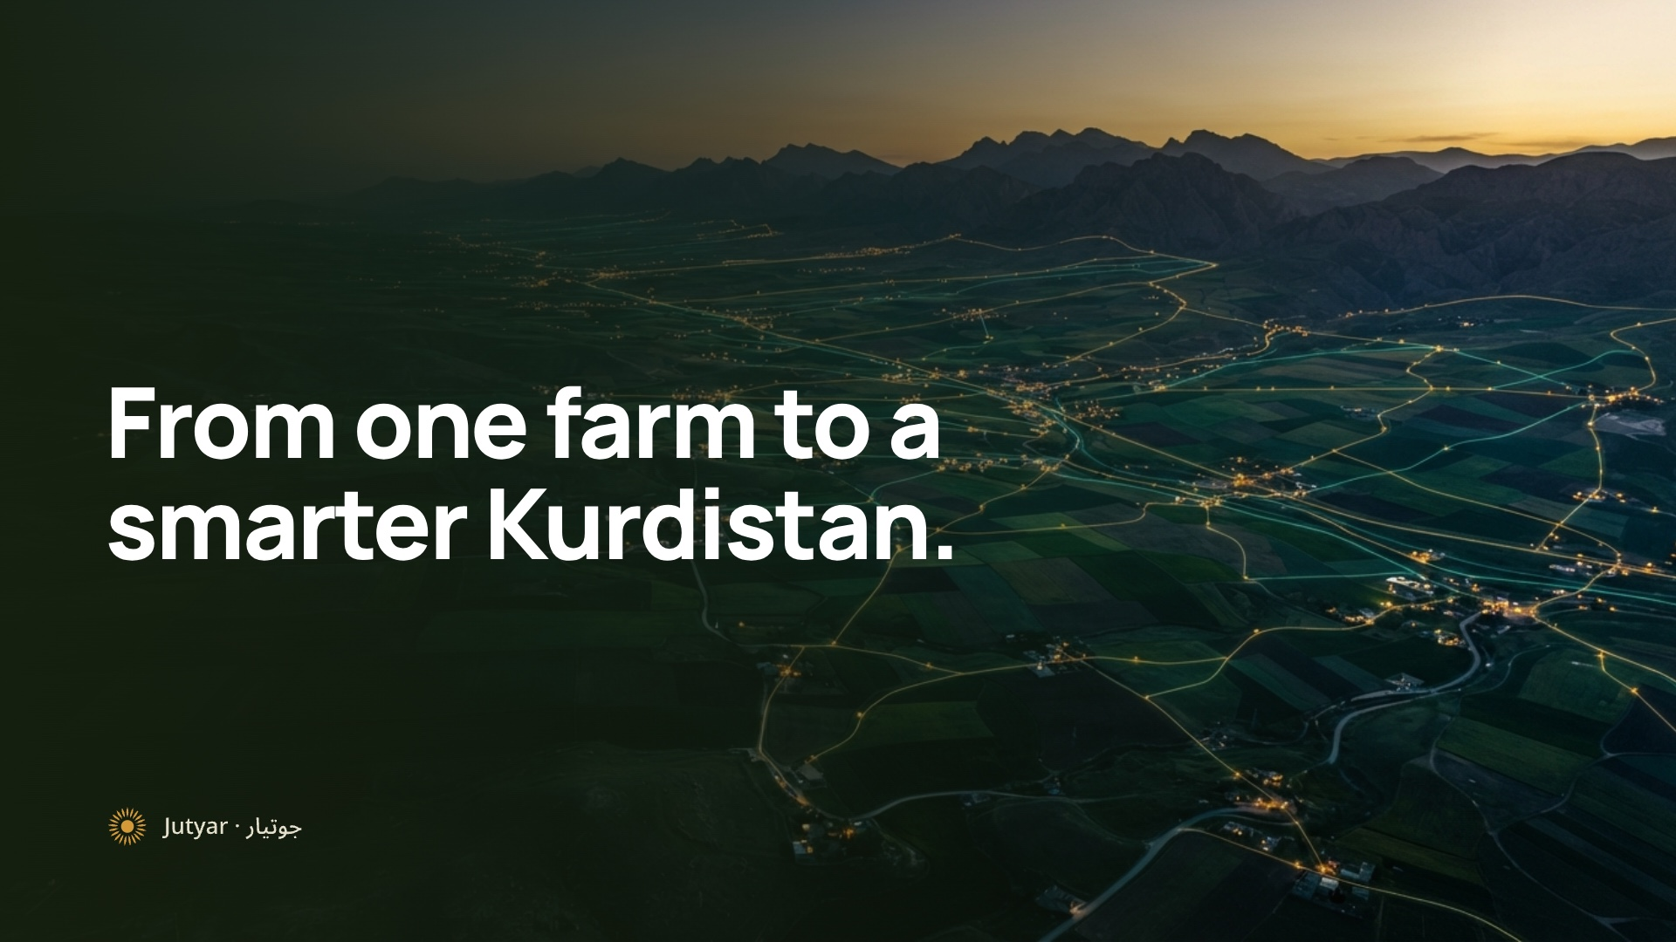
Notes:
BACKUP. The vision picture, if a judge asks where this goes next.

