Slide 1
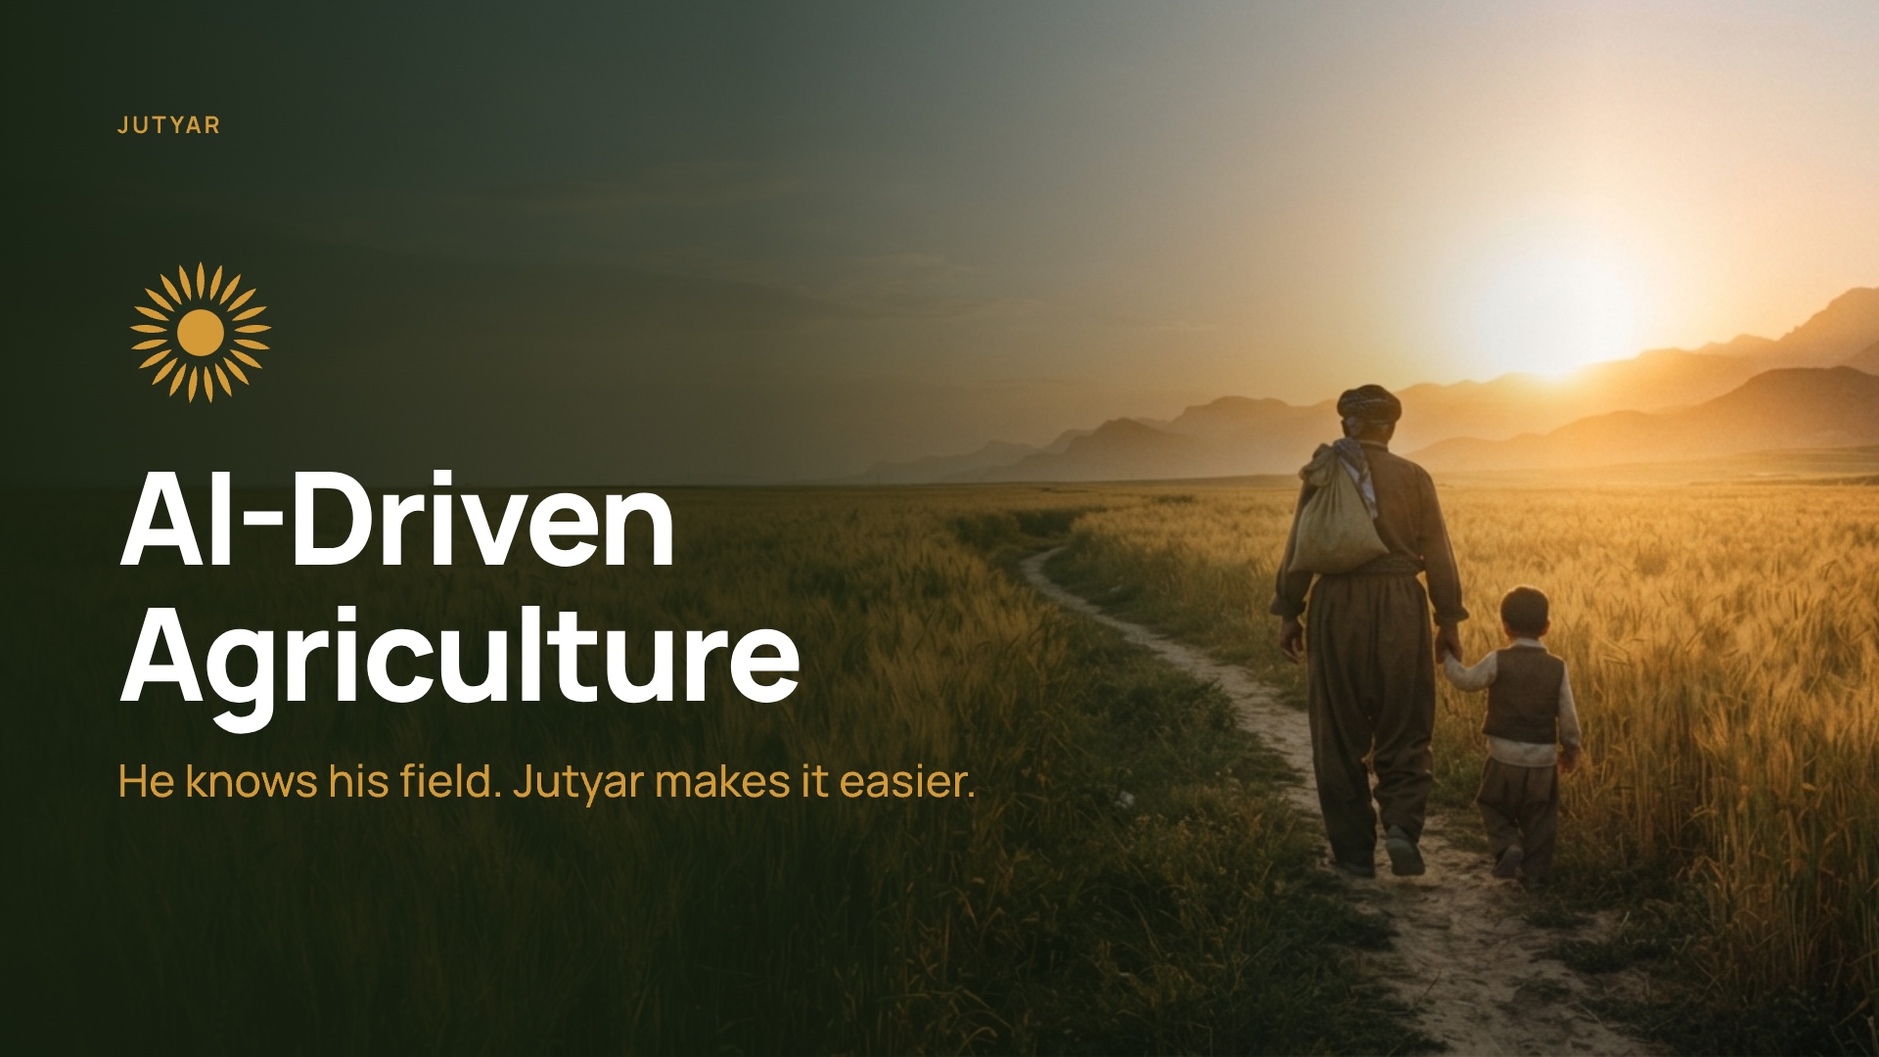
Notes:
0:00 to 0:10. We are AI-Driven Agriculture, and this is Jutyar.

Slide 2
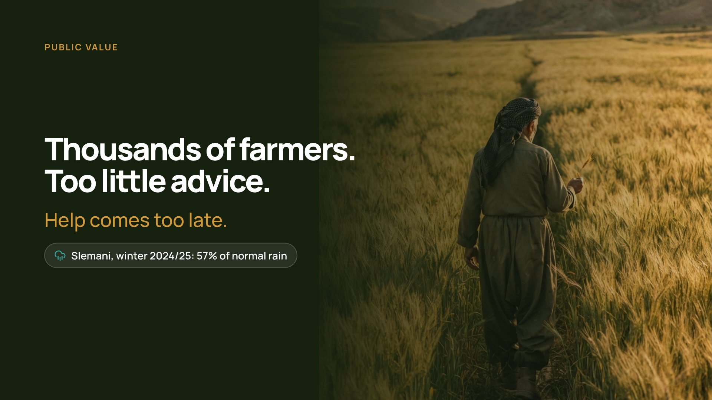
Notes:
0:10 to 0:45. PUBLIC VALUE. Kurdistan has tens of thousands of farmers, but access to extension advice is limited. In a 2024 study, the region's own extension staff described the service as weak. In the 2025 drought the region lost about 800,000 tonnes of wheat. That winter Slemani got 57 percent of its normal rain, and most farmers learned it from their own fields. Jutyar gives every farmer advice for his own field, every week, in his own language, and gives the Ministry the same picture for the whole region.

Slide 3
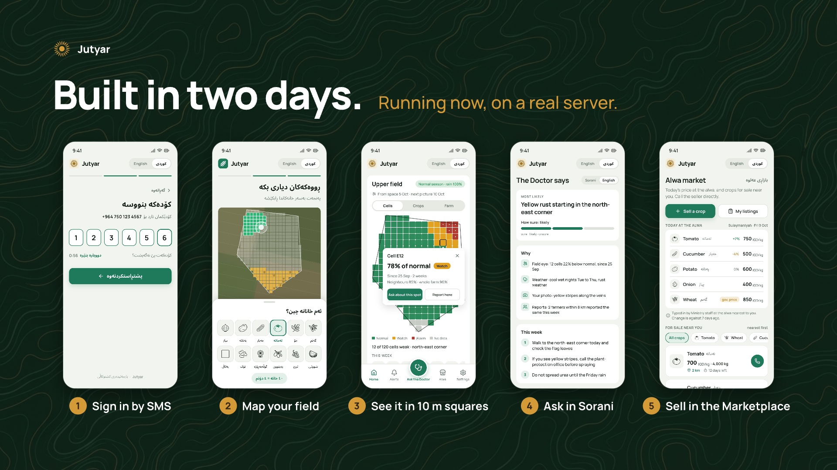
Notes:
0:45 to 1:30. DEMO ON THE PHONE. This is running now, on a real server. I sign in with my phone number and an SMS code. This is my farm. I walked its corners and marked my crops. The app cuts it into 10 metre squares, the size of one satellite pixel. Here is my 10-day plan from the live forecast. I asked a question with a photo, and this is the answer, in Sorani. And this is Alwa, the marketplace: my tomatoes are on sale, and other farmers see them on their phones.

Slide 4
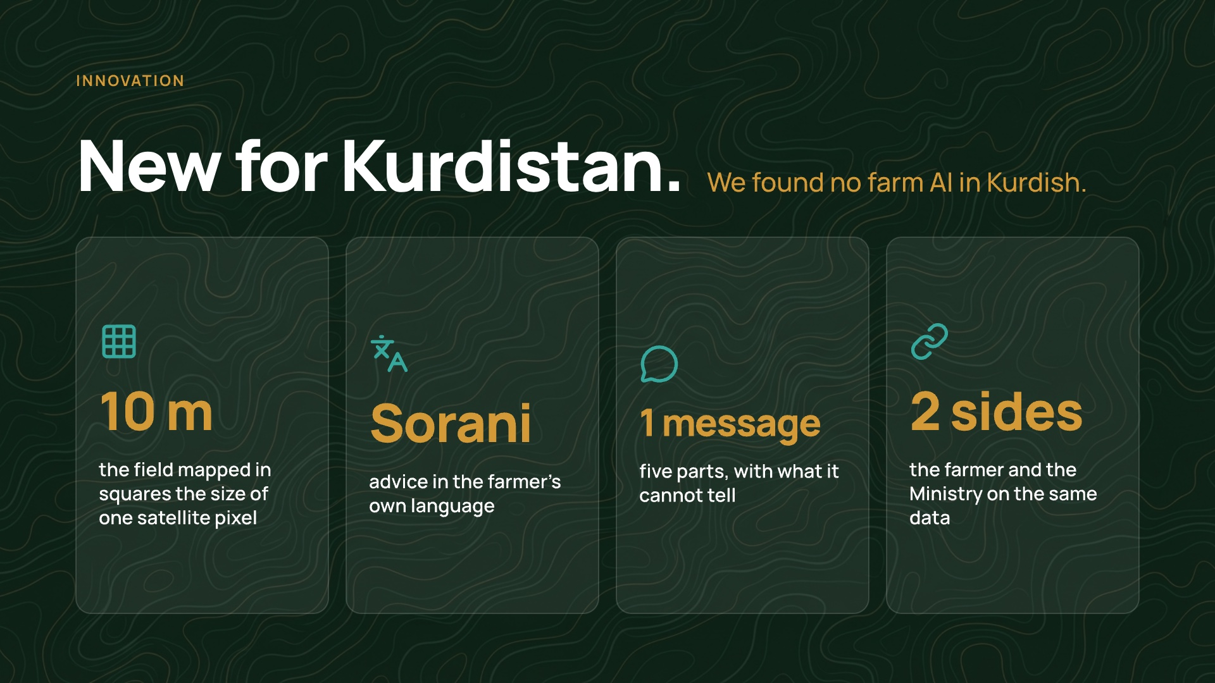
Notes:
1:30 to 2:05. INNOVATION. What is new? Our research found no farm AI in Kurdish anywhere. Jutyar maps a field in 10 metre squares, reads it from space, and answers in Sorani, in one message of five parts, including what it cannot tell. And the farmer and the Ministry work on the same data.

Slide 5
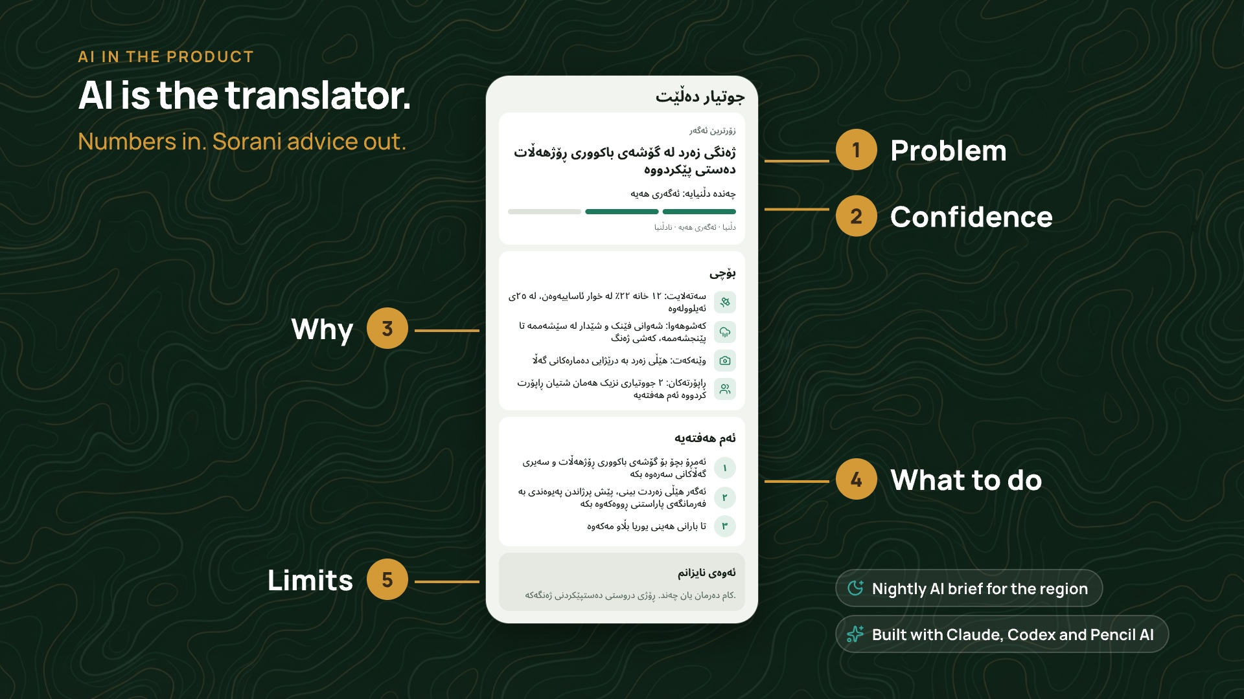
Notes:
2:05 to 2:35. AI is the translator. The satellite, the forecast and the field's history are only numbers. An AI model turns them, with the farmer's photo, into advice in Sorani, and it says when it is unsure. Every night another AI agent writes the daily brief for the region. And we built all of this with AI: Claude, Codex and Pencil.

Slide 6
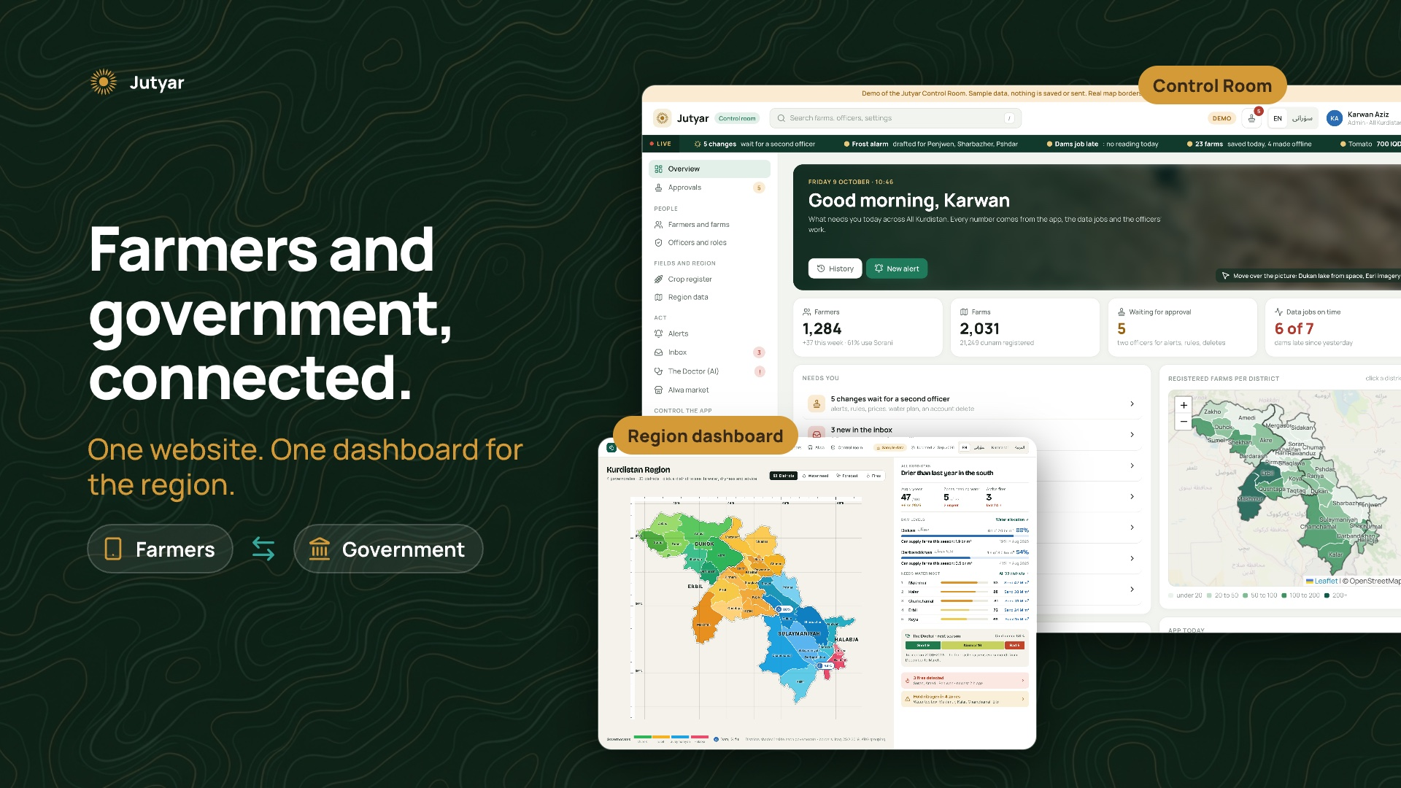
Notes:
2:35 to 3:05. SCALABILITY AND ADOPTION. Can it grow? It already covers all 33 districts in four governorates, because the satellite and weather data are free everywhere. A government office adopts it through this website: the farms, the alerts, the reports and the region on one map.

Slide 7
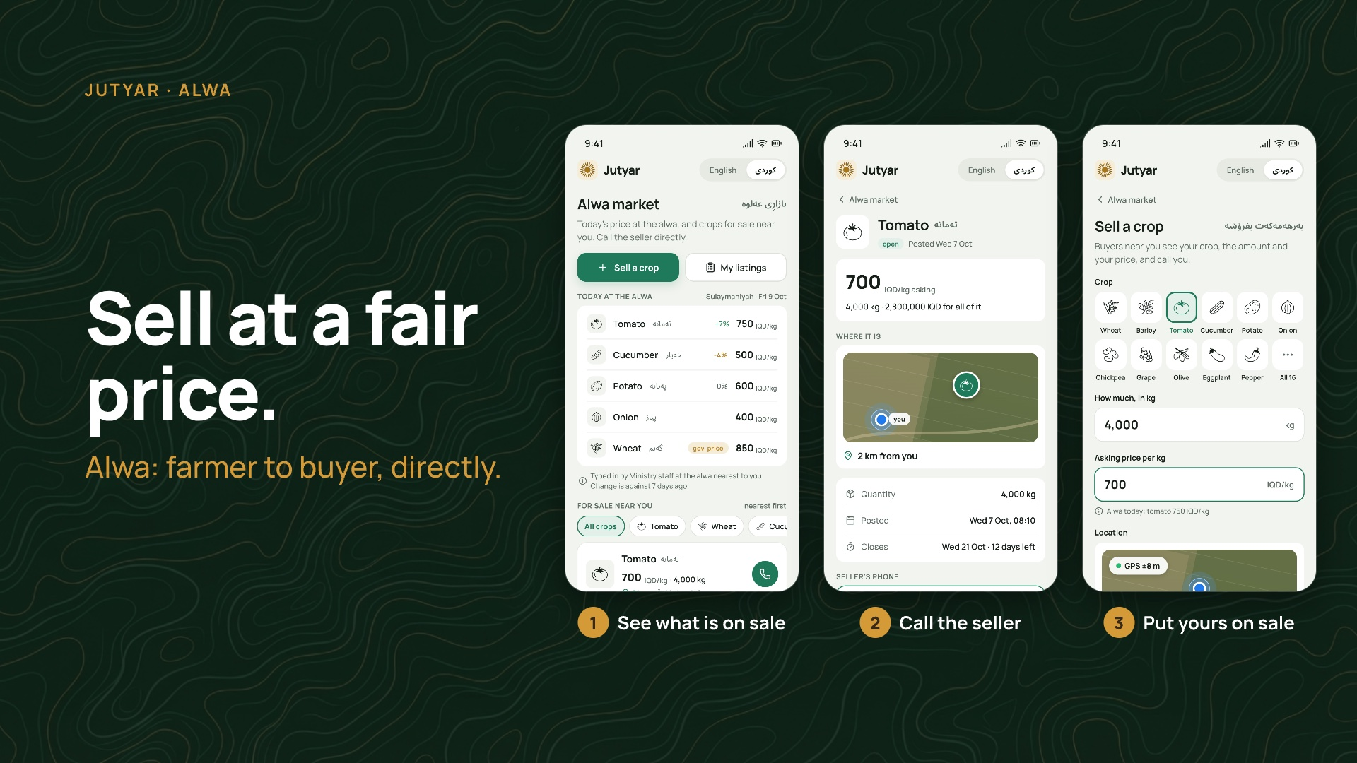
Notes:
3:05 to 3:25. And farmers have a reason to open it every day: Alwa, the marketplace, where they sell directly to buyers.

Slide 8
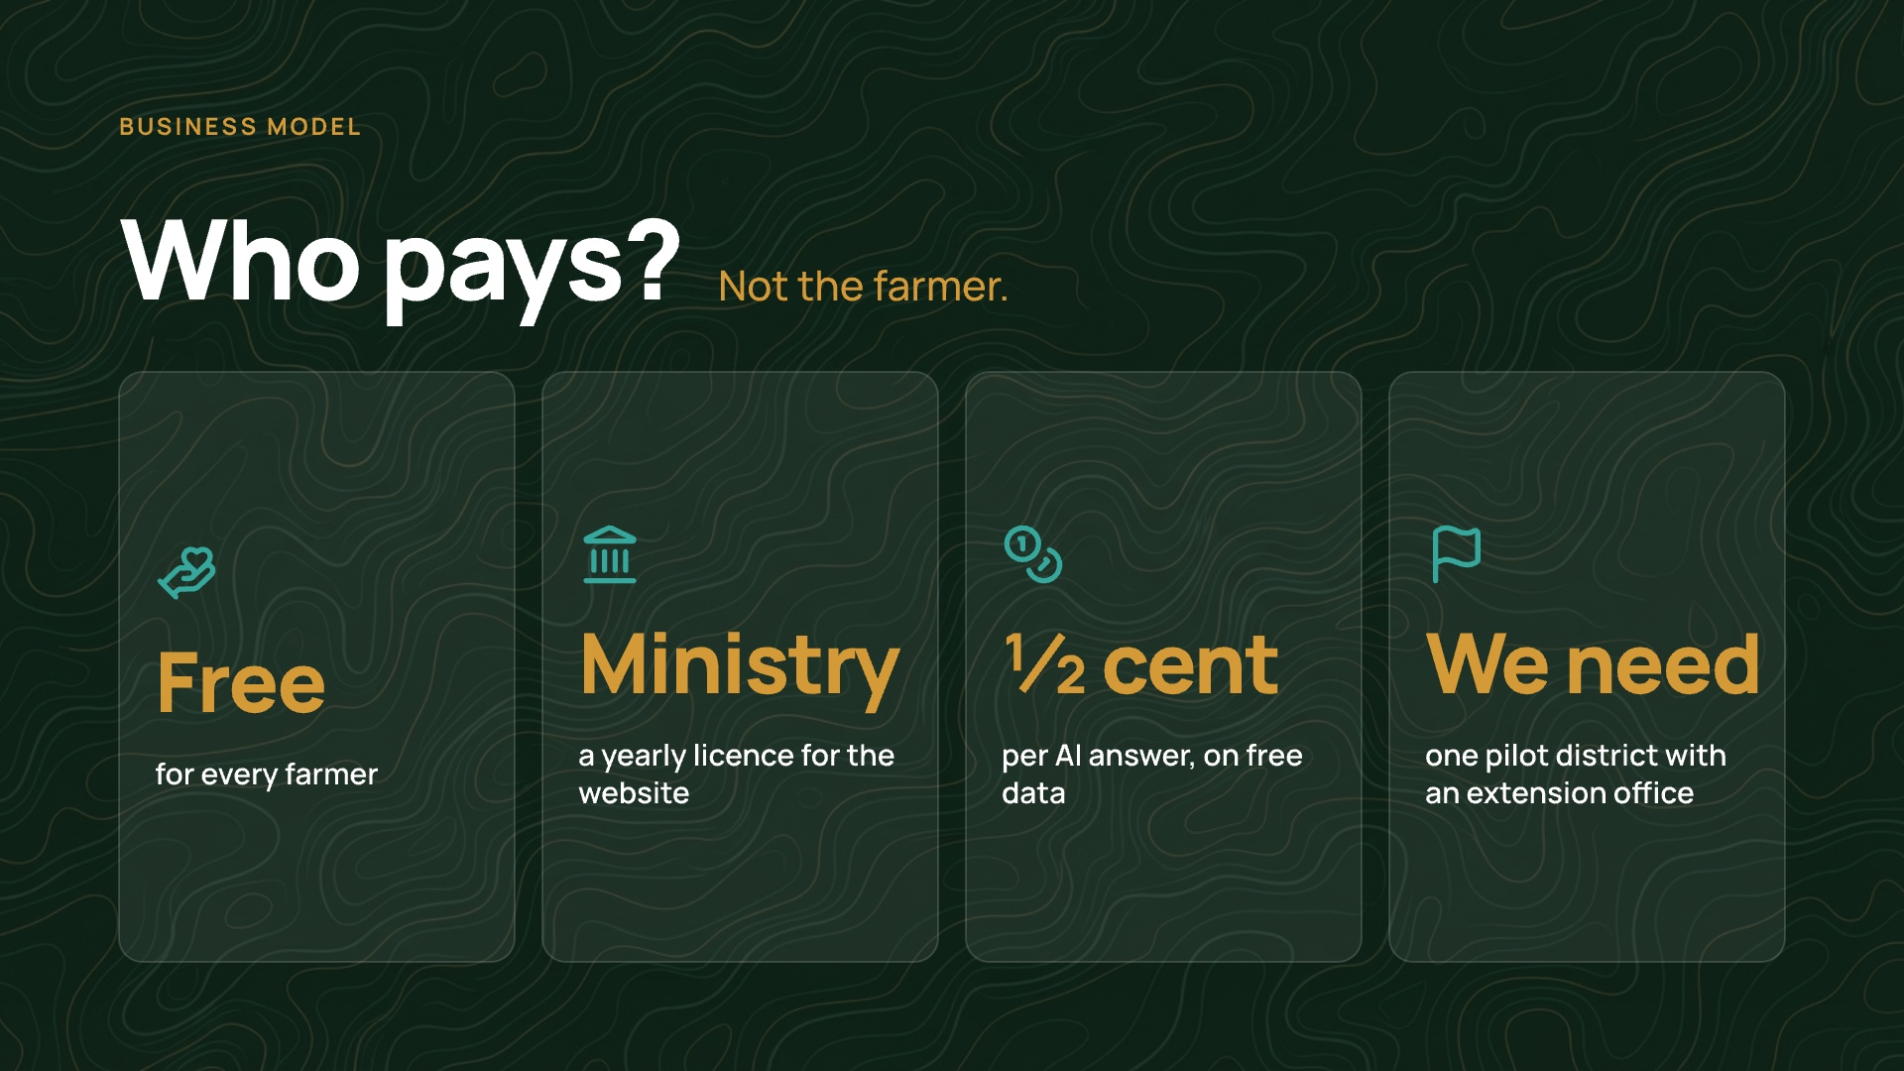
Notes:
3:25 to 4:05. BUSINESS MODEL. Who pays? Not the farmer. Jutyar is free for farmers. Our plan is a yearly licence for the Ministry's website. Running costs are small: the data is free and one AI answer costs half a cent. What we need now is one pilot district with an extension office.

Slide 9
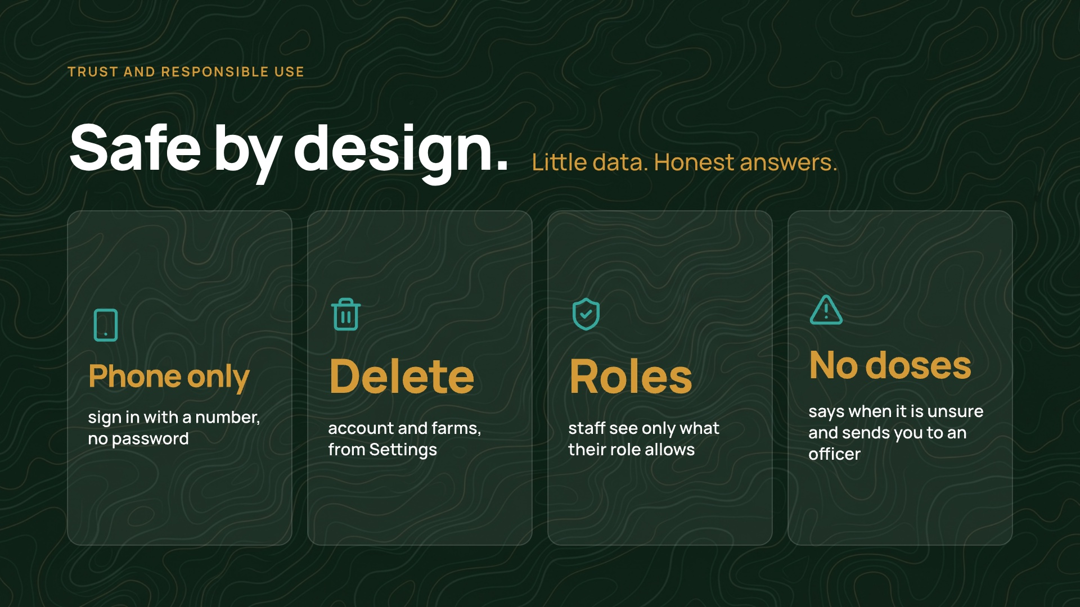
Notes:
4:05 to 4:40. TRUST. Is it safe? To sign in, a farmer gives only a phone number, no password. He can delete his account and his farms from Settings. Staff see only what their role allows. And the advice is careful: it never gives a chemical dose, it says when it is unsure, and it sends the farmer to an officer.

Slide 10
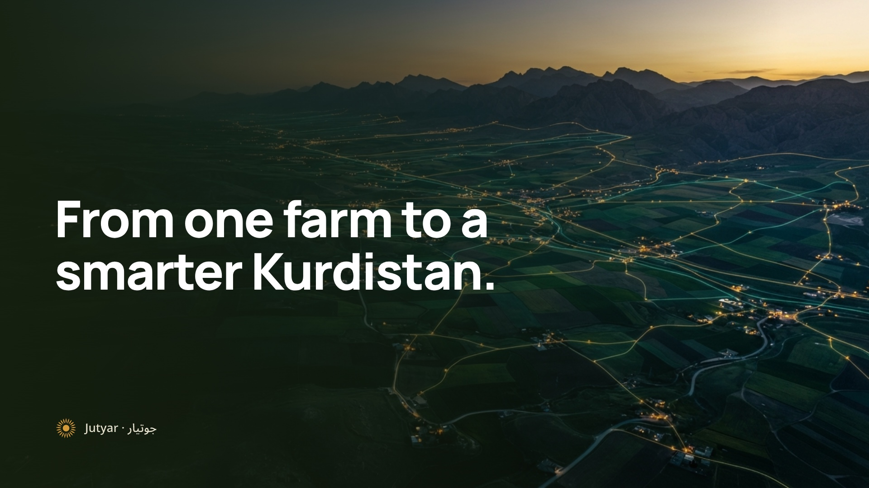
Notes:
4:40 to 4:50. Built in two days, running today. Jutyar: from one farm to a smarter Kurdistan. Thank you.

