Slide 1
Predicting Portfolio Risk with Machine Learning
A walk-forward comparison against GARCH-type baselines on Indian equities and ETFs
Presented by: [Author 1] [Author 2] [Author 3] [Author 4]
Mentor: [Mentor name]
Minor Specialization Mini Project, Manipal Institute of Technology
Notes:
Replace the bracketed names and the mentor before presenting. One-sentence summary: we asked whether ML predicts portfolio risk better than classic econometric models, and tested it carefully.

Slide 2
Why portfolio risk prediction?
• Investors care about how bad a portfolio can get, not only its expected return
• Three questions over the next 21 trading days:
– How volatile will it be? (volatility)
– How likely is a drawdown of 5% or more? (probability)
– How much can it lose on a bad day? (95% Value-at-Risk)
• Classic answers: GARCH, HAR, EWMA, historical VaR
• ML promises more flexibility, but is it actually better?
Hansen & Lunde (2005): hard to beat a plain GARCH(1,1) out of sample
Portfolio Risk Prediction Using Machine Learning
2
Notes:
Set the stakes. Investors want to know how bad things can get, not only the expected return. Three questions: how volatile, how likely a drawdown, how much can I lose in a day.

Slide 3
Research gap and our contributions
The gap
What we do
• Comparisons often use a single asset
• Random train/test splits leak the future
• Weak baselines make ML look good
• Multiple testing is ignored
• Portfolio-level model: one model for any user portfolio (400 random portfolios)
• Same folds, rows and metrics for every model; leakage tests
• Strong baselines incl. GJR-GARCH-t, HAR, simulation
• Holm-corrected tests, confidence sets, held-out portfolios
• Downstream test: do the forecasts help control risk?
Portfolio Risk Prediction Using Machine Learning
3
Notes:
The gap: ML-vs-econometrics comparisons often use one asset, random splits or weak baselines. We fix that at portfolio level with one shared, strict evaluation.

Slide 4
Agenda
• 1. Data, targets and models
• 2. Evaluation design (no look-ahead)
• 3. Results: volatility, drawdown, VaR
• 4. Downstream test: volatility targeting
• 5. Discussion, limitations, conclusion
Portfolio Risk Prediction Using Machine Learning
4

Slide 5
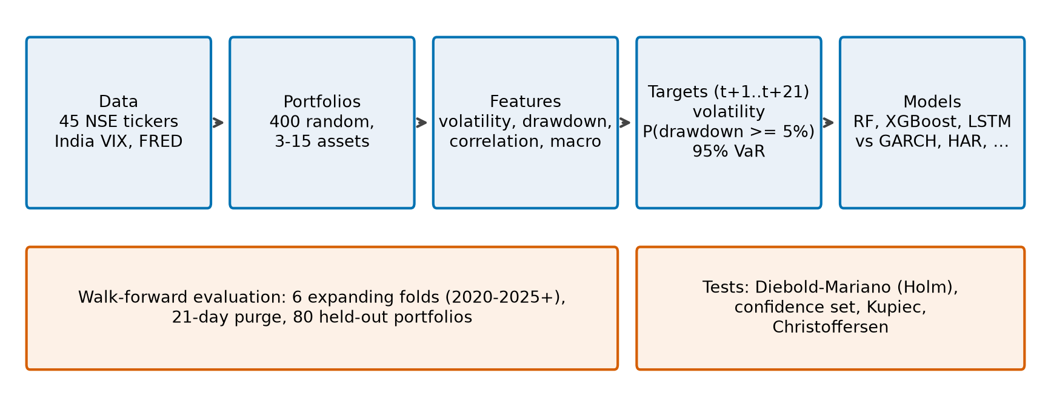
End-to-end pipeline
Features at t use data up to t. Targets use t+1 .. t+21 only. Scalers are fit on training rows only.
Portfolio Risk Prediction Using Machine Learning
5
Notes:
Walk through left to right. Emphasise that features at time t use data up to t and targets use t+1..t+21 only.

Slide 6
Data and portfolios
• 45 liquid NSE instruments: 40 large caps + 5 ETFs (Nifty 50, Next 50, Bank, PSU Bank, gold)
• Daily adjusted closes, Jan 2010 to Oct 2026 (4,149 trading days), cached as parquet
• India VIX + FRED: US 10Y, USD/INR, Brent, Fed funds, CPI
– each series lagged by its publication delay
– entered as changes, not levels
• 400 random portfolios: 3-15 assets, Dirichlet weights
• 310,400 rows (every 5th trading day); 80 portfolios held out of all training
Any user portfolio is scored by the same feature code path
Portfolio Risk Prediction Using Machine Learning
6
Notes:
45 NSE instruments; macro lagged by publication delay; changes instead of levels because trees memorise calendar regimes through levels.

Slide 7
Three forward-looking targets (H = 21 days)
Target | Definition | Type
Volatility | annualised std of returns t+1 .. t+21 | regression
Drawdown | 1 if max drawdown over the next 21 days >= 5% | probability
95% VaR | 5% quantile of the next-day return | quantile regression
• Volatility model predicts log(vol_fwd / vol_21): the change from today's level
• VaR scored by pinball loss and exceedance rate; expected shortfall for baselines (FZ0 loss)
Portfolio Risk Prediction Using Machine Learning
7
Notes:
All three use only returns after t.

Slide 8
Features
• Lookbacks 21, 63 and 126 days, from the portfolio return series:
– rolling volatility, max drawdown, Sharpe, Sortino
– momentum, skewness, kurtosis
– market beta, correlation, mean pairwise correlation of holdings
• Market and macro: India VIX (level, change), lagged changes of US yields, FX, oil, CPI
• Model-based inputs (HAR, two GARCH forecasts), refit once a year on earlier data
Perturbation tests: changing future data cannot change a feature at t
Portfolio Risk Prediction Using Machine Learning
8
Notes:
Lookbacks 21, 63, 126 days. Everything computed from data up to and including t.

Slide 9
Models and baselines
Machine learning
Traditional + combinations
• Random Forest (vol, drawdown)
• XGBoost (vol, drawdown, quantile VaR)
• LSTM: one single-layer multi-task network, PyTorch, window 21
• Fixed hyperparameters, not tuned; seed 42
• Naive, EWMA, Ledoit-Wolf volatility
• HAR, GARCH(1,1), GJR-GARCH with t errors
• Historical, parametric and filtered-historical VaR
• Base rate and simulated drawdown (2,000 paths)
• Combos: HAR+GARCH, HAR+GARCH+XGBoost
• Optional conformal VaR correction
Portfolio Risk Prediction Using Machine Learning
9
Notes:
The baselines are strong on purpose: GJR-GARCH with t errors, HAR, simulation. Two equal-weight combinations were added after seeing earlier ranks: disclosed selection effect.

Slide 10
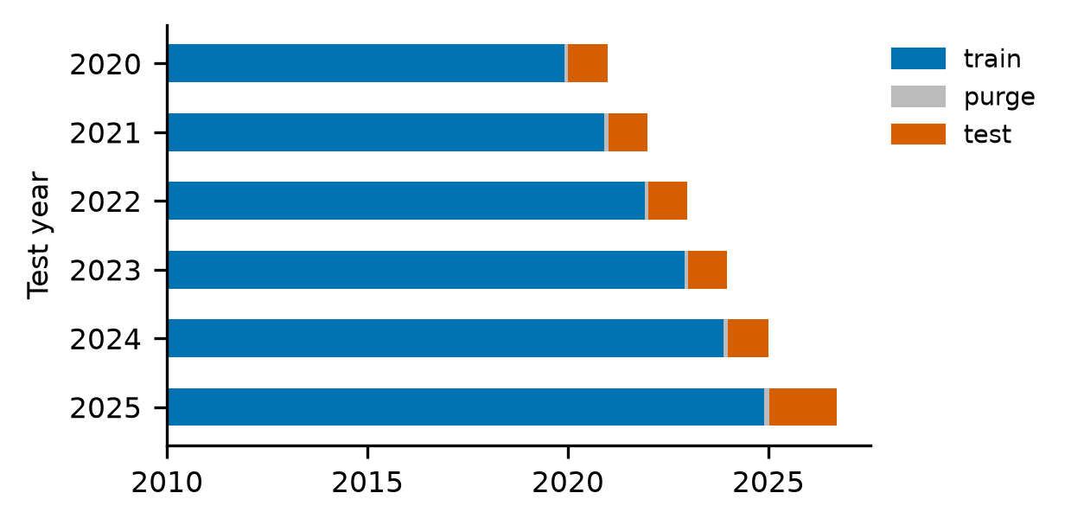
Evaluation: walk-forward, no look-ahead
• 6 expanding-window folds: test 2020 ... 2025+
• 21-day purge between train and test
• Early stopping on the last 252 training days, then refit on all training rows
• Same rows, folds and metrics for every model
• 80 portfolios never used for training
• Mean +/- std across folds
Portfolio Risk Prediction Using Machine Learning
10
Notes:
Never a random split. The purge stops a training target window from reaching into the test period.

Slide 11
Statistical rigour and safeguards
• Volatility ranked by QLIKE and MSE on variance (robust to a noisy proxy), plus RMSE
• Diebold-Mariano tests on date-level losses (HAC variance), Holm-corrected
• 90% model confidence set; Kupiec, Christoffersen tests for VaR
• Round-4 choices pre-registered in code and pinned by tests
• 210 automated tests: leakage, purge, hand-computed metrics, train/serve parity
About 190 independent 21-day periods since 2010: power is low, so we say so
Portfolio Risk Prediction Using Machine Learning
11
Notes:
119 inferential tests; Holm within pre-registered families. Pre-registration: choices written into code before the numbers existed.

Slide 12
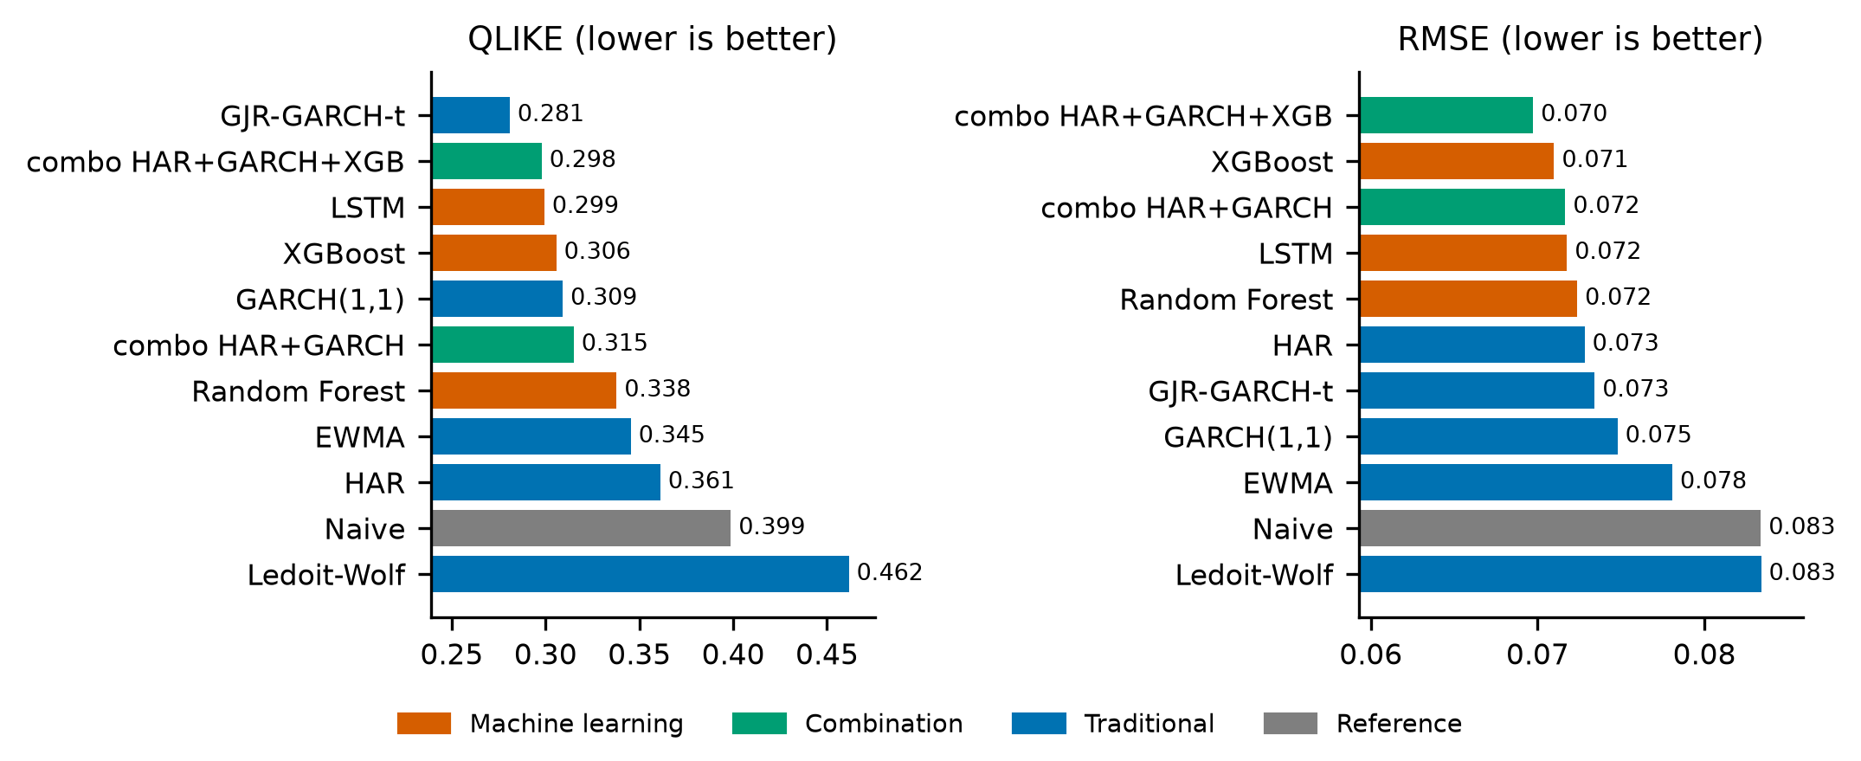
Result 1: volatility ranking depends on the loss
• GJR-GARCH-t is best on QLIKE and MSE-variance
• The HAR+GARCH+XGB combo is best on RMSE
• Std across folds (~0.05 RMSE) exceeds the gaps
• Held-out portfolios: same picture
No ML model beats GJR significantly; XGBoost and LSTM beat naive on QLIKE (Holm p = 0.015, 0.008)
Portfolio Risk Prediction Using Machine Learning
12
Notes:
QLIKE: GJR first (0.281), best ML is LSTM (0.299). RMSE: combo with XGBoost first (0.0697). Fold std ~0.05 is larger than the gaps. Held-out portfolios give the same picture.

Slide 13
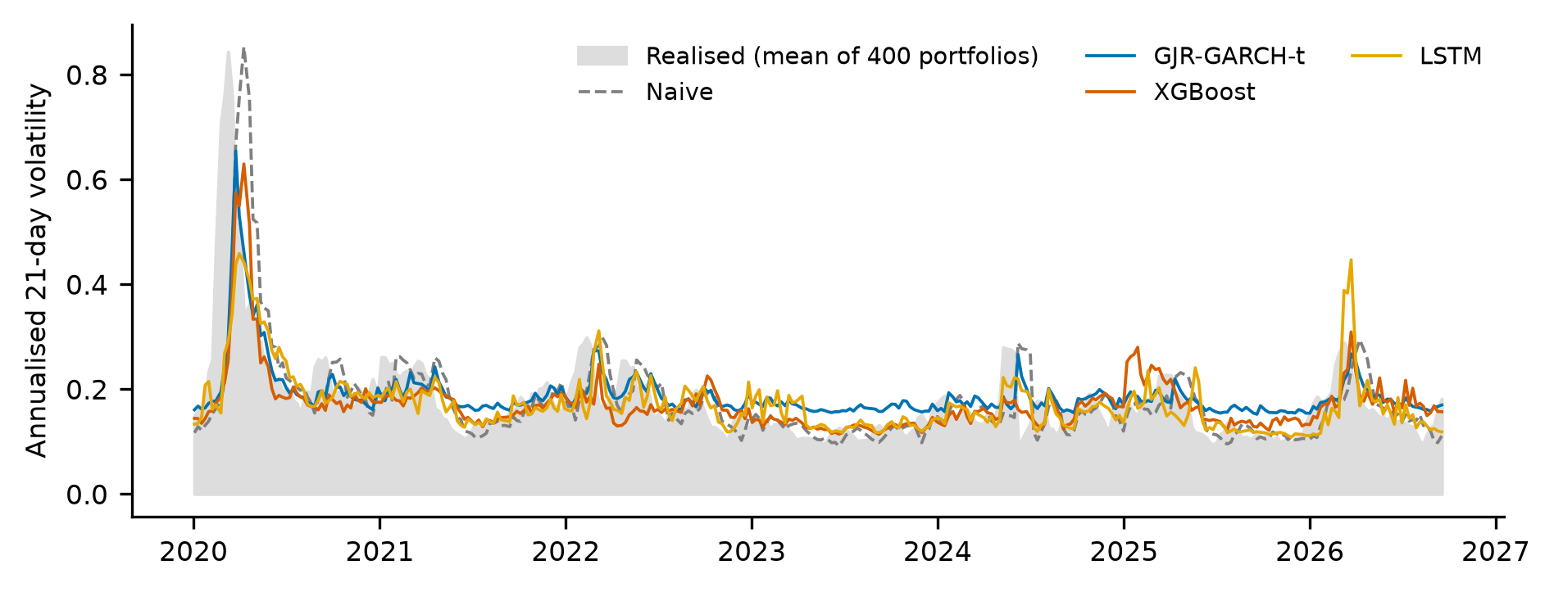
Volatility forecasts over time
Calm periods: XGBoost, HAR and the combo lead. Stress: GJR and GARCH lead. No regime test is significant.
Portfolio Risk Prediction Using Machine Learning
13
Notes:
All models follow the 2020 spike; naive lags turning points.

Slide 14
Significance: ML beats naive, not the best baseline
ML model | versus | QLIKE difference | raw p | Holm p
Random Forest | GJR (best baseline) | +0.049 | 0.362 | 1.000
Random Forest | naive | -0.063 | 0.007 | 0.074
XGBoost | GJR (best baseline) | +0.020 | 0.531 | 1.000
XGBoost | naive | -0.092 | 0.001 | 0.015
LSTM | GJR (best baseline) | +0.017 | 0.548 | 1.000
LSTM | naive | -0.095 | 0.001 | 0.008
Not significant: any ML model vs GJR. Significant: XGBoost and LSTM vs naive (Holm p < 0.02).
Portfolio Risk Prediction Using Machine Learning
14
Notes:
Negative difference favours ML. Only XGBoost and LSTM versus naive survive Holm correction.

Slide 15
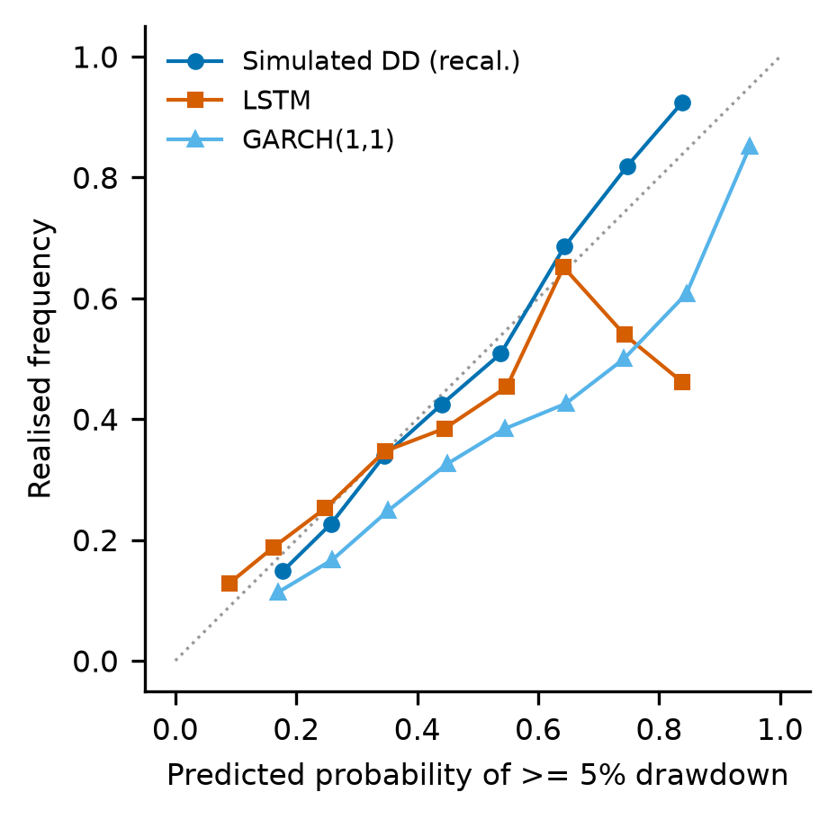
Result 2: drawdown probability
• Brier: simulated drawdown 0.2046, RF 0.2061, LSTM 0.2062, combo 0.2068, base rate 0.2199
• Mean prediction 0.335 vs realised 0.318 (GARCH over-predicts: 0.452)
• Edge over GARCH (raw p = 0.034) and base rate (0.013) does not survive Holm (0.101, 0.052)
• GJR-GARCH has the best ROC-AUC (0.644)
Portfolio Risk Prediction Using Machine Learning
15
Notes:
The simulated drawdown model has the best Brier (0.2046) and is well calibrated; edge over GARCH and base rate does not survive Holm correction (0.101, 0.052). GJR has best AUC.

Slide 16
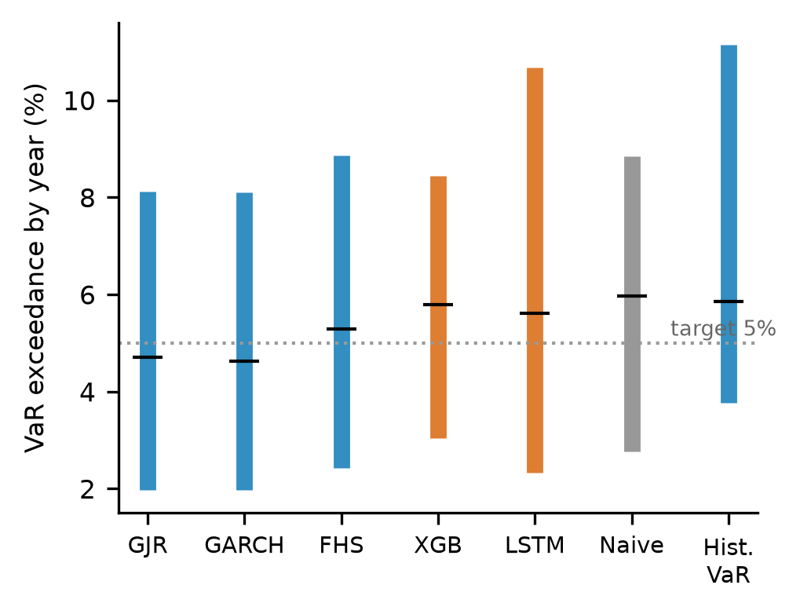
Result 3: Value-at-Risk
• Pinball loss nearly equal: GJR lowest (1.367e-3)
• Average exceedance 4.6-6.0%, but 2%-11% by year
• GARCH-type models under-state risk in 2020-21 and over-state it in 2023-25
• Pooled Kupiec rejects in most years; the date-clustered test does not reject any model
• Conformal calibration: average 4.6-4.9%, narrower range
Portfolio Risk Prediction Using Machine Learning
16
Notes:
Average exceedance near 5% but 2-11% year to year. Pooled Kupiec rejects in most years but treats dependent portfolio-dates as independent; the date-clustered test does not reject. Conformal correction narrows the range.

Slide 17
Do HAR and GARCH inputs help the ML models?
Model | Vol QLIKE | Drawdown AUC | Drawdown Brier
LSTM | 0.321 -> 0.299 | 0.606 -> 0.632 | 0.217 -> 0.206
XGBoost | 0.317 -> 0.306 | 0.584 -> 0.616 | 0.213 -> 0.210
Random Forest | 0.341 -> 0.338 | 0.582 -> 0.607 | 0.208 -> 0.206
Better on most metrics, but none of the 8 paired tests is significant: suggestive only
Portfolio Risk Prediction Using Machine Learning
17
Notes:
Most metrics improved, but none of the 8 paired tests is significant (raw p 0.13-0.63). Suggestive only.

Slide 18
Downstream test: volatility targeting
• Exposure = min(1, 10% / forecast vol); the rest in cash (6% a year)
• Weekly rebalance, buy-and-hold in between, no leverage
• 15 bps cost on the change from the drifted position
• Main metric: RMSE of 63-day realised volatility vs the 10% target, on reachable blocks
• Also: Sharpe, max drawdown, turnover; Diebold-Mariano on the 21-day tracking loss
Oracle (true future vol) and no-scaling rows bound the results
Portfolio Risk Prediction Using Machine Learning
18
Notes:
Idea from the sample paper: judge forecasts by portfolio outcomes. We size exposure from each volatility forecast. This metric was fixed after a code review and is not pre-registered.

Slide 19
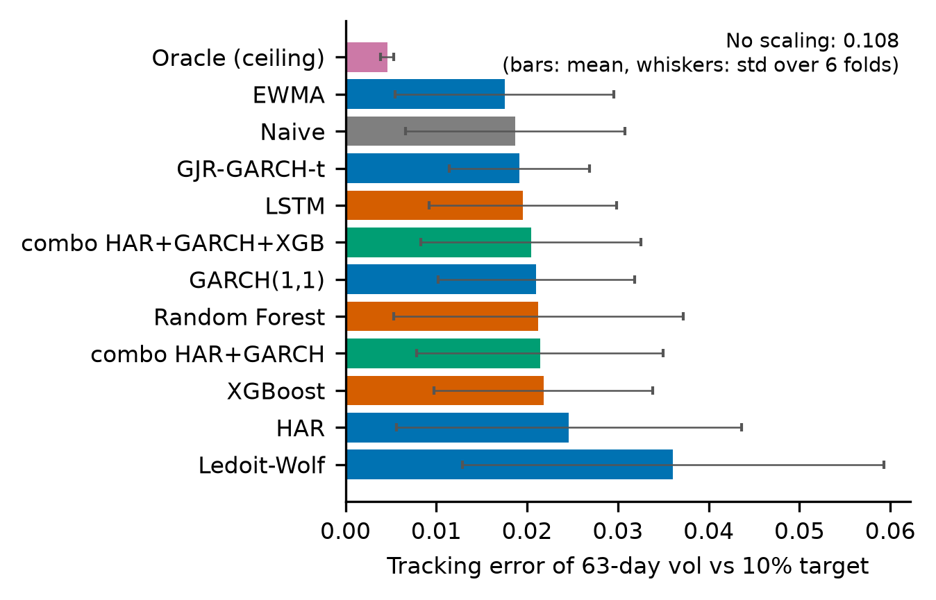
Downstream results
• Realised vol 10-11% vs 19% unscaled; max drawdown roughly halved
• EWMA, naive and GJR rank first; ML and combo are close behind, not ahead
• DM favours the combo over naive (Holm p = 0.0006), but the realised metric does not
• No model beats GJR; Sharpe 0.65-0.74 is indistinguishable
Portfolio Risk Prediction Using Machine Learning
19
Notes:
Any forecast brings realised vol to ~10-11% vs 19% unscaled and roughly halves max drawdown. Models are not reliably ranked: DM favours the combo vs naive, the realised 63-day metric ranks EWMA/naive/GJR first.

Slide 20
The dashboard (live demo)
• Forecast: enter tickers and weights; get volatility, drawdown probability, VaR and a risk band next to the baselines
• Backtest: what each year's walk-forward models predicted for a past date vs what happened
• Risk breakdown: which holdings drive volatility and tail loss; replay of past market stress
• Forecast log: saved forecasts scored against reality after 1 and 21 trading days
Same feature code as the evaluation: any user portfolio is scored consistently
Portfolio Risk Prediction Using Machine Learning
20
Notes:
Run: streamlit run app/streamlit_app.py. Enter tickers and weights, show Forecast, then Backtest for a past date, then Risk breakdown. Add screenshots here if a live demo is not possible.

Slide 21
Discussion: where ML helps and where it does not
Helps
Does not
• Beats naive volatility significantly (XGBoost, LSTM on QLIKE)
• Leads in calm periods
• Best RMSE when combined with HAR + GARCH
• Model-based inputs lift ML on most metrics
• No ML model significantly beats GJR-GARCH-t
• Not better on VaR clustering or drawdown calibration
• No reliable edge in the downstream test
• Consistent with Hansen & Lunde (2005)
Portfolio Risk Prediction Using Machine Learning
21

Slide 22
Limitations
• About 190 independent 21-day periods; 400 portfolios add little independent information
• Hyperparameters not tuned; one seed per model in the final configuration
• Yahoo data are delayed and sometimes wrong; survivorship bias; no bond asset; US macro only
• Portfolios are rebalanced daily; downstream test ignores internal turnover
• Some choices (combination members) made after seeing earlier ranks
• Deployed app models are weakly trained; all reported numbers come from walk-forward fold models
• Educational project, not investment advice
Portfolio Risk Prediction Using Machine Learning
22
Notes:
Be upfront: an honest limitations slide is a strength.

Slide 23
Conclusion
• ML predicts portfolio risk about as well as strong econometric models and better than naive
• No ML model significantly beats GJR-GARCH-t after correction
• Most dependable gains: combining ML with HAR + GARCH, and simulated drawdowns
• Any forecast helps control realised risk; the models are not reliably ranked
Takeaway: ML complements, rather than replaces, econometric risk models
Portfolio Risk Prediction Using Machine Learning
23
Notes:
Rigour of comparison over number of models.

Slide 24
Future work
• Tuning and multiple seeds with the HAR/GARCH inputs
• Other horizons and assets: bonds, international equities
• An expected-shortfall head for the ML models
• Regime-aware training and online updating
• Dashboard: live forecast log scored against realised outcomes
Portfolio Risk Prediction Using Machine Learning
24

Slide 25
Thank you
Questions?

