Slide 1

Enabling a “RISC” Approach for Software-Defined Monitoring using Universal Streaming
Zaoxing Liu,
Greg Vorsanger,
Vladimir Braverman
Vyas Sekar

Slide 2
Network Management: Many Monitoring Requirements
“Entropy”,
“Traffic Changes”
“Flow size distribution”
“Heavy-hitters”
Traffic Engineering
Network
Forensics
Anomaly Detection
Accounting
“SuperSpreaders”
…….
Analyze new
user apps
Botnet analysis
Worm Detection
SDN Controller
(OpenDayLight etc.)

Slide 3
Traditional: Packet Sampling
Sample packets at random,
aggregate into flows
Flow = Packets with same pattern Source and Destination Address and Ports
FlowId
Counter
Flow reports
1
1
2
1
1
6
1
3
1
1
1
6
1
3
1
1
1
1
1
6
1
3
1
1
Estimate: FSD, Entropy, Heavyhitters, Changes, SuperSpreaders ….
Not good for fine-grained analysis
Extensive literature on limitations for many tasks!

Slide 4
Application-Specific Sketches
Heavy Hitter
Entropy
Superspreader
Application-Level
Metric
Application-Level
Metric
….
Application-Level
Metric
Computation
(off router)
Bloom-filter,
Count-min Sketch,
reversible sketch, etc.
Counter
Data Structures
Counter
Data Structures
….
Counter
Data Structures
Monitoring
(on router)
Packet
Processing
Packet
Processing
Packet
Processing
Traffic
Complexity: Need per-metric implementation
Recent Example: OpenSketch [NSDI’13]
Trend: Many more applications appear!

Slide 5
Holy Grail of Flow Monitoring?
Application-Level
Metric
Results with high accuracy
Support many applications
Counter
Data
Structures
Packet
Processing
Traffic

Slide 6
Our Solution: Universal Monitoring
App 1
…...
App n
Application-specific Computation
UnivMon Control Plane
UnivMon Data Plane
Packet
Processing
Universal
Sketch
Recent theory advances: Universal Streaming
One sketch does it ALL
Traffic

Slide 7
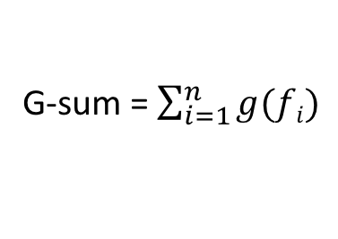
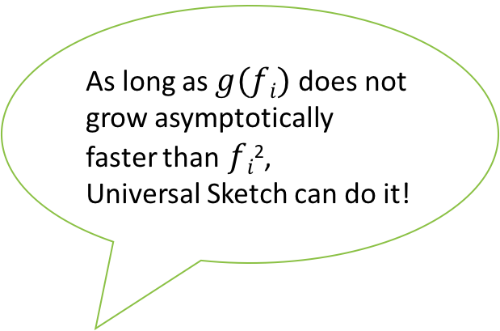
Theory of Universal Streaming
Estimated
G-sum
As long as $g(fi)$does not grow asymptotically faster than$fi$²,
Universal Sketch can do it!
‘Universal’ Sketch
G-sum = $\sum_{i=1}^{n}{g(fi)}$
frequency vector is <f₁,f₂ … f_{n}>
…...
(A stream of length m with n unique items)
1
1
5
1
3
3
1
2
4
6
5
1. Vladimir Braverman, Rafail Ostrovsky: Zero-one frequency laws. STOC 2010
2. Generalizing the Layering Method of Indyk and Woodruff: Recursive Sketches for Frequency-Based Vectors on Streams. APPROX-RANDOM 2013

Slide 8
Universal Sketch Data Structure
Count Sketch Alg
L2 Heavy Hitter Algorithms
Levels
In Parallel
+4 | +2 | -2
-2 | -4 |  | +2
+2 | +4 |  | -2
Heavy Hitters
0
Heavy Hitter Alg
1
1
5
1
3
3
1
2
4
6
5
(1,4), (3,2),(5,2)
H1(1)=1, H1(5)=1, H1(2)=1
 | +4 | -2 | -1
+4 | -2 | +1
+1 | -2 | -4
1
1
1
5
1
1
2
5
Heavy Hitter Alg
(1,4), (5,2),(2,1)
H2(5)=1, H2(2)=1
…...
Heavy Hitter Alg
…...
5
2
5
(5,2), (2,1)
…...
H3(2)=1
 |  | +1
 |  |  | -1
 | +1
log(n)
Heavy Hitter Alg
(2,1)
2
Generate k=log(n) pairwise ind. zero-one hash functions:
H1 …. Hk
Count-Sketch, Pick-and-drop etc.
Similar to counting bloom filter

Slide 9
Estimating G-sum
Counters from Universal Sketch
Estimated G-sum
Levels
0
(1,4), (3,2),(5,2)
Y0=2g(1)+2g(2)+g(4)
(1,g(4)), (3,g(2)),(5,g(2))
Apply arbitrary g()
1
(1,4), (5,2), (2,1)
Y1=g(1)+g(2)+g(4)
(1,g(4)), (5,g(2)), (2,g(1))
…...
…...
(5,2),(2,1)
Y2=g(1)+g(2)
(5,g(2)),(2,g(1))
Recursive Steps:
Yi-1 = 2Yi +
new counters – repeated counters
log(n)
(2,1)
Sum of the g()s
(2,g(1))
Y3=g(1)

Slide 10
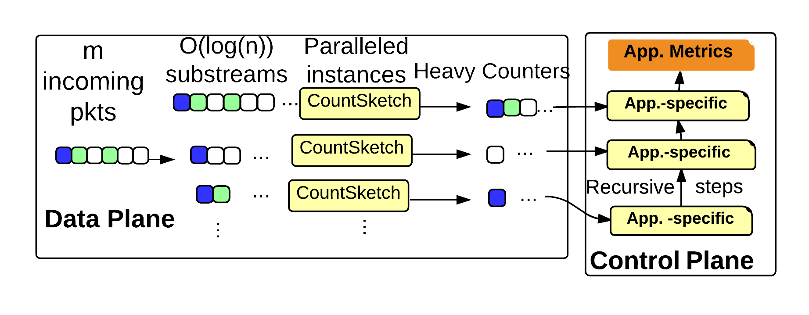
Putting it together: UnivMon
Universal Sketch
Offline Recursive Computation

Slide 11
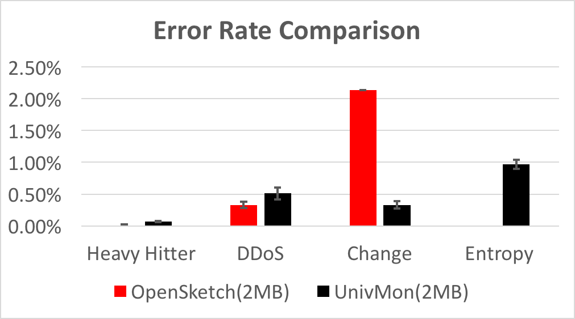
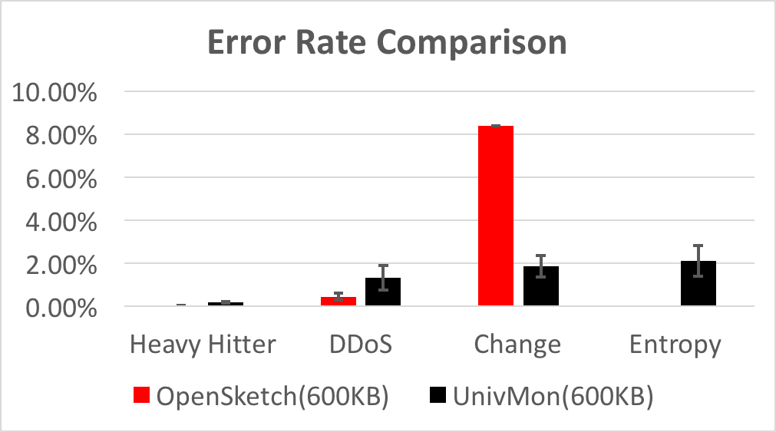
Preliminary Evaluation
Comparison with custom sketches via OpenSketch
N/A

Slide 12
Future Directions
Distributed universal streaming
Multidimensional data
Dynamically change monitoring scope
Feasibility of hardware implementations?

Slide 13
Conclusions
Network management needs many traffic metrics
Today’s solutions offer undesirable extremes
Generic but low fidelity (e.g., sampling)
High fidelity but high complexity (e.g., specific-sketches)
Holy grail: Universal Monitoring
Decouple monitoring control and data plane like SDN!
This work: Can be viable via Universal Sketches
Several open questions
e.g. dynamic, multidimensional, distributed, hardware viability

