Slide 1
大纲
1. 简介
2. 安装, 启动, 停止
3. 权限管理
4. 连接, 数据导入, 导出
5. 数据库, 表, 数据字典
6. MySQL参数
6. MySQL日志
7. MySQL备份与恢复

Slide 2
MySQL简介
MySQL（官方发音為英语发音：/maɪ ˌɛskjuːˈɛl/ "My S-Q-L",^{[1]}，
但也经常读作英语发音：/maɪ ˈsiːkwəl/ "My Sequel"）
是一个开源的关系数据库管理系统
原开发者为瑞典的MySQL AB公司
该公司于2008年被SUN收购
2009年，Oracle收购SUN，MySQL成为Oracle旗下产品。
全球十大互联网公司有9个在使用MySQL(除了微软)
中国的腾讯, 阿里, 百度,网易, 360等, 均有使用并维护自己的定制版本.
最著名的衍生版本: MariaDB, Percona Server

Slide 3
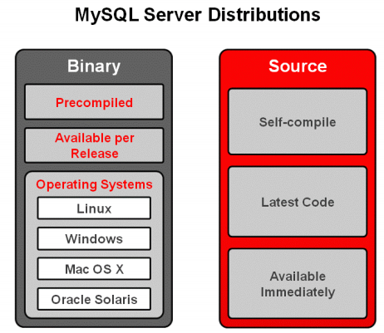
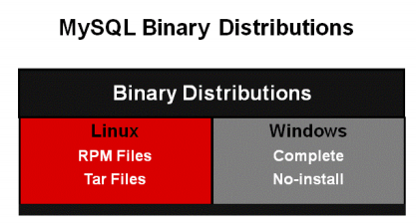
MySQL安装
MySQL三种安装方式: 包安装, 源码安装, 二进制安装

Slide 4

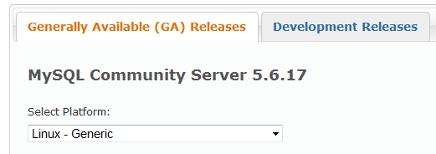

MySQL安装 - 二进制安装

Slide 5

MySQL安装 - 二进制安装
shell> groupadd mysql
shell> useradd -r -g mysql mysql
shell> tar -xvf mysql-5.6.10-linux-glibc2.5-i686.tar.gz
shell> mv mysql-5.6.10-linux-glibc2.5-i686 /opt/mysql
shell> cd /opt/mysql
shell> cp support-files/my-default.cnf /etc/my.cnf
shell> vi /etc/my.cnf

Slide 6

MySQL安装 - 二进制安装
shell> scripts/mysql_install_db --basedir=/opt/mysql --datadir=/opt/mysql/data
shell> cp support-files/mysql.server /etc/init.d/mysql
shell> vi /etc/init.d/mysql
shell> chown -R mysql /opt/mysql
shell> chgrp -R mysql /opt/mysql
shell> service mysql start
shell> bin/mysql_secure_installation
注意socket位置问题

Slide 7
MySQL安装 – MySQL启动 & 停止
shell> service mysql start
shell> service mysql stop
shell> cd /opt/mysql
shell> bin/mysqld_safe --defaults-file=/etc/my.cnf &
shell> bin/mysqladmin –u root –p –socket=/opt/mysql/mysql.sock shutdown
shell> service mysql status
Shell> ps –aef | grep mysqld

Slide 8
MySQL权限
用户与HOST/IP_ADDRESS绑定
没有Role
分全局权限, DB, Table, Column, Routine权限

Slide 9
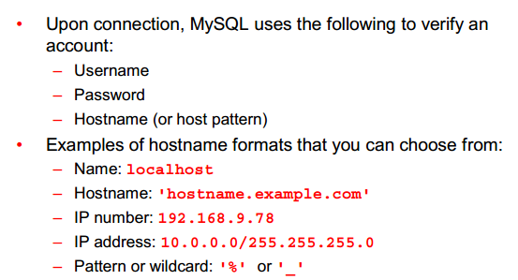
MySQL权限

Slide 10
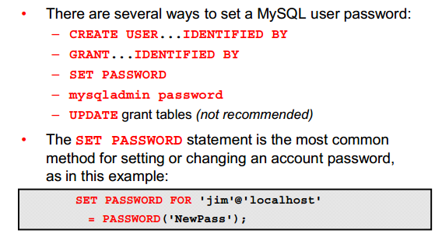
MySQL权限

Slide 11
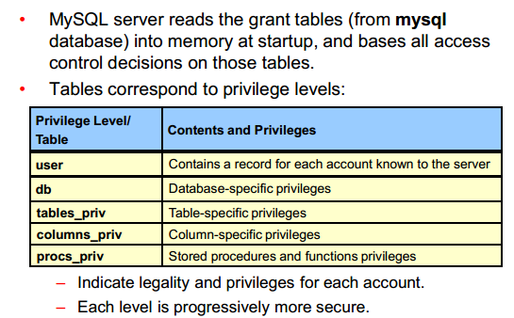
MySQL权限

Slide 12
MySQL权限
使用All来赋给所有权限(不包含将权限赋给其他user)
Usage权限其实是不含任何权限, 仅可以连接数据库(可以show variable/status)
Grant select on test.* to jim@localhost identified by ‘abcjim’;
Show grants…
REVOKE select on test.* from to jim@localhost;
DROP USER;
WITH GRANT OPTION
忘记root密码….
用户权限表还有host表

Slide 13
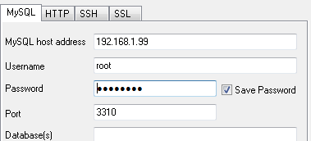
MySQL数据库连接
shell> bin/mysql -u root -p --socket=/opt/mysql/mysql.sock
shell> bin/mysql -u root -p -h10.168.2.224 -P3306

Slide 14
MySQL数据导入导出
Mysqldump
Mysqlimport
Select into outfile
Load data infile
工具
Source命令

Slide 15
MySQL数据导入导出 - mysqldump
Mysqldump
Usage: mysqldump [OPTIONS] database [tables]
OR mysqldump [OPTIONS] --databases [OPTIONS] DB1 [DB2 DB3...]
OR mysqldump [OPTIONS] --all-databases [OPTIONS]
-a, --create-options Include all MySQL specific create options.
--add-drop-database Add a DROP DATABASE before each create.
--add-drop-table Add a DROP TABLE before each create.(Defaults to on; use --skip-add-drop-table to disable.)
-c, --complete-insert Use complete insert statements.
-e, --extended-insert
Use multiple-row INSERT syntax that include several
VALUES lists.
(Defaults to on; use --skip-extended-insert to disable.)
-t, --no-create-info
Don't write table creation info.
-d, --no-data No row information.
-R, --routines Dump stored routines (functions and procedures).

Slide 16
MySQL数据导入导出 - mysqlimport
Usage: mysqlimport [OPTIONS] database textfile...
-c, --columns=name Use only these columns to import the data to. Give the
column names in a comma separated list. This is same as
giving columns to LOAD DATA INFILE.
-d, --delete First delete all rows from table.
--fields-terminated-by=name
Fields in the textfile are terminated by ...
--fields-enclosed-by=name
Fields in the importfile are enclosed by ...
--fields-optionally-enclosed-by=name
Fields in the i.file are opt. enclosed by ...
--fields-escaped-by=name
Fields in the i.file are escaped by ..

Slide 17
MySQL数据导入导出
LOAD DATA [LOW_PRIORITY | CONCURRENT] [LOCAL] INFILE 'file_name'
[REPLACE | IGNORE]
INTO TABLE tbl_name
[PARTITION (partition_name,...)]
[CHARACTER SET charset_name]
[{FIELDS | COLUMNS}
[TERMINATED BY 'string']
[[OPTIONALLY] ENCLOSED BY 'char']
[ESCAPED BY 'char']
]
[LINES
[STARTING BY 'string']
[TERMINATED BY 'string']
]
[IGNORE number{LINES | ROWS}]
[(col_name_or_user_var,...)]
[SET col_name= expr,...]
SELECT .. INTO OUTFILE ‘..’ FROM … EXPORT_OPTION
Notes:
select * into outfile '/tmp/load_data_test.txt' FIELDS TERMINATED BY ',' ENCLOSED BY '"' ESCAPED BY '\\' from test.load_data_test;
LOAD DATA INFILE '/tmp/load_data_test2.txt' INTO TABLE test.load_data_test
FIELDS TERMINATED BY ',' ENCLOSED BY '"' ESCAPED BY '\\'

Slide 18
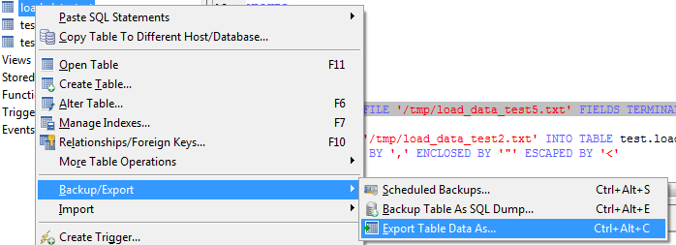
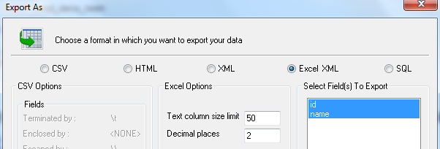
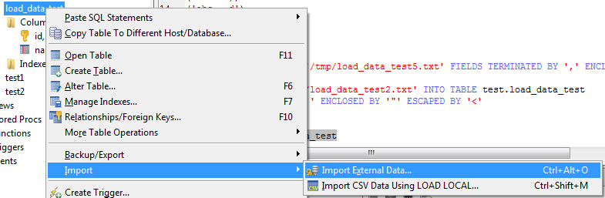
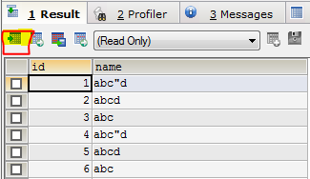
MySQL数据导入导出
Notes:
select * into outfile '/tmp/load_data_test.txt' FIELDS TERMINATED BY ',' ENCLOSED BY '"' ESCAPED BY '\\' from test.load_data_test;

Slide 19
MySQL数据库/表/数据字典
每个数据库对应在data目录下有一个同名文件夹
每个表在对应数据库目录下有一个frm(数据结构)文件,
MYISAM引擎同时还有MYD(数据)文件, MYI(索引)文件, INNODB文件有ibd文件(innodb_file_per_table为on)
MYISAM引擎表可以直接通过复制文件来达到复制表的目的(INNODB不可)
innodb_file_per_table为OFF的话, 会有共享table space IBD文件
IBD文件不可SHRINK
数据字典表: information_schema.schemata, information_schema.tables, information_schema.columns, information_schema.routines… views, triggers, TABLE_CONSTRAINTS, KEY_COLUMN_USAGE , STATISTICS

Slide 20
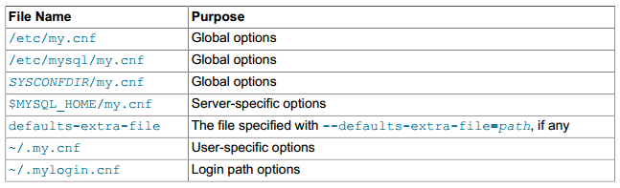
MySQL参数
SHOW STATUS
My.cnf
3. SET GLOBAL/SESSION

Slide 21
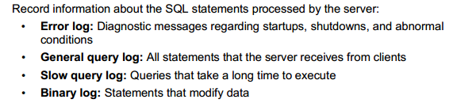
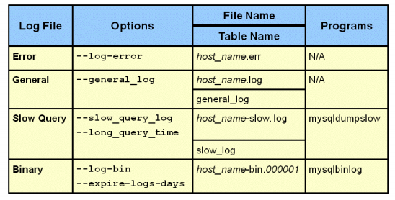
MySQL日志

Slide 22
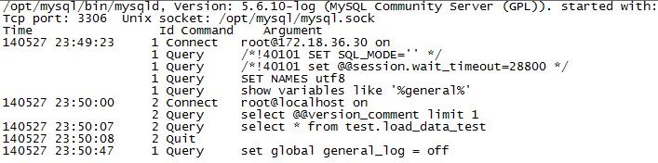
MySQL General Log
该参数可动态修改

Slide 23
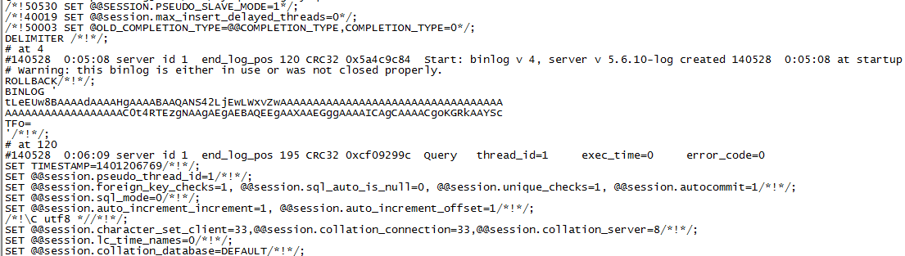
MySQL二进制日志

Slide 24
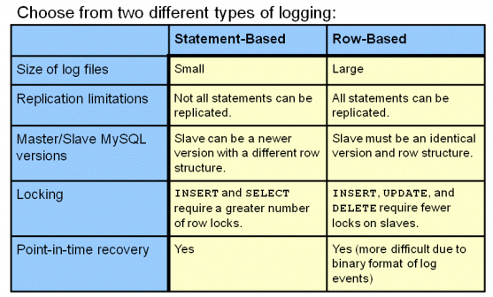
MySQL二进制日志

Slide 25
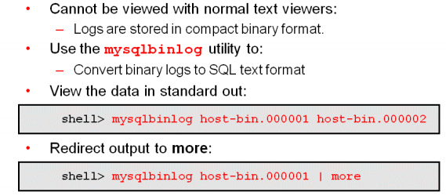
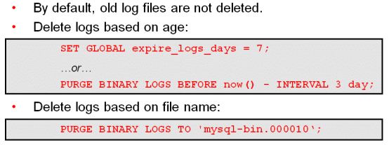
MySQL二进制日志

Slide 26

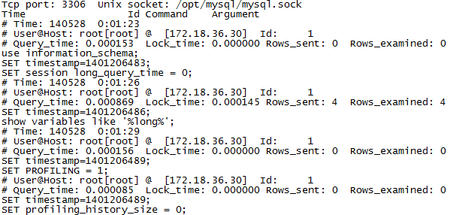
MySQL慢查询日志
该参数可动态修改

Slide 27
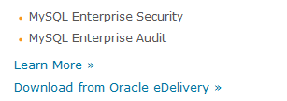
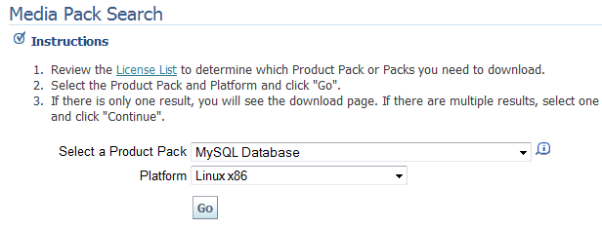
MySQL备份恢复

Slide 28
MySQL备份恢复
bin/mysqlbackup --with-timestamp --user=root --password=‘******’ --socket=/data/mysql/mysql.sock --incremental --start-lsn=411828581612 --incremental-backup-dir=/backup/scm_db backup
/bin/mysqlbackup --backup-dir=/backup/scm_db/full apply-log
/bin/mysqlbackup --incremental-backup-dir=/backup/scm_db/inc --backup-dir=/backup/scm_db/full apply-incremental-backup
/bin/mysqlbackup --with-timestamp --user=root --password=‘******' --socket=/data/mysql/mysql.sock --backup-dir=/backup/scm_db backup

Slide 29
总结
MySQL应用广泛, 前景光明
MySQL是开源的, 且文档详实, 多看文档, 多多练习
MySQL权限与Host绑定
开启二进制日志很重要
慢查询日志不可忽视
备份恢复方法多, 但要不锁表热备必利用二进制日志(MYSAM除外)

Slide 30
QA?
Thanks.

