Slide 1
StockSync
Real-Time Automated Retail Inventory Tracking
on NVIDIA Jetson Orin Nano Using YOLOv8 Instance Segmentation
Disha Shetty (Lead)
Kashish Pavan Daulatani
Hassan Asim
Aashlesha Peddiboyina

Slide 2
Problem & Motivation
$1T
Manual shelf counting is slow, inconsistent, and error-prone
Out-of-stocks lead directly to lost sales and poor customer experience
Lost annually to
retail out-of-stocks
Computer vision can automate tracking in real-time on affordable edge hardware
StockSync addresses this with a complete edge AI pipeline.

Slide 3
Dataset
425
5
Roboflow
Masks
Images
Classes
Platform
Annotation Type
Class Distribution (total images)
Train / Val / Test Split
Class | Tr | Val | Te
waterbottle | 113 | 29 | 23
granola | 87 | 15 | 12
chocolate | 68 | 21 | 16
pen | 33 | 8 | 9
mouse | 18 | 2 | 2
waterbottle
165
granola
114
chocolate
105
pen
50
mouse
22

Slide 4
Model & Training
Training Setup
YOLOv8n-seg
Platform:
Google Colab (Tesla T4 GPU)
Parameters
3.26M
Epochs:
65 (early stopped, patience=15)
GFLOPs
11.5
Best Epoch:
Epoch 50 | Batch: 8 | Image: 640×640
Backbone
CSP + PANet neck
Optimizer:
AdamW (lr=0.001111, wd=0.0005)
Base Weights
ImageNet Pretrained
Task
Instance Segmentation
Augmentation:
Flip, HSV, Mosaic, Erase, Blur, CLAHE

Slide 5
Results
Per-Class Performance (Mask mAP@50)
88.7%
mouse
99.5%
granola
99.2%
Mask mAP@50
(Test Set)
waterbottle
98.5%
chocolate
86.2%
pen
60.1%
Key Insight: Performance correlates with training data size. Pen (60.1%) and Mouse (99.5%) show the range. More data for pen would close the gap.
Performance correlates with training data size — more data → higher accuracy.

Slide 6
TensorRT Optimization
3.93× Speedup
TensorRT FP16 vs PyTorch GPU · measured over 100 frames
PyTorch (GPU)
TensorRT FP16
63.35 ms
16.11 ms
Latency
Latency
15.8 FPS
62.1 FPS
Baseline on Jetson Orin Nano
Optimized on Jetson Orin Nano
Exported best.pt → TensorRT FP16 on Jetson Orin Nano — nearly 4× faster inference at real-time frame rates.

Slide 7
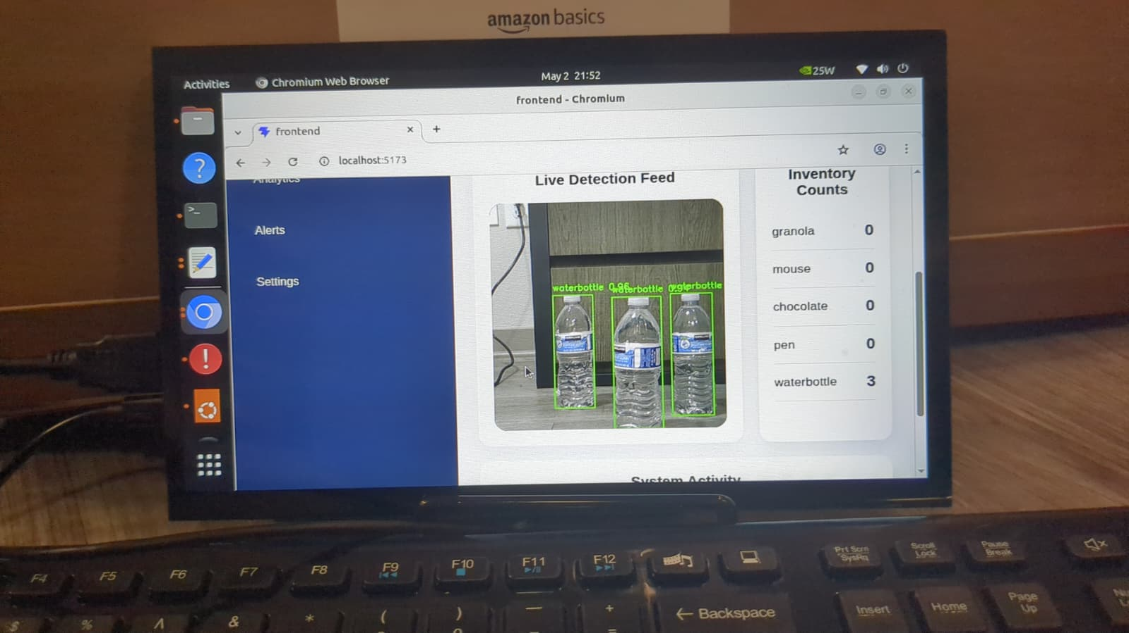
System Demo
🎥 Live Feed
Real-time YOLOv8 segmentation overlay
📊 Inventory Counts
Per-class item count updated in real-time
🔔 Low Stock Alerts
Automatic alerts when items run low
⚡ Stack
FastAPI backend + React frontend

Slide 8
Conclusion & Future Work
What We Built
✓ Complete end-to-end computer vision pipeline
✓ YOLOv8 instance segmentation trained on custom retail dataset
✓ TensorRT FP16 optimization: 3.93× speedup on Jetson Orin Nano
✓ Live FastAPI + React dashboard with inventory tracking & alerts
✓ 88.7% Mask mAP@50 on held-out test set
StockSync — Smarter Shelves. Real-Time Intelligence.

