Slide 1
AeroQuad Flight Software Timing
November 2010

Slide 2
Outline
Time each critical portion of the AeroQuad flight software loop
  The timing of the new I2C based sensors will be documented
    Gyro – ITG3200
    Accel – BMA180
    Magnetometer – HMC5843
    Barometer – BMA085
Test methodology
  Turn on a digital pin before executing the function, then turn it off afterwards
  Use a logic analyzer to measure the active high pulse

Slide 3
Timing Summary with I2C Sensors
Overall flight loop takes 3.756ms
  Sensors = 2.85ms
  Motor Commands = 0.503ms
  Read Receiver = 0.403ms
Takes 2.85ms to read flight sensors
  Read accels and gyros only (0.849ms), then use DCM to calculate flight angle (2.001ms)
Other sensors periodically affect flight loop timing
  Barometer = 0.976ms every 26ms
  Magnetometer = 1.289 every 125ms

Slide 4
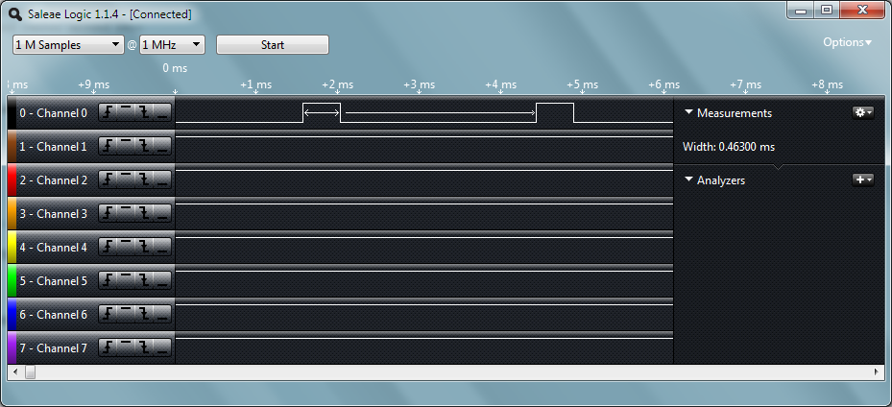
Measure ITG3200 Gyros
gyro.measure() = 0.463ms

Slide 5
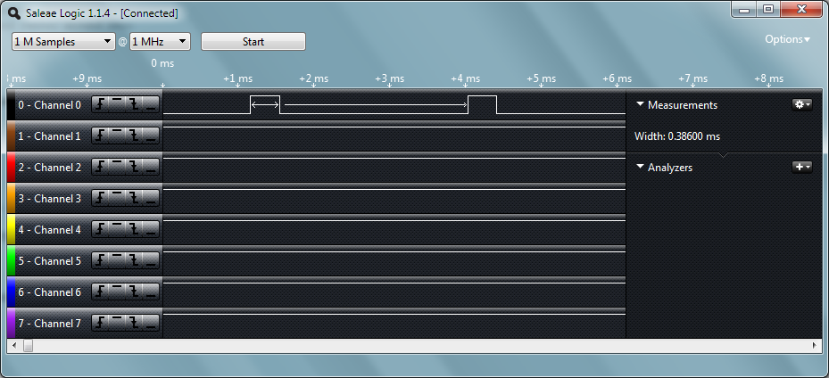
Measure BMA180 Accelerometers
accel.measure() = 0.386ms

Slide 6
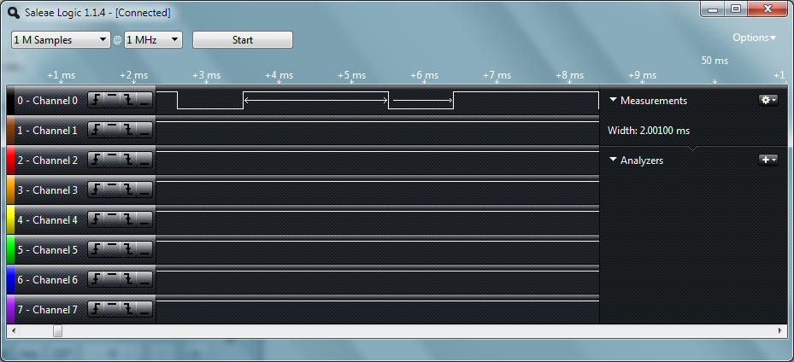
Duration of DCM Calculation
flightAngle.calculate() → DCM = 2.001ms

Slide 7
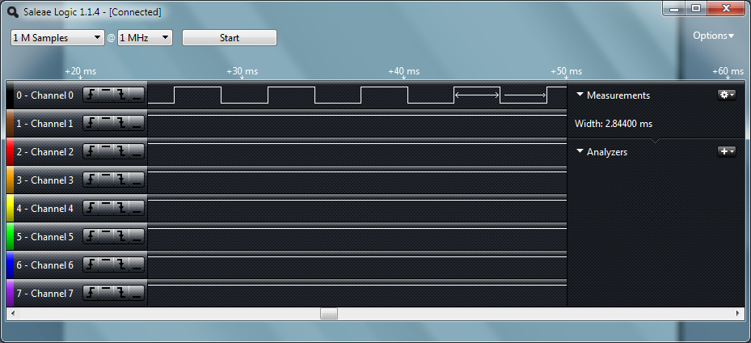
Timing Summary for Basic Sensors
gyro.measure() + accel.measure() + flightAngle.calculate() = 2.85ms
Measured readSensors() with altitude and compass off = 2.844ms
Individual measurements + overall function time duration agree.

Slide 8
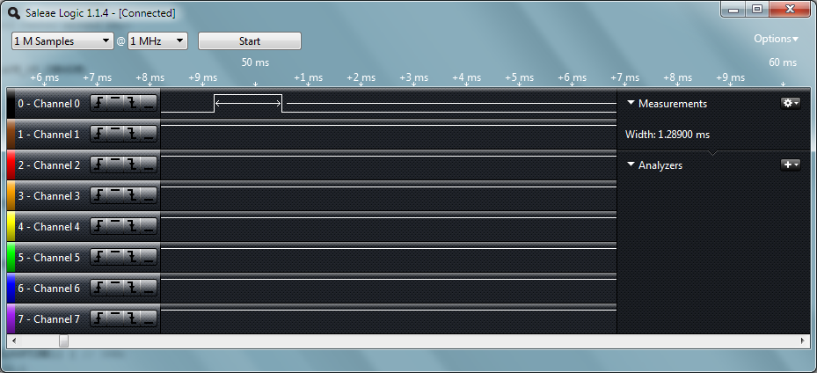
Measure HMC5843 Magnetometer
compass.measure() = 1.289ms

Slide 9

Measure BMA085 Barometer
altitude.measure() = 0.976ms

Slide 10
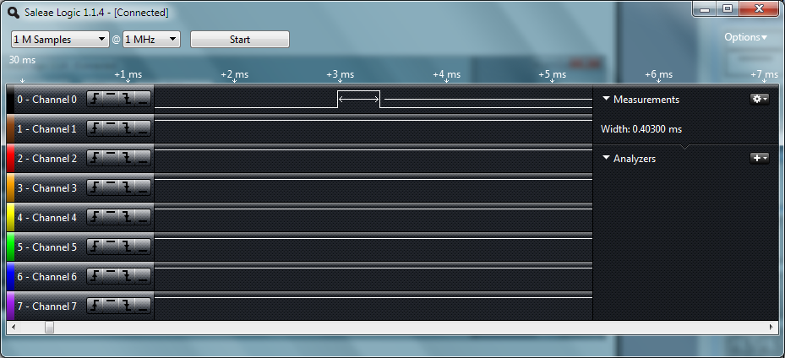
PCINT Read of Receiver Data
ReadPilotCommands() = 0.403ms
PCINT is actually used to measure pin value changes, the above function call
Reads variables which store timing data as calculated during ISR

Slide 11
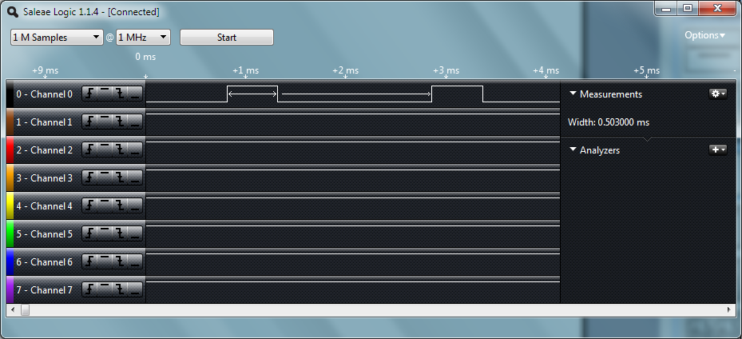
Duration of AnalogWrite() to Motors
flightControl() = 0.503ms
The above function uses analogWrite() to perform PWM update per channel (4)

Slide 12
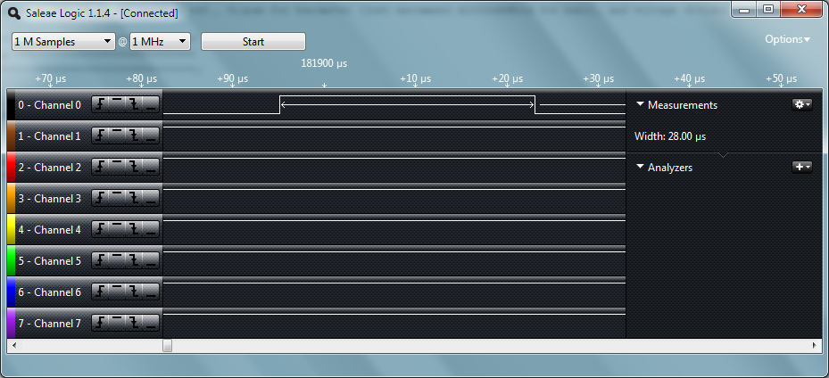
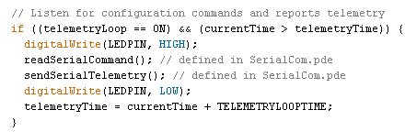
Duration of Serial Command/Telemetry
wrapped with digital on/off
and measured with
logic analyzer
Measured readSerialCommand() and sendSerialTelemetry()
Duration = 28us, implies that UART is loaded and hardware sends data
but does not block flight loop

