Slide 1
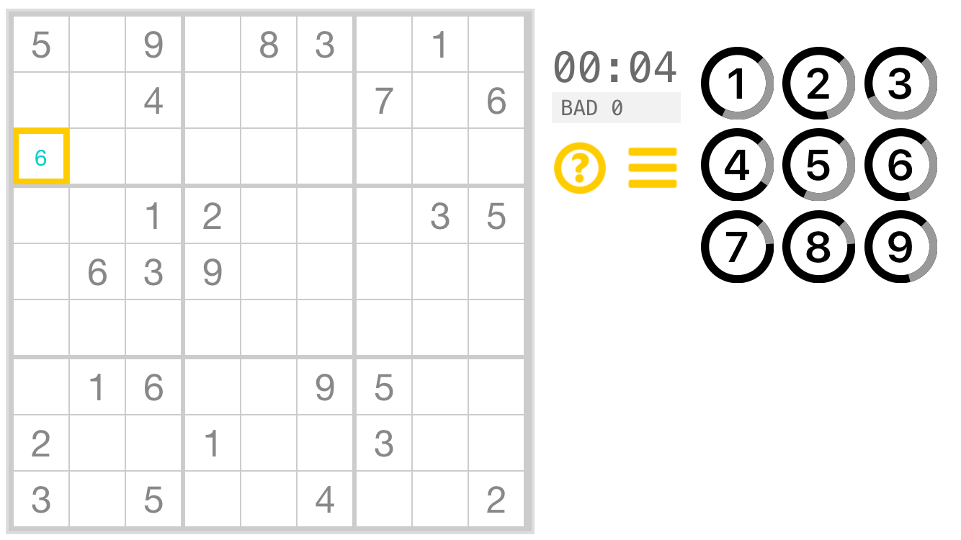
use left thumb
to select cell
use right
thumb to
tap on number pad:
one tap = pencil
two taps = lock number

Slide 2
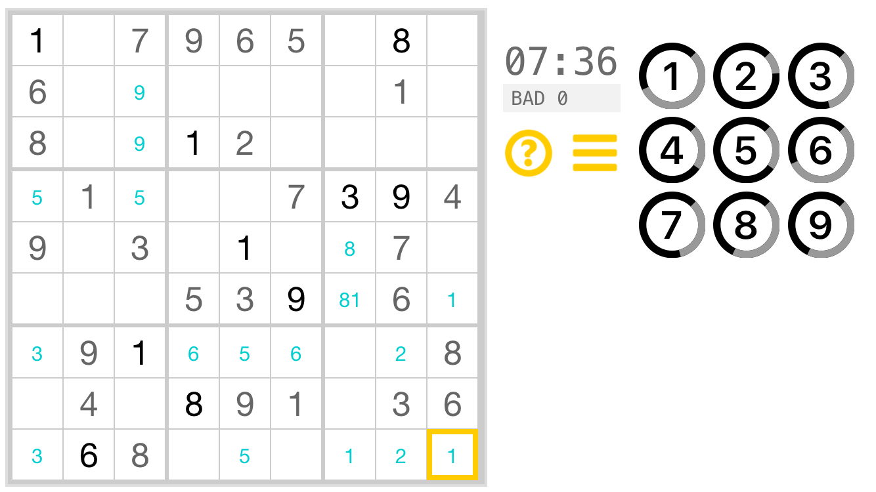
bad moves
timer
progress
indicator for
given number
solved cell
pencilled cell

Slide 3
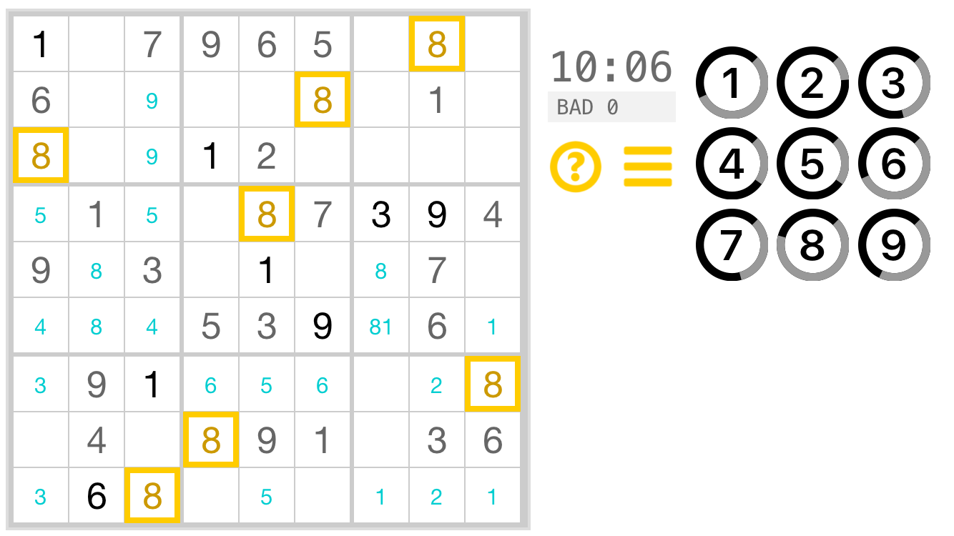

Slide 4
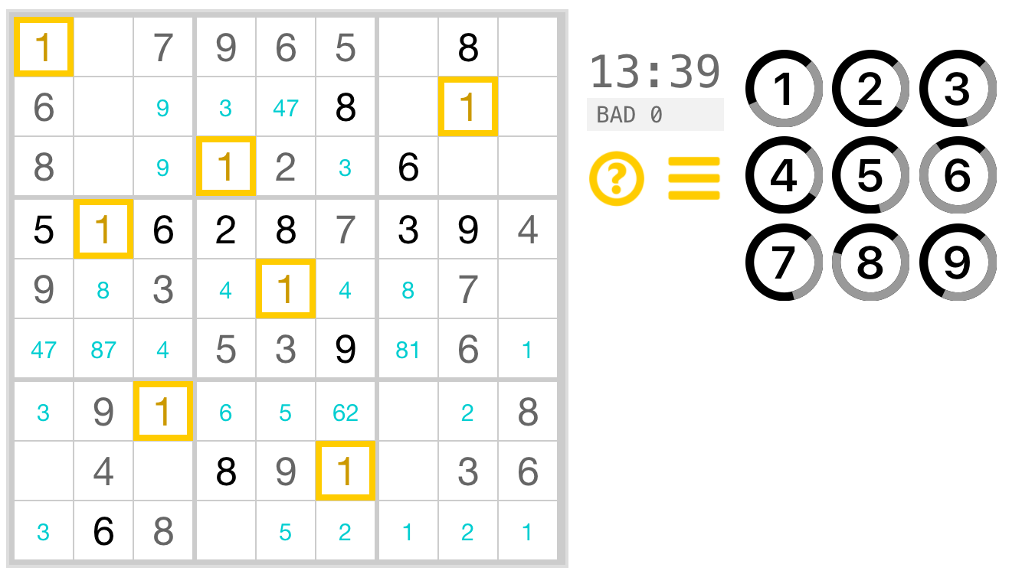

Slide 5
