Slide 1
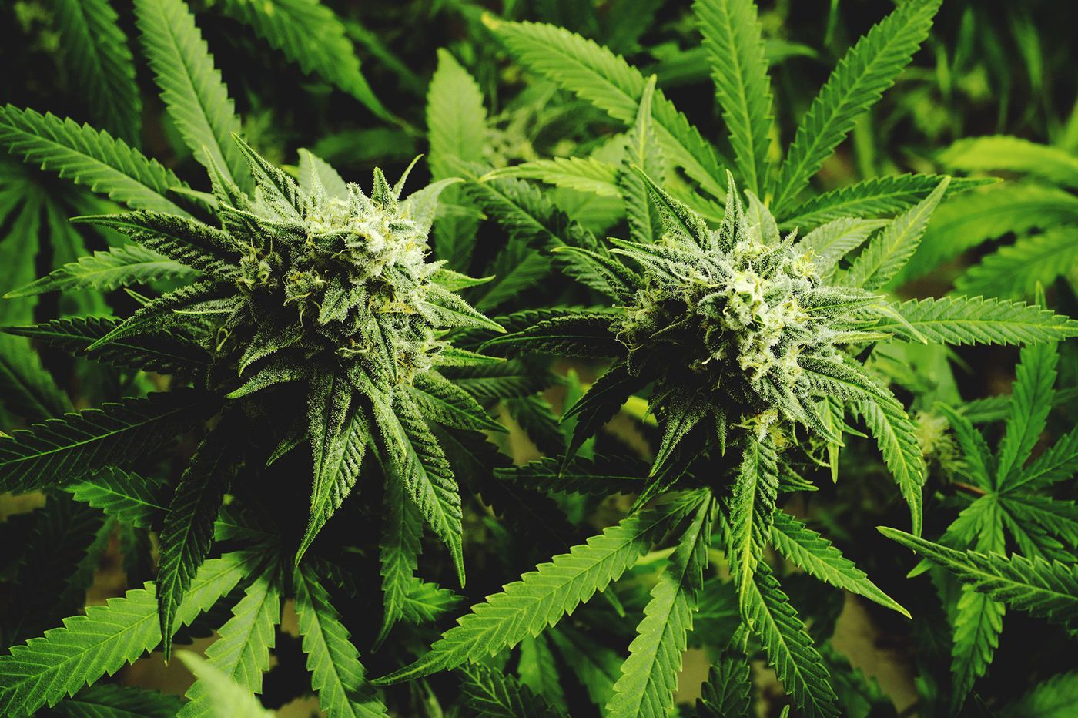
High Times, High Crimes
An analysis of the effects of legalization on crime and the growth in dispensaries in the Denver area

Slide 2
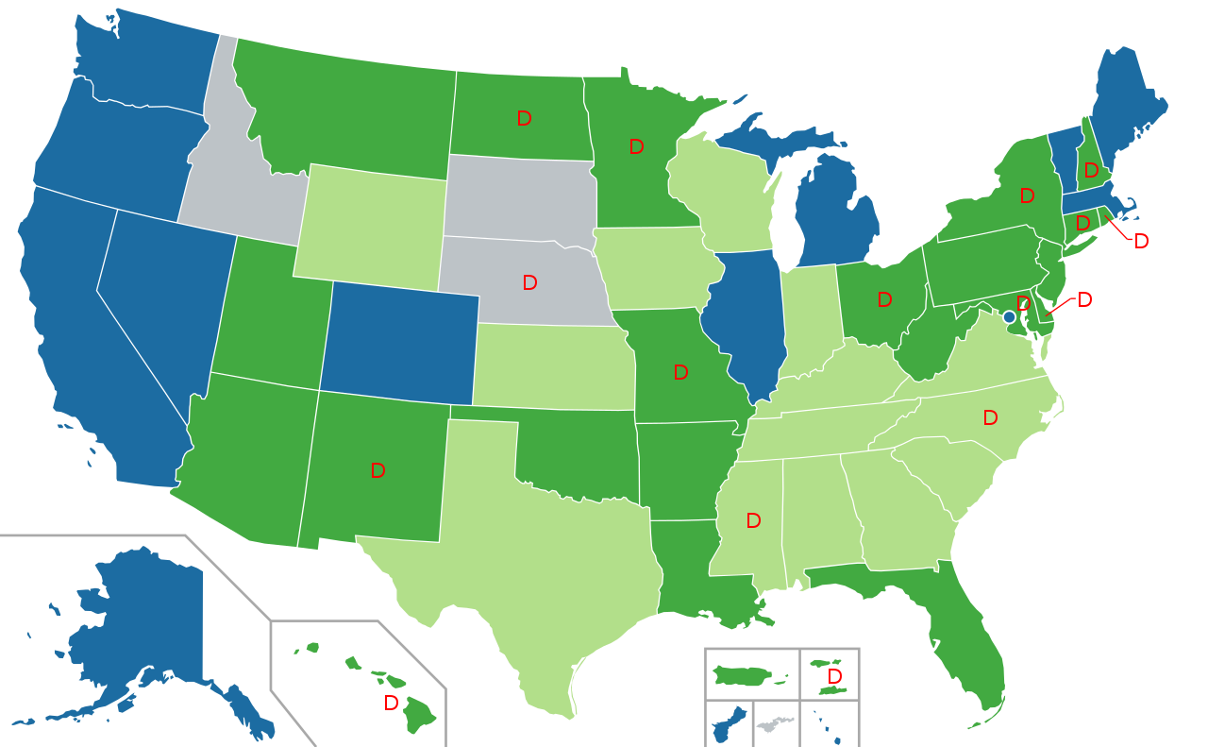
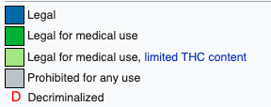
The Legalization Train
By Lokal_Profil, CC BY-SA 2.5, https://commons.wikimedia.org/w/index.php?curid=2370050

Slide 3

The Data
Active Marijuana Business Licenses
Crime data for 2014-2017
Income and population by zip code
Neighborhoods in each zip code
City of Denver has a well developed database (through csv files) for data analysis on this and other topics

Slide 4
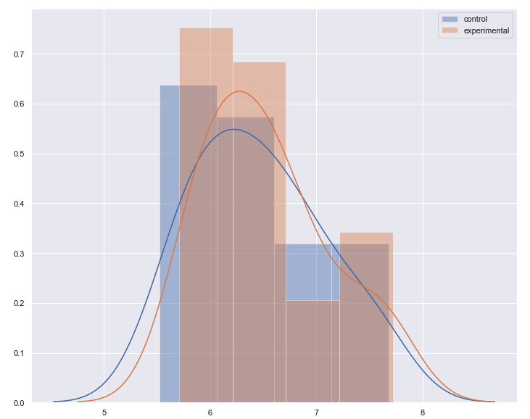
1. Overall Change in Crime After Legalization

Slide 5
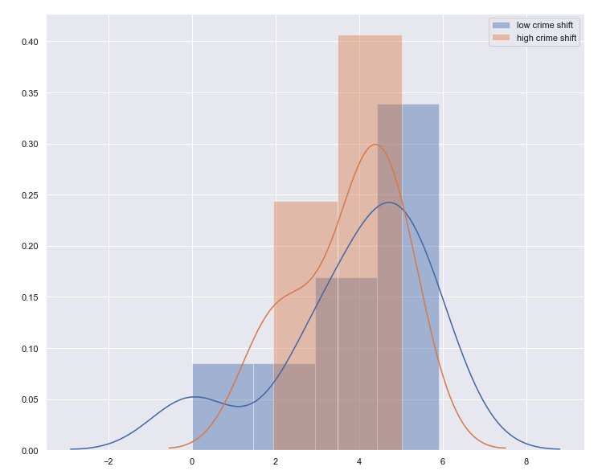
2. Differences in Crime: Low Income v. High Income Neighborhoods

Slide 6

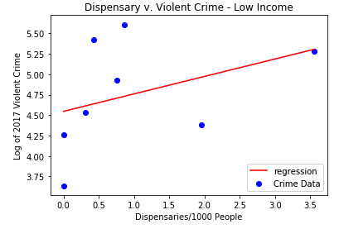
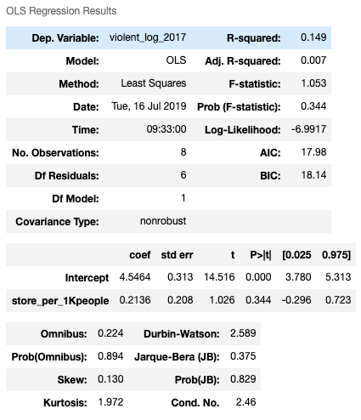

3a. Dispensary Saturation and Violent Crimes
z

Slide 7
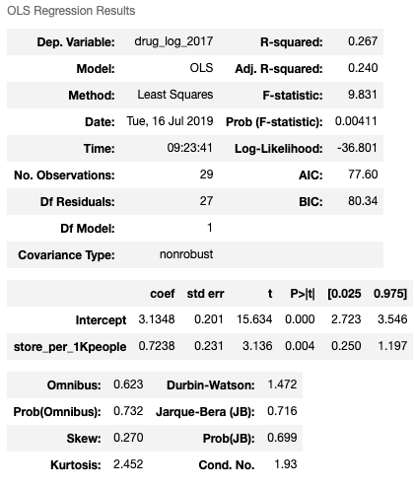
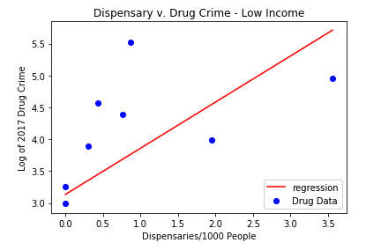
3b. Dispensary Saturation and Drug Crimes
z

Slide 8
Next Steps
Our analysis was focused on the Denver area, and fairly limited in scope
Next steps could include:
Analysis of Colorado crime pre/post legalization
Comparison of crime rate increase/decrease in urban v. rural areas
Comparison of all recreational states’ crime pre/post legalization
US states’ crime movement against crime movement in provinces of other recreationally legal countries (e.g. Canada)

