Slide 1
WEATHER FORECASTING USING SNNs
By - Team 2

Slide 2
Introduction

Slide 3
What is SNN?
SNNs ( Spiking neural network) have evolved out of the need for artificial neural networks that better mimic natural ones. SNNs transmit and process the information on the occurrence of a spike or an event generated by a neuron. The large spike sparsity and simple synaptic operations (SOPs) in the network enable SNNs to outperform ANNs in terms of energy efficiency. SNNs also incorporate time into their operating model. The neurons generate signals at the moment threshold synaptic potential is crossed.
Their massive parallelism, asynchronous event-driven operations, and distributed memory provide huge potential in accelerating information processing and reducing energy consumption in many applications.

Slide 4
How is it different from the standard Neural Network ?
The main difference between ANN and SNN operation is the notion of time. While ANN inputs are static, SNNs operate based on dynamic binary spiking inputs as a function of time.
While the output of ANN depends only on the current stimuli, the output of SNN depends on previous stimuli also. That is, a neuron in SNN will fire when the accumulated stimuli reaches above a threshold value.

Slide 5
Neuron Model
The “leaky integrate and fire” (LIF) model of Spiking Neural Networks (SNNs) has so far dominated this area of neural network research. This model is biologically appropriate and computationally cost efficient. Its only shortcoming is that it simulates relatively lower number of spiking behaviours.
It cannot simulate a number of spiking (single), bursting (multiple spike burst) or phasic (where a neuron may fire only a single spike at the onset of the input and remain quiescent afterwards) behaviours

Slide 6
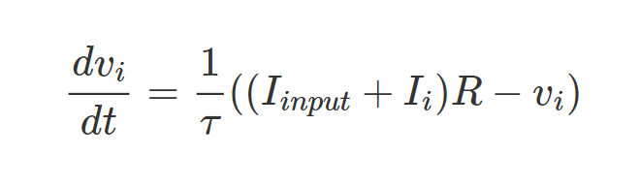
Learning..
Membrane potential reaches Threshold Potential(Vₜₕ)
It produces a spike
Membrane potential is reset to V_{reset}
After time t_{ref} .
Membrane Potential recovers to resting potential.

Slide 7
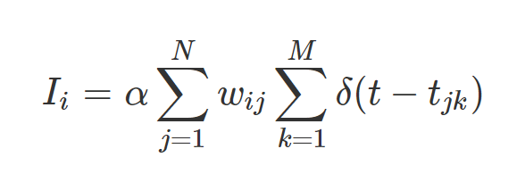
Current from the synapses:
N - Number of Presynaptic Neurons
M - Number of times the jth presynaptic neuron has fired since ith neuron fired.

Slide 8
Forecasting Weather Signals

Slide 9
Why does LIF not work ?
It cannot simulate bursting (multiple spike burst)
It cannot simulate phasic behaviours (where a neuron may fire only a single spike at the onset of the input and remain quiescent afterwards).
Moreover, there is no explicit mechanism for modelling spike latencies or delays.
But these spiking types can be given by Izhikevich Model and is therefore used.

Slide 10
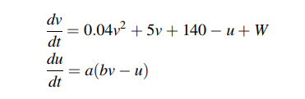
Izhikevich Model
The Izhikevich model uses two variables, a variable representing voltage potential (v) and another representing membrane recovery (activation of potassium currents and inactivation of sodium currents) (u).
W is the weighted inputs (thalamic input) and a and b are control parameters for the model.

Slide 11

When the voltage v exceeds a threshold value (usually 30 mV) both v and u are reset as follows:

Slide 12
Learning
The learning rule mostly followed in such networks is the hebbian rule.
STDP adjusts the connection strengths based on the relative timing of a particular neuron’s output and input spikes. Synapses increase their efficacy if a pre-synaptic spike arrives just before the postsynaptic neuron is activated but are weakened if they occur afterwards.

Slide 13
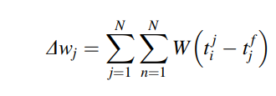
The weight change Δwj of a synapse from a presynaptic neuron j depends on the relative timing between presynaptic spike arrivals and postsynaptic spikes from neuron i. If we label the presynaptic spike arrival times at j as tfj where f is presynaptic spike count at time t, and similarly tni is the postsynaptic spike count at time t then the total weight change Δwj can be calculated as:

Slide 14
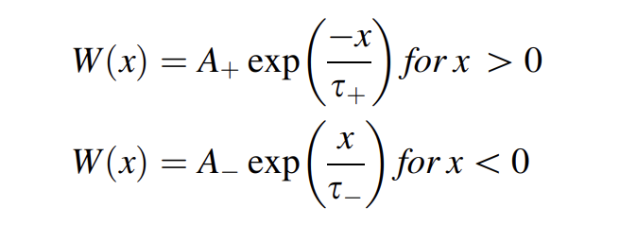
where W(....) denotes a specific STDP function. This function is often:
where parameters A+ and A- are parameters dependant on the value of the current synaptic weight and τ+ and τ-are time constants/boundaries normally in the order of 10 ms.

Slide 15
Oak Weather Station in Ireland
Used three weather signals representing The maximum and the minimum temperatures and the rainfall for Oak weather station in Ireland from the period between September 2013 and September 2014
Metric used : Individual neurons were created that correspond to specific weather data values
Metrics were activated modified element input to those neurons.
This creates as these activations are inherently temporally encoded chains of firing events correspond to the firing events along the X axis. In this way neural network learns the seen part of the signal.As these firing chains are strengthened or weakened a path emerges (by STDP) that corresponds to learning the weather input signal.

Slide 16
Oak Weather Station in Ireland
The best performing chain of activations (determined by Euclidean distance) are then used to make a prediction about the weather in the future; the activation patterns of future events are extrapolated by the chain of firing events of the dominant paths that have been learnt in the past.
The prediction performance of our networks was evaluated using two statistical metrics :
Normalised Mean Squared Error shows overall deviations between predicted and measured values. NMSE is a useful measure because if a system has a very low NMSE, then it indicates that it is correctly identifying patterns.
The Signal to Noise Ratio compares the level of a desired signal to the level of background noise; in this case it is the ratio of useful information about a portfolio compared to false or irrelevant data.
The results also indicate that the proposed PSNN network generates significantly better results than the Linear and the MLP network with an average improvement of 10.2156 dB and 3.2160 dB, respec- tively as shown
Notes:
As these activations are inherently temporally encoded chains of firing events correspond to the firing events along the X axis. In this way neural network learns the seen part of the signal

Slide 17
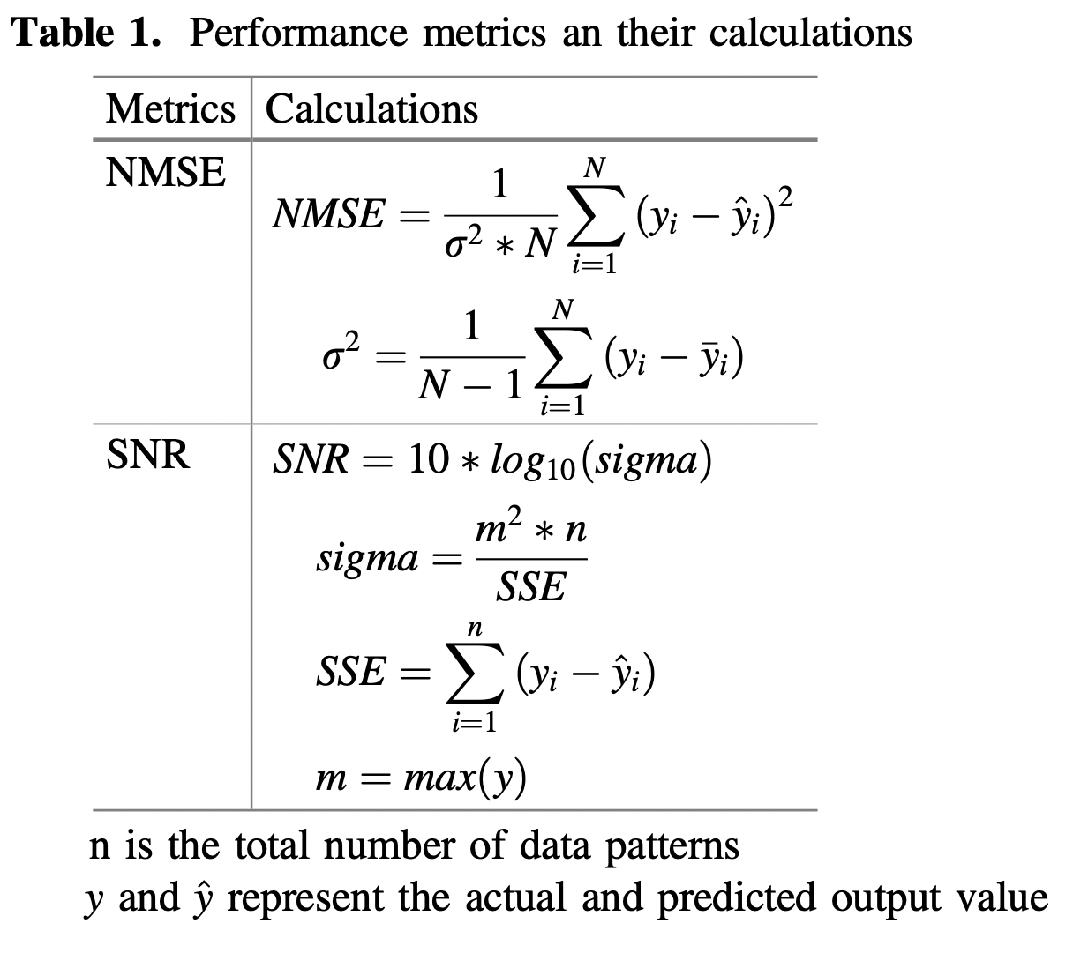

Slide 18
