Slide 1
CLMS.FRAMEWORK
Migration Guide

Slide 2
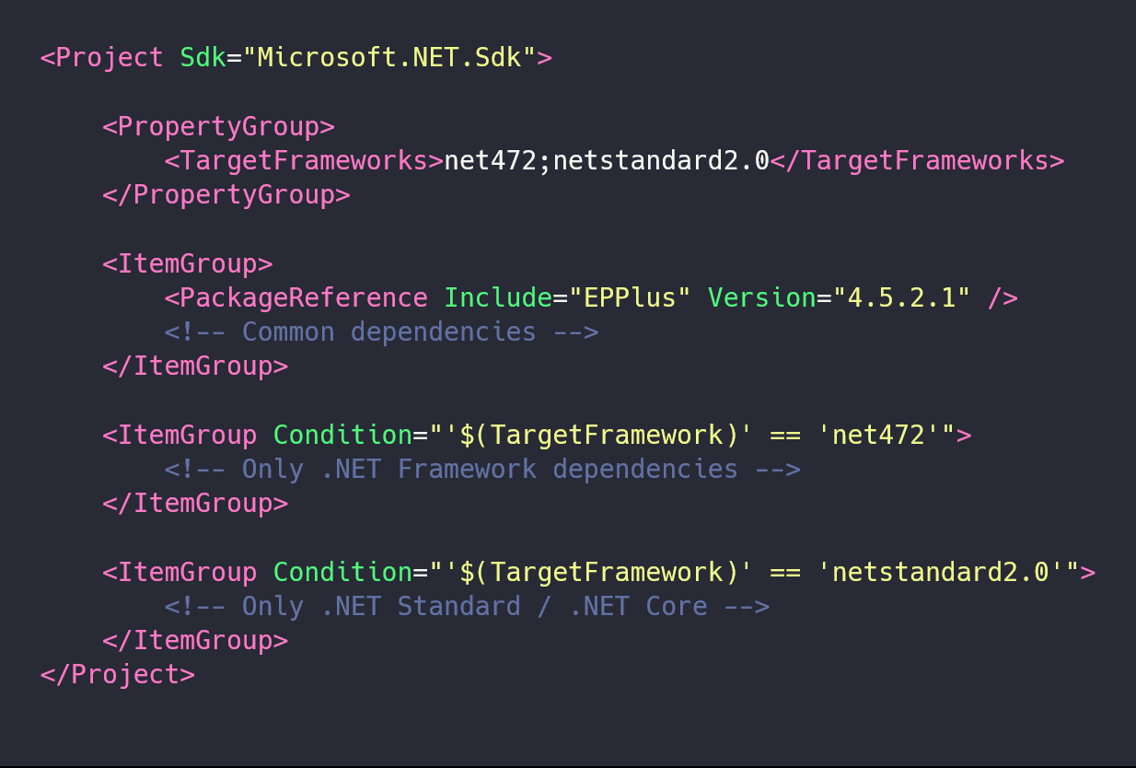
Project Configuration File
Use condition to import required dependencies.
Both .NET 4.7.2 and .NET Standard 2.0
For the existing applications works without any modification.
CAUTION: All new dependencies should target .NET Standard 2.0

Slide 3
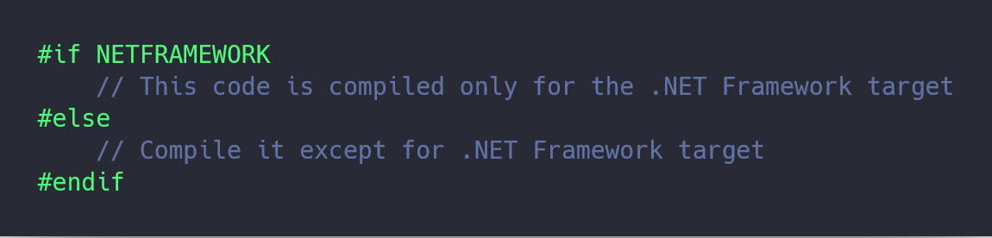
Write multi-target code
Use #if directive to choose if a piece of code should be compiled for the targeted framework.
CAUTION: Only in case of something isn’t working at .NET Standard 2.0
E.g. HTTPContext.Current

Slide 4
Unit testing

