Slide 1

Validating R functions against SAS outputs: How RTest can build a bridge allowing to validate R.
Sebastian Wolf – @zappingseb – PhuseEUConnect, Amsterdam – Nov 11th 2019

Slide 2
The story of RTest
R in Diagnostics
Risks for patients
Minimizing Risks
Some R Test Code

Slide 3
The story of RTest
R in Diagnostics
Risks for patients
Minimizing Risks
Some R Test Code

Slide 4



R in Diagnostics
Sensor Data
Algorithm
Measurement Value
Inserting a blood sample of a patient into a measurement device.
The blood sample and chemical reagent will produce a signal of some kind, mostly optical.
Algorithms transform optical signals into human interpretable values.
Algorithms are used to standardize signals for different reagents and devices.
The measurement will inform the doctor about the level of a certain compound in the blood.
Compounds can be vitamins, hormons, ...

Slide 5
R in Diagnostics
Sensor Data
Algorithm
Measurement Value
Influenced by:
Reagent
Reagent Lot
Device
Lab factors
Blood of patient
Developer
Test Case library
Computing environment (speed)

Slide 6
The story of RTest
R in Diagnostics
Risks for patients
Minimizing Risks
Some R Test Code

Slide 7




Risks for patients
Any treatment decision is based on Diagnostics reports
sensor data
Algorithm
Measurement Value
The patient’s screening data gets translated into a report.
The report is interpreted by a doctor.
The treatment is based on that.
Treatment
Icons from FlatIcon.com

Slide 8
Risks for patients
In case of a wrong algorithm patients treatments can go wrong
Sensor data
Algorithm
Measurement Value
In case of errors in the algorighm, the report may be wrong.
A wrong report result may lead to a wrong decision.
The patient does not receive the right treatment.
Treatment
Icons from FlatIcon.com

Slide 9
The story of RTest
R in Diagnostics
Risks for patients
Minimizing Risks
Some R Test Code

Slide 10
Minimizing Risks
Software testing explained
Test Case
Known
Outcome
Test Case
Known
Outcome
Test Case
Known
Outcome
Algorithm
Test Case
Known
Outcome
Test Case
Known
Outcome
Test Case
Known
Outcome

Slide 11
Minimizing Risks
Software testing explained
Test Case
Known
Outcome
Compare
Tool
Algo
Outcome
Test Case
Known
Outcome
Algo
Outcome
Test Case
Known
Outcome
Algo
Outcome
Algorithm
Algorithm
Test Case
Known
Outcome
Algo
Outcome
Test Case
Known
Outcome
Algo
Outcome
Test Case
Known
Outcome
Algo
Outcome

Slide 12
Minimizing risks
How to improve testing?
More test cases
More diverse people writing and reading test cases
Easier and regular execution of test cases

Slide 13
Minimizing risks
How to improve testing?
More test cases
More diverse people writing and reading test cases
Easier and regular execution of test cases
RTest
CI / CD e.g. Jenkins

Slide 14
The story of RTest
R in Diagnostics
Risks for patients
Minimizing Risks
Some R Test Code

Slide 15
Some RTest Code
How Rtest works
Literature
SAS
R-package
XML
Reference Result
Function call
RTest
Report
Human readible
Easy to edit with Altova XMLspy
No coding experience needed
Human readible
Contains execution information
Contains environment information

Slide 16
Some RTest Code
Function to test
my_function <- function(
data = data.frame(x = c(1,2), y = c(1,2))){
stopifnot(dim(data)[2] == 2)
data[, "sum"] <- apply(data, 1,
function(x){sum(x)})
return(data)
}
Adds a column «sum» which adds up column 1 and column 2

Slide 17
Some RTest Code
XML test description – defines the reference value and the comparison parameters
<my_function test-desc="Test data.frame">
<params>
<RTestData_input_data param="data" name="test01" />
</params>
<reference>
<col-defs>
<coldef name="x" type="numeric" />
<coldef name="y" type="numeric" />
<coldef name="sum" type="numeric" />
</col-defs>
<row>
<cell>1</cell>
<cell>2</cell>
<cell>3</cell>
</row>
<row>
<cell>1</cell>
<cell>2</cell>
<cell>3.5</cell>
</row>
</reference>
<testspec>
<execution execution-type="silent" />
<return-value compare-type="equal" diff-type="absolute"
tolerance="0.001" />
</testspec>
</my_function>

Slide 18
Some RTest Code
XML input data – contains a simple data frame with the definition of column types
<input-data>
<data.frame name="test01">
<col-defs>
<coldef name="x" type="numeric" />
<coldef name="y" type="numeric" />
</col-defs>
<row>
<cell>1</cell>
<cell>2</cell>
</row>
<row>
<cell>1</cell>
<cell>2</cell>
</row>
</data.frame>
</input-data>

Slide 19
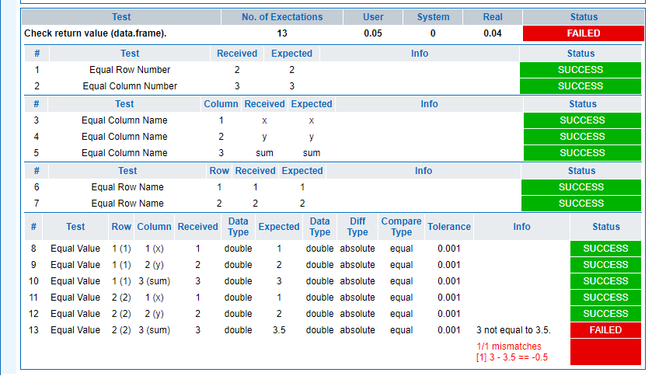
Some RTest Code
The RTest report visualizes the test result in a human-readible way and also describes all reference values.
R> RTest.execute(getwd(),“TestCase.xml")

Slide 20

Some final notes
Where to get the Code?
Install: https://cran.r-project.org/web/packages/RTest/index.html
Code: https://github.com/zappingseb/RTest
Read: https://phuse2019.mail-wolf.de
Testing: https://travis-ci.org/zappingseb/RTest
My recommendation for today:
Adrian Waddel on Analyzing Clinical Trials with R
SD09 – 4.30 pm – E104

Slide 21

Thank you
#' @email
#'
#' @blog
#'
#' @bugReport
#'
#' @cv
#'
#' @twitter
sebastian@mail-wolf.de
mail-wolf.de
github.com/zappingseb
linkedin.com/in/zappingseb
twitter.com/zappingseb
r
#' Roche Diagnostics
#' Biostats Penzberg, Germany
#'
#' @co-developer
#' Sergej Potapov
#' sergej.potapov@roche.com

Slide 22

CT10: Validating R functions against SAS outputs: How RTest can build a bridge allowing to validate R.
Name: Sebastian Wolf
Company: Freelancer
Sebastian Wolf has 5 years experience in the industry
Sebastian Wolf interests are R-shiny, cancer disease mechanisms and running marathons
Notes:
Use this slide if there is only one presenter on the podium

