Slide 1
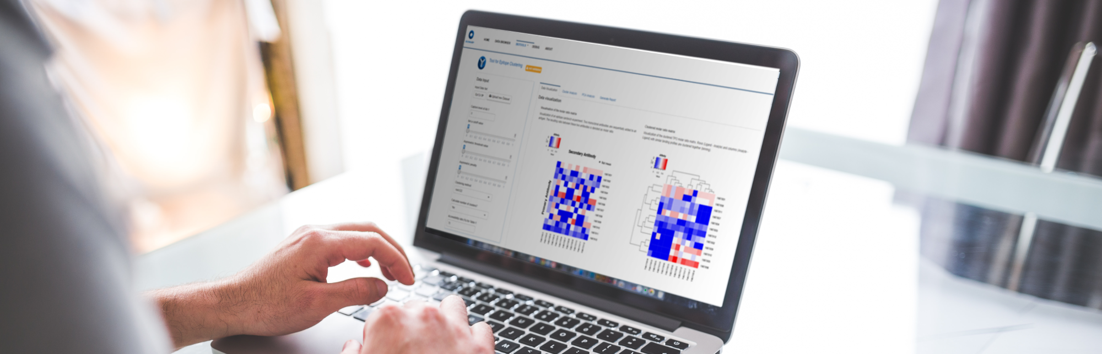
R-Shiny framework in Pharma
Sebastian Engel-Wolf – @zappingseb

Slide 2
Slides in here
About me
Projects in the Pharmaceutical space:
Diagnostics Clinical Study App
Pharma Clinical Study Framework
Diagnostics App to explain clustering
Showcase: COVID-19 dashboard
Why R-Shiny?

Slide 3

About Sebastian Engel-Wolf
since 2019 - Freelance
R-shiny platform for analyzing clinical trials
Mathematical R-packages for analyzing clinical trials
2017 – 2019 - Biostatistician
R-shiny platform for Diagnostics device validation
2015 – 2017 – Project Manager
Modeling production data
Background:
MSc in Molecular Biotechnology
15+ years of programming experience
Expert in Dashboard reporting with R + R-Shiny + Python + ggplot + matplotlib

Slide 4
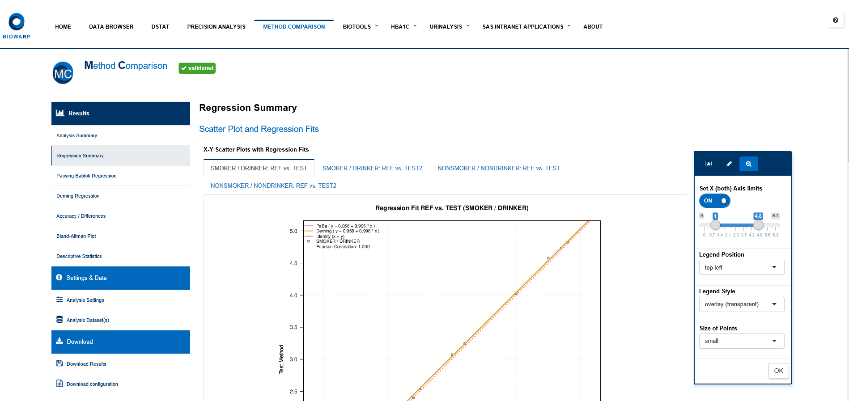
Diagnostics Clinical Study App
Projects
bioWARP
An app to let non-statistians analyze device data without contacting Biostats deparment
App is conform to SOPs
App allows PDF reporting to sign and store results

Slide 5
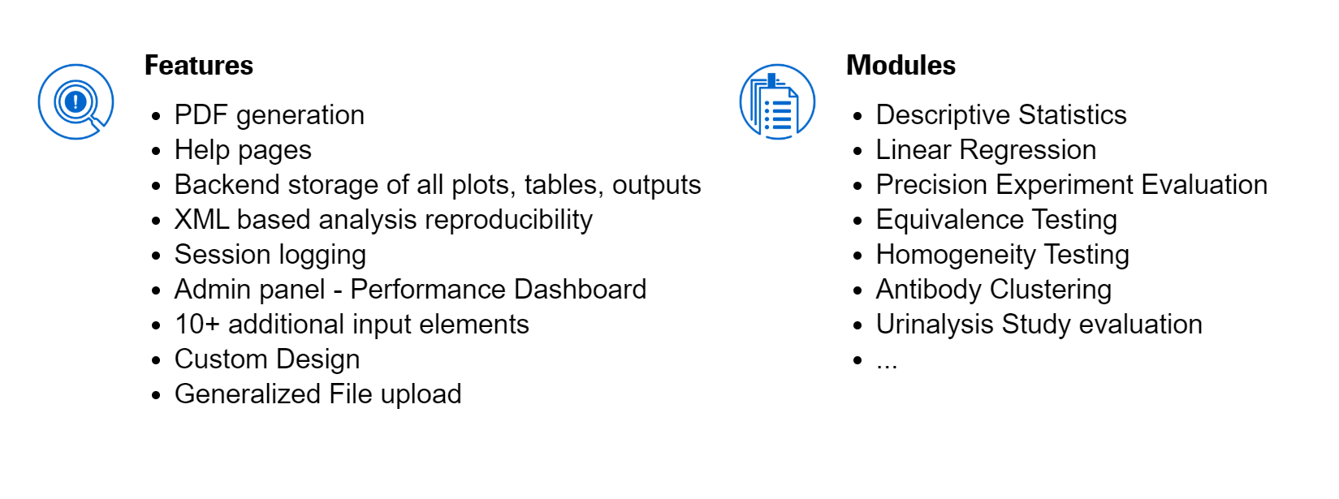
Diagnostics Clinical Study App
Projects
bioWARP
Rstudio Webinar: https://resources.rstudio.com/webinars/the-role-of-r-in-drug-discovery-research-and-development (13:25)
How to build a shiny truck: https://rviews.rstudio.com/2018/09/04/how-to-build-shiny-trucks-not-shiny-cars/
A shiny Web App from LEGO— truck + trailer https://mail-wolf.de/?p=4401
Presentation at R/Pharma https://zappingseb.github.io/RPharma2018/

Slide 6
Pharma Clinical Study Framework
Projects
An app-framework to enable dynamic clinical study reporting
Data
R-Shiny Code
WebApp
R-Code
Reprodicible database
Easy to code!
Dynamic:
Plots
Tables
Listings
Reproducible Reporting
More details are confidential – ideas to be found at: https://mail-wolf.de/?p=4407

Slide 7
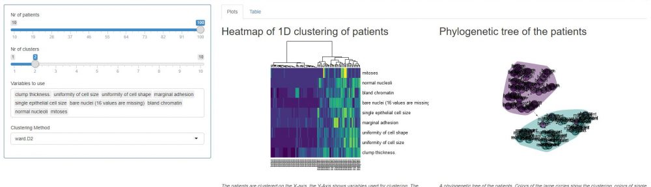
Diagnostics App to explain clustering
Projects
An assay needed to cluster Antibodies by their force of attraction
Data was only available in Excel
Solution: A clustering visualization for R-shiny (confidential)
Public solution: https://mail-wolf.de/?p=4344

Slide 8
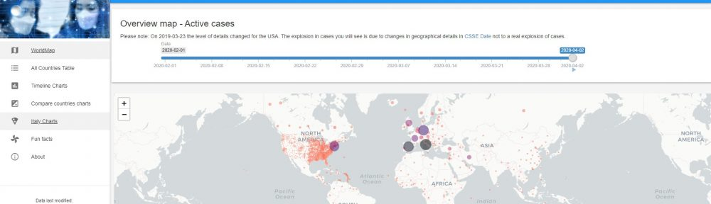
Showcase: COVID-19 dashboard
Projects
Map including spread of cases
Customizable plots of different parameters:
# of cases
# of new cases
# of days to double # of cases
....
Material Design to work on mobile devices and tablets
App: https://sebastianwolf.shinyapps.io/Corona-Shiny/
Article: https://mail-wolf.de/?p=4632

Slide 9
Why R-Shiny?
R is a commonly used programming language for statisticians
WebApps allow dynamic reporting, non-statisticians know WebApp interfaces really well
R-Shiny is simple to learn
R-Shiny is well documented
R-Shiny computing environments are easy to set up
R leaves you with a lot of flexibility – see the showcase
More:
https://shiny.rstudio.com/
https://rstudio.com/products/connect/
https://rstudio.com/products/shiny/shiny-server/
https://www.business-science.io/business/2020/03/09/shiny-vs-tableau.html

Slide 10

#' @email
#'
#' @blog
#'
#' @bugReport
#'
#' @cv
#'
#' @twitter
sebastian@mail-wolf.de
mail-wolf.de
github.com/zappingseb
linkedin.com/in/zappingseb
twitter.com/zappingseb

