Slide 1
Little big WOrld
FYP2

Slide 2
The Team
Leader
Kee Yang
Programmers
Darren
Hazim

Slide 3
The Intro
Life isn’t easy for [insert name here] - an ant-sized human - as he has to live in a big world, hiding from ordinary humans, yet living amongst them.
You play as [insert name here], living out his everyday life, scavenging for food in an ordinary household, all the while avoiding humans and other threats.

Slide 4
The Game
Genre
First Person, Puzzle, Stealth
Target platform
Microsoft Windows
Distribution platform
Steam

Slide 5
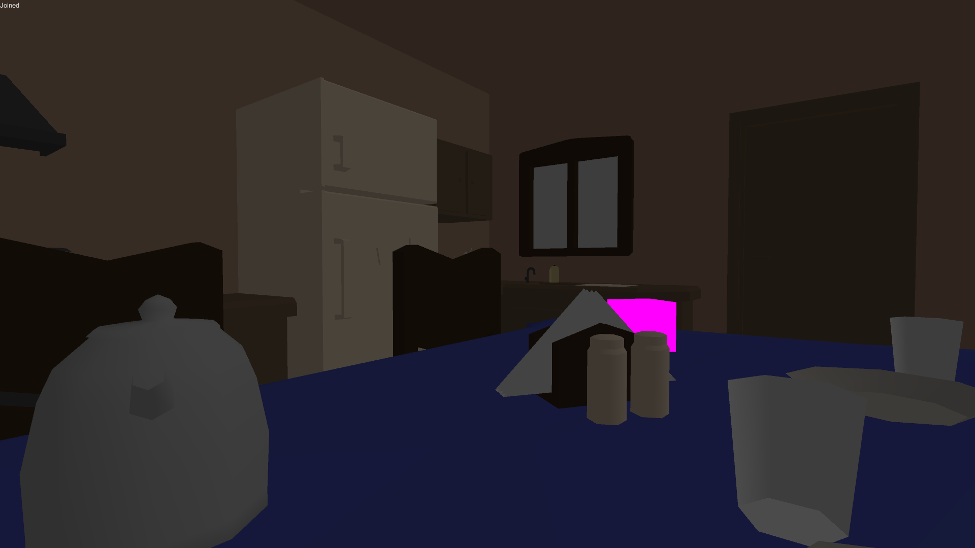
The Game
Follow through objectives
Open-world approach
Suitable for all ages

Slide 6
The Intention
Stimulate a different, unique perspective for players
Promote player’s creativity and resourcefulness on their approach to the objectives
Promote concentration and calmness by letting player walk on a tightrope, surviving and completing tasks
Promote awareness of how small human is to the world

Slide 7
The USPs
Uncommon perspective for player (role playing as little creature)
Stealthy, puzzle game in a house
Various ways to achieve tasks
Familiar world setting, allowing easier immersion

Slide 8
Gameplay
Navigate around the house as a tiny human
Crafting and utilizing objects found along the way in order to overcome obstacles and reach your goal
Being in the open and making loud noises would alarm humans/pets
players would be attacked eventually

Slide 9
Game Logic
To win: reach designated location/finding certain item set by the game
Lose: when human is alarmed and caught you

Slide 10
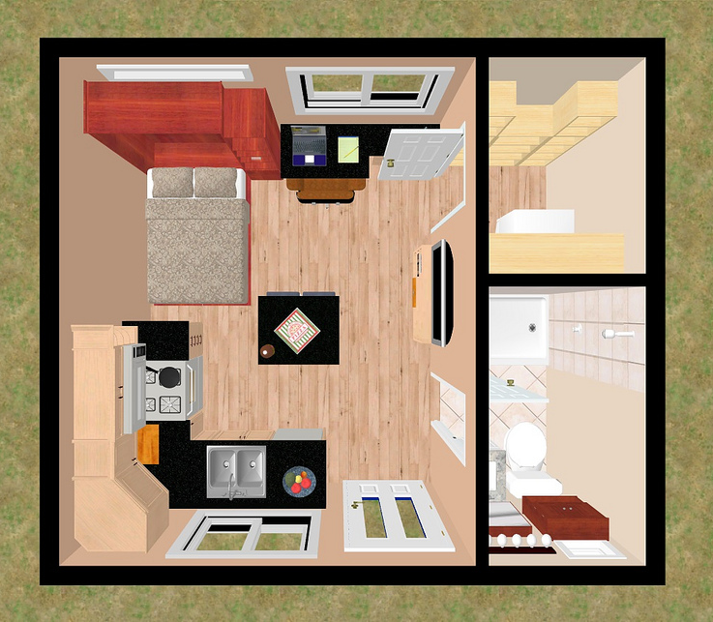
Level Design Concept
Put some pics here
Maybe could show map/layout of house
>> example

Slide 11
Level Design
Game divided into ‘Chapters’
Each Chapter takes place in a part of the house
Upon completing objective(s), players would unlock and move on to the next chapter
First Chapter would show players the ropes

Slide 12
Level Design
Planned Main Objectives
Creating of tools (e.g. grappling hook, parachute, etc.)
Reaching to food storage location (fridge/cupboards)
Retrieving of food to [protagonist]’s home

Slide 13
Advertising Strategies
Social Media Connect
Inclusion of advertiser’s product as game object
Sponsor page with links
Occasional ads banner outside main game.

Slide 14
Monetization Strategies
DLC Chapters
Sound and Music download
Remove advertisement

Slide 15
Retention Strategies
Release DLC biannually
Release different avatar fortnightly
Online leaderboard

Slide 16
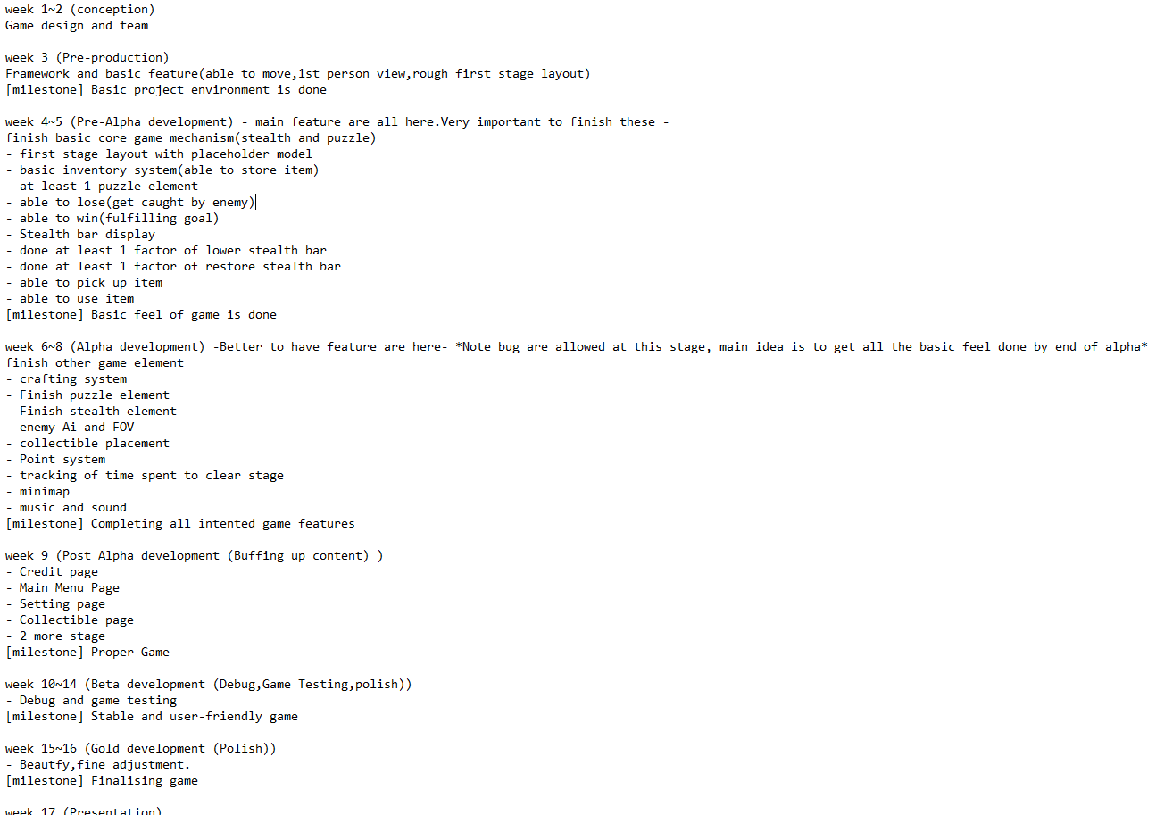
Production Milestones

Slide 17
Q& A

