Slide 1
Little big WOrld
FYP2

Slide 2
Team Members
Leader: Kee Yang
Programmers: Darren, Hazim

Slide 3
Introduction
You are playing as a little human who is trying to live by every day in a world filled with gigantic animals and human without being caught or eaten.

Slide 4
Game(Little Big World)
Genre: FPS, Puzzle, Stealth
3D
1 Player
Solve puzzle while being stealthy
Suitable for all ages

Slide 5
Key Information
Target platform: Microsoft Windows
Distribution platform: Steam

Slide 6
Game Core Intention
1.Stimulate a different perspective for player,using vast contrast of size.
2.Promote creative and resourcefulness of player in solving puzzle
3.Promote concentration and calmness by letting player walk on a tightrope and survival and completing task.
4.Promote awareness of how small human is to the world.

Slide 7
Unique Selling Point
Stealthy puzzle game at a house
Various usage of tool to achieve task
Unusual perspective for player(role playing as little creature)
Familiar world setting allowing easier immersion
~10 to 20 mins gameplay

Slide 8
Game Play
Navigate around in a room as little human and being resourceful and creative in overcoming obstacle to reach goals by utilizing objects found along the way
Every movement ,every sound made, will potentially alarmed human and being attacked by them

Slide 9
Game Logic
To win: reach designated location/finding certain item set by the game
Lose: when human is alarmed and caught you

Slide 10
Level Design Concept
Put some pics here

Slide 11
Level Desgin
The game will run in a setting of a house
New levels will unlock sequentially after completing the first level
Different level will resemble a part of the house
The first level will be a tutorial stage

Slide 12
Advertising strategy
Ad strategy:
Social Media Connect
Inclusion of advertiser’s product as game object
Sponsor page with links
Occasional ads banner outside main game.

Slide 13
Monetization Strategy
DLC Stage
Remove advertisements
Unlock all levels
From advertisement

Slide 14
Retention Strategy
Add new levels and items as DLC fortnightly
Different avatar weekly
Online leaderboard
Multiplayer competition

Slide 15
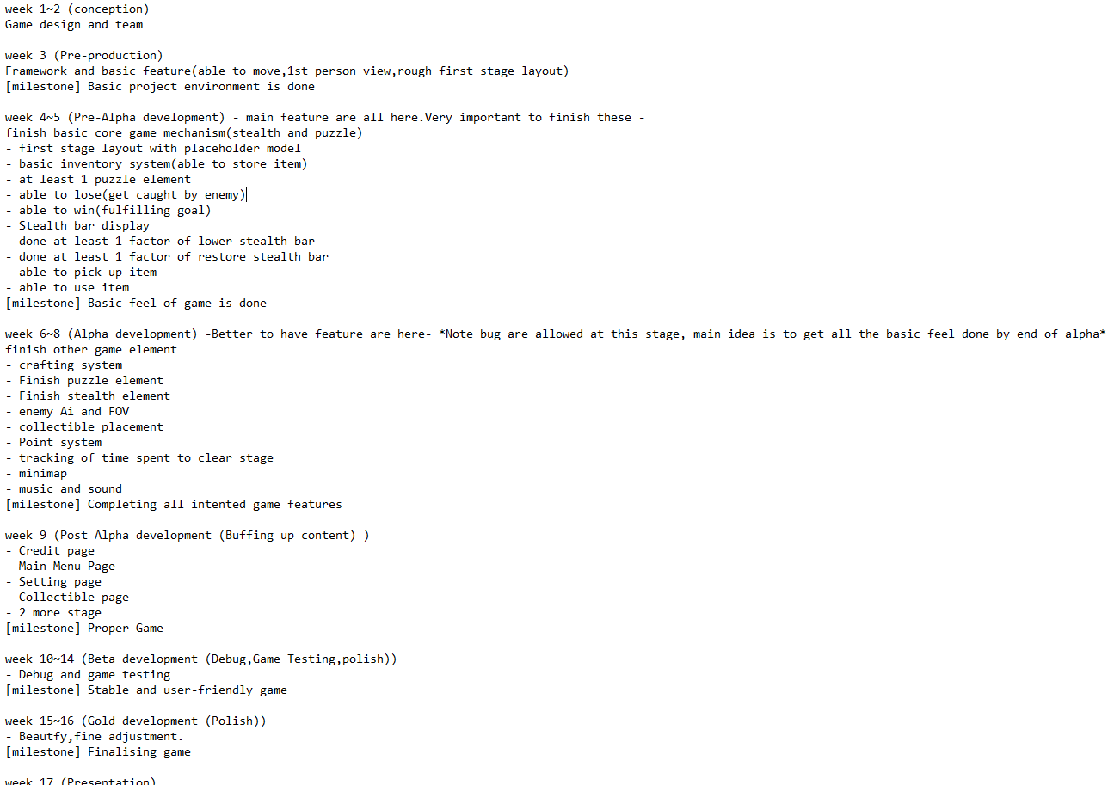
Production Milestone

Slide 16
Q & A

