Slide 1
Simple Linux
Network programming
2017/09/28

Slide 2
Outline
Introduction of virtual machine and installation tutorial
How to connect to a remote machine ?
Basic Linux command
Basic Linux programming
Networking tools on Linux

Slide 3
Outline
Introduction of virtual machine and installation tutorial
How to connect to a remote machine ?
Basic Linux command
Basic Linux programming
Networking tools on Linux

Slide 4
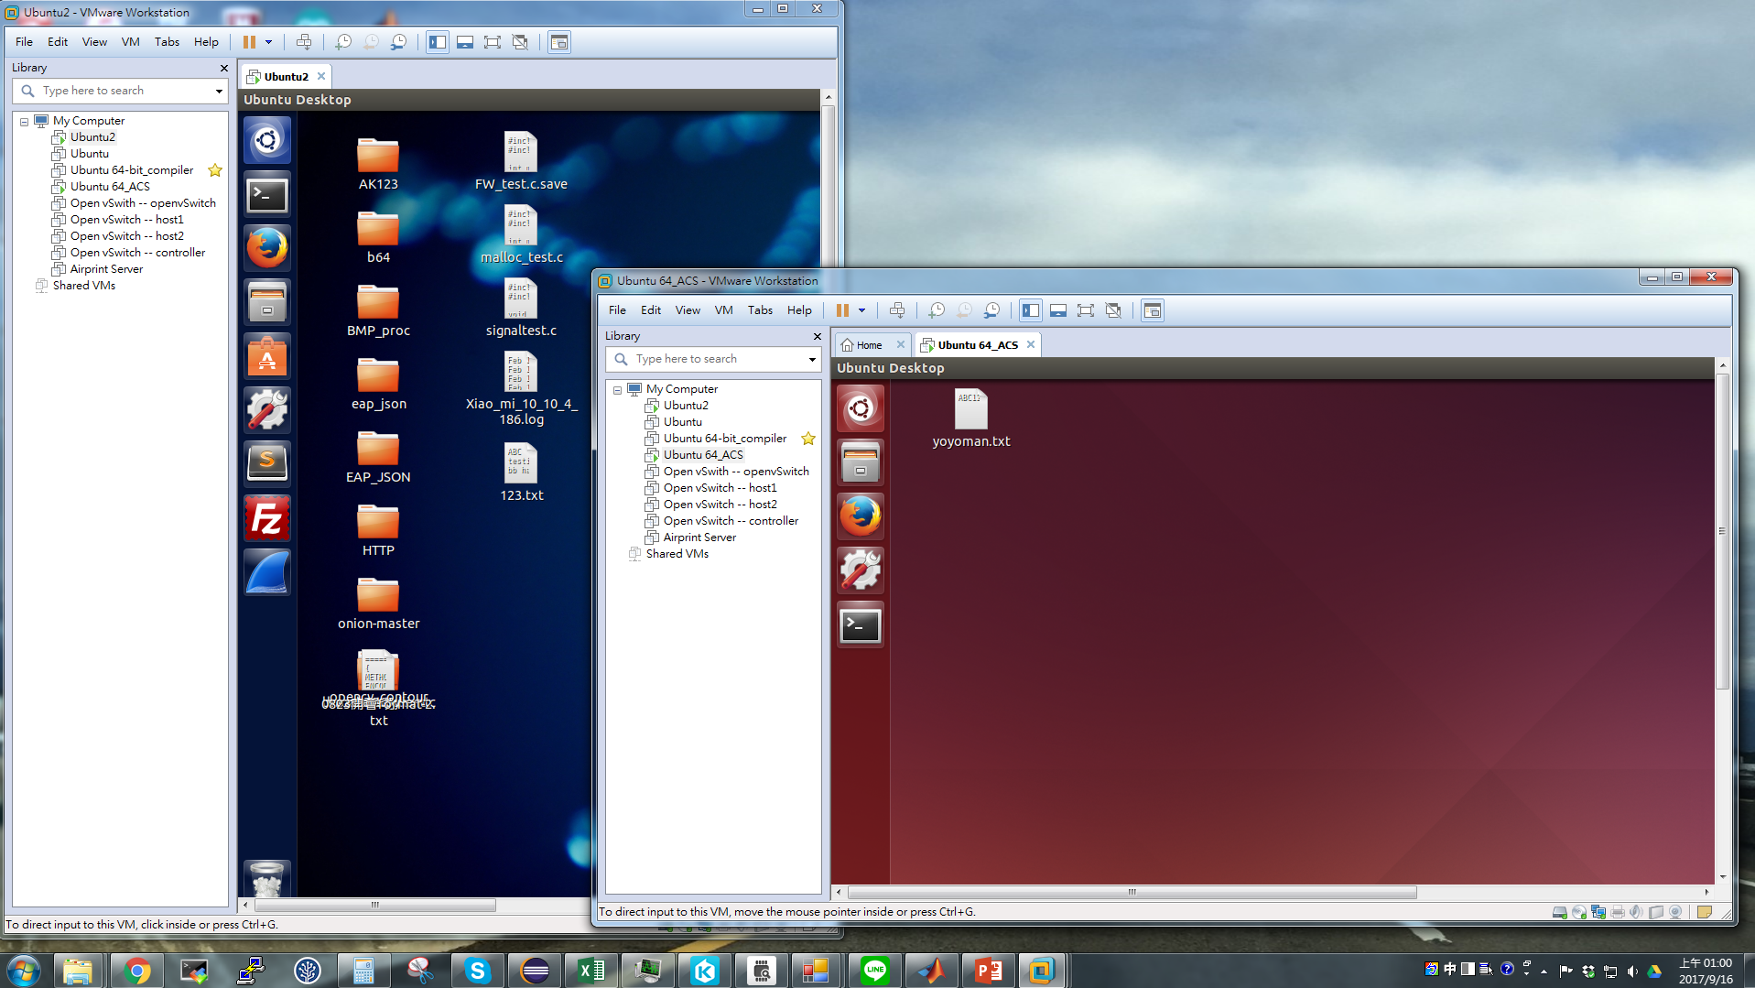
Introduction of virtual machine and installation tutorial

Slide 5
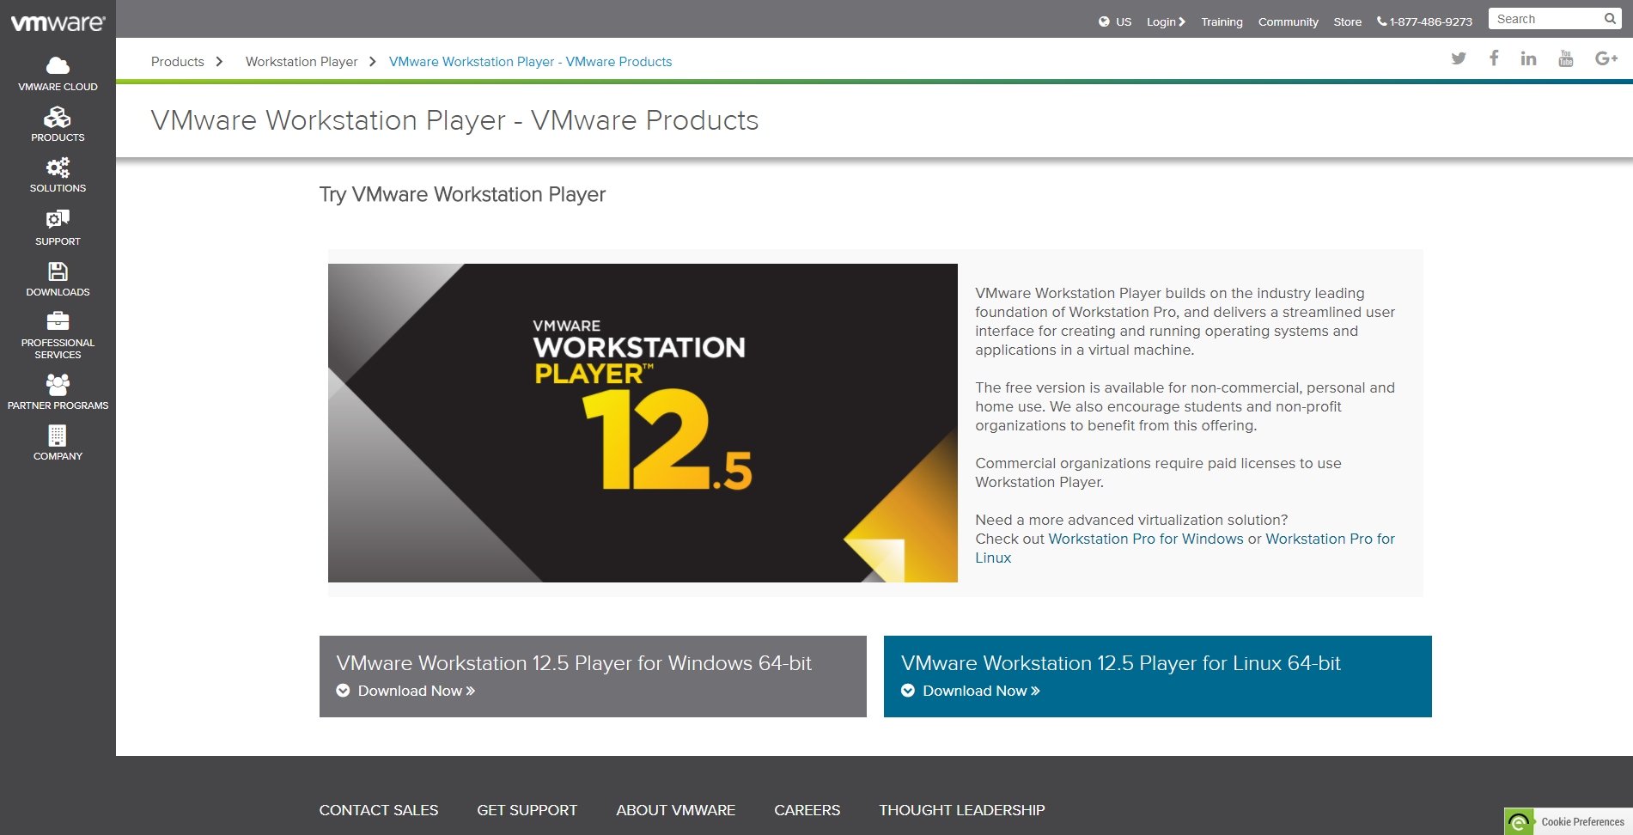
Introduction of virtual machine and installation tutorial
Download VMware workstation
https://www.vmware.com/products/player/playerpro-evaluation.html
Or google VMware workstation player

Slide 6
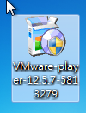
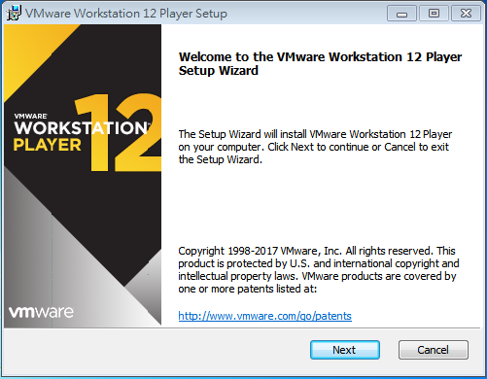
Introduction of virtual machine and installation tutorial
Click the program you downloaded
Press “Next” to continue installation

Slide 7
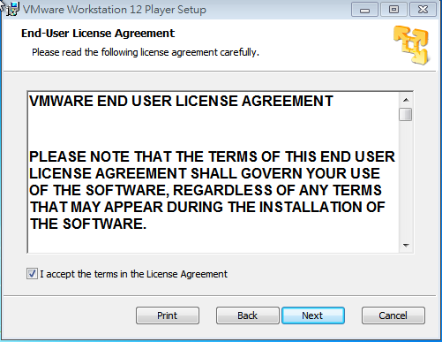
Introduction of virtual machine and installation tutorial
Click “I accept the terms in the license Agreement” and press “Next”

Slide 8
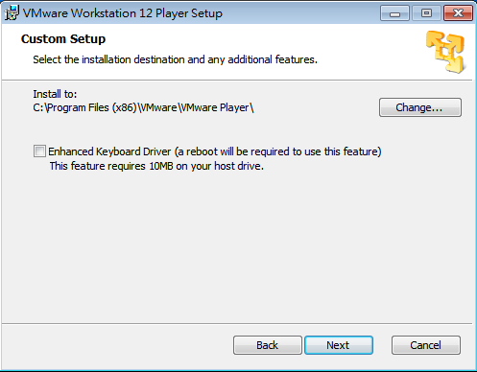
Introduction of virtual machine and installation tutorial
Press “Next” if you accept default setup

Slide 9
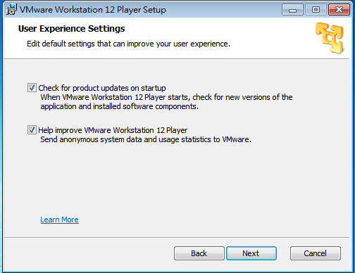
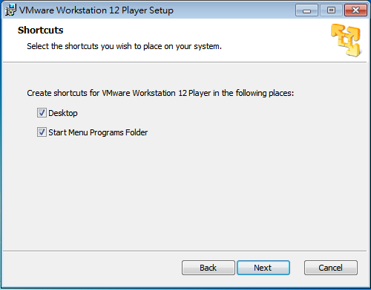
Introduction of virtual machine and installation tutorial
Press “Next” if you accept default setup

Slide 10
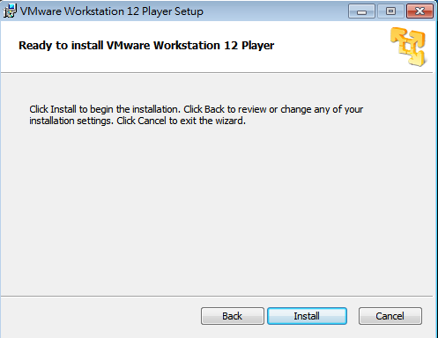
Introduction of virtual machine and installation tutorial
Press “Install” to start install it

Slide 11
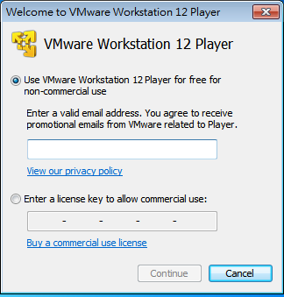
Introduction of virtual machine and installation tutorial
Start your Vmware workstation player and you will see
Choose “for non-commercial” use and enter your email
Press “continue”

Slide 12
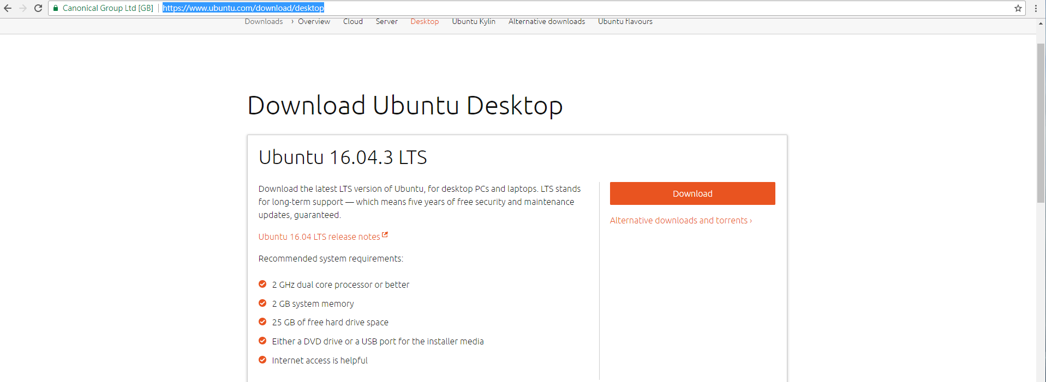
Introduction of virtual machine and installation tutorial
Install guest OS
Download whatever kind of Linux distribution you like
In this tutorial, I will use Ubuntu 16.04 LTS
Download Ubuntu from here: https://www.ubuntu.com/download/desktop

Slide 13
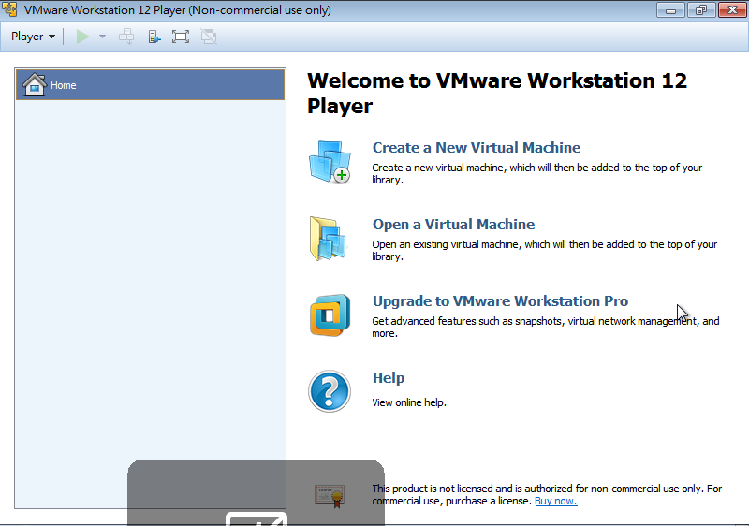
Introduction of virtual machine and installation tutorial
Install guest OS
Back to Vmware workstation player
Press “Create a New Virtual Machine”

Slide 14
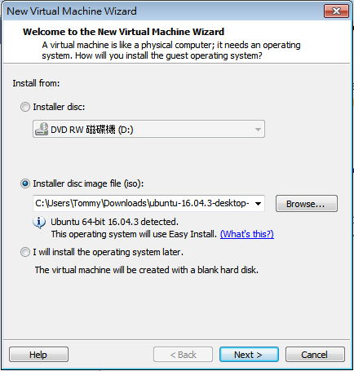
Introduction of virtual machine and installation tutorial
Install guest OS
Choose “Installer disc image file(iso)” and press “Browse” to find the ISO file you download from website
Press “Next” to continue

Slide 15
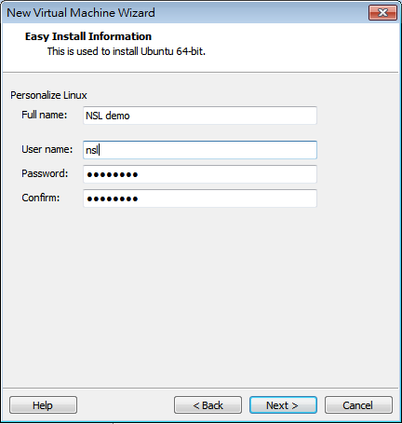
Introduction of virtual machine and installation tutorial
Install guest OS
Enter user name and Password for your guest machine
Press “Next”

Slide 16
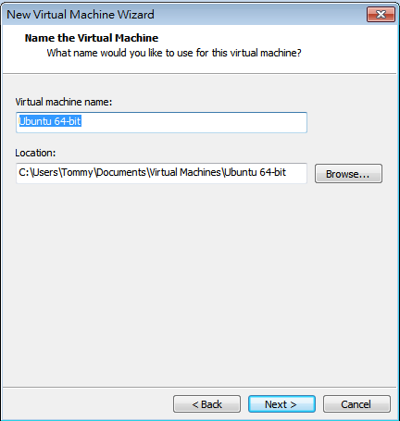
Introduction of virtual machine and installation tutorial
Install guest OS
Press “Next” if you accept default setup

Slide 17
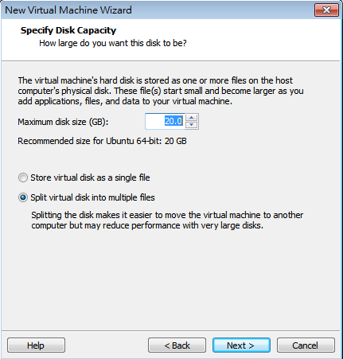
Introduction of virtual machine and installation tutorial
Install guest OS
Set maximum disk size of your guest OS
Choose “Split virtual disk into multiple files”
Press “Next”

Slide 18
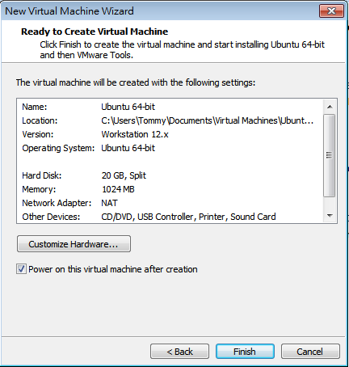
Introduction of virtual machine and installation tutorial
Install guest OS
Press “Finish” if you accept default setup
Guest OS will be powered on automatically

Slide 19
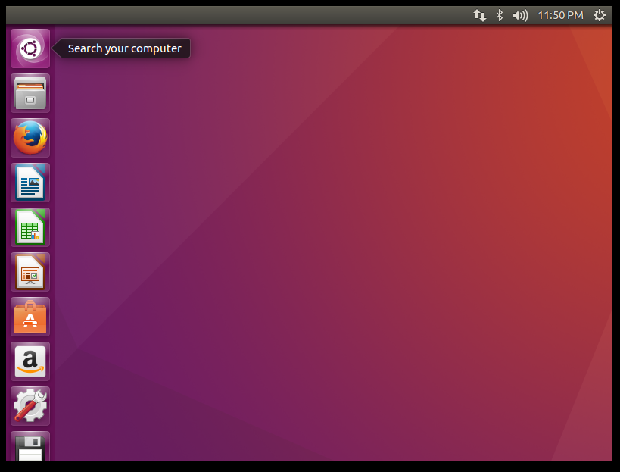
Introduction of virtual machine and installation tutorial
Install guest OS
After waiting for a while, you can get a whole new guest OS on your computer

Slide 20
Introduction of virtual machine and installation tutorial
Common problem
Get error message: This host does not support Intel VT-x
Solution:
First of all, do make sure that your computer is 64-bit
Check your CPU is support VT-X or not, if your CPU is Intel you can check here: http://ark.intel.com/Search/FeatureFilter?productType=processors
Your CPU does support it, you can enable it in the BIOS
Your CPU doesn’t support it, it’s OK to install 32-bit guest OS on your computer.

Slide 21
Outline
Introduction of virtual machine and installation tutorial
How to connect to a remote machine ?
Basic Linux command
Basic Linux programming
Networking tools on Linux

Slide 22
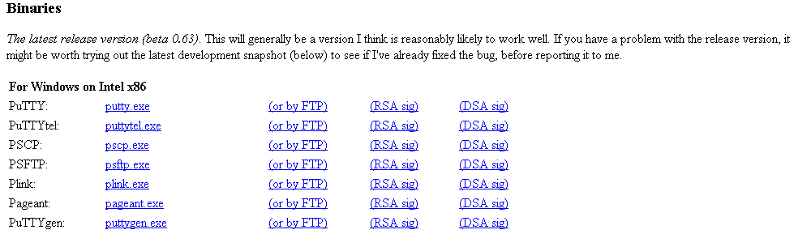
To start with...
Download putty.exe
http://www.chiark.greenend.org.uk/~sgtatham/putty/download.html
Or google putty

Slide 23
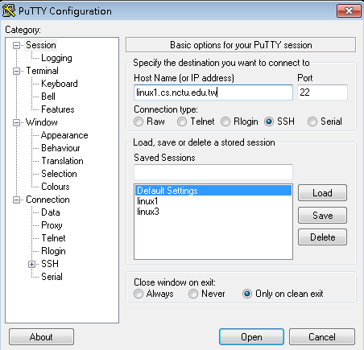
To start with... (Continued)
linux1.cs.nctu.edu.tw
linux2.cs.nctu.edu.tw
linux3.cs.nctu.edu.tw
linux4.cs.nctu.edu.tw
linux5.cs.nctu.edu.tw
linux6.cs.nctu.edu.tw

Slide 24
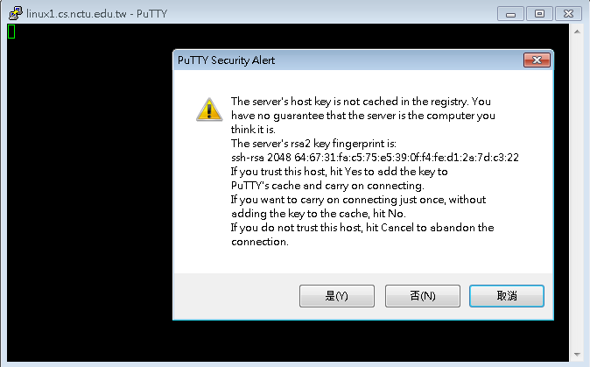
To start with... (Continued)

Slide 25
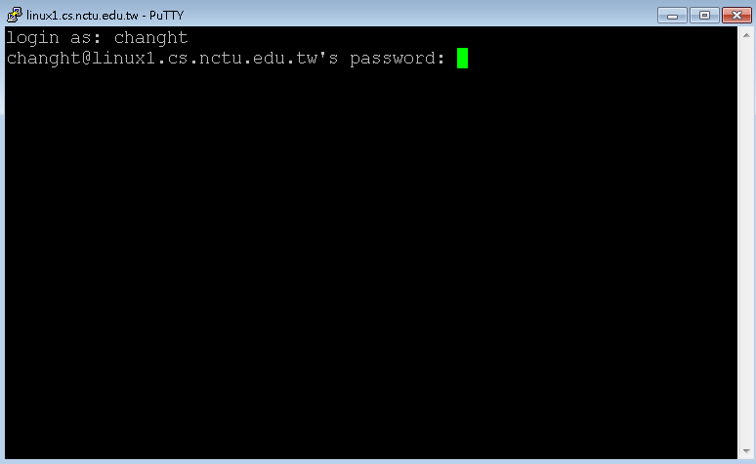
To start with... (Continued)

Slide 26
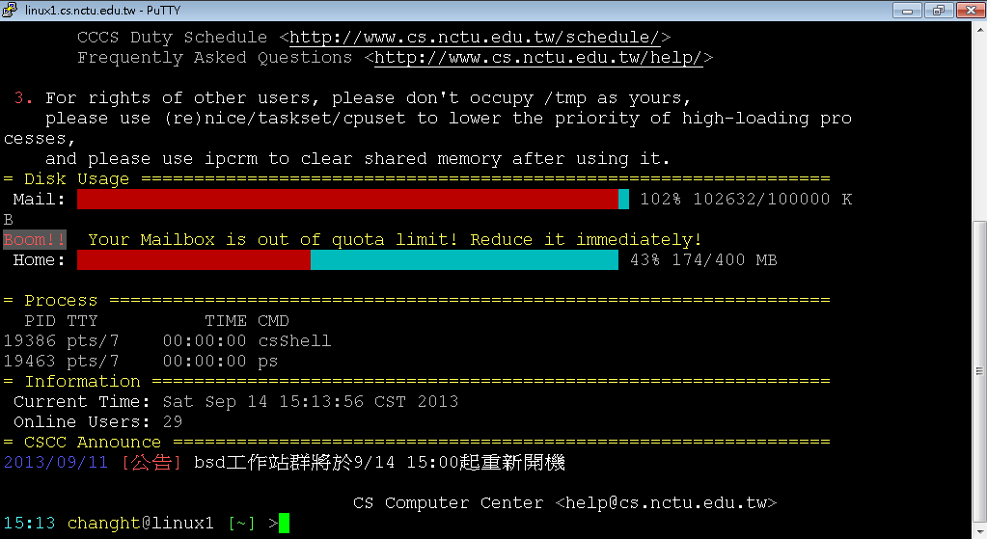
To start with... (Continued)

Slide 27
Outline
Introduction of virtual machine and installation tutorial
How to connect to a remote machine ?
Basic Linux command
Basic Linux programming
Networking tools on Linux

Slide 28
Basic Linux command
account@server hostname [current directory]
You can type “ls”, which means “list “, to show all the files in the home directory.
command | explanation
ls ~ | List contents in user home directory.
ls . | List contents in current directory.
ls .. | List contents in parent directory.

Slide 29
Basic Linux command
command | explanation | 中文解釋
ls | List directory contents | 把現在資料夾下的檔案顯示出來
pwd | Print name from working directory | 看現在在哪個資料夾底下
mkdir <dir> | Make directories | 建立資料夾
cd <dir> | Change directory | 換資料夾
mv <src file> <dst file> | Move (rename) file | 移動檔案 (重新命名) 檔案
cp <src file> <dst file> | Copy file | 複製檔案
rm <file> | Remove file | 刪除檔案
clear | Clean up the screen | 把畫面清乾淨

Slide 30
Basic Linux command
Use command ‘man’ to discover more usages.
man ls
ls –a : show all files, including files starting with . , which are hidden files.
ls -l : show long information of contents.
ls –al : show all the files and their long information.
ls <path> : show the content of given path
You can also man the function you may use in the program.
man printf
man strtok

Slide 31
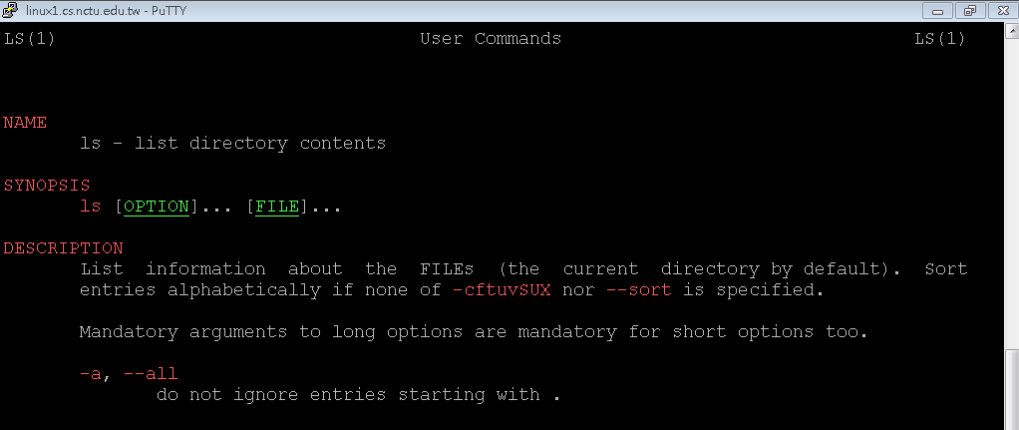
Basic Linux command

Slide 32
Outline
Introduction of virtual machine and installation tutorial
How to connect to a remote machine ?
Basic Linux command
Basic Linux programming
Networking tools on Linux

Slide 33
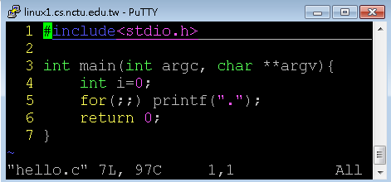
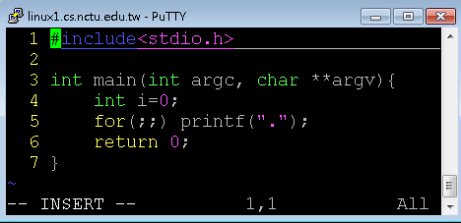
Basic Linux programming-VIM
vim is a text editor
vim hello.c
Press ”insert” or “i” to enter insert mode, or you can type nothing.
Notes:
http://zh.wikipedia.org/wiki/Vim

Slide 34
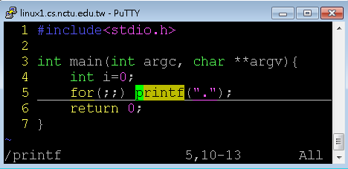
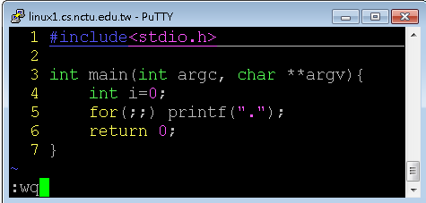
Basic Linux programming-VIM
Press “Esc” to enter back to normal mode, where you can type some commands, including “:wq” for saving and leaving, “:q!” for leaving without saving, “/printf” for searching the string “printf”.
You can pick up other usage by your self.

Slide 35
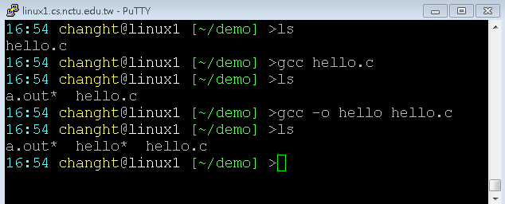
Basic Linux programming – GCC/G++
gcc/g++ –o <output> <filename>
-o
Binary produced will be the same name as assigned.
If –o is not provide, a.out will be default output.

Slide 36
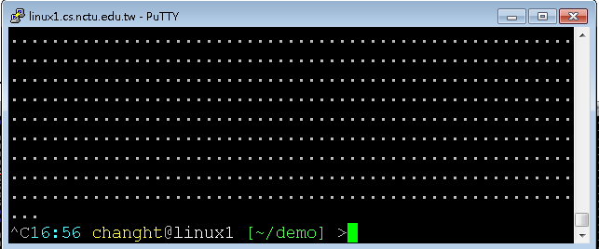
Basic Linux programming - Execute and Forced Terminate
Execute
./a.out
./hello
~/demo/a.out
~/demo/hello
Forced Terminate
Ctrl+c

Slide 37
More explanation

Slide 38
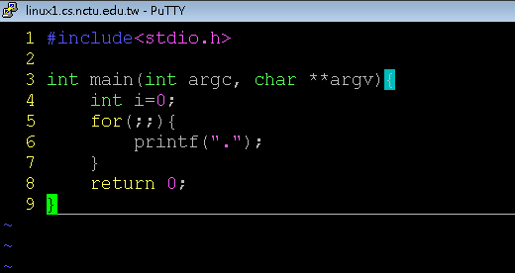
Argument variable
Argument count
Argument vector

Slide 39

Argument variable
Int main ( int argc, char** argv)
argc
Integer
The sum of given arguments count, including the binary name.
argv
Char** (string array)
a string array that holds arguments.

Slide 40
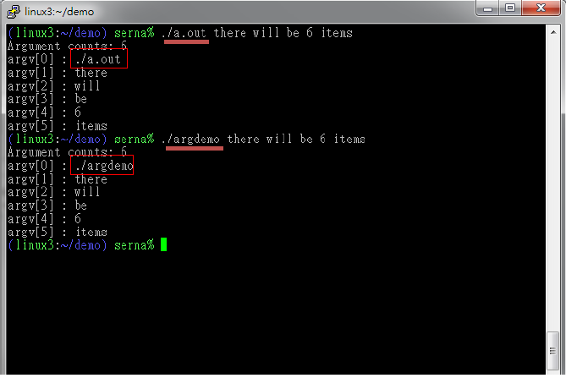
Argument variable

Slide 41
Basic Linux programming - Process commands
ps
report a snapshot of the current processes.
ps u
All of your process in difference login session.
Get process ID
kill
terminate or signal a process
When a process doesn’t went your way or out of control, use this command to terminate it
kill <pid>

Slide 42
Basic Linux programming - Run Program in Linux
Every command is a executable binary
ls -> /bin/ls
vim -> /usr/bin/vim
Environment variables
env
PATH=/usr/local/bin:/usr/bin:/bin:/opt/bin
When user commit an command, if it wasn‘t a shell‘s builtin command, OS will try to put each environment variable in front of the command and find that binary for execute.
That means we can‘t just simply type a.out and hope to execute the program we compiled
You have to detetmine the file path of the output binary.
./a.out
~/demo/a.out

Slide 43
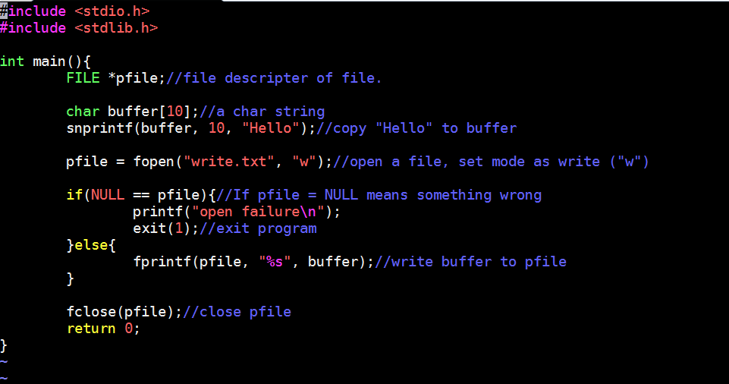
Basic Linux programming – FILE I/O
Write file

Slide 44
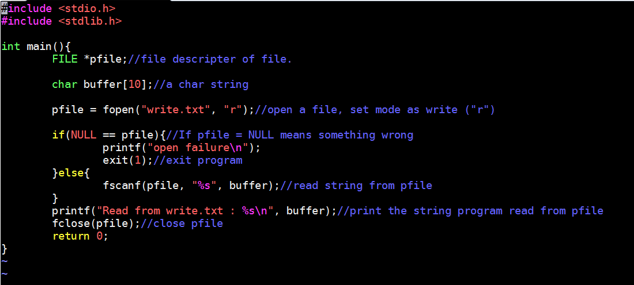
Basic Linux programming – FILE I/O
Read file

Slide 45
Outline
Introduction of virtual machine and installation tutorial
How to connect to a remote machine ?
Basic Linux command
Basic Linux programming
Networking tools on Linux

Slide 46
Networking tools on Linux - Network commands
ifconfig
Show current system NIC
eth* as intel Ethernet card
Placed in /sbin/ifconfig
ping <host IP>
Send ICMP packet to host
Simple test if an server is alive
Not working if firewall is set.
Windows 7 default
telnet <host IP> <host Port>
User interface to the TELNET protocol
Not only TELNET protocol
A simple but solid text based network client

Slide 47
Networking tools on Linux - Capture and analyze packets
Command line interface:
Tcpdump
Graphical User Interface:
Wireshark

Slide 48
Networking tools on Linux - What is tcpdump?
Packet analyzer runs under the command line.
Works on most Unix-like OS.
Support common protocols not just TCP.

Slide 49
Networking tools on Linux - How to Install tcpdump
Ubuntu
$ sudo apt-get update
$ sudo apt-get install tcpdump

Slide 50
Networking tools on Linux - tcpdump
tcpdump [ -AennqX ] [ -i 網路介面 ] [ -c 數量 ] [ -w 儲存檔案名 ]
-A ：Print each packet in ASCII. Handy for capturing web pages
-e ：Print the link-level header (MAC) on each dump line.
-nn：Print data with IP and port number instead of host name
-X ：print the data of each packet in hex and ASCII
-i ：Listen on interface, e.g.: eth0, lo, ppp0
-c ：Exit after receiving count packets, if without the parameter, tcpdump will continue capture packets until press [ctrl]-c
-w ：Write the raw packets to file rather than parsing and printing them out.
Notes:
-A ：封包的內容以 ASCII 顯示，通常用來捉取 WWW 的網頁封包資料
-e ：使用資料連接層 (OSI 第二層) 的 MAC 封包資料來顯示
-nn：直接以 IP 及 port number 顯示，而非主機名與服務名稱
-X ：可以列出十六進位 (hex) 以及 ASCII 的封包內容
-i ：後面接要『監聽』的網路介面，例如 eth0, lo, ppp0 等等的介面
-c ：監聽的封包數，如果沒有這個參數， tcpdump 會持續不斷的監聽， 直到使用者輸入 [ctrl]-c 為止。
-w ：如果你要將監聽所得的封包資料儲存下來，後面接檔名
-r 從指定的檔中讀取包(這些包一般通過-w選項產生)；

Slide 51
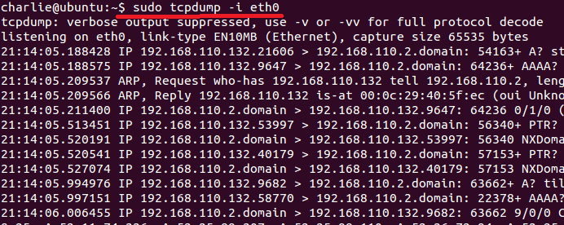
Networking tools on Linux - tcpdump
$ sudo tcpdump –i eth0

Slide 52
Networking tools on Linux - What is Wireshark?
Wireshark is the world's foremost network protocol analyzer. It lets you see what's happening on your network at a microscopic level. It is the de facto (and often de jure) standard across many industries and educational institutions.

Slide 53
Networking tools on Linux - How to Install Wireshark
Ubuntu
$ sudo apt-get update
$ sudo apt-get install wireshark

Slide 54
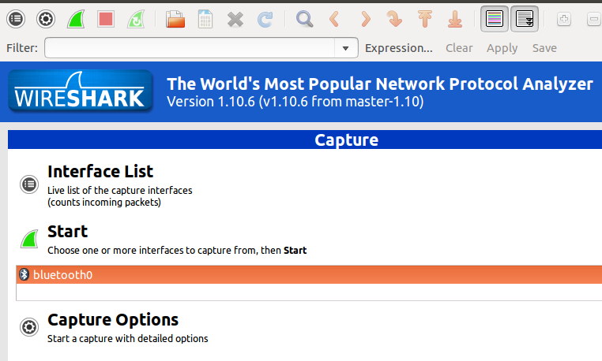
Networking tools on Linux - Start Wireshark (I)
$ wireshark # can’t find interface

Slide 55
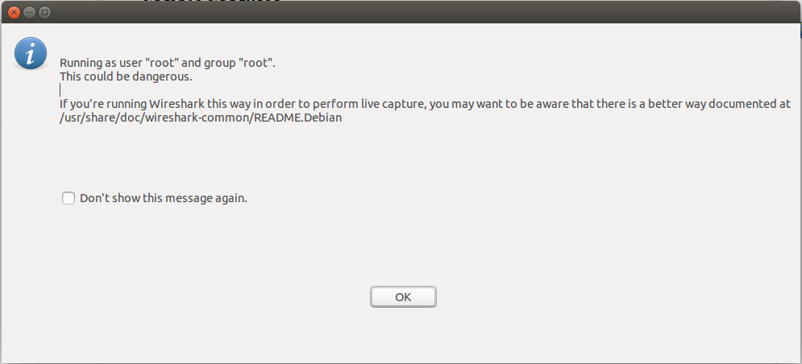
Networking tools on Linux - Start Wireshark (II)
$ sudo wireshark # Run as super user but have some warning

Slide 56
Networking tools on Linux - Start Wireshark (III)
Solution
$ sudo chgrp YOUR_USERNAME /usr/bin/dumpcap
$ sudo chmod 750 /usr/bin/dumpcap
$ sudo setcap cap_net_raw,cap_net_admin+eip /usr/bin/dumpcap
Why
https://blog.wireshark.org/2010/02/running-wireshark-as-you/

Slide 57
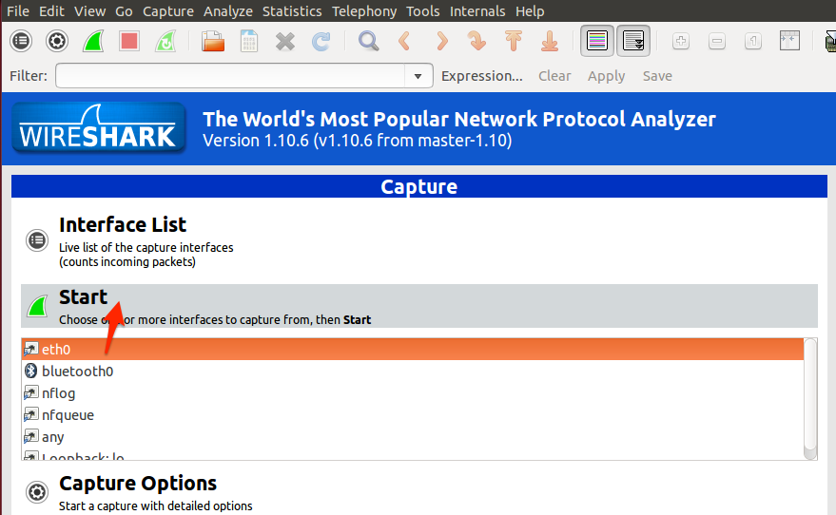
Networking tools on Linux - Start Wireshark (IV)
$ wireshark

Slide 58
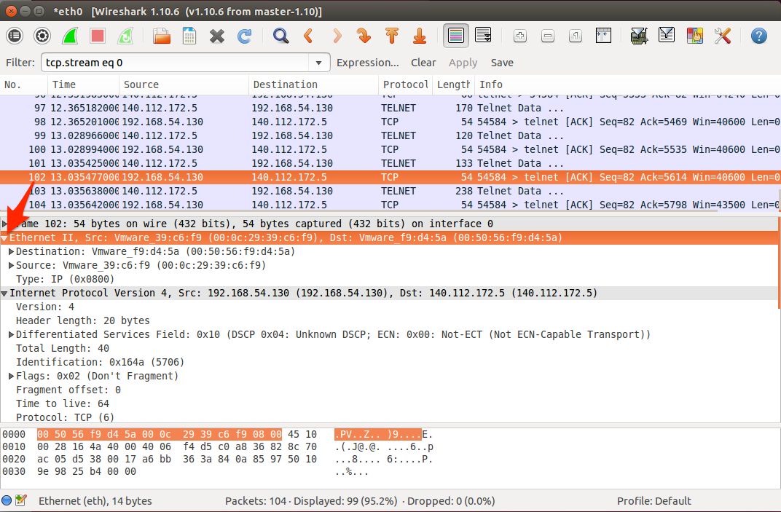
Networking tools on Linux - Basic Functions (I)

Slide 59
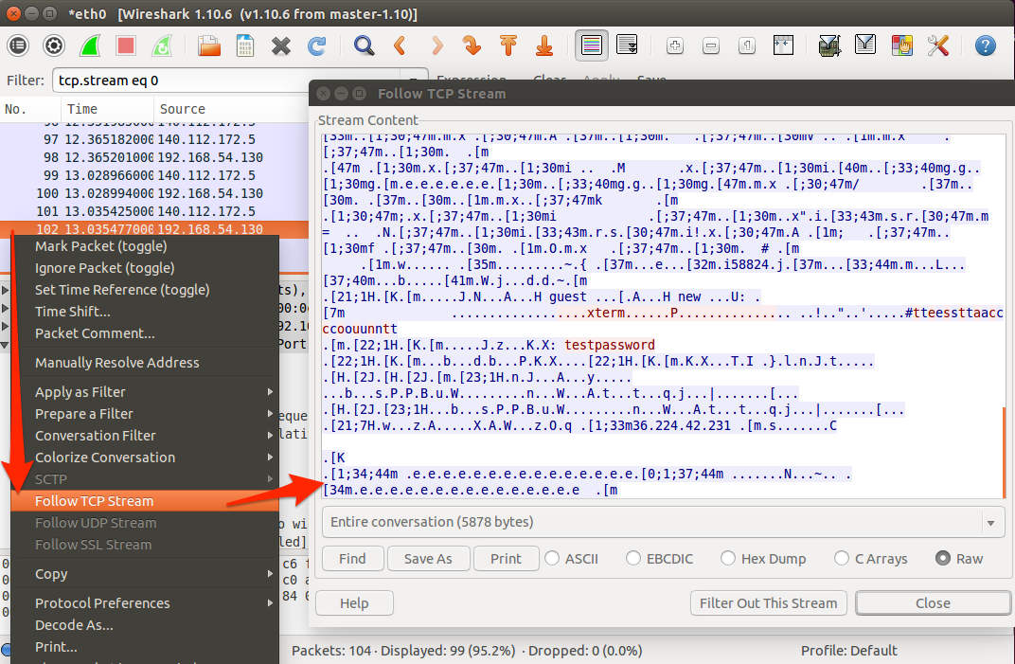
Networking tools on Linux - Basic Functions (II)
Notes:
只看這條 tcp stream的

Slide 60
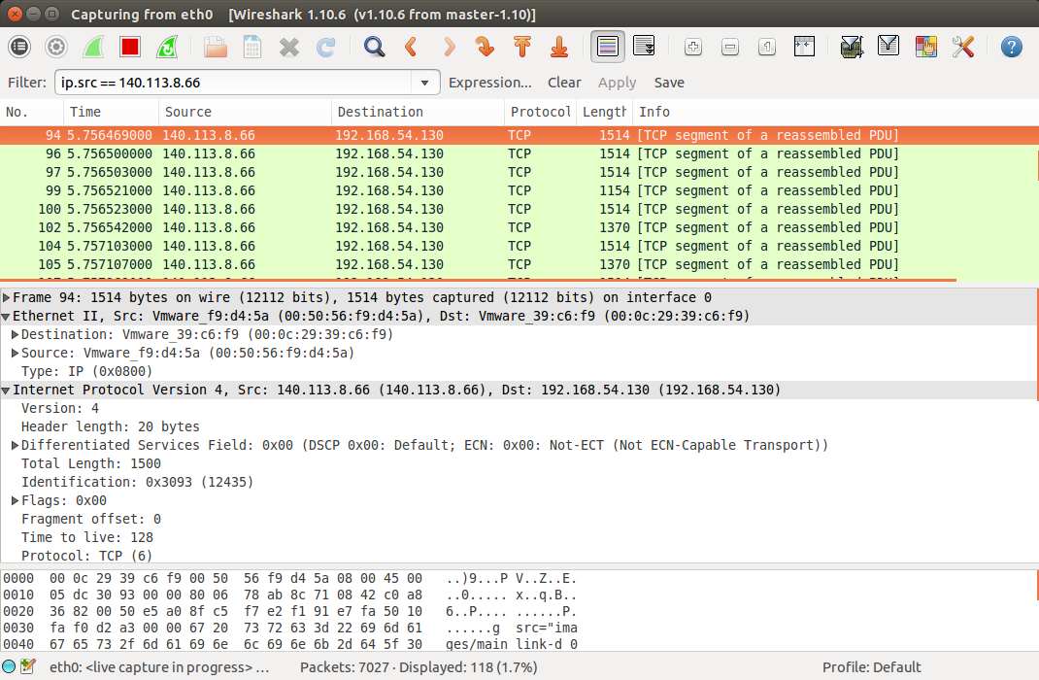
Networking tools on Linux - Filter (I)

Slide 61
Networking tools on Linux - Filter (II)
Common expression
ip.src / ip.dst / ip.addr
tcp / udp / arp
tcp.port / udp.port
openflow_v1 / openflow_v4 / openflow_v5 (*)
openflow_v4.type (*)
(*) The OpenFlow dissector is available in the current Wireshark stable release (v1.12.x)
Notes:
https://wiki.wireshark.org/OpenFlow

Slide 62
Homework
String processing

Slide 63
Overview
Warm-up mini program (10%)
Due date 10/18 23:59
if you can’t submit it on time, your score will *0.75 for one day.
In this mini program, you will write a program (C or C++) with three commands:
Reverse the string that you type.
Split the string with specific character.
Terminate itself by the command.
You have to submit your code to e3 system, compress your code with zip file, and renamed as your student ID (e.g. 0256521.zip). https://dcpc.nctu.edu.tw/
If you have any questions, please email TAs.

Slide 64
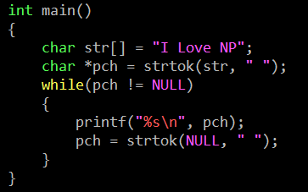
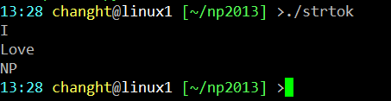
String - strtok
char * strtok ( char * str, const char * delimiters );
CODE
OUTPUT

Slide 65
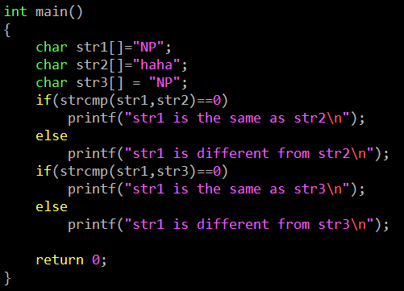

String - strcmp
int strcmp ( const char * str1, const char * str2 );
CODE
OUTPUT

Slide 66
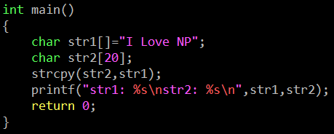

String - strcpy
char * strcpy ( char * destination, const char * source );
CODE
OUTPUT

Slide 67
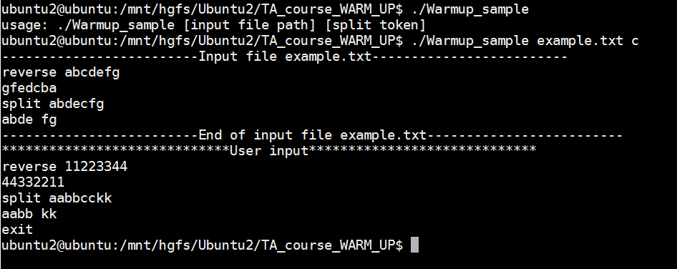
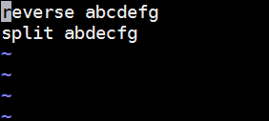
DEMO

Slide 68
Q & A

