Slide 1
Age identification using biometrical data
ADVANCED TOPICS IN COMPUTER AND NETWORK SECURITY
Reza Ghasemi
A.Y. 2022/2023

Slide 2
Biometrics
Definition: measurements whether behavioral or physical to identify individuals.
Various features could be employed:
  - Gait
  - Iris
  - Voice
  - Odor

Slide 3
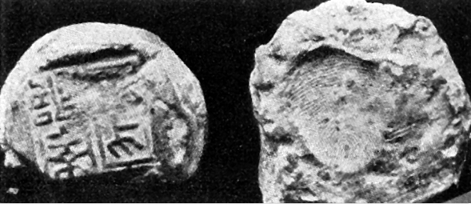
Biometrics: History
Different forms used since ancient times..
”Experience shows that no two individuals have fingers exactly alike.”
Rashid al-Din Hamadani in 1303

Slide 4


Biometrics: Advantages
More convenient
Improved security
More efficient (e.g. faster login time)

Slide 5


Biometrics: Disadvantages
It could affect privacy and security negatively
Biometric data cannot be changed like passwords (data breach)

Slide 6
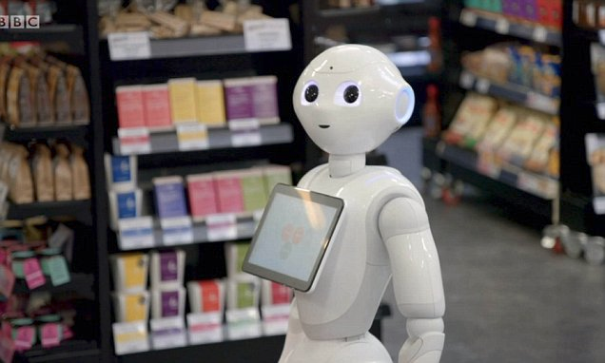
Soft Biometrics
Not sufficiently unique to be used for identification
Additional information is provided such as:
  - Age
  - Gender
  - Height
Useful for commercial purposes where recommendation may differ based on age and gender

Slide 7

Soft Biometrics (cont.)
According to UNICEF, a quarter of children under the age of 5 are not registered.
Possible issues:
  - Child trafficking
  - Children used in wars
  - Issues entering countries as refugees
  - Lacking certain priviledges due to incorrect estimation (e.g. child may be imprisoned)

Slide 8

Soft Biometrics: DNA methylation
A methyl group (-CH3) is added to 5′ carbon of cytosines
positioned next to guanines (CpG)
Tissue
Skeleton
….
Saliva
Buccal Swabs
Semen

Slide 9

DNAm: Advantages
Studied mostly for forensic applications
It can be used to reduce number of suspects (soft biometrics)
It can be used with both living and dead subjects
Could be used as a biomarker (e.g. mortality)
Consistent among different populations

Slide 10
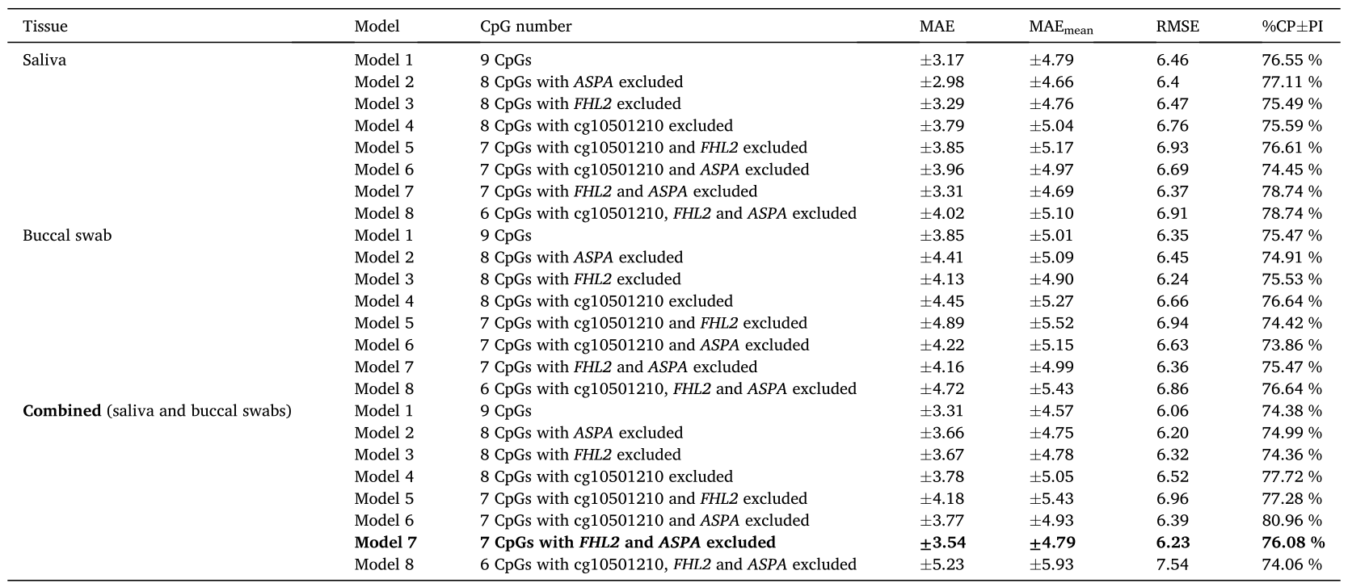
Soft Biometrics: DNA methylation
Credit: Ambroa-Conde et al. (2022)

Slide 11
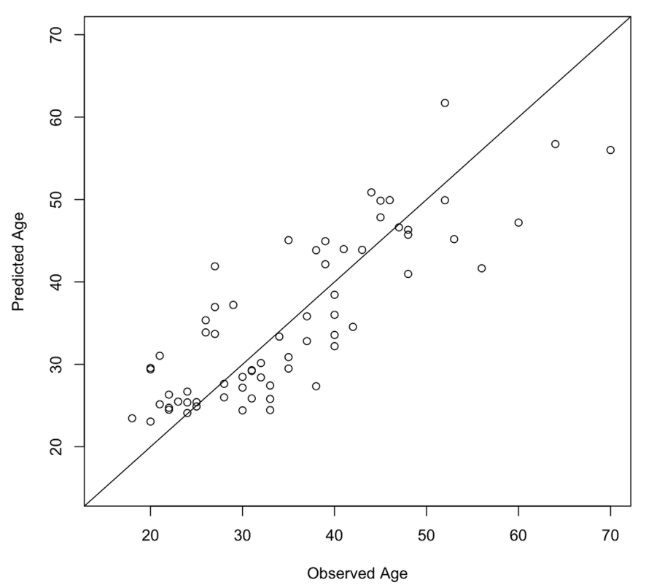
Soft Biometrics: DNA methylation
Bocklandt et al. (2011) used regression to estimate age
Average accuracy reported: 5.2 years

Slide 12
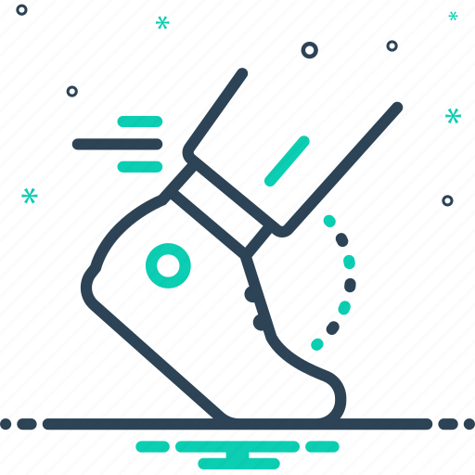
Soft Biometrics: Gait
Gait refers to patterns of movements of individuals.
A behavioral feature that has many advantages, including:
    - Different angles (unlike face)
    - No cooperation is needed
It has been used for age estimation, most studies have relied on full gait cycle.
Full gait cycle is not practical for real-time systems

Slide 13
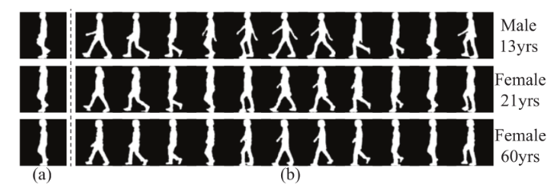
Soft Biometrics: Gait
Motion information contained in a full cycle is extremely valuable. (e.g. Females have smaller arm swings)
Credit: Xu et al. (2021)
Xu et al. Proposed a solution where full cycle is created from a single shot.
It can handle different angles
The model was implemented to demonstrate it could be used as a real time system
Credit: Xu et al. (2021)

Slide 14
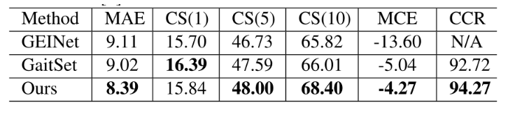
Soft Biometrics: Gait
Age estimation for children is easier than adults due to smaller head-body ratio. (Single shot is sufficient)
Credit: Xu et al. (2021)
Credit: Xu et al. (2021)

Slide 15
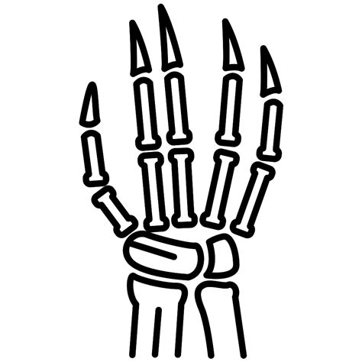
Soft Biometrics: Hand Bones
Analyzing x-ray images of hand bones could be used to estimate age
Why hands?
- High bone count
- Low level of radiation
Greulich
and Pyle (GP)
Two common approaches
Tanner-Whitehouse
(TW)

Slide 16
Soft Biometrics: Hand Bones
Issues with GP and TW
Manual
Subjective
Costly
Additional elements could play a role such as:
- Gender
- Race
- Diet
- Socio-economic factors

Slide 17
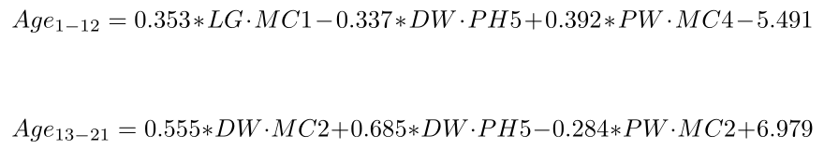
Soft Biometrics: Hand Bones
Remy et al. (2021) proposed a quantitative approach. Variability was considered by including children from north and south of France.
It follows a two step procedure: first the most likely age is determined.
In the second step, age is estimated using one of the formulas below:

Slide 18
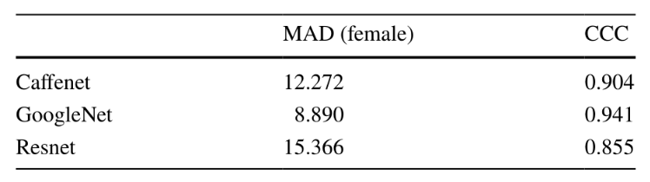
Soft Biometrics: Hand Bones
Lee et al. (2020) used different deep learning architectures to estimate the age.
Deep learning could reduce costs and increase speed of estimation. (compared to GP and TW)
Age estimation treated as regression problem.
Credit: Lee et al. (2020)

Slide 19
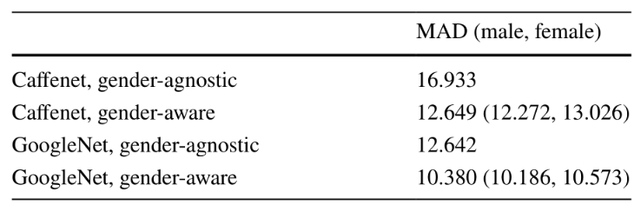
Soft Biometrics: Hand Bones
Later work indicated that gender had a substantial effect on age estimation.
Credit: Lee et al. (2020)
Gender-aware models have better performance compared to gender-
agnostic models

Slide 20

Biometrics: Fingerprints
Fingerprint is simply a representation of epidermis
Fingerprint systems could be:
- Optical
- Capacitance
A wide array of elements could affect the scanner:
- Skin condition (oil, moisture, etc.)
- Pressure
- Sensor noise

Slide 21
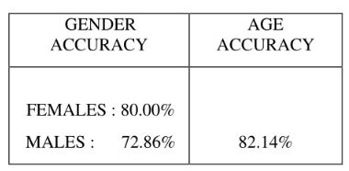
Soft Biometrics: Fingerprints
Fingerprint could be used to estimate age of a subject
Falohun et al. (2016) used DWT+PCA
The authors believed that Back Propagation neural network (BPNN) and ANN are not effective for age estimation
Credit: Falohun et al. (2016)

Slide 22
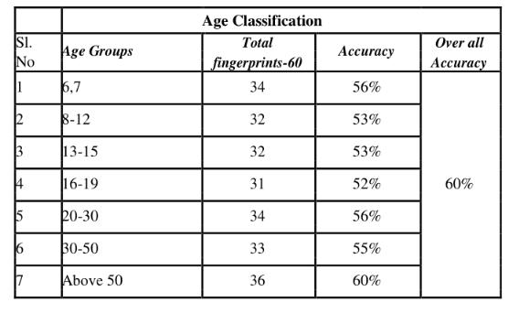
Soft Biometrics: Fingerprints
T Abraham and M (2016) proposed a model based on wavelet transform and SVD
Credit: T Abraham and M (2016)
Subjects above the age of 50 had the maximum success rate while the worst performance was reserved for subjects in the range of 16–19

Slide 23
Soft Biometrics: Fingerprints
Jayakala and Sudha (2022) employed ResNet50 to estimate the age
Subjects used in the study ranged between 1 to 60
1000 images used for training and 200 images used for testing.
Authors claimed 93% accuracy in age estimation

Slide 24

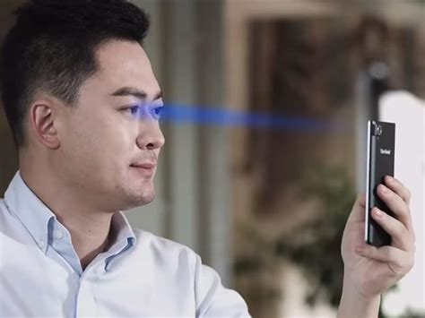
Biometrics: Pupil
Periocular area is rich in useful features:
  - Skin texture
  - Iris
  - Pupil
  - Retina
Advantages:
  - Non intrusive
  - Easy to collect
  - Long-distance friendly
  - Hygienic

Slide 25

Soft Biometrics: Pupil
Pupils can reveal valuable and interesting information like:
  - Emotional state
  - Age
  - Gender
  - Health status
Dilation of pupil differs between males and females.
Heterosexual females pupils dilate whether we show them a picture of a male or female subject. (gender estimation)
Moreover, pupils dilation changes with time (age estimation)

Slide 26
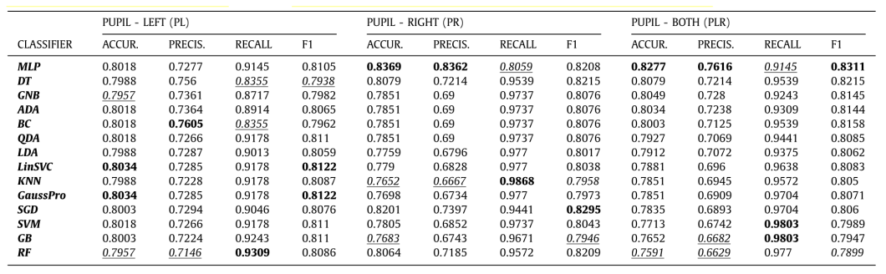
Soft Biometrics: Pupil
Cascone et al. (2020) achieved better results for age rather than gender
Several classifiers were trained and evaluated:
Image credit: Cascone et al. (2020)

Slide 27

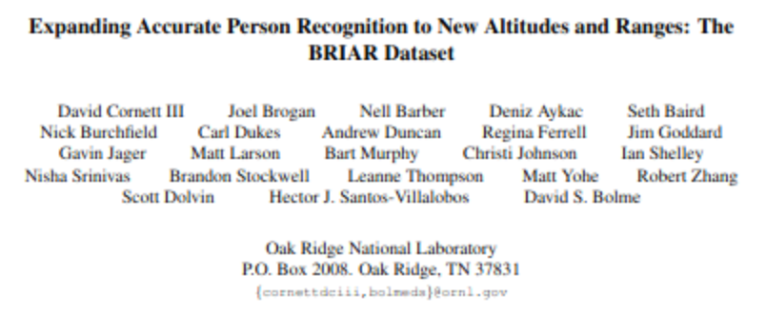
Biometrics: Facial Features
One of the most common and widespread biometric features
Advantages:
- No cooperation
- No special hardware
IARPA is actively trying to improve biometric systems:

Slide 28
Soft Biometrics: Facial Features
Useful when showing an item which is age restricted to users.
Features of the face could indicate gender, age, ethnicity, etc.
Local features of the face (e.g. wrinkles) could be used to estimate age according to Aznar-Casanova et al. (2010)
Various factors could affect age estimation:
- Skin diseases
- Living in polluted cities
- Race
- Gender
- ...

Slide 29
Soft Biometrics: Facial Features
Most studies indicate deep learning achieves better results.
Age estimation
Classification
Hybrid
Regression
Ranking
Datasets that have been used: AgeDB, UTKFace, IMDB-wiki, etc.

Slide 30
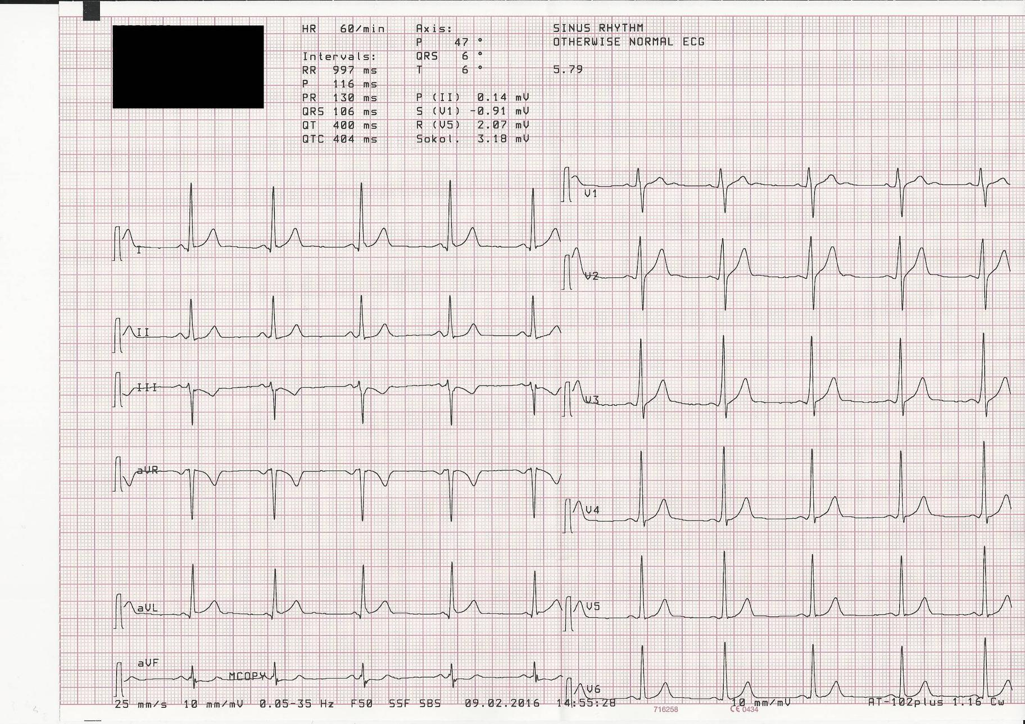
Soft Biometrics: ECG
Mainly used to measure heart activity and detect abnormalities
Numerous wearable-devices support ECG-capability
Well known that 12-lead ECG undergo change during life

Slide 31

Soft Biometrics: ECG (cont.)
Various approaches have been used:
- Starc et al. (2012) → Multi-linear regression
- Ball et al. (2014) → Bayesian
- Attia et al. (2019) → CNN
Attia et al. (2019) treated age as a continous value.
Deep learning vs. Traditional algorithms: Lack of explainability remains a challenge

Slide 32
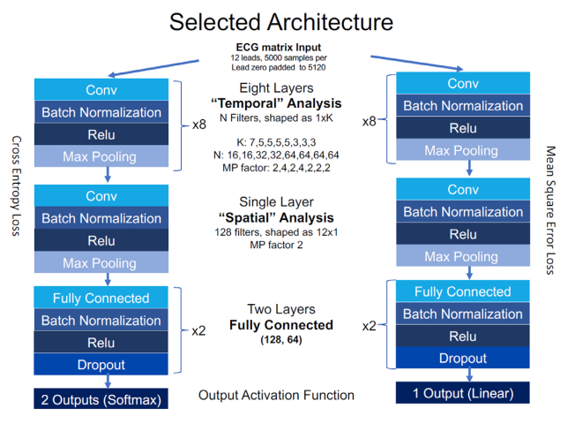
Soft Biometrics: ECG (cont.)
Image credit: Attia et al. (2019)
MAE reported was 6.9 ± 5.6 years
Results more accurate for younger subject compared to elderly (>55 y/o)
Alterations in hormonal level may explain inferior results for elderly

Slide 33

Ear Biometrics
First introduced in 1896 by Bertillon for identification purposes.
Ear’s individuality has not been scientifically proven.
Could be used with other features (e.g. face) where:
- Issues with illumination
- Occlusions due to hair, limited view, ...
Studied have mostly focused on closed and controlled environments.

Slide 34
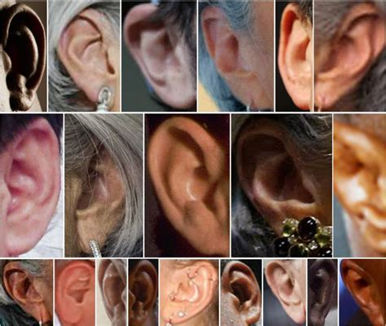
Ear Biometrics (cont.)
Various datasets are available:
- USTB (University of Science and Technology Beijing)
- UND (University of Notre Dame)
- FERET
- ...
Various datasets are available:
- WVU (West Virginia University)
For segmentation, different approaches exist:
- Viola-Jones
- Shape-based
- Hybrid
- ...
VJ does not suffer from image quality (+) but it is time consuming (-).

Slide 35

Ear Biometrics (cont.)
To further improve accuracy, futile features (e.g. hair) must be removed.
A solution would be to use a thermogram of ear.
Regions lower in temperature indicate hair where higher temperature
regions are related to ear.
Image credit: Burge and Burger (2000)

Slide 36
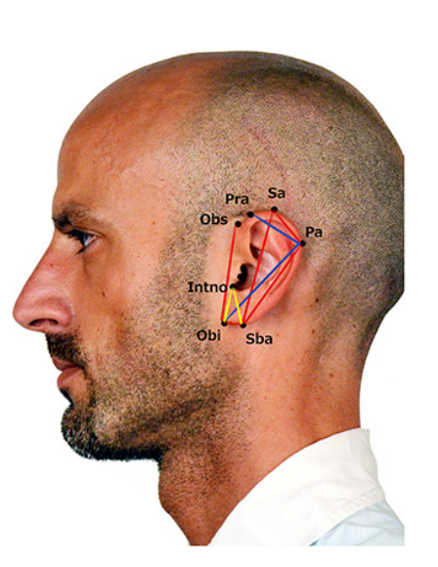
Soft Biometrics: Ear
Mostly studies have focused on gender rather than age.
Yaman et al. (2018) Used two approaches:
Geometric
Appearance based
Geometric features: based on eight landmarks from which eighteen measurements
were derived.

Slide 37
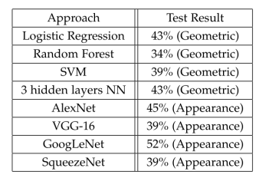
Soft Biometrics: Ear
Apperance based approaches had better results compared to geometric approaches
Image credit: Yaman et al. (2018)
To further improve the results, in another study number of samples were increased
By the authors which resulted in 9% improvement for accuracy.

Slide 38
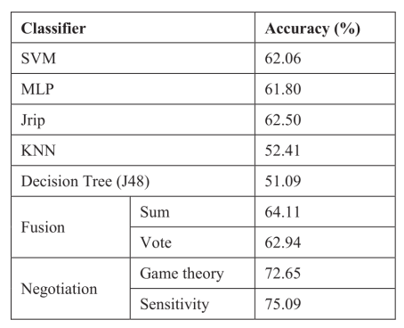
Soft Biometrics: Iris
Sgroi et al. (2013) used Random Forest with 300 trees.
The correct classification rate reported 64.68%
Erbilek et al. (2013) used various classifiers and reported the following results:

Slide 39
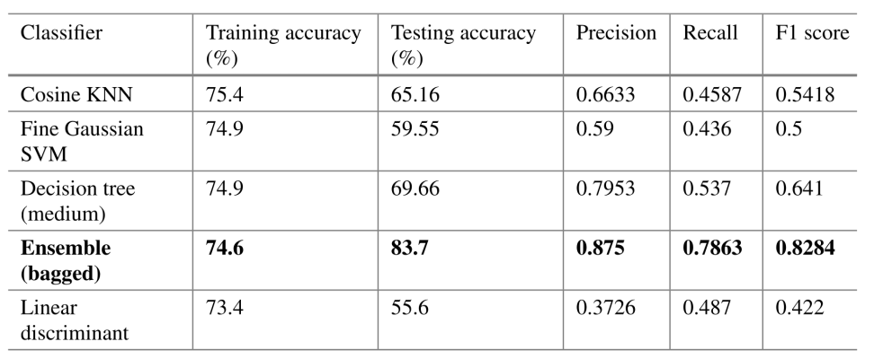
Soft Biometrics: Iris
Rajput and Sable (2020) proposed a new model to estimate age.
Only three statistical features were selected to be used
Different classifiers were evaluated with the following results:

Slide 40

Q & A

