Slide 1
Security and Privacy of Keyboard
ADVANCED TOPICS IN COMPUTER AND NETWORK SECURITY
Alessandro Benetti
Reza Ghasemi
A.Y. 2022/2023

Slide 2
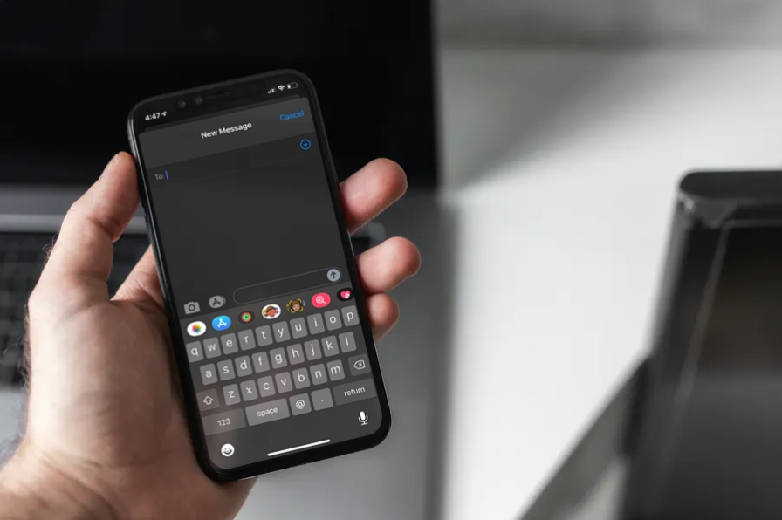
Keyboards
Before keyboards, devices similar to teleprinters were used to transmit and type text data
Up until the invention of mouse, keyboard remained the primary point of interacting with computers
Virtual keyboards are still used in smart-phones, etc.

Slide 3
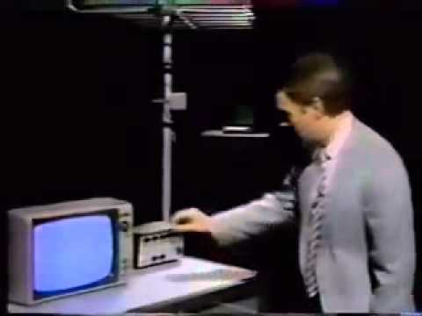
Side Channel Attacks
Definition: Unconventional channels used to attack.
Any physical phenomenon could be seen as a channel (e.g. power consumption, time, sound)
One early example was Van Eck phreaking. Electromagnetic radiation leak information.

Slide 4
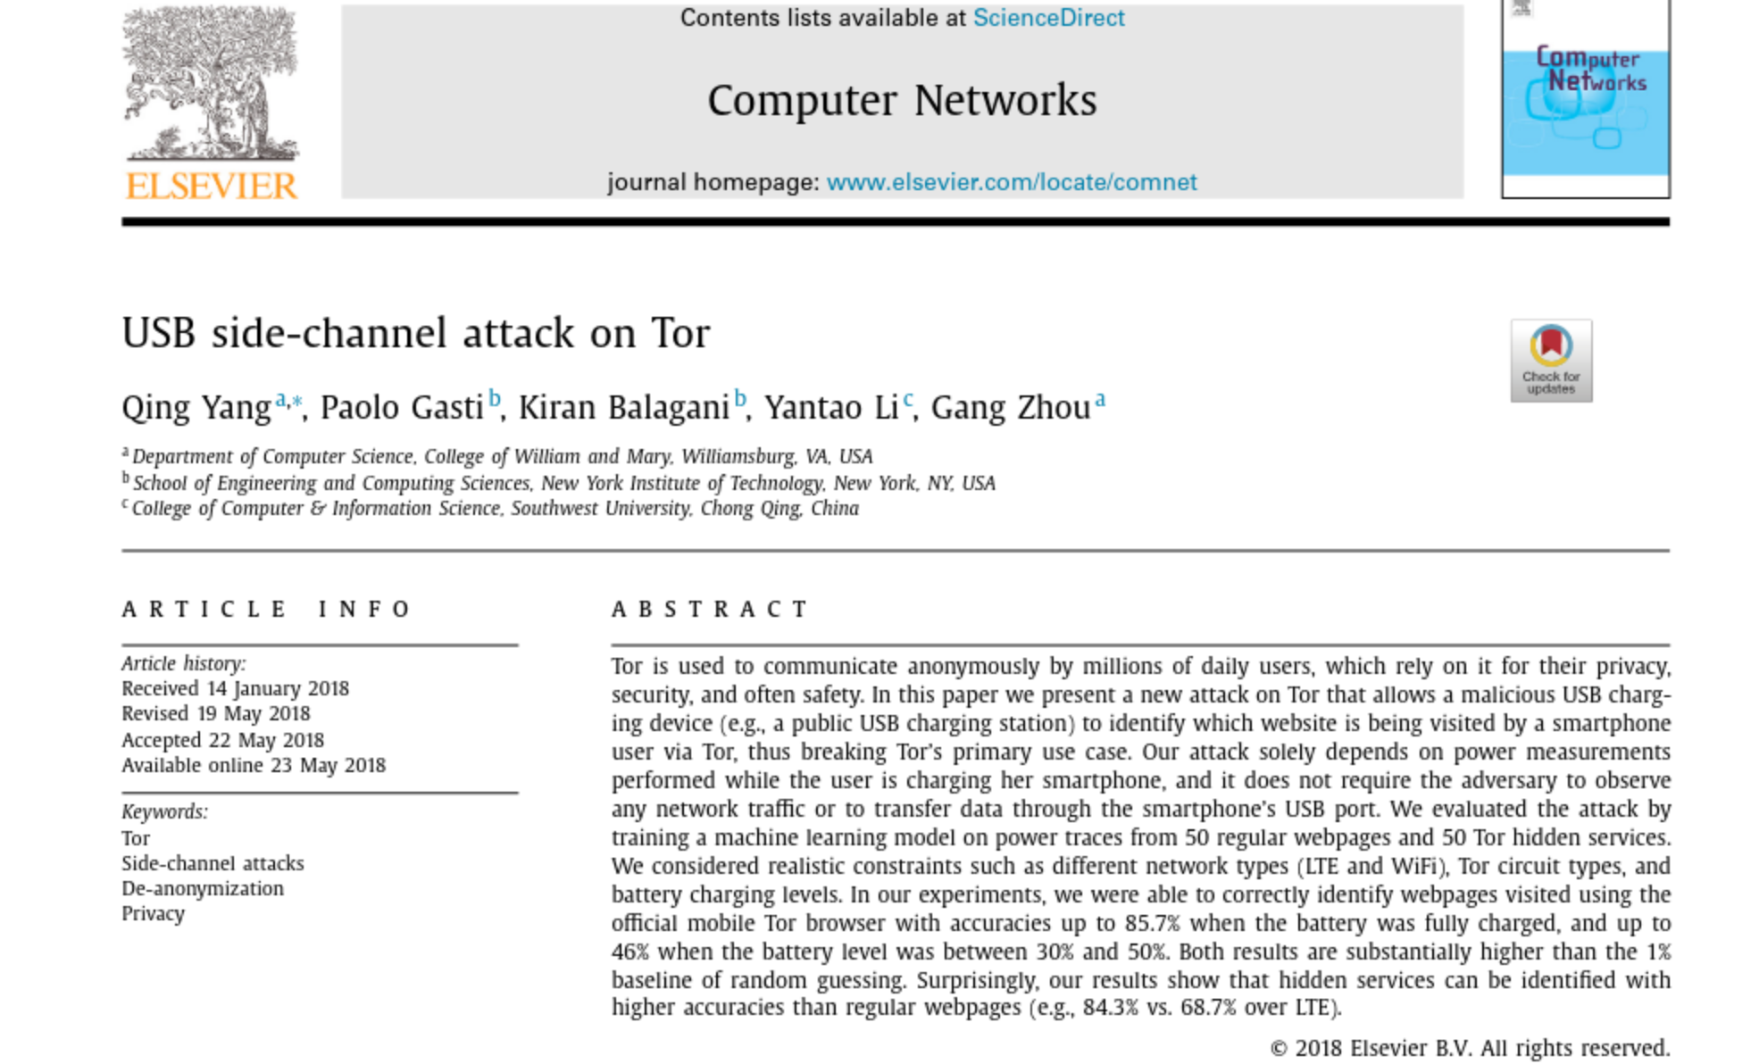
Example: Side Channel Attacks
Without observing the network traffic (which is encrypted), attacker could identify which web pages user is observing (USB Side Channel Attack)
Yang, Q., Gasti, P., Balagani, K., Li, Y., & Zhou, G.

Slide 5
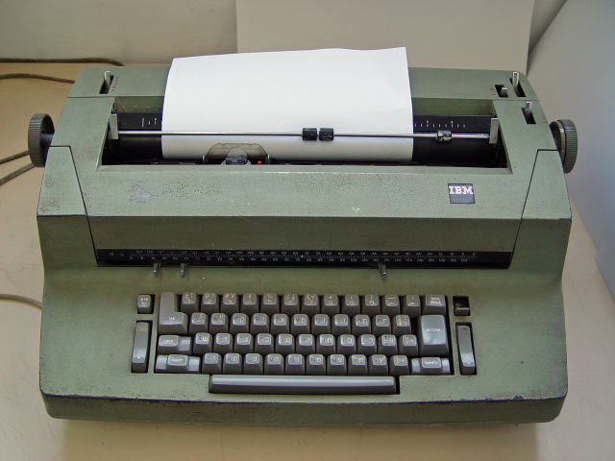
Historic Example: Operation Gunman
KGB embedded bugs within IBM selectric typewriters used in U.S. Embassy, one of the earliest cases of hardware keyloggers.
Every keystroke was captured and stored in memory.
When memory became full, contents were broadcasted periodically via radio bursts to nearby listening stations.
Used for nearly eight years before being discovered.

Slide 6
Keylogging
Definition: Practice of recording the keys a person types on the keyboard.
Keystrokes can be identified and detected through various ways:
WiFi signal
Electromagnetic emanations
CPU cache usage (e.g. a program running on host machine to measure CPU load)
Network traffic patterns (packet length, timing, direction)
Trivial countermeasures:
Reduce emanations (e.g. use shields to prevent emanations from leaking)
Mask typing behavior (e.g. white noise)
Side channel attacks may leverage:
Temporal information (Keystroke timing is used to detect which keys are pressed)
Spatial information (Spatial information is used to detect physical location of the keys)

Slide 7
Spatial Side Channels
Spatial side channel attacks can be performed through:
  Acoustic localization
  Video of the keyboard
  WiFi signal distortion
Spatial side channels
First-order spatial
Second-order spatial
Two categories:
First-order: reveals location of physical keys
Second-order: provides only distance between keys (e.g. measuring acoustic similarity between two keys.

Slide 8
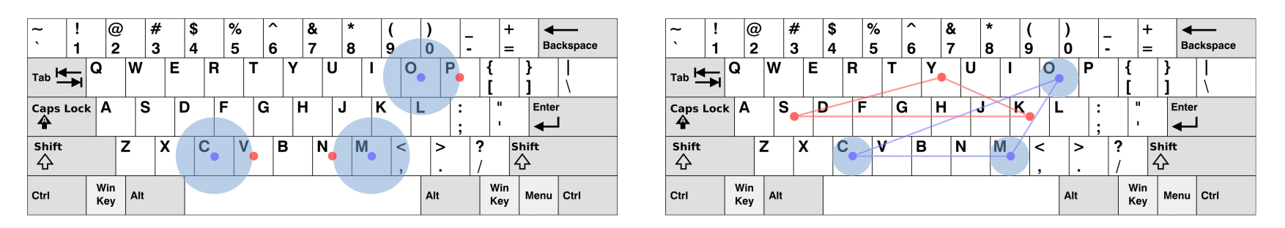
Spatial Side Channels (cont.)
Keys within spatial proximity produce similar sounds.
Figure (a)
Figure (b)
Figure (a) shows 1st order spatial side channel while Figure (b) reveals 2nd order spatial side channel.
SoK: Keylogging Side Channels. (2018)
Disadvantage of Spatial Side Channels:
Spatial side channels are incapable of revealing individual keys.

Slide 9
Temporal Side Channels
In temporal keylogging, sequence of keystroke timings for press and release is used to predict the keys.
t^{P} = timing for key press
t^{R} = timing for key release
Full keystroke is composed of two elements:
Full Keystroke = Key press + Key release
A Keystroke has three three element within its tuple: key release (t^{R}), key press (t^{P}) and key (k):
(t^{p} , t^{r}, k)
Advantage: Unlike spatial side channels, temporal side channels can identify individual keys!

Slide 10
Keylogging (cont.)
Keyboards communicate via host/computer through two ways:
  USB
  PS/2
Encoding and
transmission
are different
Several elements can affect precision and accuracy of measurement:
Physical delay: Time from physical contact to between the user’s finger and key cap to the point of actuation depends on characteristics of the keyboard. Elements which could possibly have an effect: actuation force, travel distance, etc.
Matrix scan rate: The rate at which the microcontroller pulses the scanning lines in the keyboard matrix varies between keyboard models
Encoding: Once key press is detected, it enters a sub-routine and it is converted to digital signal to be transmitted to the host. Delay could be used to have a narrow list of possible keys.

Slide 11
Keylogging (cont.)
Process Scheduling: The kernel must receive scan-code and acknowledge the interrupt which adds time delay.
Polling rate: Limited to USB keyboards only. PS/2 keyboards are
interrupt-based, therefore do not suffer from polling delays.
Keyboards can emit different signals:
Acoustic: Acoustic sound is emitted upon pressing each key which can be captured up to several meters away. In supervised approach, known waveforms can be compared to unknown ones to identify individual keys.
Seismic: Vibrations which can be captured and transmitted via mobile device nearby or laser microphone.
Electromagnetic radiation: EM spikes enable keys to be identified by their “falling edge” scancode.
e.g. Letter E Bit pattern: 00010010011 Falling edge: ↓↑↑↑↓↑↑↓↑↑↑

Slide 12
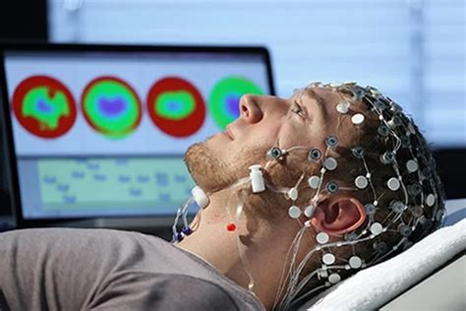
EEG (electroencephalogram)
What is EEG?
a test that measures electrical activity in the brain
Attack scenario:
By observing electrical activity of the brain,
attacker could learn information.
Possible defense:
User could induce fake responses to protect his real thoughts by thinking of irrelevant keys.

Slide 13


Acoustic Side Channel
Two modes:
  Local: Listening device is placed near victim (traditional approach)
  Remote: Attacker captures audio remotely (e.g. VoIP)
We have better approaches to attack the victim in local setting (e.g. shoulder surfing)

Slide 14
Acoustic Side Channel
Scenario: Victim is typing sensitive information while on a VoIP call.
How can the attacker build the training set?
  Use social engineering techniques to ask user to login to a website or web application to authenticate himself.
  Coercing the victim to send an email while on the call
  Online editing of a shared document

Slide 15
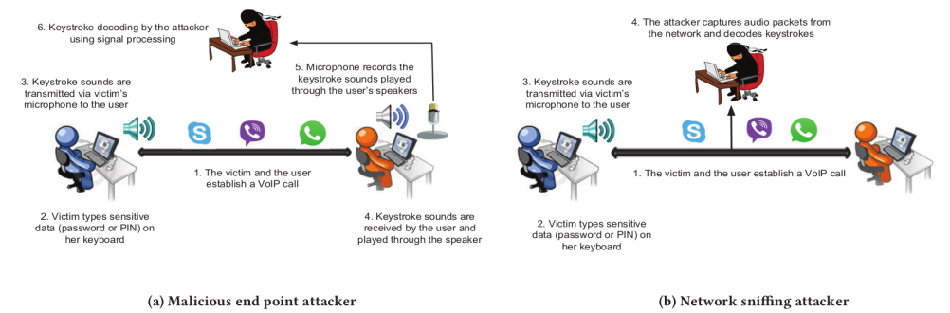
Attack Scenarios
Anand, S. A., & Saxena, N. (2018).
We have the two scenarios:
  a) Malicious entity collects audio samples by communicating with victim
  b) Malicious entity sniffs and captures audio packets from the network.

Slide 16
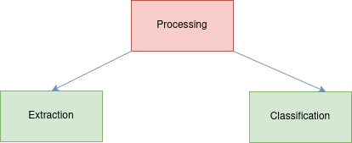
Processing
Keystroke processing is divided into two stages:
Keystroke extraction: Attacker has to collect audio samples whether remotely or locally from the victim.
Keystroke classification: After collecting audio samples, attacker has to identify which audio correlates with what key.

Slide 17
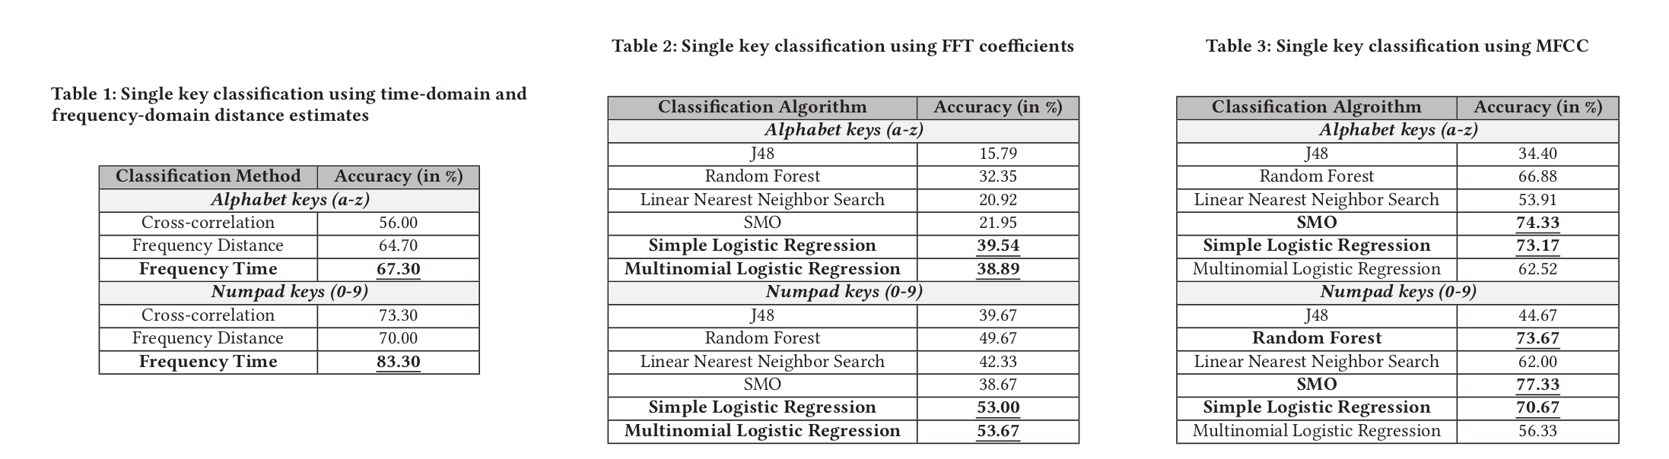
Classification
Different methods could be used for classification:
Mel-frequency cepstral coefficients (MFCCs)
Fast Fourier transform (FFT) coefficients
Frequency distance measure
Frequency time-distance measure
….
Machine learning method using MFCC performs better (accuracy) for both alphabet and numpad keys.

Slide 18
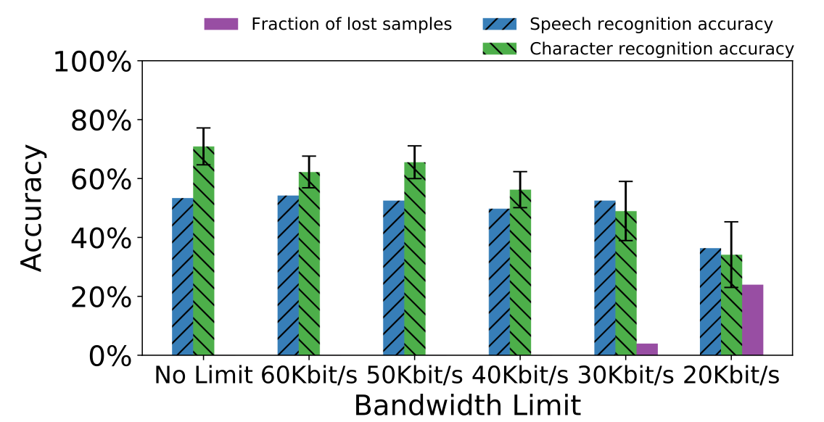
Additional Defense: Bandwidth
Bandwidth:
Classification suffers noticeable loss under 40kbit/s → Attacker’s capability to decode is degraded.
Transmission of audio signal from victim’s side to attacker’s side affects the accuracy of the classifier. VoIP application by default encode and compress signals, therefore classifier might be affected by It.
Cecconello, S., Compagno, A., Conti, M., Lain, D., & Tsudik, G. (2019).

Slide 19
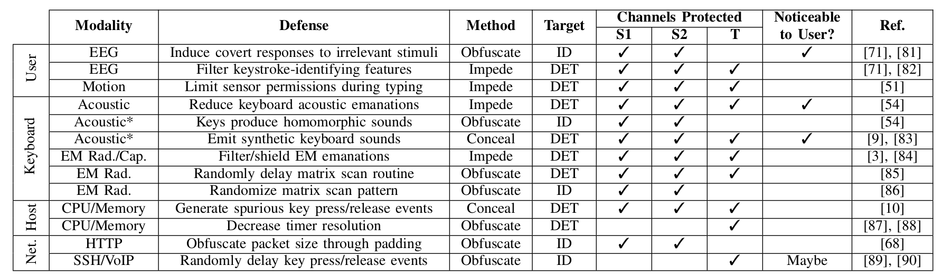
Defenses against attacks
Obfuscate: Decrease the SNR to make information content low for key identification. For instance user could add background noise.
Impede: Restrict access to a sensor or shield emanations coming from it. Example: physical shielding
Conceal: Adding redundant information. (e.g. fake keystroke sounds)

Slide 20




Additional Defense: Speech
During each entry of Password/PIN, user read a piece of text from an English newspaper.
Passwords: Using top 5 matching character list, only 2 out of 6 characters were decoded
PINS: 3 out of 4 PINS were decoded correctly
In terms of performance:
Disadvantage: User has to converse to mask his keystroke emanations (Usability)

Slide 21
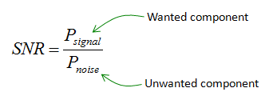
Additional Defense: Audio Masking
Audio Masking: Cloak sensitive sound by injecting additional sound.
  The main idea is to reduce SNR (signal-to-noise ratio):
Lower SNR → More difficult to filter signal from noise
In this context: Keyboard emanations are the signal and background sound will be the noise.

Slide 22
Audio Masking (cont.)
Possible defense solutions:
  White noise:
    Definition: Random signal with equal intensities at different frequencies
    Application: Used in meetings to mask conversations,
    by students to study to mask nearby chatter, etc.
    Disadvantage: Susceptible to filtering by most applications and microphones and not very effective
  Masking via fake keystrokes:
    Fake keystrokes in the same frequency spectrum, so that
    it overlaps with real keystroke sounds

Slide 23
Fake keystroke vs. White Noise
Fake keystrokes are more effective as a cloak compared to using white noise.
White Noise has no effect on the accuracy of the attack:
Out of the 180 decoded characters, 16 characters were decoded successfully.
Using top-5 matching list, percentage of accuracy increased to 67.2%

Slide 24
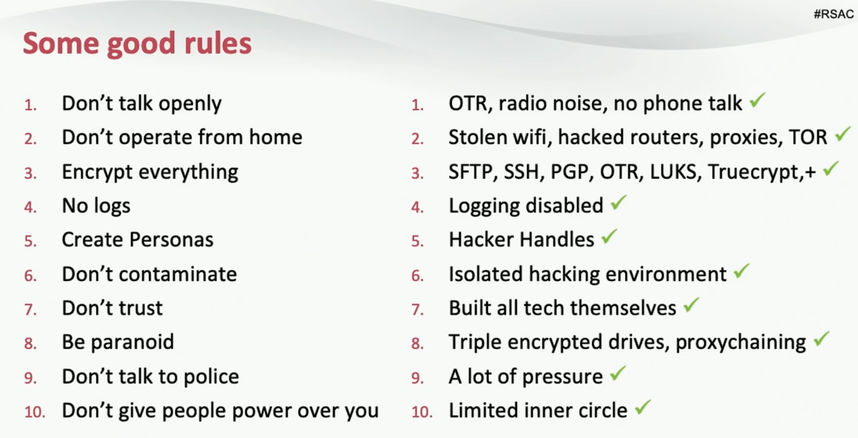
Case Study: Bayrob Group
Installed malware on users device that would show fake eBay pages for products like cars.
Blocked websites such as Crime Complaint Center of FBI to prevent citizens from filing report.
Fake vehicle history and delivery services were created.
In the beginning malware was tailored for each vicitm.
They had very strong OPSEC (e.g. radio noise to mask keyboard sounds).

Slide 25
Conclusions
It is not possible to completely eliminate keylogging side channels attacks.
Different layers and communications channels require different protection mechanisms. No perfect solution exists.
Protection mechanisms must be considered by acknowledging a user’s threat model and adversary’s capabilities (challenging objective).
Security is the goal, but usability of the user should be considered as well.

