Slide 1
Microdata Protection
Privacy Preserving Information Access: Homework 1
Reza Ghasemi
A.Y. 2022/2023

Slide 2
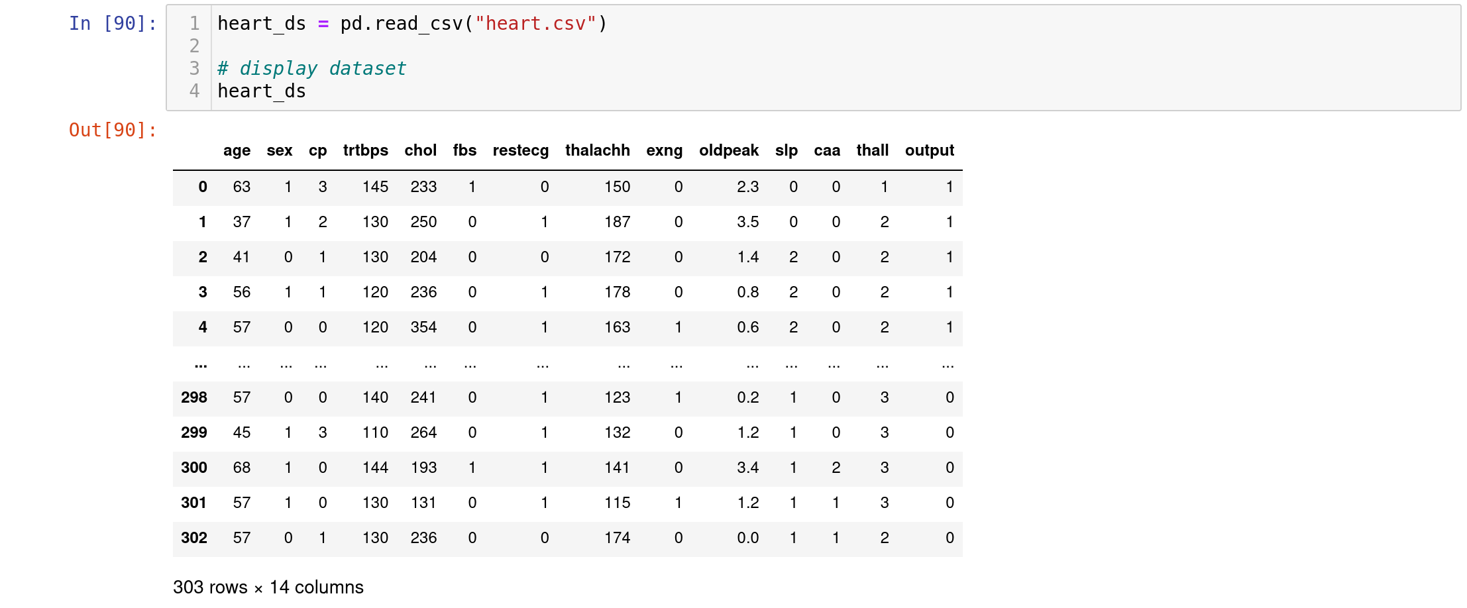
Context
Heart Attack Analysis & Prediction Dataset

Slide 3
Context
Used in ML to predict whether a patient is going to have heart attack or not.
Dataset contains the following information regarding patients:
Age : Age of the patient
Sex : Sex of the patient
cp : Chest Pain type
rtbps : resting blood pressure (in mm Hg)
chol: cholesterol in mg/dl fetched via BMI sensor
output: diagnosis of heart disease
…
Identifiers have been removed (e.g. name, SSN). Based on the information, we see the likelihood of heart attack as output (medical data which must be protected).

Slide 4
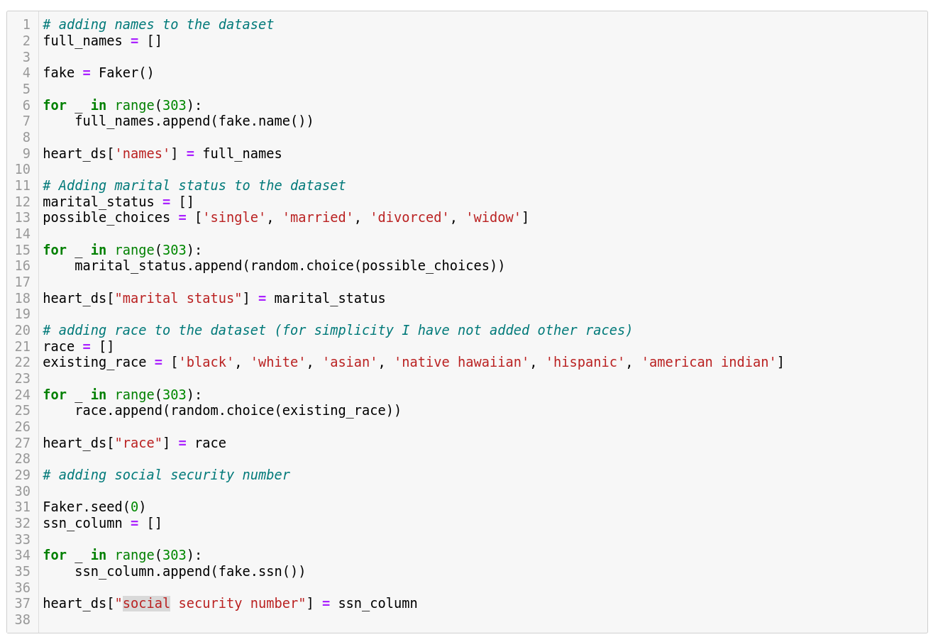
Dataset Expansion
Fake information is generated and added

Slide 5
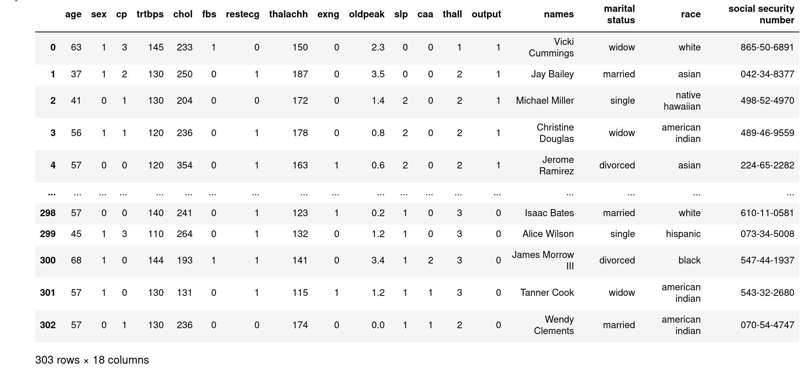
Expanded dataset

Slide 6
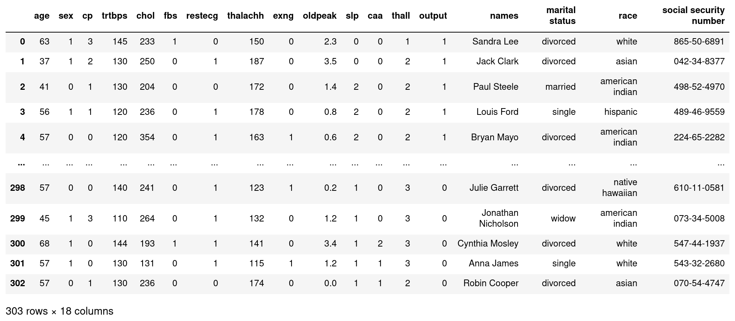
Identifiers

Slide 7
Quasi-identifiers

Slide 8
Confidential Attributes

Slide 9


Data Release
Who releases data?
  - Government agencies
  - Research institutions
  - Businesses (e.g. Netflix)
What harms can be done?
  - Reputation of business and individual
  - Employability
  - Personal relationships
  - Physical harm

Slide 10

Adversaries
Malicious actors
Researchers may single out an individual
by accident
Doxxers may use information for harassment (e.g. sharing home address of target on 4chan)

Slide 11
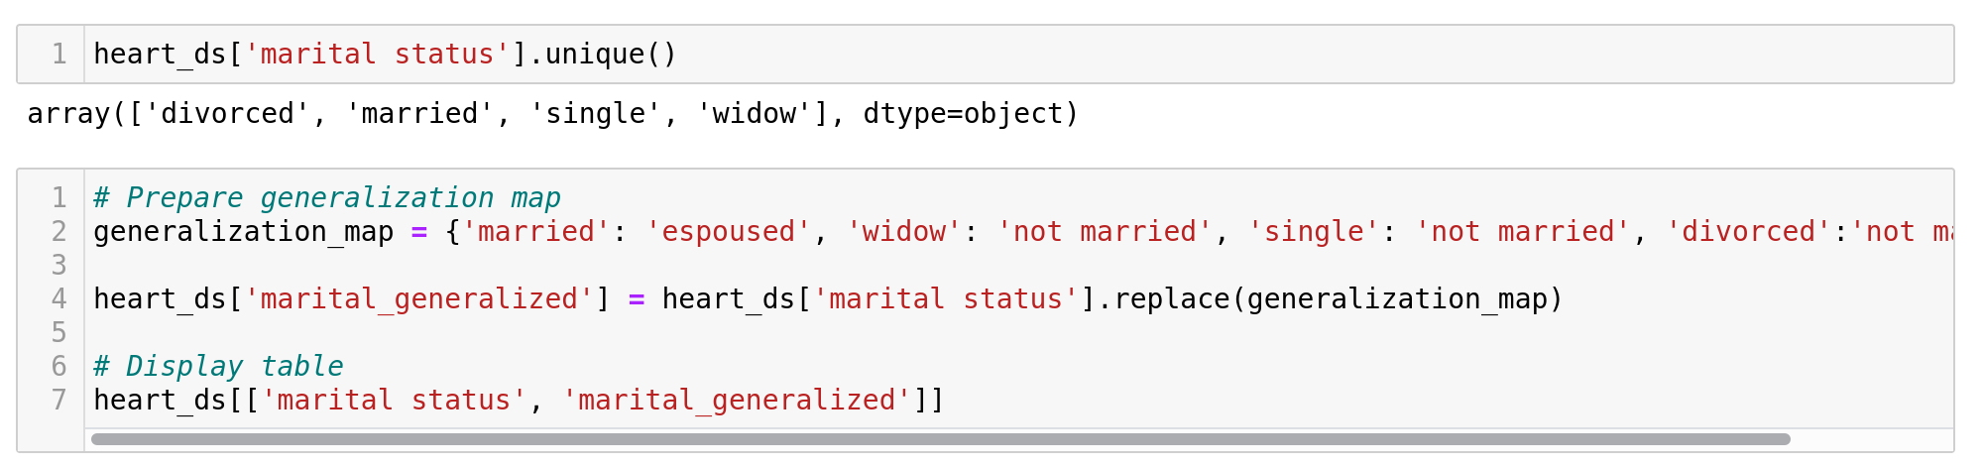
Generalization
The idea behind generalization is putting multiple categories under one category. (e.g. instead of divorced, widow, single and married, we have “espoused” or “not married”)

Slide 12
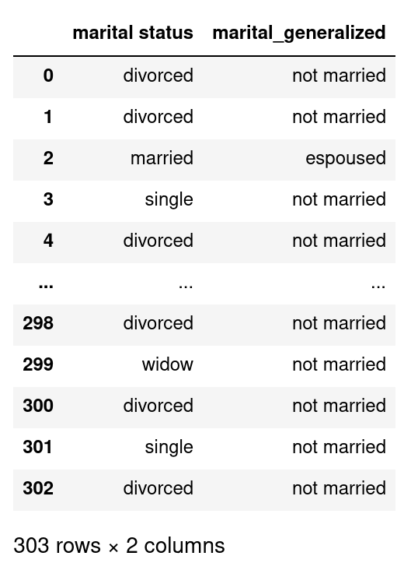
Generalization
Result:

Slide 13
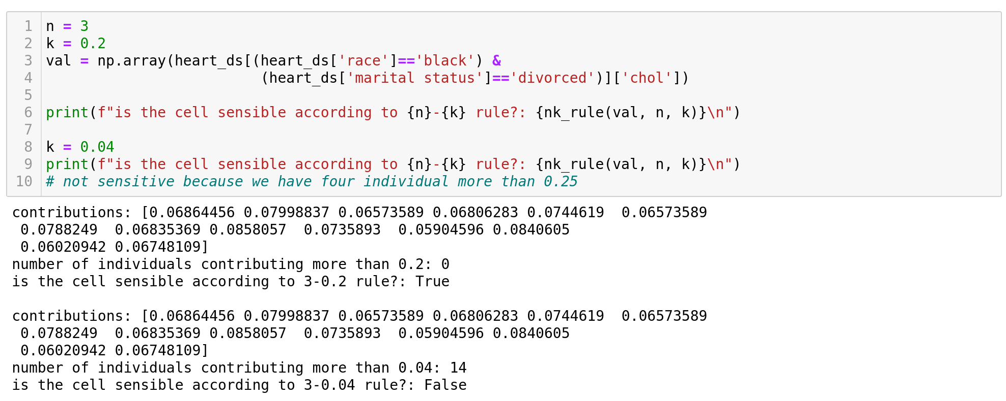
(n,k) dominance rule
It measures sensitivity. primary suppression should be applied when the sum of the n largest contributors exceeds k% of the cell total.

Slide 14
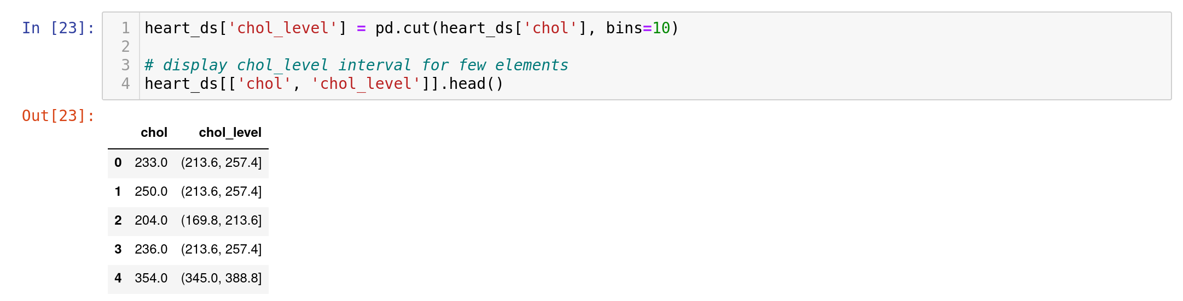
Global Recoding
Domain is divided into disjointed intervals
… Why not use qcut instead?

Slide 15
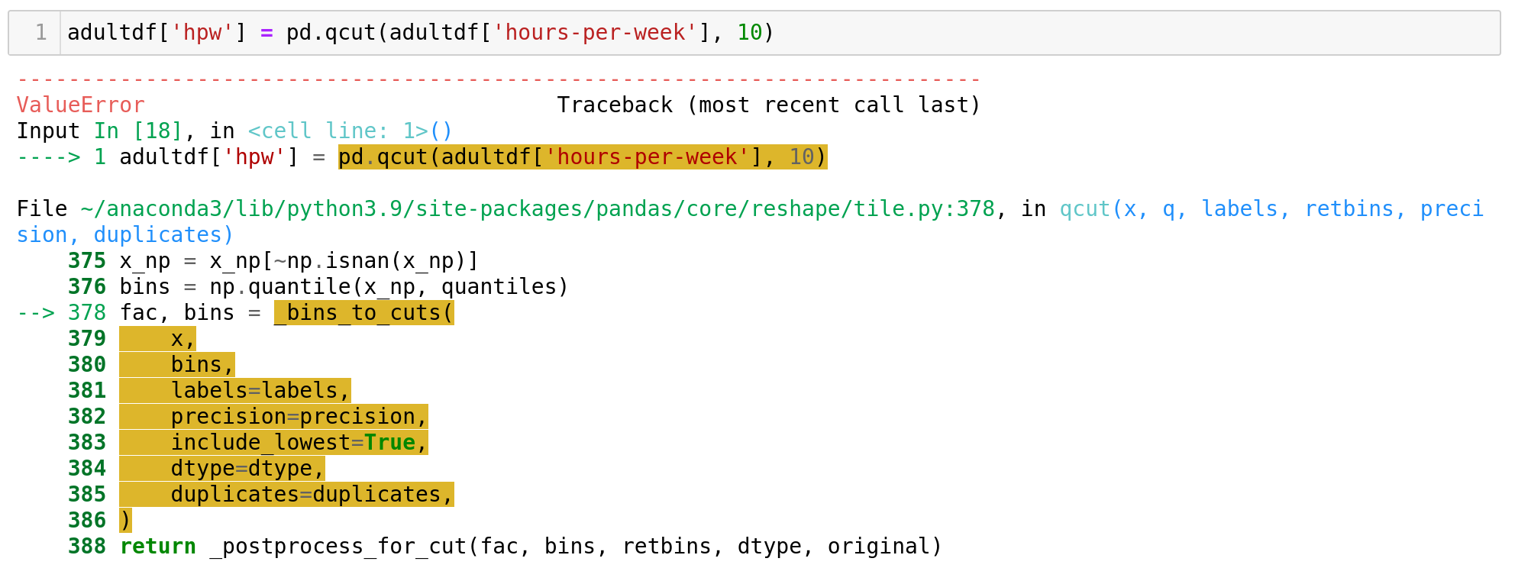
Global Recoding (cont.)
As we saw in the example, qcut may give us errors
Solutions?

Slide 16
Global Recoding (cont.)
Possible Solutions:
- Use cut instead
- Fixed since panda>=0.20.0 (use duplicates='drop')
- Use lower number for bins to have less number of same samples
Why errors? Many samples are put in the same category while trying to maintain same quantity.
Issues? outliers are not protected
Solutions?

Slide 17
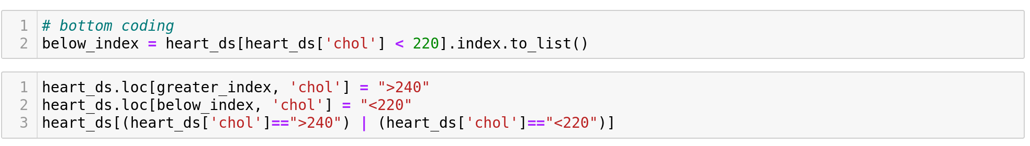
Top coding and Bottom coding
Top coding:
Bottom coding:

Slide 18
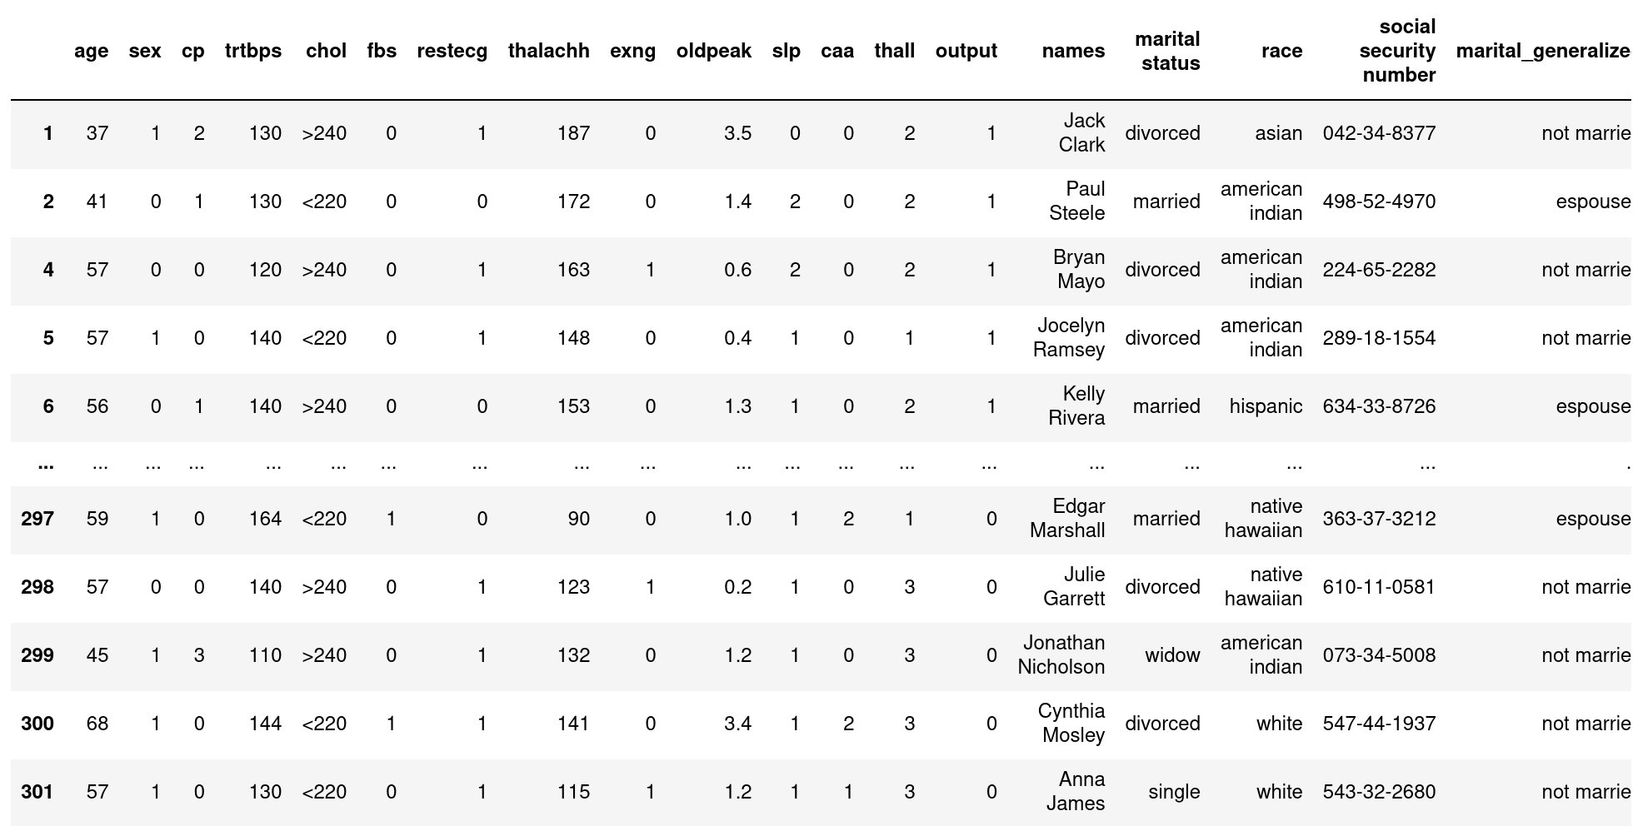
Top coding and Bottom coding (cont.)
We can use top coding and bottom coding to protect them

Slide 19
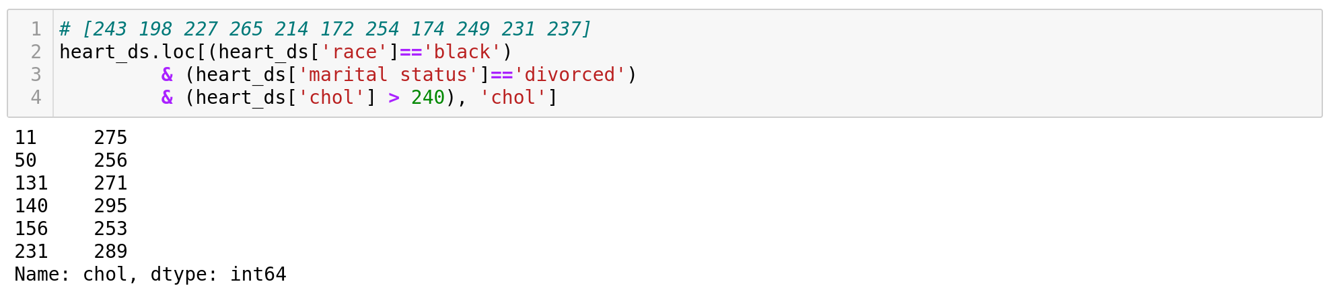
Local Suppression
A well known technique in which value of sensitive cell is removed.
Example: Removing chol level higher than 240 for black and divorced individuals.

Slide 20
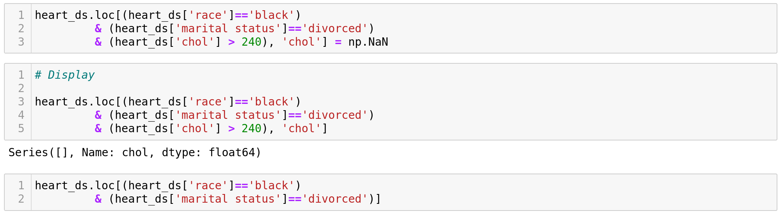
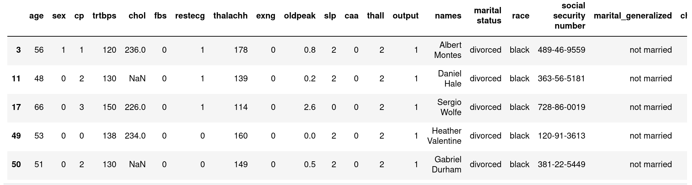
Local Suppression (cont.)

Slide 21
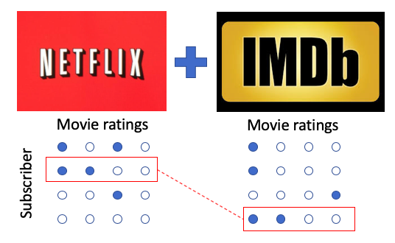
Record Linkage
Two sources of information: one anonymized, another public are used for comparison (e.g. Netflix and IMDB)

Slide 22
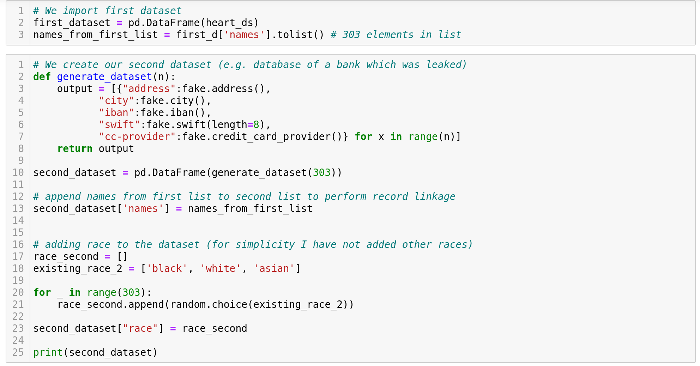
Record Linkage (cont.)

Slide 23
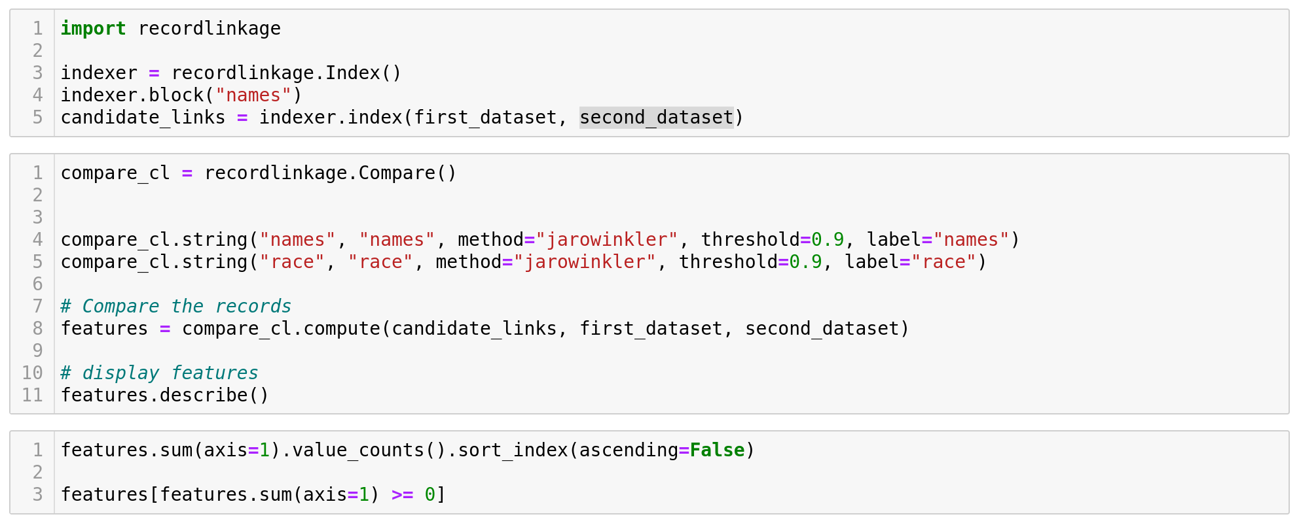
Record Linkage (cont.)
Records are compared using recordlinkage module

Slide 24
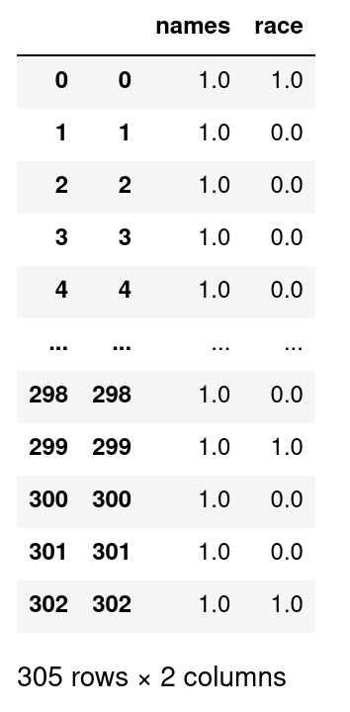

Record Linkage (cont.)
We used same name for both sets.
name is the same (1.0) while race
for some indexes is different.
In your opinion, what are possible solutions
to prevent record linkage?

Slide 25
Conclusions
Privacy is slowly gaining attention (not just in academia)
New libraries are beginning to be developed (e.g. PyMASq)
Many possible attack scenarios and defenses are yet to be discovered.

