Slide 1
Differential Privacy
Privacy Preserving Information Access: Homework 2
Reza Ghasemi
A.Y. 2022/2023

Slide 2
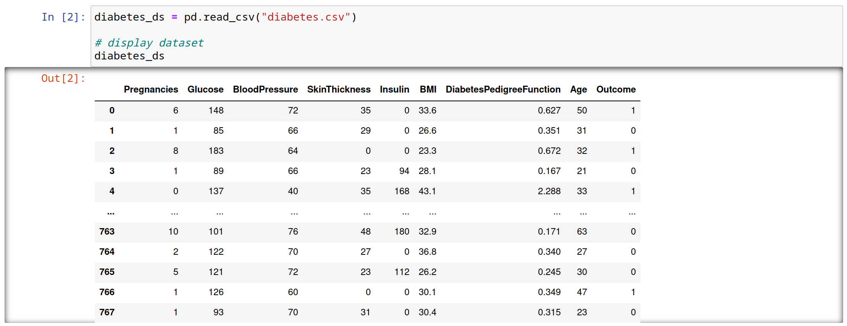
Context
Diabetes Dataset

Slide 3

Context
Used to predict whether a patient has diabetes or not.
The dataset contains the following information regarding patients:
Pregnancy: number of pregnancies
BMI: body mass index (weight in kg/(height in m)^2)
Age: years
Glucose : glucose concentration
BloodPressure: Diastolic blood pressure (mm Hg)
output: diagnosis of diabetes (0 or 1)
…
Identifiers have been removed (e.g., name, SSN), making this dataset "anonymized."

Slide 4
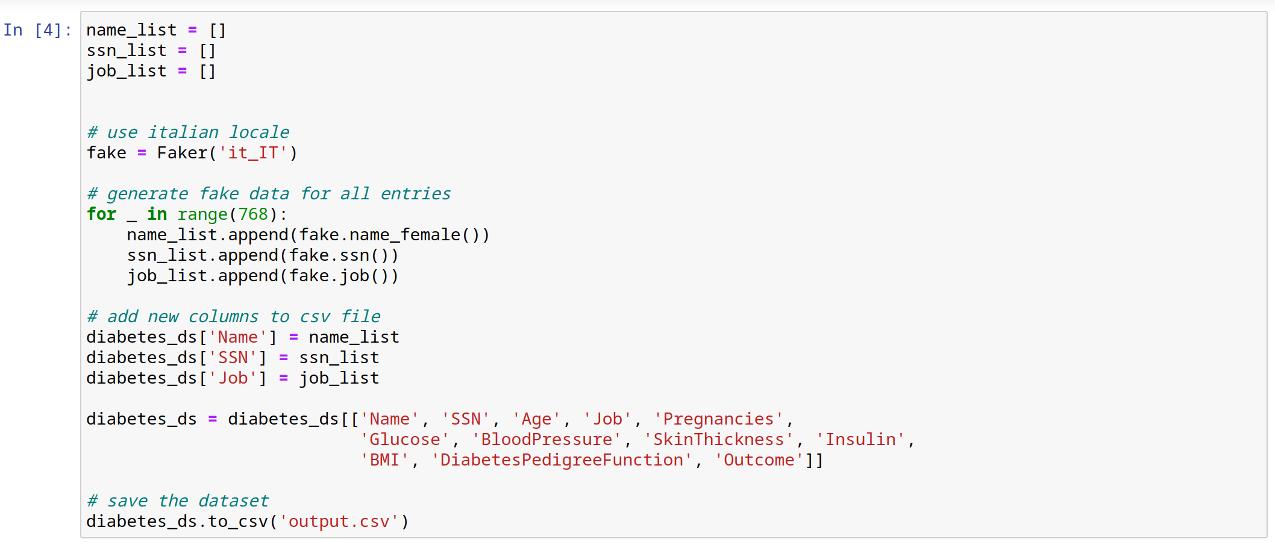
Fake Data Generation
Fake information was added to make the dataset more interesting: name, SSN, and job.

Slide 5
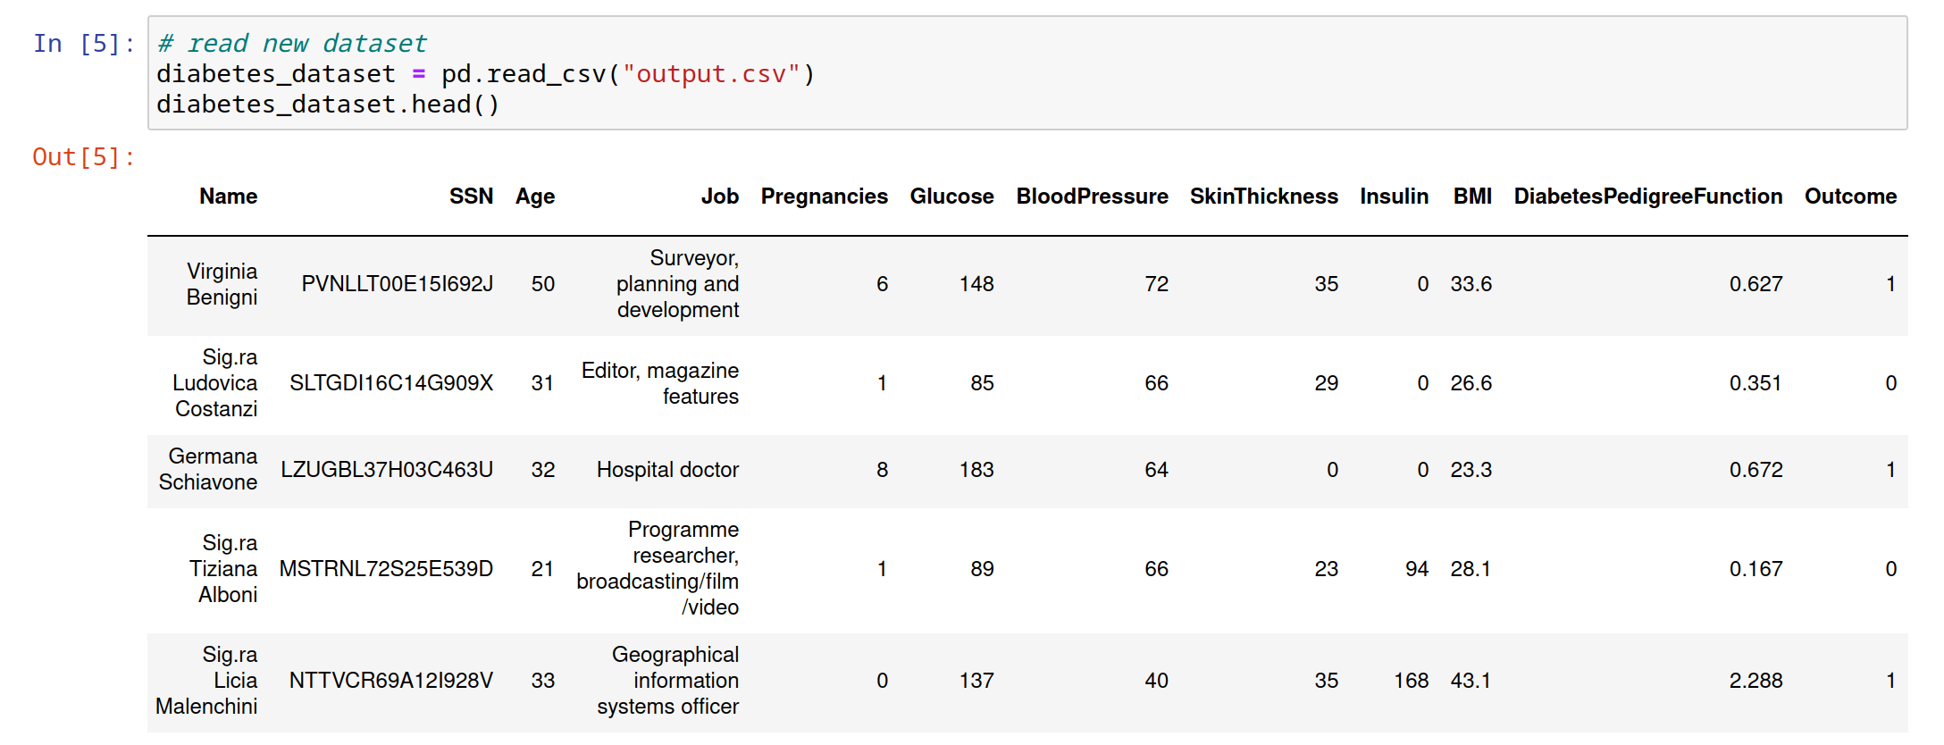
Dataset with PII

Slide 6
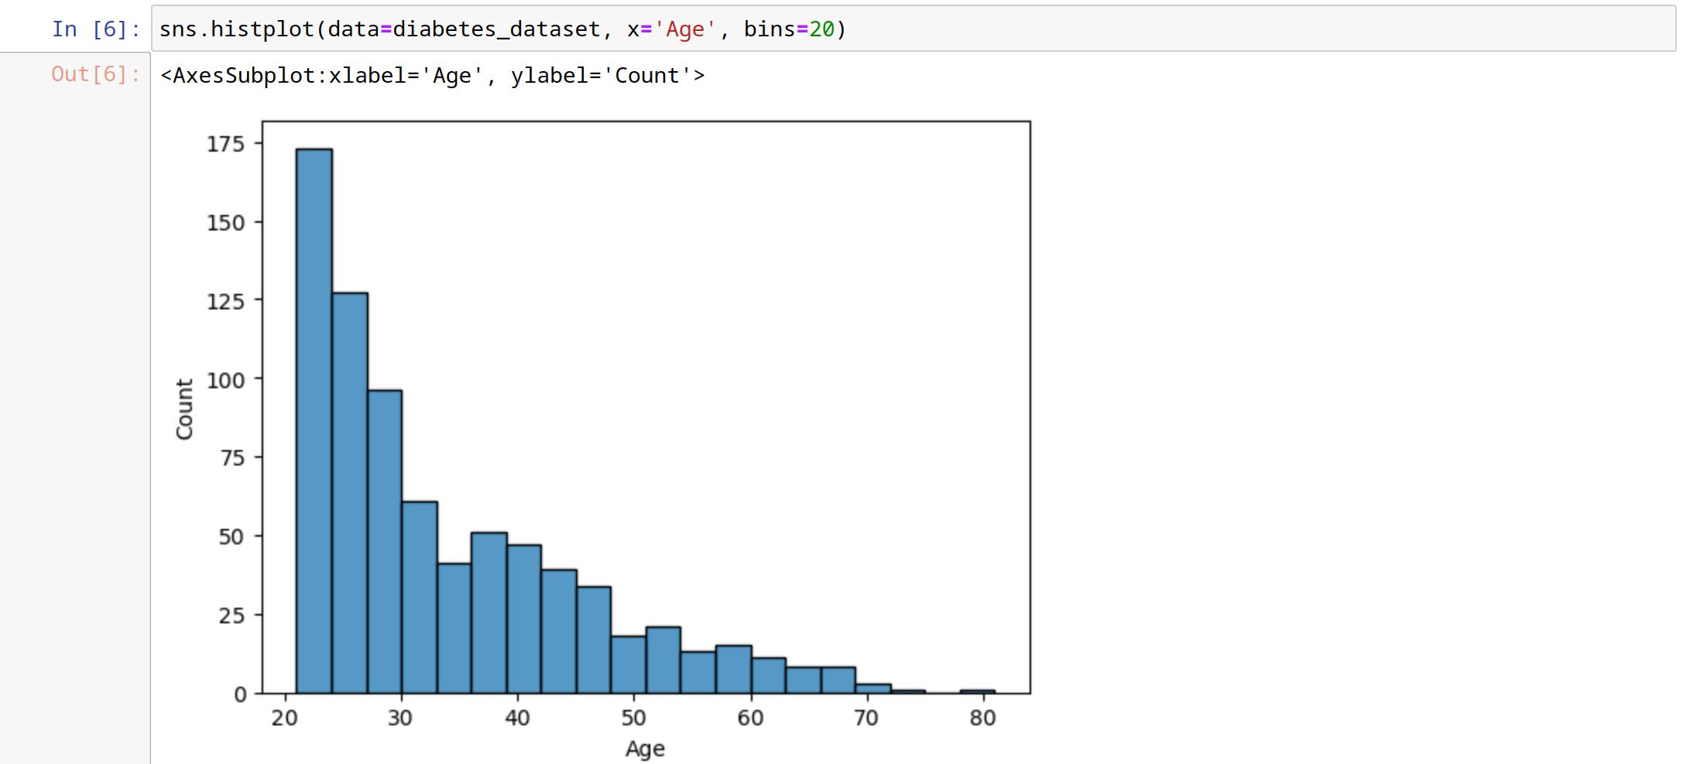
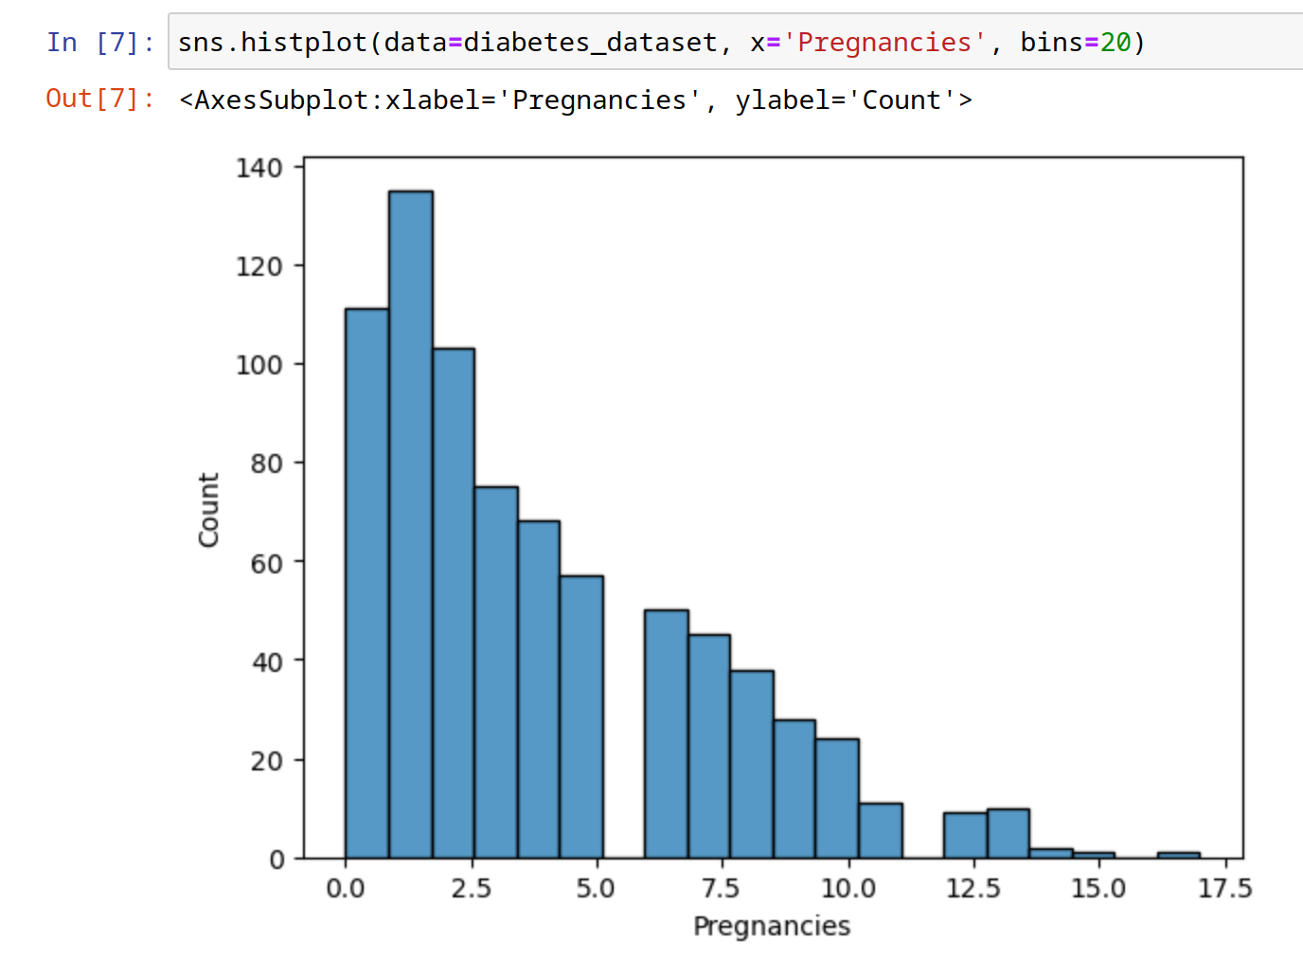
Histograms
Age:
Pregnancies:

Slide 7
K-anonymity
Definition: A property of a dataset indicating its level of anonymity.
We say a dataset is k-anonymous when we have k-1 individuals with the same quasi-identifiers.
What is the best k value? Well, it depends...
For k-anonymity, two values must be avoided: k = 1 and k = n (table dimension).
We do not have 50-anonymity

Slide 8
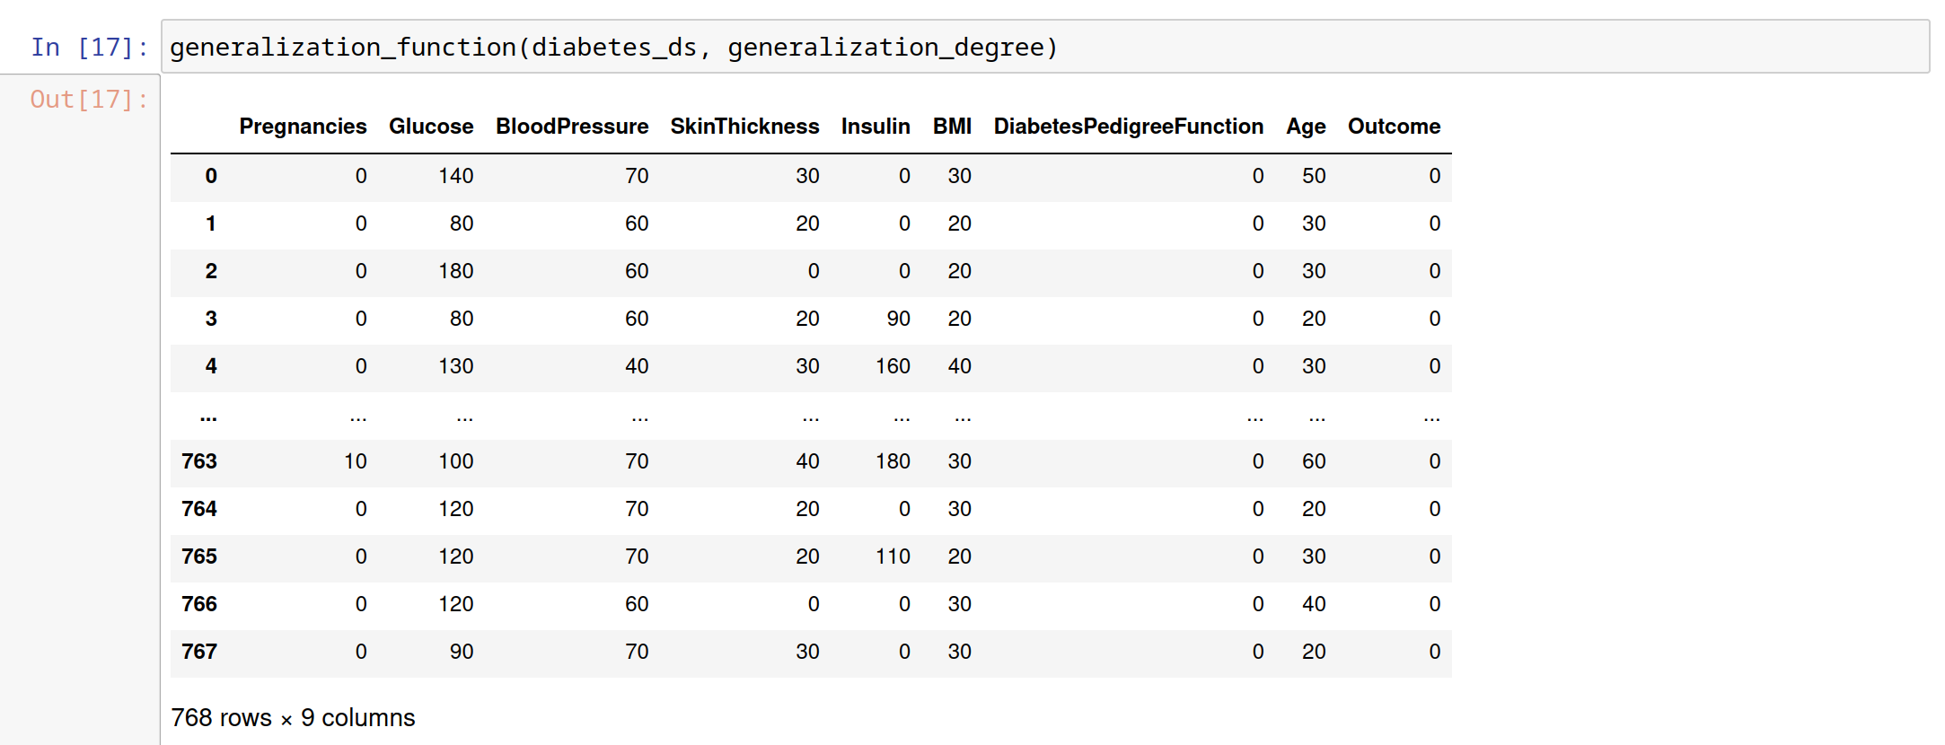
Generalization
Suppression and generalization can be used to achieve k-anonymity.
In the following example, the generalization function is used to remove the second digit:
Value is completely lost!

Slide 9
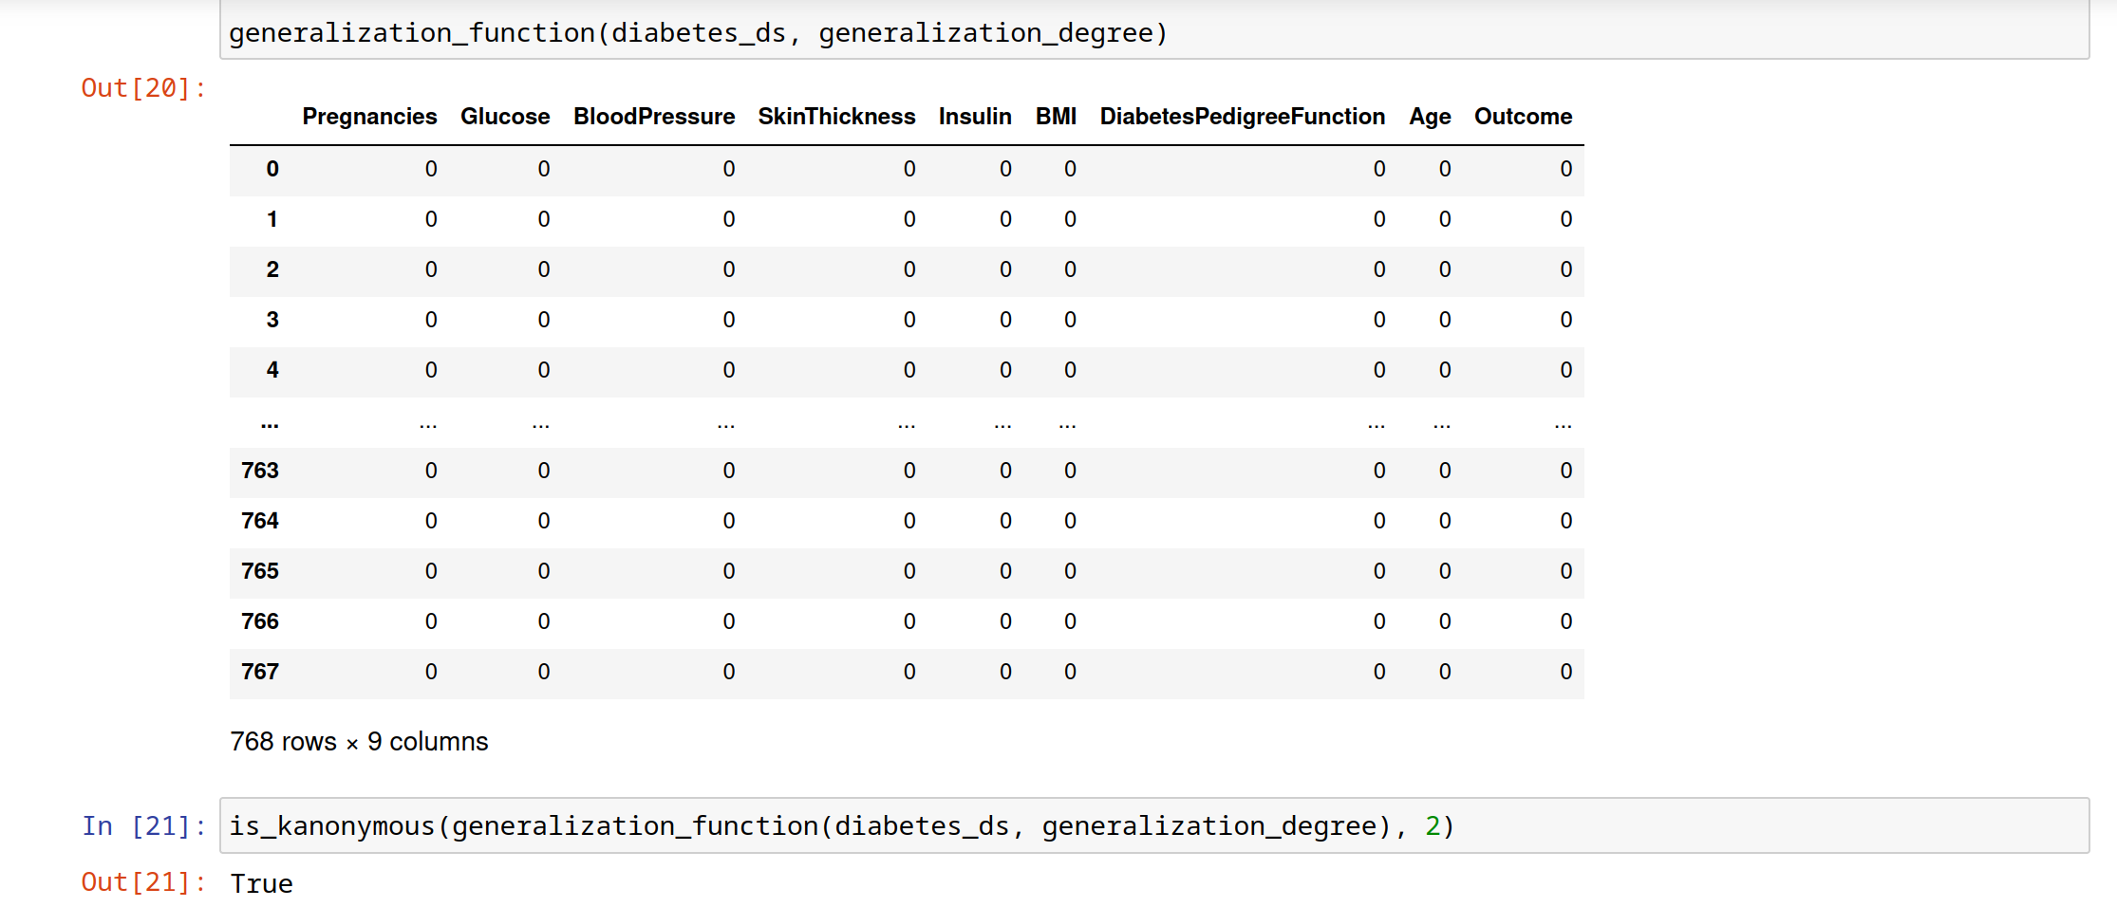
Generalization (cont.)
Did we achieve the desired level of privacy?
Keep on generalizing until we reach it...
We achieved it, but at what cost?

Slide 10
Distributional Queries
If we wanted to understand how many individuals in the dataset have a BMI over 50, we could do the following:
Raw Results
How many individuals have been pregnant more than five times?
How can we protect patients?
Possible solution: Differential Privacy

Slide 11
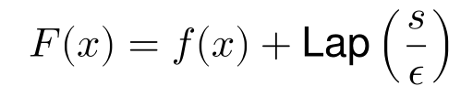
DP: Laplace Mechanism
Raw Results
Added noise to achieve privacy
ε: Privacy Budget S: Sensitivity

Slide 12
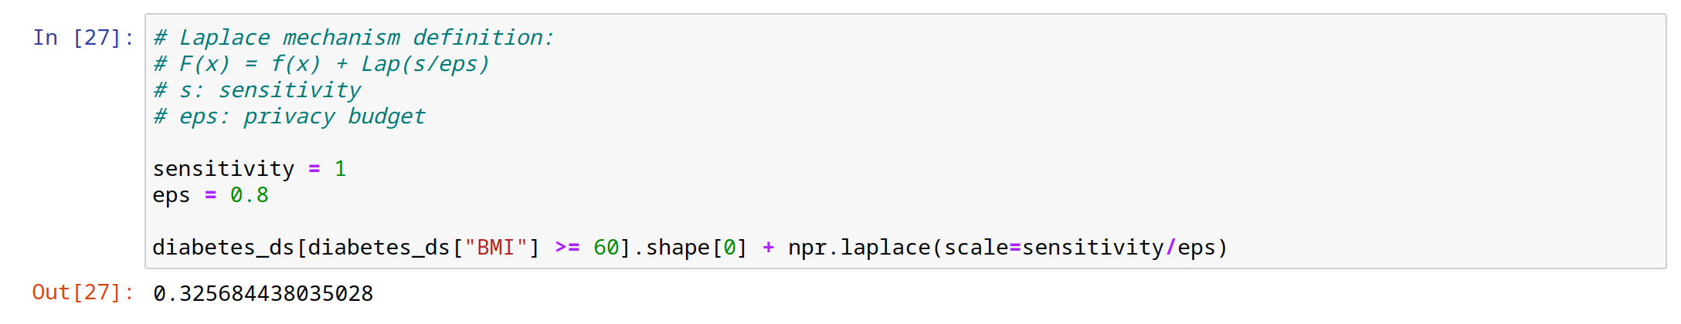
DP: Laplace Mechanism (cont.)
A query that looks for users with a BMI greater than or equal to 60.
Only one person
If the value for epsilon is large, we will not be able to protect the privacy of individuals, and the value will be close to original value:

Slide 13
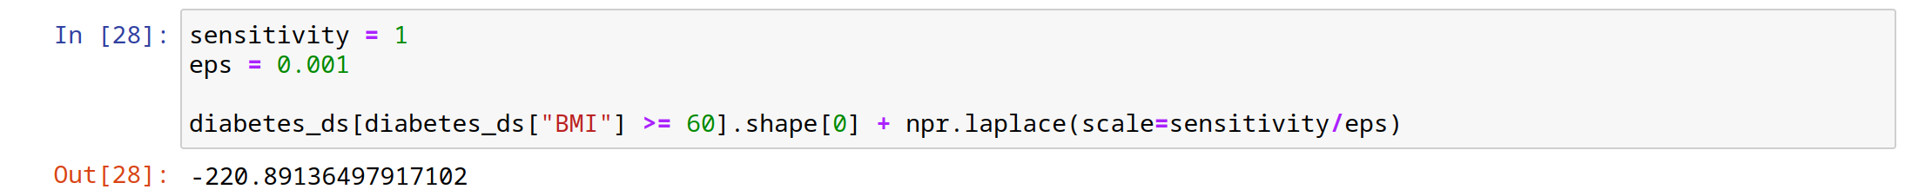
DP: Laplace Mechanism (cont.)
If the value for epsilon is small, we will focus more on protecting the privacy of the user, and the returned value will be far from the original value:
Raw result + Laplace noise

Slide 14
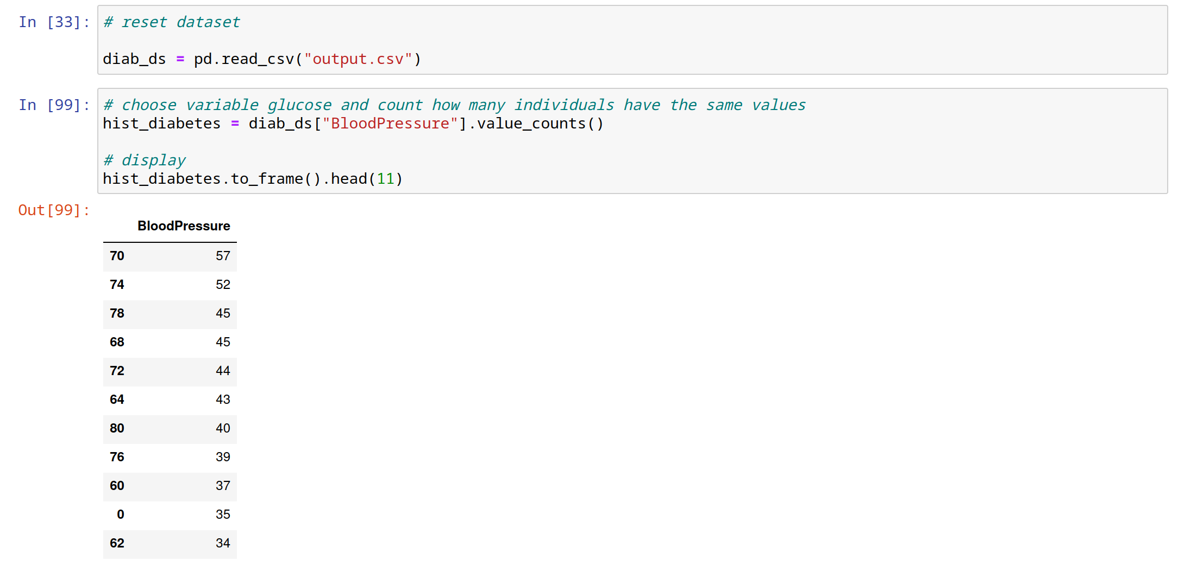
Laplace Mechanism on Histograms
We create a histogram based on blood pressure, with the number of individuals as the count (e.g., 57 individuals with blood pressure equal to 70).

Slide 15
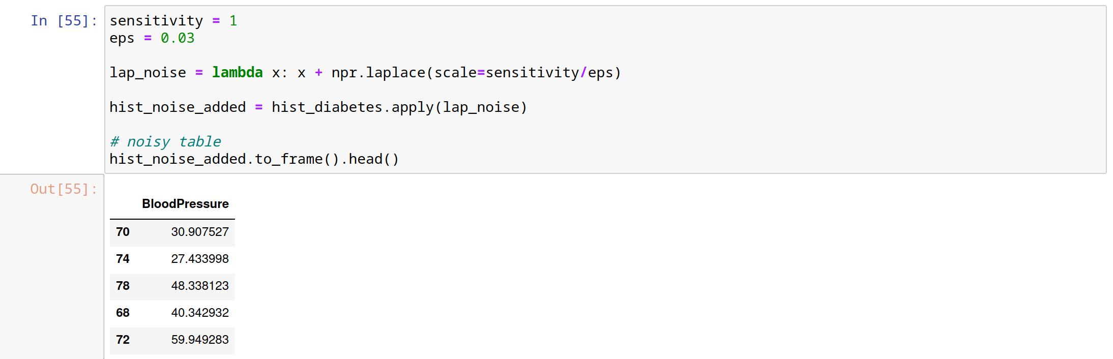
Laplace Mechanism on Histograms
Laplace noise can be applied to histograms:
Values have been perturbed according to the privacy budget that we defined.

Slide 16
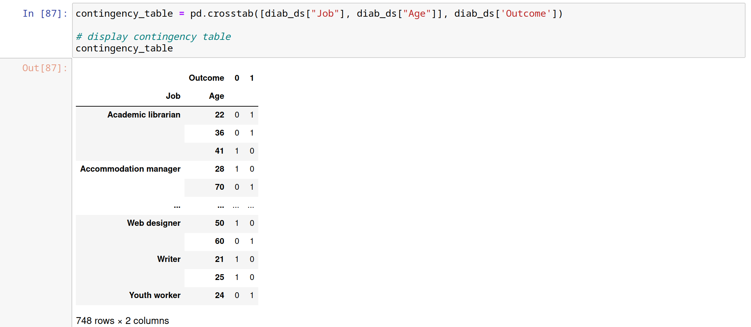
Laplace Mechanism on Contingency Tables
Laplace noise can be applied to contingency tables as well. Using pd.crosstab(), multiple columns are joined to build the following table:
The outcome determines whether or not a person has diabetes.(1 indicates diabetes; 0 indicates no diabetes).

Slide 17
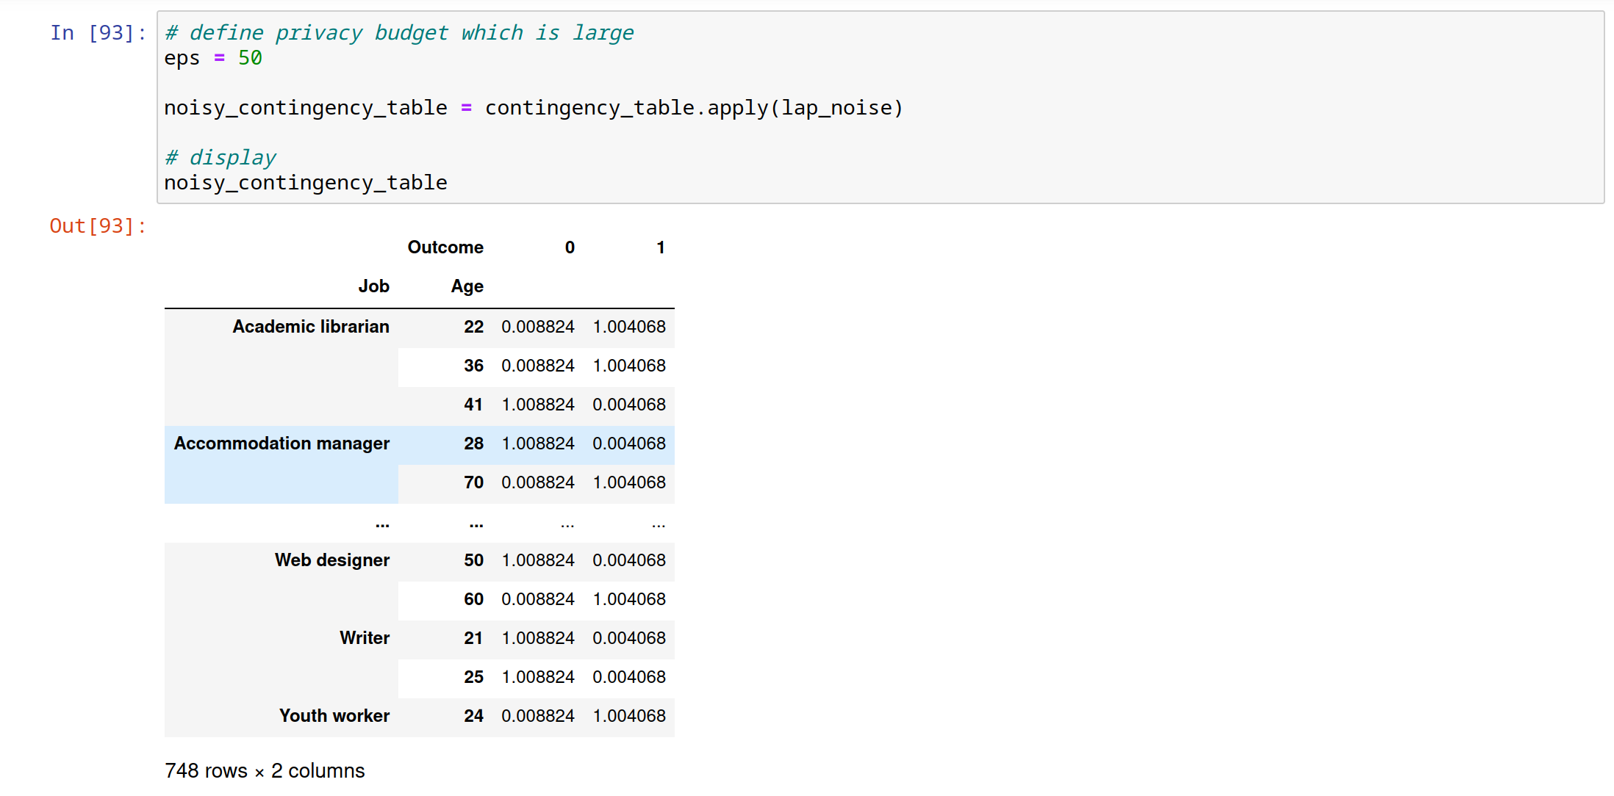
Laplace Mechanism on Contingency Tables (cont.)
Similar to what we encountered before, if the privacy budget is large, the final outcome will not be drastically different from the original value:

Slide 18
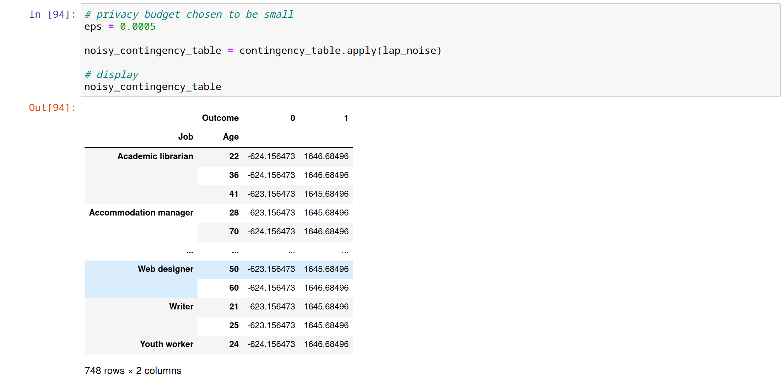
Laplace Mechanism on Contingency Tables (cont.)
If the privacy budget is small, the end result will be distant from the original value:

Slide 19
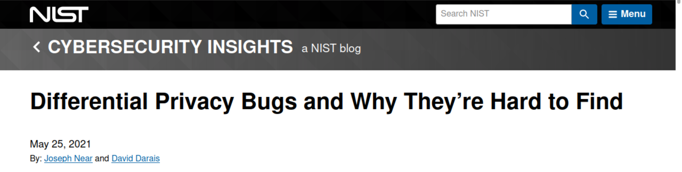
Final Remarks
Resistant to record linkage attacks
Bugs in implementation are possible (due to incorrect sensitivity calculation or adding the incorrect amount of noise).
Not suitable for every scenario (e.g., medical data is sensitive; a small privacy budget is needed. Simultaneously, too much noise will make diagnosis difficult for doctors.)

