Slide 1
Segmentation
Presented : Muhammad Zaqeem

Slide 2
Overview
Image Segmentation
Semantic Segmentation
Instance Segmentation
Panoptic Segmentation
Pre-trained model for Segmentation

Slide 3
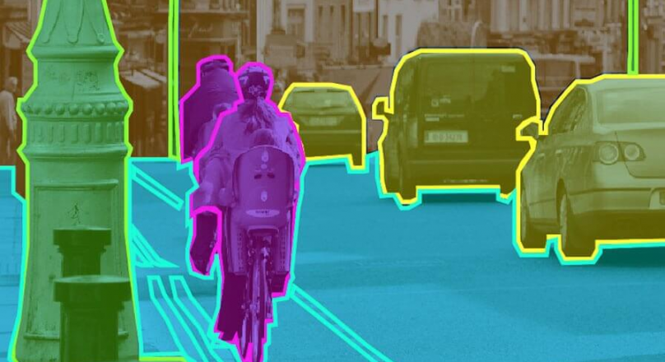
Image Segmentation
A computer vision technique that divides an image into meaningful regions by grouping similar pixels.
Helps in precise object localization, making images clearer and easier to analyze.
Applications:
Medical Imaging: Detects tumors, segments organs, and aids in diagnosis.
Autonomous Vehicles: Identifies roads, pedestrians, and obstacles for safe navigation.
The image demonstrates semantic segmentation, where objects like the motorcyclist, vehicles, and street elements are highlighted in different colors. This technique helps in autonomous driving, object detection, and scene understanding by distinguishing objects within a scene.

Slide 4
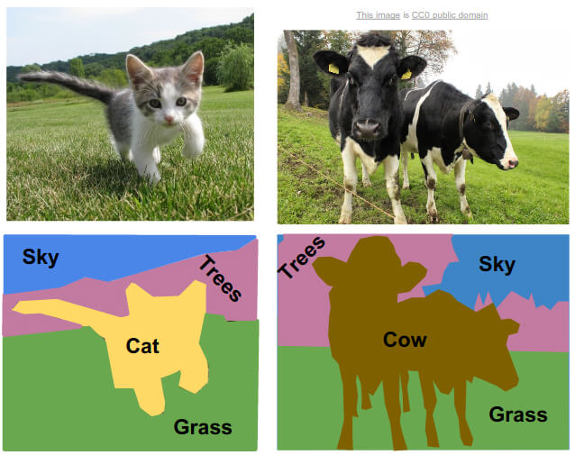
Semantic Segmentation
Semantic segmentation assigns a class label to each pixel in an image or video.
It provides a detailed understanding of object boundaries and regions.
Uses deep learning and CNNs to accurately identify objects in complex scenes.
Semantic segmentation is used in medical imaging (tumor detection), autonomous vehicles (pedestrian detection),video surveillance, and image enhancement (e.g., advertising).
The image illustrates semantic segmentation, where each pixel is classified into meaningful categories. The bottom half shows segmented versions of the original images, labeling regions like sky, trees, grass, cat, and cow in distinct colors. This technique enhances object recognition and scene understanding by differentiating various elements in an image.

Slide 5
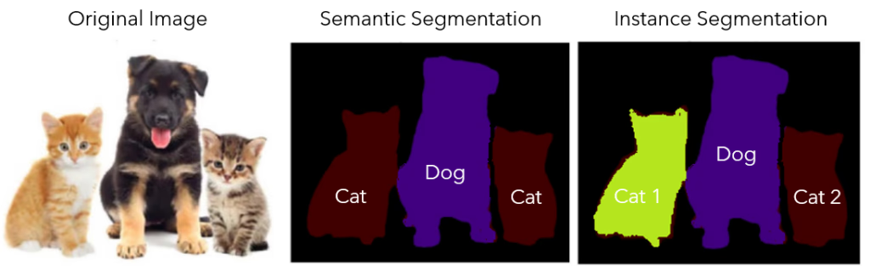
Instance Segmentation
Instance segmentation detects and separates individual objects of the same class in an image.
Each object gets a unique label and boundary.
Unlike semantic segmentation, which labels all objects of a type the same, instance segmentation distinguishes each one.
It combines object detection (finding objects) with pixel-wise classification (segmenting them).
The original image shows three animals—a dog and two cats. The instance segmentation result assigns a unique label and boundary to each animal, distinguishing them as "Cat 1," "Dog," and "Cat 2." Unlike semantic segmentation, which would group all cats under one label, instance segmentation treats each as a separate entity.

Slide 6
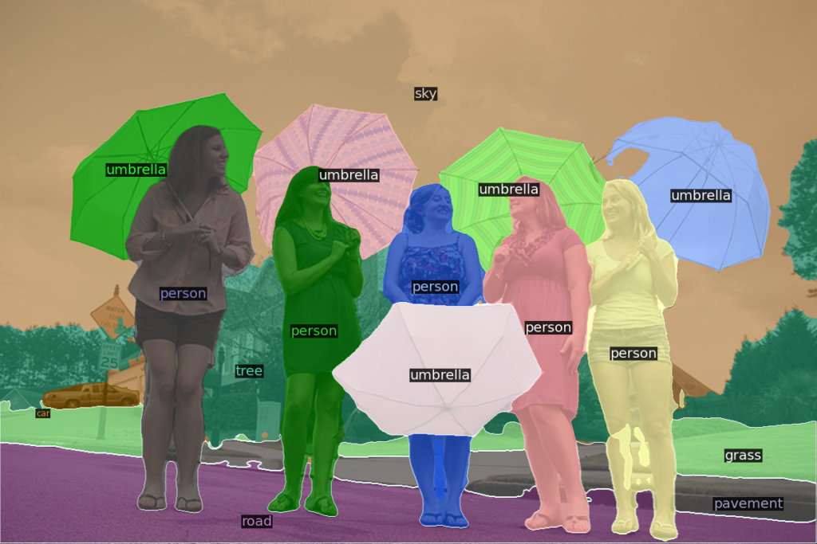
Panoptic Segmentation
Panoptic Segmentation is a computer vision task that combines semantic segmentation and instance segmentation to provide a unified view of an image.
Class Labels for Every Pixel:
Assigns a category to each pixel (e.g., person, car, road) like semantic segmentation.
Instance Masks for Objects:
Each object is uniquely segmented and assigned a separate instance ID.
Enables precise object detection and differentiation.
This image demonstrates Panoptic Segmentation, where each pixel is assigned both a category label (e.g., sky, road, grass) and an **instance ID for objects (e.g., multiple umbrellas and people are uniquely segmented). Different colors represent distinct objects, while labeled regions like "sky" and "road" show background segmentation. This approach provides a unified view of the scene, helping in applications like autonomous driving, surveillance, and scene understanding.

Slide 7
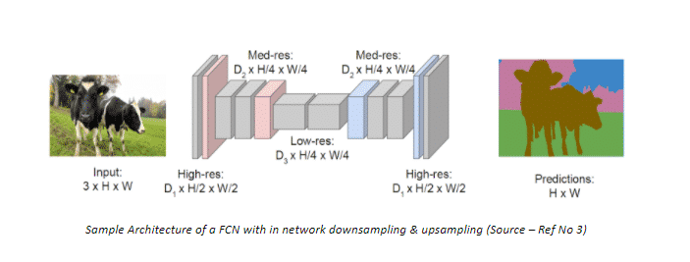
Pre-Trained Model For Segmentation
Model For Semantic Segmentation:
1. Fully Convolutional Network (FCN):
Encoder (Downsampling)
A backbone CNN (e.g., VGG16, ResNet) extracts feature maps.
Fully Convolutional Layer
Converts feature maps into class scores using 1×1 convolutions.
Decoder (Upsampling)
Uses transpose convolutions (deconvolutions) to increase the resolution.
The image shows the architecture of a Fully Convolutional Network (FCN) for semantic segmentation. It takes an input image and processes it through an encoder that extracts features using convolutional and pooling layers. The bottleneck applies fully convolutional layers to refine the features. Then, the decoder upsamples the feature maps to restore the original image size, generating a pixel-wise segmentation mask where each pixel is assigned a class label. This method helps accurately segment objects while preserving spatial details.

Slide 8
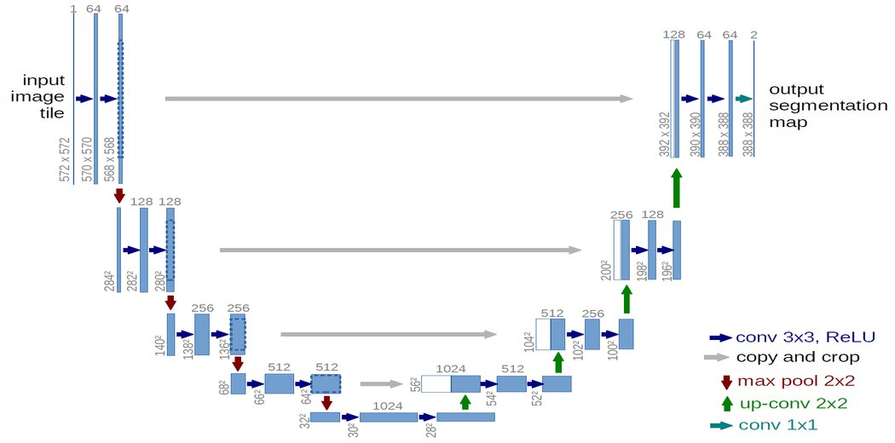
Pre-Trained Model For Segmentation
2. U-Net Architecture:
It has a U-shaped structure especially design for medical imaging
Encoder:
Extracts important features using convolutional layers.
Bottleneck:
Connects encoder and decoder.
Decoder:
Restores spatial details using skip connections.
Final Output Layer:
Assigns a class label to each pixel.
This image shows the U-Net architecture for image segmentation. It has an encoder for feature extraction, a bottleneck, and a decoder for upsampling. Skip connections** help retain spatial details, and the final layer produces a segmentation map with class labels for each pixel.

Slide 9
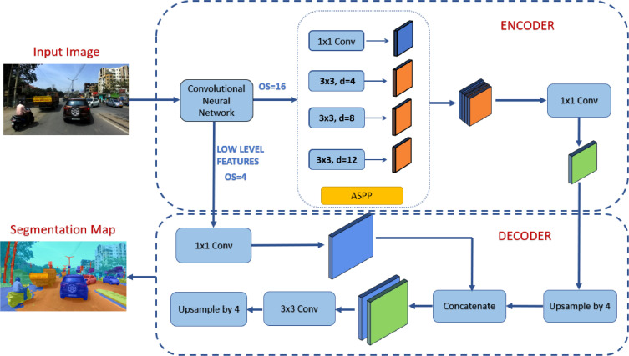
Pre-Trained Model for Segmentation
This is the architecture of DeepLabV3+, an improved version of DeepLabV3. It consists of an encoder and a decoder for better segmentation results. The encoder uses a CNN (like ResNet or Xception) to extract features, followed by Atrous Spatial Pyramid Pooling (ASPP), which captures multi-scale information using different atrous (dilated) convolutions. The decoder refines the segmentation map by combining low-level features with high-level ASPP features. It uses upsampling and convolution layers to restore spatial details, leading to an accurate segmentation map. This architecture is widely used for tasks like autonomous driving and medical imaging.

Slide 10
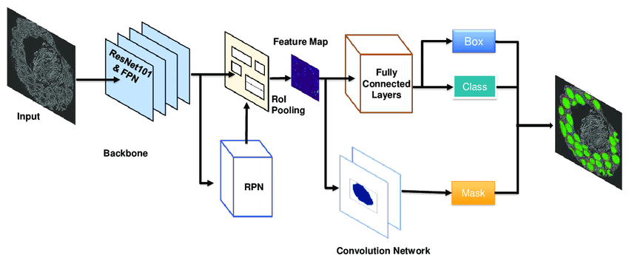
Pre-Trained Model For Segmentation
The image shows the Mask R-CNN architecture for instance segmentation. A backbone network (ResNet101 & FPN) extracts features from the input image, which are then processed by the Region Proposal Network (RPN) to identify object regions. RoI Pooling converts these regions into fixed-size feature maps. The model then classifies objects, refines bounding boxes, and generates segmentation masks using a separate convolutional network. The final output includes bounding boxes, class labels, and precise object masks, making Mask R-CNN effective for detecting and segmenting multiple objects.

Slide 11
Thank You

