Slide 1
Artifical Neural Network
Presented by: Muhammad Zaqeem

Slide 2


Overview
Artifical Neural Network
Fowward Propagation
Activation Function
Why Activation Function
Backpropagation

Slide 3


Artifical Neural Network
An Artificial Neural Network (ANN) consists of interconnected units called artificial neurons.
Each neuron receives numerical signals from connected neurons, processes them, and transmits signals to others
Neurons are grouped into layers, with each layer performing specific transformations.
Signals flow from the input layer to the output layer, passing through one or more hidden layers.

Slide 4
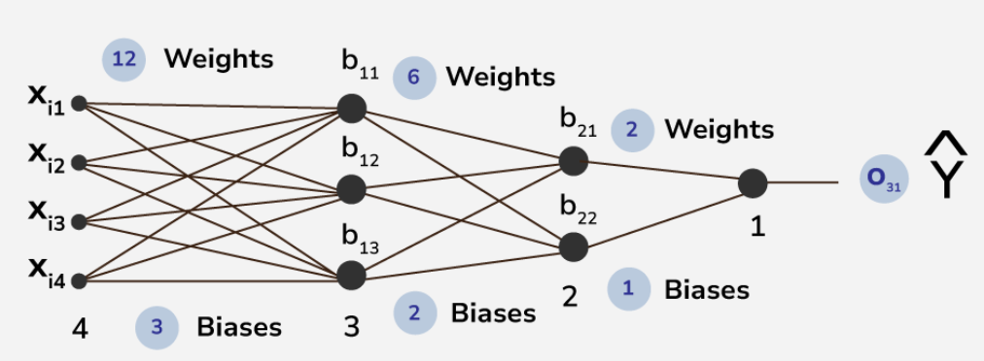
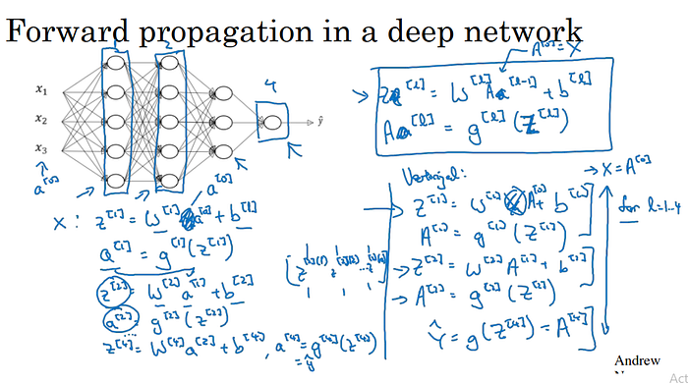
Forward Propagation
Forward propagation is the process used in neural networks to pass input data through the network layers to produce an output.
Working:
For each layer, Computes the dot product of inputs and weights, Adds the bias to the result.
Apply the activation function, and pass it to the next layer.
This process is repeated for all layers until the final output is produced.

Slide 5
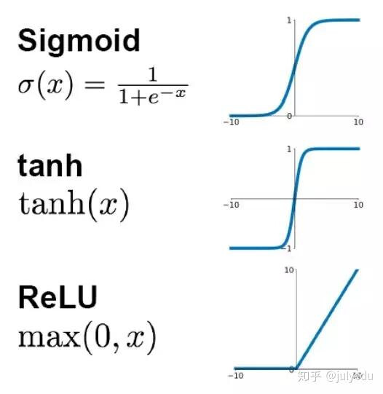
Activation Function
A function that calculates the node's output based on its inputs, their corresponding weights, and the bias.
Common Activation Function:
ReLU :
Output is z if z> 0 otherwise 0.
Sigmoid:
Output is a value between 0 and 1.
Tanh:
Output is between -1 and 1.
Softmax:
Used in the output layer for multi-class classification.

Slide 6
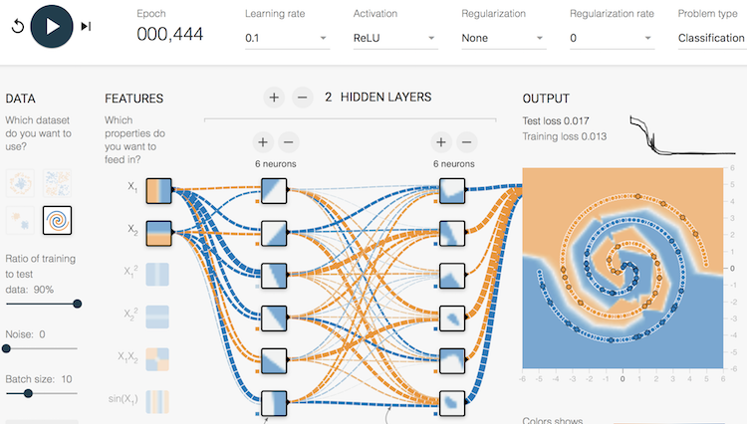
Why Activation Function
As we discuss An activation function is a mathematical function applied to the output of a neuron.
Without an activation function, the neural network would just be a linear model, no matter how many layers it has.
The activation function adds non-linearity, allowing the network to learn and approximate complex, real-world patterns that are often non-linear.

Slide 7
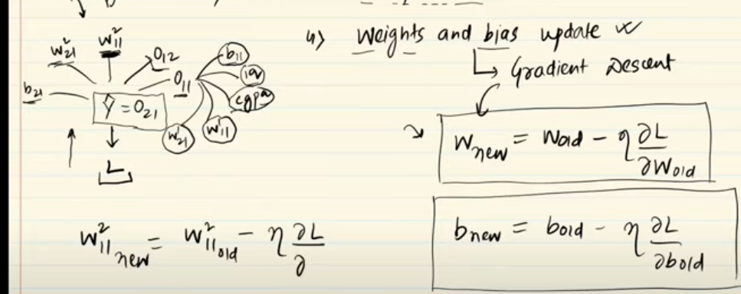
Back Propagation
Backpropagation is an algorithm used to train neural networks by minimizing the error (or loss) between predicted and actual outputs.
It computes the gradient of the loss function with respect to each weight and bias using the chain rule of calculus, enabling the efficient computation of updates to these parameters.
It propagating the error backward through the network, starting from the output layer to moving toward the input layer

Slide 8
Thank You

