Slide 1
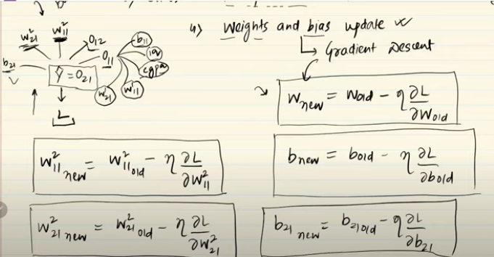
Backpropagation
Backpropagation is an algorithm used to train neural networks by reducing the error between predicted and actual outputs.
It computes the gradient of the loss function with respect to each weight and bias using the chain rule of calculus, allowing efficient updates to these parameters.
It propagates the error backward through the network, starting from the output layer and moving toward the first hidden layer.

Slide 2

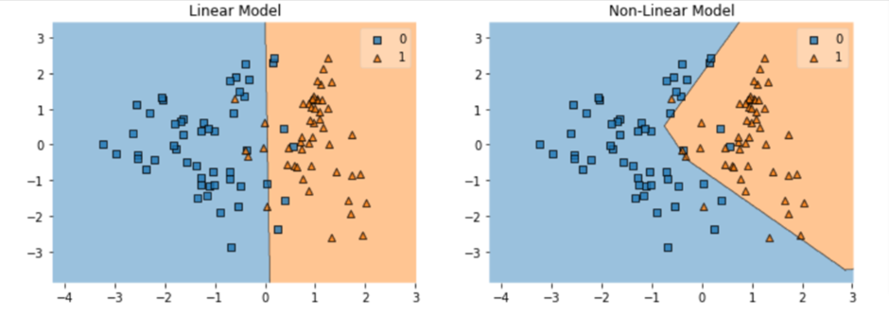
Activation Function
The activation function determines whether a neuron 'fires' (activates) and to what extent it contributes to the final output.
In artificial neural networks, each neuron forms a weighted sum of its inputs and passes the resulting scalar value through function referred to as an activation function or transfer function
If a neuron has n input then the output or activation of a neuron is
This function g is referred to as the activation function

Slide 3
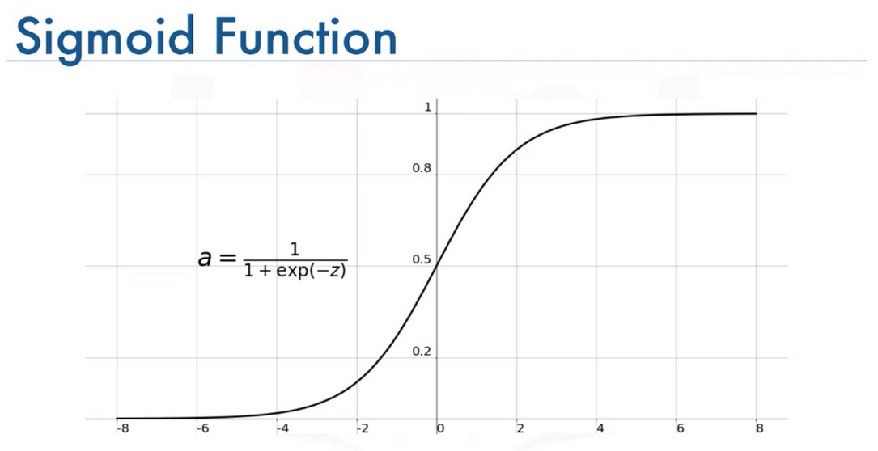
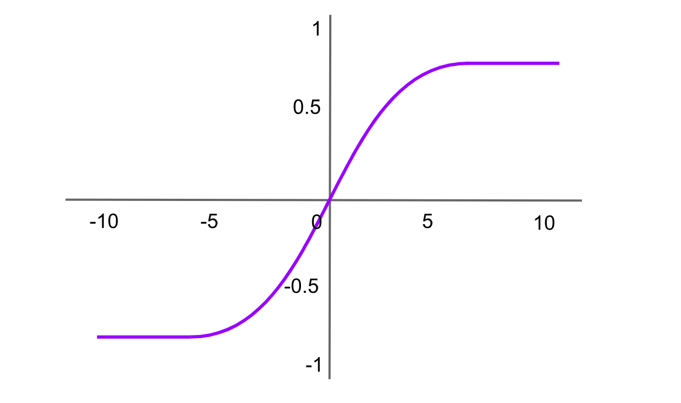
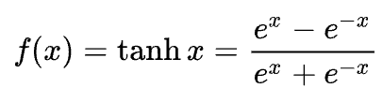
Types of Activation Function
Sigmoid Activation Function:
it is characterized by ‘S’ shape. It is mathematically defined f(x)=1/1+e^-x
The output is interpreted as a probability, making it useful for binary classification tasks.
Tanh Activation Function:
it is a shifted version of the sigmoid, allowing it to stretch across the y-axis. It is defined as:
It’s output is between -1 and 1

Slide 4
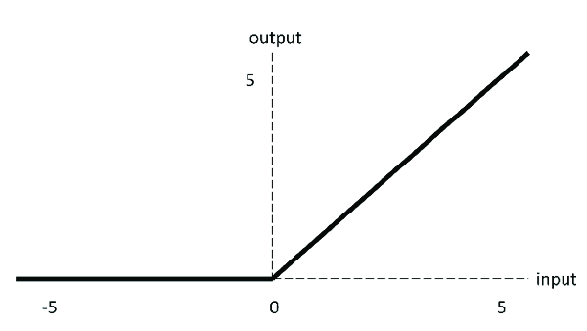
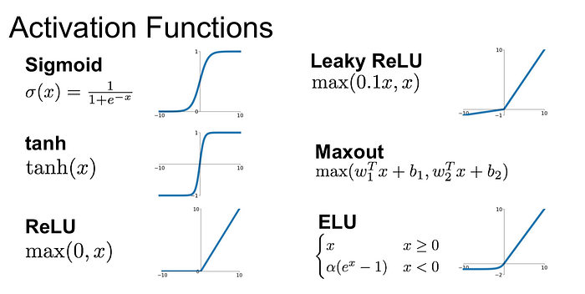
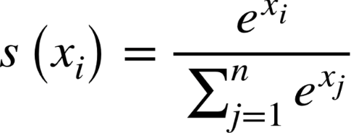
Continue
Relu :
Output is z if z> 0 otherwise 0.
Mostly used in hidden layer
Mathematical formula is :
Softmax:
Used in the output layer for multi-class classification.
Mathematical formula is:

Slide 5
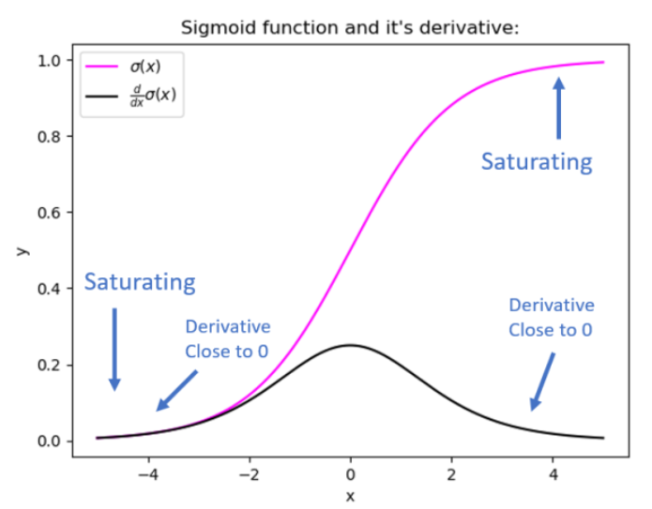
Problem in Sigmoid
One of the most common issues with the sigmoid activation function is the vanishing gradients problem
This occurs when the output of the sigmoid function is near 0 or 1, which causes the gradient to become very small.
During backpropagation, these small gradients are multiplied together, causing them to vanish as they propagate through multiple layers of a deep network.
This hampers learning in earlier layers, as negligible weight updates can slow or stall training, especially in deep networks.

