Slide 1
LIE DETECTION USING MACHINE VISION​
Avlonitis Ektor – 216882
Gaitanis Pavlos – 265879
Lazarevic Milos – 272036
Vavakas Alex –272483

Slide 2
The Project Idea – A Brief Overview
01 | What is it?
 | It is a program that depicts if a person in a video/image is lying or not to questions given to them.​
02 | The Approach
 | Our approach is to create a program that can decide that by analysing the facial expressions of the person. ​
03 | How does it work?
 | By capturing frames throughout the video, the program decides whether the person is being honest or not. It compares these frames to frames acquired from previous videos of the individual in which we already know if they were truthful.
04 | The Limitations
 | A person does not necessarily need to make facial expresssions when lying. For the purposes of this project, we assume they do.

Slide 3
Assumptions and Limitations
How to tell if lie?
Assumptions
Person will cooperate in creating the truthful and dishonest responses for 2 videos required for calibrating the machine.
Individual’s facial features do not deviate from the standard facial features. No extreme facial scars, lacking facial parts such as eye/s or teeth.
Lighting conditions are the same on both the videos required for calibration and the one the machine depicts as truthful or dishonest
Limitations
The machine can respond to an individual only after calibrated for the same individual with videos.
Unbale to work with facial features deviating from the standard features

Slide 4
Project Components
01
02
Controlled Environment
Machine Vision
Lighting, angle, distance
Lie Detection
Techniques Learned
What makes our lie detector?
03
04
Haar Cascades
ABC Method
Face Detection, eye detection, mouth/smile detection
Finding the unknown using previous information

Slide 5
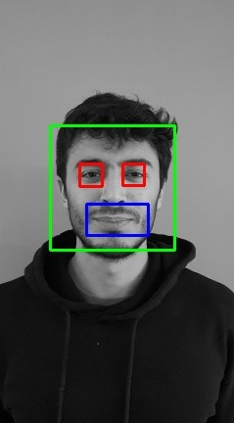
Haar Cascades - The Backbone
Face Detection
The encapsulating box
Eye Detection
The tricky component
Smile Detection
The naive component
Social networks

Slide 6
The ABC Method
Prediction
Depiction
Using A and B, find C
C
02
Unknown
A
B
01
Known
The Truth
The Lie

Slide 7
A Sample Test
A
B
Neutral Expression
Change in Expression
For 3 seconds the person makes a neutral face
For 3 seconds the person changes facial expression
C

Slide 8
The Machine Vision Scope
Machine Vision
Machine Learning
Haar Cascades/Classifiers
Thresholding
Preprocessing
Background Subtraction
Edge Detection/Blurring
Histogram Inspection
Video Capture
Vs
Machine Vision +
Other Pre-Trained Models
Convolutional Neural Networks
SVM ( Support Vector Machine )
Keras Model

Slide 9
Our Project in Practice
Record the videos
Collect the frames
Truth and Lying Videos
Write a python script to gather frames from each video
Face / Face features detection
Create a python script and use cascades
Output the results
Grayscale / Binary Threshold
Calculate the white pixels for the eyes / the size of the smile
Show how facial expression change in the two cases

Slide 10

Collect the Frames
Outputs
Inputs
The frames we request
The mp4 file

Slide 11
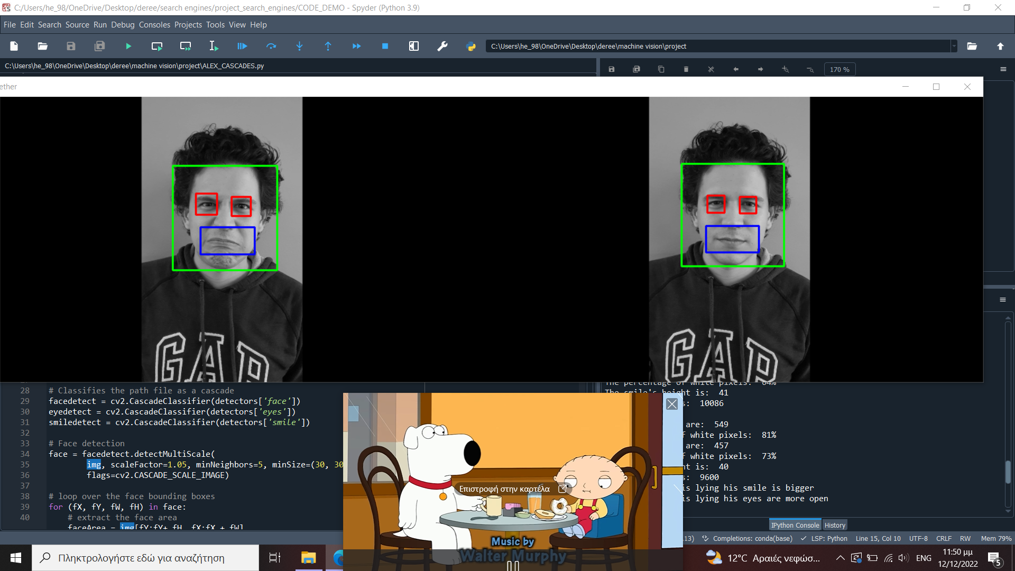
Detections / Cascades
Example
when the person is telling the truth: shrinking + smaller smile
when the person is lying wide eyes + bigger smile
01
02
03
04
Step 1
Step 2
Step 3
Step 4
Import the images – Loads detectors from local opencv library
Detect the face – Detect the eyes in the upper half of the face – the smile in the bottom half
Do a binary threshold – Calculate white pixels and smile size
Present the Output

Slide 12
Work in Progress – Live Video
Limitations of MV Approach
Instead of using a trained model to predict whether the person is lying, it uses the Haar cascade classifier to detect the person's smile and eyes in the video frame. ​
A Lie Detector should be able to identify if someone is lying at real time.​
Current Progress
If a smile is detected, but no eyes are detected, the code assumes that the person is lying.

Slide 13
Some things we can add
01
More Preprocessing
04
Contextual Information
02
Body Language
05
Alert System
03
Vocal Cues
It can never be 100%...

Slide 14
Thank you for your time!

