Slide 1
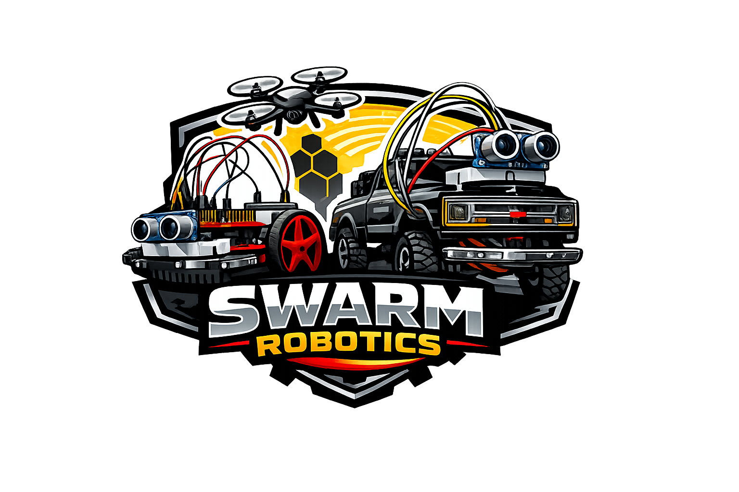

Ricardo Zaragoza
Spring 2026
Instructor: Aaron Nanas

Slide 2
SWARM Robotics Behavior ECE-528 Robotics and Embedded Systems Ricardo Zaragoza Instructor: Aaron Nanas Spring 2026
Project Overview:
The goal of this project is to recreate SWARM robotics behavior using a combination of the Tiva C Series TM4C123G and the MSP432 microcontrollers for sensor readings and motor control. A wireless communication network will be implemented using the ESP32 microcontroller.
Swarm robotics is a system where multiple simple robots collaborate to achieve a common goal without a central controller. Each robot responds to their peers and the environment using local decision making-rules. This idea is inspired by natural system like bees and ants where complex group behavior emerges from simple individual actions.

Slide 3
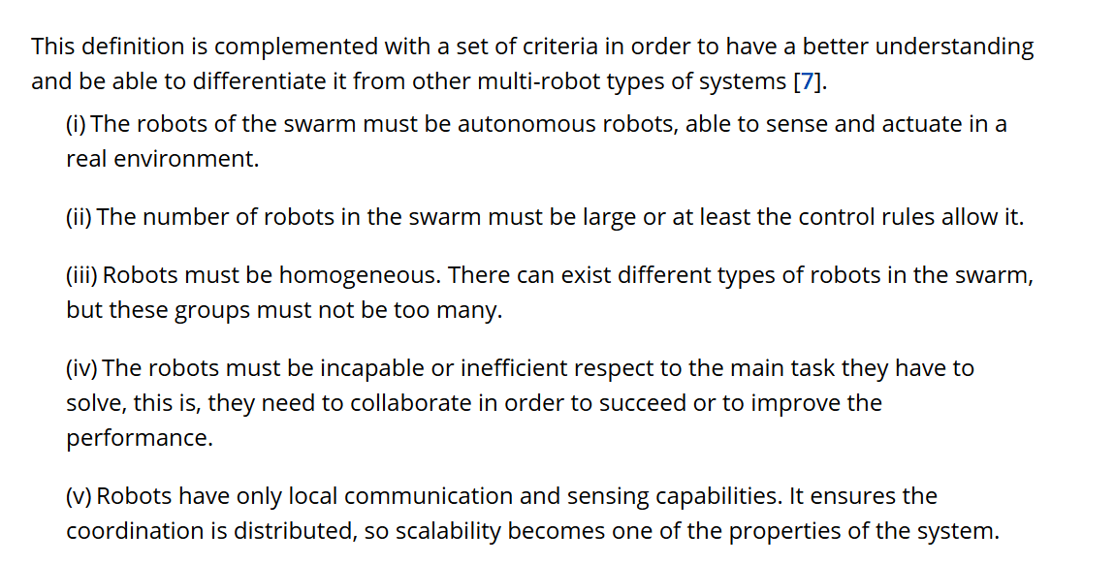
SWARM Robotics main characteristics

Slide 4
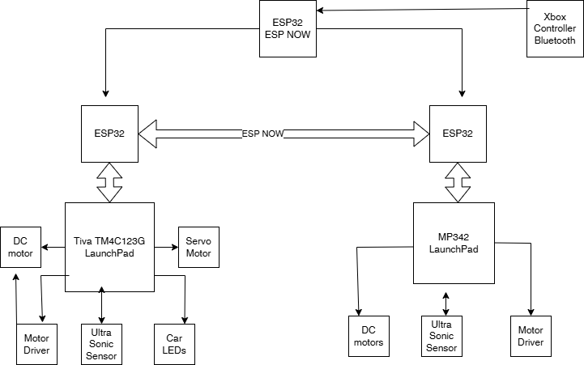
Block diagram of components

Slide 5
System Architecture
System Architecture Overview:
The proposed system architecture is divided into three main layers. Control, communication and peripherals. The Tiva C series and MPS432 microcontrollers are used for low-level controls such as reading sensors, driving motors and handling peripheral operations. The ESP32 is used as the communication layer because it provides built-in wireless capability that is useful for coordination between robots in swarm. In addition, an Xbox controller is integrated through Bluetooth to provide instant manual override capability for both robots.
One important design choice was to separate real-time control from wireless communication. Each robot has a two microcontrollers: a Tiva or MSP432 for handling hardware related-tasks, and an ESP32 that is use for managing communication. If communication layer fails or is interrupted, the local microcontroller can still manage basic robot behavior.
The architecture is also inspired by insect swarm behavior, where simple agents rely on local rules and limited communication to produce coordinated group actions. In this system, robots begin in manual mode, where commands from the Xbox controller are sent to an ESP32 initiator and then broadcast to selected robots. The user may control one robot individually or multiple robots simultaneously based on the selected robot ID. If the controller signal is lost, the robots transition into autonomous mode. This idea is reflected in the robots by using a finite state machine and sensors to interreact with the with the environment for local decision making.
During autonomous operation, each robot runs a finite state machine and interacts with its environment to determine its current behavior. State information may be shared among peers using ESP-NOW to support swarm coordination. Obstacle detection is currently based on an ultrasonic sensor because only one main peripheral sensor is available at this stage, the navigation logic is designed so that the robot reverses when an obstacle is detected, then checks left and right before selecting a new direction. This allows the robot to continue moving through the environment while avoiding obstructions. Manual override remains an essential part of the architecture, allowing the user to retake control at any time.

Slide 6
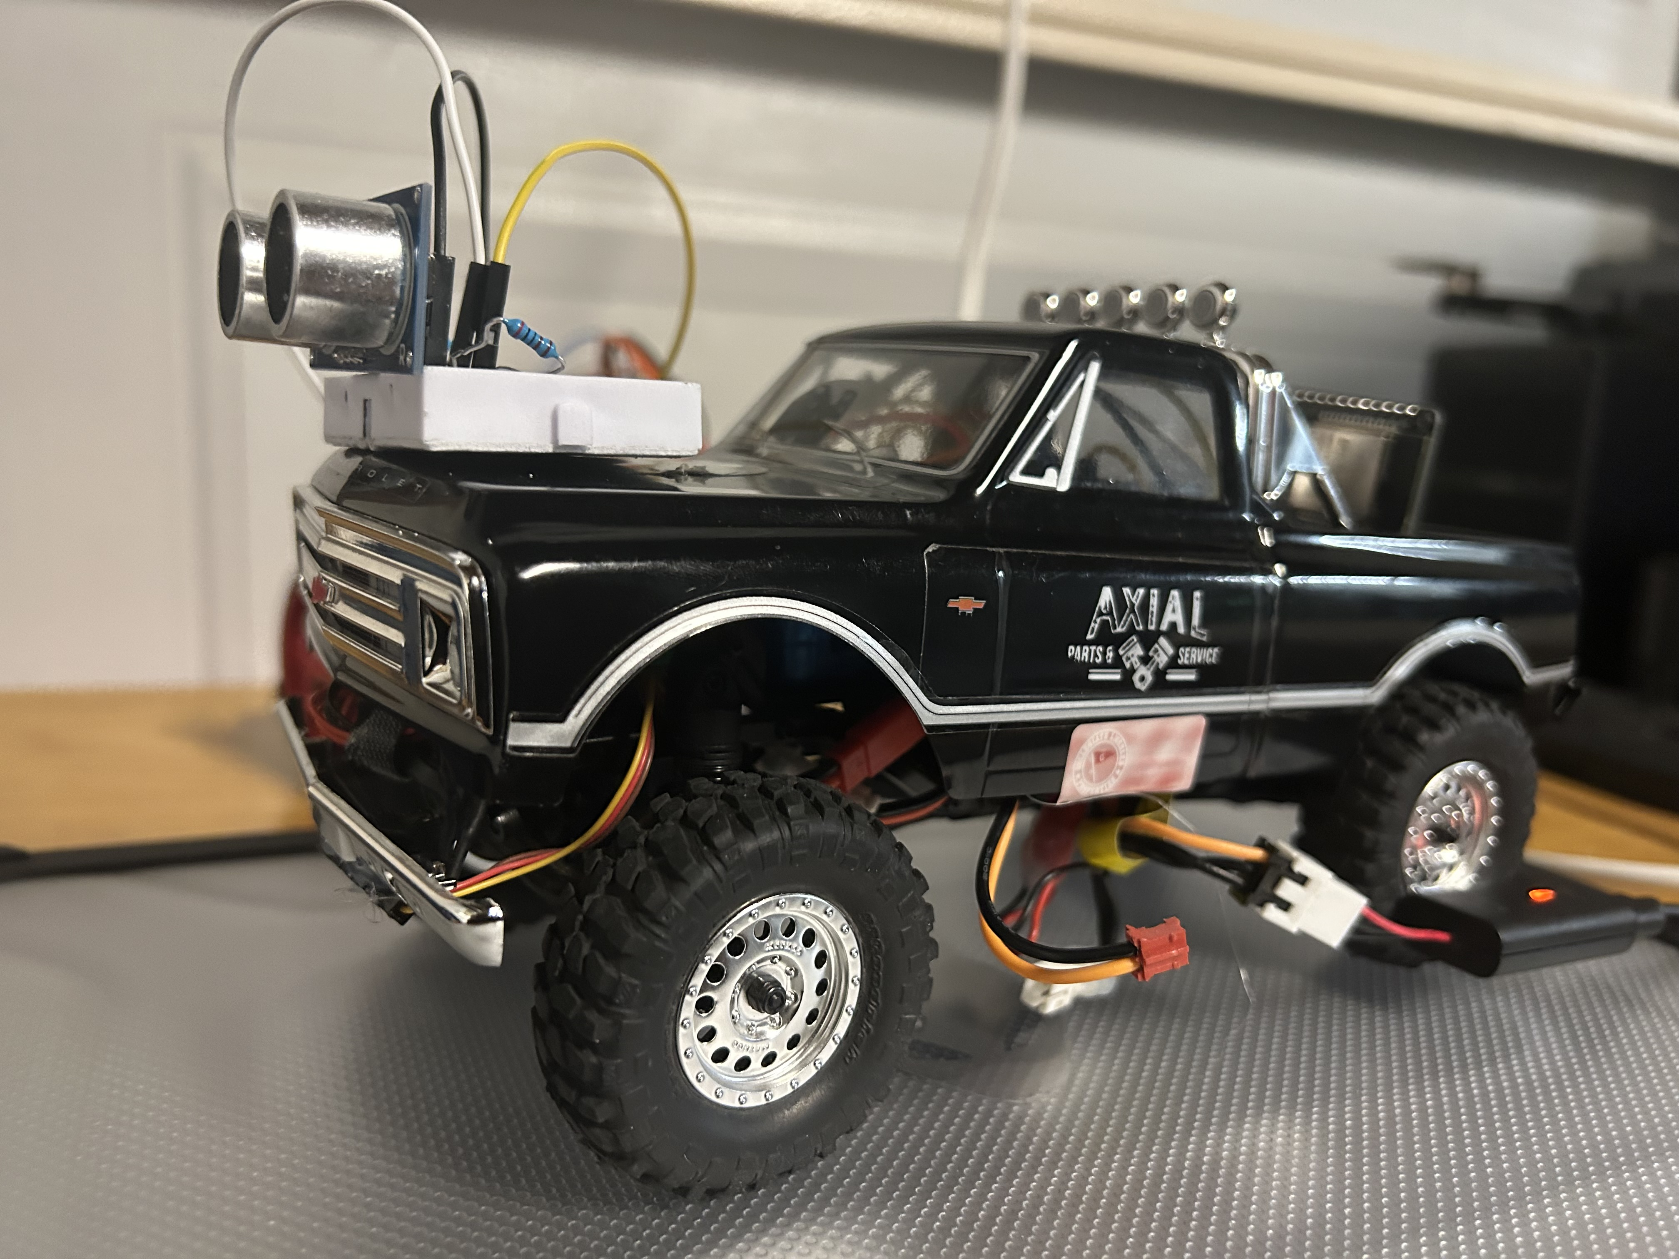
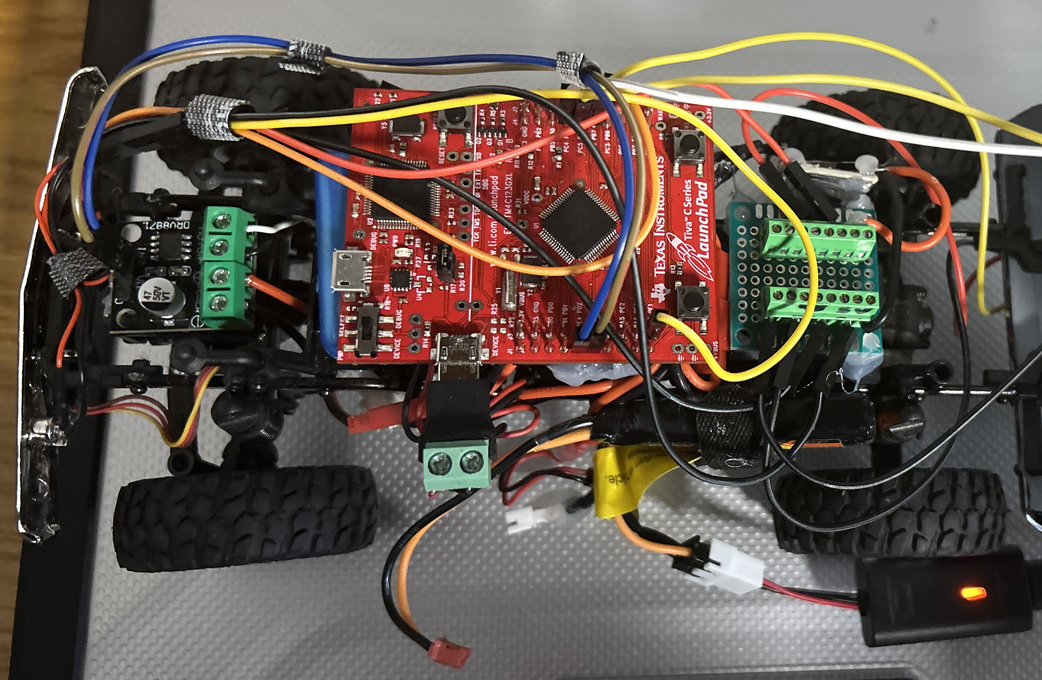
Interfaces and Peripherals
Robot 1 is built on a repurposed RC crawler chassis and uses the Tiva microcontroller for control. Existing components from the RC crawler, including the servo motor, DC motor, LED lights, and 7.4V battery, were reused as part of the embedded system design.
Tiva C Series TM4C123G
MCU peripheral | Components | Pins
UART | ESP32 | PC7 (Tx), PC6 (Rx)
GPIO | Ultra Sonic Sensor | PC4 (Trigger), PC5 (Echo)
GPIO | LEDs | PF1
PWM | Motor Driver | PE4, PE5
PWM | Servo Motor | PB6

Slide 7
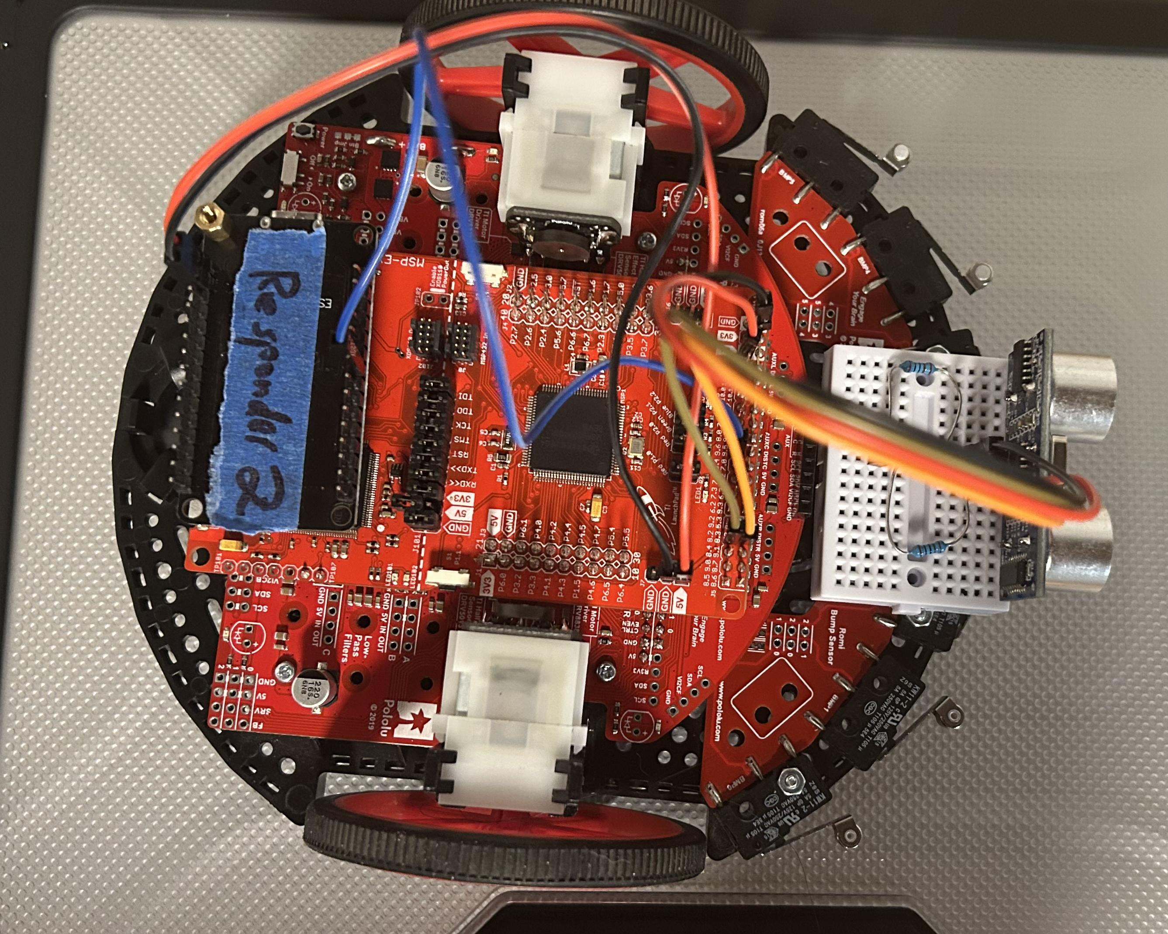
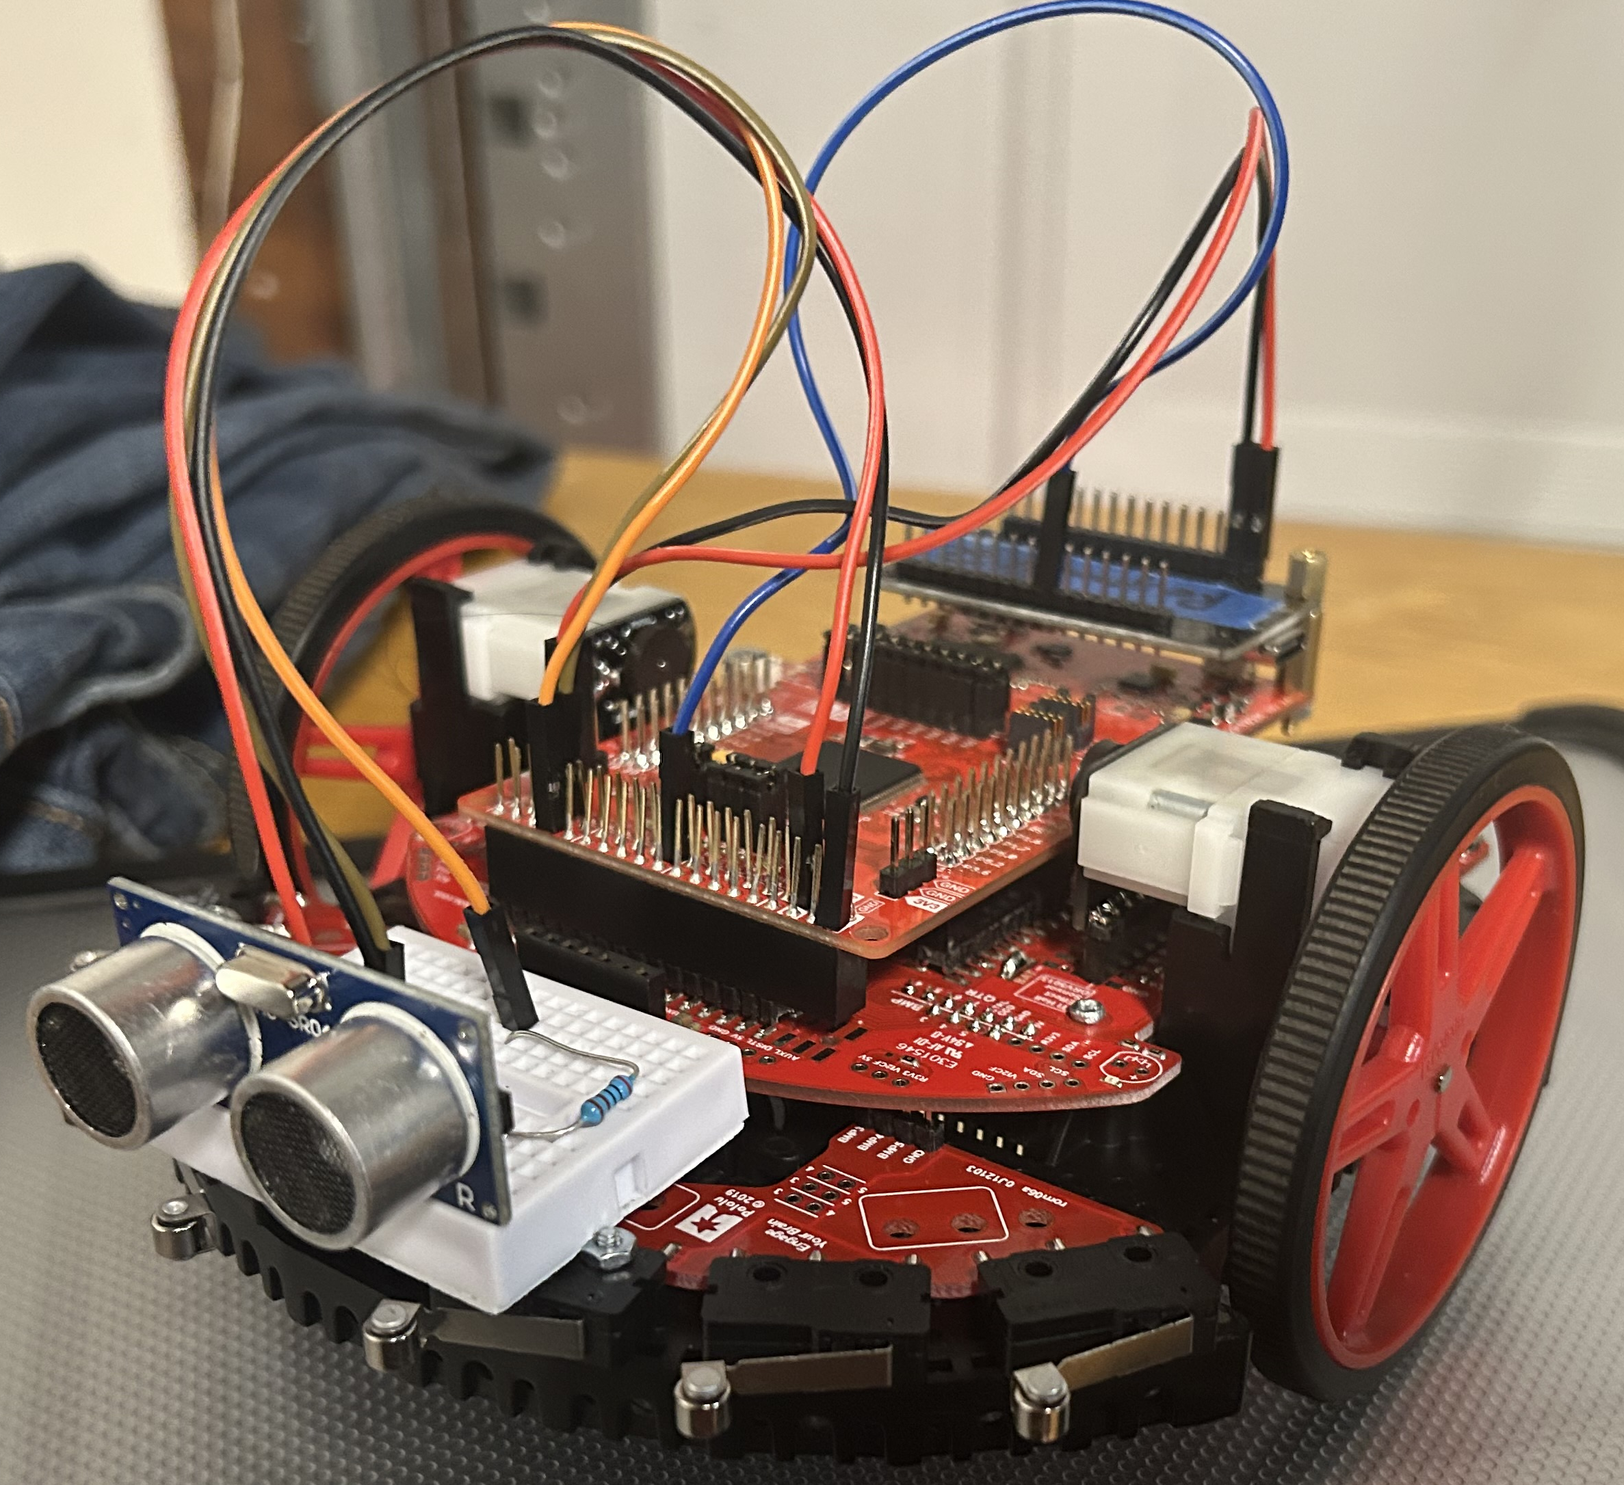
Interfaces and Peripherals
Robot 2 is built on the TI-RSLK-MAX chassis and used the MSP432 microcontroller for control. The robot is equipped with DC motor and an ultra sonic sensor.
MSP 432
MCU peripheral | Components | Pins
UART | ESP32 | (P9.6Rx), (P9.7Tx)
GPIO | Ultra Sonic Sensor | (P8.2Trigger), (P8.3Echo)
PWM | DC motors | P2.6 (PM_TA0.3) and P2.7 (PM_TA0.4)

Slide 8
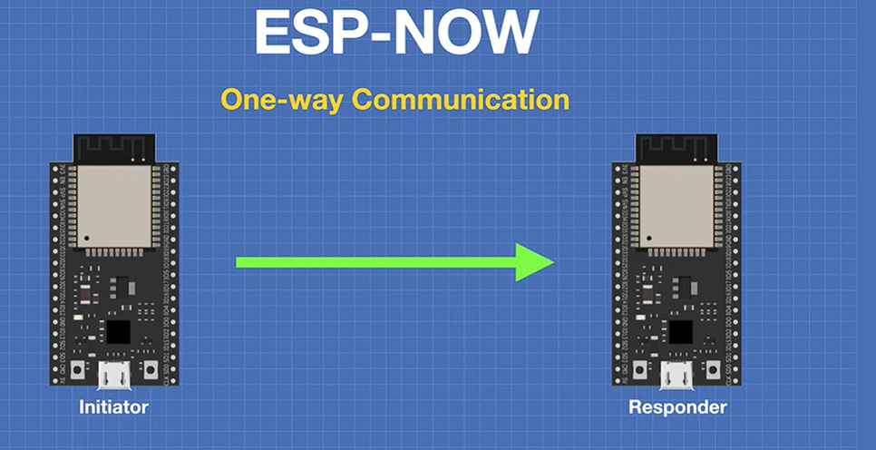
Interfaces and Peripherals
ESP NOW is a wireless communication protocol developed by Espressif, and it allows simple communication between ESP devices with no Wi-Fi configuration required.
ESP NOW can be configured as unidirectional and Bidirectional modes. It provides persistent connection after paring. The Xbox controller is connected to an ESP32 that acts as an ESP-NOW initiator while the ESP32 microcontrollers on the robots can use bidirectional communication modes with their peers.
One-way communication
Initiator -> responder
One Initiator -> multiple responders
One responder -> multiple initiators
Two-way communication
Each device act as a responder and initiator
ESP32
MCU peripheral | Components | Pins
UART | ESP32 | 17 (Tx), 16 (Rx)
ESP NOW | ESP32 | Wireless
Bluetooth | ESP32 | Wireless

Slide 9
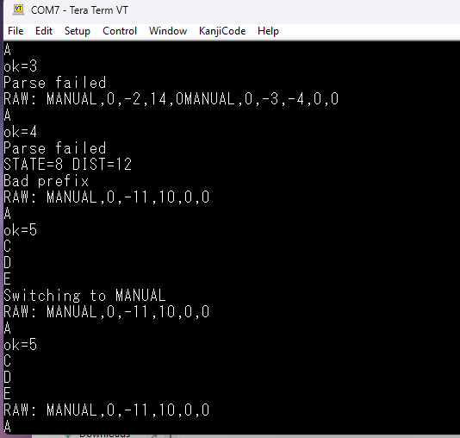
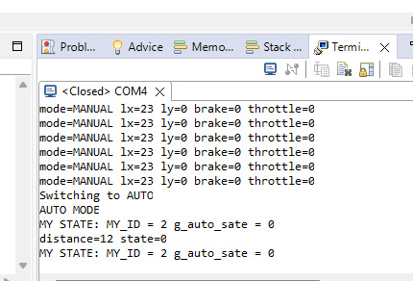
Verification and Testing: sensor readings and motor control
Robot 2 (MPS432), switching from manual inputs to autonomous state machine, after no input is detect from UART.
Robot 1 (Tiva), switching from autonomous state machine to manual controller inputs when UART is detected. This example show the issue encountered when switch to manual from autonomous mode.

Slide 10
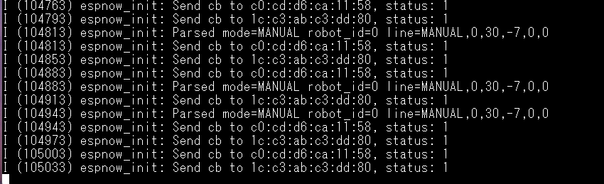
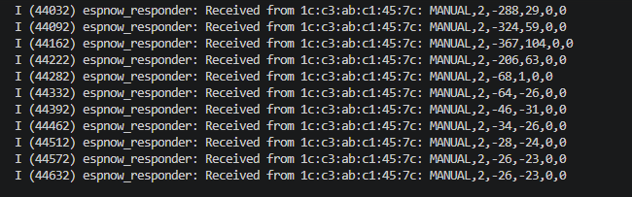
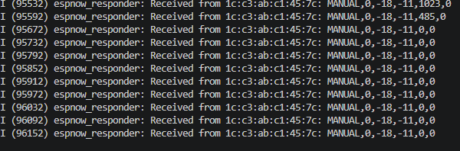
Verification and Testing: wireless communication
ESP NOW Responders receiving commands
ESP NOW Initiator sending commands

Slide 11
Conclusion
This project demonstrated the potential for implementing swarm robotics using the ESP32’s built-in wireless communication together with Tiva and MSP432 microcontrollers. The project successfully achieved the transition from manual to autonomous operation, although the transition from autonomous back to manual control still requires further refinement. Future work will focus on improving transition reliability and expanding the swarm capabilities of the robots. This may be improved by using timer interrupts to detect the presence or loss of the control signal, rather than relying solely on polling methods.
The project also provided valuable experience in embedded systems design, hardware-level programming, finite state machine implementation, and wireless communication. In addition, it highlighted the importance of debugging and iterative design in building reliable embedded systems. Overall, the work serves as a strong example of how simple swarm robotics behavior can be developed using decentralized control. With the addition of more advanced sensors, such as localization and environmental sensing, the robots could make more intelligent decisions based on both peer interactions and environmental conditions, leading to more advanced and natural swarm behavior.

Slide 12
Thank You.
Video links
ESP-NOW wireless communication
https://youtu.be/asMD70wlka4
Manual Mode
https://youtu.be/8eCgVpozRfA
Autonomous Mode
https://www.youtube.com/watch?v=fQHsLGS3hqU

Slide 13
Works Cited
https://onlinelibrary.wiley.com/doi/full/10.5402/2013/608164
https://www.espressif.com/en/solutions/low-power-solutions/esp-now
https://www.mdpi.com/2504-446X/7/4/269
https://www.youtube.com/watch?v=bEKjCDDUPaU&t=1s
https://github.com/sparkfun/HC-SR04_UltrasonicSensor/blob/master/Firmware/HC-SR04_UltrasonicSensorExample/HC-SR04_UltrasonicSensorExample.ino
https://cdn.sparkfun.com/datasheets/Sensors/Proximity/HCSR04.pdf
https://github.com/espressif/esp-idf/tree/c0087486/examples/wifi/espnow
https://github.com/ricardoquesada/bluepad32
https://www.axialadventure.com/product/1-24-scx24-1967-chevrolet-c10-4wd-truck-rtr/AXI00001V2.html

