Slide 1
Two Birds One Stone
Business Analysis

Slide 2
Hypothesis and Assumptions
There are 4 reasons I believe Two Birds One Stone’s ebook sales have decreased:
I hypothesize Two Birds One Stone is not meeting an important proven customer value: empowerment in self publishing.
I also hypothesize that the niche of ebook subject matter Two Birds One Stone has is limiting ebook sales volume.
The current ability to view ebooks only on Amazon is limiting customer accessibility.
I can assume that they are not currently offering audiobook downloads, therefore this can be another reason for low sales.
Top ebook companies I explored: Lulu, Amazon Kindle and Direct Publishing, Apple Books for Authors and Apple Books
These top companies offer a user optimized ebook interface you can access on most devices as well as self publishing resources.
Leading ebook platforms empower people. They empower people to reach their goals, explore new books, and push themselves to become better.

Slide 3
Design Thinking - Empathize
3 people interviewed - *see empathy map and analysis for insights on next slide*
Asking the 5 why’s:
Why aren’t more people buying subscriptions?
They feel the value, features, and benefits aren’t worth the money.
Why do they feel it’s not worth the money?
There aren’t enough variety of books to choose from, and they can get more access to books from competitors on more devices
Why aren’t there enough variety of books and limited ebook access?
TBOS ebook subject matter is limited and ebooks are only sold on Amazon and accessed via Kindles.
Why is the subject matter and access limited?
TBOS ebooks started out transitioning only their current print books and entered the digital space 5 years ago solely through Amazon.
Root Cause
Categories of ebooks available and accessibility.

Slide 4
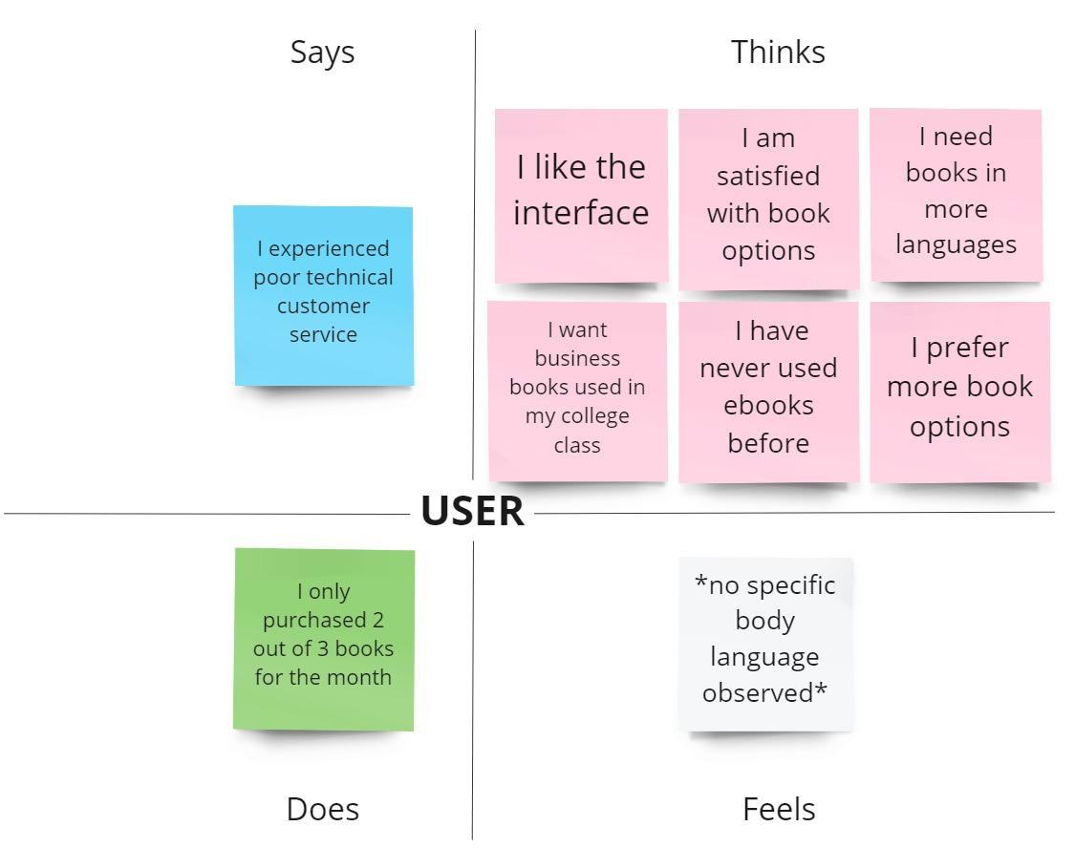
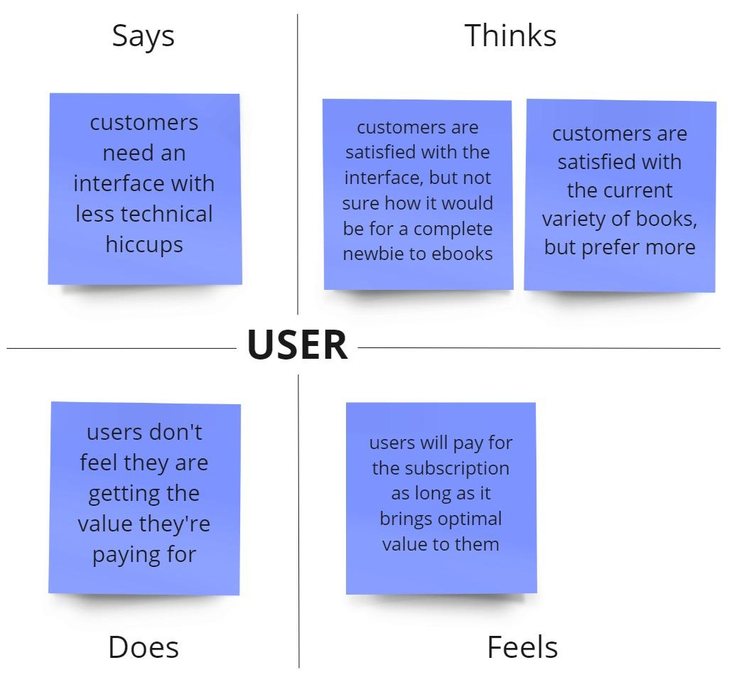
Design Thinking - Empathize cont.
Empathy Map
Insights

Slide 5
Design Thinking - Define
Customer Problem Statement
“I am a reader trying to access an array of ebooks but there isn’t enough variety to choose from and I can’t access any book I want unless I have a Kindle which makes me feel frustrated.”

Slide 6
Design Thinking - Ideate
Expand the ebook categories?
Open access to more devices?
Empower the reader to buy more books per month?
Empower the reader to refer the service to their friends?
Empower the reader to spend more time on our platform?
Empower loyal readers who continue to purchase TBOS subscriptions?
Connect readers with each other to enhance user experience?
How Might We…

Slide 7
Design Thinking - Ideate
Solutions:
Provide x # of top seller books of all genres
Provide best sellers in the 20 most common languages
Open access to Apple Books, Google ebookstore, Barnes and Noble Online
Provide referral coupon or discount to monthly membership (ex. You get x free books for x # of friends you refer who actually sign up)
If you buy x # of books in a month then you can have a “golden subscription” which takes an additional % off your annual membership
Provide self publishing service for current genre list (persuasion, entrepreneurship, innovation and design, etc…)
Provide audio books
Loyalty program for returning customers
Create ebook community forum for each genre
Add reader reviews to each ebook

Slide 8
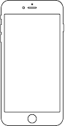





Design Thinking - Prototype
Access
Variety
Customer Experience
Your favorite reads now available on
Explore Genres…
See what others are saying about this read..
Romance
This book was relatable because the main character had a family just like me….
Non-Fiction
Fiction
Fantasy
Sci-fi
Explore communities
See more…

Slide 9
Design Thinking - Testing
Introduce prototype of TBOS app with additional features covering accessibility, variety of ebooks, and enhanced customer experience to a focus group of x # of users.
Instruct them to ponder the following while testing:
What they like about it, what they wish it had, what they wonder about it
Collect feedback and work with design and engineering teams to iterate prototypes based on comments.
Test iteration with new focus group of x # of users.
Strategy for testing prototype

Slide 10
Design Thinking - Reflecting on the process
Empathize
Used customer interviews to organize feedback into empathy map, and collected overall insights to get into the mind of what a customer might think, feel, say and do about the product
Define
Identified commonalities in customer feedback and defined overarching value proposition that would not only meet baseline customer needs, but enhance their overall experience
Ideate
Began with questions (how might we…) to brainstorm and braindump possible solutions to the overarching problem of ebook variety and access
Prototype
Added solutions from ideation into interactive models for a customer to try out
Testing Strategy
Test prototype with new users and iterate based on feedback. Repeat process until have achieved desired, optimized interface

Slide 11
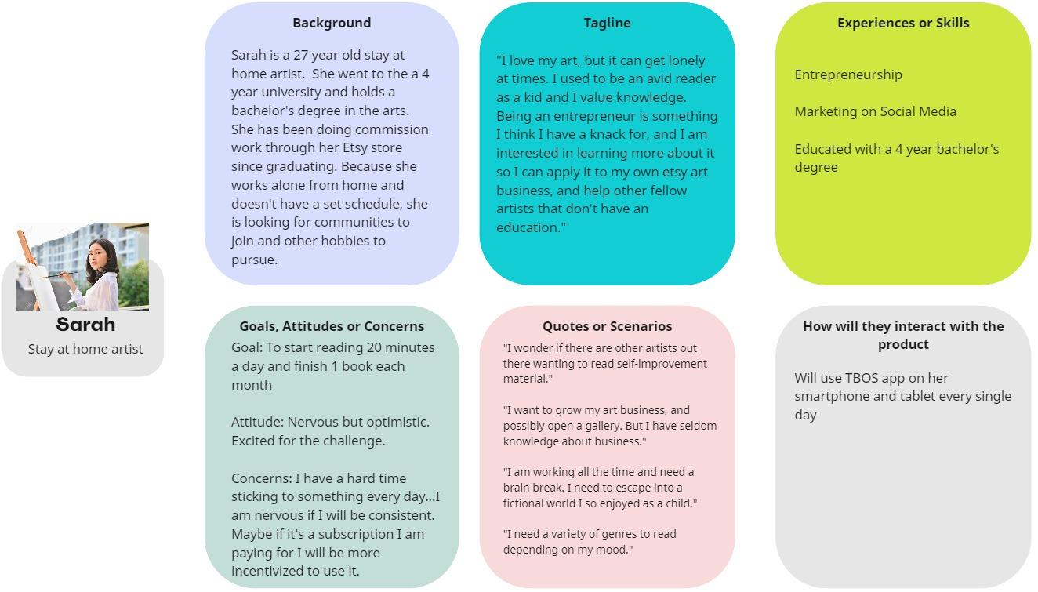
User Persona #1

Slide 12
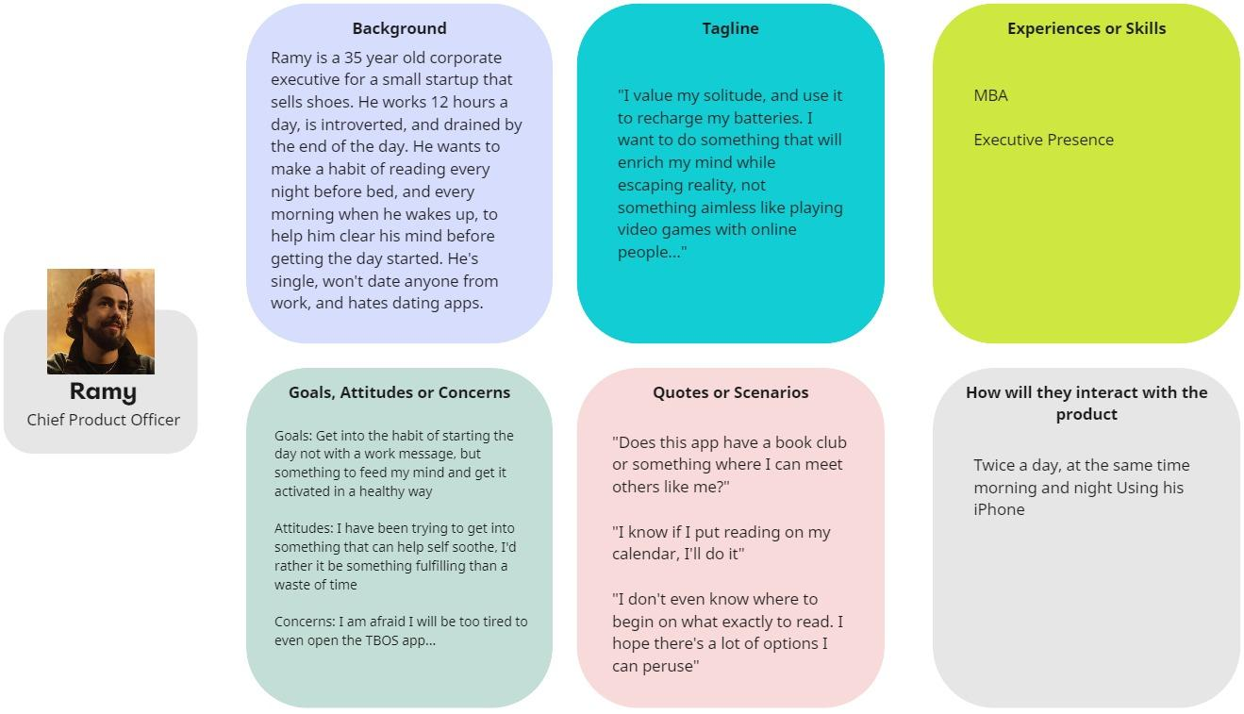
User Persona #2

Slide 13
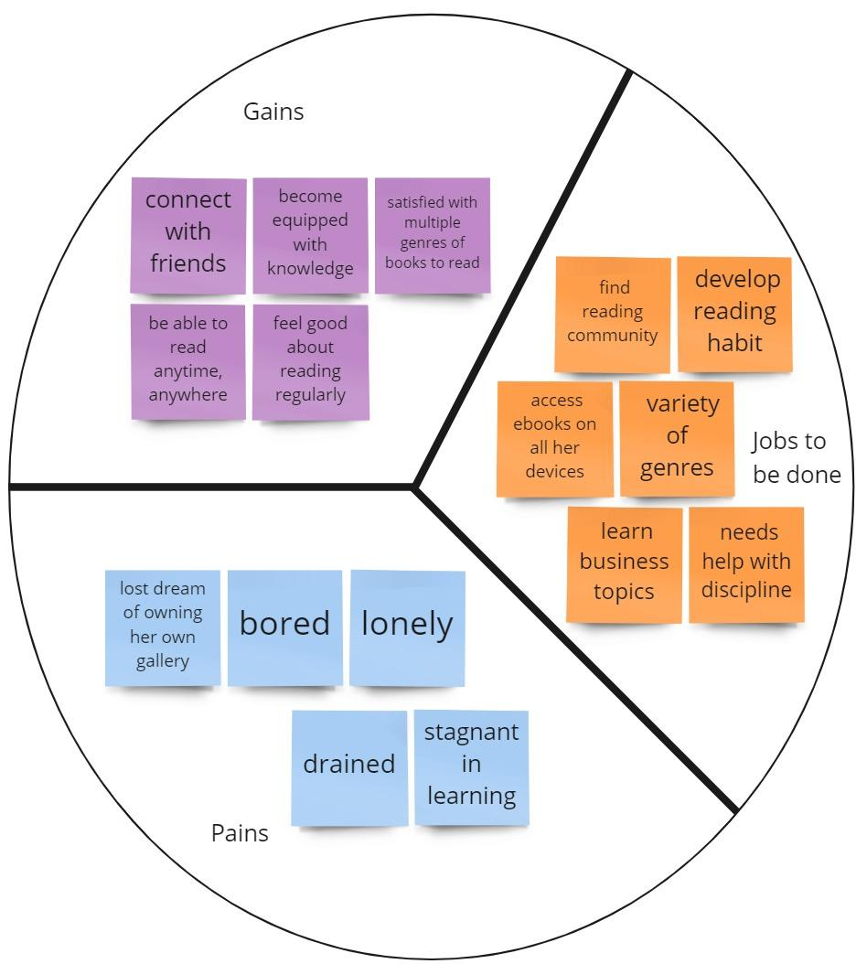
Value Proposition Canvas
Customer Canvas

Slide 14
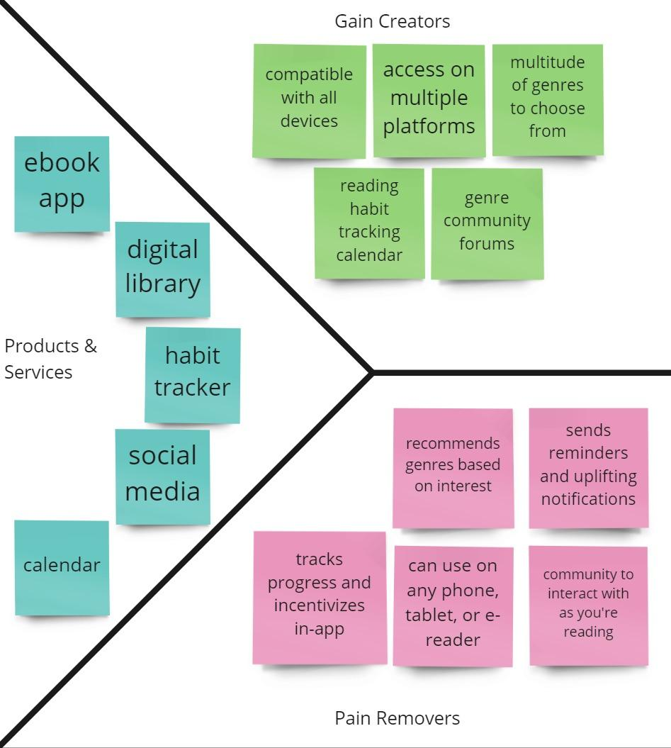
Value Proposition Canvas
Product Canvas

Slide 15
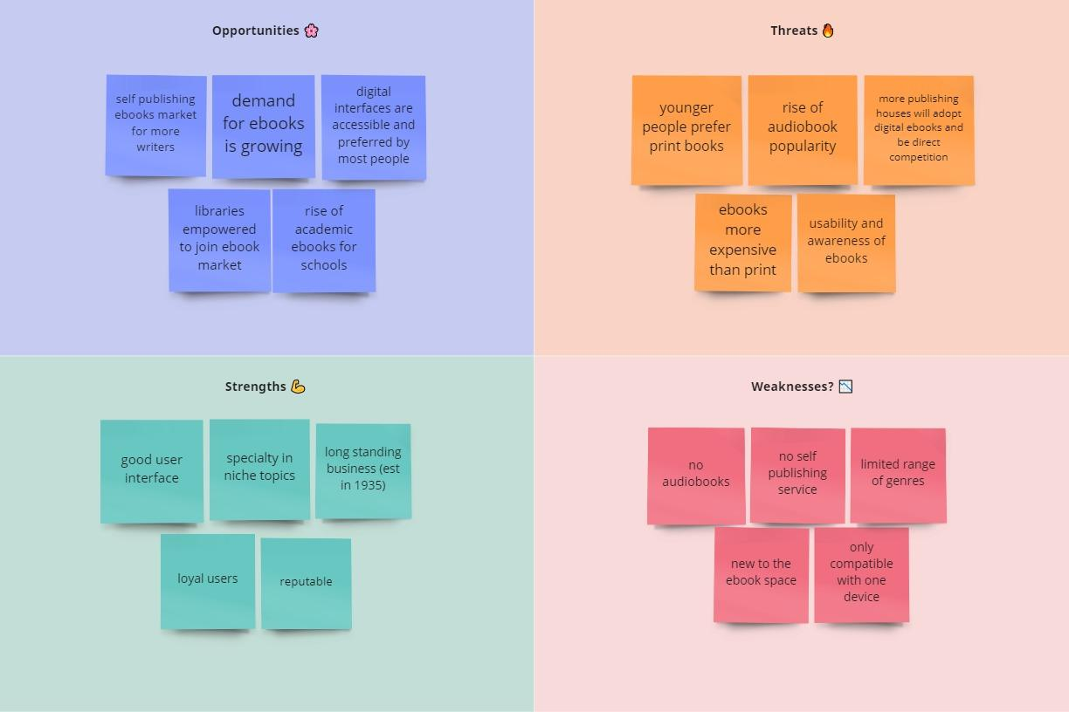
SWOT Analysis

Slide 16
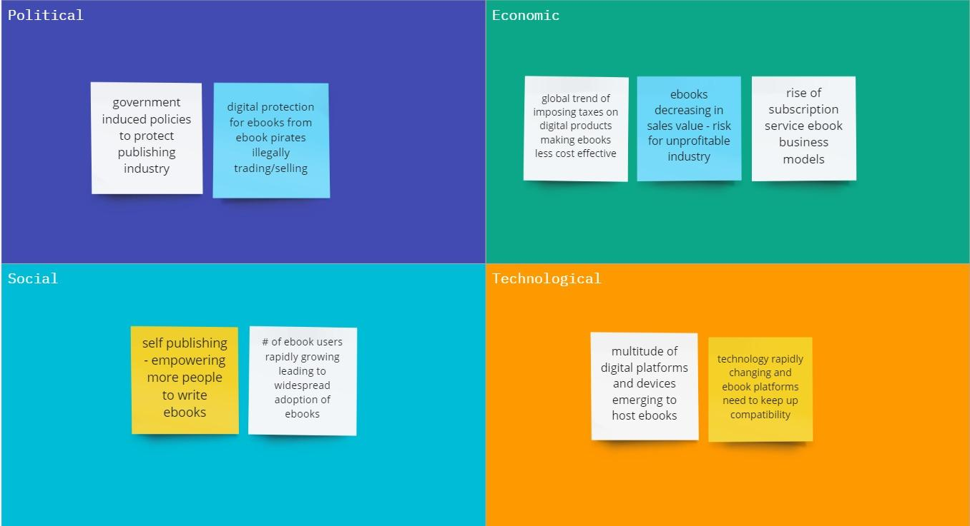
PEST Analysis

Slide 17
Summary - Key Findings
Ebooks aren’t going anywhere anytime soon. As more people adopt this technology, ebooks and audiobooks will become even more a part of everyday life
Limitations will appear in the form of competitors; each competing with leading ebook platforms such as Amazon and Apple
Two Birds One Stone will need to keep up with the major players, stick to a niche, and build a community of loyal readers similar to their legacy print readers
Empowering people to reach their goals is key, no matter what industry or platform
Customer experience and referrals allow the product to market itself

Slide 18
Summary - Next Steps and Recommendations
Improve ebook accessibility across most devices and leading platforms to increase overall users
Launch audiobooks to keep up with market demand
Launch community forums per genre to connect readers with one another fostering relationships
Launch reading habit tracker with goals, incentives, and rewards to build relationship between business and customer
Expand ebook library to more genres and multiple languages to increase target audience ebook downloads
Experiment with a self publishing ebook service to empower those who want to share their stories

