Slide 1
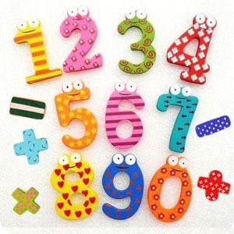

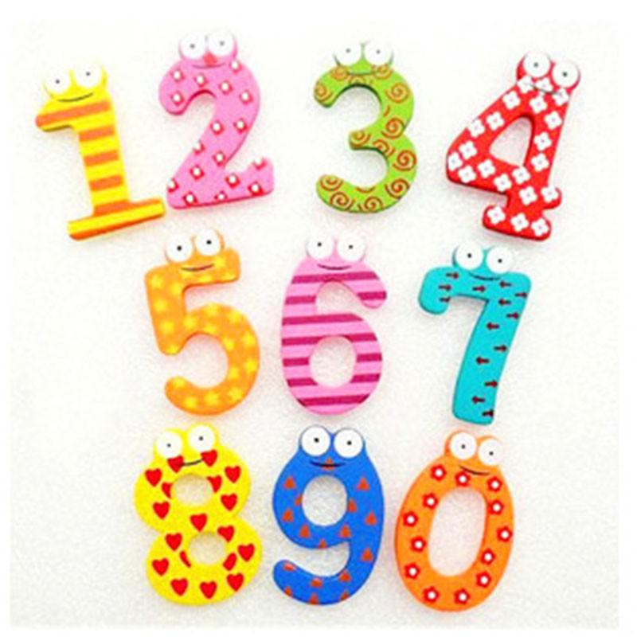
Posting_id: train_86570404
Posting_id: train_786914553
Posting_id: train_2837452969
Posting_id: train_77364776
Recall = 100%
Precision = 66.7%
F1 = 0.8

Slide 2





Posting_id: train_3906985249
Posting_id: train_174234095
Posting_id: train_871824210
Posting_id: train_3017064859
Posting_id: train_836450777
Recall = 100%
Precision = 75%
F1 = 0.86

