Slide 1

University Admission System
Group Number 4
Mentor: N. Kathiresan
Capgemini Public
Notes:
Add instructor notes here.

Slide 2
Team Members
Ashwini Shinde (Single Point Of Contact)
Zarana Matani (Configuration Manager)
Ashu Gupta
Redin krishna Podishetti
Sharvari More
Srishty Saxena
Vipul Samala
Capgemini Public

Slide 3
Objectives
Project Understanding
Project Execution
Modules
Demo and Code Walkthrough
Q&A
Capgemini Public
Notes:
Add instructor notes here.

Slide 4
Project Understanding
This project is aimed at developing an online University Admission System (UAS) for applicants. This is a web based application that can be accessed throughout the web.
There are 3 categories of people who would access the system viz. applicants, members of admission committee (mac) and administrators.
Applicants can apply for a program by filling up the online form without any login process.
Members of admission committee(MAC) alone will be able to view applicant details and filter the applicants for a specific program they have applied for.
The administrator has the right to keep track of the university’s program details.
Capgemini Public
Notes:
Add instructor notes here.

Slide 5
Approaches Used
Front End & Web Components:-
  HTML/JavaScript
  Servlets
  JSP
Business Logic Components and Services :-
  Java Beans
Application Servers:-
  WildFly
Databases:-
  Oracle 9i
Capgemini Public

Slide 6
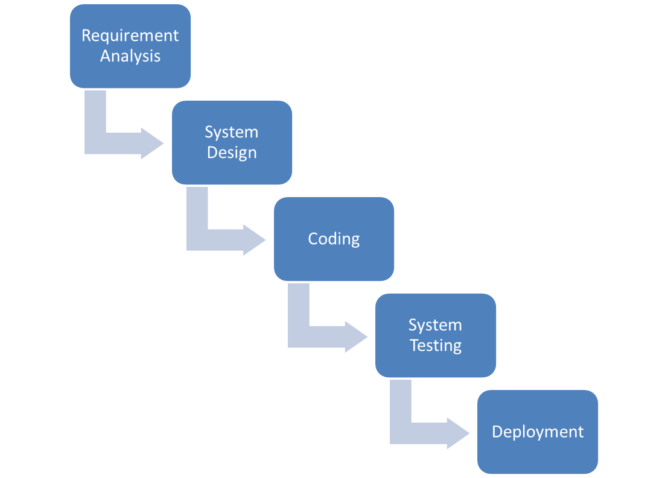
SDLC Model: Waterfall Model
Capgemini Public

Slide 7
Applicant Module
View all programs offered
Apply Online for a program
Applicant
View the application status
Capgemini Public
Notes:
Add instructor notes here.

Slide 8
MAC Module
Accept/Reject an applicant
Login
View Applicants
MAC
update the status of the applicants
Capgemini Public
Notes:
Add instructor notes here.

Slide 9
Admin Module
Update/manage Programs offered
Login
Update/manage Program schedules
Admin
Generate various reports
Capgemini Public
Notes:
Add instructor notes here.

Slide 10
Modules
Login
Apply by filling admission form
Generate Application ID
Accept/Reject Applicants
Assign Interview Dates
Update Applicant Status
Update/Manage programs offered
Update/Manage program schedules
Generate various reports
Capgemini Public
Notes:
Add the notes here.
Add instructor notes here.

Slide 11
Modules
LOGIN Module:
Login module is common for MAC and admin.
Applicant can fill form without any login process.
Basic functionality of the login module are as follows:
Taking login credentials from the user.
If given credentials are wrong, show appropriate message.
If login succeeds, user will be navigated to his/her respective page as per his/her role.
Capgemini Public

Slide 12
Modules
Apply by filling admission form:
This module is for the applicant to apply for various programs.
Basic functionality of this module are as follows:
Applicant can fill the admission form in order to apply for specific programs from universities.
He/She can choose the university and courses provided by that university then they can fill the form.
Capgemini Public

Slide 13
Modules
Generate Application ID:
An application ID will be displayed after filling the admission form.
Basic functionality of this module are as follows:
After filling the form, the applicant can get their application unique id.
The application ID will be auto generated by using sequence in database.
Capgemini Public

Slide 14
Modules
Accept/Reject Applicants:
This module is for the MAC to accept the applicants on the basis of the eligibility criteria.
Basic functionality of this module are as follows:
• Accept an Applicant.
• Reject an Applicant.
Capgemini Public

Slide 15
Modules
Assign Interview Dates:
This is to assign date to the applicant after confirming his/her form.
Basic functionality of this module are as follows:
• Once the form is confirmed, MAC will assign the interview dates to the applicant.
Capgemini Public

Slide 16
Modules
Update Applicant Status:
This module is for MAC, decide the status of applicant.
Basic functionality of this module are as follows:
Confirm an Applicant
Reject an Applicant
Capgemini Public

Slide 17
Modules
Update/Manage programs offered :
This module is for Admin only, to update or manage the offered programs.
Basic functionality of this module are as follows:
The programs offered by the university is managed and if the university wants to update any program, it can be done by the Admin.
Capgemini Public

Slide 18
Modules
Update/Manage program schedules:
This module is for Admin only.
Basic functionality of this module are as follows:
Admin can update and manage the program scheduled by the university.
Capgemini Public

Slide 19
Modules
Generate various reports:
This module is for Admin. It generates the various reports.
Basic functionality of this module are as follows:
It will give the list of applicants confirmed/rejected for scheduled program.
It will show the list of programs scheduled to be commenced in a given time period.
Capgemini Public

Slide 20
Q & A
Capgemini Public
Notes:
Add the notes here.
Add instructor notes here.

Slide 21
THANK YOU
Capgemini Public
Notes:
Add the notes here.
Add instructor notes here.

