Slide 1
Prediction of Residual Tumour in Breast-Conserving Therapy

Slide 2
Variables
Data Size: 500 rows x 9 columns
Outcome: Re-excision (0 or 1)
Predictors:
Age
tomour Size
Histology (0: none, 1: Invasive-duct/ductal-lob.)
Multifocality (0: no, 1: yes)
Accomp. In situ (0: no, 1:DCIS and LCIS)
Lymphovascular Invasion (0: no, 1: yes)
Estrogen-receptor (0:no, 1: yes)
Progesterone-receptor (0: no, 1: yes)
Aim: Understanding probability of re-excision after the initial surgery

Slide 3
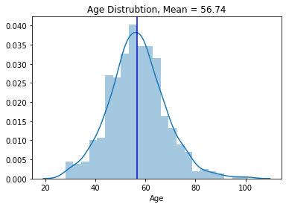
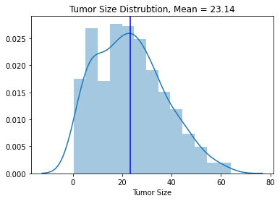
Exploratory Data Analysis

Slide 4
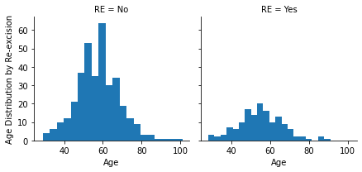
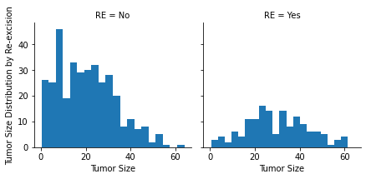
Exploratory Data Analysis

Slide 5
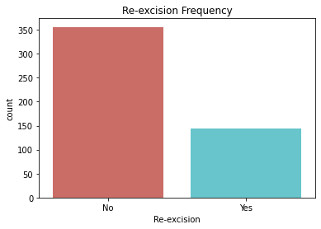
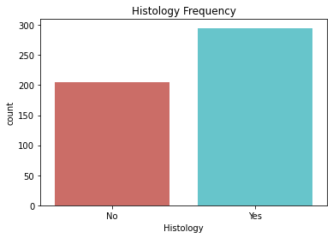
Frequency charts
295
356
205
144

Slide 6
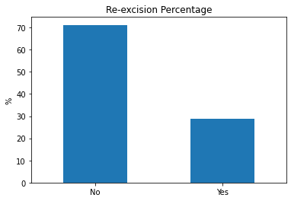
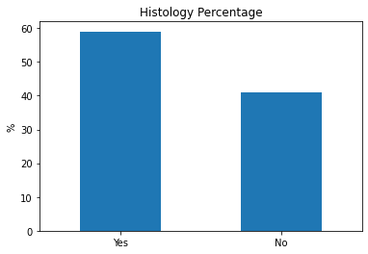
Percentages

Slide 7
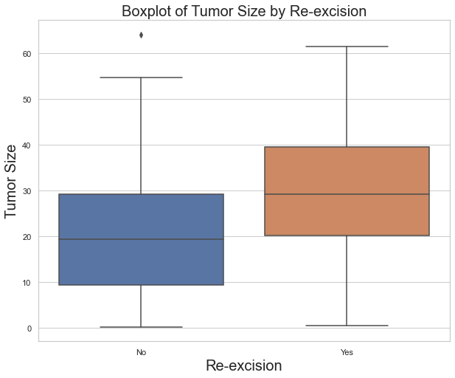
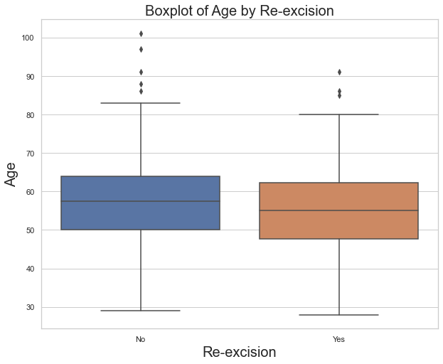
Box-plot
The box plot shows how a feature's values spread out for each class. It's a compact representation of the distribution, showing the extreme high value, upper quartile, median, lower quartile and extreme low value.

Slide 8
Correlation Plot

Slide 9
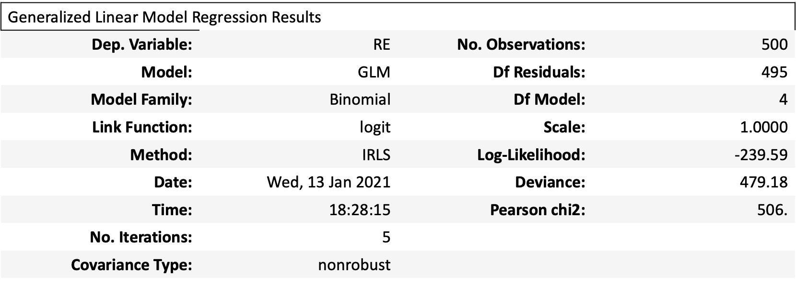
Statistical Modeling
model = sm.GLM.from_formula("RE ~ hist + age + tumorsize + accinsitu + lymphinv -1 ", family = sm.families.Binomial(), data=data)

Slide 10
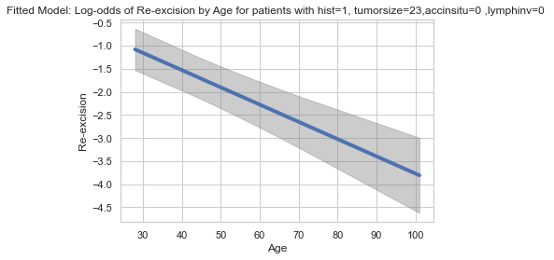
Log-odds plot by Age

Slide 11
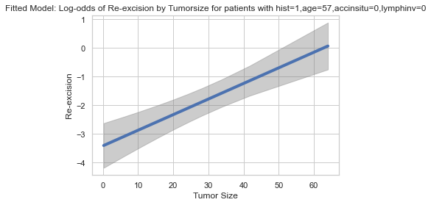
Log-odds plot by Tumour Size

Slide 12
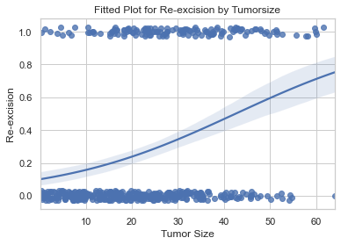
Fitted plot of Re-excision by Tumour Size
- The lower tumor sizes are associated with value 0 for Re-excision
- Tumor sizes of over 55 are associated with value of 1 for Re-exicision.
- The confidence interval gets wider as the value of the predictor increases. The wide interval is partly due to the small amount of data for larger tumor size.

Slide 13
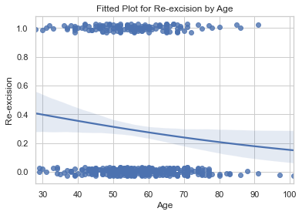
Fitted plot of Re-excision by Age

