Slide 1
HW18
File created on: 3/20/2023 5:40:49 AM

Slide 2
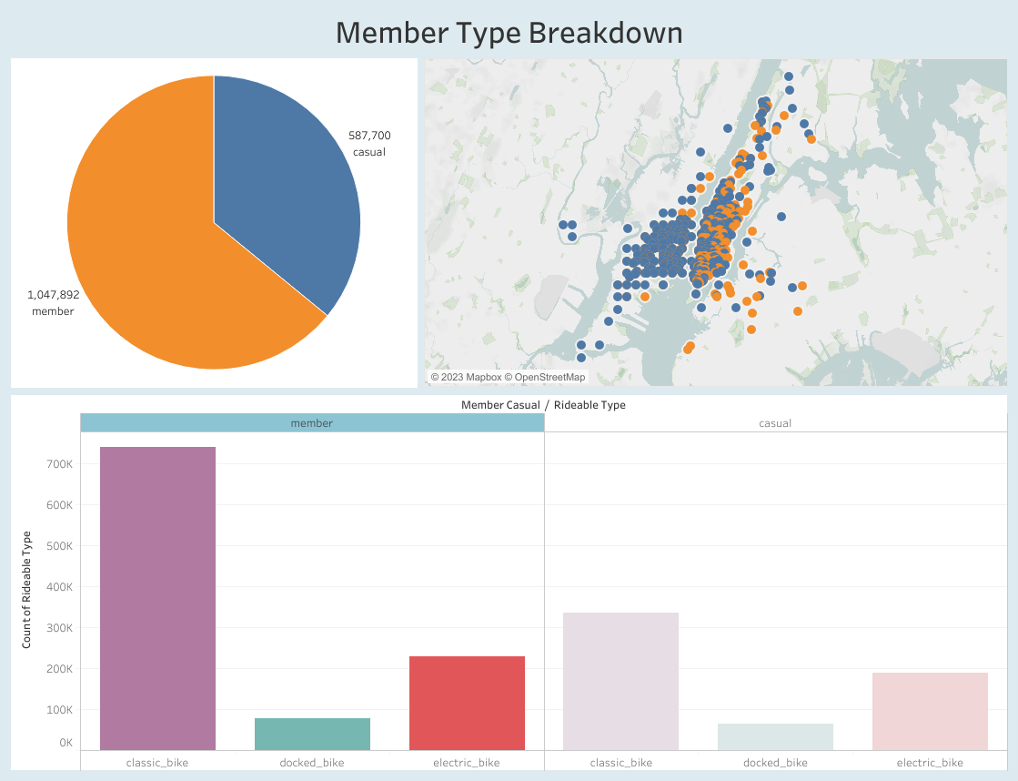

Slide 3
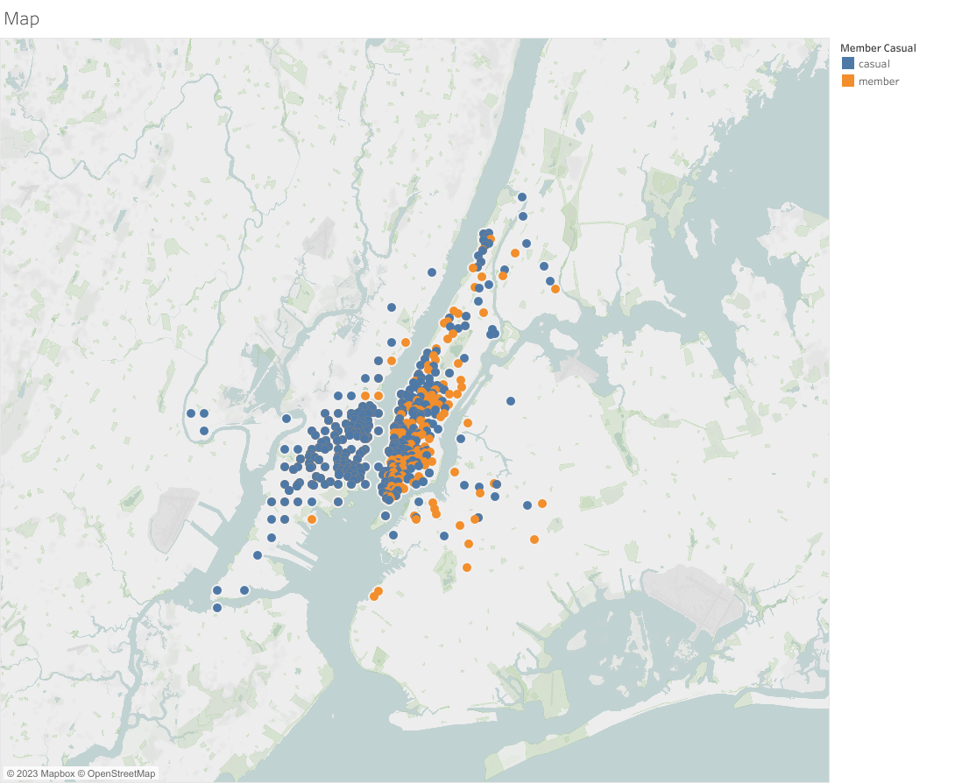

Slide 4
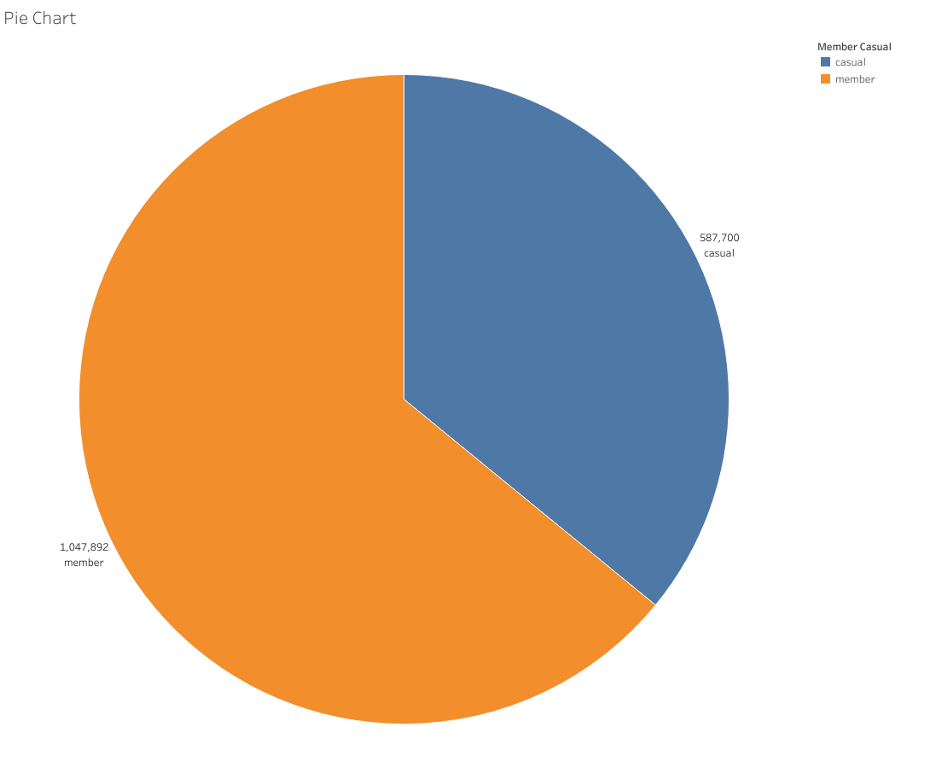

Slide 5
