Slide 1
Rising Rates and housing Impact
Justin Bernier, Ankita Sarkar, Kimberly Sernett

Slide 2
Introduction

Slide 3
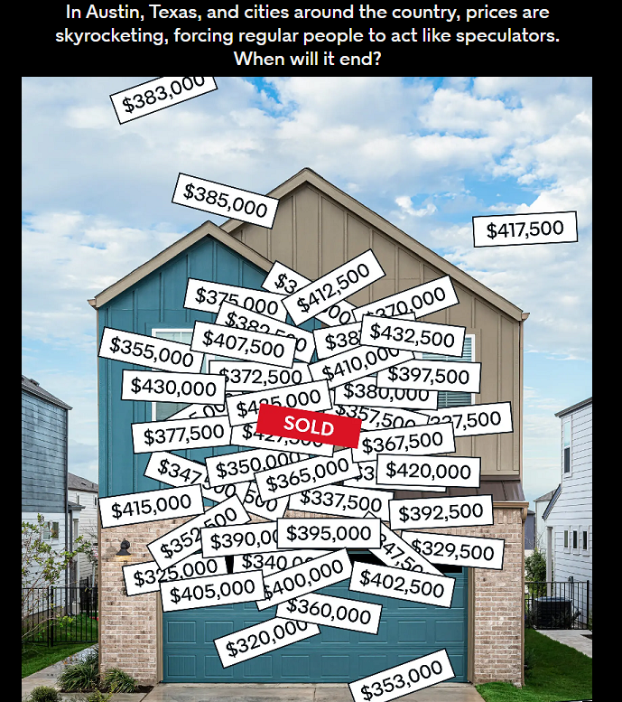
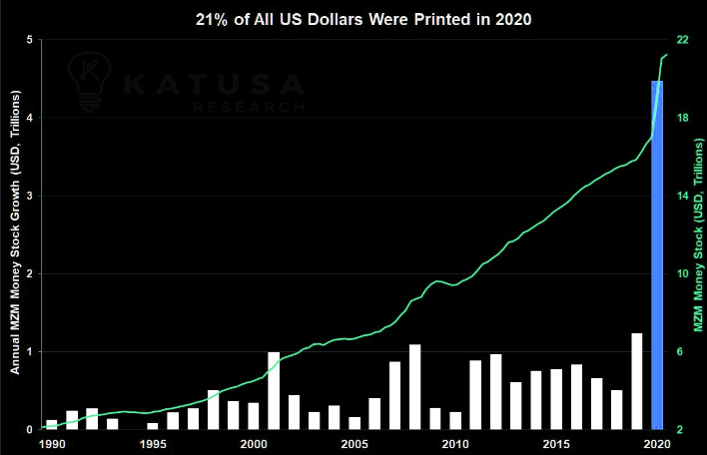
Austin, TX
Known as a hot real estate market
Fed set lending rates to near 0% in 2020
~4 trillion US Dollars printed in reaction to Covid

Slide 4
Hypothesis
Fed rate increases in 2022 are cooling down the Austin real estate market.
Trend saw rising housing prices in local markets during 2020 and 2021 with down trends occurring in 2022
Impacts we focused on included housing sale prices, inventory, and whether homes are being sold above or below listing price.

Slide 5
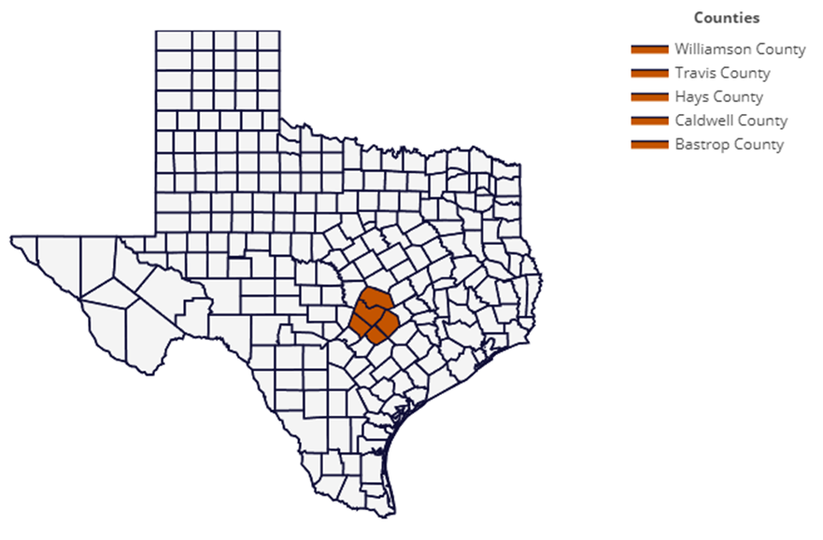
Geographic focus

Slide 6
Real estate metrics

Slide 7
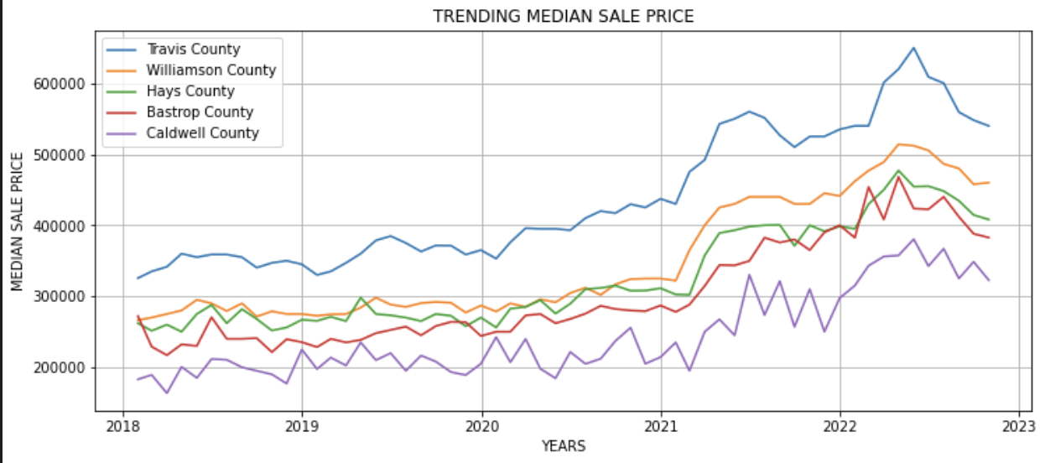
Trending median sale price

Slide 8
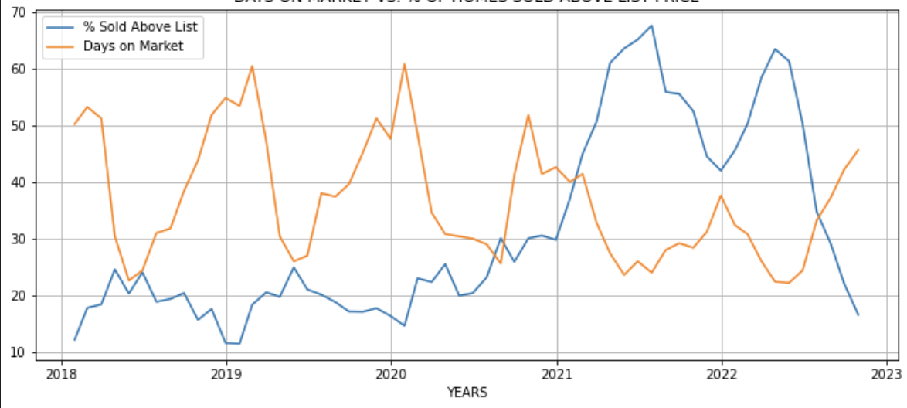
Days on market vs. % of homes sold above list price

Slide 9
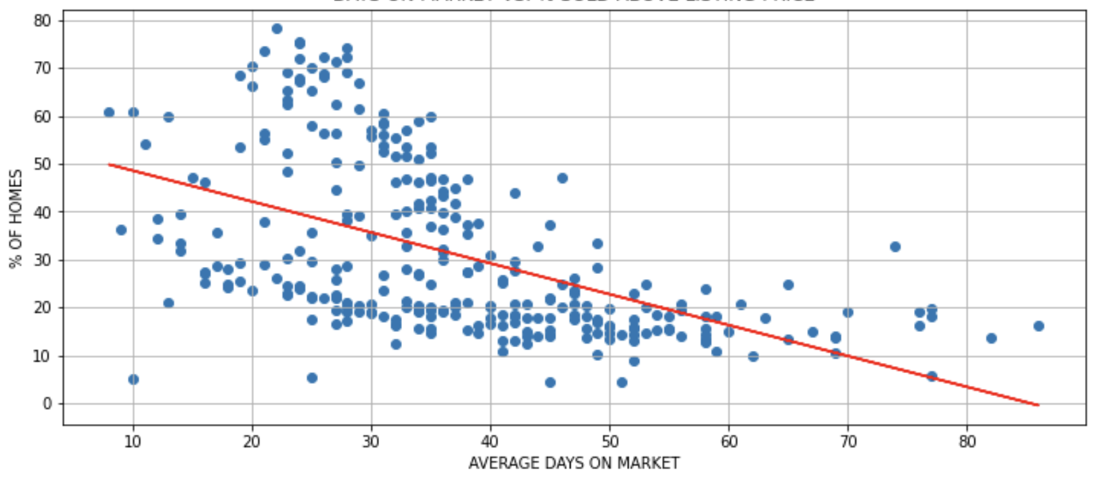
Days on market vs. % sold above listing price
R-value -0.52

Slide 10
Fed & Mortgage Rates

Slide 11
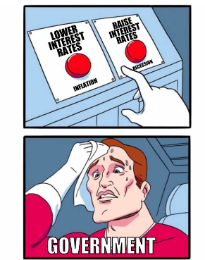
What is FED rate?
Fiscal policy tool to regulate money flow.
The rate at which financial institutions borrow from the federal reserve.
Affects mortgage rates
Pic Source

Slide 12
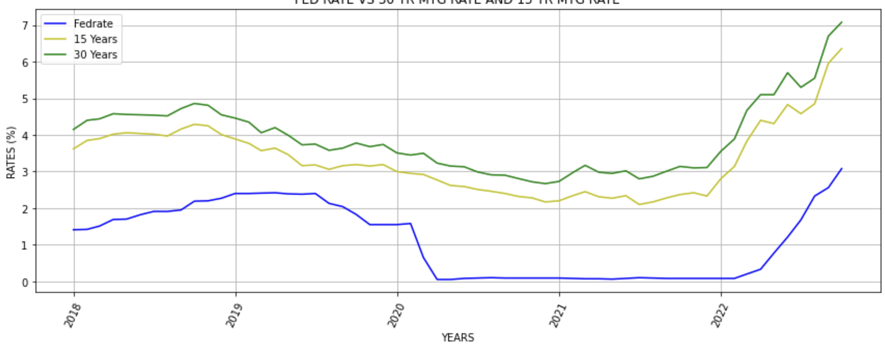
Fed rate vs. 30-year mtg rate and 15-year mtg rate

Slide 13
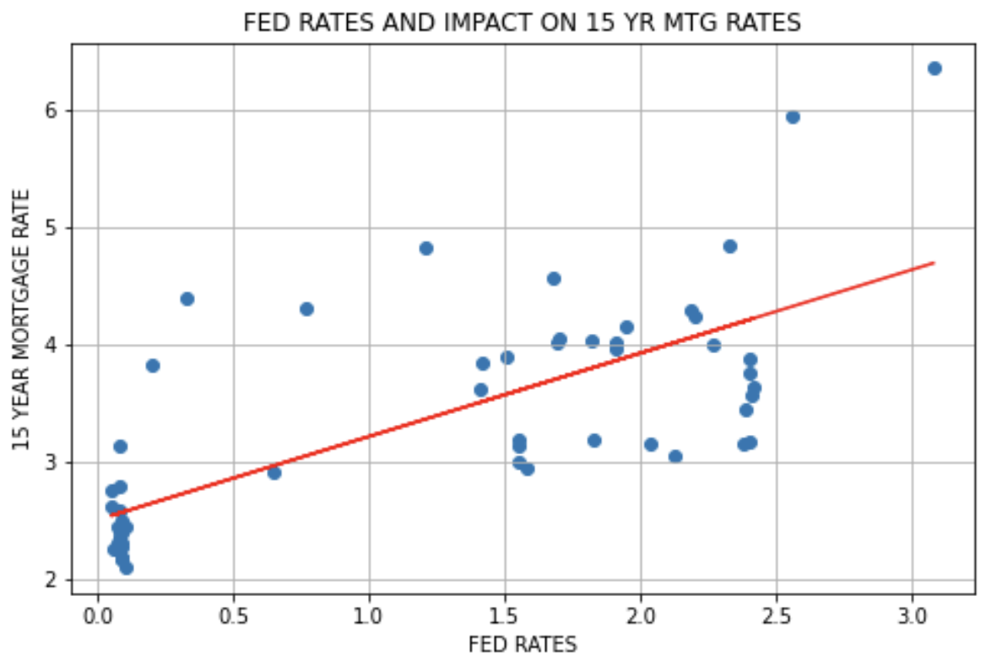
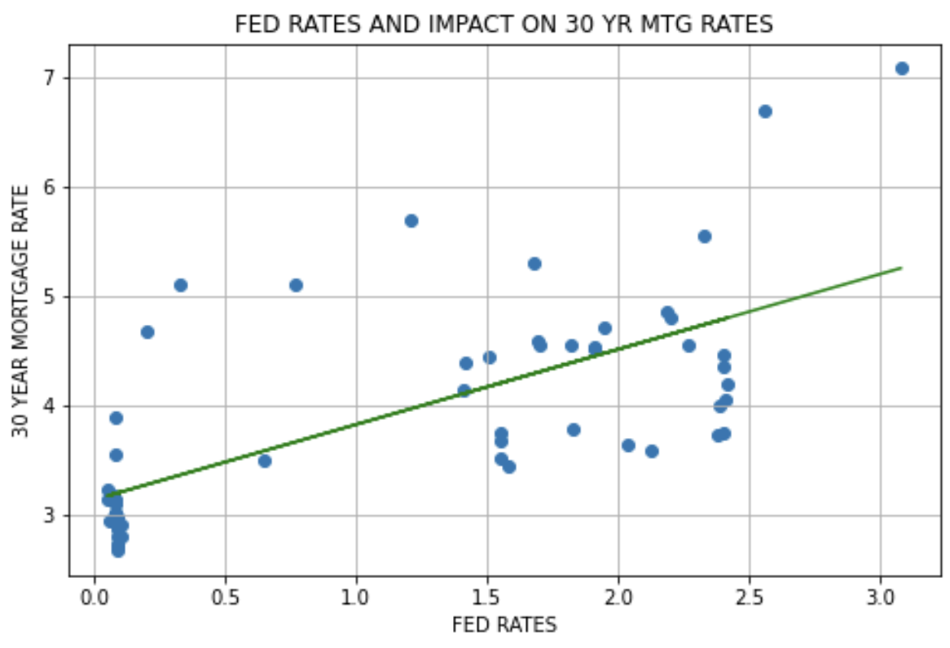
R-value 0.73
R-value 0.69

Slide 14
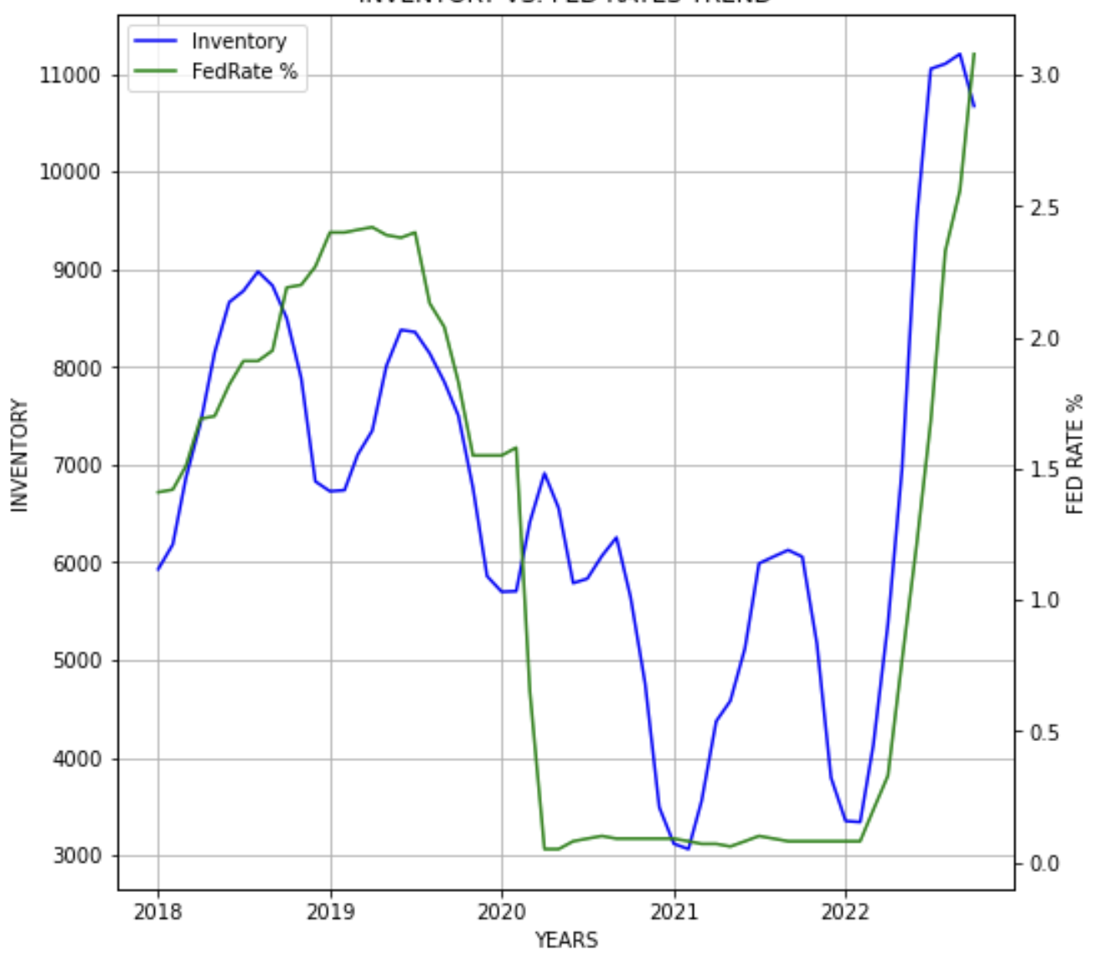
Inventory vs. fed rates trend

Slide 15
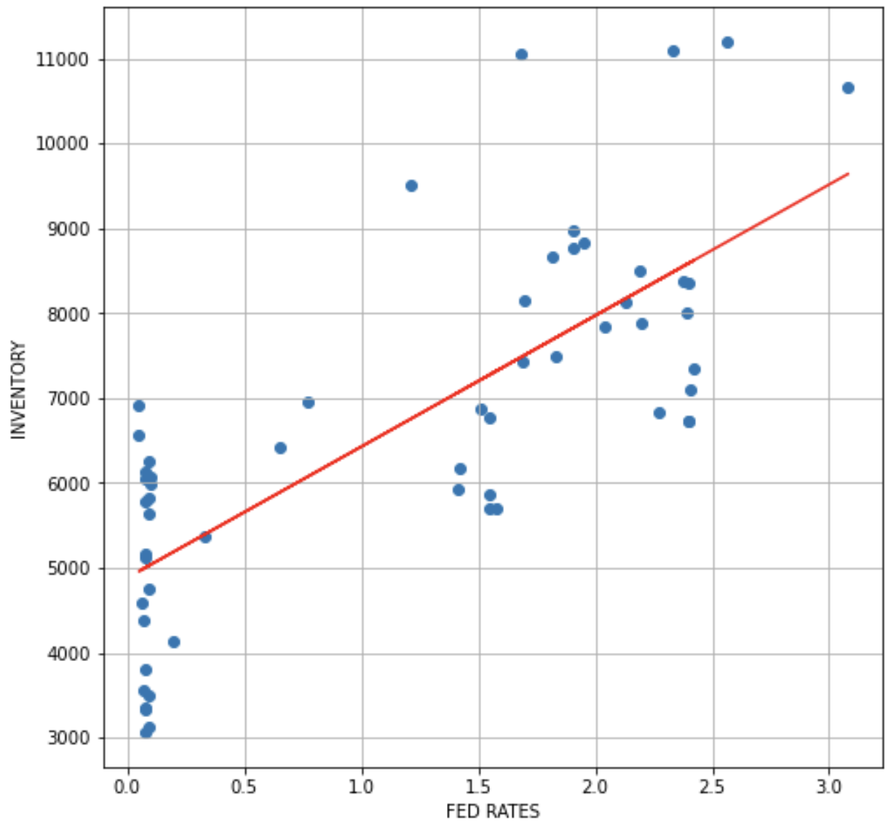
Inventory vs. fed rates correlation
R-value 0.76

Slide 16
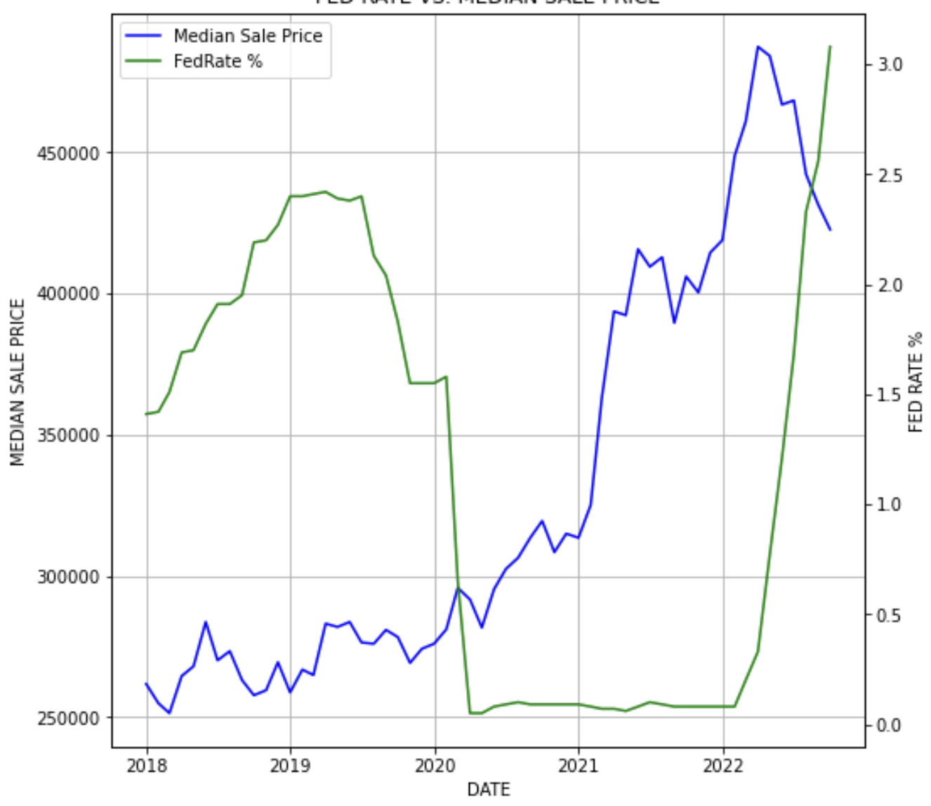
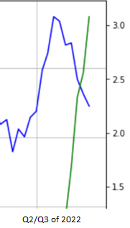
Fed rate vs. median sale price
Zoom

Slide 17
Conclusion
Raising Fed Rates are causing Mortgage Rates to go up significantly
We are seeing trends in Median Price, Inventory, Price Cuts, Days on Market with sufficient statistical correlation to support our hypothesis
Fed rate increases are cooling down the Austin housing market.

Slide 18
Thank you!

