Slide 1
Rising Rates and housing Impact
6-8 visualizations of data
Slides are visually clean and professional
Slides are relevant to material
Slides effectively demonstrate the project
Slides are clear and maintain audience interest
About 7 minutes for presentation
Justin Bernier, Ankita Sarkar, Kim Sernett

Slide 2
Introduction
Objective:
See if the changes in the federal funds rates and mortgage rates are having an impact on the real estate markets in the Austin area.
Impacts we focused on included housing sale prices, inventory, and whether homes are being sold above or below listing price.

Slide 3
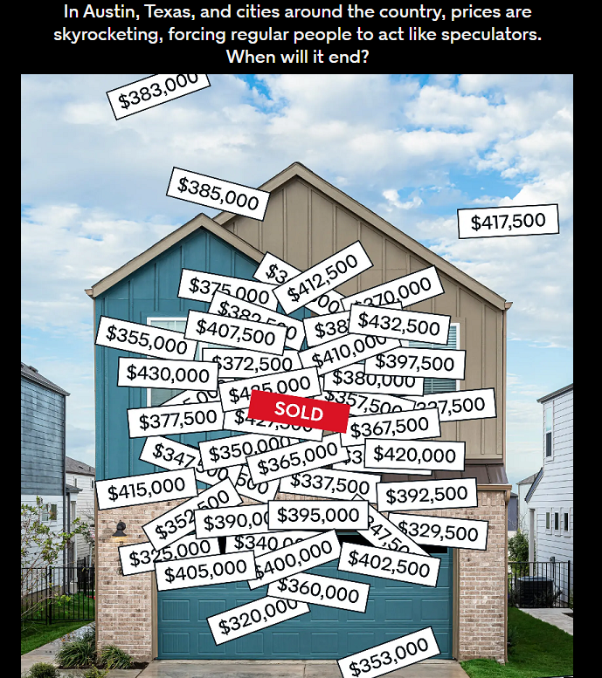
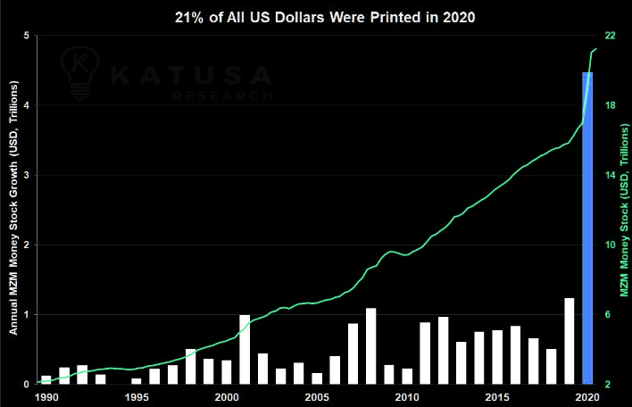
Austin, TX
Known as a hot real estate market
Fed set lending rates to near 0% in 2020
~4 trillion US Dollars printed in reaction to Covid

Slide 4
Hypothesis
Fed rate increases are impacting the Austin real estate market by slowing it down.

Slide 5
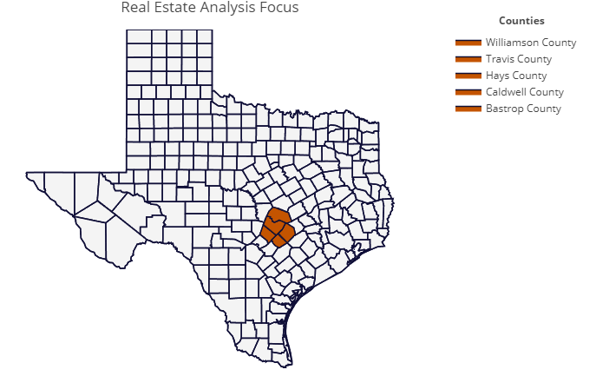
Geographic focus

Slide 6
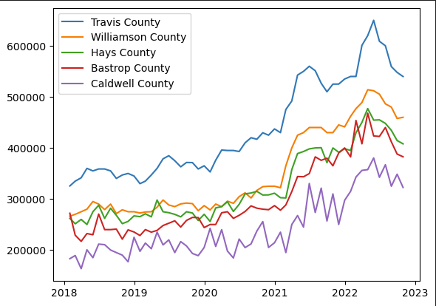
Add lables. Median sales

Slide 7
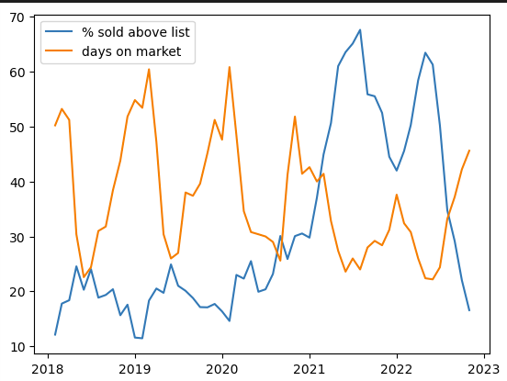
Add lables. Median sales

Slide 8
Graph 2
​ | CATEGORY 1 | CATEGORY 2 | CATEGORY 3​ | CATEGORY 4​
Q1 | 4.5​ | 2.3​ | 1.7​ | 5​.0
Q2 | 3.2​ | 5.1​ | 4.4​ | 3​.0
Q3 | 2.1​ | 1.7​ | 2.5​ | 2.8​
Q4 | 4.5​ | 2.2​ | 1.7​ | 7.0

Slide 9
Graph 3
​ | CATEGORY 1 | CATEGORY 2 | CATEGORY 3​ | CATEGORY 4​
Q1 | 4.5​ | 2.3​ | 1.7​ | 5​.0
Q2 | 3.2​ | 5.1​ | 4.4​ | 3​.0
Q3 | 2.1​ | 1.7​ | 2.5​ | 2.8​
Q4 | 4.5​ | 2.2​ | 1.7​ | 7.0

Slide 10
Graph 4
​ | CATEGORY 1 | CATEGORY 2 | CATEGORY 3​ | CATEGORY 4​
Q1 | 4.5​ | 2.3​ | 1.7​ | 5​.0
Q2 | 3.2​ | 5.1​ | 4.4​ | 3​.0
Q3 | 2.1​ | 1.7​ | 2.5​ | 2.8​
Q4 | 4.5​ | 2.2​ | 1.7​ | 7.0

Slide 11
Graph 5
​ | CATEGORY 1 | CATEGORY 2 | CATEGORY 3​ | CATEGORY 4​
Q1 | 4.5​ | 2.3​ | 1.7​ | 5​.0
Q2 | 3.2​ | 5.1​ | 4.4​ | 3​.0
Q3 | 2.1​ | 1.7​ | 2.5​ | 2.8​
Q4 | 4.5​ | 2.2​ | 1.7​ | 7.0

Slide 12
Graph 6
​ | CATEGORY 1 | CATEGORY 2 | CATEGORY 3​ | CATEGORY 4​
Q1 | 4.5​ | 2.3​ | 1.7​ | 5​.0
Q2 | 3.2​ | 5.1​ | 4.4​ | 3​.0
Q3 | 2.1​ | 1.7​ | 2.5​ | 2.8​
Q4 | 4.5​ | 2.2​ | 1.7​ | 7.0

Slide 13
Graph 7
​ | CATEGORY 1 | CATEGORY 2 | CATEGORY 3​ | CATEGORY 4​
Q1 | 4.5​ | 2.3​ | 1.7​ | 5​.0
Q2 | 3.2​ | 5.1​ | 4.4​ | 3​.0
Q3 | 2.1​ | 1.7​ | 2.5​ | 2.8​
Q4 | 4.5​ | 2.2​ | 1.7​ | 7.0

Slide 14
Graph 8
​ | CATEGORY 1 | CATEGORY 2 | CATEGORY 3​ | CATEGORY 4​
Q1 | 4.5​ | 2.3​ | 1.7​ | 5​.0
Q2 | 3.2​ | 5.1​ | 4.4​ | 3​.0
Q3 | 2.1​ | 1.7​ | 2.5​ | 2.8​
Q4 | 4.5​ | 2.2​ | 1.7​ | 7.0

Slide 15
SUMMARY
Summary 1
Summary 2
Summary 3

Slide 16
Thank you!

