Slide 1
Market Data, Sentiment, and Signals
Project 4
Contributors
Justin Bernier
John Quinn
Jennifer Shulyak
Joe Moreno
Michael Raminki

Slide 2
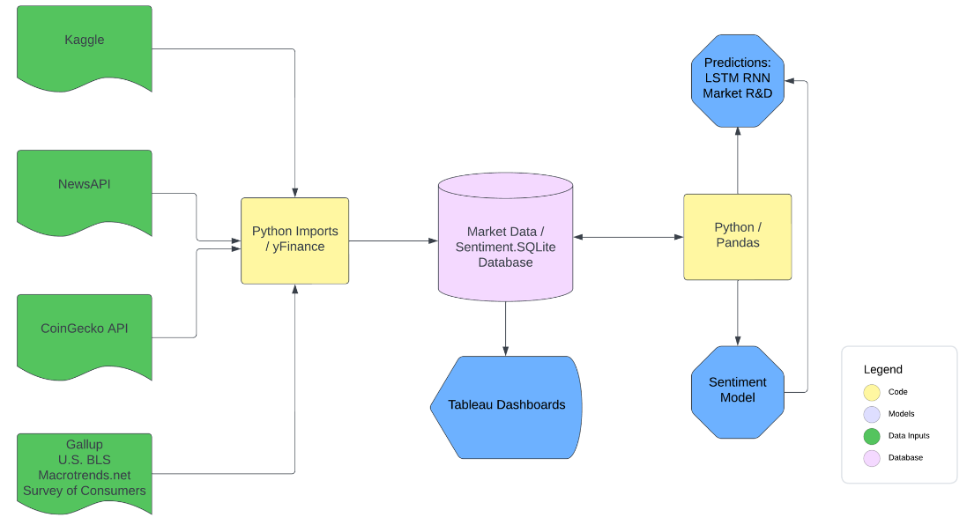
Market Data, Sentiment, and Signals Flow Chart

Slide 3
Market Data, Sentiment, and Signals Flow Chart
Tableau Demo

Slide 4
Long-Short Term Memory Recurrent Neural Network
Recurrent Neural Network
RNNs process sequences of data. Maintain a hidden state to capture information from previous time steps.
LSTM include a memory cell, an input gate, a forget gate, and an output gate. Which enable it to learn long-term dependencies in the data.
LSTM RNNs are often used for sequence tasks, where the goal is to predict a sequence of outputs based on a sequence of inputs.
Long Short-Term Memory
Sequence-to-sequence Modeling

Slide 5
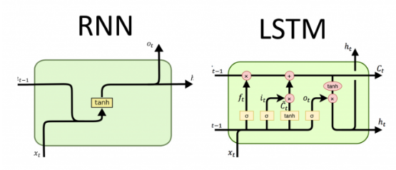
Long-Short Term Memory Recurrent Neural Network

Slide 6
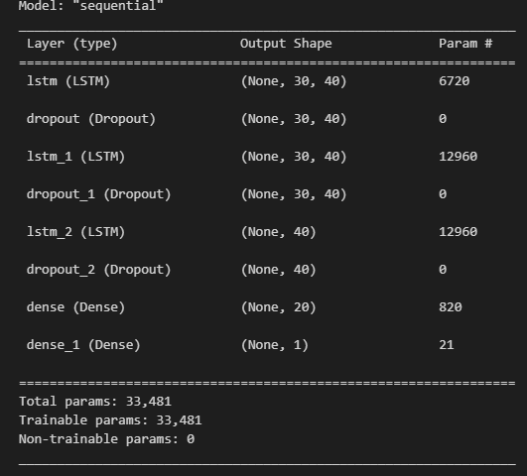
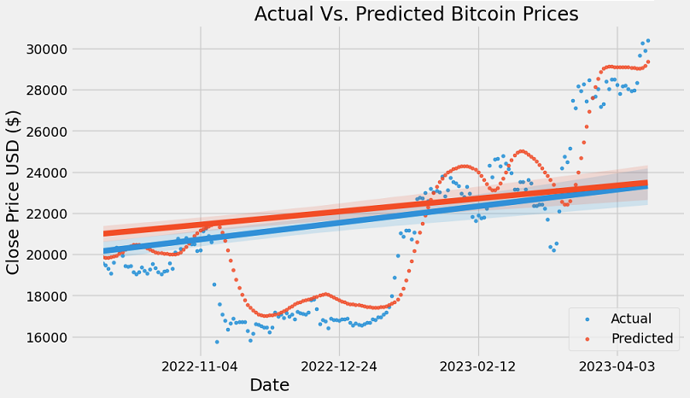
Long-Short Term Memory Recurrent Neural Network
Model Evaluation Score (MSE): 0.000733

Slide 7
Market Data, Sentiment, and Signals
Tableau Demo

Slide 8

Does media sentiment correlate with market performance?
Text Sentiment Analysis Tool
Lexical Approach
Machine Learning
Uses dictionary of sentiment
Uses pre-labeled data set
Random Forest
(Obi-wan)
VADER
Does not require training data!
BUT
accuracy is highly variable
Requires training data!
BUT
can attain higher accuracy
Notes:
Valence Aware Dictionary for sEntiment Reasoning

Slide 9

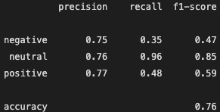
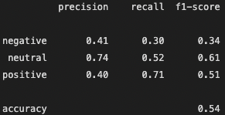


Random Forest (ensemble classifier) for NLP
Read in and explore data
Feature Creation
Clean Text
Vectorize
Random Forest Algorithm
* Balance of labels
* Initial Cleaning
* Punct %
* Len(text)
* Transform
* Remove punct
* Tokenize
* Stopwords
* Stemmer
* Count Vectorize
* TF-IDF
* Hold Out Test
* Parameters
* Grid Search
Obi-wan NLP VS. Vader
on Training Data
Obi-wan NLP VS. Vader
on BTC News
Why Bitcoin Miner Stocks Soared This Week. Bitcoin mining company stocks have soared this week, amplifying the gains of Bitcoin itself…."
Notes:
Jenn’s slide: No touchy

Slide 10
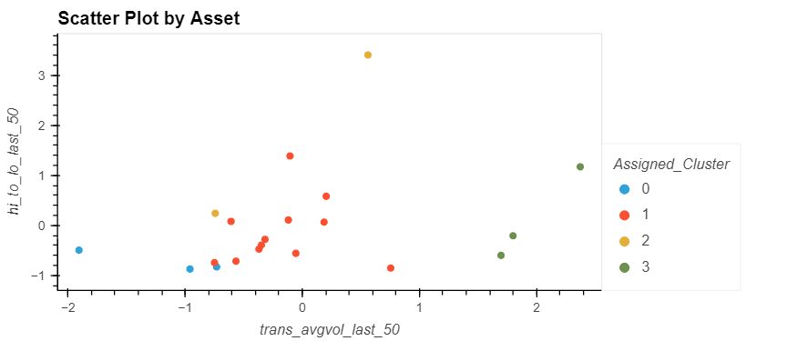
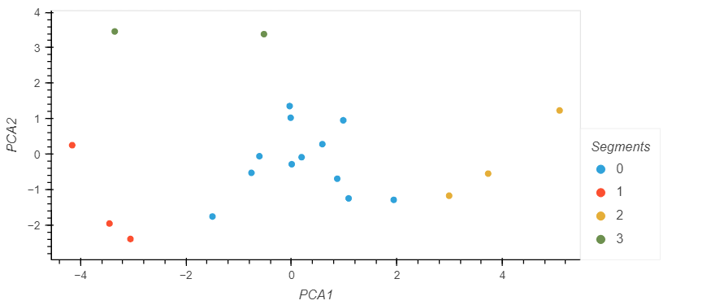
K-Means
Tesla,
Volatility
US Banks, FAANGs, etc
Bitcoin, Nasdaq,
S&P
Crude, US Dollar, Treasuries
PCA
Tesla,
Volatility
US Banks, FAANGs, etc
Crude, US Dollar, Treasuries
Bitcoin, Nasdaq,
S&P

Slide 11
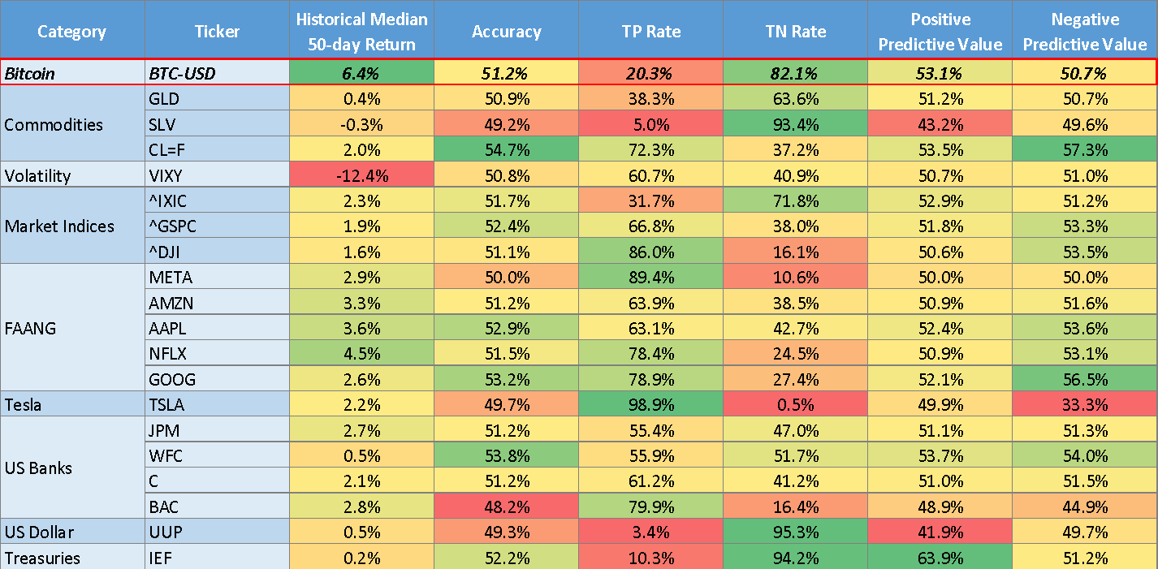

Slide 12
Created three logistic regression models to predict if Bitcoin will outperform it’s historical median 50-day return over the next 50 days:
Model 1 - Historical Trading
Used historical trading metrics (over the past 1, 5, 15, and 50 days):
Volume
Return
Price Volatility
Model 2 - Additional Features
Incorporated additional features including:
Consumer Sentiment Index (CSI)
Gallup Institutional (president, police, banks, big business) Trust Polling
Consumer Price Index (CPI)
US GDP
Crypto Tweet Sentiment Analysis
Model 3 - Lower Threshold
Lowered the decision threshold in order to increase ‘positive’ scenarios at the expense of some predictive accuracy (resulting in higher volume of ‘positive’ trades with lower accuracy)

Slide 13
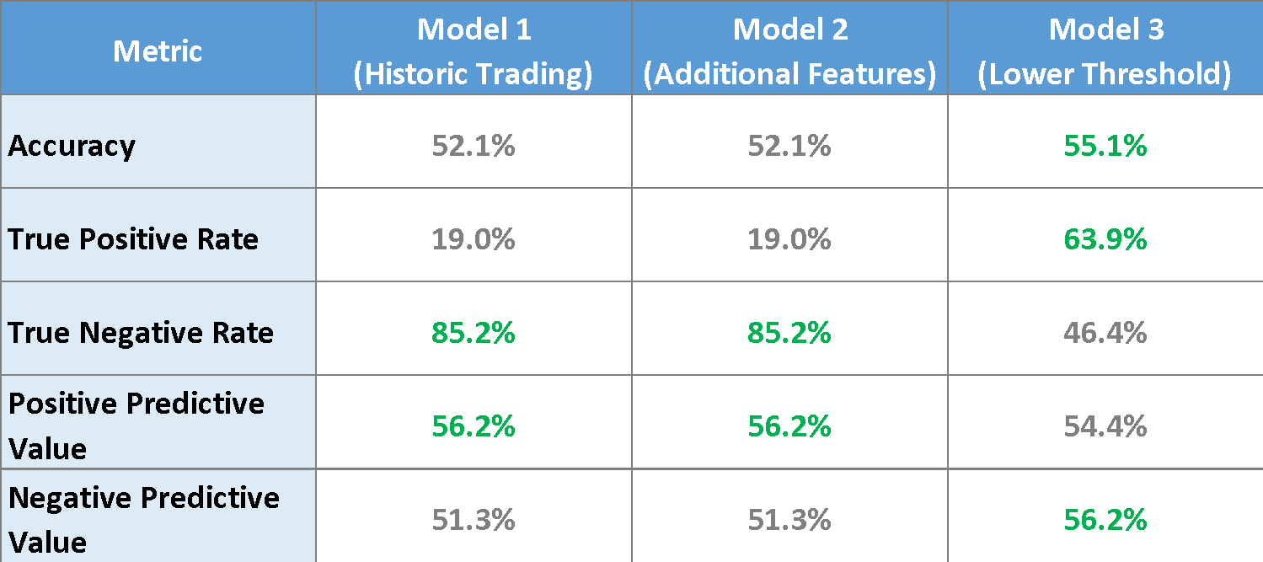
Many more ‘positives’ detected at the cost of only slightly lower ‘positive’ accuracy
Additional features in Model 2 do not provide any lift in predictive power…

Slide 14
Market Data, Sentiment, and Signals
The End!!

