Slide 1
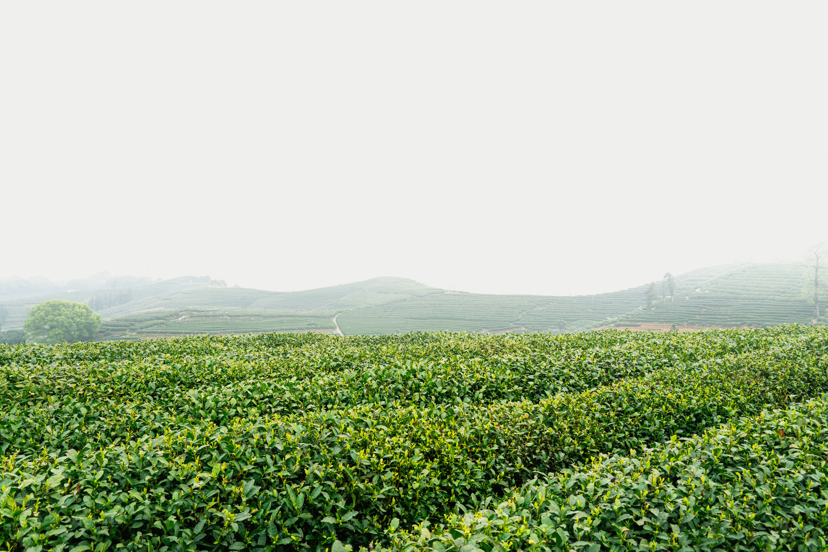


AI Based Automation for Smart Farming Management
GROUP MEMBERS :
ZAREEN BUSHRA (0112230248)
NOWSHIN NAWAR (0112230331)
REDWAN HOSSAIN ROMIT (0112230544)
SHAKIB HOSSEN (0112230173)

Slide 2
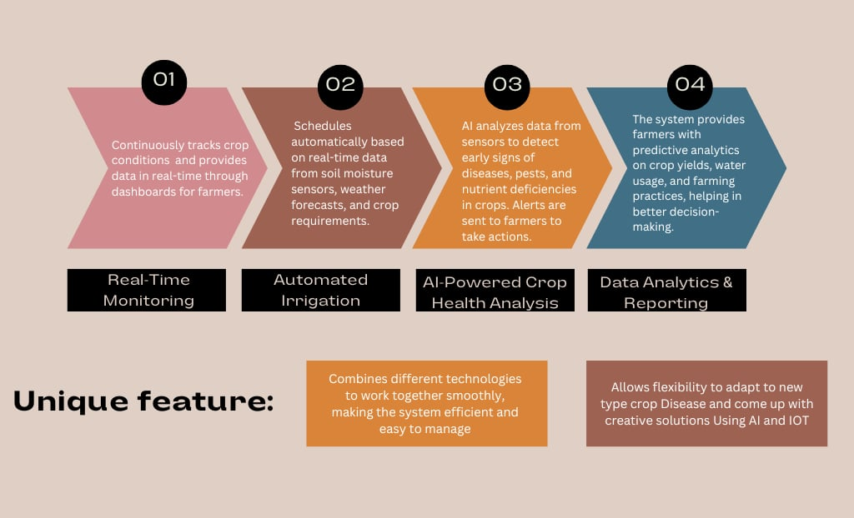
Functionality

Slide 3
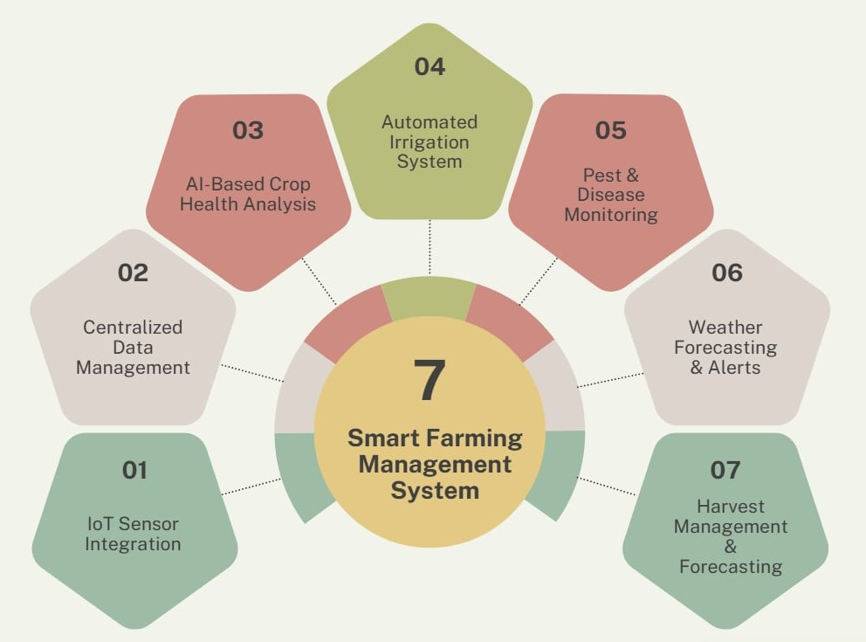
Major Components
02

Slide 4


Benefits &
Improved Crop Yield
Food Security
Cost Savings Over Time
Early Detection of Issues
Water Conservation
Promotes Smart Agriculture Adoption
Real-Time Decision Making:
Empowers Small and Large Farmers

Slide 5
Thank You

