Slide 1
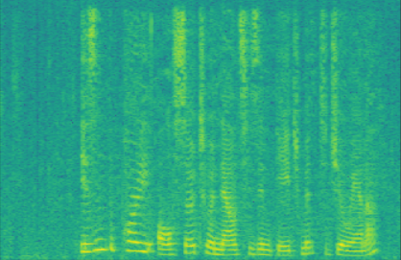
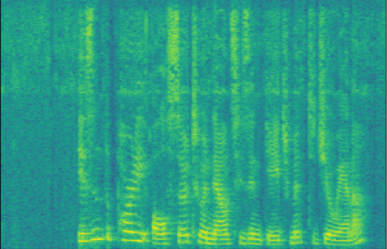
Original Method
Optimized Method
8
8
7
7
5kHz Boundary
Sensitive
range
6
6
5
5
Frequency (KHz)
4
4
Pertb. Removed
3
3
Sensitive
Range
Pertb. Added
2
2
1
1
0
0
Time

