Slide 1
HANDWRITTEN DIGIT RECOGNITION
DEPARTMENT OF ARTIFICIAL INTELLIGENCE AND DATA SCIENCE
PROJECT BY -
SHIVAM A. | SHIVAM B. | SHIVANI G. | SUDHANSHU D.

Slide 2
Table of contents
01.
02.
03.
The project
Requirements
Motivation
04.
05.
System Design
06.
Applications
Reference

Slide 3
What are we working on?
Deep Learning
MNIST database
CNN

Slide 4
01.
About the project

Slide 5
Do you know what is Handwritten digits recognition?
Handwritten digit recognition is the process to provide the ability to machines to recognize human handwritten digits. It is not an easy task a) Digits are not perfect.
b) Vary from person-to-person.
c) can be made with many different flavors.

Slide 6
02.
Requirements

Slide 7
Dataset:
MNIST(Modified National Institute of Standards and Technology)
Deep Learning Framework:
PyTorch, TensorFlow, Keras.
Model Architecture:
CNN( Convolutional Neural Network )
User Interface: (UI)
Python:
Flask framework, PyTorch lib., NumPy lib.,
PIL(Python Imaging Lib.)

Slide 8
03.
Motivation

Slide 9
Developing a highly accurate digit classification model to improve efficiency and reduce errors
Promoting transparency by providing insights into the models decision-making process and visualizing features.
The project enables users to leverage image classification tech. for their specific use cases.
Can be served as an educational tool for deep learning and learning image classification.
Image classification is a widely applicable technology.

Slide 10
Goal 1
Goal 2
Goal 3
Venus has a beautiful name, but also high temperatures
Mercury is the closest planet to the Sun and the smallest one
Mars is actually a cold place. It’s full of iron oxide dust

Slide 11
05.
Applications

Slide 12
Applications
Postal Services
Education
Banking and Finance
Healthcare
Document Digitization
Proofreading
1
4
Handwritten zip codes or addresses on envelopes can be accurately recognized and classified.
Auto grading or conversion of Handwritten answersheets to digitized sheets.
2
5
Cheques or handwritten forms can be automatically processed
Handwritten prescriptions can be processed.
3
6
such as historical manuscripts can be digitized.
Can automate the scripting and proofreading process by automatically training the tools to cure the mistakes.

Slide 13
06.
Conclusion

Slide 14
1
2
• The web application can be extended to support other image classification tasks and different pre-trained models by modifying the model loading and inference steps.
• Overall, this project demonstrates the integration of deep learning models into web applications, enabling users to interact with and benefit from the capabilities of image classification algorithms.

Slide 15
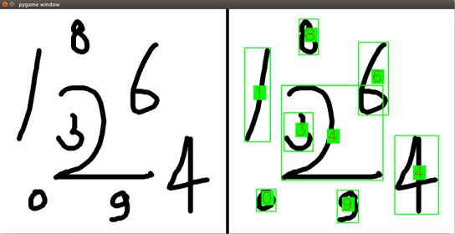
A picture always reinforces the concept
Images reveal large amounts of data.

Slide 16
Refrences
Flask Documentation. (2021). Retrieved from: https://flask.palletsprojects.com/
PyTorch Documentation. (2021). Retrieved from: https://pytorch.org/docs/stable/index.html
Base64 Documentation. (2021). Retrieved from: https://docs.python.org/3/library/base64.html
Matplotlib Documentation. (2021). Retrieved from: https://matplotlib.org/stable/contents.html
PIL (Python Imaging Library) Documentation. (2021). Retrieved from: https://pillow.readthedocs.io/en/stable/
Chollet, F. (2017). Deep learning with Python. Manning Publications.
MNIST handwritten digit database. (n.d.). Retrieved from http://yann.lecun.com/exdb/mnist/
Goodfellow, I., Bengio, Y., & Courville, A. (2016). Deep learning. MIT Press.

Slide 17
THANK YOU

