Slide 1
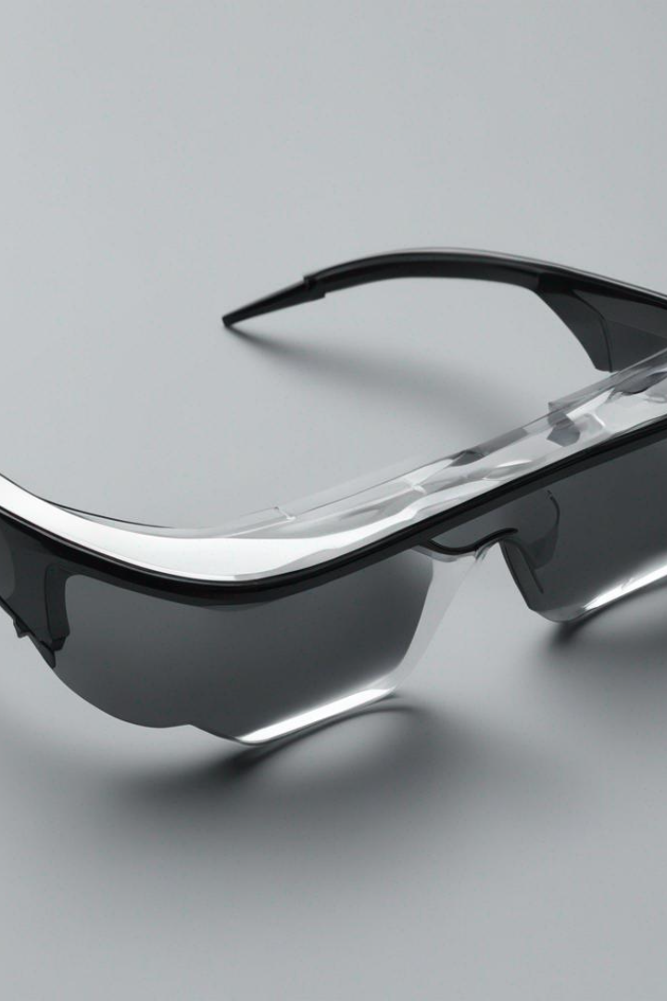
Smart Glasses
by Shivam Awasare
S

Slide 2
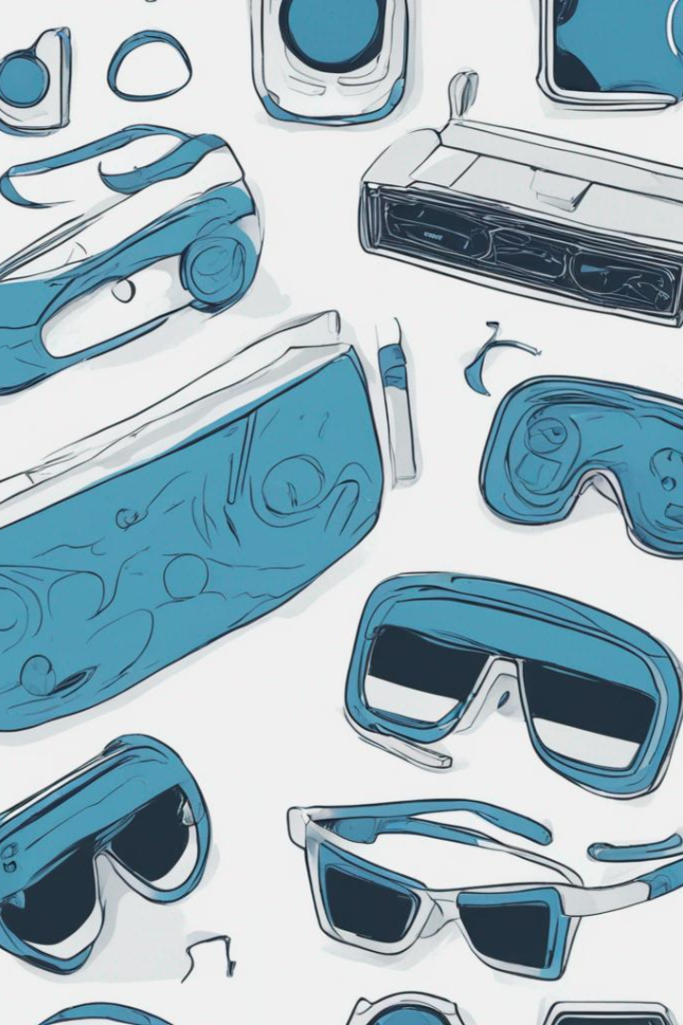
Agenda/Introduction
Welcome to our presentation on Smart Glasses! In this session, we will cover the following topics:
Definition and Evolution: We will start by exploring what smart glasses are and how they have evolved over time.
Literature Review: Next, we will review the latest research and insights from experts in the field of smart glasses.
Real-World Applications and Use Cases: We will discuss various practical applications and use cases of smart glasses in industries such as healthcare, manufacturing, and education.
Future Scope: We will examine the potential future developments and advancements in smart glasses technology.
By the end of this presentation, you will have a comprehensive understanding of smart glasses and their impact on various sectors. Let's dive in!

Slide 3
Definition and Evolution
What are Smart Glasses?
A Brief History
Current Innovations
Explore the evolution of smart glasses, from the early prototypes to the cutting-edge technologies that are reshaping our daily lives.
Discover the latest advancements in smart eyewear, including sleek designs, enhanced functionalities, and seamless integration with other devices.
Smart glasses are wearable devices that combine advanced technology with eyewear, providing users with a heads-up display and various interactive functionalities.

Slide 4
Literature Review 1
Paper Name
Author
Publication
Methodology
Applications of Smart Glasses in Applied Sciences: A Systematic Review
Dawon Kim and Yosoon Choi
MDPI (2016)
The study employed a systematic review methodology, analyzing 82 academic papers published between January 2014 and October 2020. Out of these, 57 papers were selected through filtering, and four research questions were formulated to investigate smart glasses applications and trends.

Slide 5
Literature Review 2
Paper Name
Author
Publication
Methodology
Augmented reality smart glasses: an investigation of technology acceptance drivers
Philipp A. Rauschnabel and Young K. Ro
Inderscience (2020)
The study proposes an adoption model for Augmented Reality Smart Glasses based on prior technology acceptance research. It conducts an empirical study to assess factors influencing adoption, including functional benefits, ease of use, individual differences, brand attitudes, and social norms. The impact of self-presentation benefits and privacy concerns on adoption is also examined.

Slide 6
Literature Review 3
Paper Name
Author
Publication
Methodology
Augmented Reality “Smart Glasses” in the Workplace: Industry Perspectives and Challenges for Worker Safety and Health
Sunwook Kim, Maury A. & Joseph L. Gabbard
Taylor and
Francis Online
(2022)
The study conducted interviews with industry experts across different sectors to investigate the potential of smart glasses and augmented reality head-worn display (AR HWD) technologies in the workplace. It focused on identifying opportunities and practical concerns related to interface design, distractions, workplace safety, and health implications.

Slide 7
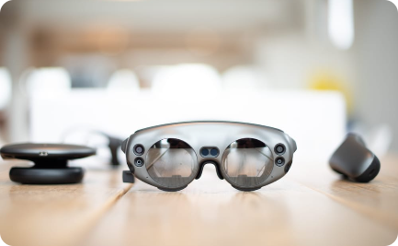
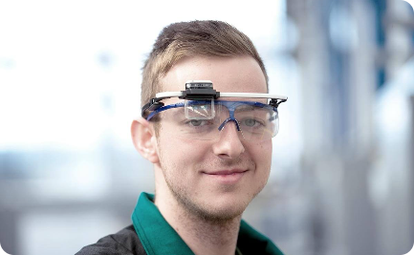
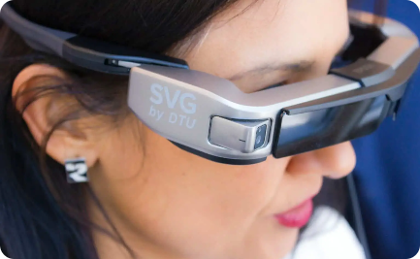
Applications and Use Cases
Augmented Reality Experiences
Hands-Free Communication and Messaging
Assistance for Visually Impaired Individuals
Embark on a virtual journey, where smart glasses transport you to immersive digital landscapes, blurring the line between reality and fiction.
Witness the empowering impact of smart glasses, offering real-time object recognition and navigation assistance for visually impaired individuals.
Experience the seamless integration of smart glasses with communication apps, enabling effortless and intuitive hands-free conversations.

Slide 8
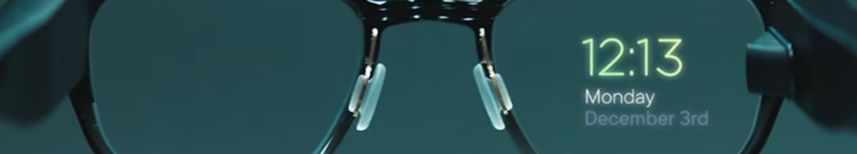
Conclusion
1
The Future Beckons
2
User-Centric Innovation
3
Limitless Possibilities
Reflect on the transformative potential of smart glasses and envision a future where technology seamlessly integrates into our daily lives.
Highlight the importance of designing smart glasses with a user-centric approach, prioritizing comfort, accessibility, and meaningful functionalities.
Encourage exploration and experimentation, as smart glasses unlock endless possibilities for communication, productivity, and self-expression.

Slide 9
Future Scope
Medical Advancements
Enterprise Solutions
Entertainment and Gaming
Imagine a future where smart glasses help healthcare professionals enhance diagnostics, monitor patients, and revolutionize the field of medicine.
Explore the potential of smart glasses in the workplace, empowering employees with real-time information, remote collaboration, and hands-free workflows.
Delve into the immersive world of smart glasses gaming, where virtual worlds come to life, transforming how we play and engage with digital entertainment.

Slide 10
References
[1] https://www.mdpi.com/2076-3417/11/11/4956
[2] https://ieeexplore.ieee.org/abstract/document/8368051/
[3] https://www.sciencedirect.com/science/article/pii/S2452414X20300509
[4] https://ieeexplore.ieee.org/abstract/document/7927376/
[5] https://content.iospress.com/articles/technology-and-health-care/thc910
[6] https://www.sciencedirect.com/science/article/pii/S2666520423000346

