Slide 1
KHAZAR UNIVERSITY • HANDS-ON DEEP LEARNING CAPSTONE
Smart Product Intelligence
An end-to-end deep learning system for the Toys & Games category of
Amazon Reviews 2023
Tabular MLP
Computer Vision
Embeddings
Transformers
LLM + RAG
Diffusion
Integration
Prepared by
Sadigova Zarifa • Amiyeva Shola

Slide 2




Project Overview & Dataset
Amazon Reviews 2023 (McAuley Lab) — Toys & Games category
One dataset, every technique from the course
Tabular metadata, review text, and product images for the same products are used across all 8 milestones (M0–M7).
Recurring rule: every predictive task starts with a simple baseline (linear/logistic regression or majority class), then a deep learning model must beat it.
Splits are performed at the product level (not by review) to avoid data leakage between train / val / test.
5,034
10,098
Products
Reviews
1,569
70/15/15
Cached Images
Train/Val/Test split (by product)

Slide 3
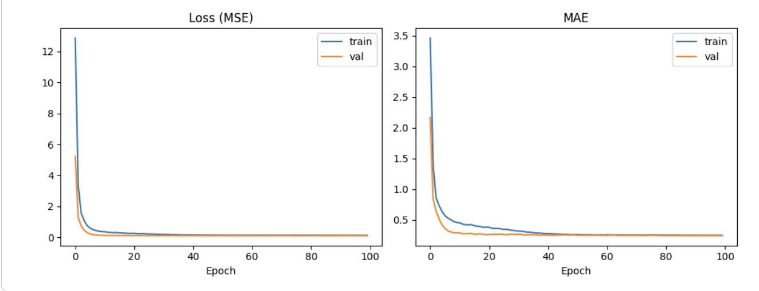

M1 — Tabular MLP
Predicting product rating from price, review count, and category count
Baseline vs. MLP
Model | MAE | RMSE | R²
Linear Regression | 0.260 | 0.356 | 0.045
MLP (Keras) | 0.246 | 0.342 | 0.122
Figure: Training/validation loss (MSE) and MAE across epochs (early stopping applied).
MLP beats the linear baseline on all 3 metrics
Smooth convergence, val. metrics track training closely — dropout + early stopping prevented overfitting on this small feature set (3 inputs).
Error analysis: largest errors occur for genuinely low-rated products (2.6–3.3★), which the model over-predicts toward ~4.3–4.5 — it regresses toward the dominant rating range in the training data.

Slide 4
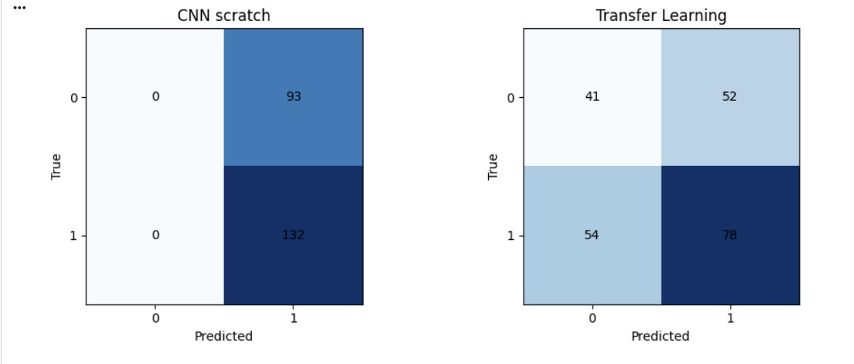

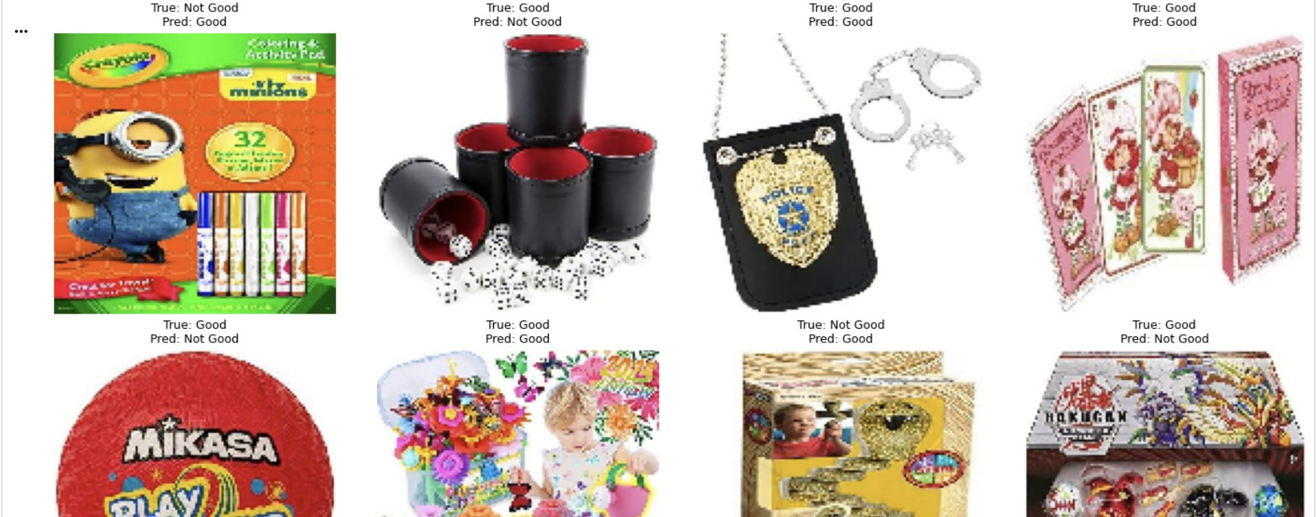
M2 — Computer Vision
Predicting image-based “good (≥4.5★)” vs “not good” from product photos
Model | Accuracy | Macro-F1
Majority-class baseline | 0.800 | 0.444
CNN from scratch | 0.771 | 0.598
Transfer learning (MobileNetV2) | 0.543 | 0.440
Honest negative result on transfer learning
Confusion matrices (test n=35): CNN scratch (left) predicts only “Good”; Transfer Learning (right) is more balanced but less accurate overall.
Macro-F1 (the fair metric here, given a tiny n=35 test set and class imbalance) is the most informative comparison.
A small CNN trained from scratch (0.598) outperforms both the baseline (0.444) and frozen MobileNetV2 (0.440).
Likely cause: generic ImageNet features aren't well aligned with a subjective “quality/rating” label, especially with very limited training data.
Sample test predictions with true vs. predicted labels.

Slide 5

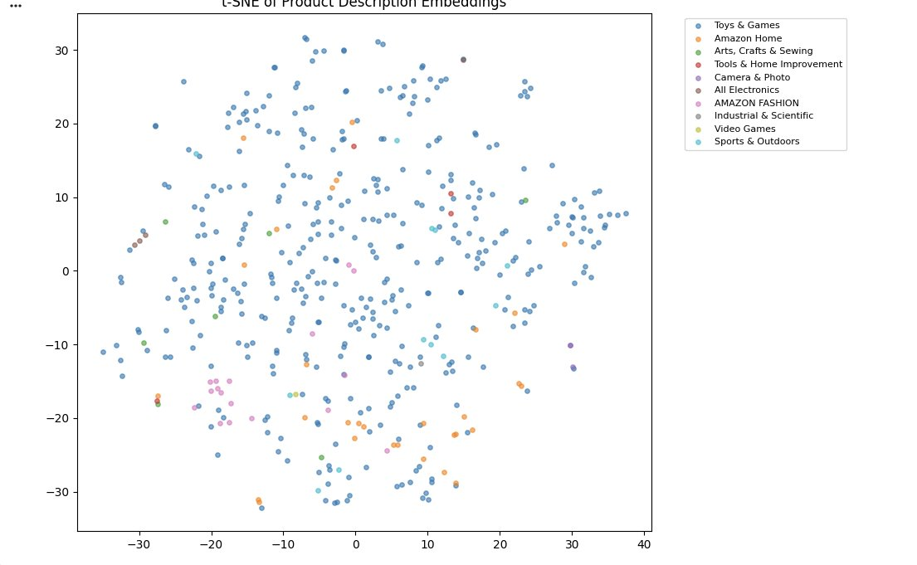
M3 — Text Vectorization & Embeddings
Sentiment classification (TF-IDF vs. learned embeddings) + semantic product search
Sentiment Classification (positive vs. negative review)
Model | Accuracy | Macro-F1
TF-IDF + LogReg | 0.882 | 0.785
Learned Embeddings (Keras) | 0.866 | 0.764
Why TF-IDF edges out embeddings here
At ~7,000 training reviews, sparse n-gram features + a linear classifier already capture most of the lexical sentiment signal (e.g. “great”, “broke”, “disappointed”).
A 64-dim embedding layer trained from scratch has less data to learn nuanced word representations — both models used class-weighting for the ~88/12 imbalance.
t-SNE of product description TF-IDF vectors, colored by main_category. Toys & Games products spread broadly, while smaller categories form loose local clusters — evidence of category-relevant lexical structure.

Slide 6


M4 — Transformers
Fine-tuning DistilBERT for sentiment classification, vs. M3 baselines
Model | Accuracy | Macro-F1 | Notes
TF-IDF + LogReg | 0.882 | 0.785 | Fast, no GPU
Embeddings (Keras) | 0.866 | 0.764 | Fast, small model
DistilBERT (fine-tuned) | 0.923 | 0.840 | ~35s, GPU req.
Fine-tuning Log
Epoch 1: val_acc = 91.75%
Epoch 2: val_acc = 91.0%
Total fine-tuning time: 35.4s on T4 GPU
DistilBERT clearly justifies its cost
Outperforms both M3 models on accuracy (0.923 vs 0.882/0.866) and macro-F1 (0.840 vs 0.785/0.764).
Largest gain on the minority (negative-sentiment) class: precision 0.75 / recall 0.71 / F1 0.73.
Training cost was tiny — 35 seconds for 2 epochs on ~1,500 examples on a free T4 GPU — making the upgrade clearly worthwhile for this task.
Within free GPU compute budget — 1,500-example subsample, 2 epochs, batch size 16, max_len 128.

Slide 7

M5 — LLMs, RAG & Fine-tuning
Flan-T5-small: review summarization + grounded Q&A + zero-shot vs. fine-tuned
Review Summarizer
Grounded vs. Ungrounded QA (RAG)
Zero-shot vs. Fine-tuned
Zero-shot Flan-T5-small output for the most-reviewed product:
"Is this good for kids and what do people say about its price?"
250 examples, 2 epochs, 8.2s on GPU. Target format: “This is a [sentiment] review. Rating: X/5.”
"Five Stars"
8/10
followed exact target format
Grounded (RAG): “Yes”
Reflects a known limitation of small (80M-param) instruction models on open-ended summarization without further tuning.
Ungrounded: “no”
7/10
correct sentiment label
The two answers diverge — retrieved product/review context (containing “Great”, “FANTA[STIC]”) measurably changes the model's output, demonstrating the value of grounding even with a tiny generation model.
~0/10
correct numeric rating
Fine-tuning taught the output format and partly improved sentiment, but the small model couldn't reliably learn precise numeric ratings from only 250 examples.

Slide 8

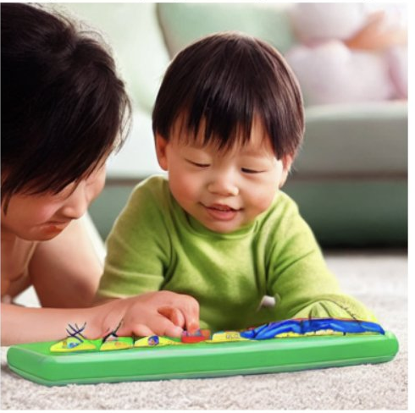
M6 — Diffusion & Generative AI
Stable Diffusion v1.5: generating product & lifestyle images from a title
Reflection
Quality:
coherent, well-composed images matching the product's general theme.
Failure modes:
real branding/packaging text isn't reproduced — the model has no access to the actual product image, only its title.
Best use:
placeholder hero/lifestyle images for new listings, or marketing concept variations — not literal product photography.
Studio product photo prompt
Lifestyle photo prompt

Slide 9
M7 — Integration & Final Takeaways
All components combined into one Smart Product Assistant (Gradio demo)
M1
M2
M3
M5
M6
Predicted vs. actual rating
Image-based quality label
Similar products (semantic search)
Pros/cons summary + grounded Q&A
On-demand generated hero image
Tested end-to-end on a T4 GPU in Google Colab — produces a complete report for any selected product without errors. Per the brief, M7 assembles earlier outputs rather than introducing new models.
Key Takeaways
Deep models beat baselines in M1, M3 (comparable), and M4 — reported transparently where they didn't (M2 transfer learning).
Macro-F1 used throughout due to strong class imbalance in ratings & sentiment.
All splits performed at the product level — no leakage between train/val/test.
Small open models (DistilBERT, Flan-T5-small) + TF-IDF retrieval cover the full transformer & LLM/RAG pipeline within a free GPU budget.
Final Gradio demo integrates all 6 predictive/generative components into one working assistant.
Sadigova Zarifa • Amiyeva Shola — Smart Product Intelligence Capstone

